Slide 1
WebPlotViz: Browser Visualization of High Dimensional Streaming Data with HTML5
STREAM2016 Workshop Washington DC March 23 2016
Supun Kamburugamuve, Pulasthi Wickramasinghe, Saliya Ekanayake, Chathuri Wimalasena and Geoffrey Fox
Indiana University

Slide 2
WebPlotViz Basics
Many data analytics problems can be formulated as study of points that are often in some abstract non-Euclidean space (bags of genes, documents ..) that typically have pairwise distances defined but sometimes not scalar products.
Helpful to visualize set of points to understand better structure
Principal Component Analysis (linear mapping) and Multidimensional Scaling MDS (nonlinear and applicable to non-Euclidean spaces) are methods to map abstract spaces to three dimensions for visualization
Both run well in parallel and give great results
In past used custom client visualization but recently switch to commodity HTML5 web viewer WebPlotViz

Slide 3
Basic WebPlotViz non Streaming example – 446K gene sequences mapped to 3D

Slide 4
WebPlotViz Basics II
Supports visualization of 3D point sets (typically derived by mapping from abstract spaces) for streaming and non-streaming case
Simple data management layer
3D web visualizer with various capabilities such as defining color schemes, point sizes, glyphs, labels
Core Technologies
MongoDB management
Play Server side framework
Three.js
WebGL
JSON data objects
Bootstrap Javascript web pages
Open Source http://spidal-gw.dsc.soic.indiana.edu/
~10,000 lines of extra code
Front end view (Browser)
Plot visualization & time series animation (Three.js)
Upload
Request Plots
JSON Format Plots
Web Request Controllers (Play Framework)
Server
Upload format to JSON Converter
Data Layer (MongoDB)
MongoDB

Slide 5
Stock Daily Data Streaming Example
Typical streaming case considered. Sequence of “collections of abstract points”; cluster, classify etc.; map to 3D; visualize
Example is collection of around 7000 distinct stocks with daily values available at ~2750 distinct times
Clustering as provided by Wall Street – Dow Jones set of 30 stocks, S&P 500, various ETF’s etc.
The Center for Research in Security Prices (CSRP) database through the Wharton Research Data Services (wrds) web interface
Available for free to the Indiana University students for research
2004 Jan 01 to 2015 Dec 31 have daily Stock prices in the form of a CSV file
We use the information
ID, Date, Symbol, Factor to Adjust Volume, Factor to Adjust Price, Price, Outstanding Stocks

Slide 6
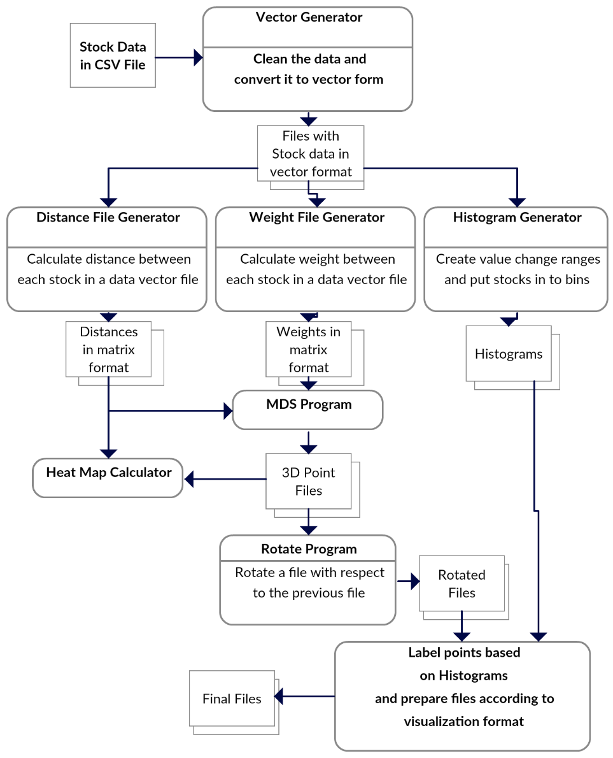
Stock Problem Workflow
Clean data
Calculate distance between stocks
Calculate distance between stocks (Pearson Correlation as missing data)
Map 250-2800 dimensional stock values to 3D for each time
Align each time
Visualize
Will move to Apache Beam to support custom runs

Slide 7
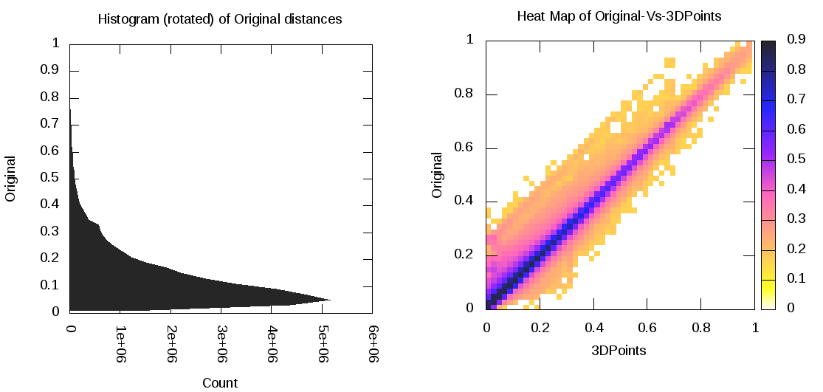
Few Notes on Mapping to 3D
MDS performed separately at each day – quality judged by match between abstract space distance and mapped space distance
Pretty good agreement as seen in heat map averaged over all stocks and all days
Each day is mapped independently and is ambiguous up to global rotations and translations
Align each day to minimize day to day change averaged over all stocks

Slide 8
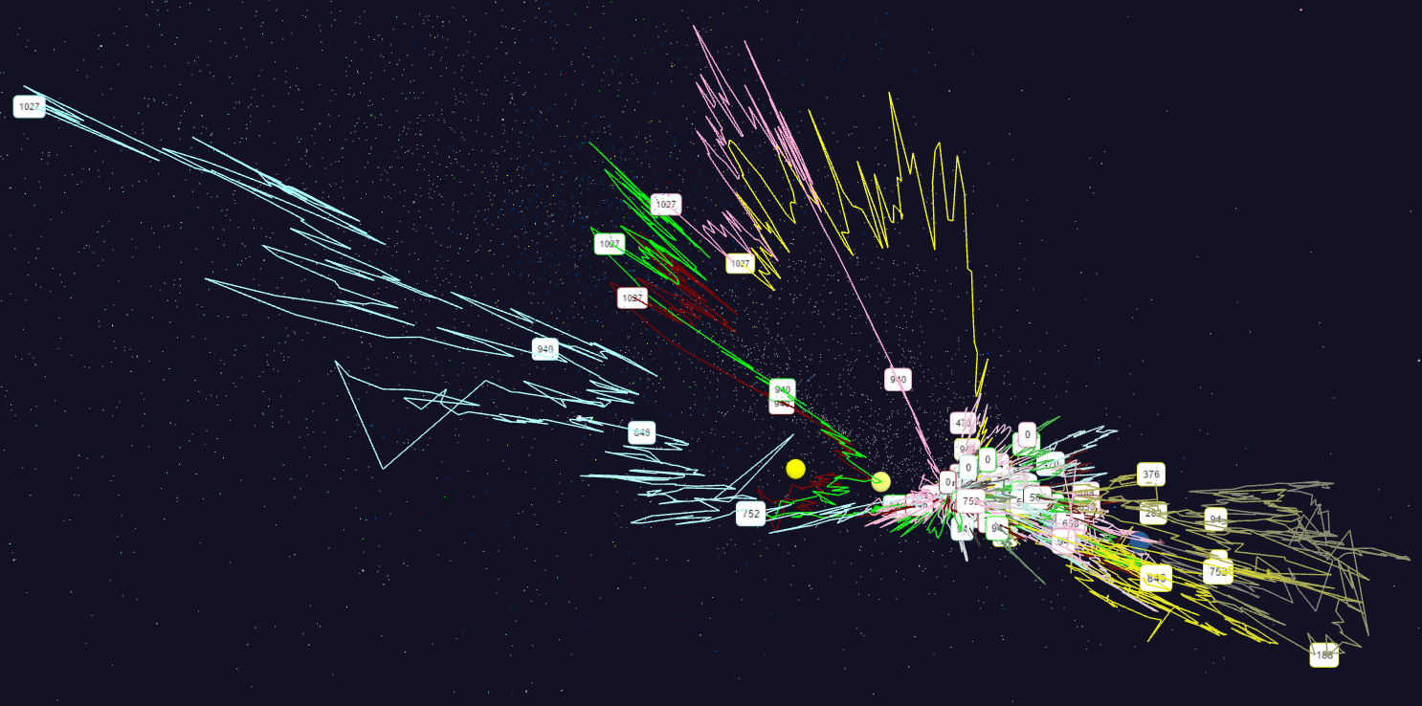
Stock Velocity Bear Market
You can look at many things. We look at values and velocities (value change over window – one year here). Can study over different ranges. 6500 points each display but can use glyphs and trajectories to study particular stocks or collections thereof
Mid Cap
Finance
S&P
Energy
Dow Jones
Down 20%
Stock Annual Velocity February 2009 starting January 2005

Slide 9
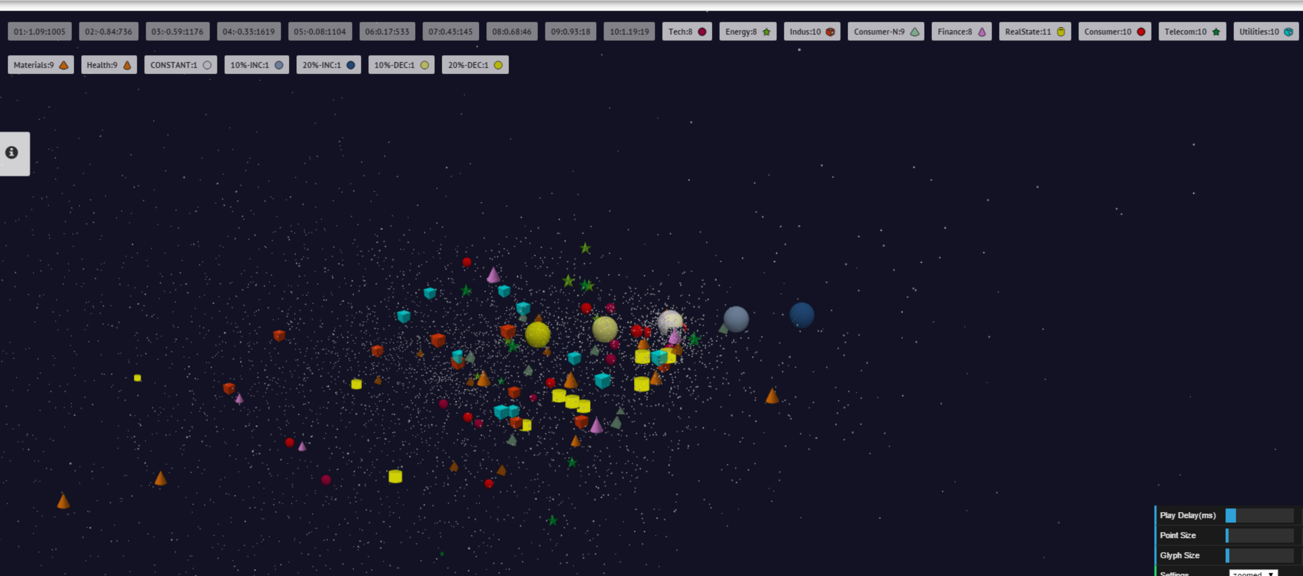
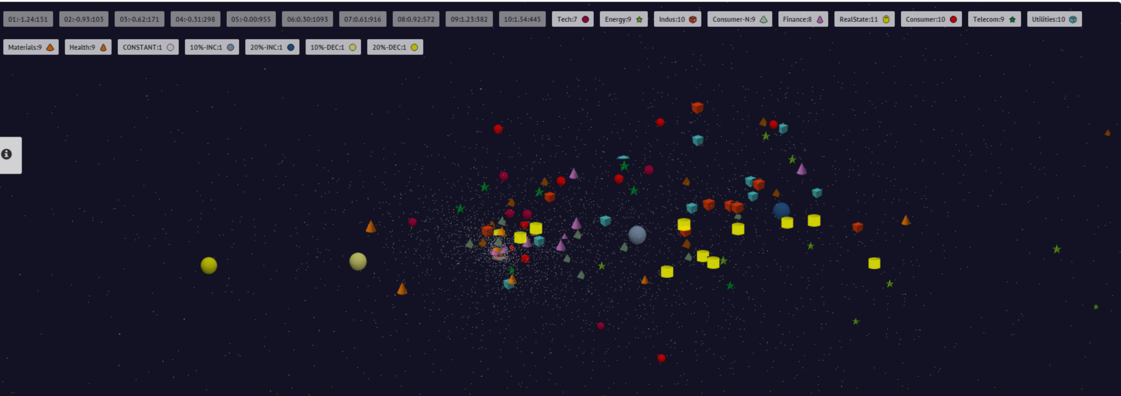
Top 10 stocks highlighted with glyphs
End 2008 Positions
July 21 2007 Positions
9

Slide 10
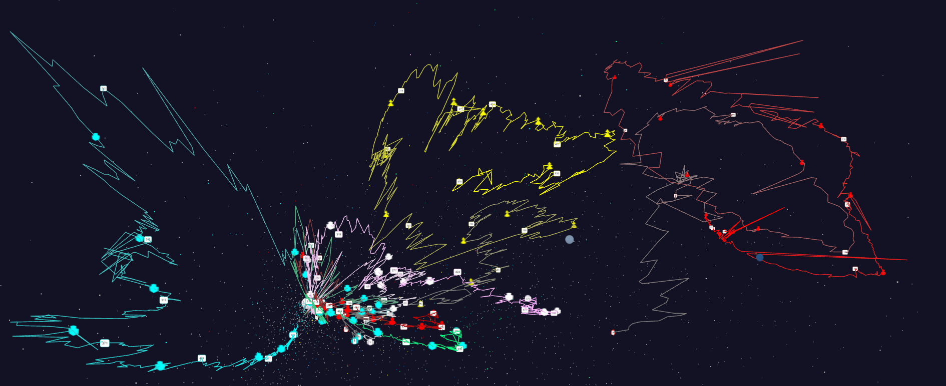
Relative Changes in Stock Values starting January 2004
Ending February 2011
Ending December 2015
Apple
Energy
Finance
Mid Cap

Slide 11
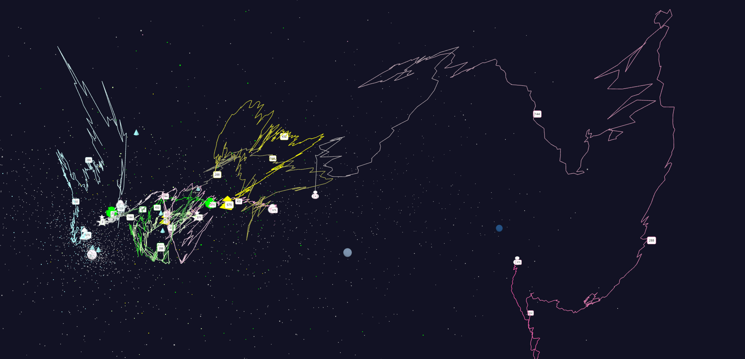
Relative Changes in Stock Values using weekly values measured from January 2004 and starting after one year January 2005 Filled circles are final values
Leading finance stocks final positions
Finance
Energy
+20%
Origin
0% change
Apple
Dow Jones S&P
Mid Cap
+10%

Slide 12
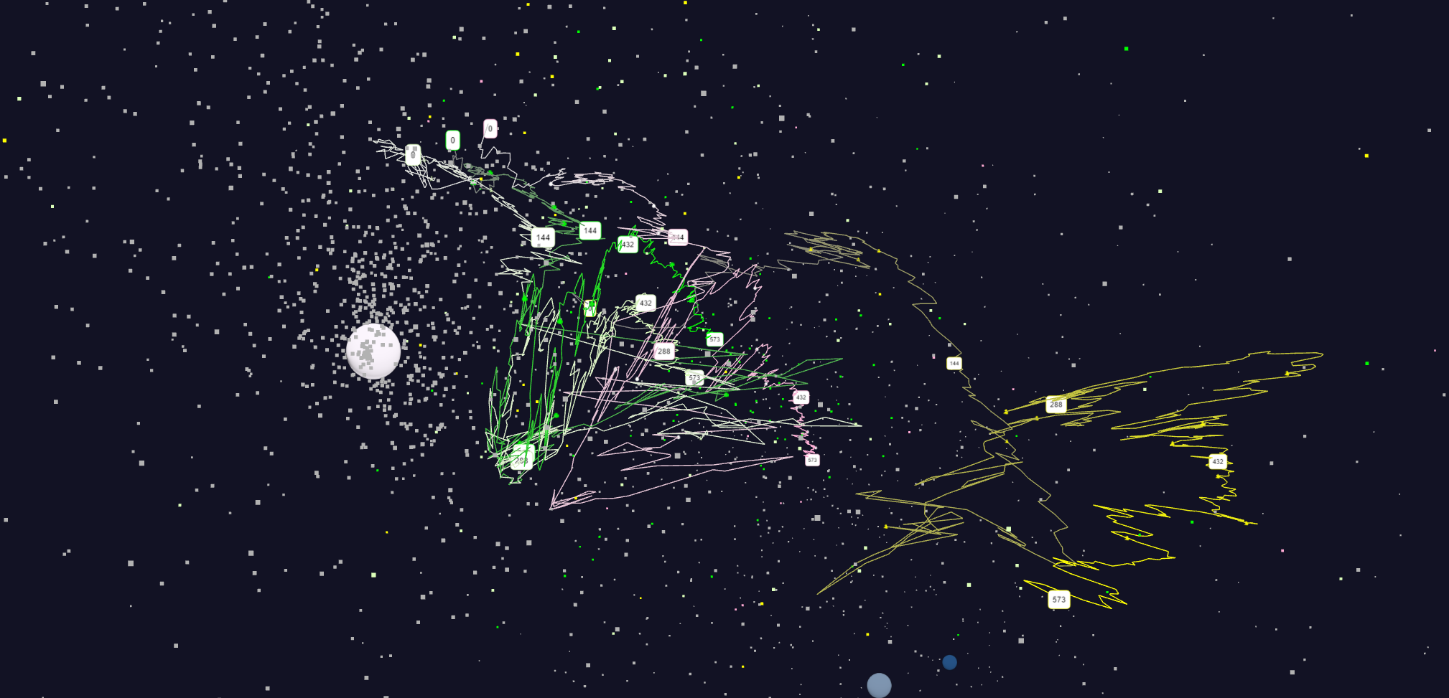
Expansion of previous graph S&P is SPY ETF Dow Jones is DIA ETF Midcap is MDY ETF Energy is XLE ETF Finance is XLF ETF
S&P
Dow Jones
Energy
Origin
0% change
Mid Cap
+20%
+10%

Slide 13
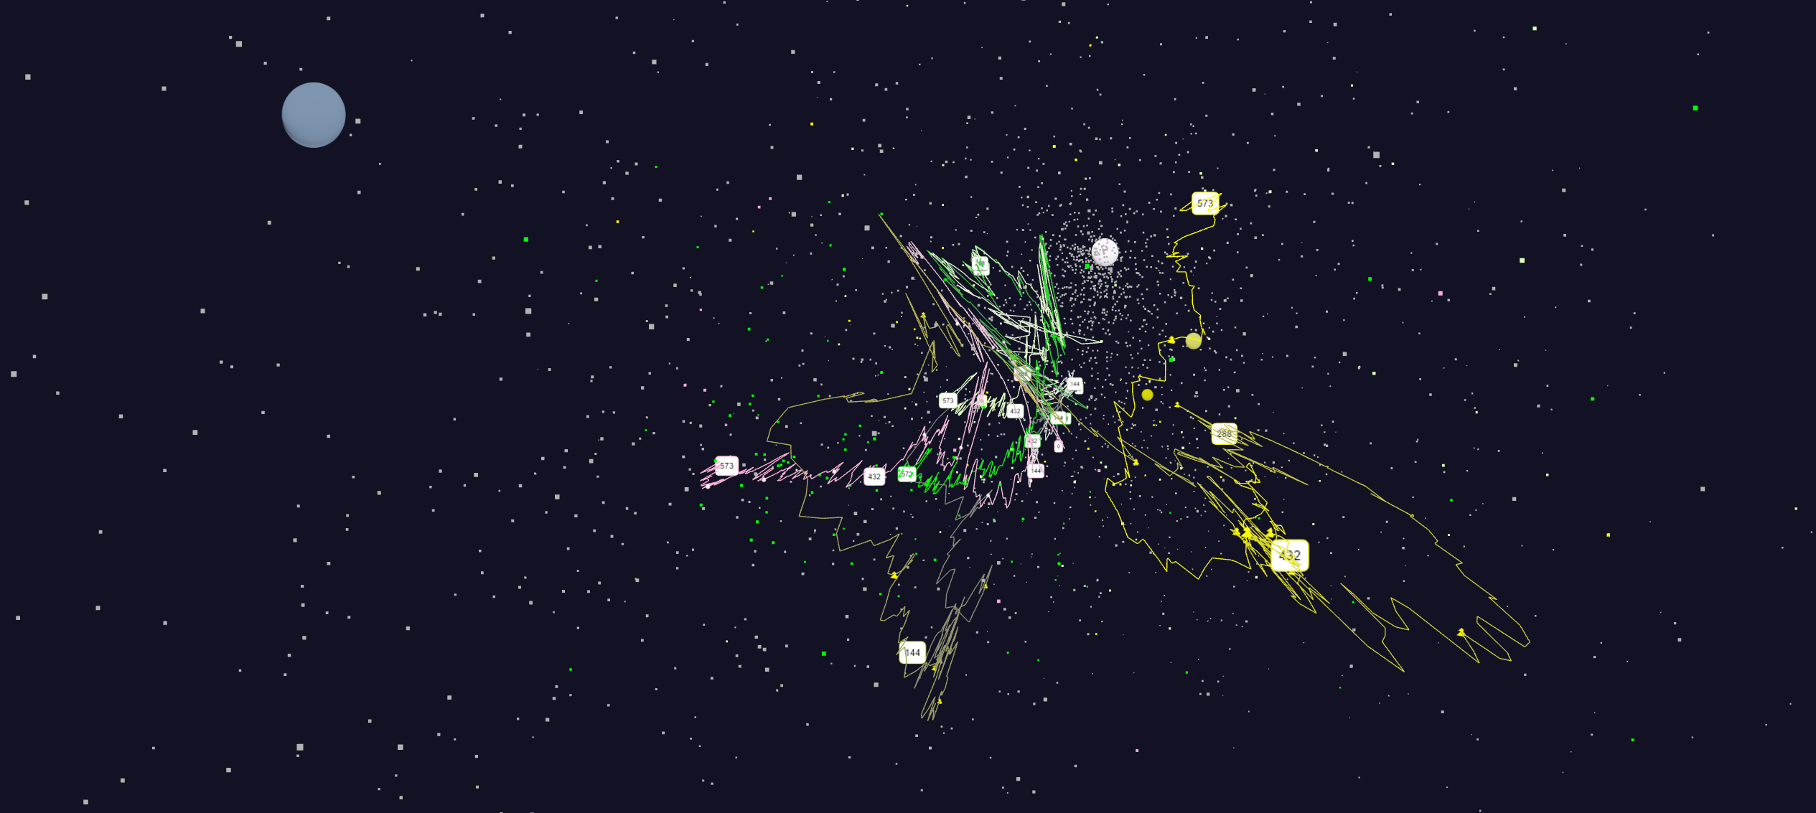
Expansion of previous graph (DIFFERENT VIEW) S&P is SPY ETF Dow Jones is DIA ETF Midcap is MDY ETF Energy is XLE ETF Finance is XLF ETF (only on first graph)
+10%
Origin
0% change
Dow Jones
S&P
Energy
Mid Cap

Slide 14
Relative Changes in Stock Values using one day values measured from January 2004 and starting after one year January 2005 Filled circles are final values
Origin
0% change
Finance
Energy
Dow Jones
S&P
Mid Cap
+10%
Apple
+20%

Slide 15
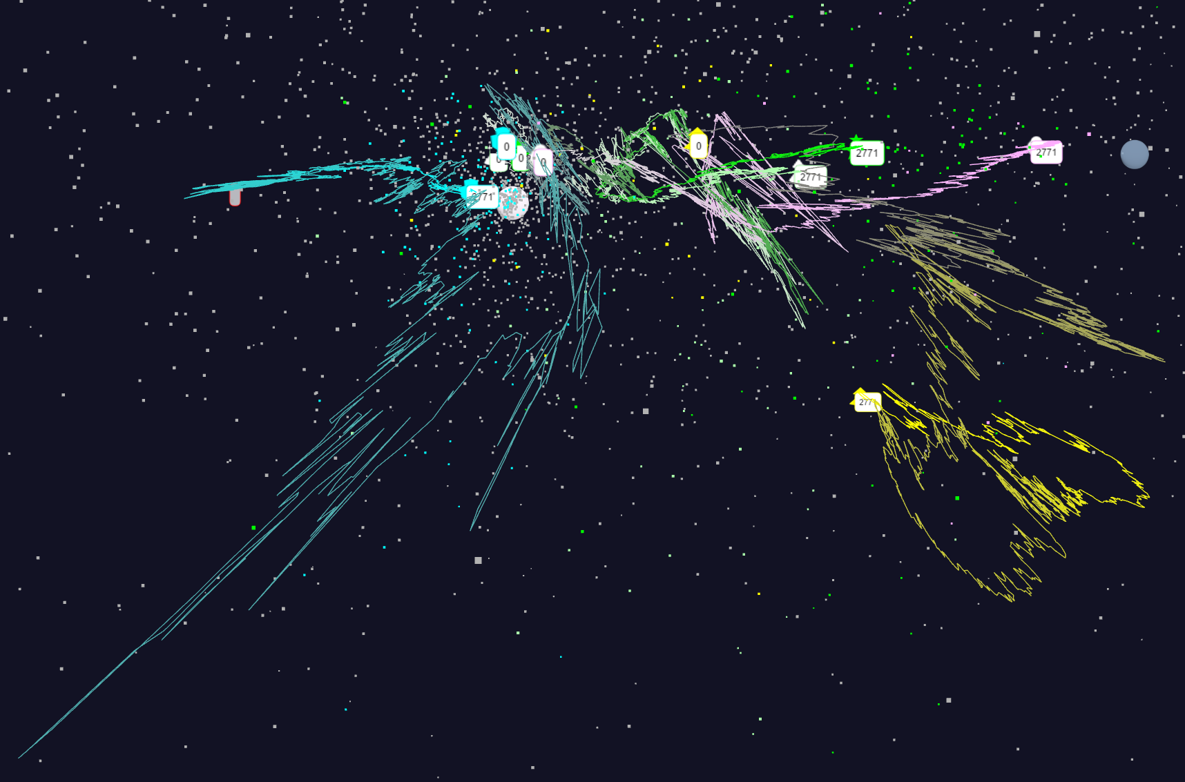
Relative Changes in Stock Values using one day values Expansion of previous data
S&P
Mid Cap
S&P
Mid Cap
Dow Jones
Dow Jones
+10%
Finance
Finance
Origin
0% change
Energy
Energy
5/8/2016
15

