Slide 1
Opportunities for Accelerating Scientific Discovery: Realizing the Potential of Advanced and Automated Workflows
Remarks on Status and Trajectory of Supporting Tools and Systems
Geoffrey Fox 16 March 2020
Digital Science Center, Indiana University
gcf@indiana.edu, http://www.dsc.soic.indiana.edu/, http://spidal.org/

Slide 2
Questions Asked
What are your observations on the impact of systems and tools to automate workflows, with respect to scientific discovery?
What is the role of artificial intelligence (AI) and automation in scientific discovery?
  We’d like you to consider both AI-driven workflows as well as workflows that include AI as part of the scientific discovery process. What are the current challenges faced by these systems?
What do you see as disruptors that will affect how workflow tools are being used by the scientific community?
What is your vision for AI in workflows in the future of scientific discovery?
  What research is needed to advance this area?

Slide 3
Challenges and Futures
What are the challenges?
  AI for science very promising
  Deep Learning broadly used in industry; many science areas need to examine it.
  AI for basic cyberinfrastructure useful but modest performance increase – factor of 10 or less
  Speedups of up to 2. 10⁹ reported for Deep Learning inside HPC applications but only in some fields and needs significant changes in application code
  Need middleware integrating simulations and AI inside HPC; Implications of new AI accelerators
How do you see the future?
  Need to enhance interactions between science and industry
  Common software stacks in workflow, deep learning
    Already PyTorch and TensorFlow are used in Industry and Research
    But can extend with more use of Apache Big Data Software in science
  MLPerf Industry benchmarks can be extended to Science
  MLSys is perhaps a very relevant meeting with strong Industry involvement and dominant use of HPC technologies but currently very little attention from cyberinfrastructure/HPC community
    No attention to science applications at MLSys 2020
  Bring Clouds and Supercomputers closer together
    Graduate students use Google Colab rather than traditional cyberinfrastructure

Slide 4
Proposal for an MLPerf Working Group in Scientific Data
MLPerf has 68 Industry members and academics from CS AI not Cyberinfrastructure; DoE labs strong
  Results on 1536 GPU’s and 2048 TPU’s i.e. clear HPC systems but called clouds
Suggest that Science Research Data should use MLPerf (presented at March 12 MLPerf Community meet)
There is no existing scientific data benchmarking activity with a similar flavor to MLPerf -- namely addressing important realistic problems aiming at modern data analytics including deep learning on modern high-performance analysis systems.
Science like industry involves big data with edge and data-center issues, inference, and training, There are some similarities in the datasets and analytics as both industry and science involve image data but also differences; science data associated with learnt simulations and pandemic time series and particle physics experiments are quite different from most industry exemplars.
The best practice science algorithms are shifting to deep learning approaches as in industry today.
When fully contributed, the benchmark suite could include the following domains: material sciences, environmental sciences, life sciences, fusion, particle physics, astronomy, earthquake, epidemiology and earth sciences, with more than one representative problem from each of these domains
Cover Accuracy and Speed. Further, the benchmarks will be exemplars of modern AI for Science
Encourage fruitful comparisons and collaborations between scientific fields and industry
Define requirements for future cyberinfrastructure to support scientific data analysis
Target users would be quite broad: academics (including teaching), researchers, scientists and the companies and service providers building systems used by Science.
Proposed working group has natural links to established MLPerf working groups including HPC and DeepTS

Slide 5
Workflow (same as Orchestration)
271 workflow systems listed at:
https://github.com/common-workflow-language/common-workflow-language/wiki/Existing-Workflow-systems
About 100 at the these two “awesome” sites:
https://github.com/meirwah/awesome-workflow-engines
https://github.com/pditommaso/awesome-pipeline
Many are domain specific but number illustrates the choices available
PyTorch and TensorFlow support a dataflow pipeline of deep learning stages
Apache Beam, Spark and Flink with support of dataflow can implement workflow functions
Growing link between DevOps and Execution (TOSCA and BPEL) Orchestration
Exploit containers, Function as a Service, Cloud Native, Pub-Sub events
Peer to Peer or Central management

Slide 6
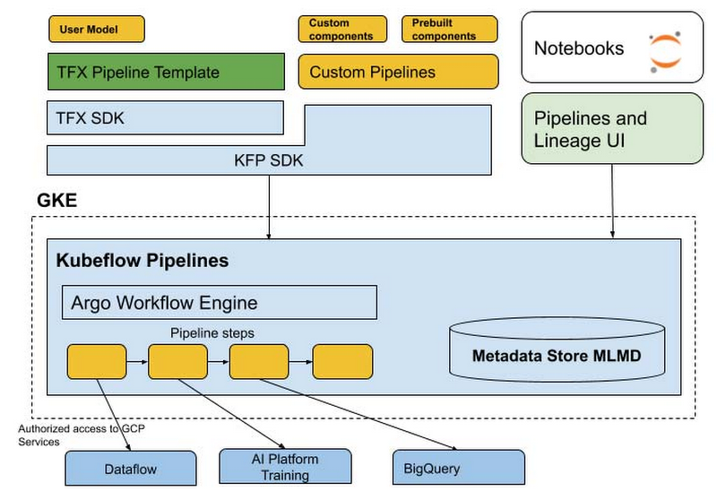
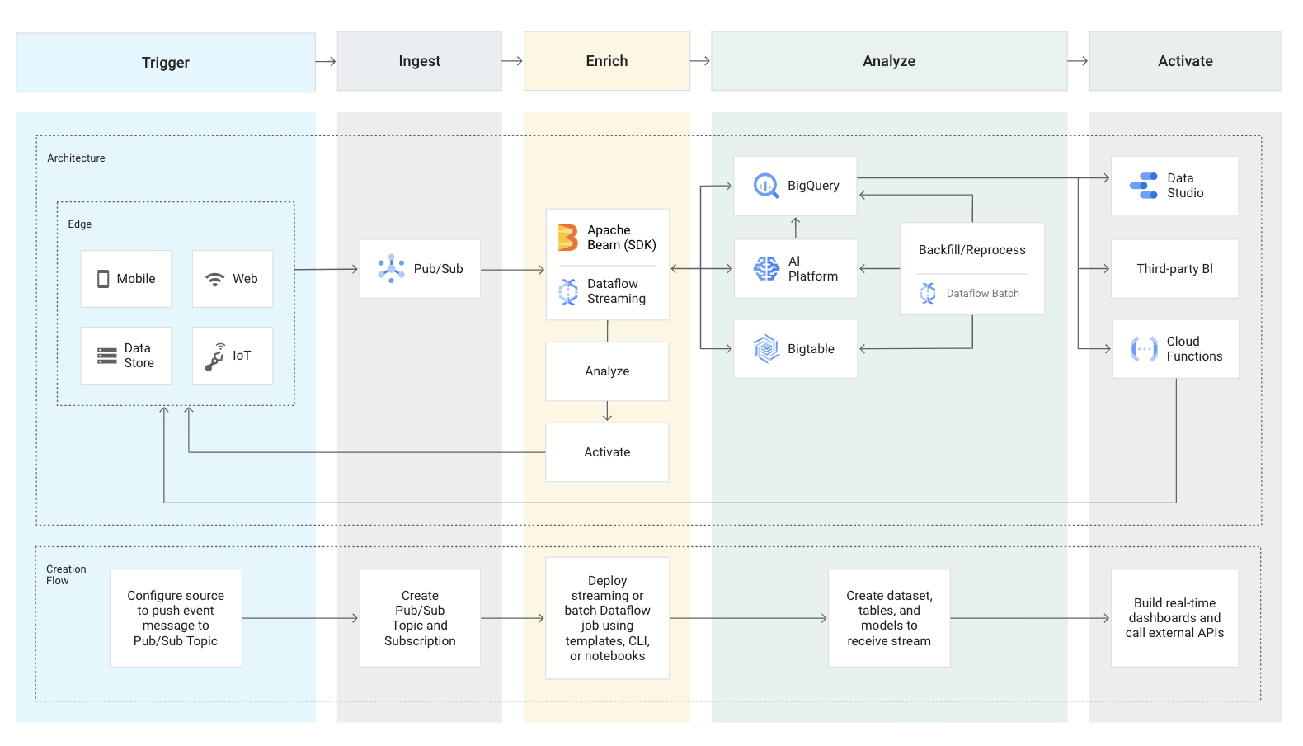
Apache Beam, Kubeflow, Argo: Typical Industry Workflow
Recent Industry solution aimed at AI workflows constructed as a graph of containers
March 11, 2020 https://cloud.google.com/blog/products/ai-machine-learning/introducing-cloud-ai-platform-pipelines
Full edge to cloud workflow
Google Cloud AI Platform Pipelines on Kubernetes
General DAG connected containers

Slide 7
Futures of MLforHPC I
MLforHPC succesful but current use is nonuniform across domains
  We need to improve Cyberinfrastructure support to make MLforHPC more effective for more users
Use of modest DL network to map material/potential drug structure to properties (generalized QSAR) with simulation and observation: Advanced Progress
Learn surrogates for large scale simulations: initial results
Use of MLforHPC in agent-based systems (learn agents replacing by surrogates): Very promising but few results
  Use in Sociotechnical simulations and in virtual tissues (agents are people or cells)
Macroscopic structure as in learn complex multi-particle potentials scaling to N⁷: many great successes
Learn Collective coordinates and guide ensemble computations: dramatic progress with speedups up to 10⁸
Microscale; learn dynamics of small scale such as clouds, turbulence: Interesting results but much more to do
Use of Recurrent NN’s to represent dynamics (learn numerical differential operators): Promising but only studied in small problems

Slide 8
Futures of MLforHPC II
Learn errors as well as values in differential equation solutions
Look at advanced solver methods such as fast multipole or ML learnt potentials
Quantify Deep Learning for (geospatial) Time Series for different applications and different methods: Looking at
  Industry is Ride Hailing and Transportation as well as audio
  MLPerf has a Deep Learning for Time Series working group
  Earthquake Forecasting (are there actually hidden variables as phase transition?)
  Epidemic Forecasting with mix of simulation and observation
Investigate different methods: RNN (LSTM, GRU), RNN-T, non-recurrent with attention: Transformer
Build Software systems to support AI dynamically mixed with simulation
Investigate optimized hardware – CPU, Accelerator, Storage, Network for AI dynamically mixed with simulation
How does this hardware and software compare to that for
  Edge to Cloud data-center use case
  Simulation supercomputer
  Classic data-center big data problem

