Slide 1
High Performance Integration of Data Parallel File Systems and Computing
Zhenhua Guo

Slide 2
Outline
Introduction and Motivation
Literature Survey
Research Issues and Our Approaches
Contributions

Slide 3
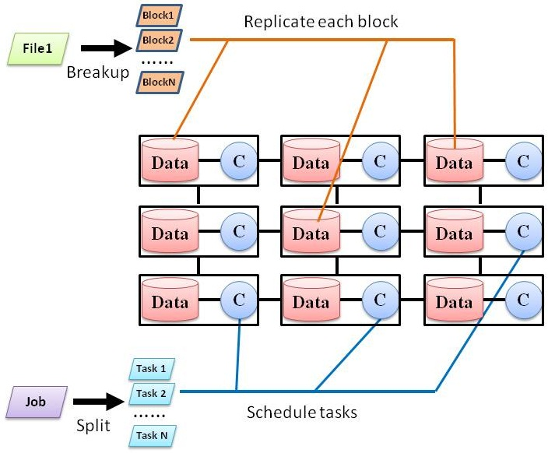
Traditional HPC Architecture vs. the Architecture of Data Parallel Systems
HPC Arch.
Separate compute and storage
Advantages
Separation of concerns
Same storage system can be mounted to multiple compute venues
Drawbacks
Bring data to compute → data movement
Impose load on oversubscribed network
Data availability: RAID, Tape
Examples: TeraGrid
Usually run on high-profile servers
Data Parallel System Arch.
The same set of nodes for compute and storage
Designed for data parallel applications
Run on commodity hardware
Data availability: replication
Scheduling
bring compute to data
bring compute close to data
Storage
Cluster 1
Cluster 2
Notes:
Why has this arch. been adopted by HPC community?
Attach the same storage cluster to multiple computation cluster.
Move data from storage cluster to computation cluster
Oversubscribe the links between storage cluster and computation clusters.
Bullet 2) becomes are critical as the amount of data to be processed keeps increasing.

Slide 4
Data Parallel Systems
Google File System/MapReduce, Twister, Cosmos/Drayad, Sector/Sphere
MapReduce has quickly gained popularity
Google, Yahoo!, Facebook, Amazon EMR,…
Academic usage: data mining, log processing, …
Substantial research
MapReduce online, Map-Reduce-Merge, Hierarchical MapReduce …
Hadoop is an open source implementation of GFS and MapReduce
Killing features
Simplicity
Fault tolerance
Extensibility
Scalability

Slide 5
MapReduce Model
Input & Output: a set of key/value pairs
Two primitive operations
map: (k₁,v₁) → list(k₂,v₂)
reduce: (k₂,list(v₂)) → list(k₃,v₃)
Each map operation processes one input key/value pair and produces a set of key/value pairs
Each reduce operation
Merges all intermediate values (produced by map ops) for a particular key
Produce final key/value pairs
Operations are organized into tasks
Map tasks: apply map operation to a set of key/value pairs
Reduce tasks: apply reduce operation to intermediate key/value pairs
Each MapReduce job comprises a set of map and reduce (optional) tasks.
Use Google File System to store data
Optimized for large files and write-once-read-many access patterns
HDFS is an open source implementation
Can be extended to non key/value pair models

Slide 6
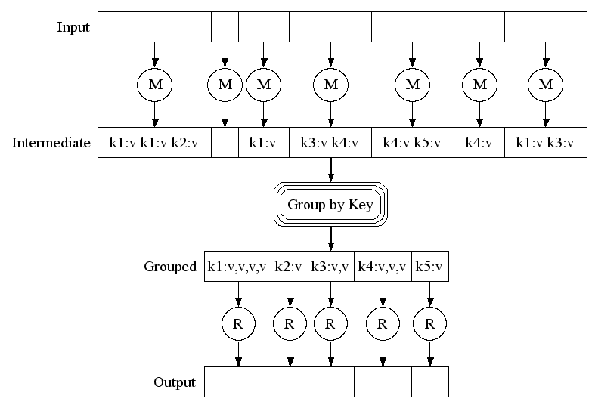
MapReduce Execution Overview
Google File System
Input file
block 0
1
2
Read input data Data locality
map tasks
Stored locally
Shuffle between map tasks and reduce tasks
reduce tasks
Stored in GFS
Google File System

Slide 7
Hadoop Implementation
Metadata mgmt.
Task scheduler
Storage: HDFS
- Files are split into blocks.
- Each block has replicas.
- All blocks are managed by central name node.
HDFS
Name node
MapReduce
Job tracker
Replication mgmt.
Fault tolerance
Block placement
……
Compute: MapReduce
- Each node has map and reduce slots - Tasks are scheduled to task slots
# of tasks <= # of slots
Hadoop
Hadoop
……
Operating System
Operating System
task slot
data block
Worker node 1
Worker node N

Slide 8
Motivation
GFS/MapReduce (Hadoop) is our research target
Overall, MapReduce performs well for pleasantly parallel applications
Want a deep understanding of its performance for different configurations and environments
Observed inefficiency (thus degraded performance) that can be improved
For state-of-the-art schedulers, data locality is not optimal
Fixed task granularity ⇒ poor load balancing
Simple algorithms to trigger speculative execution
Low resource utilization when # of tasks is less than # of slots
How to build MapReduce across multiple grid clusters

Slide 9
Outline
Motivation
Literature Survey
Research Issues and Our Approaches
Contributions

Slide 10
Storage
Storage
Distributed Parallel Storage System (DPSS): disk-based cache over WAN to isolate apps and tertiary archive storage systems
Storage Resource Broker (SRB): unified APIs to heterogeneous data sources; catalog
DataGrid: a set of sites are federated to store large data sets.
Data staging and replication management
GridFTP: High-performance data movement
Reliable File Transfer, Replication Location Service, Data Replication Service
Stork: treat data staging as jobs, support many storage systems and transport protocols.
Parallel File System
Network File System, Lustre (used by IU data capacitor), General Purpose File System (GPFS) (used by IU Bigred), Parallel Virtual File System (PVFS)
Google File System: non-POSIX
Other storage systems
Object store: Amazon S3, OpenStack Swift
Key/Value store: Redis, Riak, Tokyo Cabinet
Document-oriented store: Mongo DB, Couch DB
Column family: Bigtable/Hbase, Cassandra
Notes:
GridFTP: third-party data transfer, security, striped data transfer, parallel data transfer, automatic negotiation of TCP buffer sizes, partial ﬁle transfer, and support for reliable and restartable data transfer.
Replication Location Service: maintains a registry of data replicas.
Data Replication Service: automatically create new data replicas when needed and register them to RLS.
Reliable File Transfer: web-service interface, checkpoint tasks.

Slide 11
Traditional Job Scheduling
Use task graph to represent dependency:
find a map from graph nodes to physical machines
Bag-of-Tasks:
Assume tasks of a job are independent. Heuristics: MinMin, MaxMin, Suffrage
Batch scheduler
Portable Batch System (PBS), Load Sharing Facility (LSF), LoadLeveler, and Simple Linux Utility for Resource Management (SLURM)
Maintains job queue and allocates compute resources to jobs (no data affinity)
Gang scheduling
Synchronizes all processes of a job for simultaneous scheduling
Co-scheduling
Communication-driven, coordinated by passing messages
Dynamic coscheduling, spin block, Periodic Boost, …
HYBRID: combine gang scheduling and coscheduling
Middleware
Condor: harness idle workstations to do useful computation
BOINC: volunteer computing
Globus: grid computing
Notes:
MinMin: task with min. expected completion time ➔ node with earliest completion time
MaxMin: task with max. expected completion time ➔ node with earliest completion time
Suffrage: assign a node to a task that would “suffer” most

Slide 12
MapReduce-related
Improvement of vanilla MapReduce
Delay scheduling: improve data locality
Largest Approximate Time to End: a better metric to make decisions about when/where to run spec. tasks
Purlieus: optimize VM provisioning in cloud for MapReduce apps
Most of my work falls into this category
Enhancements to MapReduce model
Iterative MapReduce: Haloop, Twister @IU, Spark
Map-Reduce-Merge: enable processing heterogeneous data sets
MapReduce online: online aggregation, and continuous queries
Alternative models
Dryad: use Direct Acyclic Graph to represent job

Slide 13
Outline
Motivation
Literature Survey
Research Issues and Our Approaches
Contributions

Slide 14
Research Objectives
Deploy data parallel system Hadoop to HPC clusters
Many HPC clusters exist already (e.g. TeraGrid/XSEDE, FutureGrid)
Evaluate performance – Hadoop and storage systems
Improve data locality
Analyze relationship between system factors and data locality
Analyze the optimality/non-optimality of existing schedulers
Propose scheduling algorithm that gives optimal data locality
Investigate task granularity
Analyze the drawbacks of fixed task granularity
Propose algorithms to dynamically adjust task granularity at runtime
Investigate resource utilization and speculative execution
Explore low resource utilization and inefficiency of running speculative tasks
Propose algorithms to allow running tasks to harness idle resources
Propose algorithms to make smarter decisions about the execution of speculative tasks
Heterogeneity Aware MapReduce scheduling
HMR: Build a unified MapReduce cluster across multiple grid clusters
Minimize data IO time with real-time network information
Perf. evaluation | Data locality | Task granularity | Heterogeneity | Resource utilization

Slide 15
Performance Evaluation - Hadoop
Investigate following factors
# of nodes, # of map slots per node, the size of input data
Measure job execution time and efficiency
Observations
Increase # of map slots
more tasks run concurrently
average task run time is increased
job run time is decreased
efficiency is decreased (overhead is increased)
turning point: beyond it, job runtime is not improved much
Vary # of nodes, the size of input data
Perf. evaluation | Data locality | Task granularity | Heterogeneity | Resource utilization

Slide 16
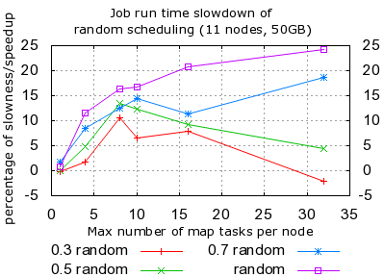
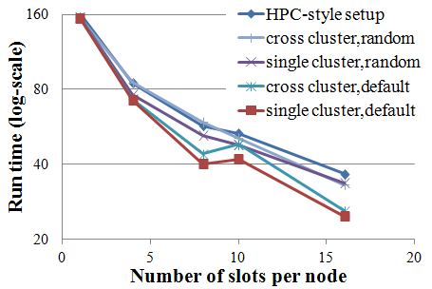
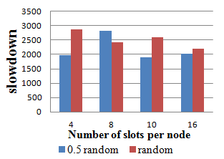
Performance Evaluation – Importance of data locality
Measure how important data locality is to performance
Developed random scheduler: schedule tasks based on user-specified randomness
Conduct experiments for single-cluster, cross-cluster and HPC-style setup
Single cluster
MapReduce
Cross cluster
MapReduce
HPC-style
HDFS
MapReduce
HDFS
HDFS
Cluster B
Cluster A
Cluster A
Cluster A
Cluster B
Percent of slowdown (%)
Number of slots per node
(1) w/ high inter-cluster BW
(2) w/ low inter-cluster BW
(a) Single-cluster
(b) Cross-cluster and HPC-style
Data locality matters
Hadoop performs poorly with drastically heterogeneous network
Perf. evaluation | Data locality | Task granularity | Heterogeneity | Resource utilization

Slide 17
Performance Evaluation - Storage
 | Direct IO (buffer size is 512B) |  |  | Regular IO with OS Caching
operation | size(GB) | time | io-rate | size(GB) | time | io-rate
seq-read | 1 | 77.7sec | 13.5MB/s | 400 | 1059sec | 386.8MB/s
seq-write | 1 | 103.2sec | 10.2MB/s | 400 | 1303sec | 314MB/s
Local Disk
 | Direct IO (buffer size is 512B) |  |  | Regular IO with OS Caching
operation | size(GB) | time | io-rate | size(GB) | time | io-rate
seq-read | 1 | 6.1mins | 2.8MB/s | 400 | 3556sec | 115.2MB/s
seq-write | 1 | 44.81mins | 390KB/s | 400 | 3856sec | 106.2MB/s
Network File System
(NFS)
Hadoop Distributed File System (HDFS)
operation | data size(GB) | time | io-rate
seq-read | 400 | 3228sec | 126.9MB/s
seq-write | 400 | 3456sec | 118.6MB/s
One worker node. All data accesses are local through HDFS API
OpenStack Swift
operation | data size(GB) | time | io-rate
seq-write | 400 | 10723sec | 38.2MB/s
seq-read | 400 | 11454sec | 35.8MB/s
HDFS and Swift are not efficiently implemented.
Perf. evaluation | Data locality | Task granularity | Heterogeneity | Resource utilization

Slide 18
Data Locality
“distance” between compute and data
Different levels: node-level, rack-level, etc.
For data-intensive computing, data locality is critical to reduce network traffic
Research questions
Evaluate how system factors impact data locality and theoretically deduce their relationship
Analyze state-of-the-art scheduling algorithms in MapReduce
Propose scheduling algorithm giving optimal data locality
Perf. evaluation | Data locality | Task granularity | Heterogeneity | Resource utilization

Slide 19
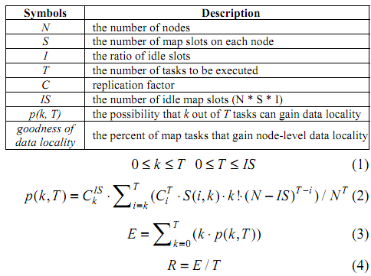
Data Locality - Analysis
Theoretical deduction of relationship between system factors and data locality (for Hadoop scheduling)
Assumptions
Data are randomly placed across nodes
Idle slots are randomly chosen from all slots
For simplicity
Replication factor is 1
# of slots on each node is 1
The ratio of data local tasks
Perf. evaluation | Data locality | Task granularity | Heterogeneity | Resource utilization

Slide 20
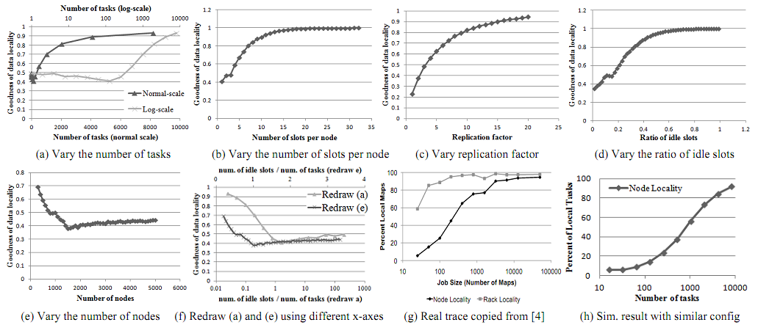
Data Locality – Experiment 1
Measure the relationship between system factors and data locality and verify our simulation
y-axis: percent of map tasks that achieve data locality.
better
Number of tasks (log scale)
Number of tasks (normal scale)
Number of slots per node
Replication factor
Ratio of idle slots
Num. of idle slots / num. of tasks (redraw e)
Number of nodes
Num. of idle slots / num. of tasks (redraw a)
Perf. evaluation | Data locality | Task granularity | Heterogeneity | Resource utilization

Slide 21
Data Locality - Optimality
Problem: given a set of tasks and a set of idle slots, assign tasks to idle slots
Hadoop schedules tasks one by one
Consider one idle slot each time
Given an idle slot, schedules the task that yields the “best” data(from task queue)
Achieve local optimum; global optimum is not guaranteed
Each task is scheduled without considering its impact on other tasks
All idle slots need to be considered at once to achieve global optimum
We propose an algorithm which gives optimal data locality
Reformulate the problem:
Construct a cost matrix
Cell C(i. j) is the incurred cost if task T_{i} is scheduled to idle slot s_{j} 0: if compute and data are co-located 1: otherwise Reflects data locality
Find an assignment to minimize the sum of cost
Found a similar mathematical problem: Linear Sum Assignment Problem (LSAP)
Convert the scheduling problem to LSAP (not directly mapped)
Proved the optimality
 | s₁ | s₂ | … | s_{m-1} | s_{m}
T₁ | 1 | 1 | 0 | 0 | 0
T₂ | 0 | 1 | 0 | 0 | 1
… | … | … | … | … | …
T_{n-1} | 0 | 1 | 1 | 0 | 0
T_{n} | 1 | 0 | 1 | 0 | 1
C(i, j) =
Perf. evaluation | Data locality | Task granularity | Heterogeneity | Resource utilization

Slide 22
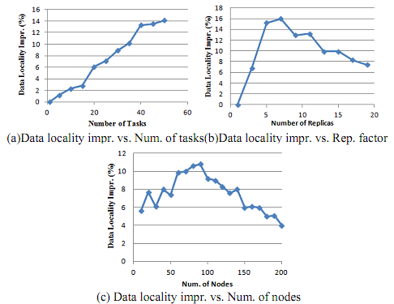
Data Locality – Experiment 2
Measure the performance superiority of our proposed algorithm
y-axis: performance improvement (%) over native Hadoop
Perf. evaluation | Data locality | Task granularity | Heterogeneity | Resource utilization

Slide 23
Task Granularity
Each task of a parallel job processes some amount of data
Use input data size to represent task granularity
To decide the optimal granularity is non-trivial
Internal structure of input data
Operations applied to data
Hardware
Each map task processes one block of data
Block size is configurable (by default 64MB)
The granularities of all tasks of a job are the same
Drawbacks
Limit the maximum degree of concurrency: num. # of blocks
Load unbalancing
An assumption made by Hadoop: Same input data size ⇒ Similar processing time May not always hold
Example: easy and difficult puzzles Input is similar (9 x 9 grid) while solving them requires drastically different amounts of time
Tradeoffs
Granularity | Mgmt. overhead | Concurrency | Load Balancing
Small | High | High | Easy
Large | Low | Low | Hard
Perf. evaluation | Data locality | Task granularity | Heterogeneity | Resource utilization

Slide 24
Task Granularity – Auto. Re-organization
Our approach: dynamically change task granularity at runtime
Adapt to the real status of systems
Non-application-specific
Minimize overhead of task re-organization (best effort)
Cope with single-job and multi-job scenarios
Bag of Divisible Tasks (vs. Bag of Tasks)
Proposed mechanisms
Task consolidation consolidate tasks T₁, T₂, …, T_{n} to T
Task splitting split task T to spawn tasks T₁, T₂, …, and T_{m}
When there are idle slots and no waiting tasks, split running tasks
For multi-job env, we prove Shortest-Job-First (SJF) strategy gives optimal job turnaround time*. (arbitrarily divisible work)
(UI: unprocessed input data)
Perf. evaluation | Data locality | Task granularity | Heterogeneity | Resource utilization

Slide 25
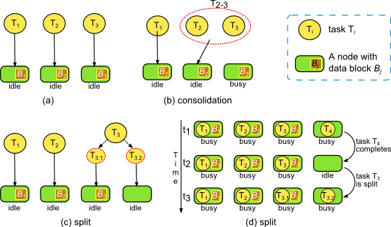
Task Granularity – Task Re-organization Examples
* May change data locality
Perf. evaluation | Data locality | Task granularity | Heterogeneity | Resource utilization

Slide 26
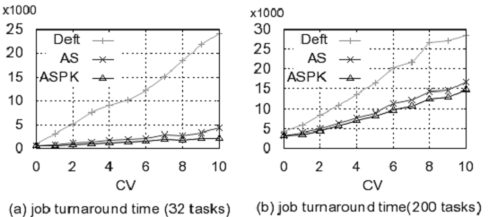
Task Granularity – Single-Job Experiment
System: 64 nodes, 1 map slot per node (can run 64 tasks concurrently at most)
better
Synthesized workload:
Task execution time follows
Gaussian distribution.
Fix mean and vary coefficient of variance (CV)
better
Trace-based workload:
Based on Google Cluster Data (75% short tasks, 20% long tasks, 5% medium tasks)
Perf. evaluation | Data locality | Task granularity | Heterogeneity | Resource utilization

Slide 27
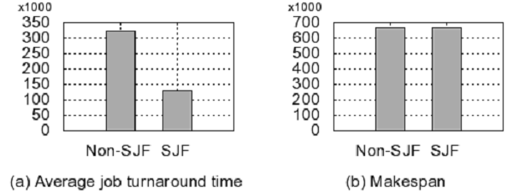
Task Granularity – Multi-Job Experiment
M/G/s model: inter-arrival time follows exponential dist (inter-arrival time << job execution time)
100 jobs are generated.
i) Task execution time is the same for a job (balanced load)
ii) Job serial execution time is different (75% short jobs, 20% long jobs, 5% others)
i) Task execution time is different.
ii) Job serial execution time is the same (all jobs are equally long)
The system is fully load until last “wave” of task execution
Perf. evaluation | Data locality | Task granularity | Heterogeneity | Resource utilization

Slide 28
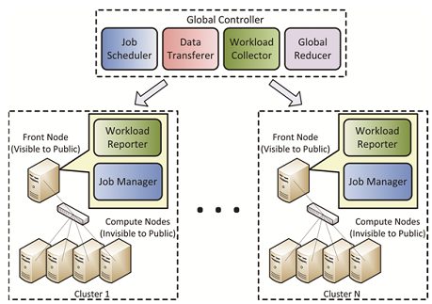
Hierarchical MapReduce
Motivation
Single user may have access to multiple clusters (e.g. FutureGrid + TeraGrid + Campus clusters)
They are under the control of different domains
Need to unify them to build MapReduce cluster
Extend MapReduce to Map-Reduce-GlobalReduce
Components
Global job scheduler
Data transferer
Workload reporter/ collector
Job manager
Global controller
Local cluster
Local cluster
Perf. evaluation | Data locality | Task granularity | Heterogeneity | Resource utilization

Slide 29
Heterogeneity Aware Scheduling – Future Work
Will focus on network heterogeneity
Collect real-time network throughput information
Scheduling of map tasks
Minimize task completion time based on
resource availability
data IO/transfer time (depending on network performance)
Scheduling of reduce tasks
Goal: balance load so that they complete simultaneously
data shuffling : impact IO time
key distribution at reducer side : impact computation time
Sum should be balanced: min{max_{S} – min_{S}} (S is a scheduling)
Both scheduling problems are NP hard.
Will investigate heuristics that perform well
Data Replication
How to increase replication rate in heterogeneous env.
Perf. evaluation | Data locality | Task granularity | Heterogeneity | Resource utilization

Slide 30
Resource Stealing
In Hadoop, each node has a number of map and reduce slots
Drawback: low resource utilization (for native MR apps)
Example: node A has 8 cores, and the number of map slots is 7 (leave one core for Hadoop daemons)
If one map task is assigned to it, only 1 core is fully utilized while other 6 cores keep idle
We propose Resource Stealing
Running tasks “steal” resources “reserved” for prospective tasks that will be assigned to idle slots
When new tasks are assigned, give back stolen resources proportionally
Enforced on a per-node basis
Resource Stealing is transparent to task/job scheduler
Can be used with any existing Hadoop scheduler
How to allocate idle resources to running tasks
Propose different strategies: Even, First-Come-Most, Shortest-Time-Left-Most, …
Perf. evaluation | Data locality | Task granularity | Heterogeneity | Resource utilization

Slide 31
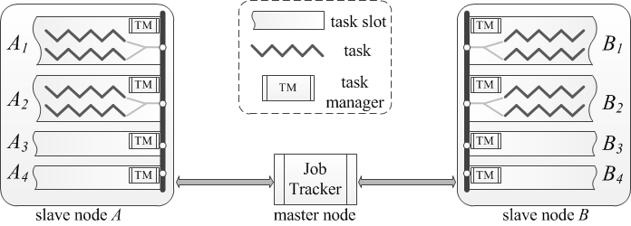
Resource Stealing - Example
Two nodes: Each has 5 cores, and 4 map slots.
Idle slots: wasted resources
Spawn more tasks to utilize idle cores
Perf. evaluation | Data locality | Task granularity | Heterogeneity | Resource utilization

Slide 32
Speculative Execution
In large distributed systems, failure is the norm rather than the exception
Causes: hardware failure, software bug, process hang, …
Hadoop uses speculative execution to support fault tolerance
The master node monitors progresses of all tasks
Abnormally slow task → start speculative tasks
Not consider whether it’s beneficial to run spec. tasks
Task A: 90% done, progress rate is 1
Task B: 50% done, progress rate is 5
A is too slow, start a speculative task A’ whose progress rate is 5
A completes earlier than A’. Not useful to run A’
We propose Benefit Aware Speculative Execution (BASE)
Estimate the benefit of starting speculative tasks, and only start them when it is beneficial
Aim to eliminate the execution of unnecessary speculative tasks
Perf. evaluation | Data locality | Task granularity | Heterogeneity | Resource utilization

Slide 33
Outline
Motivation
Literature Survey
Research Issues and Our Approaches
Contributions

Slide 34
Contributions and Future Work
Conduct in-depth evaluation of data parallel systems
Propose improvements for various aspects of MapReduce/Hadoop
Data locality
Adjustment of task granularity
Resource utilization and Speculative Execution
Heterogeneity Aware
Conduct experiments to demonstrate the effectiveness of our approaches
Future work
Investigate network heterogeneity aware scheduling

Slide 35
Questions?

Slide 36
Backup slides

Slide 37
Introduction
Data intensive computing
The Fourth Paradigm – Data deluge in many areas
Ocean science, ecological science, biology, astronomy …
Several terabytes of data are collected per day
Exascale computing
New challenges
Data management - bandwidth/core drops dramatically
Heterogeneity
Programming models and runtimes
Fault tolerance
Energy consumption

Slide 38
MapReduce Walkthrough - wordcount
wordcount: count the number of words in input data
More than one worker in the example
groupby
intermediate data
(the, 1)
final output
input (3 blocks)
reduce
(the, 1)
(weather, 1)
(the, 1)
the weather is good
(is, 1)
(good, 1)
(is, 1)
map
(is, 1)
reduce
(is, 3)
(is, 1)
(for, 1)
today is good
map
(today, 1)
(weather, 1)
reduce
(weather, 2)
(is, 1)
(good, 1)
(weather, 1)
good weather is good
(today, 1)
map
(today, 1)
reduce
(good, 4)
(good, 1)
(weather, 1)
...
(good, 1)
(is, 1)
(good, 1)
(good, 1)
reduce
(good, 1)
map(key,value):
For each word w in value:
emit (w, 1)
reduce(key,values):
result = 0 For each count v in values: result += v
emit (key, result)
(good, 1)

Slide 39
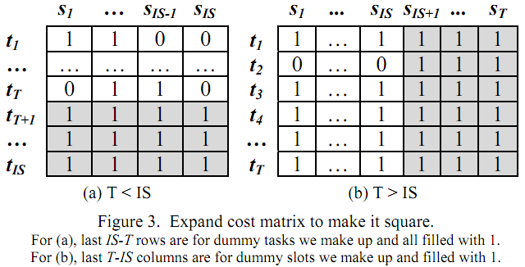
Data Locality – Optimality
Linear Sum Assignment Problem: Given n items and n workers, the assignment of an item to a worker incurs a known cost. Each item is assigned to one worker and each
worker only has one item assigned. Find the assignment that minimizes the sum of cost
T: num. of tasks; IS: num. of idle slots
T < IS: add IS-T dummy tasks, fill with a constant
T > IS: add T-IS dummy slots fill with a constant
Apply LSAP
Filter result
Figure

Slide 40
Task Re-organization: Definitions
UI(T): unprocessed data of task T.
Task consolidation: consolidate tasks T₁, T₂, …, T_{n} to T
Task splitting: split task T to spawn tasks T₁, T₂, …, and T_{m}
Ways to split tasks are not unique
b) and c) have the same makespan. Different number of task splittings

Slide 41
Task Re-organization: Research Issues
Metrics to optimize
Job turnaround time
The time between job submission and Job completion
Performance measurement from users’ POV
Different from overall system throughput
Makespan
Time to run all jobs (wait time + exec time)
Research issues
When to trigger task splitting
Which tasks should be split and how many new tasks to spawn
How to split
Scope
Single-job
Prior knowledge is unknown
Prior knowledge is known
Multi-job

Slide 42
Single-Job Aggressive Scheduling: Task Splitting w/o Prior Knowledge
When: tasks in queue < available slots
How
Evenly allocate available map slots until all are occupied
idle_map_slots / num_maptasks_in_queue
Split each block to sub-blocks, logically
Tasks processing one sub-block cannot be split
# of unprocessed
sub-blocks
# of sub-blocks to
be processed by each
task after splitting
# of new tasks to spawn

Slide 43
Task Splitting with Prior Knowledge
ASPK: Aggressive Scheduling with Prior Knowledge
When
# of tasks in queue < # of available slots
Prior knowledge
Estimated Remaining Exec Time (ERET)
Heuristics
Big tasks should be split first
Avoid splitting tasks that are small enough already
Favor dynamic threshold calculation
Split tasks when there is potential performance gain

Slide 44
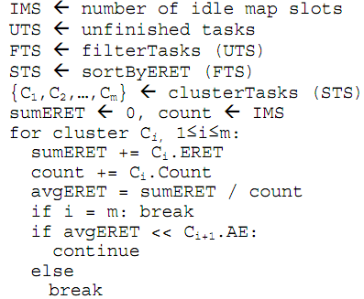
Task splitting: Algorithm Skeleton

Slide 45
Task splitting: Algorithm Details
Filter tasks with small ERET
Optimal Remaining Job Execution Time (ORJET)
total_ERET / num_slots
Compare ERET with ORJET
Adaptive
Sort tasks by ERET in descending order
Cluster tasks by ERET
One dimensional clustering: linear
Tasks with similar ERET are put into the same cluster
Go through clusters to calculate the gain
Given that splitting tasks in first i clusters is beneficial
Decide whether to also split tasks in cluster i+1
For each task to split, evenly distribute unfinished work
# of new tasks: task_ERET / optimal_ERET(after splitting)

Slide 46
Task splitting: Example
Initial state
Running tasks: {100, 30, 80, 1, 10};
# of idle slots: 8
Filtering: {100, 30, 80, 10}
Sorting: {100, 80, 30, 10}
Clustering: { {100, 80}, {30}, {10} }
Iterating:
Split tasks in C₁ and C₂
Tasks in C₁:
Tasks in C₂:
Cluster | avg_ERET | optimal_ERET | Split
C₁ {100, 80} | 90 | (100+80)/(2+8)=18 | Y
C₂ {30} | 30 | (100+80+30)/(3+8)=19 | Y
C₃ {10} | 10 | (100+80+30+10)/(4+8)=18 | N

Slide 47
Task splitting: Multi-Job Scenarios
Constraints of Scheduling
r(t,i): amount of resource consumed by job i at time t
C: the capacity of a certain type of resource
S_{i}: resource requirement of job i
Goal function
Assume jobs can be “arbitrarily” split into tasks
But not beyond minimum allowed task granularity

Slide 48
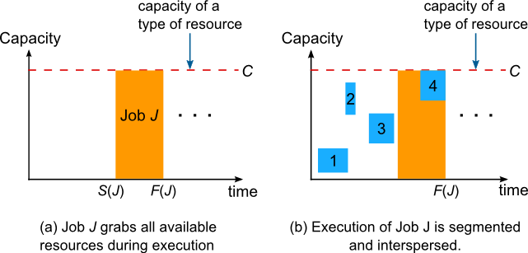
Short Job First Strategy
(c) Continuous job exec. arrangement
Once F(J) is fixed, S(J) does NOT affect job turnaround time
Once a job start running, it should use all available resources
This problem can be solved by converting it to n jobs/1 machine problem
Shortest Job First (SJF) is optimal
Periodic scheduling: non-overlapping or overlapping

Slide 49
Task splitting: Experiment Environment
Simulation-based: mrsim
Environment setup
Number of nodes | 64 | Disk I/O - read | 40MB/s
Processor frequency | 500MHz | Disk I/O - write | 20MB/s
Map slots per node | 1 | Network | 1Gbps

Slide 50
Hierarchical MapReduce
MaxMapper_{i}: sum of map slots on cluster_{i}
MapperRun_{i}: # of running tasks on cluster_{i}
MapperAvail_{i}: # of available map slots on cluster_{i}
NumCore_{i}: # of CPU cores on cluster_{i}
p_{i}: max. num. of tasks concurrently running on each core
MaxMapper_{i} = p_{i} x NumCore_{i}
MapperAvail_{i} = MaxMapper_{i} – MapperRun_{i}
Weight_{i} = (MA_{i} x W_{i})/Sigma_{i=1…N}(MA_{i} xW_{i})
W_{i}: static weight of each cluster (e.g. it can reflect compute power, or memory capacity)
NumMap_{J}^{i} = Weight_{i} x NumMap_{J}

