Slide 1
GPUs on Clouds
Andrew J. Younge
Indiana University
(USC / Information Sciences Institute)
UNCLASSIFIED: 08/03/2012

Slide 2
Outline
Introduction to IaaS
GPUs - CUDA programming
Current State of the Art
Using GPUs in Clouds
  Options
  System design/overview
  Current work and progress
Performance
Conclusion
  Petascale GPUs today, want to use in cloud
  Excascale future likely to have GPUs
  Need to support scientific cloud computing

Slide 3
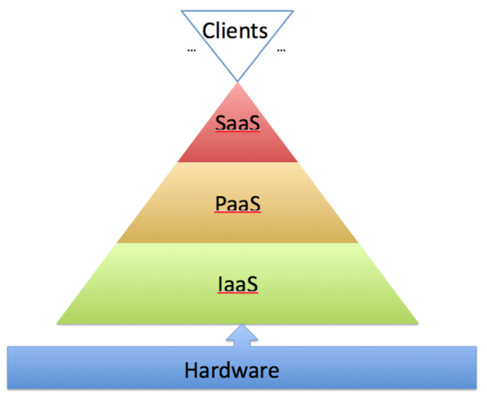
Where are we in the Cloud?
Cloud computing spans may areas of expertise
Today, focus only on IaaS and the underlying hardware
Things we do here effect the entire pyramid!

Slide 4
Conventional CPU Architecture
Space devoted to control logic instead of ALU
CPUs are optimized to minimize the latency of a single thread
Multi level caches used to hide latency
Limited number of registers due to smaller number of active threads
Control Logic
L2 Cache
L3 Cache
ALU
~ 25G bps
System Memory
A present day multicore CPU could have more than one ALU ( typically < 32) and some of the cache hierarchy is usually shared across cores

Slide 5
Modern GPU Architecture
Generic many core GPU
  Less space devoted to control logic and caches
  Large register files to support multiple thread contexts
Low latency hardware managed thread switching
Large number of ALU per “core” with small user managed cache per core
Memory bus optimized for bandwidth
High Bandwidth
bus to ALUs
On Board System Memory
Simple ALUs
Cache

Slide 6
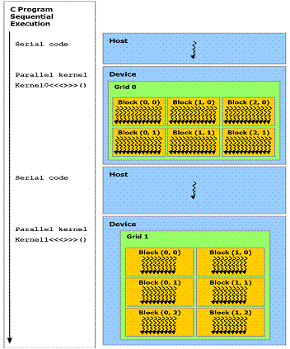

Slide 7
blockIdx and threadIdx
Each thread uses indices to decide what data to work on
  blockIdx: 1D, 2D, or 3D (CUDA 4.0)
  threadIdx: 1D, 2D, or 3D

Slide 8
CPU and GPU Memory
Program compiled has code executed on CPU and (kernel) code executed on GPU
Separate memories on CPU and GPU
Need to:
  Explicitly transfer data from CPU to GPU for GPU computation, and
  Explicitly transfer results in GPU memory copied back to CPU memory
CPU
CPU main memory
Copy from CPU to GPU
Copy from GPU to CPU
GPU global memory
GPU

Slide 9
Programming Model
GPUs historically designed for creating image data for displays.
That application involves manipulating image pixels (picture elements) and often the same operation each pixel
SIMD (single instruction multiple data) model - An efficient mode of operation in which the same operation is done on each data element at the same time

Slide 10
SIMD (Single Instruction Multiple Data) model
Also know as data parallel computation. One instruction specifies the operation:
Instruction
a[] = a[] + k
ALUs
a[0]
a[1]
a[n-2]
a[n-1]
Very efficient of this is what you want to do. One program.
Can design computers to operate this way.

Slide 11
Array of Parallel Threads
A CUDA kernel is executed by a grid (array) of threads
  All threads in a grid run the same kernel code (SPMD)‏
  Each thread has an index that it uses to compute memory addresses and make control decisions
0
1
2
254
255
…
i = blockIdx.x * blockDim.x + threadIdx.x;
C_d[i] = A_d[i] + B_d[i];
…

Slide 12
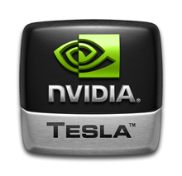
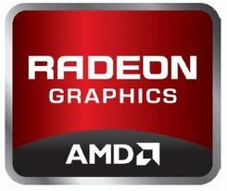
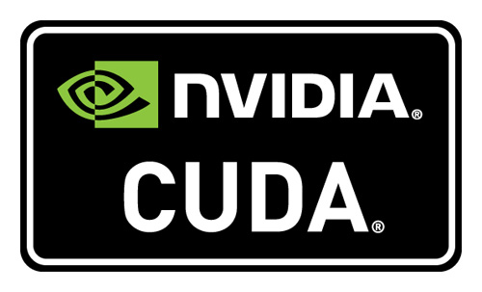
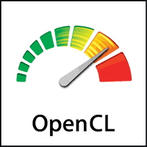
GPUs Today

Slide 13
Virtualized GPUs
Need for GPUs on Clouds
  GPUs are becoming commonplace in scientific computing
  Provide great performance-per-watt
Different competing methods for virtualizing GPUs
  Remote API for CUDA calls
  Direct GPU usage within VM
Advantages and disadvantages to both solutions

Slide 14
Front-end GPU API
Translate all CUDA calls into a remote method invocations
Users share GPUs across a node or cluster
Can run within a VM, as no hardware is needed, only a remote API
Many implementations for CUDA
  RCUDA, gVirtus, vCUDA, GViM, etc..
Many desktop virtualization technologies do the same for OpenGL & DirectX

Slide 15
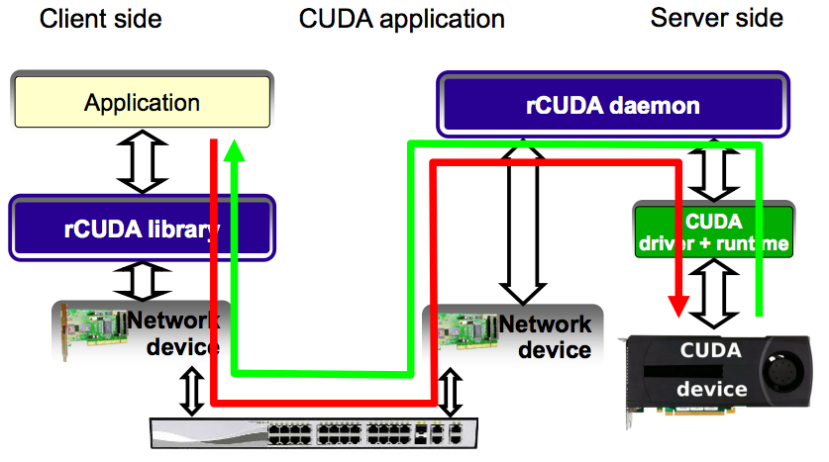
Front-end GPU API

Slide 16
Front-end API Limitations
Can use remote GPUs, but all data goes over the network
  Can be very inefficient for applications with non-trivial memory movement
Usually doesn’t support CUDA extensions in C
  Have to separate CPU and GPU code
  Requires special decouple mechanism
Cannot directly drop in solution with existing solutions.

Slide 17
Direct GPU Virtualization
Allow VMs to directly access GPU hardware
Enables CUDA and OpenCL code!
Utilizes PCI-passthrough of device to guest VM
  Uses hardware directed I/O virt (VT-d or IOMMU)
  Provides direct isolation and security of device
  Removes host overhead entirely
Similar to what Amazon EC2 uses

Slide 18
Direct GPU Virtualization

Slide 19
Current Work
Build GPU Passthrough into IaaS
Use OpenStack IaaS
  Free & open source
  Large development community
  Easy to deploy on FutureGrid
  Build GPU Cloud!
Use XenAPI and XCP (4.1.2 hypervisor) with modifications.

Slide 20
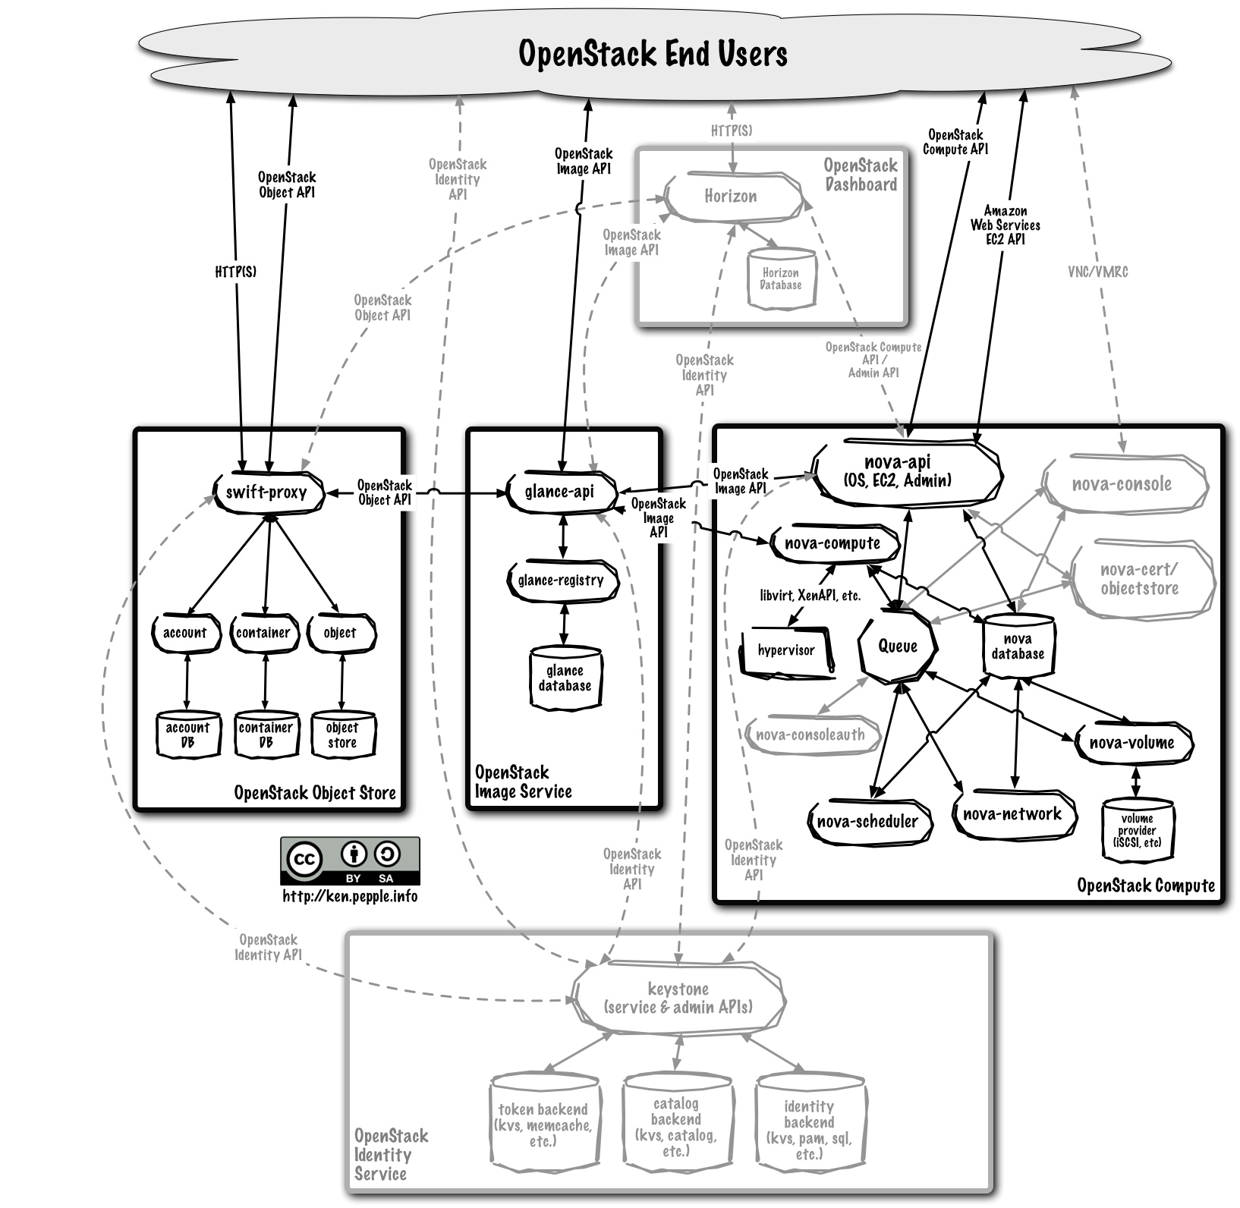
OpenStack Implementation

Slide 21
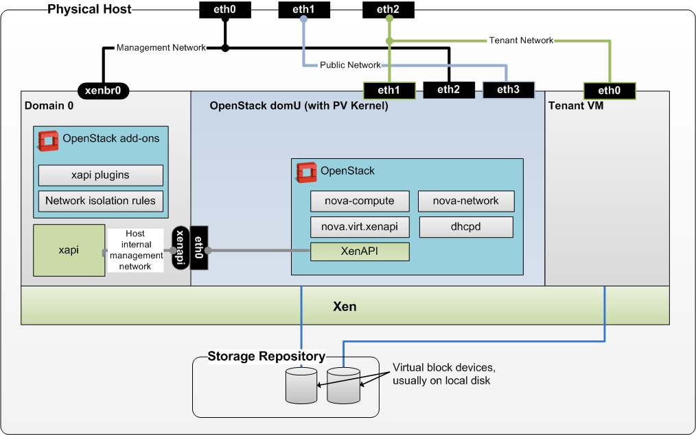
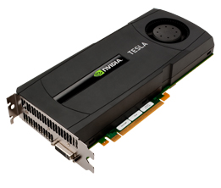
Implementation

Slide 22
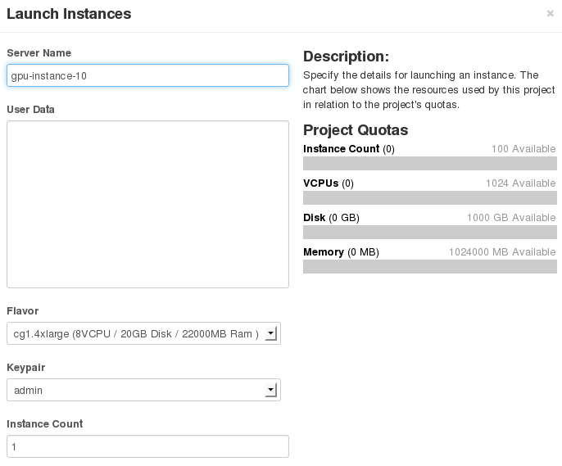

User Interface

Slide 23
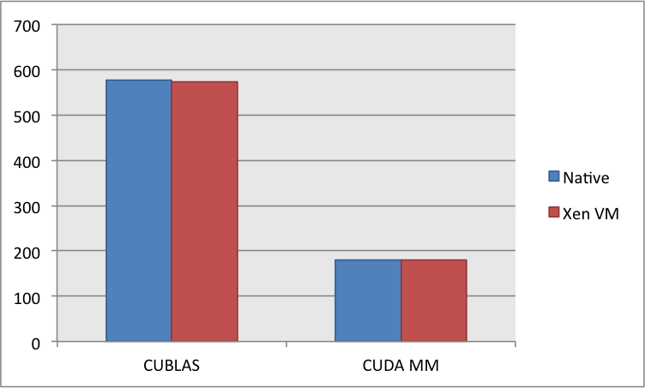
Performance
CUDA Benchmarks
  89-99% efficiency ☺
  VM memory matters
  Outperform RCUDA?

Slide 24
Conclusion
GPUs are here to stay in scientific computing
  Many Petascale systems use GPUs
  Expected GPU Exascale machine (2020-ish)
Providing HPC in the Cloud is key to the viability of scientific cloud computing.
  So GPU usage in IaaS matters!
OpenStack provides an ideal architecture to enable HPC in clouds.

Slide 25
Acknowledgements
USC / ISI
  JP Walters & Steve Crago
  DODCS team
IU
  Geoffrey Fox
  Jerome Mitchel!!
  SalsaHPC team
  FutureGrid
NVIDIA

