Slide 1

Architectural Principles and Experimentation of Distributed High Performance Virtual Clusters
Andrew J. Younge
PhD Dissertation Defense
Indiana University
ajyounge@indiana.edu

Slide 2
Outline
Introduction to High Performance Virtual Clusters
Hypervisor experiments
GPU Passthrough in Xen
GPU Passthrough evaluation
SR-IOV Interconnects
Molecular Dynamics Virtual Clusters
Conclusion & future work

Slide 3

Cloud Infrastructure
A large-scale distributed computing paradigm
  Driven by economies of scale
  Pools of abstracted, virtualized, managed, and dynamically scalable computing resources
  Delivered on demand
Focus on Infrastructure-as-a-Service
Virtualization at the base of cloud infrastructure
  Provide Virtual Machines (VMs) which are hardware abstractions of underlying physical hardware
Notes:
While I will touch upon cloud infrastructure, I don’t plan to spend the rest of the time talking about meteorology

Slide 4
Cloud Infrastructure for mid-tier Scientific Computing
Can cloud infrastructure, which leverages virtualization, support a wide range of scientific computing?
  Rent-a-workstation
  High throughput computing, pleasingly parallel tasks
  Cloud platform services and big data analytics
  High Performance Computing ??
    with complex communication patterns??

Slide 5
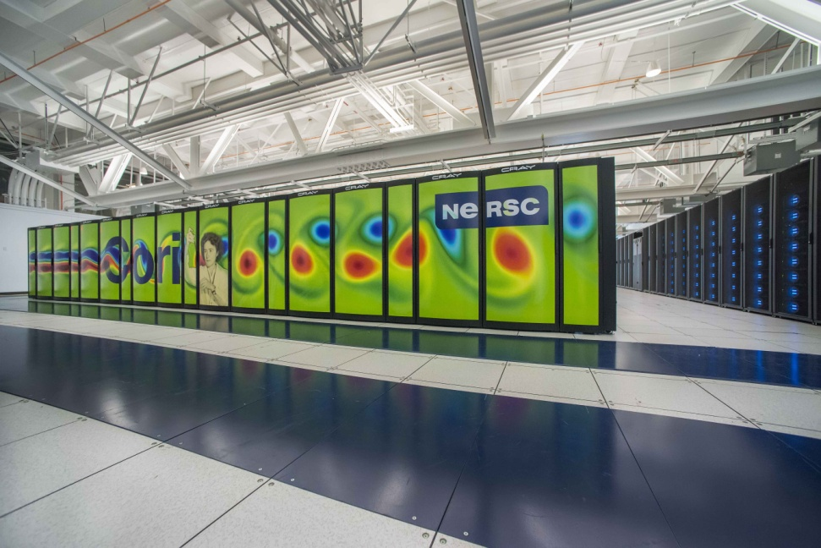
High Performance Computing
Fast, tightly coupled systems
Performance is paramount
Large-scale massively parallel applications
MPI for distributed memory communication
  Advanced interconnects
    high bandwidth
    low latency
Recent increase in the use of accelerators and co-processors

Slide 6
Motivation
Number of advantages of virtualized infrastructure
  Customized OS & runtime environment
  Multi-tenancy
  Environment portability
  Experiment Management
  Fault tolerance & packaging
Potential for other future abilities
  Experiment sharing
  Dynamic computational movement
  In-situ analytics and workflows
  Hybrid kernels and advanced runtime systems

Slide 7
Virtualized HPC
Virtualization has struggled to support HPC in the past
  Large variation in performance
  Significant overhead in hypervisors
  Lack of hardware support
    Ethernet not well suited for HPC
    Lack of accelerator support
Magellan project examined DOE HPC software stacks on cloud IaaS and found numerous performance concerns

Slide 8
High Performance Virtual Clusters
Virtual Clusters are just clusters, but deployed on VMs within a virtualized infrastructure
  Can provision cluster nodes dynamically
  Manage different guest OSs, environments
  Increases application flexibility
  VC’s share physical resources and keep application isolation
Virtual Clusters don’t take performance into consideration!
Image from: Distributed and Cloud Computing: From Parallel Processing to the Internet of Things.
Notes:
One attempt to support HTC and HPC applications in virtualized infrasturcture is through the use of Virtual Clusters
Virtual Clusters are…

Slide 9
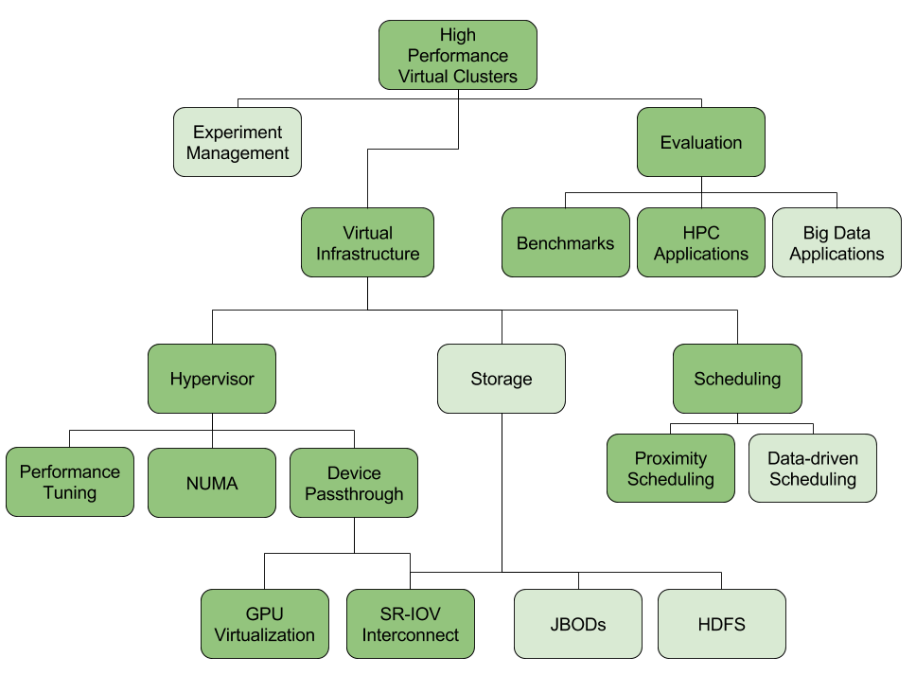
Notes:
As such, we’ve designed a framework to help guide our investigation of High Performance Virtual Clusters
Dark green = addressed
Light green = to be addressed

Slide 10
Virtualization Overhead
Theoretically, virtualization could run with no overhead
  Stay in guest mode 100% of the time
  NO VM exit/entry, hypercalls, traps, shadow page tables….
Need to pinpoint sources of virtualization overhead
  Overcome issues using both hardware and software
  Identify inherent limitations of virtualization
Start with open source solutions and optimize
Notes:
However, in reality we’re not in guest mode 100% of the time, so we have to deal with the Overhead associated!

Slide 11
Outline
Introduction to High Performance Virtual Clusters
Hypervisor experiments
GPU Passthrough in Xen
GPU Passthrough evaluation
SR-IOV Interconnects
Molecular Dynamics Virtual Clusters
Conclusion & future work

Slide 12
FutureGrid
FutureGrid part of XSEDE set up as a NSF testbed with cloud focus
Operational since Summer 2010, now called FutureSystems
  Support of Computer Science and Computational Science research
  A flexible development and testing platform for middleware and application users looking at interoperability, functionality, performance or evaluation
  User-customizable, accessed interactively and supports Grid, Cloud and HPC software with and without VM’s
  A rich education and teaching platform for classes
Offers OpenStack, Eucalyptus, Nimbus, OpenNebula, LRMS on same hardware moving to software defined systems; supports both classic HPC and Cloud storage
Supported 500+ projects, over 3000 users from 53 countries.

Slide 13
Heterogeneous Systems Hardware
Name | System type | # CPUs | # Cores | TFLOPS | Total RAM (GB) | Secondary Storage (TB) | Site
India | IBM iDataPlex | 256 | 1024 | 11 | 3072 | 512 | IU
Alamo | Dell PowerEdge | 192 | 768 | 8 | 1152 | 30 | TACC
Hotel | IBM iDataPlex | 168 | 672 | 7 | 2016 | 120 | UC
Sierra | IBM iDataPlex | 168 | 672 | 7 | 2688 | 96 | SDSC
Xray | Cray XT5m | 168 | 672 | 6 | 1344 | 180 | IU
Foxtrot | IBM iDataPlex | 64 | 256 | 2 | 768 | 24 | UF
Bravo | Large Disk & memory | 32 | 128 | 1.5 | 3072 (192GB per node) | 192 (12 TB per Server) | IU
Delta | Large Disk & memory With Tesla GPU’s | 32 CPU 32 GPU’s | 192 | 9 | 3072 (192GB per node) | 192 (12 TB per Server) | IU
Lima | SSD Test System | 16 | 128 | 1.3 | 512 | 3.8(SSD) 8(SATA) | SDSC
Echo | Large memory ScaleMP | 32 | 192 | 2 | 6144 | 192 | IU
TOTAL |  | 1128 + 32 GPU | 4704 +14336 GPU | 54.8 | 23840 | 1550

Slide 14
Initial Hypervisor Experiments
Use FutureGrid as base environment
  Neutral testing ground
  India’s Nehalem processors
Goal: determine initial intra-node performance for HPC tasks running in VMs
Default Hypervisor setup
  Xen 3.1
  KVM v83
  Virtualbox 3.2.10
  VMWare
Common benchmarks
  HPCC Benchmark suite w/ LINPACK
  SPEC OpenMP

Slide 15
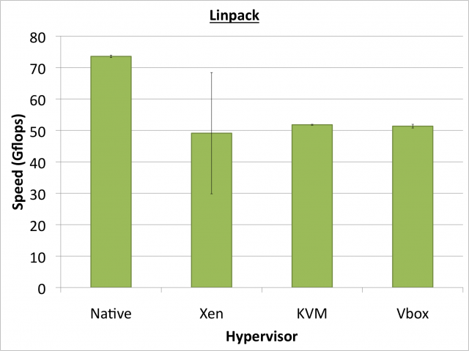
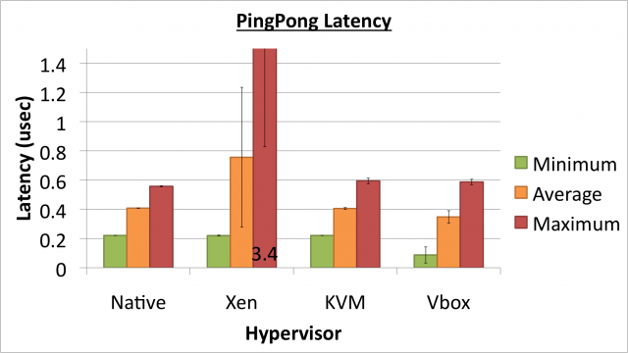
VM Performance
Initial Question: Does the overhead in the hypervisor VM model prohibit scientific HPC?
  Sometimes Yes
  Sometimes No
Feature set: All hypervisors are similar
In 2011, notable overhead in HPC benchmarks
  HPCC Linpack ~70% efficiency
  High workload variance
  Unpredictable latencies
From: Analysis of Virtualization Technologies for High Performance Computing
Environments, A. J. Younge et al. IEEE Cloud 2011
Notes:
Is the hypervisor vm model a prohibitive solution for sicentific hpc. Ie do overheads kill you?

Slide 16
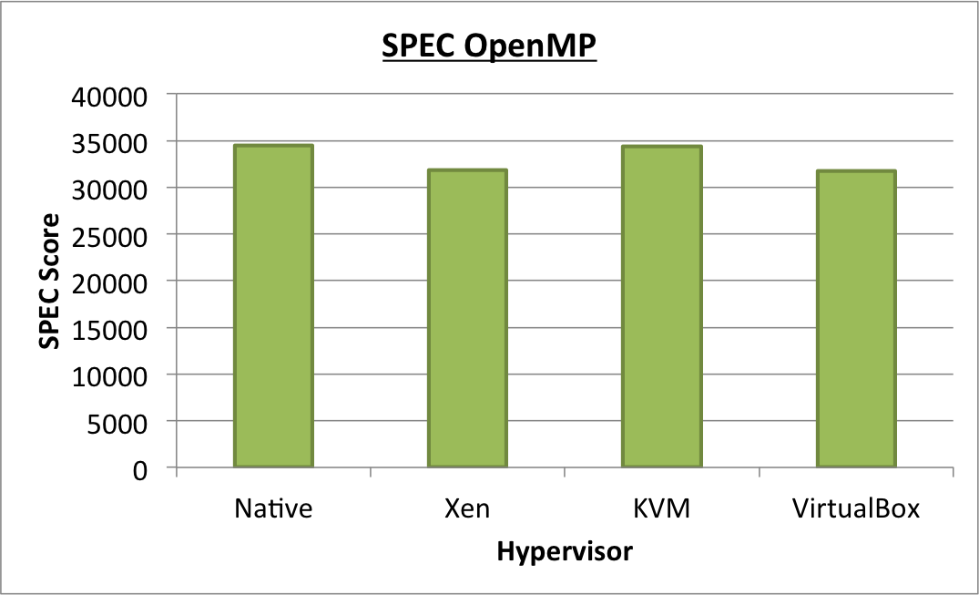
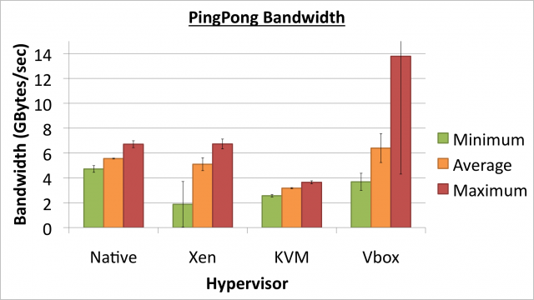
VM Performance
Initial Question: Does the overhead in the hypervisor VM model prohibit scientific HPC?
  Sometimes Yes
  Sometimes No
Performance: Hypervisors are not equal
  KVM performance often very good, VirtualBox close, Xen good & bad
  Overall, we have found KVM to be the best hypervisor choice for HPC.
  Latest Xen results show improvements
From: Analysis of Virtualization Technologies for High Performance Computing
Environments, A. J. Younge et al. IEEE Cloud 2011
Notes:
Is the hypervisor vm model a prohibitive solution for scientific hpc? Ie do overheads kill you?

Slide 17
IaaS with HPC Hardware
Providing near-native hypervisor performance may not solve all challenges of high performance virtual clusters
Need to leverage HPC hardware
  Accelerator cards
  High speed, low latency interconnects
  Other future HW advances…
Need to characterize and actively minimize overhead wherever it exists

Slide 18
Outline
Introduction to High Performance Virtual Clusters
Hypervisor experiments
GPU Passthrough in Xen
GPU Passthrough evaluation
SR-IOV Interconnects
Molecular Dynamics Virtual Clusters
Conclusion & future work

Slide 19
Direct GPU Virtualization
Allow VMs to directly access GPU hardware
Utilizes PCI Passthrough of device to guest VM
  Uses hardware directed I/O virtualization (VT-d or AMD-v)
  DMA-remapping, interrupt posting, & error handling
  Provides PCI device isolation and security
  Potential for lower hypervisor overhead
Creates a 1-1 mapping between GPU and VM guest
  Not emulated or para-virtualized hardware
Enables both CUDA and OpenCL codesets natively
Not really virtualization, but GPU Passthrough
Potentially better than front-end remote API solutions
  rCUDA, vCUDA, gVirtus, others
  Rely on shared memory buffers or interconnects
  Native usage of GPUs not always possible

Slide 20
Hardware Setup
 | Westmere + Fermi | Sandy Bridge + Kepler
Name | Delta (IU) | Bespin (ISI)
CPU (cores) | 2xX5660 (12) | 2xE5-2670 (16)
Clock Speed | 2.6 GHz | 2.6 GHz
RAM | 192 GB | 48 GB
NUMA Nodes | 2 | 2
GPU | 2xC2075 | 1xK20m
PCI-Express | 2.0 | 3.0 (with bug)
Release | ~2011 | ~2013

Slide 21
Evaluating Xen GPU Passthrough
Methodology for GPU Passthrough developed first in Xen hypervisor
  Need to measure performance and overhead
SHOC Benchmark Suite developed by ORNL
  Provides 70 benchmarks
    Synthetic micro-benchmarks
    3rd party applications
    CUDA and OpenCL implementations
Can give well-rounded viewpoint of GPU performance

Slide 22
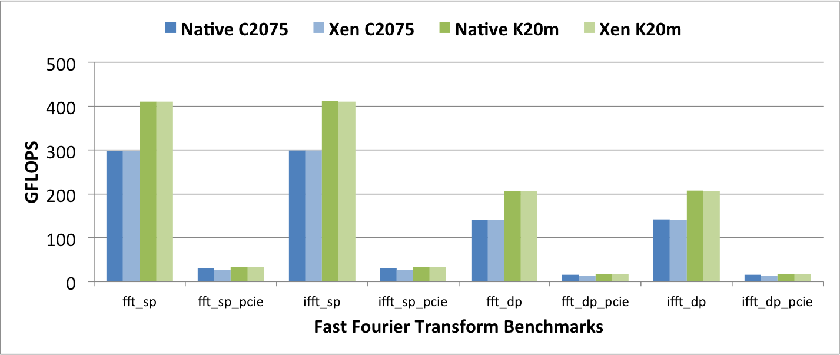
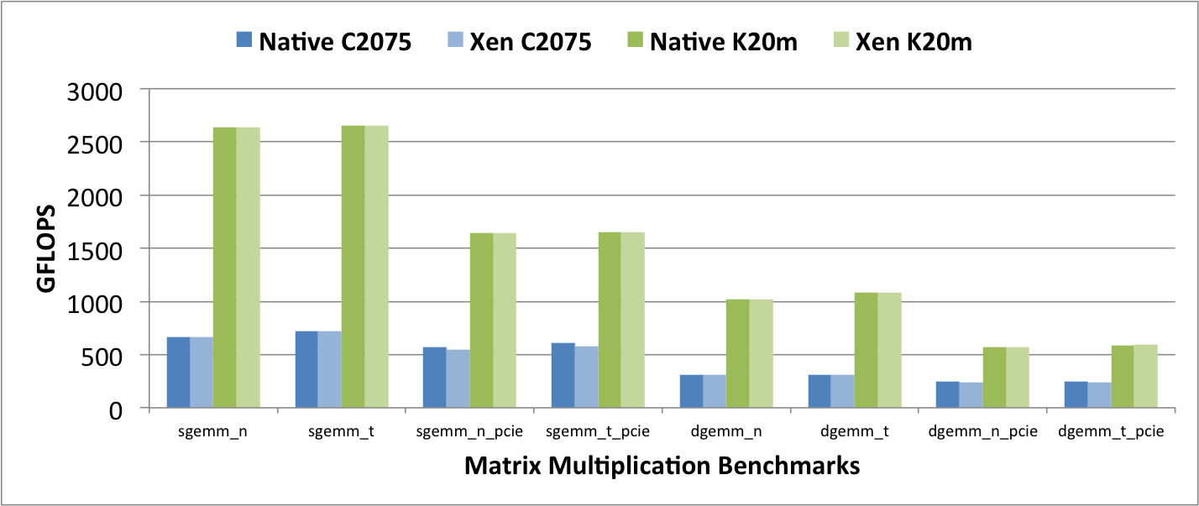
From: Andrew J. Younge, John Paul Walters, Stephen Crago, Geoffrey C. Fox, Evaluating GPU Passthrough in Xen for High Performance Cloud Computing, in High-Performance Grid and Cloud Computing Workshop at the 28th IEEE International Parallel and Distributed Processing Symposium. 2014
Notes:
Non-PCIe benchmarks = near- native performance using the Kepler GPUs and Fermi GPUs when compared to bare metal cases
overhead within Xen VMs is consistently less than 1%
some performance impact when calculating the total FLOPs with the pcie bus in the equation
With PCIE: - PCIE plays significant factor in the overall performance
C2075 15% impact for FFT and 5% impact for MM
K20m – only around 1% as worst, much better!
GEMM= General Matrix Multiplication. T/N = with/without transpose input
FFT/IFFT = regular FFT and inverse FFT & normalization

Slide 23
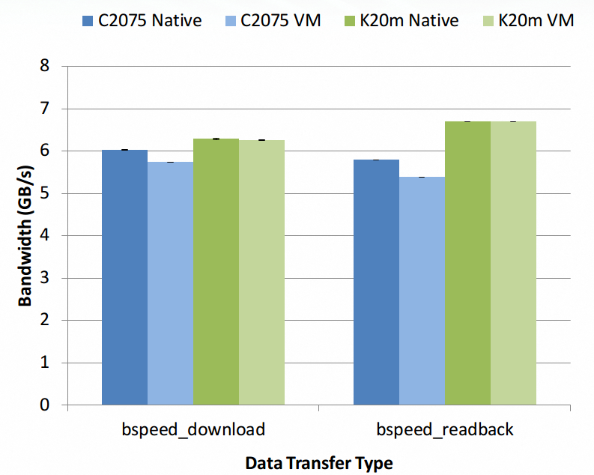
Notes:
consistent overhead in the Fermi C2075 VMs
-14.6% performance impact for download (to-device)
- 15% impact in readback (from- device).
Kepler K20 VMs do not experience the same overhead in the PCI-Express bus, and instead perform at near-native performance.

Slide 24
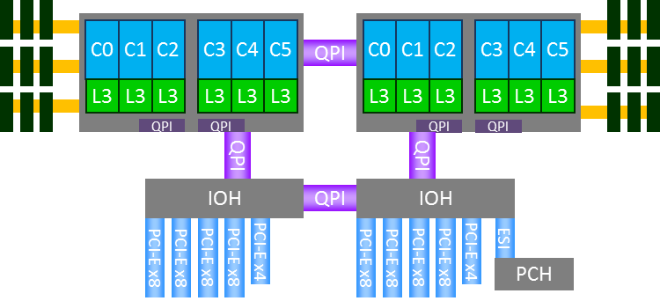
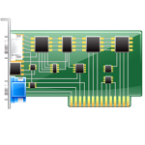
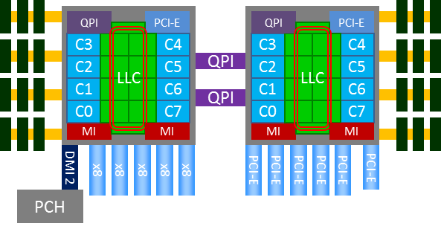
CPU Architecture
Westmere/Nehalem
Single QPI connection between NUMA sockets
Intel 5500 chipset for I/O Hub (IOH) with own QPI
  PCI-E from 2 IOHs
Sandy Bridge
Dual QPI connection between NUMA sockets
PCI-E built into processor
  If VMs pinned, no QPI traversal
Notes:
In older Westmere, we had to traverse QPI where we see overhead in VT-d security mechanisms.
Newer archs like Sandy Bridge, the IOH and PCIE is directly on chip, reducing overhead.
QPI 1.1 in Sandybridge major revamp
Dual QPI no longer limiting, but vCPU pinning can also have major impact.

Slide 25
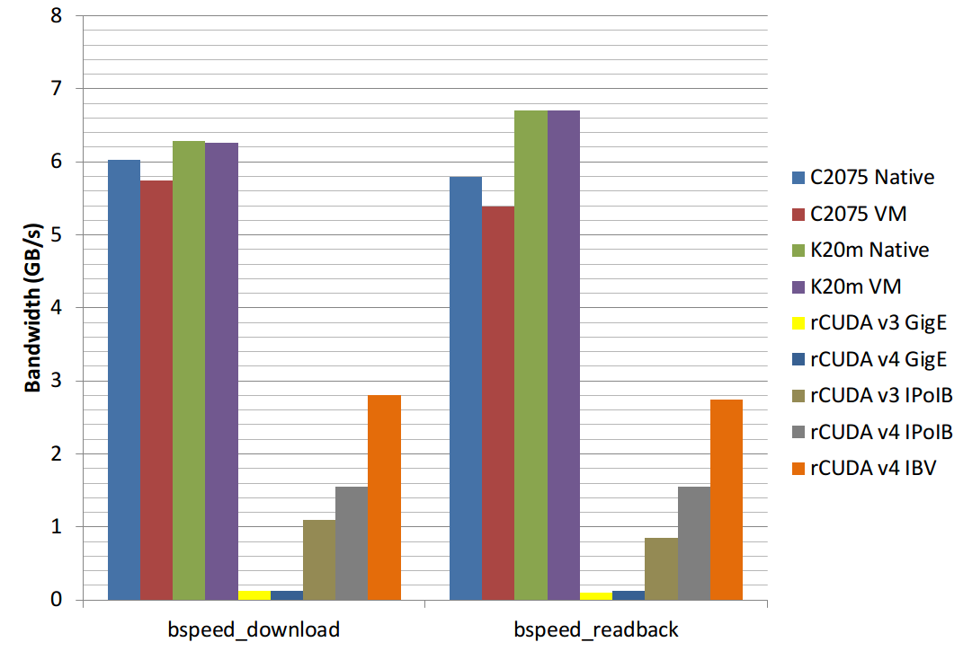
GPU Passthrough vs rCUDA
Notes:
Can use remote GPUs, but all data goes over the network
Can be very inefficient for applications with non-trivial data movement
Some implementations do not support CUDA extensions in C
Have to separate CPU and GPU code
Requires special decouple mechanism
Cannot directly drop in code with existing solutions.

Slide 26
GPU Passthrough
Need for GPUs in virtual infrastructure
  GPUs are becoming more common in scientific computing
  Remote API solution for GPUs suboptimal
Solution: Direct GPU Passthrough
Prototype GPU Passthrough with Xen
  Overhead is minimal for GPU computation
  Bespin (SandyBridge) has < 1.2% overall overhead
  Delta (Westmere) has 1% to 15% due to accessing PCI-E bus
  Our solution performs better than other front-end remote API solutions
Notes:
To summarize: ther eis a need for GPUs in virtualized environments
GPUs can be used in virtual machines at near-native speeds. a new advancement

Slide 27
Outline
Introduction to High Performance Virtual Clusters
Hypervisor experiments
GPU Passthrough in Xen
GPU Passthrough evaluation
SR-IOV Interconnects
Molecular Dynamics Virtual Clusters
Conclusion & future work

Slide 28
GPU Hypervisor Experiment
In 2012, the Xen GPU Passthrough implementation was novel for Nvidia GPUs
Today GPUs available through most of the major hypervisors
  KVM, VMWare ESXi, Xen, LXC
Also developed similar methods for GPU Passthrough in KVM
  Based on kvm/qemu VFIO in new kernel >= 3.9
Performance implications:
  Near-native performance possible?
Benchmarks
  Micro-benchmarks: SHOC OpenCL (70 total benchmarks)
  LAMMPS: hybrid multicore CPU+GPU
  GPU-LIBSVM: machine learning support vector machine
  LULESH: hydrodynamics application
Platforms
  Delta - Westmere with Fermi C2075
  Bespin - Sandy Bridge with Kepler K20m
From: John Paul Walters, Andrew J. Younge, Dong-In Kang, Ke-Thia Yao, Mikyung Kang, Stephen P. Crago, Geoffrey C. Fox, GPU-Passthrough Performance: A Comparison of KVM, Xen, VMWare ESXi, and LXC for CUDA and OpenCL Applications, in Proceedings of the 7th IEEE International Conference on Cloud Computing (CLOUD 2014).

Slide 29
Notes:
Results normalized to Native performance
Because SHOC is 70 benchmarks, we will only look at “Outliers”
- where performance differed > .5%
Overall both Fermi and Kepler systems perform near-native
KVM and LXC showed no notable performance degredation
Xen on the C2075 system shows some overhead
Likely because Xen couldn’t activate large page tables
VMWare results vary significantly between architecture
Kepler shows greater than base performance
VMWare timing issues seen here! Likely TSC manipulation
Fermi shows largest overhead
Some unexpected performance improvement for Kepler Spmv

Slide 30
LULESH Hydrodynamics Performance
Bespin K20m Results
LULESH (K20m only)
Highly compute-intensive, little data movement
  Expect little virtualization overhead
Initially slight overhead from Xen
  Decreases as mesh resolution (N³) increases
From:John Paul Walters, Andrew J. Younge, Dong-In Kang, Ke-Thia Yao, Mikyung Kang, Stephen P. Crago, Geoffrey C. Fox, GPU-Passthrough Performance: A Comparison of KVM, Xen, VMWare ESXi, and LXC for CUDA and OpenCL Applications, in Proceedings of the 7th IEEE International Conference on Cloud Computing (CLOUD 2014).
Notes:
Lulesh build to run only on Kepler+ GPUs, so no Delta
Lulesh is very compute-intensive
- so we see little overhead
- only Xen overhead decreases with mesh size (more computation todo on GPU)

Slide 31
GPU-LIBSVM Results
Delta C2075 Results
Bespin K20m Results
Unexpected performance improvement for KVM on both systems
  Most pronounced on Westmere/Fermi platform
What caused performance improvement over bare metal?
  Not timing issues like with VMWare
From:John Paul Walters, Andrew J. Younge, Dong-In Kang, Ke-Thia Yao, Mikyung Kang, Stephen P. Crago, Geoffrey C. Fox, GPU-Passthrough Performance: A Comparison of KVM, Xen, VMWare ESXi, and LXC for CUDA and OpenCL Applications, in Proceedings of the 7th IEEE International Conference on Cloud Computing (CLOUD 2014).
Notes:
A Library for Support Vector Machines – GPU instance – looking at runtime

Slide 32
KVM libSVM Performance
KVM can outperform native solution!
This is due to the use of transparent huge pages (THP)
  Back the entire guest memory with 2MB pages
  Improves memory performance
    Separate TLB for 2M pages, less TLB pressure
    Increased TLB reach
    2M TLB miss => less page table walk references
LibSVM is memory-intensive, large amount of CPU->GPU data movement
Notes:
Using 2MB huge pages extends the TLB reach, which benefits large memory operations.
TLB miss costs 15 memory references, instead of 24 references
- native only 4/3 memory references, so still not native, but better
GPU data access backed by 2M pages, decreasing TLB miss count & cost.
NOTE: This performance is an exception, rather than a rule. But it shows the power of virtualization.

Slide 33
Lessons Learned – GPU Hypervisor Performance
KVM consistently yields near-native performance across architectures
VMWare’s performance inconsistent
  Near-native on Sandy Bridge, high overhead on Westmere
  Virtual TSC issues
Xen performed consistently average across both architectures
LXC performed closest to native
  Unsurprising, given LXC’s design
  Trades performance for flexibility
Given these results we see KVM as holding a slight edge for GPU passthrough
Virtualization of high performance GPU workloads historically controversial
  Remote API solutions suboptimal
  Westmere results suggest this was sometimes legitimate
    More than 10% overhead common
More recent architectures (e.g. Sandy Bridge) have nearly erased those overheads
  Lowest performing hypervisor (Xen) within 95% of native
  Improved CPU integration with PCI-Express bus
Notes:
KVM = best full virt option
VMWare = inconsistant
Xen = slowest
LXC = near-native, but usability tradeoffs with OS-virt

Slide 34
Outline
Introduction to High Performance Virtual Clusters
Hypervisor experiments
GPU Passthrough in Xen
GPU Passthrough evaluation
SR-IOV Interconnects
Molecular Dynamics Virtual Clusters
Conclusion & future work

Slide 35
Interconnects in Virtual Clusters
While intra-node hypervisor performances improves, I/O support in virtualized environments still suffers
  Bridged 1GbE or 10GbE often state-of-the-art for IaaS
  Latency also suffers with emulated drivers
Inter-node communication fundamental to HPC
  Distributed memory applications rely on interconnects for distributing work and communicating results
Need for high performance, low latency interconnect
  InfiniBand - Not possible until recently
Notes:
While intra-node performance may increase with newer HW and SW, intra-node performance still fundamentally limited by Ethernet
Amazon EC2 can only offer 1Gb or at best 10Gb Ethernet.
Well documented how Ethernet solutions involve too high of protocol overhead
We focus on InfiniBand due to its prevalence in HPC and array of potential solutions

Slide 36
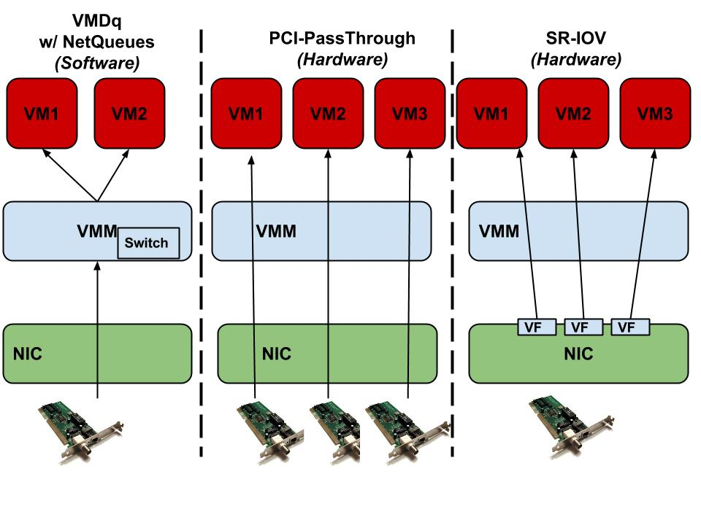


Interconnect Virtualization
Overhead Reduction
Performance
Scalability
Performance
Scalability
Performance
Scalability
From: Malek Musleh, Vijay Pai, John Paul Walters, Andrew J. Younge, Stephen P. Crago, Bridging the Virtualization Performance Gap for HPC using SR-IOV for InfiniBand, in Proceedings of the 7th IEEE International Conference on Cloud Computing (CLOUD 2014).
Notes:
. The center block shows that only one VM has access
to a speciﬁc NIC at a time, whereas the rightmost part shows
how a single NIC can be shared across different VMs. In both
PCI-passthrough and SR-IOV the VMM is bypassed, which
eliminates the extra overhead mentioned earlier. This is in
contrast to the leftmost component of Figure 1 that illustrates
the: Virtual Machine Device Queue (VMDq) w/NetQueues
technique, that requires the VMM to route incoming packets
from the NIC to the correct VM.

Slide 37
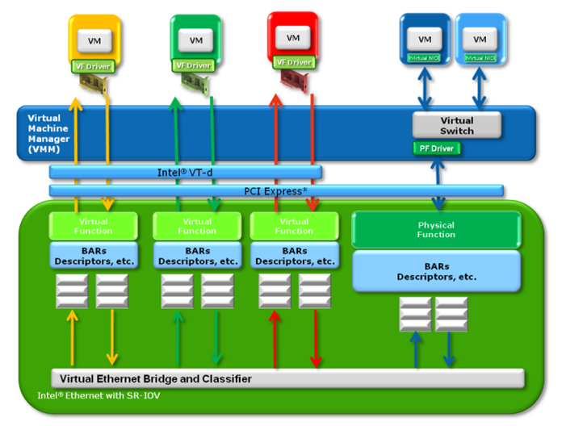
SR-IOV VM Support
Ethernet and InfiniBand cards with SR-IOV support
Different device model
  Physical Function (PF) for hypervisor control
  Virtual Functions (VF) to passthrough to guest VMs
Requires extensive device driver support
  Mellanox now supports KVM SR-IOV for CX2 and CX3 cards
  Separate driver for VF in VM
Host
PF Driver
Image from “PCI-SIG SR-IOV Primer: An Introduction to SR-IOV Technology - Intel”

Slide 38
SR-IOV InfiniBand
Initial evaluation shows promise for IB-enabled VMs
  SR-IOV Support for Virtualization on InfiniBand Clusters: Early Experience, Jose et al – CCGrid 2013
  Exploring Infiniband Hardware Virtualization in OpenNebula towards Efficient High-Performance Computing, Ruivo et al –CCGrid 2014
  ** Bridging the Virtualization Performance Gap for HPC Using SR-IOV for InﬁniBand, Musleh et al – IEEE CLOUD 2014 **
  SR-IOV: Performance Benefits for Virtualized Interconnects, Lockwood et al – XSEDE14

Slide 39
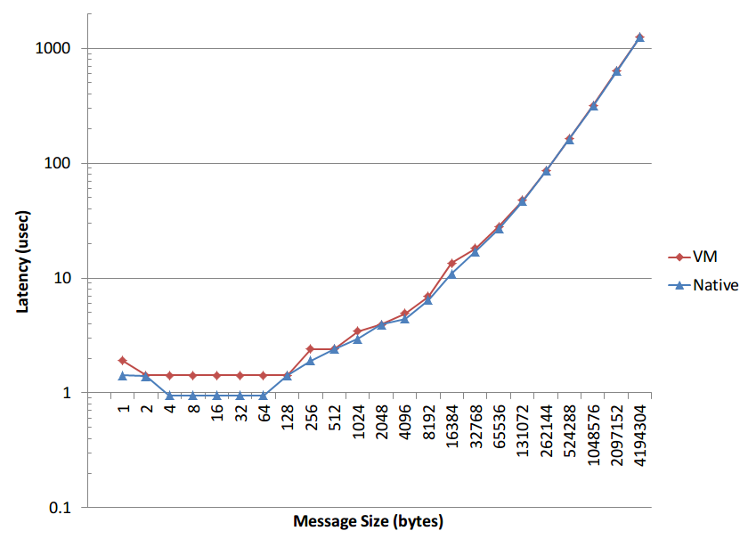
SR-IOV InfiniBand
Initial SR-IOV InfiniBand with KVM hypervisor
  Bandwidth is near-native
  Latency overhead is convoluted
    ~15-30% overhead for 1byte messages
Data from: Malek Musleh, Vijay Pai, John Paul Walters, Andrew J. Younge, Stephen P. Crago, Bridging the Virtualization Performance Gap for HPC using SR-IOV for InfiniBand, in Proceedings of the 7th IEEE International Conference on Cloud Computing (CLOUD 2014).
Notes:
Slight overhead in HW switch when routing data to VFs – seen as latency
As message size increase, latency becomes negligable
Which is why we see near-native bandwidth
SRQ – allows sharing of buffers across multiple connections
Observation: Native InfiniBand optimizations may be sub-optimal for SR-IOV
Possible Solution: Tune parameters for better performance with SR-IOV (~15% improvement)
Interrupt Moderation & Coalescing
IRQ Balancing
Shared Receive Queue

Slide 40
Outline
Introduction to High Performance Virtual Clusters
Hypervisor experiments
GPU Passthrough in Xen
GPU Passthrough evaluation
SR-IOV Interconnects
Molecular Dynamics Virtual Clusters
Conclusion & future work

Slide 41
High Performance Virtual Clusters
Found KVM to be best performing hypervisor
Illustrated GPU Passthrough with latest GPUs
SR-IOV InfiniBand to provide VM interconnect
Bespin hardware as test-bed
  4 nodes: 2x Intel SB 8c CPUs, Kepler GPU, CX3 QDR InfiniBand
  OpenStack IaaS Deployment
    KVM/QEMU, virtio passthrough
  Guest VMs: RHEL6, Nvidia CUDA 6 Toolkit, MLNX VF drivers, MVAPICH 2.0 GDR

Slide 42
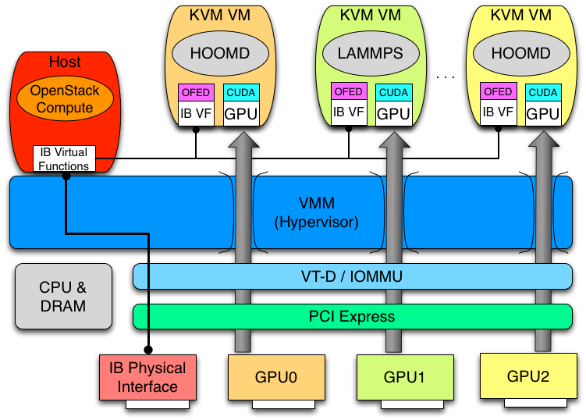
High Performance Virtualized Host
Notes:
Now we have VMs with direct IB and GPU access through PCI Passthrough and SR-IOV.

Slide 43
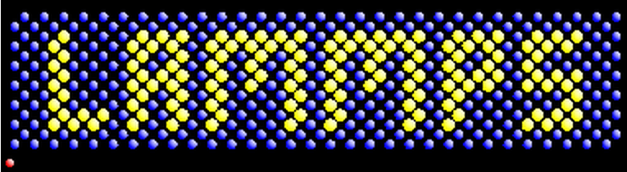

Real-world Applications – Molecular Dynamics Simulation
LAMMPS - "Large-scale Atomic/Molecular Massively Parallel Simulator“
Very common MD simulator
From Sandia National Laboratories
Uses MPI and has the GPU package for hybrid CPU and GPU computation
HOOMD-blue is a general-purpose particle simulation toolkit
From University of Michigan
It scales from a single CPU core to thousands of GPUs with MPI
HOOMD also has support for GPUDirect, introduced in CUDA 5
Notes:
Build virtual cluster solutions for these MD simulation application
RHEL6
MVAPICH GDR 2.0
CUDA 6

Slide 44
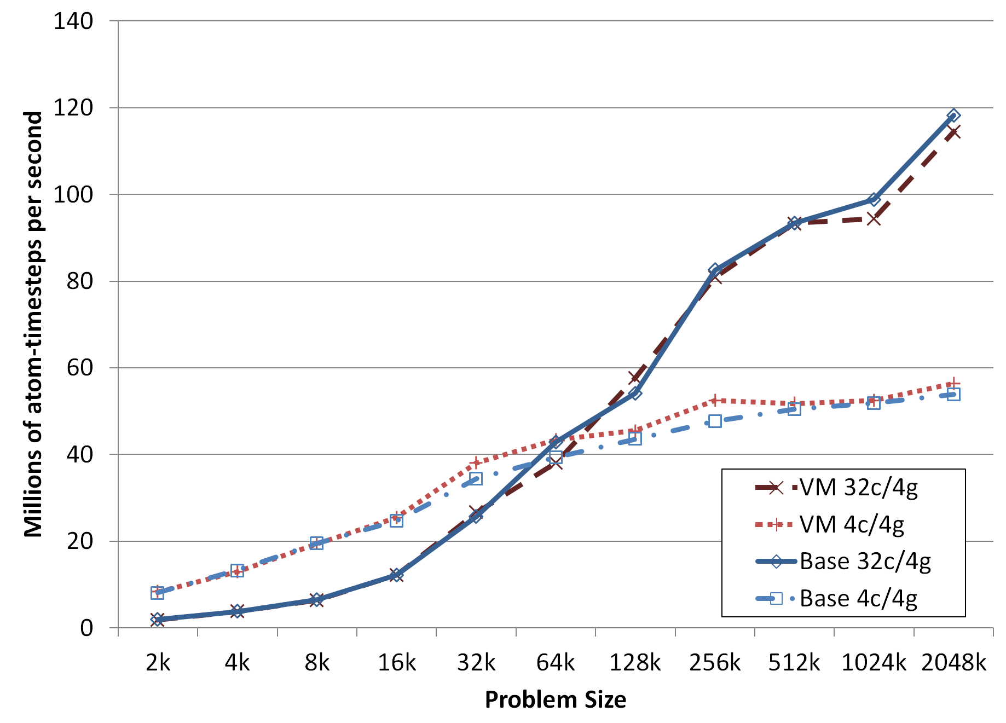
LAMMPS LJ
VMs running LAMMPs achieve near-native performance at 32 cores & 4GPUs
  99.3% efficiency for all LJ experiments.
  98.5% for multicore, ~100% for single core (due to THP)
Notes:
Figure of the Lennard-Jones potential across 4 Bespin nodes.
We see here that VM mode closely matches native performance.
Mostly native outperforms VM as expected, however VM mode has slight performance bump with 4c/4gpu matching. Because more data tranfer to GPU, takes advantage of huge pages in VM.
- irreleveant for the most part, as its not as efficient as large core mappings
If the number of particles per MPI task is small (e.g. 100s of particles), it can be more efficient to run with fewer MPI tasks per GPU, even if you do not use all the cores on the compute node.
We see here that

Slide 45
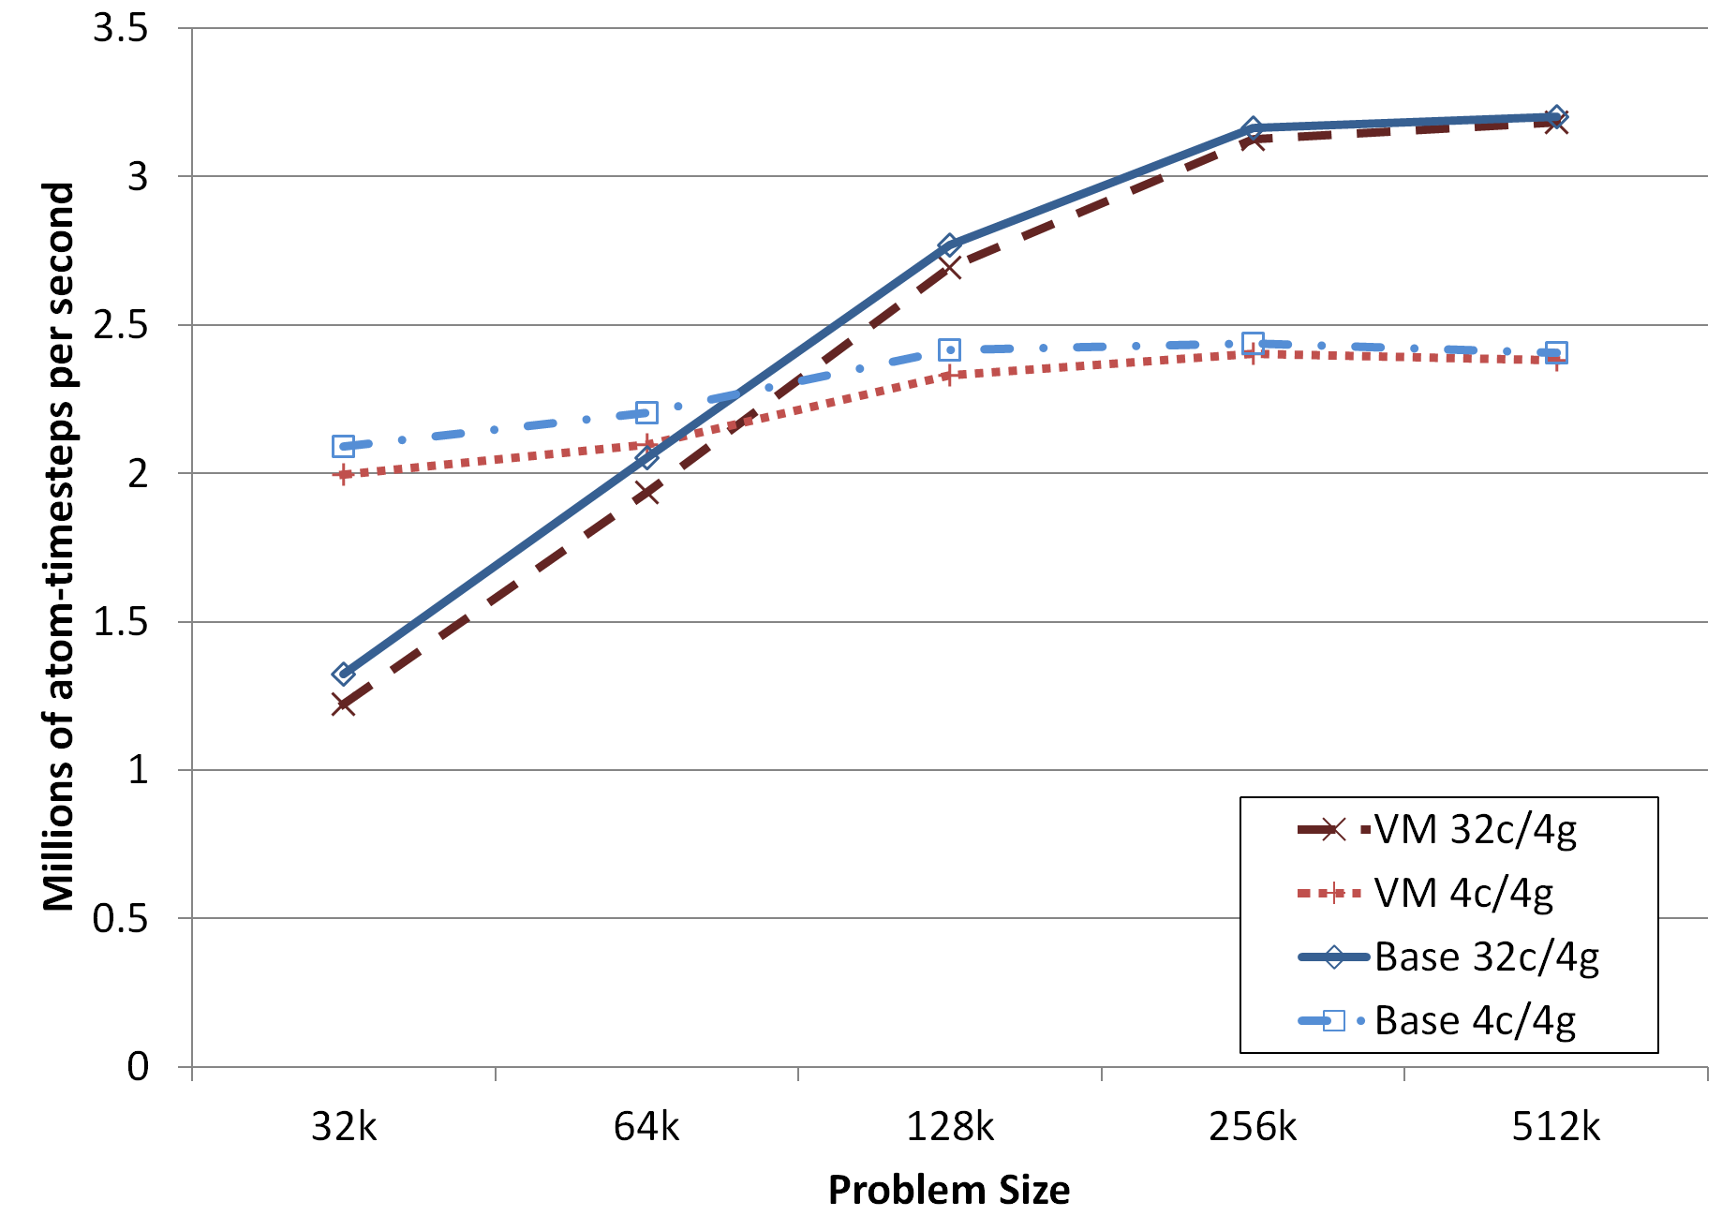
LAMMPS Rhodo
96.7% efficiency for Rhodo
Notes:
See similar effect with the Rhodopsin benchmark runs.
Little less efficiency in VM.

Slide 46
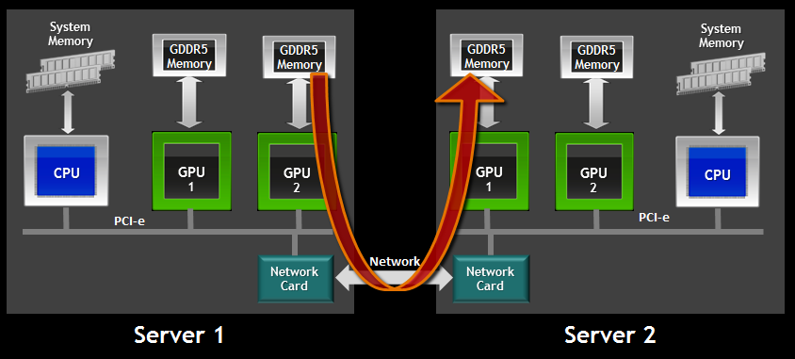
GPU Direct
GPUDirect facilitates multi-GPU computation
  v1 avoids dual CPU buffers (2010)
  v2 P2P communication between intra-GPUs (2011)
  v3 RDMA via InfiniBand (2013)
    Ideal solution for large scale MPI+CUDA applications
Notes:
GPU v1 allowed IB and GPU to share pinned CPU memory, so memcopy wasn’t necessary
GPU v2 allows for GPU->GPU memory transfers without CPU involvement
GPU v3 allows for IB to send from GPU memory directly
- doesn’t need to copy back to CPU at all

Slide 47
HOOMD-Blue
GPUDirect has small but noticeable improvement (~9%) in performance for MPI+CUDA applications.
Both HOOMD simulations, with and without GPUDirect, perform very near-native.
  GPUDirect 98.5% efficiency
  non-GPUDirect 98.4% efficiency
Notes:
First, we see VM perform very close to native solution
- Under 2% overhead in all cases
Also find GPUDirect can provide ~9% performance boost
- big note here is that GPUDirect RDMA is possible within virtual cluster

Slide 48
Discussion
Large potential in running MD simulations in virtualized infrastructure
Overhead remains low, effectively “near-native”
  LAMMPS – 1.9% overhead
  HOOMD – 1.5% overhead
GPUDirect RDMA provides 9% performance boost in HOOMD
Neither problem size or resource utilization increase virtualization overhead
  Larger deployment needed to scale out

Slide 49
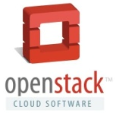
A. J. Younge, J. P. Walters, S. P. Crago, and G. C. Fox, Supporting high performance molecular dynamics in virtualized clusters using IOMMU, SR-IOV, and GPUdirect, VEE 2015
A. J. Younge et al., Analysis of Virtualization Technologies for High Performance Computing Environments, IEEE Cloud 2011
A. J. Younge, J. P. Walters, S. P. Crago, G. C. Fox, Evaluating GPU Passthrough in Xen for High Performance Cloud Computing, Workshop in IPDPS 2014
J. P. Walters, A. J. Younge et al., GPU-Passthrough Performance: A Comparison of KVM, Xen, VMWare ESXi, and LXC for CUDA and OpenCL Applications, IEEE CLOUD 2014.
M. Musleh, V. Pai, J.P. Walters, A. J. Younge, S. P. Crago, Bridging the Virtualization Performance Gap for HPC using SR-IOV for InfiniBand, IEEE CLOUD 2014

Slide 50
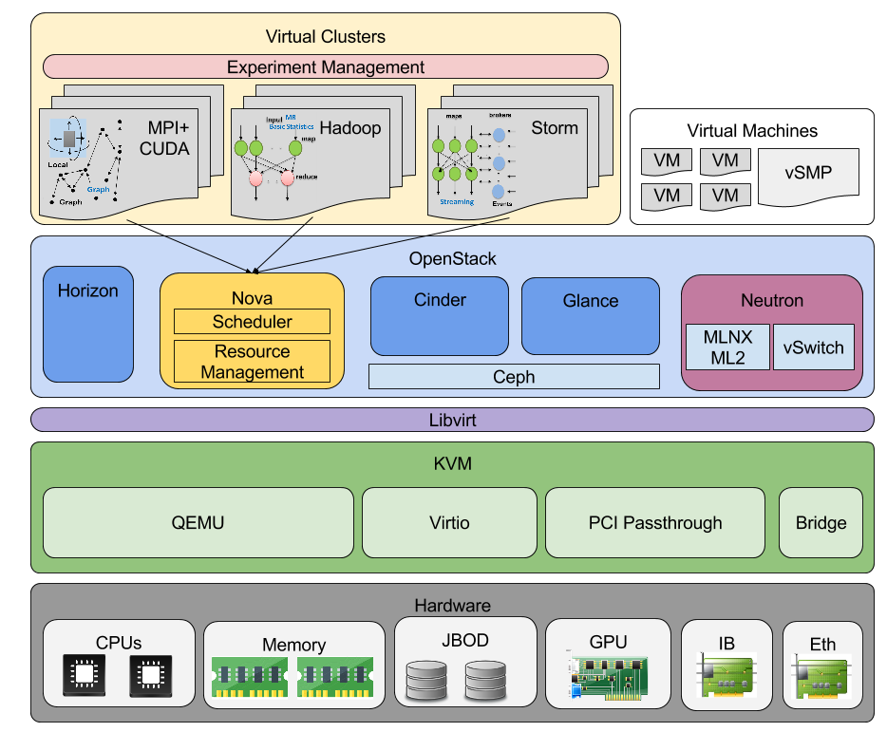

Slide 51
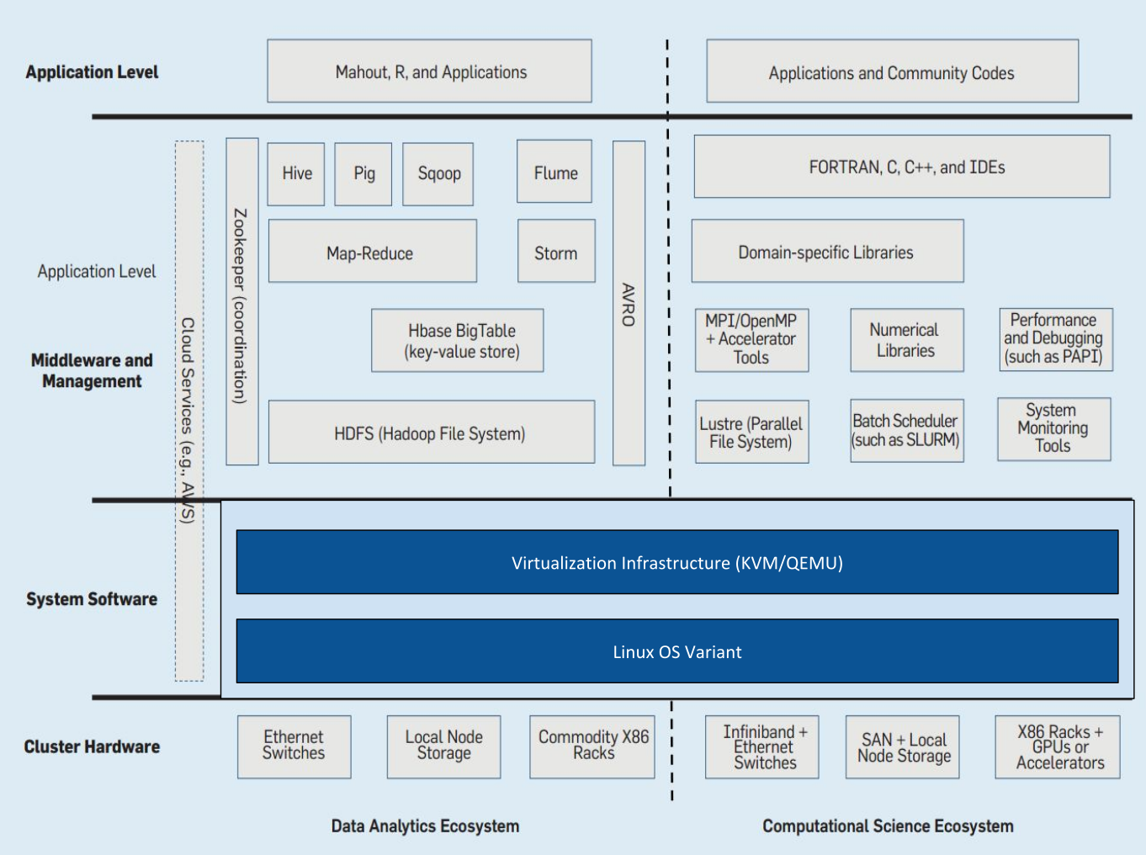
HPC and Big Data Convergence
Notes:
We have two divergent ecosystems between Big data and HPC.
Have the ability to embrace diversity
It may be possible to use virtualization to provide convergence between HPC and big data across same physical hardware
Added flexibility for HPC applications, minimal performance tradeoff
Little impact on existing HPC environment
Increased exposure to advanced hardware for Big data analytics
Run all concurrently on same hardware

Slide 52
Outline
Introduction to High Performance Virtual Clusters
Hypervisor experiments
GPU Passthrough in Xen
GPU Passthrough evaluation
SR-IOV Interconnects
Molecular Dynamics Virtual Clusters
Conclusion & future work

Slide 53
Conclusion
Today’s virtual clusters can support HPC applications at near-native performance
  Careful configuration necessary for best performance
  Molecular Dynamics virtual clusters perform well
GPUs in VMs now a reality
  Promising performance with PCI Passthrough
  Some overhead, but decreasing
InfiniBand SR-IOV is a leap forward for virtual clusters
  Some latency overhead, but optimistic performance
Integrated into OpenStack IaaS
Potential to support other ecosystems & runtimes
Mid-tier scientific applications can perform well in
High Performance Virtual Clusters

Slide 54
Future Work
Virtual infrastructure scaling
  Scaling to hundreds and thousands of nodes
Incorporate New hardware
  Intel Xeon Phi, Omni-path, FPGAs, EDR IB, virtual SMP
  Address storage gap w/ interconnects?
  Moving beyond PCI-Express bus?
Virtual cluster resource management
  Support multiple software stacks simultaneously
  Create one-click deployable HPVCs
  Reproducible experiment management
    CloudMesh
    OpenStack heat
Evaluate new distributed memory platforms
  HPC-ABDS on virtualized infrastructure
  MPI, CUDA, new OS/Runtime deployments

Slide 55
Will Virtualization Exascale?
Need to continue to demonstrate virtualized HPC
  Focus on current architectures
  Work with hardware providers & target large deployments
Virtualization not important for few truly exascale apps
  However, hordes of smaller tasks will look to utilize exascale architectures
  Leverage advantages of virtualization
    Support traditional HPC environments and novel OS and runtime systems concurrently
      Provide novel OS/runtime systems without disrupting current HPC ecosystem
    Integrate in-situ data analysis alongside simulation
    Move computation to data sources
      Live-migrate VMs to burst-buffers or secondary storage?
    Live migration retooling: RDMA, Post-copy
    Fast VM Cloning
Notes:
We need to get virtualization to support current mid-tier scientific workloads first. Through this research, we see that may be within reach now.
Need to focus on integration with HW providers more, target specific to hardware, and build large deployment to support on the order of thousands of nodes
For virtualization to play a part in exascale systems, it needs to provide advancements to make the effort worthwhile
- simple support for diverse runtime ecosystems concurrently.
- this is where HPC big data convergence can also benefit.
- virt also allows for novel OS and runtime efforts to exist with current HPC
- vrit can offer other advancements with fast cloning, live-migration, partial migration towards data, etc.
- these features could feed back to OS/R efforts

Slide 56
Publications (1-2)
[1] A. J Younge, C. Reidy, R. Henschel, and G. C. Fox, “Evaluation of SMP Shared Memory Machines for Use With In-Memory and OpenMP Big Data Applications,” in IEEE International Workshop on High-Performance Big Data Computing at the 30th IEEE International Parallel and Distributed Processing Symposium (IPDPS). May, 2016.
[2] N. Keith, A. E. Tucker, C. E. Jackson, W. Sung, J. I. L. Lled, D. R. Schrider, S. Schaack, J. L. Dudycha, M. S. Ackerman, A. J Younge, J. R. Shaw, and M. Lynch, “High mutational rates of large-scale duplication and deletion in daphnia pulex,” Genome Research, 2015.
[3] A. J Younge, J. P. Walters, S. P. Crago, and G. C. Fox, “Supporting high performance molecular dynamics in virtualized clusters using IOMMU, SR-IOV, and GPUDirect,” in Proceedings of the 11th ACM SIGPLAN/SIGOPS International Conference on Virtual Execution Environments (VEE ’15). ACM, 2015, pp. 31–38.
[4] J. P. Walters, A. J Younge, D.-I. Kang, K.-T. Yao, M. Kang, S. P. Crago, and G. C. Fox, “GPU-Passthrough Performance: A Comparison of KVM, Xen, VMWare ESXi, and LXC for CUDA and OpenCL Applications,” in Proceedings of the 7th IEEE International Conference on Cloud Computing (CLOUD 2014),AK: IEEE, 2014.
[5] M. Musleh, V. Pai, J. P. Walters, A. J Younge, and S. P. Crago, “Bridging the Virtualization Performance Gap for HPC using SR-IOV for InfiniBand,” in Proceedings of the 7th IEEE International Conference on Cloud Computing (CLOUD 2014), IEEE. Anchorage, AK: IEEE, 2014
[6] N. DiFonzo, J. Suls, J. W. Beckstead, M. J. Bourgeois, C. M. Homan, S. Brougher, A. J Younge, and N. Terpstra-Schwab, “Network structure moderates intergroup differentiation of stereotyped rumors,” Social Cognition, vol. 32, no. 5, pp. 409–448, 2014.
[7] X. Gao, E. Roth, K. McKelvey, C. Davis, A. J Younge, E. Ferrara, F. Menczer, and J. Qiu, “Supporting a Social Media Observatory with Customizable Index Structures-Architecture and Performance,” in Cloud Computing for Data Intensive Applications, 2014.
[8] A. J Younge and G. C. Fox, “Advanced Virtualization Techniques for High Performance Cloud Cyberinfrastructure,” in Doctoral Symposium at 14th IEEE/ACM International Symposium on Cluster, Cloud and Grid Computing (CCGrid 2014), IEEE. Chicago, IL, 2014.
[9] A. J Younge, J. P. Walters, S. Crago, and G. C. Fox, “Evaluating GPU Passthrough in Xen for High Performance Cloud Computing,” in High-Performance Grid and Cloud Computing Workshop at the 28th IEEE International Parallel and Distributed Processing Symposium, IEEE. Phoenix, AZ: IEEE, 2014.
[10] A. J Younge, G. von Laszewski, L. Wang, and G. C. Fox, “Providing a Green Framework for Cloud Based Data Centers,” in The Handbook of Energy-Aware Green Computing, I. Ahmad and S. Ranka, Eds. Chapman and Hall/CRC Press, 2012, vol. 2, ch. 17.
[11] J. Diaz, G. von Laszewski, F. Wang, A. J Younge, and G. C. Fox, “FutureGrid Image Repository: A Generic Catalog and Storage System for Heterogeneous Virtual Machine Images,” in Proceedings of Third IEEE International Conference on Cloud Computing Technology and Science (CloudCom2011), IEEE. Athens 2011.
[12] G. von Laszewski, J. Diaz, F. Wang, A. J Younge, A. Kulshrestha, and G. Fox, “Towards generic FutureGrid image management,” in Proceedings of the 2011 TeraGrid Conference: Extreme Digital Discovery, ser. TG ’11. Salt Lake City, UT: ACM, 2011, pp. 15:1–15:2.
[13] A. J Younge, R. Henschel, J. T. Brown, G. von Laszewski, J. Qiu, and G. C. Fox, “Analysis of Virtualization Technologies for High Performance Computing Environments,” in Proceedings of the 4th International Conference on Cloud Computing (CLOUD 2011). Washington, DC: IEEE, July 2011.

Slide 57
Publications (2-2)
[14] A. J Younge, V. Periasamy, M. Al-Azdee, W. Hazlewood, and K. Connelly, “ScaleMirror: A Pervasive Device to Aid Weight Analysis,” in Proceedings of the 29h International Conference Extended Abstracts on Human Factors in Computing Systems (CHI2011). Vancouver, BC: ACM, May 2011.
[15] J. Diaz, A. J Younge, G. von Laszewski, F. Wang, and G. C. Fox, “Grappling Cloud Infrastructure Services with a Generic Image Repository,” in Proceedings of Cloud Computing and Its Applications (CCA 2011), Argonne, IL, Mar 2011.
[16] G. von Laszewski, G. C. Fox, F. Wang, A. J Younge, A. Kulshrestha, and G. Pike, “Design of the FutureGrid Experiment Management Framework,” in Proceedings of Gateway Computing Environments 2010 at Supercomputing 2010. New Orleans, LA: IEEE, Nov 2010.
[17] A. J Younge, G. von Laszewski, L. Wang, S. Lopez-Alarcon, and W. Carithers, “Efficient Resource Management for Cloud Computing Environments,” in Proceedings of the International Conference on Green Computing. Chicago, IL: IEEE, Aug 2010.
[18] N. DiFonzo, M. J. Bourgeois, J. M. Suls, C. Homan, A. J Younge, N. Schwab, M. Frazee, S. Brougher, and K. Harter, “Network Segmentation and Group Segregation Effects on Defensive Rumor Belief Bias and Self Organization,” in Proceedings of the George Gerbner Conference on Communication, Conflict, and Aggression, Budapest, Hungary, May 2010.
[19] N. Stupak, N. DiFonzo, A. J Younge, and C. Homan, “SOCIALSENSE: Graphical User Interface Design Considerations for Social Network Experiment Software,” Computers in Human Behavior, vol. 26, no. 3, pp. 365–370, May 2010.
[20] L. Wang, G. von Laszewski, A. J Younge, X. He, M. Kunze, and J. Tao, “Cloud Computing: a Perspective Study,” New Generation Computing, vol. 28, pp. 63–69, Mar 2010.
[21] G. von Laszewski, L. Wang, A. J Younge, and X. He, “Power-Aware Scheduling of Virtual Machines in DVFS-enabled Clusters,” in Proceedings of the 2009 IEEE International Conference on Cluster Computing (Cluster 2009). New Orleans, LA, Sep 2009.
[22] G. von Laszewski, A. J Younge, X. He, K. Mahinthakumar, and L. Wang, “Experiment and Workflow Management Using Cyberaide Shell,” in Proceedings
of the 4th International Workshop on Workflow Systems in e-Science (WSES 09) with 9th IEEE/ACM International Symposium on Cluster Computing and the Grid (CCGrid 09). IEEE, May 2009.
[23] L. Wang, G. von Laszewski, J. Dayal, X. He, A. J Younge, and T. R. Furlani, “Towards Thermal Aware Workload Scheduling in a Data Center,” in Proceedings of the 10th International Symposium on Pervasive Systems, Algorithms and Networks (ISPAN2009), Kao-Hsiung, Taiwan, Dec 2009.
[24] G. von Laszewski, F. Wang, A. J Younge, X. He, Z. Guo, and M. Pierce, “Cyberaide JavaScript: A JavaScript Commodity Grid Kit,” in Proceedings of the Grid Computing Environments 2007 at Supercomputing 2008. Austin, TX: IEEE, Nov 2008.
[25] G. von Laszewski, F. Wang, A. J Younge, Z. Guo, and M. Pierce, “JavaScript Grid Abstractions,” in Proceedings of the Grid Computing Environments 2007 at Supercomputing 2007. Reno, NV: IEEE, Nov 2007.

Slide 58
Thanks!
Questions?
Acknowledgements:
Committee members: Geoffrey Fox, Judy Qiu, Thomas Sterling, Martin Swany
Persistent Systems Fellowship @ School of Informatics and Computing
USC/ISI Apex Group: John Paul Walters and Stephen Crago
Future Systems members
SalsaHPC lab members
Digital Science Center members
Google Summer of code project
Indiana University Bloomington

Slide 59
Backup slides

Slide 60
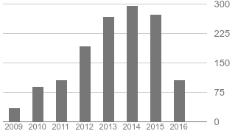

root@localhost:~/# whoami
Ph.D Candidate at Indiana University
  Advisor: Dr. Geoffrey C. Fox
  Persistent Systems Fellowship via SOIC
  @ IU since 2010
  Worked on the FutureGrid Project
Previously at Rochester Institute of Technology
  B.S. & M.S. in Computer Science in 2008, 2010
Visiting Researcher at USC/ISI East (2012 & 2013)
Google summer code with UC/ANL (2011)
Involved in Distributed Systems since 2006 @UMD
http://ajyounge.com

Slide 61


Slide 62
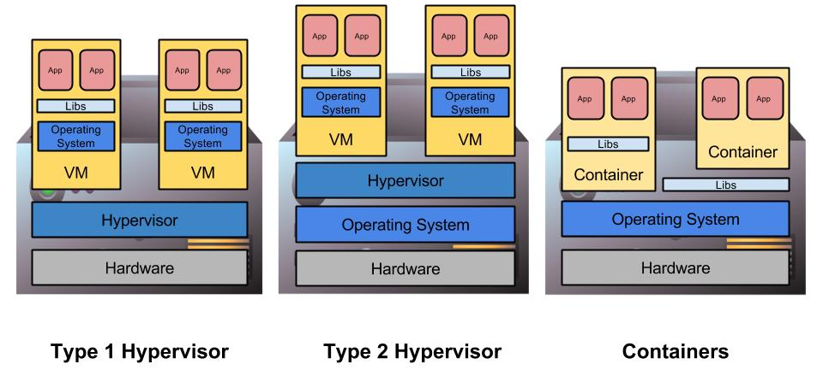
Virtualization
Virtual Machine (VM) is a software implementation of a machine that executes as if it was running on a physical resource directly.
Enables multiple operating systems & environments to run simultaneously on one physical machine.
…
…
…

Slide 63
Docker Containers for HPVC?
Docker provides the ability to easily package & ship containers (sudo-VMs) to various deployments
Shifter brings user-defined container images to HPC resources.
Linux containers (LXC) is fast and efficient, always at near-native performance.
  Dependent on host OS kernel, lack of flexibility
  “Containers don’t contain”
    Hardware availability, serious security concerns & considerations

Slide 64
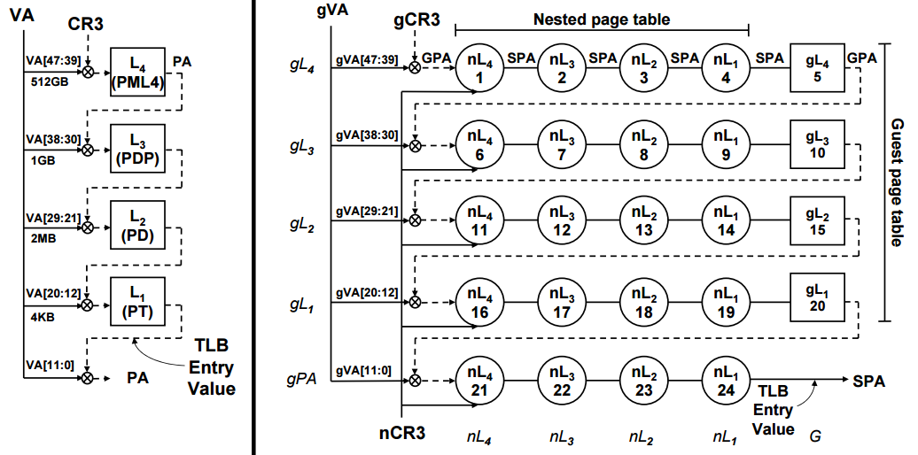
TLB Reach = (TLB Size) x (Page Size)
2D walk cost = (n * m) + n + m where n = page levels and m = nested page levels
Notes:
TLb reach calculations for Nahelam;
64 entries * 4kb pages = 265kb reach
32 entries * 2000kb pages =64000kb = 64mb TLB reach
250x increase in TLB reach with 2MB pages

Slide 65
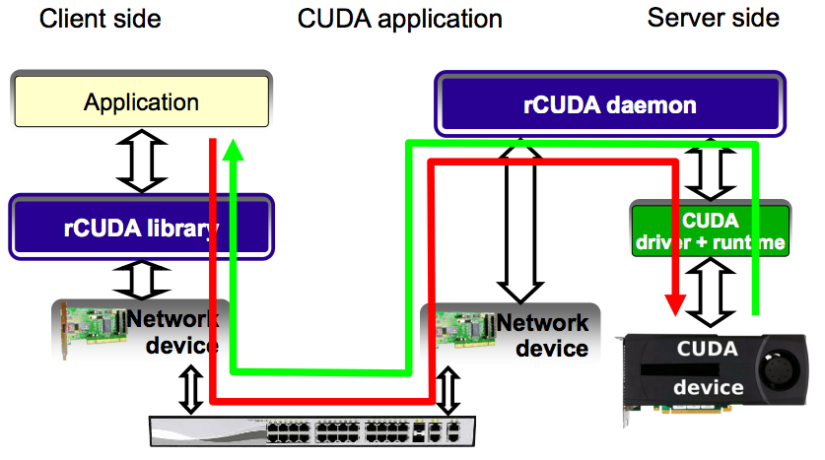
Front-end Remote GPU API

Slide 66
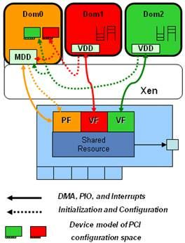
SR-IOV VM Support
Ethernet and InfiniBand solutions with SR-IOV
  Reduce host CPU utilization
  Maximize Bandwidth
  “Near native” performance
Maintains both hypervisor control and VM connectivity with Physical Functions (PF) and Virtual Functions (VF)
Requires extensive device driver support
  Mellanox now supports KVM
  SR-IOV for CX2 and CX3 cards
Image from “SR-IOV Networking in Xen: Architecture, Design and Implementation”

Slide 67
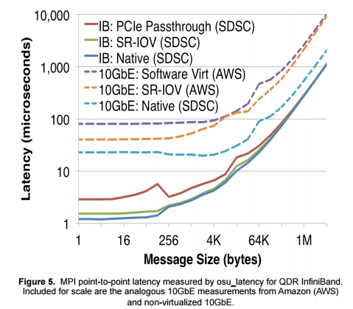
SDSC SR-IOV IB and Ethernet

Slide 68
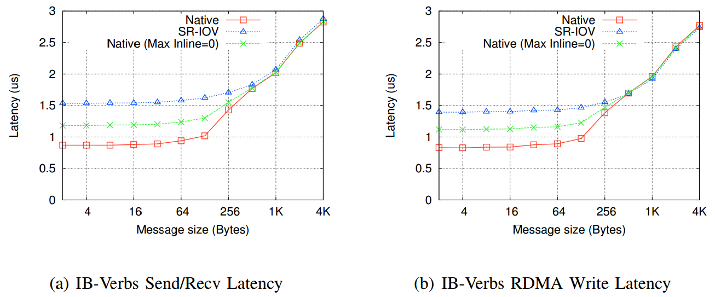
From Jose et al, SR-IOV Support for Virtualization on InfiniBand Clusters: Early Experience. 2013

Slide 69
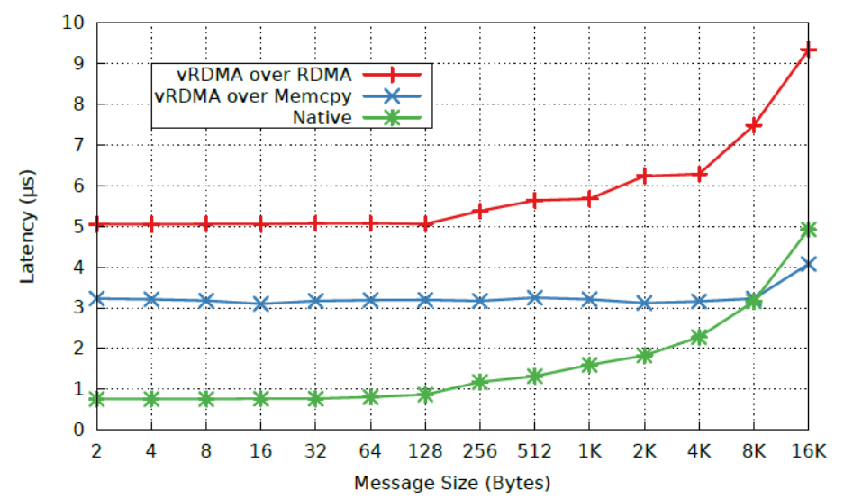

Slide 70
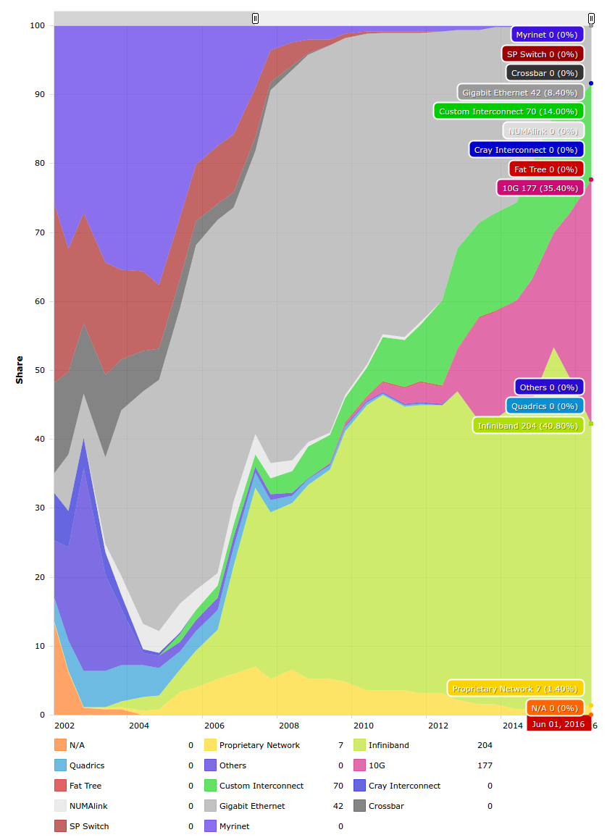
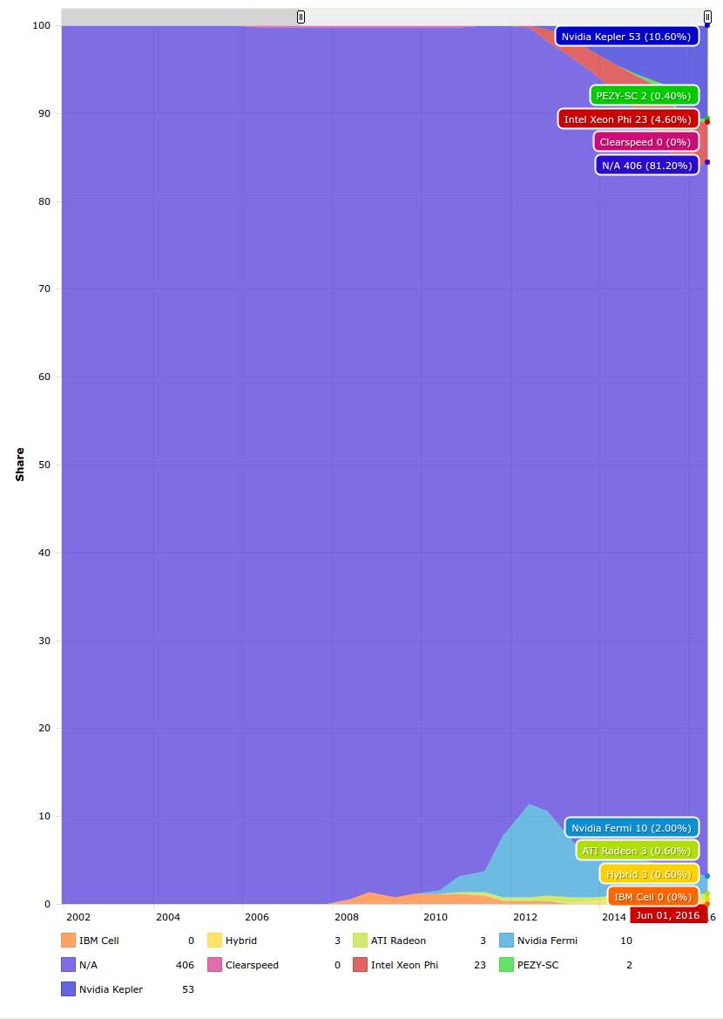

Slide 71
Mid-tier Scientific Computation
Scientific problems that require more computational power than available in a workstation
Reality, the start of distributed memory parallel computation
  Usually more interested in problems more involved than just pleasingly parallel apps
  MPI, threads, advanced communications, etc
Up to Peta-scale, roughly speaking
But maybe not extreme-scale
  top 10 supercomputers

Slide 72
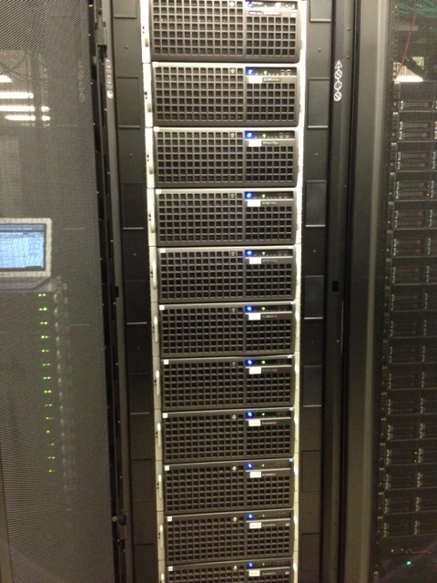
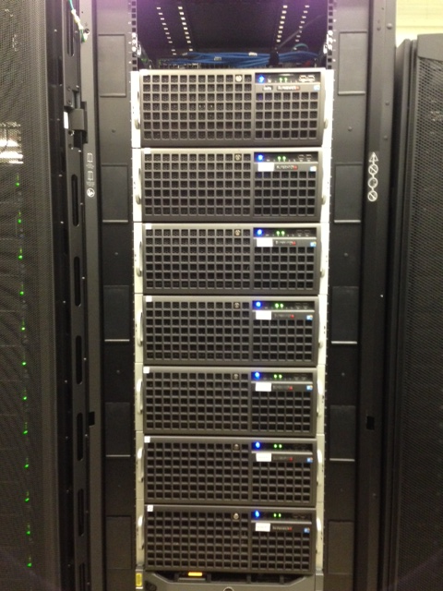
Experimental Deployment:
Delta
16x 4U nodes in 2 Racks
  2x Intel Xeon X5660
  192GB Ram
  Nvidia Tesla C2075 Fermi
  QDR InfiniBand - CX-2
Management Node
  OpenStack Keystone, Glance, API, Cinder, Nova-network
Compute Nodes
  Nova-compute, KVM/Xen, libvirt

Slide 73
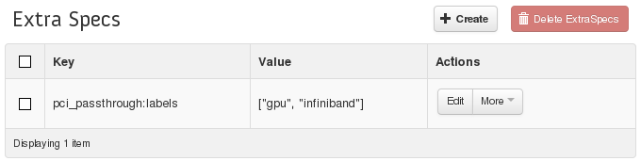
OpenStack Integration
Integrated into OpenStack “Havana” fork
  Xen support for full virtualization with libvirt
  Custom Libvirt driver for PCI-Passthrough
  Use instance_type_extra_specs to specify PCI devs
root@test-nvidia-xqcow2-vm-58 ~]# lspci
...
00:04.0 3D controller: NVIDIA Corporation Device 1028 (rev a1)
00:05.0 Network controller: Mellanox Technologies MT27500 Family [ConnectX-3]

Slide 74
Hypervisor Configuration
Hypervisor | Linux Kernel | Linux Distro
KVM | 3.12 | Arch 2013.10.01
Xen 4.3.0-7 | 3.12 (dom0) | Arch 2013.10.01
VMWare ESXi 5.5.0 | N/A | N/A
LXC | 2.6.32-358.23.2 | CentOS 6.4
Notes:
We do our very best to make comparisons as fair as possible.
Have to pay specific attention to NUMA issues for PCI devices

Slide 75
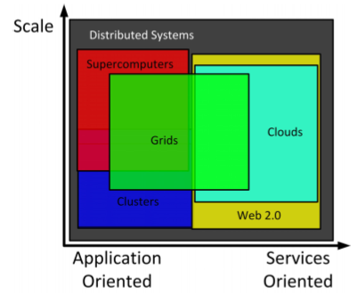
Cloud Computing
High Performance Clouds
From: Cloud Computing and Grid Computing 360-Degree Compared, Foster et al.

Slide 76
Advantages of Virtualization and Cloud Infrastructure
Scalability
Resource Consolidation
Multi-tenancy
Elasticity
Manageability
Agility
Fault tolerance
Monitoring & control

Slide 77
HPC Application Viability
Running high performance computing workloads feasible in virtual clusters
HPC hardware such as Nvidia GPUs and InfiniBand interconnects now usable in virtualized environments
Current MPI+CUDA applications run with very little overhead
Need to evaluate scalability
Notes:
We see initial promise with High Performance Virtual Clusters
Demonstrated usage of advanced hardware, including GPU and high speed, low latency interconnect (InfiniBand)
MD simulations run with very small amount of overhead
Experiments only on 4 physical nodes, but no initial roadblocks

Slide 78
Advancing Cloud Infrastructure
Already-known advantages
  Economies of scale, agility, manageability
  Customized user environment, multi-tenancy
  New programming paradigms for big data challenges
There could be more to be realized
  Leverage heterogeneous hardware
  Advanced scheduling for diverse workload support
  Runtime system to avoid synchronization barriers
  Check-pointing, snapshotting, enable fault tolerance
  Precise packaging and deployment, cloning
Notes:
Targeting usable performance, not stunt-machine

