Slide 1
Collaborative Framework for High-Performance P2P-based Data Transfer in Scientific Computing
Ali Kaplan
alikapla@cs.indiana.edu
Advisor: Prof. Geoffrey C. Fox

Slide 2
Outline
Introduction
Background
Motivation and Research Issues
GridTorrent Framework Architecture
Measurements and Analysis
Contributions and Future Works

Slide 3
Data, Data, more Data
Computational science is changing to be data intensive
Scientists are faced with mountains of data that stem from three sources[1]:
New scientific instruments double their output every year or so
Simulations generates flood of data
The Internet and computational Grid allow the replication, creation, and recreation of more data[2]
Notes:
The Internet and and computational Grid that makes all these archives accessible to anyone anywhere, allowing the replication, creation, and recreation of more data

Slide 4
^{Data, Data, more Data (cont.)}
Scientific discovery increasingly driven by data collection[3]
Computationally intensive analyses
Massive data collections
Data distributed across networks of varying capability
Internationally distributed collaborations
Data Intensive Science: 2000-2015
Dominant factor: data growth (1 Petabyte = 1000 TB)
2000 ~0.5 Petabyte
2005 ~10 Petabytes
2010 ~100 Petabytes
2015 ~1000 Petabytes?
Notes:
Scientific community has large set of distributed data

Slide 5
^{Scientific Application} ^{Examples}
Scientific applications generates petabytes of data are very diverse.
Fusion power
Climate modeling
Earthquake engineering
Astronomy
Bioinformatics
High-energy physics

Slide 6
Scientific Application Examples (cont.)
Some examples
Climate modeling
Community Climate System Model and other simulation applications generates 1.5 petabytes/year
Bioinformatics
The Pacific Northwest National Laboratory is building new Confocal microscopes which will be generating 5 petabytes/year
High-energy physics
The large hadron collider (LHC) project at CERN will create 15 petabytes/year
Notes:
The National Center for Atmospheric Research (NCAR)
Cern is a funded jointly by 20 European countries, with 3000 staff supporting 6500 researchers in 35 nations

Slide 7
Background
Systems for transferring bulk data
Network level solutions
System level solutions
Application level solutions
Notes:
Super-Computers must be balanced system, not just CPU farms but also petascale IO and networking arrays.

Slide 8
Background (cont.)
Network Level Solutions
System Level Solutions
Application Level Solutions
Cost
Prevalence

Slide 9
System Level Solutions
-Require modifications to
the operating systems of the machine
The network apparatus
Or both
+ Yield very good performance
- Expensive solutions
- Not applicable to every system
Group Transport Protocol for Lambda-Grids (GTP)

Slide 10
Network Level Solutions
Network Attached Storage (NAS)
File-level storage system attached to traditional network
Use higher-level protocols
Does not allow direct access to individual storage
Simpler and more economical solution than SAN
Storage Area Network (SAN)
Storage devices attached directly to LAN
Utilize low-level network protocols (Fibre Channels)
Handle large data transfers
Provide better performance

Slide 11
Application Level Solutions
+Use parallel streaming to improve performance
+Require no modifications to underlying systems
+Inexpensive
+Broader use
+-May require auxiliary component for data management
-May not be as fast as Network/System level solutions
Type of application solutions
TCP based solution
UDP based Solutions

Slide 12
TCP-Based Solutions
+Harness the good features of TCP
+Reliability
+-Built-in congestion control mechanism (TCP Window)
+Require no changes on existing system
+Easy to implement
+Broader use
-Not suitable for real-time applications
GridFTP, GridHTTP, bbFTP and bbcp
Use mainly FTP or HTTP as base protocol

Slide 13
UDP-Based Solutions
+Small segment head overhead (8 vs. 20 bytes)
-Unreliable
+-Require additional mechanism for reliability and congestion control (at application level)
+May overcome existing problems of TCP
+May make UDP faster
-Integration with existing systems require some changes and efforts
SABUL, UDT, FOBS, RBUDP, Tsunami, and UFTP
Utilized mainly rate-based control mechanism

Slide 14
Auxiliary Components
Used for file indexing and discovery
GridFTP utilizes the Replica Location Service (RLS)
Local Replica Catalogs (LRCs)
Replica Location Indices (RLIs)
LRCs send information about their state to RLIs using soft state protocols
Optional "Bloom Filter" compression can be used to summarize the contents of the LRC.
The current RLS implementation maintains static information about the LRCs and RLIs participating in the distributed system

Slide 15
Motivation and Research Issues
Problems of Existing Solutions
Built-on client/server model
Why not P2P?
Utilize mainly FTP/HTTP type of protocols
Suffer from drawbacks of FTP/HTTP
Modification is very difficult
Require to build some vital services as separate modules
Use existing system resources inefficiently

Slide 16
Motivation and Research Issues (cont.)
If a P2P model can be solution
Which P2P can be the right model?
What additional features does it require?
Collaborative Framework
P2P Client communication hub
Moderate security
Is it scalable?
How is the performance of it?
What is the overhead of it?
How is it flexible and extensible?

Slide 17
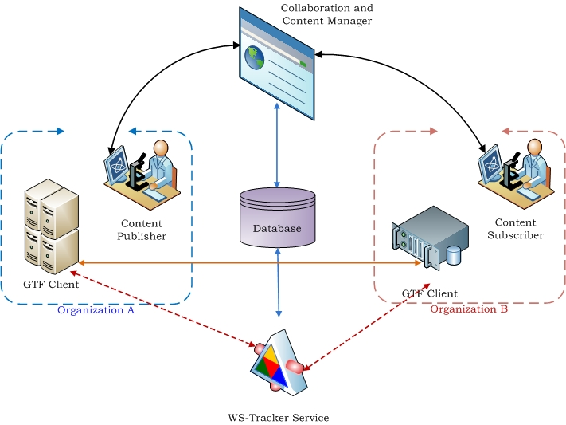
GridTorrent Framework Architecture

Slide 18
Collaboration and Content Manager
An Interface between users and the system
Capabilities:
Share content
Browse content
Download content
Add/remove group
Add/remove users for a particular content (Access Right Controls)
Add/remove users for a particular group (Access Right Controls)
Everything is metadata

Slide 19
GridTorrent Framework Architecture

Slide 20
WS-Tracker Service
The communication hub of the system
Loosely-coupled, flexible and extensible
Deliver tasks to GridTorrent clients
Update tasks status in database
Store and serve .torrent files
Database
GridTorrent
Client
Get Available
Tasks
Update Records
Deliver .torrent file
Ask for tasks
Deliver Task
WS-Tracker Service

Slide 21
GridTorrent Framework Architecture

Slide 22
Task
A task is simply metadata (wrapped actions)
Request
Response
Periodic
Non-periodic
Instructs a GridTorrent client what to do with whom
Created by users
Exchanged between WS-Tracker service and GridTorrent client

Slide 23
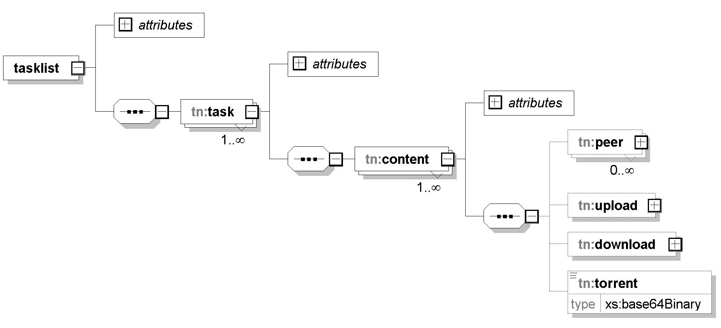
Task Format

Slide 24
GridTorrent Client
Modular architecture
Provides extensibility and flexibility
Built-on P2P file sharing protocol
Enables to utilize idle resources efficiently
Provides adequate security
Authentication
Authorization
Utilizes regular and parallel stream connection (other transferring mechanism could be used)

Slide 25
Security in GridTorrent Client
Only Security Module port is public
Each peer has to be authenticated and authorized (A&A) before starting download process
After a successful A&A, they receive data port number and passkey
Peers use passkey for second verification just before download process
If everything is valid and successful, actual data downloading is started

Slide 26
Security in GridTorrent Client-I
PeerA’s
Security Module
PeerB’s Security Module
PeerB handles PeerA’s request
PeerA starts authentication process
Yes
No
Authorization successful?
Yes
PeerA in ACL?
No
PeerB gives PeerA data port number and passkey, also save passkey for further use
Reject
Connection
PeerA’s
Data Sharing Module
PeerA’s Data Sharing Module
No
Yes
Passkey
verification
PeerA connects received data port and sends passkey to start download process
PeerB starts data transferring process

Slide 27
Measurements and Analysis
The set of benchmarks
Performance
Overhead
Utilized PTCP transferring method for comparison
Performed test-bed in these benchmarks
LAN (Bloomington, IN-Indianapolis, IN)
WAN (Bloomington, IN-Tallahassee, FL)

Slide 28
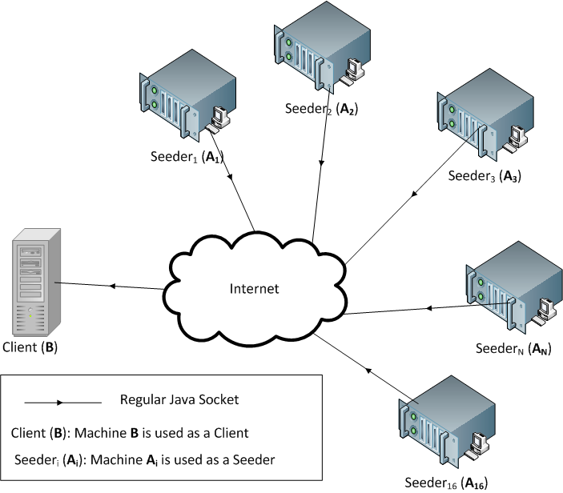
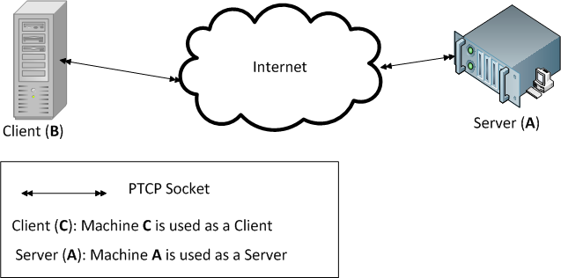
LAN Test Setup
PTCP
GridTorrent

Slide 29
LAN Test Result

Slide 30
WAN Test-I Setup
PTCP
GridTorrent

Slide 31
WAN Test-I Result

Slide 32
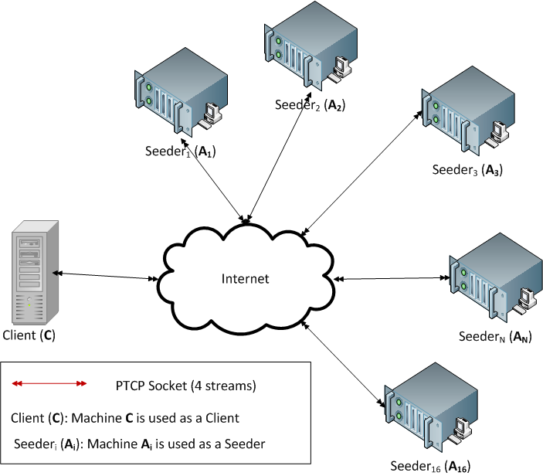
WAN Test-II Setup
PTCP
GridTorrent

Slide 33
WAN Test-II Result

Slide 34
Evaluation of Test Results
GridTorrent provides better or same performance on WAN
PTCP reaches maximum data transfer speed at 15 streams
Utilizing PTCP in GridTorrent yields higher data transfer rate
Total size of the overhead message is between 148-169 KB for transferring 300 MB file
Scalability is not an issue due to bulk data transfer characteristic

Slide 35
Contributions
System research
A Collaborative framework with P2P based data moving technique
Efficient, scalable and modular
Integrating with SOA to increase modularity, flexibility and extensibility
Strategies for increasing performance and scalability
Unification of many useful techniques such as reliable file transfer, third-party transfer and disk allocation in a simple but efficient way
Benchmarks to evaluate the GridTorrent performance
System software
Designing and implementing a infrastructure consists of GridTorrent client, WS-Tracker service, and Collaborative framework

Slide 36
Future Works
Utilizing other high-performance low-level TCP or UDP based data transfer protocols in data layer
Improving existing P2P technique
Adapting existing system to support dynamic(real-time) content
Developing and deploying Intelligent source selection algorithm into WS-Tracker Service
Security
Security framework for WS-Tracker Service if necessary
Transforming Collaborative framework into portlets for reusability

