Slide 1
Gregor von Laszewski
Indiana University
laszewski@gmail.com

Slide 2
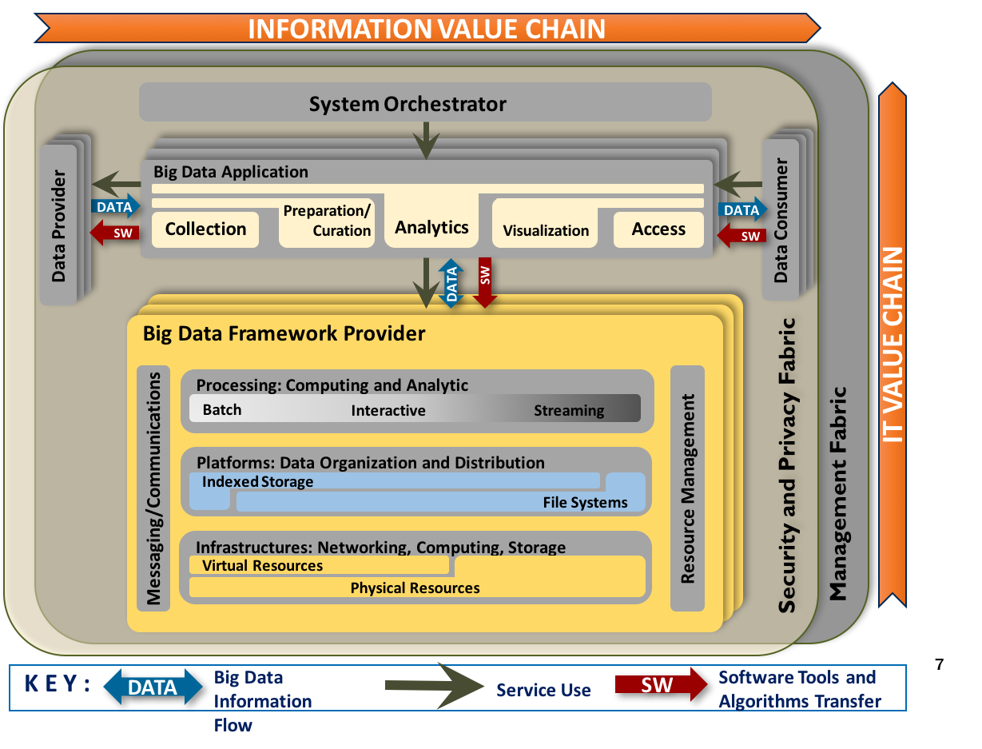
NIST Big Data Reference Architecture
  Composable Services
  NIST Big Data Reference Architecture
    Not just specification
    Specification is accompanied by implementation
    Cloudmesh is such an implementation

Slide 3
Cloudmesh
Makes use of advanced cyper infrastructure and platforms easy
Has deployment features
Exposes functionality through
  API
  CLI
  Web
  Integration of AI as a composable items (functions and messaging between them)
Simple use and deploy
  cms cloud=AWS
  cms vm start
  cms generate spec.ymal
    ->generates a service with that function
    Lesson learned by collaborating with NIST

Slide 4
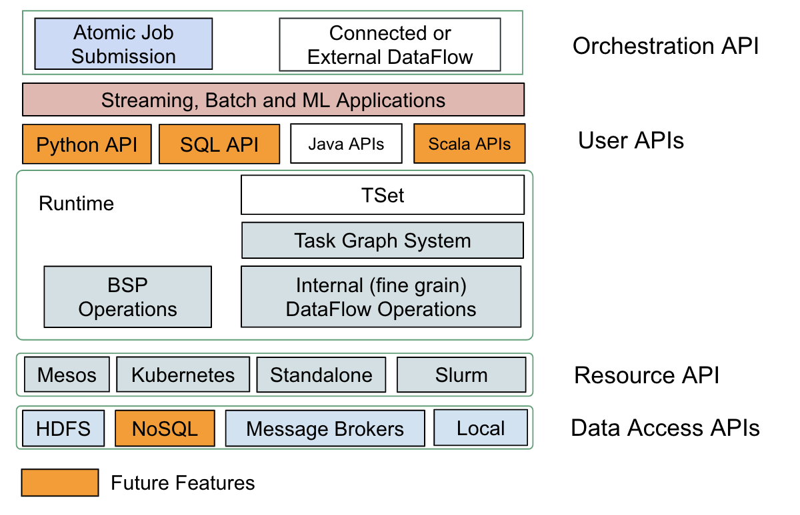
Twister2
Pure batch engine
  Not on top of a streaming engine
Pure streaming engine
  Not on top of a batch engine
Generic System
  Can support many models of computation
    Supports DataFlow model
    BSP model
    Timely (Iterative) DataFlow will be added
Provides multiple levels of programing API's
  Communication API
  Task API
  Data API
Component based architecture -- it is a toolkit
  Clearly defines the important layers of a distributed processing engine
  Implements these layers separately for data analytics and with high performance

Slide 5
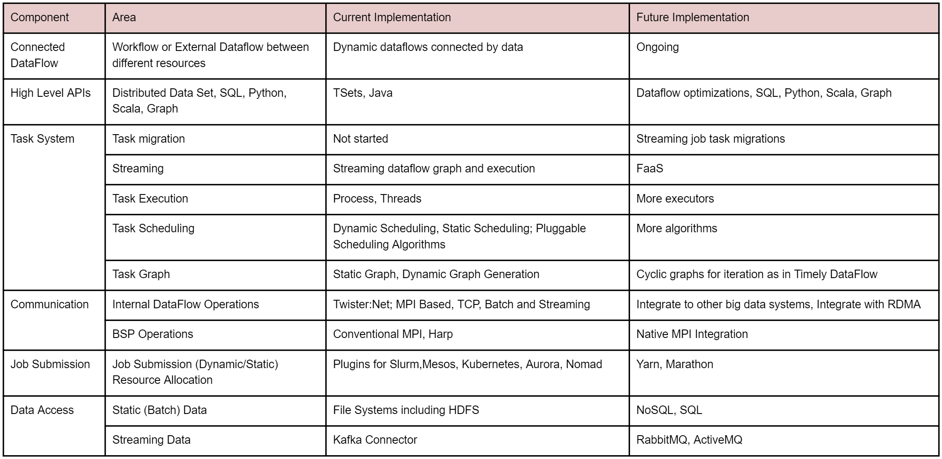
Twister2 Details

Slide 6
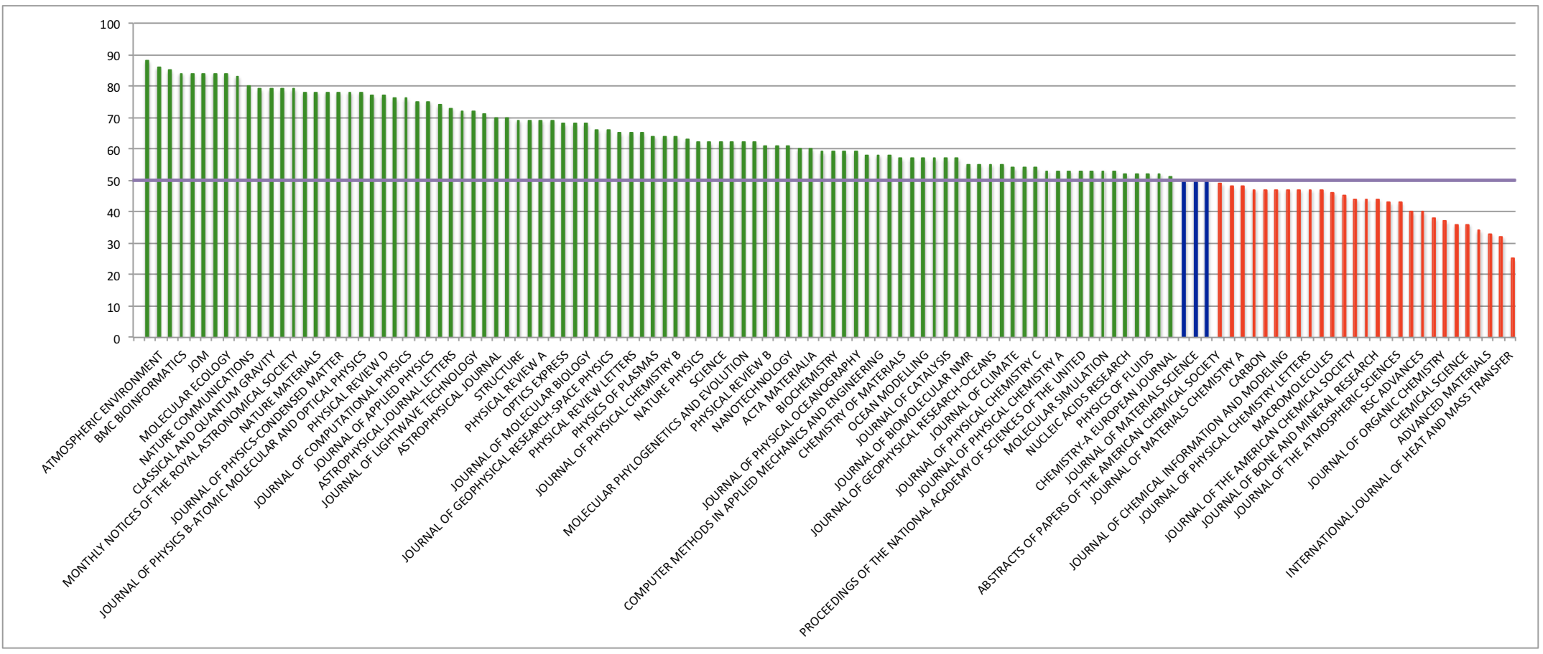
Scientific Impact
XSEDE, NCAR, Blue Waters, ….
Impact of a Facility
  Here example of XSEDE

