Slide 1
Big Data Benchmarks of Commercial Bare Metal and Serverless Clouds
gcf@indiana.edu, http://www.dsc.soic.indiana.edu/, http://spidal.org/
CLOUD2019, Milan Italy
Geoffrey Fox, Hyungro Lee July 9, 2019

Slide 2
Outline
Choosing the right system configuration for an application is challenging because of these:
Resource utilization
Performance

Slide 3
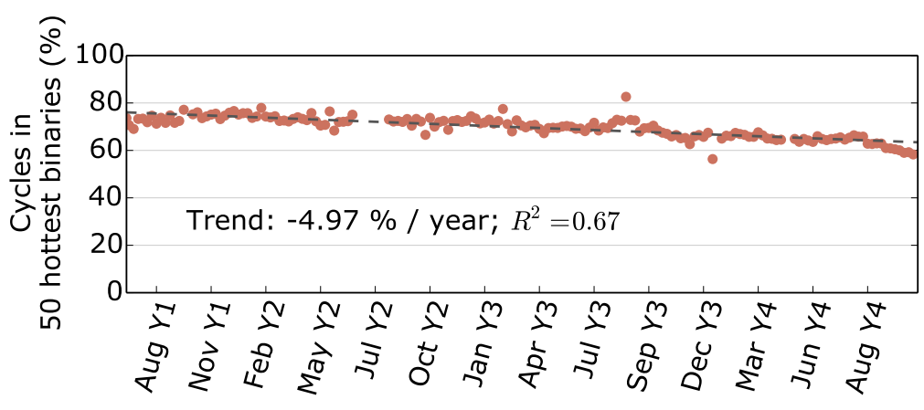
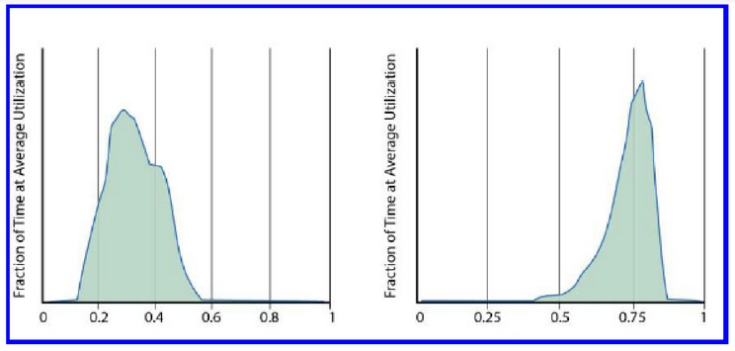
Resource Utilization
Workload diversification over 3 years at Google ͥ
Utilization can be low because of:
Workloads
Server types
Alibaba cluster over 4k machines ͣ
ͥ Kanev, Svilen, et al. "Profiling a warehouse-scale computer." ACM SIGARCH Computer Architecture News 43.3 (2016): 158-169.
Mixed workloads (b) batch workloads
at Google clusters over 20k+ machines ͤ
ͣ Jiang, C., Han, G., Lin, J., Jia, G., Shi, W., & Wan, J. (2019). Characteristics of Co-allocated Online Services and Batch Jobs in Internet Data Centers: A Case Study from Alibaba Cloud.
ͤ LA Barroso, J Clidaras, U Hölzle. (2013). The datacenter as a computer: An introduction to the design of warehouse-scale machines
Notes:
Figure on Top : which plots the fraction of CPU cycles spent in the 50 hottest binaries for each week of the study. While at the earliest periods we examined, 50 applications were enough to account for 80% of execution time, three years later, the same number (not necessarily the same binaries) cover less than 60% of cycles. On average, the coverage of the top 50 binaries has been decreasing by 5 percentage points per year over a period of more than 3 years
Figure on Middle: Machine average CPU utilization per Day in 8 days where the average CPU utilization of entire cluster is between 20%- 50%
Figure on Bottom: shows the average CPU utilization of two Google clusters during a representative three month period (measured between January and March 2013); each cluster has over 20,000 servers. The cluster on the right (b) represents one of Google’s most highly utilized WSCs, where large continuous batch workloads run.

Slide 4
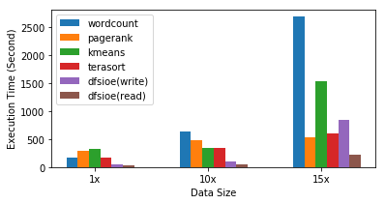
Heterogeneous Workloads – Hadoop Benchmark
Scaling behavior is not identical over different workloads
System: Oracle Bare Metal BM.DenseIO2.52 (104 vcores, 768GB mem, 51.2TB local NVMe)
5x
Wordcount / pagerank
0.6x
1.4x
Notes:
BM- Baremetal
DenseIO – Local NVMe storage
52 – number of Oracle CPU cores (similar to EC2 cores)
15x is peculiar

Slide 5
Performance in different I/O systems
Distributed Filesystem IO benchmark (TestDFSIO)
Two similar server types:
Oracle Bare Metal:
104 cores
768 GB memory
network storage (blue bar)
direct NVMe (orange bar)
TestDFSIO: Distributed HDFS Hadoop I/O Benchmark tool

Slide 6
Performance in different I/O systems
Distributed Filesystem IO benchmark (TestDFSIO)
Two similar server types:
common:
104 cores
768 GB memory
network storage (blue bar)
direct NVMe (orange bar)
Network storage - Read speed gets worse over increased data size
2x better direct NVMe
2.7x decreased for networked
Notes:
12x700gb – 8.4TB In total, aggregating 12 volumes (each 700gb) per server
8x6TB local nvme - 48TB in total, aggregating 8 volumes (each 6TB) per server

Slide 7
Serverless Performance

Slide 8
Requirements
Dynamic infrastructure provisioning
Multi dimensional problem; CPU/memory/network/storage
Elasticity
Compatibility

Slide 9
Architecture Decision
Scale-out: Large numbers of low-end servers: Serverless, Linux process level vs Scale-up: Small numbers of high-end servers: Baremetal, high performance storage

Slide 10
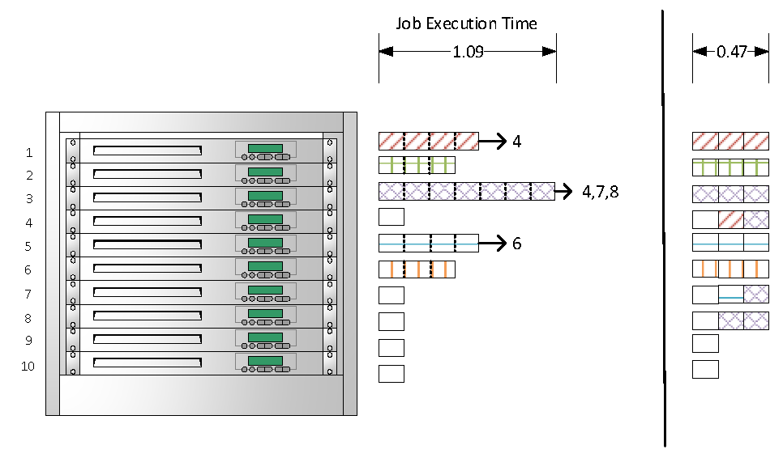
Task Placement
10 servers
In rack
Increased task granularity better than improving resource granularity
N tasks
Reduced execution time
: bag of tasks

Slide 11
Serverless: Increased task granularity
Benefits - Reduced Time To Completion - Less reserved time - Overall increased resource utilization - Flexibility
Limitations - Scaling overhead - Not for small number of big tasks - Efficient BSP parallelism hard

Slide 12
CPU Cost ($/TFLOP per hour)
AWS
EC2 96 vCPUs: $6.048/hr (r5.24xlarge) => 917.78GFLOPS
Serverless: $0.00002501/sec (1.5GB memory) => 22.1GFLOPS
Azure
64 vCPUs: $3.629/hr (E64s_v3) => 704.13GFLOPS
Serverless: $0.000016/sec (1GB memory) => 2.646GFLOPS
GCE
96 vCPUs: $5.6832/hr (n1-highmem-96) => 806.07GFLOPS
Serverless: $0.000029/sec (2GB memory) => 4.34GFLOPS

Slide 13
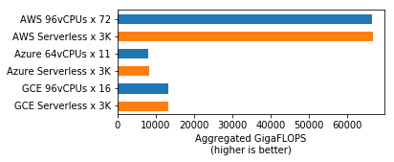
CPU Performance
3k AWS Serverless $≈$ 72 servers 1 AWS Serverless $≈$ 2.3vCPUs
3k Azure Serverless $≈$11 servers 1 Azure Serverless $≈$ 0.2vCPU
3k GCE Serverless $≈$ 16 servers, 1GCE Serverless $≈$ 0.5vCPU
AWS Lambda (Serverless) 3000 concurrent invocations: 66.30TFLOPS
AWS 96 vCPUs (r5.24xlarge): 0.917TFLOPS

Slide 14
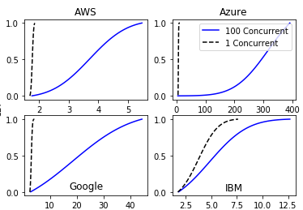
Scaling Performance (CPU) I
Smoothed Cumulative Distribution Function
Workload: Matrix multiplication
Execution time (mean value in secs)
Platform | Execution set | Task time secs | Total Time secs | Cost ($)
AWS Lambda | 100 sequential calls | 1.77 | 177 | 0.0044
 | 100 concurrent calls | 3.72 | 3.72 | 0.0093
Azure Functions | sequential | 6.78 | 678 | 0.011
 | concurrent | 319 | 319 | 0.51
Google Functions | sequential | 3.09 | 309 | 0.0090
 | concurrent | 18.8 | 18.8 | 0.054
IBM OpenWhisk | sequential | 3.79 | 379 | 0.0032
 | concurrent | 4.88 | 4.88 | 0.0041
Function Execution Time (s)
Note: Be careful with truncated different X-axes

Slide 15
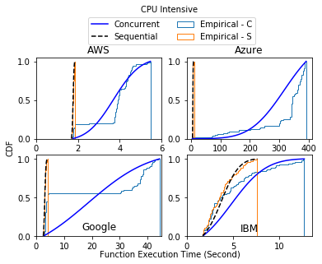
Scaling Performance (CPU) II
AWS Lambda shows big difference with other vendors especially when it's dealing with concurrent function calls.
AWS quickly adds more resources when there are many function calls (1 core to 2 functions ratio is observed as the maximum allocation) whereas other serverless takes a longer period of time to spin up more system processes for requested calls.
Nominal versus observed (empirical) CDF)
Note: Be careful with different x-axis ranges

Slide 16
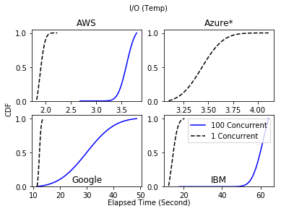
Scaling Performance (Disk)
Workload: File random read and random write of 100MB size of a file
Bandwidth per function
Platform | Execution set | Mean in sec (std) | Total Time | Read (MB/s) | Write (MB/s)
AWS Lambda | 1x100 | 1.88 (0.08) | 188 | 152.98 | 82.98
 | 100x1 | 3.61 (0.14) | 3.61 | 92.95 | 39.49
Azure Functions | 1x100 | 3.44 (0.17) | 344 | 423.92 | 44.14
 | 100x1 | failed | failed | (device busy) | (device busy)
Google Functions | 1x100 | 12.3 (0.55) | 1226 | 55.88 | 9.44
 | 100x1 | 30.1 (8.39) | 30.11 | 54.14 | 3.57
IBM OpenWhisk | 1x100 | 14.0 (2.33) | 1404 | 68.23 | 7.86
 | 100x1 | 61.6 (4.49) | 6155 | 33.89 | 0.50
Note: Be careful with truncated different X-axes
Notes:
write off the initial cost over a period

Slide 17
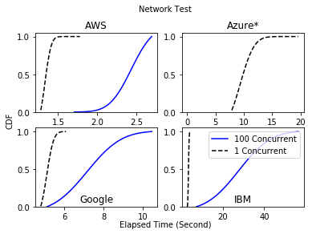
Scaling Performance (Network Bandwidth)
Workload: Transferring 100MB size of a file
Platform | Execution set | Mean in sec (std) | Total time
AWS Lambda | 1x100 | 1.34 (0.06) | 134
 | 100x1 | 2.44 (0.21) | 2.44
Azure Functions | 1x100 | 9.42 (1.93) | 942
 | 100x1 | failed | failed
Google Functions | 1x100 | 5.12 (0.27) | 512
 | 100x1 | 7.19 (1.37) | 7.19
IBM OpenWhisk | 1x100 | 3.61 (0.26) | 361
 | 100x1 | 28.0 (12.3) | 28.0
Note: Be careful with truncated different X-axes

Slide 18
Bare Metal Performance

Slide 19
Less Overhead on high-end machines?
Bare Metal with high performance storage
Local NVMe
High IOPS/throughput SSD type block storage
We look at direct NVMe and networked Block Storage – latter is SSD based in rest of talk

Slide 20
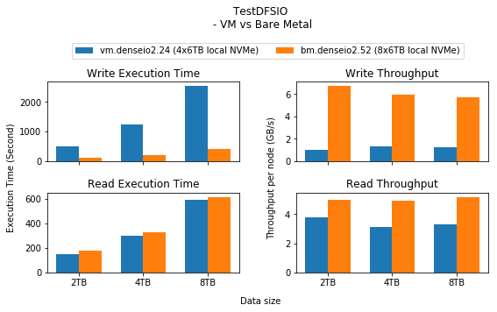
Performance with Large data sizes
Similar configuration with:
6 VM servers (24vCPUs each) versus
3 BM servers (52vCPUs each)
Cost per vCPUs: $0.1275
6 VM servers: $18.36 (144 vCPUs)
3 BM servers: $19.89 (156 vCPUs)
System: Oracle Cloud
VM.DenseIO2.24: 48 logical processors, 320GB memory, 24.6Gb Ethernet, 25.6TB NVMe
BM.DenseIO2.52: 104 logical processors, 768GB memory, dual 25Gb Ethernet, 51.2TB NVMe
Notes:
Plots are Figure 1 in the CLOUD 2019 paper

Slide 21
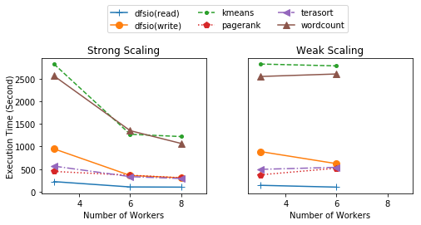
Scaling Tests
Strong Scaling: Increased number of workers, constant benchmark data size (Left)
Weak Scaling: Benchmark data size proportional to the number of workers (Right)

Slide 22
IOPS (Block Storage for Hadoop Cluster)
IOPS is multiplied by block size (4K) for rate
Notes:
Bar chart is based on TABLE I of the CLOUD 2019 paper

Slide 23
IOPS (Direct NVMe compared to Block Storage from previous slide)
Much faster than Block storage
Notes:
Bar chart is based on TABLE I of the CLOUD 2019 paper

Slide 24
Fio - Flexible I/O Tester Synthetic Benchmark IOPS
Random read and write tests
Fio Raw storage
DFSio HDFS
AWS best at small sizes, Oracle at large block sizes
IOPS: x1000
Notes:
Bar chart is based on TABLE III of the CLOUD 2019 paper

Slide 25
Hadoop Block Storage Bare Metal Benchmark
The result shows block storage performance using Hadoop benchmark tools
Configurations:
3 worker nodes
Multiple block storages attached (HDFS mounts) for maximum IOPS and throughput per worker node
Five HDFS based Hadoop workloads
Wordcount
PageRank
Kmeans clustering
Terasort
DFSIO (Read/Write)
Amazon (Orange bar)
Microsoft (Red bar)
Google (Green bar)
Oracle (blue bar)
GCE Failed due to disk errors
 | AWS | Azure | GCE | OCI
Wordcount\n(1.6TB) | 2917.403 | 5203.261 | 0.000 | 2561.097
Pagerank\n(50M pages) | 427.872 | 557.370 | 485.084 | 446.669
K-means\n(1.2B samples) | 2733.394 | 3854.514 | 3577.521 | 2824.252
Terasort\n(600GB) | 517.907 | 1431.441 | 1481.658 | 564.447
DFSIO\n(2TB Write) | 1214.513 | 1874.317 | 5022.967 | 946.954
DFSIO\n(2TB Read) | 479.424 | 859.940 | 624.591 | 221.298
Notes:
Block storage - Storage Area Network (SAN) e.g. iSCSI, permanent, independent to cloud instance (no deletion after instance termination)
Bar chart is a simple version of Figure 5 in the CLOUD 2019 paper

Slide 26
Details of Hadoop Block Storage Bare Metal Benchmark
Map Reduce
The result shows Hadoop benchmark with Map/Reduce progress as a function of time
AWS and Oracle in front
Notes:
Block storage - Storage Area Network (SAN) e.g. iSCSI, permanent, independent to cloud instance (no deletion after instance termination)
Bar chart is a simple version of Figure 5 in the CLOUD 2019 paper

Slide 27
Terasort on Oracle Cloud
Workload: Terasort with 10TB (10¹³ Bytes) size of data
100 billion 100bytes records
With 10 bytes key
System of each worker node: Oracle BareMetal (server name: BM.DenseIO2.52)
104 logical processors, 768GB Memory, dual 25Gb Ethernet
NVMe disks (1.3MM IOPS, 19.8GB/s throughput)
Good behavior. Should compare with traditional cloud nodes
Notes:
Bar chart is from Figure 6 of CLOUD 2019 paper

Slide 28
Terasort on Oracle Cloud (System Resource)
Map Phase Reduce Phase
Monitoring system resource activity shows proper system configuration between CPU, storage and network bandwidth. Note difference between Map and Reduce phases
600 GB data
High performance computing, networking and storage work together improving overall performance of mixed workloads i.e. terasort
Notes:
Bar chart is from Figure 7 of CLOUD 2019 paper

Slide 29
Experiment Setup
Item | AWS | Azure | GCE | OCI
 | r5.24xlarge | E64s v3 | n1-highmen-96 | bm.standard.52
CPU | Xeon Platinum 8175M | Xeon E5-2673 v4 (Broadwell) | Xeon Skylake | Xeon Platinum 8167M
vCPU count | 96 | 64 | 96 | 104
Memory | 768GB | 432GB | 624GB | 768GB
HDFS Volumes | 2TB x 7 | 1TB x 7 | 834GB x 8 | 700GB x 6
Max IOPS (per volume) | 6,000 | 5,000 | 25,000 | 25,000
Max IOPS (Per Server) | 42,000 | 35,000 | 60,000 (read)/ 30,000(write) | 150,000
Max Throughput (per volume) | 262MB/s | 200MB/s | 400MB/s | 320MB/s
Max Throughput (per server) | 1750MB/s | 1400MB/s | 1200MB/s (read)/ 400MB/s (write) | 1920MB/s
Notes:
Table is from TABLE II of the CLOUD 2019 paper

Slide 30
Oracle I/O Performance NVMe v. Block Storage
 | 12 x 700 GB Block Storage | 8 x 6.4 TB Local NVMe | Difference
4K rand write IOPS | 303,000 | 1,098,000 | 3.62x
4K rand read IOPS | 292,000 | 1,334,000 | 4.56x
256K rand write Throughput | 3.0 GB/s | 18.0 GB/s | 6x
256K rand read Throughput | 3.0 GB/s | 19.8 GB/s | 6.6x
4k rand write Latency | 7,908 μsec | 1,455 μsec | 5.4x
4k rand read Latency | 8,205 μsec | 1,198 μsec | 6.8x

Slide 31
SSD Based Block Storage: Vendor limits on performance
Provider | Pricing ($) GB/month | Throughput per volume (MiB/s) | Throughput per instance (MiB/s) | IOPS per volume | IOPS per instance | IOPS ratio to volume size (IOPS/GB) | Volume capacity (TiB)
AWS base (gp2) | 0.1 | 250 | 1,750 | 16,000 | 80,000 | 3:1 | 16
AWS high end (io1) | 0.125 + 0.065/IOPS | 1,000 | 1,750 | 64,000 | 80,000 | 50:1 | 16
Azure base (premium ssd) | 0.1 | 900 | 1,600 | 20,000 | 80,000 | - | 32
Azure high end (ultra ssd in preview) | 0.05986 + 0.02482/IOPS + 0.5MB/s | 2,000 | 2,000 | 160,000 | 160,000 | - | 64
Google (persistent ssd) | 0.17 + 0.0057/IOPS | Write: 400 Read: 1,200 | Write: 400 Read: 1,200 | Write: 30,000 Read: 60,000 | Write: 30,000 Read: 60,000 | 30:1 | 60
Oracle | 0.0425 | 320 | 3,000 | 25,000 | 400,000 | 60:1 | 32
AWS Limits https://docs.aws.amazon.com/AWSEC2/latest/UserGuide/EBSVolumeTypes.html
Notes:
Table VI of the CLOUD 2019 paper

Slide 32
IOPS by Volume Size (block storage)
 | aws (gp2) @ 4k | oci @ 4k | aws (gp2) @ 16k | oci @ 16k | aws (gp2) @ 256k | oci @ 256k
volume size
334GB | 1002 | 20040 | 1002 | 10020 | 1002 | 640
417GB | 1251 | 25000 | 1251 | 12510 | 1002 | 800
667GB | 2001 | 25000 | 2001 | 17800 | 1002 | 1280
1TB | 3000 | 25000 | 3000 | 17800 | 1002 | 1280
5.3TB | 16000 | 25000 | 16000 | 17800 | 1002 | 1280
High IOPS are offered at different volume sizes and block size (4K, 16K, 256K bytes)
Table (on the right) shows a comparison between Amazon and Oracle Block Storage

Slide 33
IOPS (System limits vs Provider limits)
 | AWS | Azure | GCE | OCI
Volume size | 1.9TB | 1.9TB | 375GB | 6TB
Interface | NVMe | NVMe | NVMe | NVMe
Performance limit | hardware | hardware | hardware | hardware
4K randread IOPS | 256,000 | 110,750 | 34,496 | 166,750
256K rw50 Throughput | 864.06MB/s | 1060.05MB/s | 248.845MB/s | 2525MB/s
NVMe based storage has no provider limits and deliver up to device performance as in general it is physically attached to a server
Network storage (e.g. AWS EBS) may not see full performance as cloud provider sets a performance limit by various factors i.e. server type, volume type, volume size and region.
Provider limit by | AWS | Azure | GCE | OCI
Server type | Yes (Nitro-based instance) | No | Yes (32+ vCPUs) | No
Volume type | Yes (Provisioned SSD – io1) | Yes (Ultra SSD) | Yes (SSD Persistent disk) | No
Volume size | Yes (1,280GB Min. for Max. IOPS) | Yes (1TB Min.) | Yes (2TB Min.) | Yes (867GB Min.)
Region | Yes (Unavailable zones exist) | Yes | Yes | Yes

Slide 34
Summary
Principles established:
Workload should be placed on scale-out systems for processing many small tasks >> Rapid bootstrap from serverless systems
Data intensive tasks can perform better on scale-up systems >> Low scaling overhead from Baremetal systems
But it depends on use case of course

