Slide 1
MapReduce, Collective Communication, and Services
Oral Exam, Bingjing Zhang

Slide 2
Outline
MapReduce
MapReduce Frameworks
Iterative MapReduce Frameworks
Frameworks Based on MapReduce and Alternatives
Collective Communication
Communication Environment
Collective operations and algorithms
Optimizations on Blue Gene/L/P and TACC Ranger
Network, Coordination, and Storage Services
Data Transfers Management and Improvement
Coordination Services
Storage Services

Slide 3
MapReduce
To solve issues about runtime and programming interface in large data processing

Slide 4
MapReduce Frameworks
Google MapReduce
Runtime running on Google cluster for Large data processing and easy programming interface
Implemented in C++
Applications: WordCount, Grep, Sort…
Hadoop MapReduce
Open source implementation of Google MapReduce
Implemented in Java

Slide 5
Google MapReduce
Mapper: split, read, emit intermediate KeyValue pairs
User
Program
Reducer: repartition, emits final output
(1) fork
(1) fork
(1) fork
(2)
assign
map
Master
(2)
assign
reduce
Worker
(6) write
Worker
Output
File 0
Split 0
(3) read
(4) local write
Split 1
Worker
Split 2
Worker
Output
File 1
Worker
(5) remote read
Input files
Intermediate files
(on local disks)
Reduce phase
Output files
Map phase

Slide 6
Iterative MapReduce Frameworks
To improve the performance of MapReduce on iterative algorithms
Applications: Kmeans Clustering, PageRank, Multidimensional Scaling…
Synchronous iteration
Twister
HaLoop
Asynchronous iteration
iMapReduce
iHadoop

Slide 7
Comparison
 | Twister | HaLoop | iMapReduce | iHadoop
Implementation | Java/Messaging Broker | Java/Based on Hadoop | Java/Based on Hadoop | Java/Based on Hadoop, HaLoop
Job/Iteration Control | Single MR task pair only | Multiple MR task pairs supported | Single task pair, asynchronous iterations | Multiple task pairs, asynchronous iterations
Work Unit | Persistent thread | Process | Persistent process | Persistent process
Intra Iteration Task Conjunction | Data combined & re-scattered /bcasted | Step input on HDFS specified in client | Static data and state data are joined and sent to Map tasks | Step input on HDFS specified in client
Inter Iteration Task Conjunction | Data combined & re-scattered /bcasted | Iteration input on HDFS specified in client | Asynchronous one-to-one Reduce to Map data streaming | Asynchronous Reducer-Mapper data streaming
Termination | Max number of iterations or combine & check in client | Max number of iterations or fixpoint evaluation | Fixed number of iterations or distance bound evaluation | Concurrent termination checking
Notes:
iHadoop has different versions, caching or without caching.
Reduce-map streaming in iHadoop can be 1:L, it has versions based on HaLoop
InTwister, persistent task is thread level, For the other three, they are process level.

Slide 8
Comparison – cont’d
 | Twister | HaLoop | iMapReduce | iHadoop
Invariant Data Caching | Static data are split and cached into persistent tasks in the configuration stage | Invariant data are cached and indexed from HDFS to local disk in the first iteration | Static data are cached on local disk, and used for Map tasks after joining with state data | Data can be cached and indexed on local disk
Invariant Data Sharing | No data sharing between tasks | Data can be shared | Data cached for Map tasks only, no sharing | Data can be shared
Scheduling /Load Balancing | Static scheduling for persistent tasks | Loop-aware task scheduling, leveraging inter-iteration locality | Periodical task migration for persistent tasks | Loop-aware task scheduling, keeping Reducer-Mapper relation locality
Fault Tolerance | Return to last iteration | Task restarted with cache reloading | Return to last iteration | Task restarted in the context of asynchronous iterations

Slide 9
Frameworks Based on MapReduce and Alternatives
Large graph processing
Pregel and Surfer
Applications: PageRank, Shortest Path, Bipartite Marching, Semi-clustering
Frameworks focusing on special applications and systems
Spark: focus on iterative algorithms but is different from iterative MapReduce
MATE-EC2: focus on EC2 and performance optimization
Task pipelines
FlumeJava and Dryad
Applications: Complicated data processing flows

Slide 10
Pregel & Surfer
 | Pregel | Surfer
Purpose /Implementation | Large scale graph processing in Google system/C++. | Large scale graph processing in the cloud (Microsoft)/C++
Work Model /Unit/Scheduling | Master and worker/process/resource-aware scheduling | Job scheduler, job manager and slave nodes/process/resource-aware scheduling
Computation Model | SuperStep as iteration. Computation is on vertices and message passing is between vertices. Topology mutation is supported. | Propagation : Transfer /Combine stages in iterations. vertexProc and edgeProc.
Optimization | Combiner: reduce several outgoing messages to the same vertex. Aggregator : tree-based global communication. | local propagation, local combination, multi-iteration propagation
Graph partitioning | Default partition is hash(ID) mod N | Bandwidth-aware graph partition
Data/Storage | Graph state: memory/Graph partition: worker machine/Persistent data: GFS, Bigtable | Graph partition: slave machine, replicas provided on a GFS-like DFS.
Fault Tolerance | Checkpointing and confined recovery | Automatic task failure recovery
Notes:
Pregel: Default partition is hash(ID) mod N where N is the number of partitions, ID is the vertex ID Confined Recovery is in development
Surfer: By explicitly exposing the cross-partition data transfer via edgeProc, this facilitates us to develop automatic optimizations to exploit the data locality of graph partitions.

Slide 11
Spark & MATE-EC2
 | Spark | MATE-EC2
Purpose /Implementation | To surport iterative jobs /Scala, using Mesos OS | MapReduce with alternate APIs over EC2
Work Unit | Persistent process and thread | Persistent process and thread
Computation Model | reduce, collect, foreach | Local reduction, Global reduction
Data/Storage | RDD (for caching) and HDFS Shared variables (bcast value, accumulators) in memory | Input data objects and reduction objects on S3. Application data set is split to data objects and organized as chunks.
Scheduling | Dynamic scheduling, managed by Mesos | Threaded data retrieval and selective Job Assignment, pooling mechanism to handle heterogeneity
Fault Tolerance | Task re-execution with lost RDD reconstruction | Task re-execution as MapReduce
Notes:
MATE-EC2: The number of Application data set split to data objects is based on the number of working processes.
MATE-EC2: Actually, fault tolerance is not mentioned explicitly
Selective Job Assignment : It is data object availability aware, depends on how many connections are already there on the data object.
Pooling mechanism: select appropriate jobs

Slide 12
FlumeJava & Dryad
 | FlumeJava | Dryad
Purpose /Implementation | A higher level interface to control data-parallel pipeline/Java | General purpose distributed execution engine based on DAG model/C++
Work Model /Unit | Pipeline executor/Process | Job manager and daemons/Process
Computation Model | Primitives: parallelDo, groupByKey, combineValues, flatten. | Jobs specified by arbitrary directed acyclic graphs with each vertex as a program and each edge as a data channel.
Optimization | Deferred evaluation and execution plan: parallelDo fusion , MSCR fusion | Graph composition, vertices are grouped into stages, pipelined execution, runtime dynamic graph refinement
Data/Storage | GFS, local disk cache, data objects is presented as PCollection, PTable and PObject | Use local disks and distributed file systems similar to GFS. No special data model.
Scheduling | Batch execution, MapReduce scheduling. | Scheduling decision is based on network locality
Fault Tolerance | MapReduce fault tolerance | Task re-execution in the context of pipeline
Notes:
FlumeJava: Paralleldo, GroupByKey , CombineValues and Flatten can be formed into single MapReduce, called MSCR
FlumeJava Derived Operations: count, join, top
Dryad: Dynamic graph refinement can be used on Aggregation
Data Channel: files, TCP pipes, shared memory FIFOs.
Dryad: Graph composition A>=B, A>>B, A||B, stages are also called skeleton

Slide 13
Challenges
Computation model and Application sets
Different frameworks have different computation models which are strongly connected to what kinds of applications they support.
Data transmission, storage and caching
In Big Data problems, it is important to provide availability and performance optimization for data accessing

Slide 14
Collective Communication
To solve performance issue about collective communication on different architectures

Slide 15
Communication Environment
Networking
Ethernet
Infiniband
Topology
Linear Array
Multidimensional Mesh, Torus, Hypercube, Fully Connected Architectures
Fat Tree
Runtime & Infrastructure
MPI, HPC and supercomputer
Different architecture needs different designs on algorithms

Slide 16
General Algorithms
Pipelined Algorithms
Use pipeline to accelerate broadcasting
Non-pipelined algorithms
Tree based algorithms for all kinds of collective communications
Minimum-spanning tree algorithms
Bidirectional exchange algorithms
Bucket algorithms
Algorithm combination
Dynamic Algorithm Selection
Test the environment and select a better algorithm than the others

Slide 17
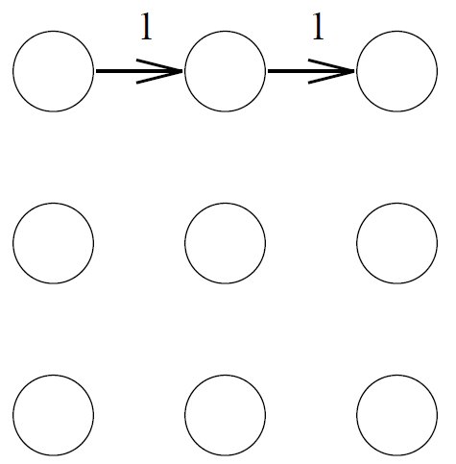
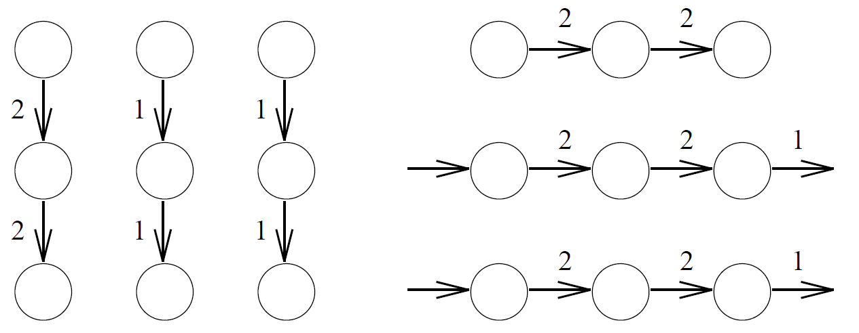
Pipeline Broadcast Theory
$p$-node Linear Array
$T_{1D}=\left(p−1\right)\left(α+\frac{n}{k}β\right)+(k−1)(α+\frac{n}{k}β)$
$α$ is the communication startup time, $β$ is byte transfer time, $k$ is the number of blocks.
$When {∂T_{1D}}/{∂k}=0, k_{opt}=\left\{\begin{aligned}1, if\sqrt{\left(p−2\right)nβ/α}<1 \\ n, if\sqrt{\left(p−2\right)nβ/α}>n \\ \sqrt{\left(p−2\right)nβ/α}, otherwise\end{aligned}\right.$
Dimensional-Order Pipeline
Alternating between dimensions for multiple times
0
1
2
3

Slide 18
Non-pipelined algorithms
Minimum-spanning tree algorithms
$T_{MSTBcast}\left(p, n\right)=\left\lceil \log\left(p\right)\right\rceil (α_{3}+{nβ}_{1})$
$T_{MSTScatter}\left(p, n\right)=\left\lceil \log\left(p\right)\right\rceil α_{3}+{\frac{p−1}{p}nβ}_{1}$
Bidirectional exchange (or recursive doubling) algorithms
$T_{BDEAllgather}\left(p, n\right)={\log\left(p\right)α}_{3}+{\frac{p−1}{p}nβ}_{1}$
Problems arise when the number of nodes is not a power of two
Bucket algorithms
embedded in a linear array by taking advantage of the fact that messages traversing a link in opposite direction do not conflict
$T_{BKTAllgather}\left(p, n\right)={(p−1)α}_{3}+{\frac{p−1}{p}nβ}_{1}$
Here $α_{3}$ is the communication startup time, $β_{1}$ is byte transfer time, $n$ is the size of data, and $p$ is the number of processes.

Slide 19
Algorithm Combination and Dynamic Optimization
Algorithm Combination
For broadcasting, use Scatter and Allgather for long vectors while use MST for short vectors
Combine short and long vector algorithms
Dynamic Optimization
Grouping Phase
Benchmark parameters and apply them to performance model to find candidate algorithms
Learning Phase
Use sample execution to find the fastest one
Running Phase
After 500 iterations, check if the algorithm still delivers the best performance, if not, fall back to learning phase
Notes:
Optimization on hypercube: View the nodes as a 𝑑 dimensional mesh, with two nodes in each dimension, and always use a long vector algorithm before a short vector algorithm

Slide 20
Optimization on Blue Gene/L/P
Blue Gene are a series of supercomputers which uses 3D Torus network to connect cores
Performance degradation on communication happens in some cases
Optimization on collective communication
Applications: Fast Fourier Transforms
Optimization on data staging through the collective network
Applications: FLASH, S3D, and PHASTA

Slide 21
Optimization of All-to-all Communication on Blue Gene/L
Randomized adaptive routing
Only work best on symmetric tori
Randomized Deterministic Routing
Deterministic routing, X->Y->Z
Work best if X is the longest dimension
Barrier Synchronization Strategy
Balanced links, balanced phases and synchronization
Two Phase Schedule Indirect Strategy
Each node sends packets along the linear dimension to intermediate nodes.
Packets are forwarded from the intermediate nodes along the other two “planar” dimensions.
Work best on $2n×n×n$, $2n×2n×n$ asymmetric tori
Optimization on 2D Virtual Mesh for short messages 1~64 bytes

Slide 22
Multicolor Bucket algorithm on Blue Gene/P
Multicolor Bucket algorithm
For an $N$-dimensional torus, divide data to $N$ parts, performing Allgather/Reduce-scatter on each of these parts, where each needs $N$ phases (along each of the dimension once).
We can perform the communication for the $N$ colors parallely in such a manner that in any phase no two colors use the links lying along the same dimension.
Overlapping computation and communication by pipeline
Parallelization with multi-cores
Utilize $2N$ cores and bidirectional links, then each core handles one of the directions for a fix color.

Slide 23
Improvement of Data I/O with GLEAN
Exploiting BG/P network topology for I/O
Aggregation traffic is strictly within the pset (a group of 64 nodes) boundary
Leveraging application data semantics
Interfacing with the application data
Asynchronous data staging
moving the application's I/O data asynchronously while the application proceeds ahead with its computation

Slide 24
Optimization on InfiniBand Fat-Tree
Topology-aware Gather/Bcast
Traditional algorithm implementation didn’t consider the topology
There is delay caused by contention and the costs of multiple hops
Topology detection
To map tree-based algorithms to the real topology
Fault tolerance
When the system scale goes larger, the Mean-Time-Between-Failure is decreasing
By providing a higher-level of resiliency, we are able to avoid aborting jobs in the case of network failures.

Slide 25
Topology-aware Gather
Phase 1
The rack-leader processes independently perform an intra-switch gather operation.
This phase of the algorithm does not involve any inter-switch exchanges.
Phase 2
Once the rack-leaders have completed the first phase, the data is gathered at the root through an inter-switch gather operation performed over the $R$ rack-leader processes.

Slide 26
Topology/Speed-Aware Broadcast
Designing topology detection service
To map the logical broadcast tree to the physical network topology
Create node-level-leaders, and create new communication graphs
Use DFT or BFT to discover critical regions
Make parent and child be close
Define ‘closeness’ by using topology-aware or speed-aware $N×N$ delay matrix

Slide 27
High Performance and Resilient Message Passing
Message Completion Acknowledgement
Eager Protocol
Used for small messages and ACK is piggybacked or explicitly sent after a few of messages
Rendezvous
For large messages, and the communication must be synchronized
Rput: sender performs RDMA
Rget: receiver performs RDMA
Error Recovery
Network Failure
retry
Fatal Event
restart
Notes:
HCA failure

Slide 28
Challenges
Collective communication algorithms are well studied on many static structures such as mesh in Torus architecture.
Fat-tree architecture and topology-aware algorithms still needs more investigation
Topology-aware gather/scatter and bcast on Torus where nodes can not form a mesh
All-to-all communication on Fat-tree
Topology detection and fault tolerance needs enhancement

Slide 29
services
To solve issues about network, coordination, and storage management in distributed computing

Slide 30
Motivation
To support MapReduce and other computing runtimes in large scale systems
Coordination services
To coordinate components in the distributed environment
Distributed file systems
Data storage for availability and performance
Network services
Manage data transmission and improve its performance
Cross Platform Iterative MapReduce (Collectives, Fault Tolerance, Scheduling)
Coordination Service
Distributed File Systems
Network Service

Slide 31
Data Transfers Management and Improvement
Orchestra
A global control architecture to manage intra and inter-transfer activities on Spark.
Applications: Iterative algorithms such as logistic regression and collaborative filtering
Hadoop-A with RDMA
An acceleration framework that optimizes Hadoop with plugin components implemented in C++ for performance enhancement and protocol optimization.
Applications: Terasort and wordcount

Slide 32
Orchestra
Inter-transfer Controller (ITC)
provides cross-transfer scheduling
Policies supported: (weighted) fair sharing, FIFO and priority
Transfer Controller (TC)
manage each of transfers
Mechanism selection for broadcasting and shuffling, monitoring and control
Broadcast
An optimized BitTorrent-like protocol called Cornet, augmented by an adaptive clustering algorithm to take advantage of the hierarchical network topology.
Shuffle
An optimal algorithm called Weighted Shuffle Scheduling (WSS) to set the weight of the flow to be proportional to the data size.

Slide 33
Hadoop-A
A novel network-levitated merge algorithm to merge data without repetition and disk access.
Leave data on remote disks until all headers arrive and are integrated
Then continue merging and fetching
A full pipeline to overlap the shuffle, merge and reduce phases
Reduce starts as soon as the data is available
An alternative RDMA-based protocol to leverage RDMA interconnects for fast data shuffling.

Slide 34
Coordination Service
Chubby
Coarse-grained locking as well as reliable (though low-volume) storage for a loosely-coupled distributed system.
Allow its clients to synchronize their activities and to agree on basic information about their environment
Used by GFS and Big Table
Zookeeper
Incorporates group messaging, shared registers, and distributed lock services in a replicated, centralized service
Applications: HDFS, Yahoo! Message Broker

Slide 35
Chubby System Structure
Exports a file system interface
A strict tree of files and directories
Handles are provided for accessing
Each Chubby file and directory can act as a reader-writer advisory lock
One client handle may hold the lock in exclusive (writer) mode
Any number of client handles may hold the lock in shared (reader) mode.
Events, API
Caching, Session and KeepAlive
Fail-over, Backup and Mirroring
Two Main Components

Slide 36
ZooKeeper
A replicated, centralized service for coordinating processes of distributed applications
Manipulates wait-free data objects organized hierarchically as in file systems, but compared with Chubby, no lock methods, open and close operations.
Order Guarantees
FIFO client ordering and Linearizable writes
Replication, and cache for high availability and performance
Example primitives
Configuration Management, Rendezvous, Group Membership, Simple Locks, Double Barrier

Slide 37
Storage Services
Google File System
A scalable distributed file system for large distributed data-intensive applications
Fault tolerance, running on inexpensive commodity hardware
High aggregate performance to a large number of clients
Application: MapReduce Framework
HDFS
A distributed file system similar to GFS
Facebook enhance it to be a more effective realtime system.
Applications: Facebook Messaging, Facebook Insight, Facebook Metrics System
Integrate PVFS to Hadoop
Let HPC run Hadoop applications

Slide 38
Google File System
Client Interface
Not standard API as POSIX
Create, delete, open, close, read and write and snapshot and record append
Architecture
Single master and multiple chunk server
Consistency Model
“Consistent” and “Defined”
Master operation
Chunk lease management, Namespace management and locking, Replica placement, Creation, Re-replication, Rebalancing, Garbage Collection, Stale Replica detection
High availability
Fast recovery and replication
Notes:
Master and chunk server communicate with Heartbeat message
Consistency Model
Consistent: all the clients see the same data
Defined: all the clients will always see what the mutation has written. The mutated file region is guaranteed to be defined

Slide 39
Hadoop Distributed File System
Architecture
Name Node and Data Node
Metadata management: image, checkpoint, journal
Snapshot: to save the current state of the file system
File I/O operations
A single-writer, multiple-reader model
Write in pipeline, checksums used to detect corruption
Read from the closest replica first
Replica management
Configurable block placement policy with a default one: minimizing write cost and maximizing data reliability, availability and aggregate read bandwidth
Replication management
Balancer: balancing disk space utilization on each node
Notes:
The HDFS client that opens a file for writing is granted a lease for the file; no other client can write to the file.
The writing client periodically renews the lease by sending a heartbeat to the NameNode. When the file is closed, the lease is revoked.
The writer's lease does not prevent other clients from reading the file; a file may have many concurrent readers.

Slide 40
Hadoop at Facebook
Realtime HDFS
High Availability: NameNode -> AvatarNode
Hadoop RPC compatibility: Software version detection
Block Availability: Placement Policy, rack window
Performance Improvement for a Realtime workload
New features: HDFS sync, and provision of concurrent readers
Production HBASE
ACID Compliance: stronger consistency
Availability Improvements: using Zookeeper
Performance Improvements on HFiles: Compaction and Read Optimization
Notes:
Rack window: for non-local replicas, they are not random, but within a window of racks
Performance Improvement on HDFS realtime workload: RPC Timeout, Recover File Lease, Reads from Local Replicas

Slide 41
Hadoop-PVFS Extensions
PVFS shim layer
Uses Hadoop’s extensible abstract file system API
Readahead buffering:
make synchronous 4MB reading for every 4KB data request
Data mapping and layout
Replication emulator
HDFS: random model
PVFS: round robin and hybrid model
PVFS extensions for client-side shim layer
Replica placement: enable PVFS to write the first data object in the local server
Disable fsync in flush to enable fair comparison
Notes:
PVFS's default strategy is a round robin policy that stripes the three copies on three different servers.
A third policy, called the hybrid layout, was created for PVFS, which places
one copy on the writer's (local) data server and stripes the other two copies in a round-robin manner.

Slide 42
Challenges
Much research and engineering work are done in past to provide reliable services with high performance.
How to effectively utilize different services in distributed computing still needs investigation.
From MapReduce aspect, past work focused on scheduling of computation and data storage service. Network service such as Orchestra is still new.

Slide 43
Current work and plan
To accelerate communication performance in Twister

Slide 44
Publications
Thilina Gunarathne, Bingjing Zhang, Tak-Lon Wu, Judy Qiu. Portable Parallel Programming on Cloud and HPC: Scientific Applications of Twister4Azure. 4th IEEE/ACM International Conference on Utility and Cloud Computing. 2011.
Bingjing Zhang, Yang Ruan, Tak-Lon Wu, Judy Qiu, Adam Hughes, Geoffrey Fox. Applying Twister to Scientific Applications. 2nd IEEE International Conference on Cloud Computing Technology and Science 2010, Indianapolis, Nov. 30-Dec. 3, 2010.
Judy Qiu, Jaliya Ekanayake, Thilina Gunarathne, Jong Youl Choi, Seung-Hee Bae, Hui Li, Bingjing Zhang, Tak-Lon Wu, Yang Ryan, Saliya Ekanayake, Adam Hughes, Geoffrey Fox. Hybrid cloud and cluster computing paradigms for life science applications. Technical Report. BOSC 2010.
Jaliya Ekanayake, Hui Li, Bingjing Zhang, Thilina Gunarathne, Seung-Hee Bae, Judy Qiu, Geoffrey Fox. Twister: A Runtime for Iterative MapReduce. Proceedings of 1st International Workshop on MapReduce and its Applications of ACM HPDC 2010 conference, Chicago, Illinois, June 20-25, 2010.

Slide 45
Twister Communication Pattern
Broadcast
Broadcasting
Multi-Chain
Scatter-AllGather-MST
Scatter-AllGather--BKT
Data shuffling
Local reduction
Combine
Direct download
MST Gather
Map Tasks
Map Tasks
Map Tasks
Map Collector
Map Collector
Map Collector
Reduce Tasks
Reduce Tasks
Reduce Tasks
Reduce Collector
Reduce Collector
Reduce Collector
Gather

Slide 46
1GB Data Broadcast

Slide 47
Shuffling Time difference on Sample Execution

Slide 48
Future Work
Twister computation model needs to be detailed specified to support current applications we work on.
To support multiple MapReduce task pairs in a single iteration
To design shared data caching mechanism
To add more job status control for coordination needs
Improve collective communication on Fat-Tree topology
Topology-aware and Speed-aware for Multi-chain algorithm
Remove messaging brokers
Utilize coordination services to improve the fault tolerance of collective communication
Add Zookeeper support to Twister

Slide 49
Backup Slides: MapReduce

Slide 50
MapReduce in Hadoop
Master
Slave
Task tracker
Task tracker
MapReduce Layer
Job Tracker
HDFS
Layer
Name Node
data node
data node
Multi-node cluster

Slide 51
Twister
Main program’s process space
Worker Nodes
configureMaps(…)
Local Disk
configureReduce(…)
while(condition){
Cacheable map/reduce tasks
runMapReduce(...)
May scatter/broadcast <Key,Value> pairs directly
Map()
Iterations
Reduce()
May merge data in shuffling
Combine() operation
Communications/data transfers via the pub-sub broker network & direct TCP
updateCondition()
Main program may contain many MapReduce invocations or iterative MapReduce invocations
} //end while
close()

Slide 52
HaLoop
Based on Hadoop
Programming Model
$R_{i+1}=R_{0}∪\left(R_{i}⋈L\right)$
Intra iteration multiple tasks support
Intra and inter iteration inputs control
Fixpoint evaluation
Loop-aware task scheduling
Caching
Reduce input cache, Reduce output cache, Map Input cache
Reconstructing caching for node failure or work node full load.
Similar works with asynchronous iteration
iMapReduce, iHadoop

Slide 53
Pregel
Large scale graph processing, implemented in C++
Computation Model
SuperStep as iteration
Vertex state machine: Active and Inactive, vote to halt
Message passing between vertices
Combiners
Aggregators
Topology mutation
Master/worker model
Graph partition: hashing
Fault tolerance: checkpointing and confined recovery
Similar works with network locality: Surfer
Inactive
active
3
6
2
1
Superstep 0
6
6
2
6
Superstep 1
6
6
6
6
Superstep 2
6
6
6
6
Superstep 3
Notes:
Application: Page Rank, Shortest Paths, Bipartite Matching and a Semi-Clustering algorithm

Slide 54
Spark
A computing framework which supports iterative jobs, implemented in Scala, built on Mesos “cluster OS”.
Resilient Distributed Dataset (RDD)
Similar to static data in-memory cache in Twister
Read only
Cache/Save
Can be constructed in 4 ways (e.g. HDFS), and can be rebuilt
Parallel Operations
Reduce (one task only, but maybe extended to multiple tasks now)
Collect (Similar to Combiner in Twister)
foreach
Shared variables
broadcast variable
accumulator

Slide 55
MATE-EC2
Map-reduce with AlternaTE api over EC2
Reduction Object
Local Reduction
Reduce intermediate data size
Global Reduction
Multiple reduction objects are combined into a single reduction object

Slide 56
Dryad
Present a job as a directed acyclic graph
Each vertex is a program
Each edge is a data channel
Files
TCP pipes
Shared memory FIFOs
Graph composition and dynamic run-time graph refinement
Job manager/Daemons
Locality-aware scheduling
A distributed file system is used to provide data replication
Another pipeline from Google: FlumeJava

Slide 57
Backup Slides: collective communication

Slide 58
Collective Operations
Data redistribution operations
Broadcast, scatter, gather and allgather
Data consolidation operations
Reduce(-to-one), reduce-scatter, allreduce
Dual Operations
Broadcast and reduce(-to-one)
Scatter and gather
Allgather and reduce-scatter
Allreduce

Slide 59
Broadcast, Reduce, Scatter, Gather

Slide 60
Allgather, Reduce-Scatter, Allreduce

Slide 61
Hypercubes

Slide 62
Broadcast MST

Slide 63
Allgather Bidirectional Exchange

Slide 64
Allgather Bucket Algorithm

Slide 65
Strategies on Linear Array
 | Short Vectors | Long Vectors
Broadcast | MST | MST Scatter, BKT Allgather
Reduce | MST | BKT Reduce-scatter, MST Gather
Scatter /Gather | MST | Simple algorithm
Allgather | MST Gather, MST Bcast | BKT algorithm
Reduce-scatter | MST Reduce, MST Scatter | BKT algorithm
Allreduce | MST Reduce, MST Bcast | BKT Reduce-scatter, BKT Allgather

Slide 66
Strategies on Multidimensional Meshes (2D)
 | Short Vectors | Long Vectors
Broadcast | MST within columns, MST within rows | MST Scatter within columns, MST Scatter within rows, BKT Allgather within rows, BKT Allgather within columns
Reduce | MST within rows, MST within columns | BKT Reduce-scatter within rows, BKT Reduce-scatter within columns, MST Gather within columns, MST Gather within rows
Scatter/Gather | MST successively in each dimension | Simple algorithm
Allgather | MST Gather within rows, MST Bcast within rows, MST Gather within columns, MST Bcast within columns | BKT Allgather within rows, BKT Allgather within columns
Reduce-scatter | MST Reduce within columns, MST Scatter within columns, MST Reduce within rows, MST scatter within rows | BKT Reduce-scatter within rows, BKT Reduce-scatter within columns
Allreduce | MST Reduce, MST Bcast | BKT Reduce-scatter, BKT Allgather

Slide 67
Blue Gene/L Machine
3D torus interconnect
No DMA Engine, the cores are responsible for managing communication
Routing protocols
Deterministic routing, X->Y->Z
Adaptive routing
4 Virtual Channels
Two dynamic (for adaptive routing)
One “bubble normal” (for deterministic routing and deadlock prevention)
For priority messages (typically not used)
Each virtual channel can store 4 packages (each has 64 bytes)

Slide 68
Blue Gene/P Machine
3-D Torus Network
Each node has 6 bidirectional links with only one shared DMA engine
Global Collective Network
A one-to-all network for compute and I/O nodes for MPI collective communication, cores need to directly handle sending/receiving packets
Global Interrupt Network
An extremely low-latency network that is specifically used for global barriers and interrupts
10-Gigabit Ethernet
File I/O
1-Gigabit Ethernet with JTAG interface
For system management

Slide 69
MPI Benchmarks on Blue Gene/P
Two-process Point-to-point Benchmarks
Intra-node communication bandwidth is about six-fold higher than the inter-node bandwidth
Large impact on latency on crossing many hops but no impact on bandwidth
Multi-process Point-to-point Benchmarks
Sender throttles the sending rate when it sees the link is busy
Multicore is better then one-core for medium sized messages (100 bytes level) on multistream bandwidth test
Bad in hotspot communication
Performance is good on fan-in and fan-out communication

Slide 70
MPI Collective Communication Benchmarks on Blue Gene/P
MPI_Barrier & MPI_Bcast
standard MPI_COMM_WORLD is the best since it is handled by hardware
When the number of multiple communicators increases, performance gets better because of the message coalescing.
Allreduce
Performance doesn’t vary with multiple parallel communicators
Allgather
Performance is bad because it is an accumulative operation where the total data size increases with system size.

Slide 71
Backup Slides: services

Slide 72
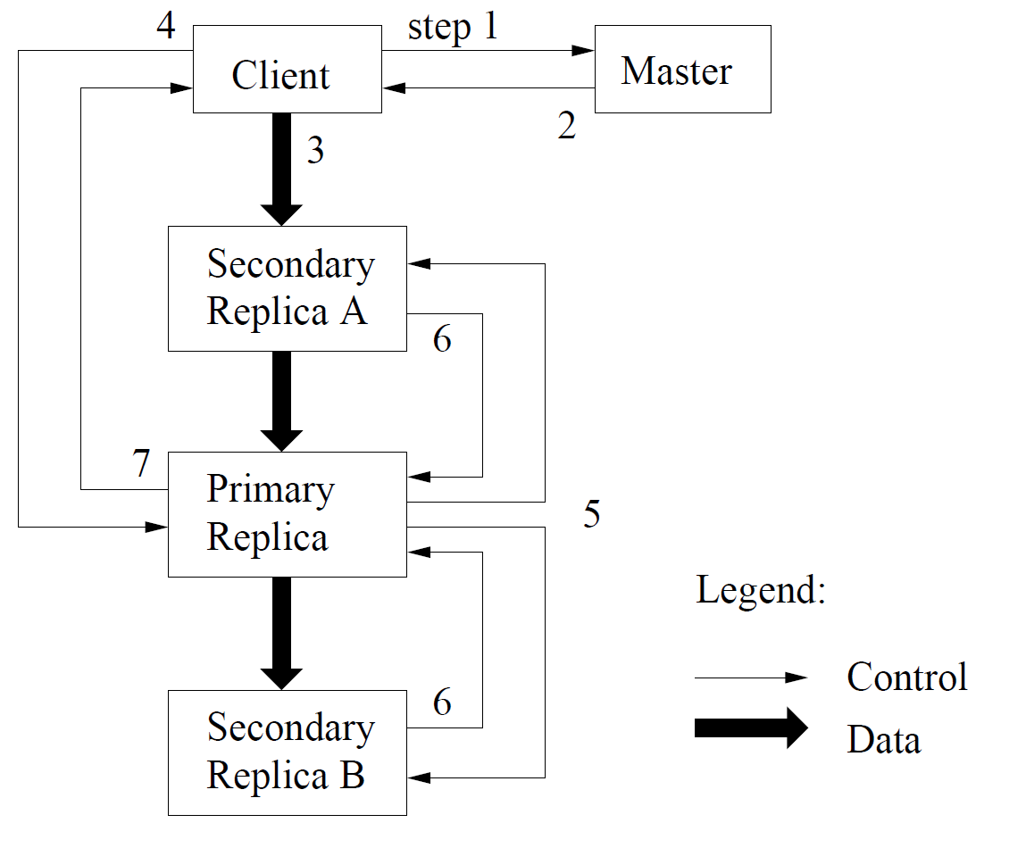
GFS Architecture
GFS Architecture
Write Control and Data Flow: To fully utilize each machine’s network bandwidth, the data is pushed linearly along a chain of chunk servers

Slide 73
Hadoop & PVFS

Slide 74
Backup Slides: Current work and plan

Slide 75
Multi-Chain
t
0
1
2
3

