Slide 1

Twister4Azure : Iterative MapReduce for Azure Cloud
Thilina Gunarathne, Judy Qiu, Geoffrey Fox
{tgunarat, xqiu,gcf}@indiana.edu
CCA 2011
April 12 – 13, 2011

Slide 2
MapReduceRoles for Azure
Familiar MapReduce programming model
Built using highly-available and scalable Azure cloud services
Co-exist with eventual consistency & high latency of cloud services
Decentralized control
  No single point of failure.
Supports dynamically scaling up and down of the compute resources.
MapReduce fault tolerance

Slide 3
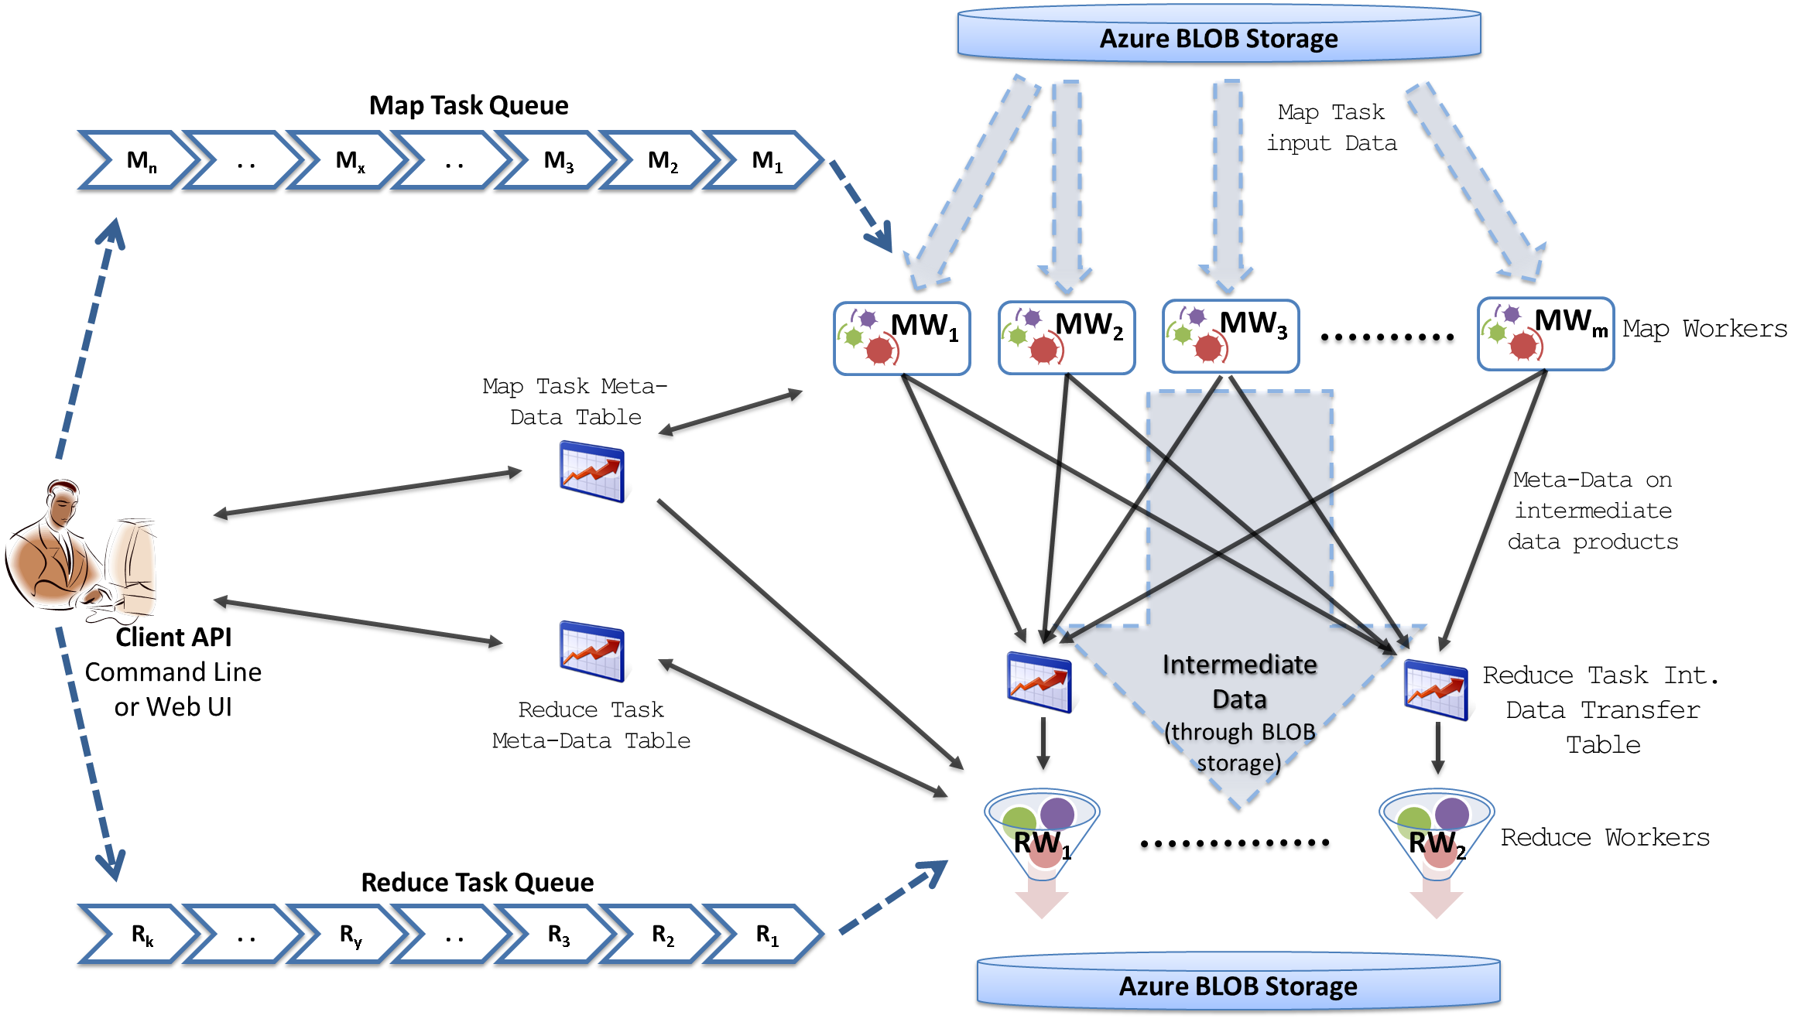
MapReduceRoles for Azure
Notes:
We use Azure Queues for scheduling, Tables to store meta-data and monitoring data, Blobs for input/output/intermediate data storage.

Slide 4
Twister for Azure
Merge Step
In-Memory Caching of static data
Cache aware hybrid scheduling using Queues as well as using a bulletin board (special table)
Notes:
In our current work, we extend MR4Azure to support iterative mapreduce computations. We added an additional merge step to the programming model, where the computations decides whether to go for a new iteration or not. We also support in-memory caching of static data between iterations and we developed a hybrid scheduling strategy to perform cache aware scheduling.

Slide 5
Twister for Azure
Notes:
We don’t have a master node, who has the global knowledge about the cached data.. Hence in each iteration, tasks will be posted to the bulleting board, where workers will first check to identify any tasks that require a data product they have in cache. If not they fall back to the queue.

Slide 6



Performance – Kmeans Clustering
Performance with/without data caching.
Speedup gained using data cache
Scaling speedup
Increasing number of iterations
Notes:
KMeans iterative MapReduce performance. 16 Azure Small instances, 6 iterations, 8 to 48 million 20-D data points.
Left: Performance with and without data caching.
Right: Speedup obtained from using the data cache
Left: Scaling speedup with increasing number of instances (Azure Small) & data for 10 iterations.
Right: Increasing number of iterations using 16 million data points with caching using 16 Azure Small instances.

Slide 7
Performance Comparisons
BLAST Sequence Search
Smith Watermann Sequence Alignment
Cap3 Sequence Assembly

Slide 8
Conclusion
Enables users to easily and efficiently perform large scale iterative data analysis and scientific computations on Azure cloud.
Utilizes a novel hybrid scheduling mechanism to provide the caching of static data across iterations.
Utilize cloud infrastructure services effectively to deliver robust and efficient applications.
http://salsahpc.indiana.edu/twister4azure

