Slide 1
Possibly useful slide

Slide 2
Which Services should we install?
We look at statistics on what users request
We look at interesting projects as part of the project description
We look for projects which we intend to integrate with: e.g. XD TAS, XSEDE
We look at community activities

Slide 3
Technology Requests per Quarter
(c) It is not permissible to publish the above graph in a paper or report without permission and potential co-authorship to avoid misinterpretation. Please contact laszewski@gmail.com

Slide 4
Selected List of Services Offered
IaaS
Nimbus
Cloud PaaS
Hadoop
Iterative MapReduce
HDFS
Hbase
Swift Object Store
MPI
TestbedaaS
Infrastructure: Inca, Ganglia
Eucalyptus
OpenStack
ViNE
HPCaaS
OpenMP
CUDA
GridaaS
Unicore
SAGA
Globus
Genesis
Provisioning: RAIN, Cloudmesh
VMs: Phantom, Cloudmesh
Experiments: Pegasus, Precip,
Cloudmesh
Accounting: FG, XSEDE
FutureGrid

Slide 5
Cloudmesh
Gregor von Laszewski

Slide 6
Terminology

Slide 7
Avoid Confusion
To avoid confusion with the overloaded term
  Dynamic Provisioning
we will use the term
  RAIN

Slide 8
What is RAIN?
Templates
&
Services
Virtual Cluster
Virtual
Machine
Hadoop
OS Image
Other
Resources

Slide 9
RAIN/RAINING is a Concept
Cloudmesh is a toolkit implementing RAIN
It includes a component called Rain that is used to build and interface with a testbed so that users can conduct advanced reproducible experiments

Slide 10
Cloudmesh
An evolving toolkit and service to
build and interface with
a testbed so that users can conduct advanced reproducible experiments

Slide 11
Cloudmesh Functionality View
Virtual Machine
Management
  IaaS Abstraction
Provisioning Management
  Rain
  Cloud Shifting
  Cloud Bursting
Experiment
Management
  Shell
  IPython
Information Services
  CloudMetrics
Accounting
  FG Portal
  XSEDE Portal
Future Grid
TaaS
User On-Ramp
Amazon, Azure, FutureGrid, XSEDE,
OpenCirrus, ExoGeni, Other Science Clouds

Slide 12
Cloudmesh Layered Architecture View
Notes:
Multiple components are part of cloudmesh. Cloudmesh is an umbrella for it. We are still debating about its name as we aslo could have used RAIN. But rain was initially just a small component and deals predominantly so far with templated image management

Slide 13
Cloudmesh RAIN Move
Orchestrates resource re-allocation among different infrastructures
Command Line interface to ease the access to this service
Exclusive access to the service to prevent conflicts
Keep status information about the resources assigned to each infrastructure as well as the historical to be able to make predictions about the future needs
Scheduler that can dynamically re-allocate resources and support manually planning future re-allocations

Slide 14
Use Case: Move Resources
Autonomous Runtime Services
CM
CM
CM
CM
CM
CM
CM

Slide 15
Use Case: Move Resources
Autonomous Runtime Services

Slide 16
Use Case: Move Resources
Autonomous Runtime Services
CM
CM
CM
CM
CM
CM
CM
2
1

Slide 17
Use Case: Move Resources
Autonomous Runtime Services
CM
CM
CM
CM
CM
CM
CM
2
1

Slide 18
Feature Summary
Provisioning
  RAIN Bare Metal
  RAIN of VMs
  RAIN of Platforms
  Templated Image Management
Resource Inventory
Experiment Management with IPython
Integration of external clouds
Integration of HPC resources
Project, Role, and user based authorization framework

Slide 19
Cloudmesh Federation Aspects
Federate HPC services
  Covered by Grid technology
  Covered by Genesis II (often used)
Thus: Should not be focus of our activities as addressed by others
  We provide users the ability to access HPC resources via key management
  This is logical as each HPC resource in FG is independent.

Slide 20
Federated Cloud services
  Data:
    No shared data services
  Accounting (via cloudmesh)
    Uniform metric framework developed, that allows us to integrate with accounting. Example XSEDE integration will include accounting data from our cloud platforms.
  Authentication & Authorization (LDAP & Project and Role based authentication, can integrate with various IAAS, Eucalyptus, OpenStack, (Nimbus does not support projects)

Slide 21
Federated Cloud Services
Templated images
  Cloudmesh will integrate with rain allowing access to a templated image library that allows to run images on multiple IaaS across its federation.
VM Management
  Cloudmesh Users can manage easily all their VMs (even on different IaaS) through a single API, commandline and GUI
Cloud Bursting
  HPC services will be augmented by cloud bursting services. Users of cloudmesh will not be aware of this detail, but we intend in a future version to add information services for it

Slide 22
Federated Cloud Services
Current: Cloud Shifting
  Administrators will be able to shift resources between IaaS and HPC. This is done via bare metal provisioning. Cloudmesh will provide a convenient role based access to such a service.
  Administrators and users will be able to use bare metal provisioning via cloudmesh through role, project, and user based access
Future: Autonomous Cloud Shifting
  Resources will be alliggned by an autonomous service that is guided by Metrics and user demand.

Slide 23
Screenshots

Slide 24
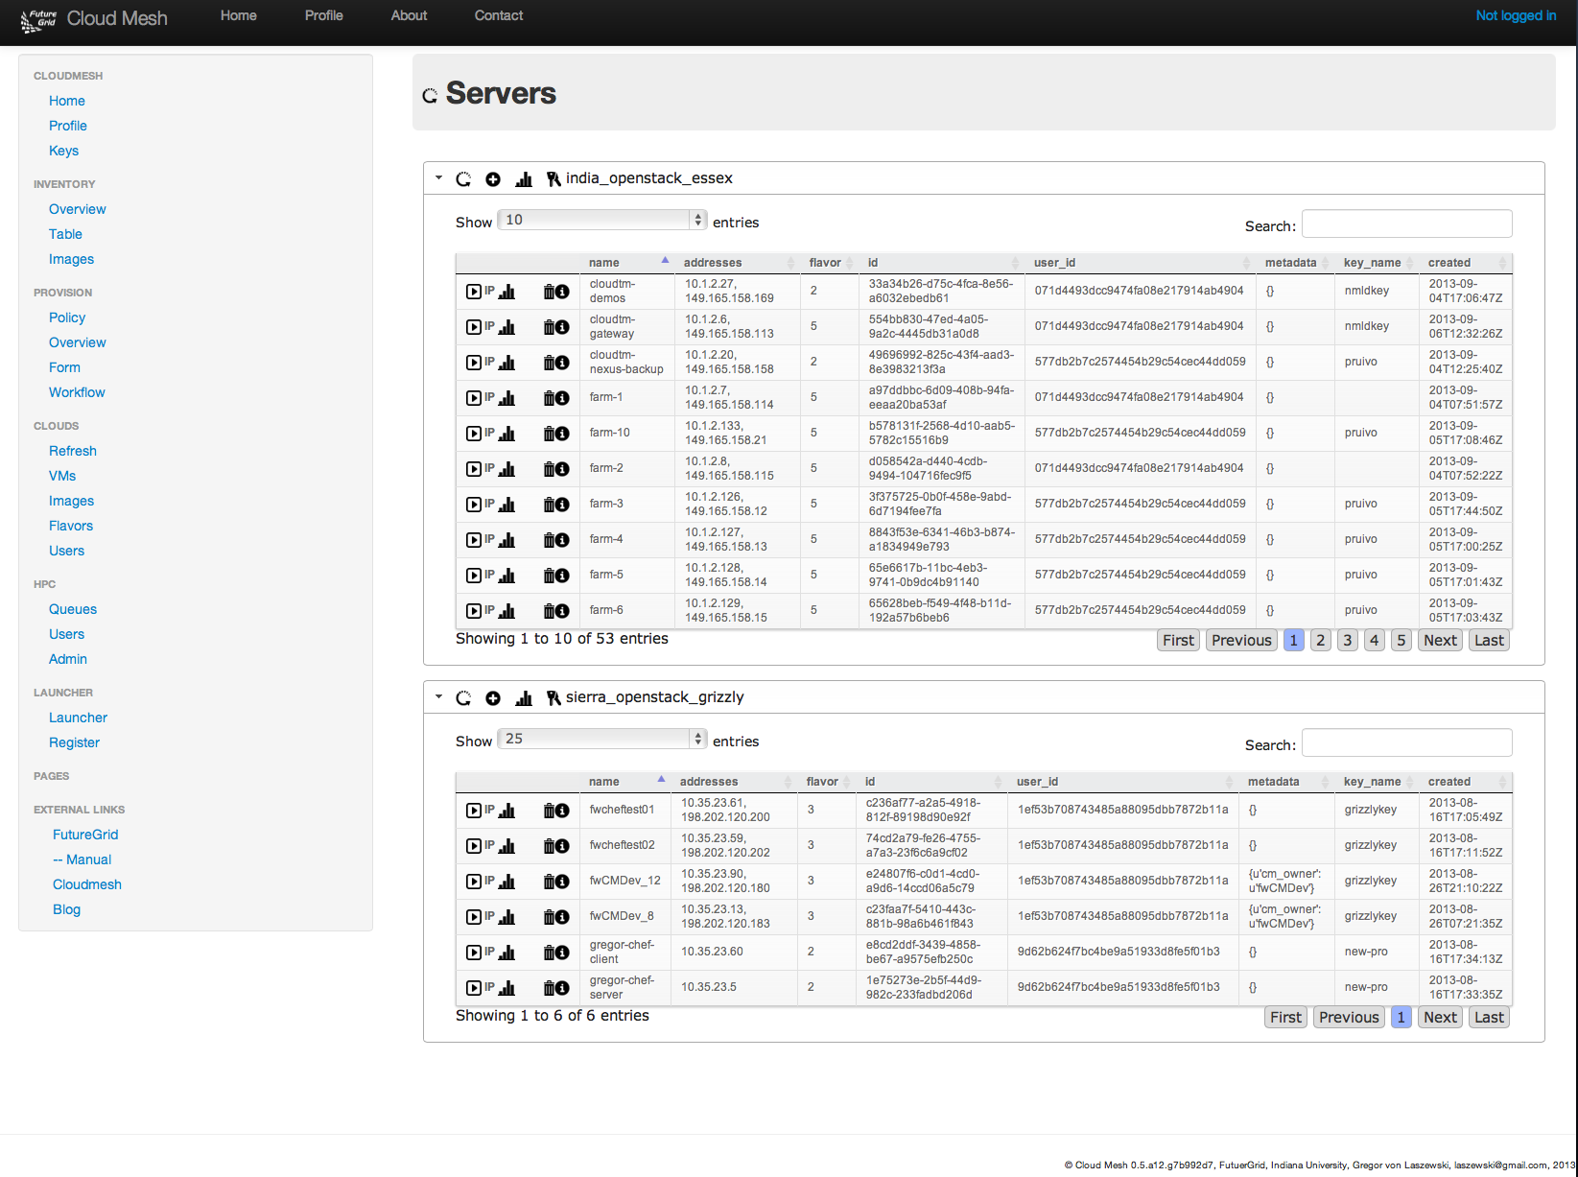
User Side Federation with
Cloud Mesh UI

Slide 25
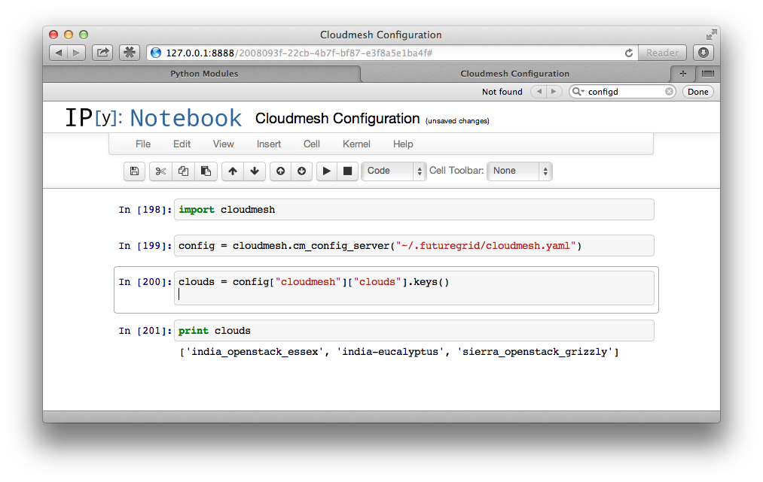
Interactive Cloudmesh with IPython

Slide 26
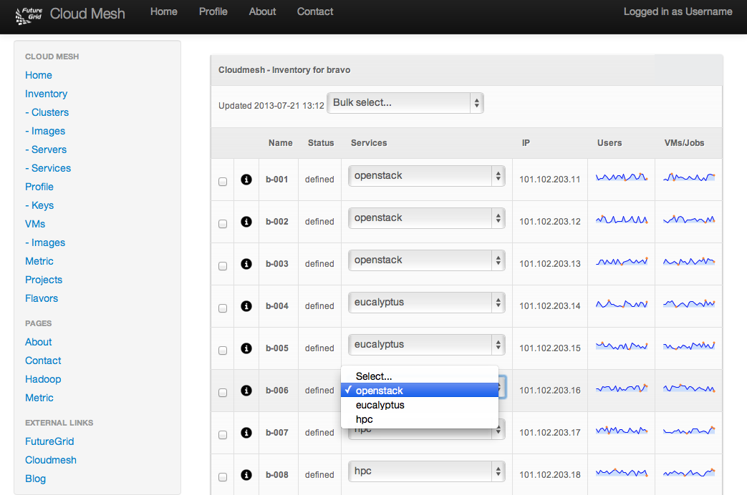
CloudMesh:
Example of Moving a Service

Slide 27
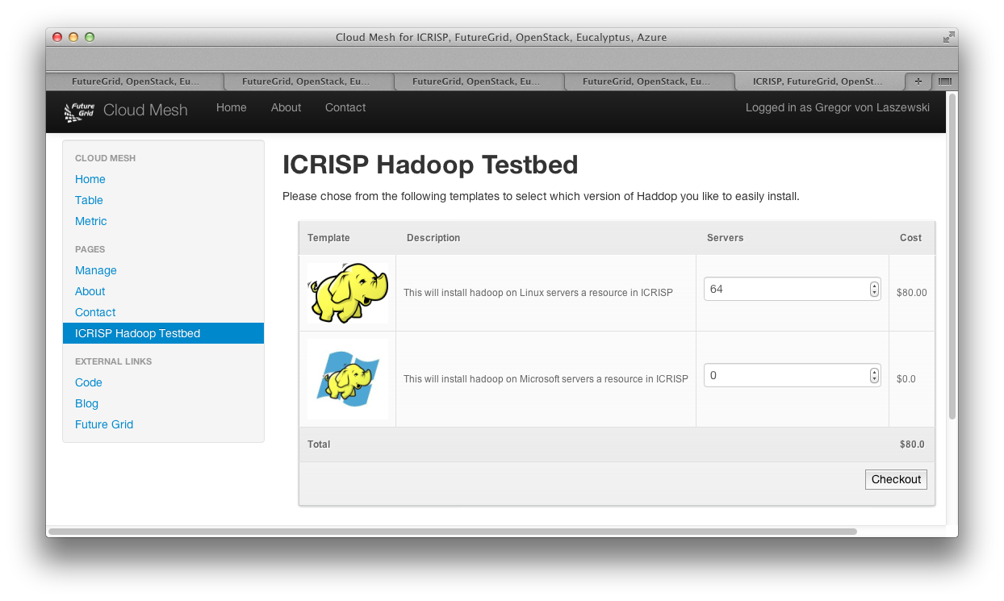
Cloudmesh One Click Install
Hadoop one-click Install

Slide 28
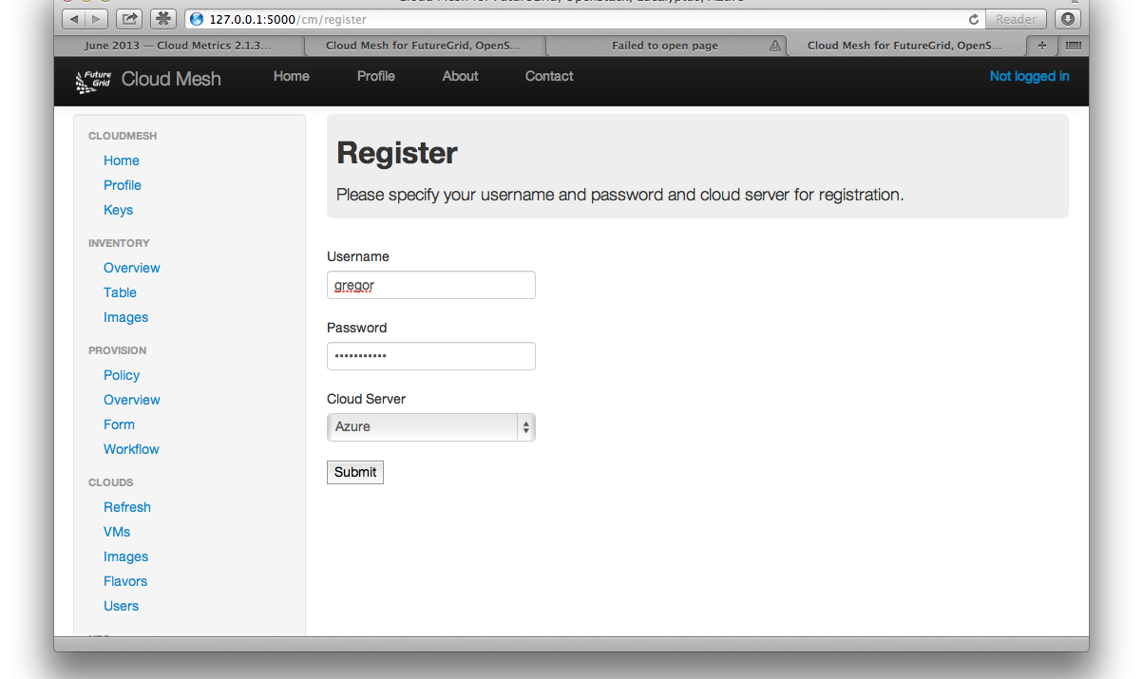
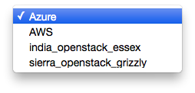
Registering External Clouds

