Slide 1
FutureGrid and Cybera
Gregor von Laszewski
Indiana University
laszewski@gmail.com

Slide 2

FutureGrid: a Grid/Cloud/HPC Testbed
NID: Network Impairment Device
Private
Public
FG Network

Slide 3

Selected List of Services Offered
FutureGrid
User
IaaS
Nimbus
PaaS
Hadoop
(Twister)
(Sphere/Sector)
MPI
Others
Portal
Inca
Eucalyptus
ViNE
(OpenStack)
(OpenNebula)
HPCC
Ganglia
(Exper. Manag./(Pegasus
(Rain)
OpenMP
ScaleMP
(XD Stack)
Grid
(Globus)
Unicore
SAGA
Genesis II
(will be added in future)

Slide 4
Detailed Software Architecture

Slide 5
Services Offered
 | India | Sierra | Hotel | Foxtrot | Alamo | Xray | Bravo
myHadoop | ✔ | ✔ |  |  | ✔
Nimbus |  | ✔ | ✔ | ✔ | ✔
Eucalyptus | ✔ | ✔
ViNe¹ | ☑ | ✔ | ☑ | ✔ | ☑
Genesis II | ✔ | ✔ |  |  | ✔ | ✔
Unicore | ✔ | ✔ |  |  |  | ✔
MPI | ✔ | ✔ | ✔ | ✔ | ✔ | ✔ | ✔
OpenMP |  |  |  |  |  | ✔
ScaleMP | ✔
Ganglia | ✔ |  | ✔
Pegasus³ | ☑ | ☑ | ☑ | ☑ | ☑
Inca | ✔ | ✔ | ✔ | ✔ | ✔ | ✔
Portal² | ☒ | ☒ | ☒ | ☒ | ☒ | ☒
PAPI |  |  |  |  |  | ✔
Vampir
ViNe can be installed on the
other resources via Nimbus ☑
Access to the resource is requested through the portal ☒
Pegasus available via Nimbus and Eucalyptus images

Slide 6
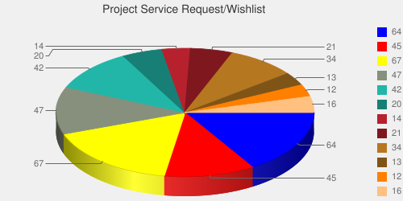
User demand influences service deployment
Based on User input we focused on
  Nimbus (53%)
  Eucalyptus (51%)
  Hadoop (37%)
  HPC (36%)
Eucalyptus: 64(50.8%)
High Performance Computing Environment: 45(35.7%)
Nimbus: 67(53.2%)
Hadoop: 47(37.3%)
MapReduce: 42(33.3%)
Twister: 20(15.9%)
OpenNebula: 14(11.1%)
Genesis II: 21(16.7%)
Common TeraGrid Software Stack: 34(27%)
Unicore 6: 13(10.3%)
gLite: 12(9.5%)
OpenStack: 16(12.7%)
* Note: We will improve the way we gather statistics in order to avoid inaccuracy during the information gathering at project and user registration time.

Slide 7
Rain in FutureGrid
Technology Preview
http://futuregrid.org

Slide 8
Opportunities
FG provides resources
FG provides services
Research and industry is welcome
Technical collaboration
  Clouds (OpenStack, Crossbar, …)
Collaborative projects between researchers, users
  How can we foster this?
  Build a distributed scientific knowledge cloud?
    The expert is a resource (1996, von Laszewski)

