Slide 1
FutureGrid and
Green Aware Computing
Gregor von Laszewski
laszewski@gmail.com
Indiana University

Slide 2

Biography
Gregor von Laszewski is conducting research in Cloud computing and GreenIT at Indiana University as part of http://futuregrid.org. During a less than 2 year leave of absence from Argonne National Laboratory he was an Associate Professor at Rochester Institute of Technology. Prior to this, he worked between 1996 and 2007 for Argonne National Laboratory where he was last a tenured scientist and a fellow of the Computation Institute at University of Chicago. He received a Masters Degree in 1989/90 from the University of Bonn, Germany, and a Ph.D. in 1996 from Syracuse University in computer science. He is involved in Grid computing since the term was coined. Current research interests are in the areas of GreenIT, Grid & Cloud computing, and GPGPUs. He is best known for his efforts in making Grids usable and initiating the Java Commodity Grid Kit which provides a basis for many Grid related projects including the Globus toolkit (http://www.cogkits.org).
His Web page is located at http://cyberaide.org.

Slide 3


Outline
Cyberaide
A project that aims to make advanced cyberinfrastructure easier to use
GreenIT & Cyberaide
How do we use advanced cyberinfrastructure in an efficient way
Future Grid
A newly funded project to provide a testbed that integrates the ability of dynamic provisioning of resources.
(Geoffrey C. Fox is PI)
GPGPU’s
Application use of special purpose hardware as part of the cyberinfrastructure

Slide 4
Outline
Where do I come from?
What is GreenIT and why should we care?
FutureGrid
Cyberaide

Slide 5
Acknowledgement
Cyberaide
  Lizhe Wang (PostDoc)
  Andrew Younge
  Xi He
  Jai Dayal
  Casey Rathborne
  Support by NSF
Biostatistics
  James Cavenaugh (PostDoc, UR)
  Andrew Pangborn (RIT)
  Jeremey Espenshade (now Microsoft HPC)

Slide 6
Where do I come from?

Slide 7
Introduction - Background
E-Science is computationally or data intensive science, carried out in a distributed computing environment
Cyberinfrastructure is a research environment supporting advanced data acquisition and information processing services over the internet
Experiment Management is the management of a large number of experiments over Cyberinfrastructure

Slide 8
Introduction – Motivation
There is a high entry barrier into Grid computing.
Experiment Management on the Grid or Cyberinfrastructure is a complicated affair.
Issues include:
  Application Design
  Scheduling of Large Scale Resources
  Orchestration of Activity
  Monitoring Execution and Quality of Service
  Data Acquisition

Slide 9
e-Science Experiment Management
Social Networks
Clouds
Globus
(Condor,Unicore, …)
Queuing
Systems
Notes:
This project has been developed

Slide 10
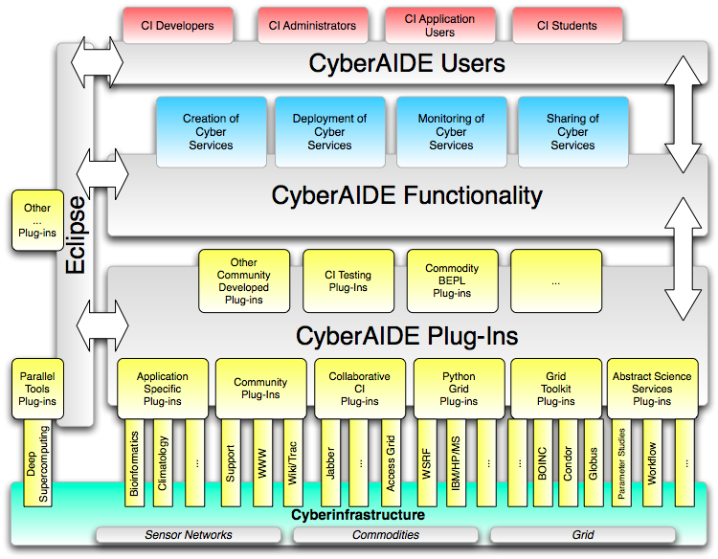
Cyberaide.org

Slide 11
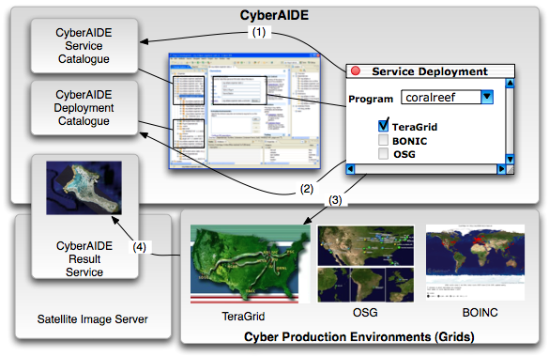
Adhoc Cyberinfrastucture

Slide 12
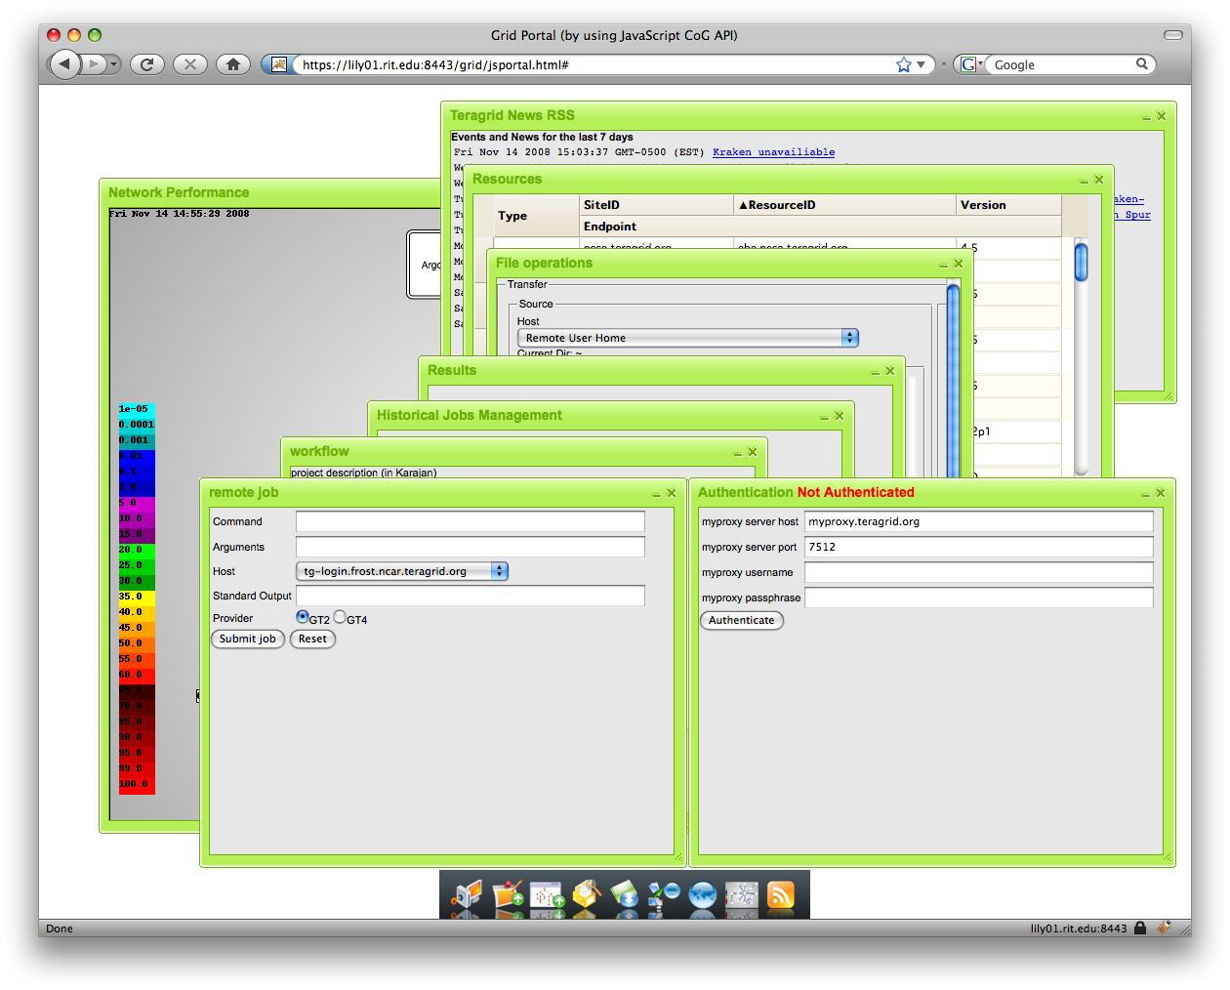
The Portal: Mimics a Desktop

Slide 13
Futuregrid

Slide 14
Gregor: a User
No available HW at previous educational institution. 386 cluster ;-)
Cyberinfrastructure should be easier
Testbeds and production platforms provided limited features and accessibility
Integration of dynamic provisioning of cyberinfrastructure is not the model typically deployed at the centers

Slide 15
Future Grid to the Rescue …
For me and others …

Slide 16
FutureGrid
The goal of FutureGrid is to support the research that will invent the future of distributed, grid, and cloud computing.
FutureGrid will build a robustly managed simulation environment or testbed to support the development and early use in science of new technologies at all levels of the software stack: from networking to middleware to scientific applications.
The environment will mimic TeraGrid and/or general parallel and distributed systems
This test-bed will enable dramatic advances in science and engineering through collaborative evolution of science applications and related software.

Slide 17
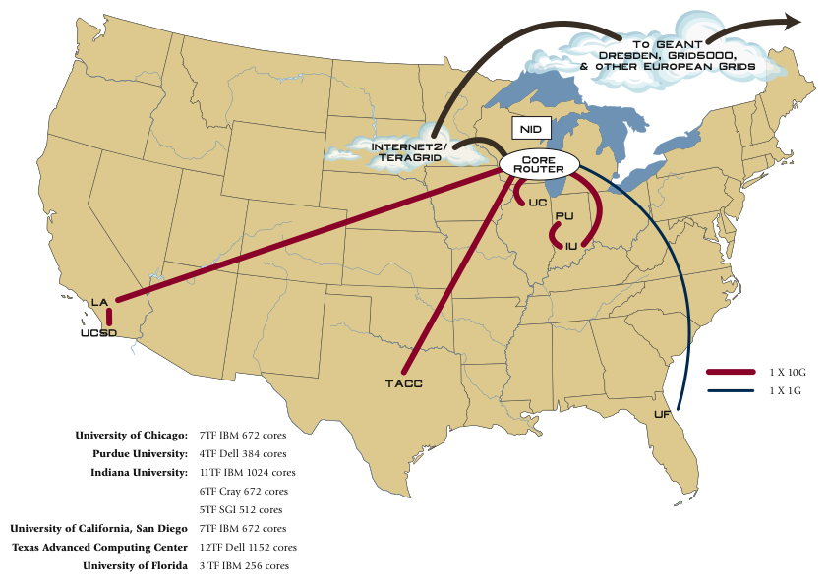
Other Participant Sites
University of Virginia (UV)
Technical University Dresden
GWT-TUD GmbH, Germany
University of Tennessee – Knoxville (UTK)

Slide 18
FutureGrid Hardware

Slide 19
FutureGrid Partners
Indiana University
Purdue University
San Diego Supercomputer Center at University of California San Diego
University of Chicago/Argonne National Labs
University of Florida
University of Southern California Information Sciences Institute, University of Tennessee Knoxville
University of Texas at Austin/Texas Advanced Computing Center
University of Virginia
Center for Information Services and GWT-TUD from Technische Universtität Dresden.

Slide 20
Other Important Collaborators
Early users from an application and computer science perspective and from both research and education
Grid5000/Aladin and D-Grid in Europe
Commercial partners such as
  Eucalyptus
  Microsoft (Dryad + Azure) – Note Azure external to FutureGrid like GPU systems
  We should identify other partners – should we have a formal Corporate Partners program?
TeraGrid
Open Grid Forum
NSF

Slide 21
FutureGrid Architecture

Slide 22
FutureGrid Architecture
Open Architecture allows to configure resources based on images
Shared images allows to create similar experiment environments
Experiment management allows management of reproducible activities
Through our “stratosphere” design we allow different clouds and images to be “rained” upon hardware.

Slide 23
FutureGrid Usage Scenarios
Developers of end-user applications who want to develop new applications in cloud or grid environments, including analogs of commercial cloud environments such as Amazon or Google.
  Is a Science Cloud for me?
Developers of end-user applications who want to experiment with multiple hardware environments.
Grid middleware developers who want to evaluate new versions of middleware or new systems.
Networking researchers who want to test and compare different networking solutions in support of grid and cloud applications and middleware. (Some types of networking research will likely best be done via through the GENI program.)
Interest in performance requires that bare metal important

Slide 24
Selected FutureGrid Timeline
October 1 2009 Project Starts
November 16-19 SC09 Demo/F2F Committee Meetings
March 2010 FutureGrid network complete
March 2010 FutureGrid Annual Meeting
September 2010 All hardware (except Track IIC lookalike) accepted
October 1 2011 FutureGrid allocatable via TeraGrid process – first two years by user/science board led by Andrew Grimshaw

Slide 25
GreenIT, an application within FutureGrid
I expect that we integrate lessens learned from Cyberaide GreenIT into FutureGrid

Slide 26
What is Green IT?
Green IT also referred as Green computing is a study and practice of using computing resources in an efficient manner such that its impact on the environment is as less hazardous as possible.
  least amount of hazardous materials are used
  computing resources are used efficiently in terms of energy and to promote recyclability
http://en.wikipedia.org/wiki/Green_computing

Slide 27
Motivation
Cost:
  A supercomputer with 360-Tflops with conventional processors requires 20 MW to operate, which is approximately equal to the sum of 22,000 US households power consumption
  Servers consume 0.5 percent of the world’s total electricity usage
  Energy usage will quadruple by 2020
  The total estimated energy bill for data centers in 2010 is $11.5 billion
Reliability:
  Every 10C increase of temperature leads to a doubling of the system failure rate
Environment:
  A typical desktop computer consumes 200-300W of power
  This results in emission of about 220Kg of CO2/annum
  Data Centers produce 170 million metric tons of CO2 worldwide currently per year
  670 million metric tons of CO2 are expected to be emitted by data centers worldwide annually by 2020
Utilization
  32 percent of all servers are running at or below 3 percent peak and average utilizations, wasting energy spinning and cooling, and doing virtually no work.

Slide 28
A Typical Google Search
Google spends about 0.0003 kWh per search
  1 kilo-watt-hour (kWh) of electricity = 7.12 x 10-4 metric tons CO2 = 0.712 kg or 712g of CO2
  => 213mg CO2 emitted
The number of Google searches worldwide amounts to 200-500 million per day.
  total carbon emitted per day:
  = 500 million x 0.000213 kg
  per search = 106500kg or 106.5 metric ton
Source: http://prsmruti.rediffiland.com/blogs/2009/01/19/How-much-cabondioxide-CO2-emitted.html
Notes:
ref:
http://www.globus.org/grid_software/security/voms.php – globus alliance ... basic definition
http://vdt.cs.wisc.edu/components/voms.html – virtual data toolkit (osg) – grid middleware
http://edg-wp2.web.cern.ch/edg-wp2/security/voms/voms.html – (datagrid)

Slide 29
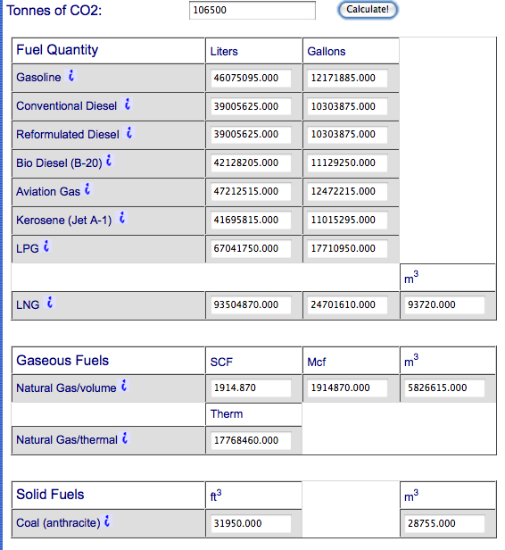
What does it mean?
10282 times around the world with a 21m/g car

Slide 30
Where is power used in Data Centers?
Data center uses large amount of electricity for 3 main components:
  IT Equipment
  Cooling
  Power Delivery
Power Usage Effectiveness (PUE)
  PUE = Total Facility Power/IT Equipment Power

Slide 31
What does PUE mean?
PUE shows the relation between the energy used by IT equipment and energy used by other facilities such as cooling needed for operating the IT equipment.
For example, a PUE of 2.0 indicates that for every watt of IT power, an additional watt is consumed to cool and distribute power to the IT equipment.
At present the PUE of a typical enterprise data center is around between 1 to 3.
PUE does not indicate if how efficient the individual equipment is.

Slide 32
Result
Evaluate Metrics carefully
A Datacenter with PUE close to 1 does not mean it produces the fewest CO2

Slide 33
How to improve this?
Use metrics and proxies we understand
Energy and Carbon Calculator
  http://www.apcmedia.com/salestools/WTOL-7DJLN9_R0_EN.swf
Google Energy Calculator for Desktops

Slide 34
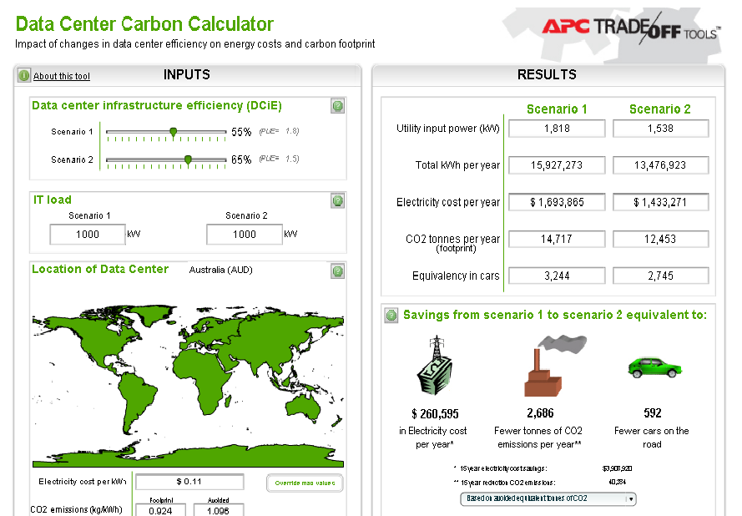
Datacenter Carbon Calculator
http://www.apcmedia.com/salestools/WTOL-7DJLN9_R0_EN.swf

Slide 35
So what can we do?

Slide 36
So what can we do?
Doing less google searches ;-)
Doing meaningful things ;-)
Create an infrastructure that supports use and monitoring of activities costing less environmental impact.
Seek services that advertise clearly their impact on the environment
Augment them with Service Level Agreements

Slide 37
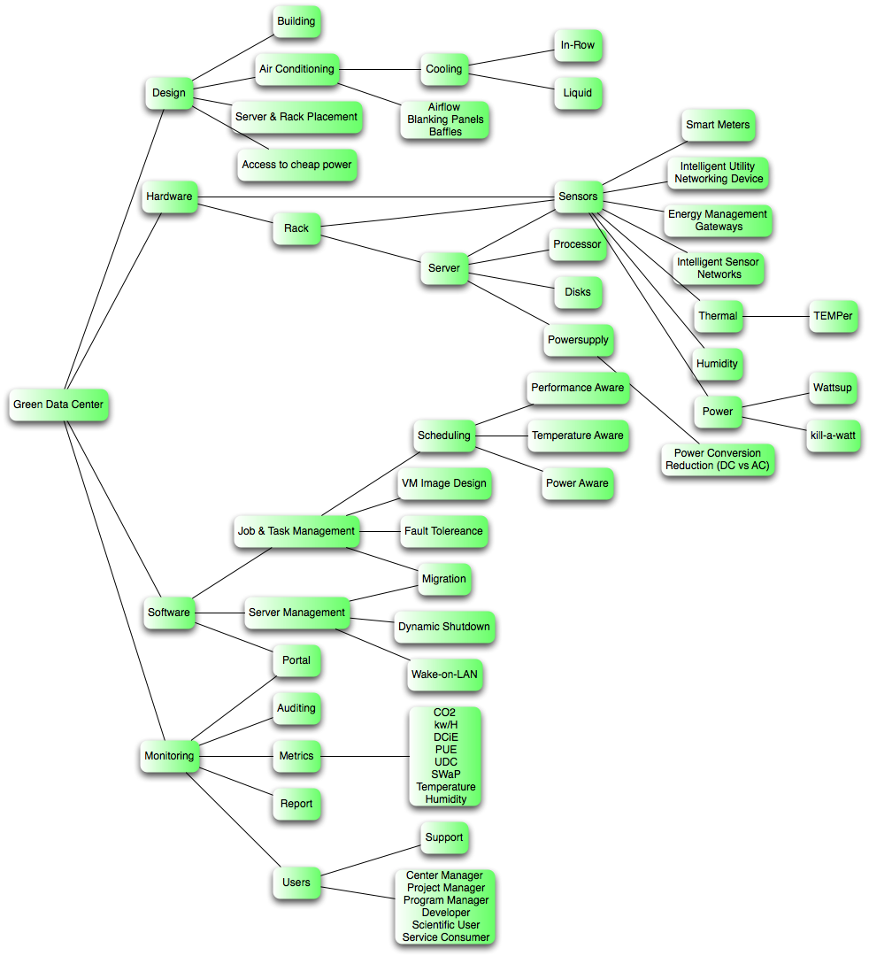
GreenIT Taxonomy
We are actively developing a Taxonomy
Helps assessing where to focus research activities
Will be resulting in
  What to Monitor?
  What Software?
  Which Services?
  What to Optimize?
  At what cost ($,CO2,perf)?

Slide 38
Cost/environment Factors in
Data Centers
Temperature
  Indirect but large impact on power
Power usage
  Direct impact on power

Slide 39
Cooling Cost of Data Center
For large data centers cooling cost of the data center contribute to about half of the total energy cost for running the data centers.
If the energy required for cooling is reduced than the total energy cost of data centers reduces
Reasoning for cooling
  Keep temperature at optimum operation temperature (avoids failure)
  Air conditioning cooling is complex
    Keep temperatures balanced

Slide 40
Cyberinfrastructure @ IU:
“green” status
Electrical power source distribution
  Coal: 94%
  hydro: <1%
  oil: <1%
  Biomass : <1%
  other: 2%
  source http://www.npr.org/templates/story/story.php?storyId=110997398
More opportunities to reduce CO2 emission

Slide 41
IU Power Consumption
Source:
Campus Sustainability Report,
Indiana University Task Force on Campus Sustainability

Slide 42
CO2 emission from purchased electricity @ IU
Source:
Campus Sustainability Report,
Indiana University Task Force on Campus Sustainability

Slide 43
Green Aware Computing

Slide 44
Green Aware Computing
Metrics
  Power, Temperature, CO2, …
Computing system
  Many-cores, Clusters, GPGPU
Algorithms and models
  task scheduling, CFD model, …
Middleware
  auditing & insertion service, green resource management service, virtualization, Grids and Clouds, …

Slide 45
Green Aware Computing

Slide 46
Green Aware Computing

Slide 47
Research methodology
Green Application
support environment
Performance metrics
  Power consumption, CO2, …
Resource operation
  Virtual machine migration
  Smart cooling system operation
  Server consolidation
  & power management
“Green” infrastructure
  Low power & high density computing resource
  Virtualized infrastructure
“Green” service & middleware
  Auditing & insertion system
  Power aware task scheduling
  Temperature aware workload placement
“Green” application support environment
  SDKs and APIs for energy aware programming
  Interfaces for “green” performance tuning
Green
service & middleware
Metrics
Operation
Green Infrastructure

Slide 48
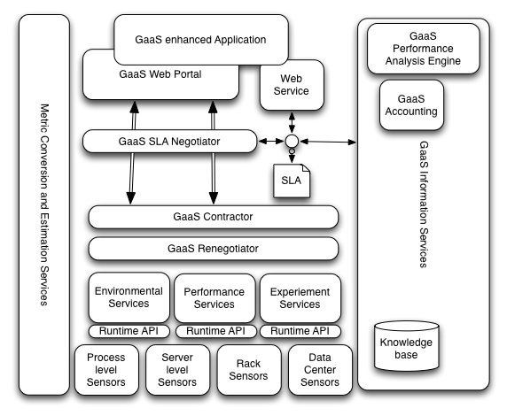
GreenIT as a Service (GaaS)

Slide 49
Green Aware Power Scheduling
Focus on virtual machine scheduling
  Many advantages for operation
  New programming uses model
  Software as a Service
    Application specific
  Software as an Infrastructure
    Middelware specific
Voltage is related to Power

Slide 50
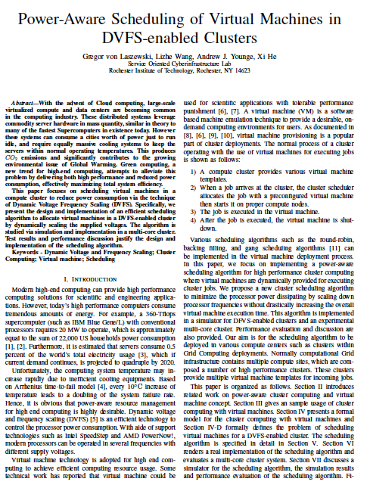
Green Aware DVFS Scheduling for VMs
How to reduce energy consumption?
  Many ways exist …
  Can we use dynamic voltages to reduce energy consumption
Objective: dynamically scale voltages for virtual machines in a cluster
  Dynamic Voltage Frequency Scheduling (DVFS)
Cluster Aug. 2009

Slide 51
Scheduling virtual machines
job
Execute job in a vm
Start a vm
vm
vm
vm
vm
vm
vm
File
server
Head
node
Compute node
PE
Compute node
PE
PE
Scheduling
algorithm
PE
VM
PE
queue
PE
cluster

Slide 52
Power aware scheduling algorithm
Sort VMs in a decreasing order of required CPU speed (e.g. deadline requirement)
Set PEs to lowest voltages
put VMs to PEs
If cannot accommodate increase PE voltages
Reduce PE voltages whenever it is possible to accommodate VMs
Return to 3.

Slide 53
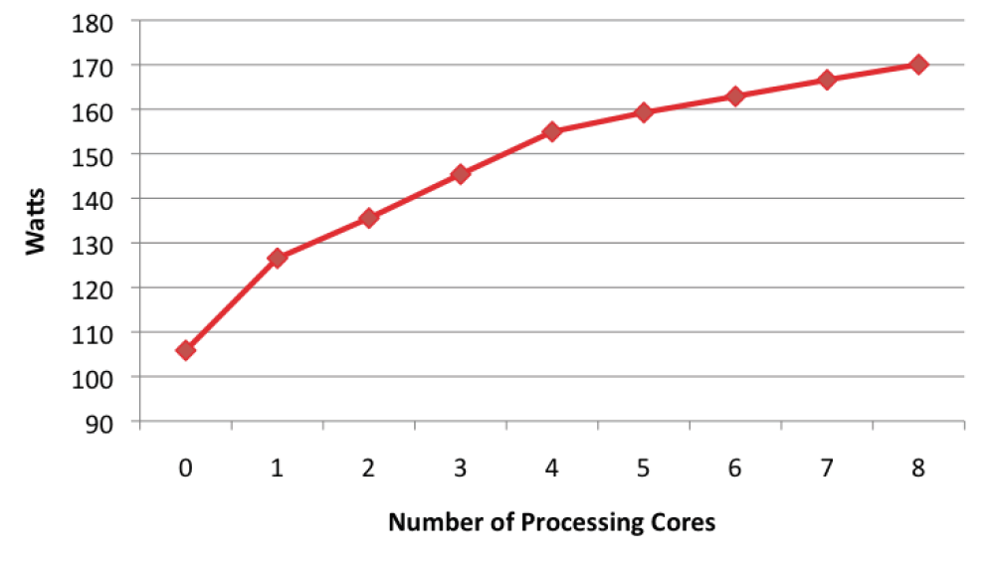
Simulations
Simulations are based on job data we got form Buffalo, …
Server:
iCore 7
under
load
Intel Nehalem 920 Quadcore (2 per board)

Slide 54
Simulation Results
Overall operating point distribution
(VM No.= 200, PE No.= 40)

Slide 55
Results
For compute intense calculations on a quad core machine
Although you get slower speed with more cores, the overall throughput is more efficient
  While the performance of each individual VM is only approximately 67% as fast when using 8 VMs instead of 4, there are twice as many VMs to contribute to an overall performance improvement of 34%
Put as much on the machine as you can

Slide 56
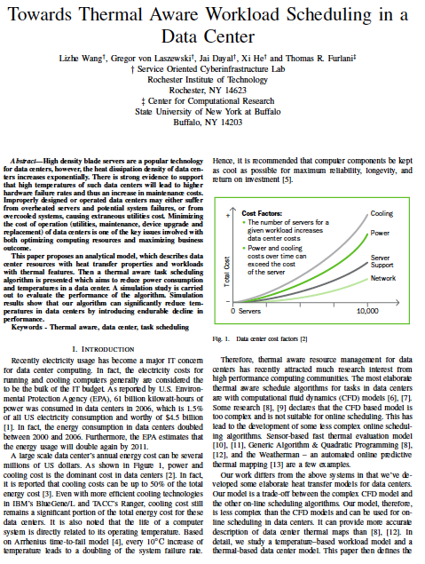
Thermal aware workload scheduling in data centers
Job-temperature model
Data center resource model
Thermal aware scheduling algorithm
Thermal aware workload scheduling framework
Simulation
To be submitted

Slide 57
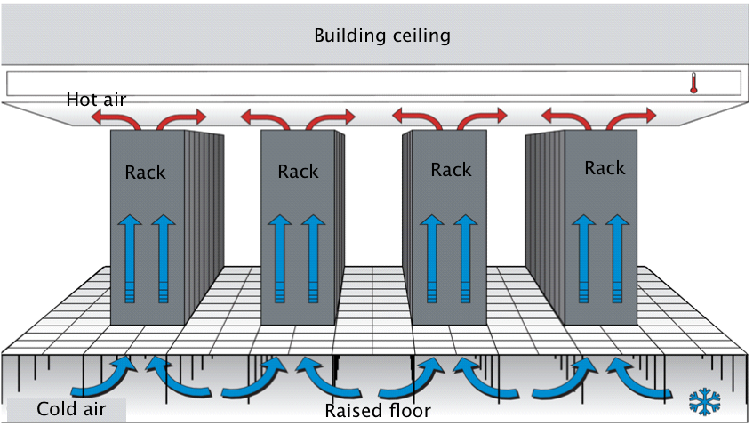
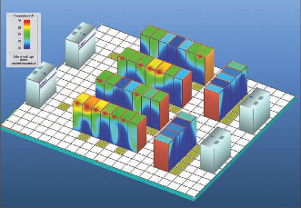
Data center model
Y
Z
Rack
Rack
Rack
Hot air
Hot air
Node
(x,y,z)
X

Slide 58
Thermal aware scheduling framework
Profiling tool
Workload model
Task-temperature profile
Workload placement
Thermal aware workload scheduling algorithm
Online
task-temperature calculation
Datacenter model
Cooling system control
RC-thermal model
Thermal map
CFD model
Monitoring service

Slide 59
Thermal aware scheduling algorithm
Get thermal field of data center
Get compute node temperature
Put hottest job to coldest resources
Predict the compute node temperature after job execution
If a compute node temperature > “redline”, set it idle
thermal aware backfilling when it is possible

Slide 60
Simulation
Real workload logged in CCR @ Buffalo Univ.
Temperature logged
CCR @ Buffalo Univ.

Slide 61
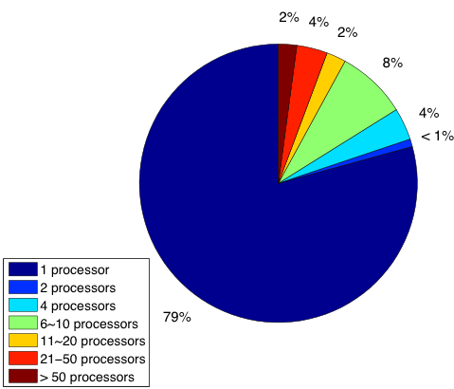
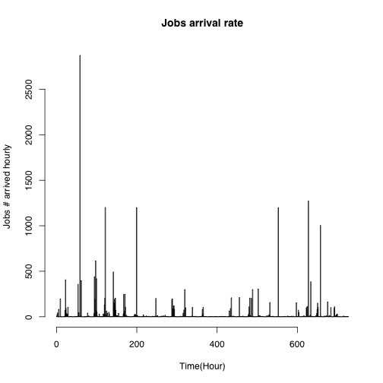
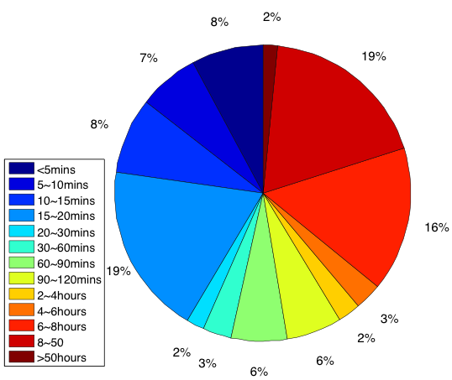
Workload in CCR

Slide 62
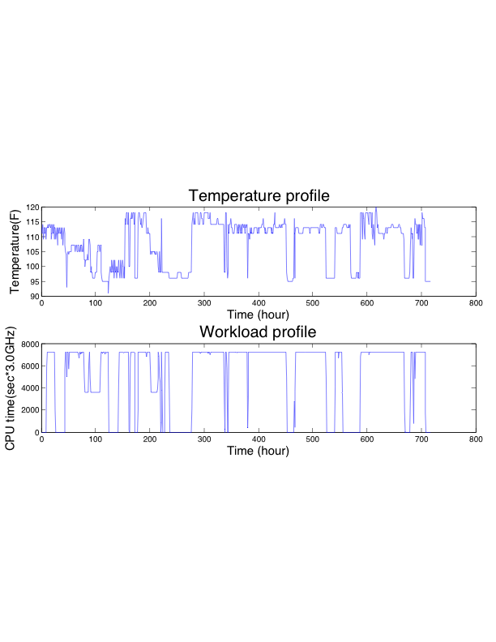
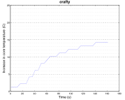
Job-temperature profile

Slide 63
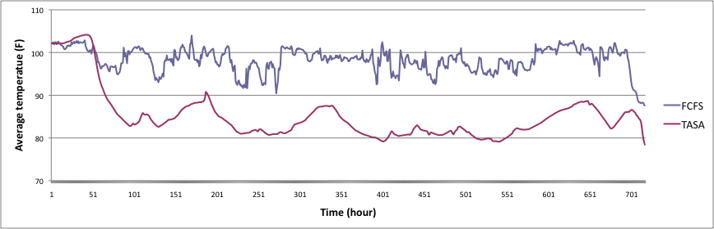
Simulation Result (1)
Reduce max temperature: 6 F
Reduce average temperature: 15 F
Reduce power consumption 4000 kW/h
Reduce CO2 emission 19 000 kg/h

Slide 64
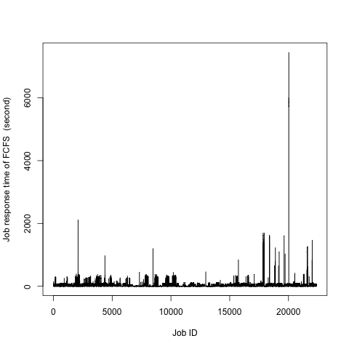
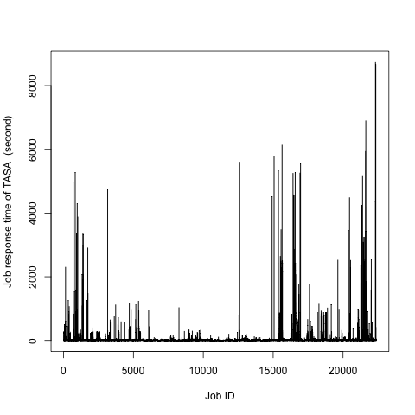
Simulation Result (2)
Response time increase 13%

Slide 65
Skip to slide 83

Slide 66
Green Data Center Computing framework
CFD model
Thermal aware resource management
Workload model
Auditing & Insertion service
Software sensor
Physical sensor
Monitoring service
Cooling system and compute resources in a data center

Slide 67
Cyberaide Green: Software achitecture
Client Layer
Java CoG Kit
Python Client
Cyberaide Portal
Secure Web Service
Cyberaide Shell
Command Line
Middleware
Layer
Authentication and Authority
Workflow
Information
collector
Thermal-Aware Meta Scheduler
Task Submission
Information
Secure Web Service
Resource Layer
Data Center
Data Center

Slide 68
Cyberaide Abstractions for Clusters, Grids & Clouds
Command line
Portal
Web service
Logic
Cyberaide
Virtual Appliance
Cyberaide Shell
Cyberaide Studio
Cyberaide Creative
Cyberaide OnServ
Cyberaide Service
Cyberaide Farm
Thermal Aware Resource Scheduler
On demand service
provision
On demand
Infrastructure provision
Access resource
job submission
Map/Reduce,
program Grids, clusters & clouds
Clouds
Grids
Clusters

Slide 69
Cyberaide Abstractions for Clusters, Grids & Clouds
Command line
Portal
Web service
Logic
Cyberaide
Virtual Appliance
Cyberaide Shell
Cyberaide Studio
Cyberaide Creative
Cyberaide OnServ
Cyberaide Service
Cyberaide Farm
Thermal Aware Resource Scheduler
On demand service
provision
On demand
Infrastructure provision
Access resource
job submission
Map/Reduce,
program Grids, clusters & clouds
Clouds
Grids
Clusters

Slide 70
Cyberaide Virtual Appliance:
On Demand Production Grids
Virtual appliance for Cyberaide that configures itself
  Facilitates the installation and the deployment of the Cyberaide toolkit
  Enables unexperienced users
JeOSVMBuilder to create virtual appliance
Four configuration files:
  Basic configuration file - basic parameters such as:
    platform type (i386)
    amount of memory of the virtual appliance
    etc.
  Hard-disk configuration file:
    Defines size of each available (virtual) hard-disk
    number and size of all the partitions that will be created on these hard-disks.
  Boot.sh: Shell script that will be executed during the first boot of the new appliance.
  Login.sh: Shell script that will be executed after the first logon in the new appliance.

Slide 71
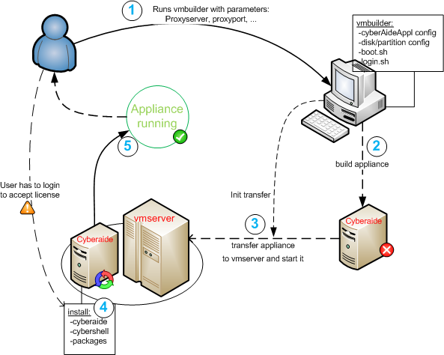
Cyberaide Virtual Appliance:
On Demand Production Grids
Installation process:
  User starts a script, passing some parameters such as proxy-host and proxy-port to it. This adapts the VMbuilder configuration files and starts the VMbuilderscript.
  VMbuilder then creates a virtual machine and installs some basic packages in it.
  The virtual machine files are moved to the VMserver and the appliance is started for the first time.
Not much time required (~1h)
Very few user interactions necessary

Slide 72
Cyberaide Abstractions for Clusters, Grids & Clouds
Command line
Portal
Web service
Logic
Cyberaide
Virtual Appliance
Cyberaide Shell
Cyberaide Studio
Cyberaide Creative
Cyberaide OnServ
Cyberaide Service
Cyberaide Farm
Thermal Aware Resource Scheduler
On demand service
provision
On demand
Infrastructure provision
Access resource
job submission
Map/Reduce,
program Grids, clusters & clouds
Clouds
Grids
Clusters

Slide 73
Cyberaide onServ: (1)
SaaS on production Grids
User’s Web service1 clients
User’s Web service2 clients
Cyberaide Web portal
Cyberaide
Virtual Appliance
User-required Web Service1
User-required Web Service2
Java executable
UDDI
DB
Cyberaide Mediator
java submission
java executable/ GridFTP
Production Grids (TeraGrid, EGEE, LCG, D-Grid)

Slide 74
Cyberaide onServ (2): Overview
Users have some compiled java executables, they want to dynamically deploy Web services based on their java executables, then execute their Web services on production Grids.
As currently, production Grids have strict interfaces, they only accept for example, Globus commands, they use the job submission model. However, users want to dynamically start web service or applications, they use the utility model. We need to translate the utility model to job submission model.
The SaaS is built as follows:
  The cyberaide virtual appliance contains a UDDI server as the index service, a FTP server for users to upload java executable (java classes).
  Users on demand start a cyberaide server with cyberaide virtual appliance, therefore they knows the URI of cyberaide UDDI and cyberaide FTP server.
  Users submit their java executables to cyberaide FTP server.
  Then cyberaide server find a suitable production Grid resource, submit the java executables to the remove Grid resource via GridFTP.
  The cyberaide server records the Grid resource information and java executables in the UDDI or other index service.
  The cyberaide server dynamically starts a web service, the web service interface is the java executable invocation interface.
  The cyberaide server also records Web service information in the UDDI.The implementation of the Web service is to translate the web service requirements to remotely execute java executables on the Grid resources, then return the results.

Slide 75
Cyberaide onServ (3): Implementation
suppose that user starts a cyberaide virtual appliance server.
implement a new function in the cyberaide portal, for example, a new button on the cyberaide portal, after you click on it, an upload menu shows,
this function is used to upload Java executable (for example, Java Executable) from user's local hard disk to cyberaide virtual appliance server. The upload files is supposed to be stored in the agent web container directory,
Then mediator call GridFTP command to send the java executable to the remote desired Grid resource (for example, GridHost).
program a UDDI service, you can use following UDDI implementations, I suggest JUDDI.
now we need to dynamically compose and deploy a web service, which receive java executable's parameters, and translate the Web service execution to a grid job which is to be submitted to the mediator.
use Maven to dynamically generate a WAR, and start the web service, this could be implemented with a script.
remember, this web service is to get java executable's parameters and construct a grid job with java executable, then forward the grid job to mediator
after the web service is deployed, the web service should be recorded in the UDDI server, the Grid Host should also be recorded in the UDDI server.
then end user is returned with web service URI for invocation.
explain: why we host dynamic web service on cyberaide mediator? because the dynamic web service only need to construct a Grid job then pass to cyberaide mediator. The cyberaide mediator handles everything for job submission to Grid resources, like resource selection, authentication, job result notification, etc.

Slide 76
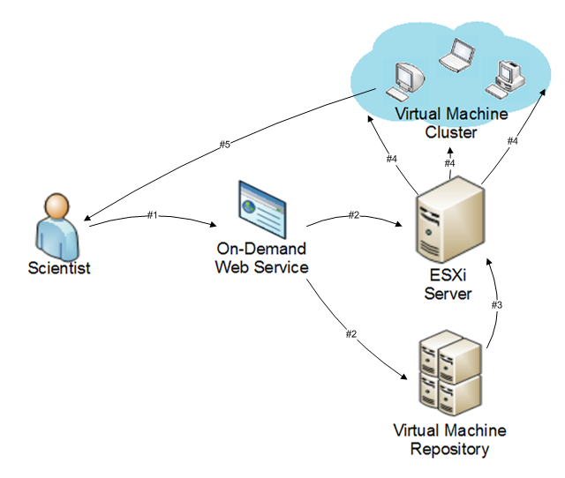
Cyberaide Creative (1): On demand cyberinfrastructure provision

Slide 77
Cyberaide Philosophy:
On Demand and On Access
Users send requirement to Cyberaide creative to demand cyberinfrastructures from Clouds
  a condor cluster, or a computational Grid with Globus Toolkit as a middleware.
Cyberadie creative then constructs a cyberinfrastructure for users
  pre-installs some Grid middleware, like condor, Globus and Cyberaide shell.
Users access the cyberinfrastructure with cyberaide shell as an aide.

Slide 78
Cyberaide Creative (2): use case
The scientist recognizes that the project requires a significant amount of resources to complete in a timely manner. The scientist proceeds to log onto the on-demand web interface and specify the job and required resources.
The web service uses these job requirements to deter- mine the allocation of available resources. Then contacting the ESXi server and virtual machine repository.
The ESXi server obtains the appropriate virtual machine image.
The ESXi server then instantiates the cluster on the cloud identifying a cluster controller for the scientist to interface with. The host controller will be created with a Cyberaide Gridshell and will be exposed directly to the scientist.

Slide 79
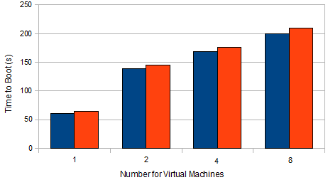
Cyberaide Creative (3): performance
Performance of cyberaide creative.
The blue column is the time for real machine boot
And the red column is the time for virtual machine (virtual cluster) boot.
Up to 8 virtual machine boot simultaneously, the overhead is up to 14%

Slide 80
Cyberaide Abstractions for Clusters, Grids & Clouds
Command line
Portal
Web service
Logic
Cyberaide
Virtual Appliance
Cyberaide Shell
Cyberaide Studio
Cyberaide Creative
Cyberaide OnServ
Cyberaide Service
Cyberaide Farm
Thermal Aware Resource Scheduler
On demand service
provision
On demand
Infrastructure provision
Access resource
job submission
Map/Reduce,
program Grids, clusters & clouds
Clouds
Grids
Clusters

Slide 81
Cyberaide Studio: programming interface for Map/Reduce on Grids
Provides Hadoop similar user interface and management interface
Provide GUI for managing Grid File replicas and transfers
Contains a bundle of client interfaces, libs, SDKs

Slide 82
Cyberaide Abstractions for Clusters, Grids & Clouds
Command line
Portal
Web service
Logic
Cyberaide
Virtual Appliance
Cyberaide Shell
Cyberaide Studio
Cyberaide Creative
Cyberaide OnServ
Cyberaide Service
Cyberaide Farm
Thermal Aware Resource Scheduler
On demand service
provision
On demand
Infrastructure provision
Access resource
job submission
Map/Reduce,
program Grids, clusters & clouds
Clouds
Grids
Clusters

Slide 83
Cyberaide Farm: map/reduce for Grid computing
Cyberaide studio
Cyberaide Farm Libs & SDKs
Production Grids

Slide 84
Cyberaide Farm: implementation
Keep Hadoop programming interfaces, APIs
Use Gfarm as Grid File System, replace Hadoop Distributed File System
Use distributed Grid resources as slaves, replace Hadoop cluster slave nodes
Use globus-job-run as remote job execution, ireplace “ssh” in Hadoop
Cyberaide Farm Libs and SDKs link Hadoop to Gfarm
Hadoop interface
Cyberaide Farm Libs & SDKs
GFarm: a Grid File System

Slide 85
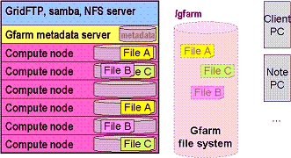
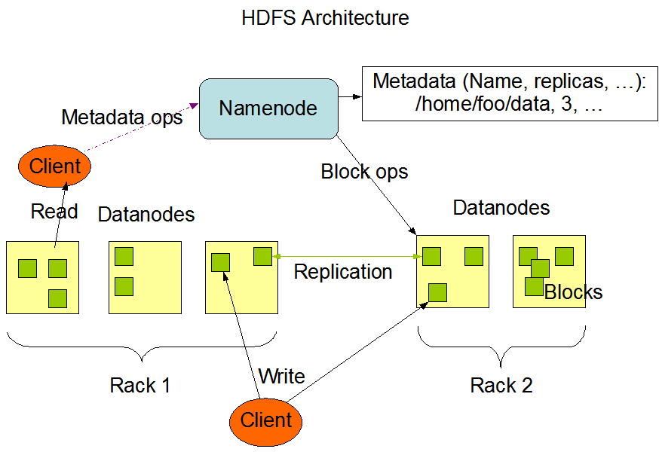
HDFS -> GFarm
GFarm

Slide 86
Cyberaide Abstractions for Clusters, Grids & Clouds
Command line
Portal
Web service
Logic
Cyberaide
Virtual Appliance
Cyberaide Shell
Cyberaide Studio
Cyberaide Creative
Cyberaide OnServ
Cyberaide Service
Cyberaide Farm
Thermal Aware Resource Scheduler
On demand service
provision
On demand
Infrastructure provision
Access resource
job submission
Map/Reduce,
program Grids, clusters & clouds
Clouds
Grids
Clusters

Slide 87
Results
We can do a lot with scheduling algorithms
We are moving towards scheduling virtual machines with green data
To do so we need lots of infrastructure
Using existing middleware makes our mission possible
What we do does not exist in the current middleware

Slide 88
Green Aware Computing

Slide 89
Green Aware Computing
Specialized Hardware

Slide 90
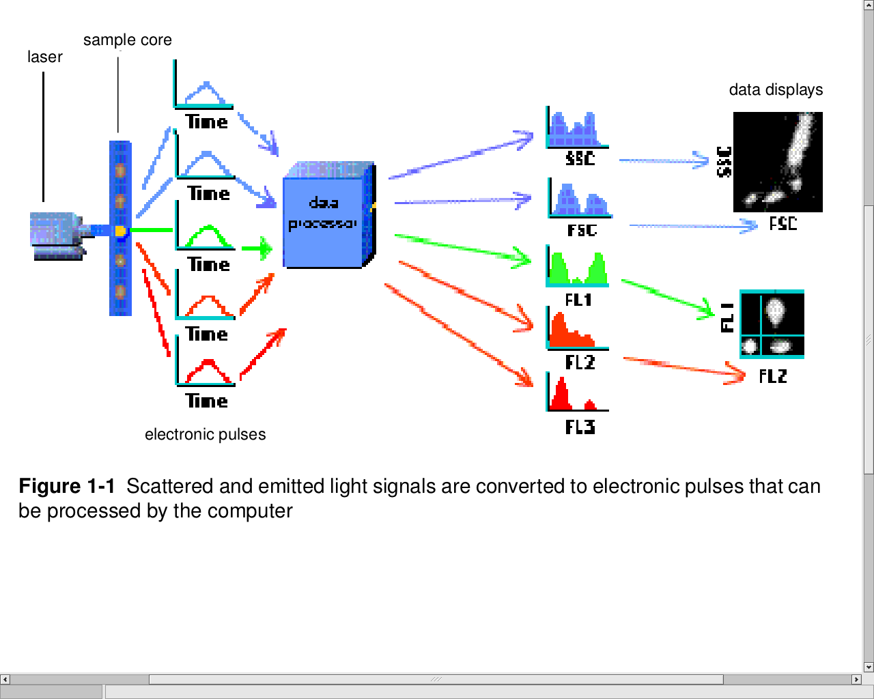
Clustering in flow cytometry
Flow cytometry (FC) is a technology in which optical measurements on fluorescently labeled cells are rapidly acquired (~ 10⁴ s⁻¹), giving datasets in ~20 dimensions and millions of events.
The dimensionality of the data is expected to continue to increase.
Current analysis methods commonly include manual sequential bivariate gating to narrow down populations of interest. This is unsatisfactory for many reasons.
From Introduction to Flow Cytometry:
A Learning Guide, BD Biosciences, 2004

Slide 91
Clustering in flow cytometry
Each cluster is a cell population and is therefore directly relevant biologically.
Although progress has been made recently on clustering FC data, important problems remain. No generally satisfactory software exists for rapidly, accurately, completely, validly (using information theoretic metrics among others), and conveniently identifying clusters, their memberships, and characteristics. An even more important problem lies in extending this across datasets for doing statistical inference between samples.
FC data are difficult to cluster due to high dimensionality and very widely varying cluster size, shape, and density. Additional complications are the very wide dynamic range and negative values (after compensation), precluding simple use of log transformation.
The number of clusters expected in typical blood samples is unknown but probably in the range 100-300. It is not practical to find all clusters using manual gating.

Slide 92
Clustering in flow cytometry
Complementary approaches are likely to be useful for different goals:
  Finding and monitoring cell populations known a priori to be of interest
  Exhaustive search for discovery of unknown cell populations
Current approaches include extensions of fuzzy c-means using scatter matrices and Gath-Geva algorithm, and Gaussian mixture models.
Minimum description length (MDL) and Bayesian information criterion are used for assessing the number of clusters.
Future work will include extending the repertoire of low-dimensional clustering techniques and applying them in exhaustive bottom-up projection clustering, comparing them against subspace clustering techniques, integration of database management of clustering results with visualization, and statistical inference using Bayesian and smoothing and nonparametric approaches.

Slide 93
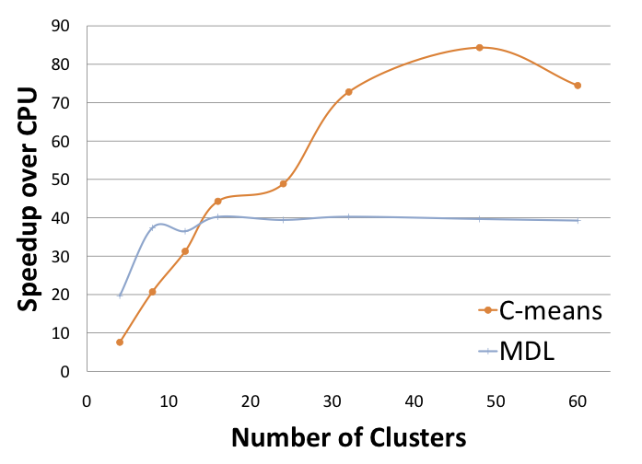
Speedup

Slide 94
Evaluation
A speedup of 40-70 will naturally be significant in reducing power and CO2
E.g. one server with CUDA cards vs.
70 single processors
Current work:
  Energy consumption
  Multi/many core systems vs. CUDA

Slide 95
Green Aware Computing

Slide 96
Changing Behavior
Making you aware of issues
Provide easy monitoring and comparison tools
Provide supporting tools to make it easy to not only do computing based on
  Performance vs. environmental impact

Slide 97
Impact through Easy Resource Utilization/Planning

Slide 98
Microsoft Project
Is used for planning a project.
Familiar to many
Allows resource planing
Workflow – a set of operations which contain the following:
  Task – a unit of work.
  Dependency – among two tasks, used to specify ordering.
  Resource – people or machines used to carry out work.
  Assignment /Mapping – of resources to tasks, to execute the workflow.
    This makes it a job

Slide 99
Features
Microsoft Project: Familiarity, Usability, Productivity
  Task Table in Spreadsheet Format
  Easy Navigation & Viewing
Resource Mapping -> Jobs
Integration with TeraGrid
  through CoG Kit to TeraGrid
  We have are developing a Grid mediator (e.g. a Super Gram Service)

Slide 100
Result
Better resource planning can reduce environmental impact

Slide 101
Impact through Easy Monitoring

Slide 102
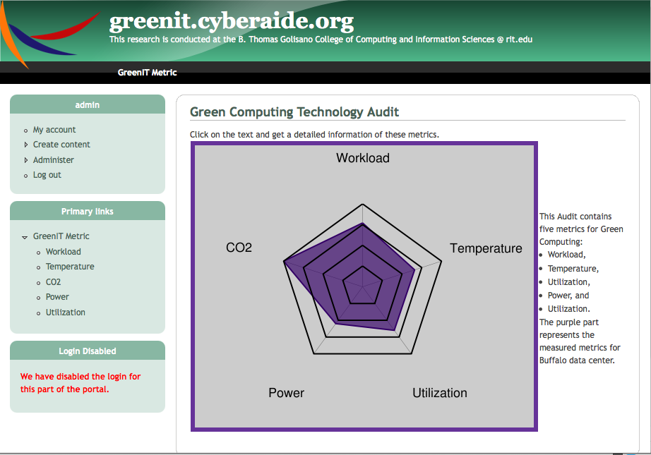
GreenIT Portal

Slide 103
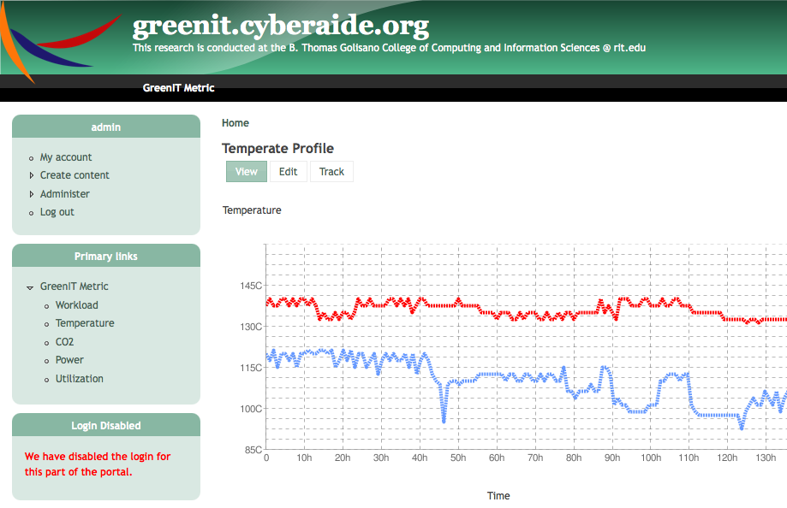
GreenIT Portal: Temperature Profile

Slide 104
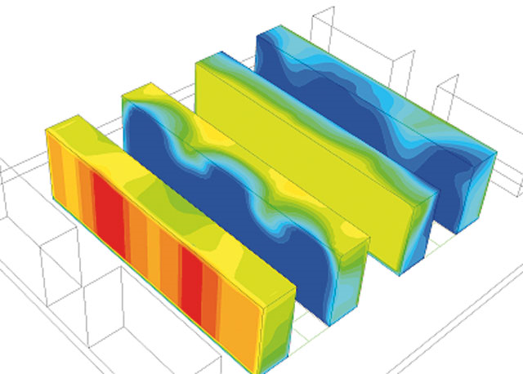
GreenIT Portal: Heat Map

Slide 105
GreenIT Portal: Proxies

Slide 106
Result
Monitoring helps raising awareness
Automatic alarms and feedback
have immediate impact

Slide 107
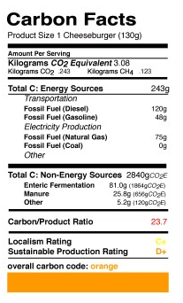
Cheeseburger Footprint
http://openthefuture.com/cheeseburger_CF.html

Slide 108
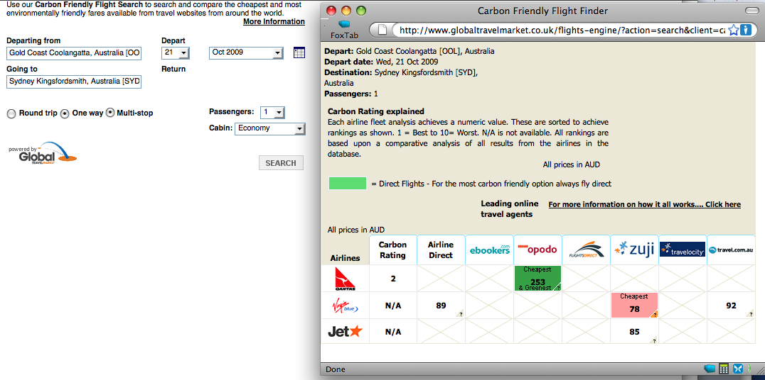
Price vs. Impact

Slide 109
FutureGrid & GreenIT
FutureGrid allows us to experiment with environmental sensors
We can use OS & Hardware sensors
HW sensors need to be considered as we do not know which OS and environment the user will be using on the system.
Normal users do typically do not have access to this, so we will provide this as a service
We plan to do dynamic provisioning based on environmental factors.
GreenIT is just one Application domain

Slide 110
More information
Futuregrid.org
Cyberaide.org

Slide 111
END

Slide 112
Backup slides in case questions occur

Slide 113
Thermal Based Task Scheduling
The main intention of these algorithms is to reduce the heat generated by IT equipments.
This is done by Thermal Based Task Scheduling.
So the tasks are assigned to the nodes in the data center based on temperature.

Slide 114
Thermal Based Task Scheduling
1. Uniform Outlet Profile: This approach is based on the inlet temperature of each computing node. The algorithm assigns more tasks to the node that have a low inlet temperature and fewer tasks to nodes that have high inlet temperature. By this a uniform outlet temperature distribution is achieved.
2. Minimal Computing Energy: In this approach all the tasks are given to the active servers and the idle servers are turned off.
3. Uniform Task: With Uniform Task scheme all nodes are assigned same amount of tasks i.e. uniform workload.

Slide 115
Thermal Based Task Scheduling
Thermal based aware task scheduling to solve this problem which is called minimizing the peak inlet temperature within a data center through task assignment (MPIT-TA).
This shows how to distribute an incoming task among the servers in order to maximize the supply temperature while respecting the redline temperatures and thus minimize the cooling requirement.
MPIT-TA problem takes the heat recirculation in to consideration.

Slide 116
The Other Approach
The other way to reduce the energy used by data centers is to reduce the energy used by the IT equipments.
This can be achieved through Virtualization.

Slide 117
Virtualization
Virtualization refers to having an abstraction of software from the underlying hardware implementation.
Virtualization is a form of server consolidation.
The process of Virtualization encapsulates the operating system and application in to a Virtual Machine (VM).

Slide 118
Why Virtualization?
On an average in a data centers the servers are utilized below 5% of their capacity.
The energy consumption of server is not of linear function to the server's utilization. For example an idle server can consume more 40% of the energy consumed by the full utilized server.
Also at 10% utilization server used 173 watts of power and at 100% processor utilization server used 276 watts.
Thus there is much scope to combine the workloads of the server so that active server is utilized more than 50% .
And if the idle or underutilized server are switched off, the total energy saved will be quite large.

Slide 119
Virtualization Technologies
Hypervisor Virtual machine
  Hypervisor is software that is capable of hosting multiple virtual machines. Hypervisor software allows operating systems and applications to run on a server shared with number of other operating systems and applications. Hypervisors account for 90% of the virtual machines deployment on Linux.
Aggregated Virtualization
  This technology enables distributed computing resources such as processors, memory and input/output processors to be aggregated for use by a single instance of an operating system.
Shared Operating System Virtualization
  By Shared Operating System the operation of multiple applications can be done using single instance of an operating system and resources are dynamically allocated to the applications such that it does not affect the operation of other applications.

Slide 120
Virtual Machines
Full Virtualization: Virtual machines based on full virtualization feature a Virtualization layer that permits multiple operating system instances to coexist on a single server. The operating systems can also be incompatible. But performance is affected because of the mediating layer. Also there cannot be cooperative resource sharing between the 2 VMs running on the same server. VMware servers are the most popular full Virtualization based VMs.
Paravirtualization: In this case the virtualized operating systems instances are modified to be aware of the Virtualization layer. It also allows for memory sharing between the 2 VMs running on the single server.

Slide 121
Cyberaide JavaScript:
A JavaScript Commodity Grid Kit
Gregor von Laszewski
laszewski@gmail.com, (585) 298 5285
Fugang Wang
http://www.cyberaide.org

Slide 122
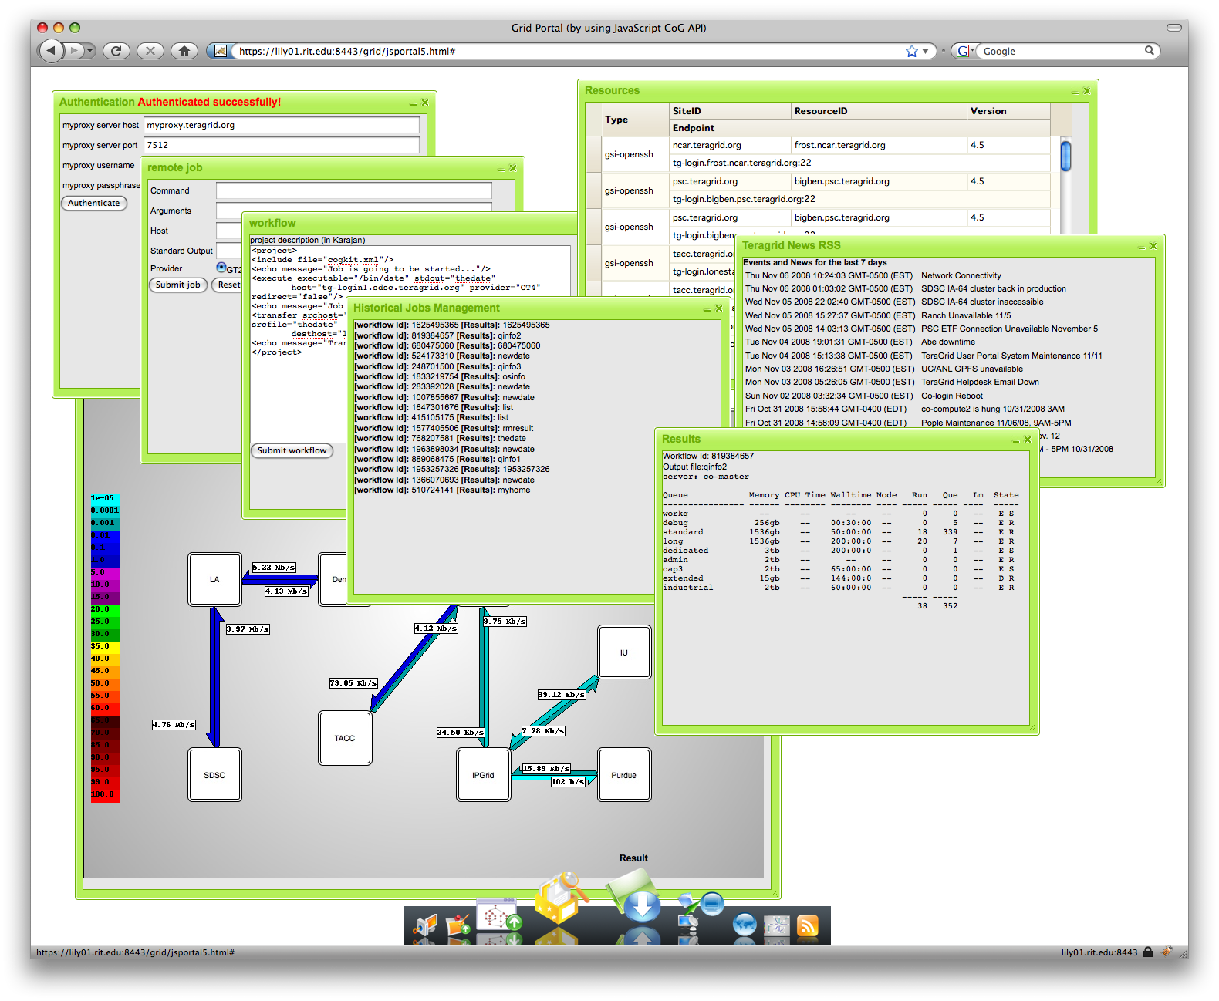
Use the JavaScript API to interact with Grid
The usage of the Cyberaide JavaScript toolkit is shown through code skeletons
Put the skeletons into your code and modify them
We developed a Teragrid portal interface that mimics a desktop

Slide 123

Job Submission
How to submit a job to remote machine to execute?
// define the job object
// make sure to use the attributes keys specified here
var execObj = new org.cyberaide.js.jsExecutable();
execObj.setAttribute("cmd", "/bin/ls");
execObj.setAttribute("arg", "-l");
execObj.setAttribute(”host", 'REMOTEHOST');
execObj.setAttribute("stdout", "lsoutput");
execObj.setAttribute("provider", "GT4");
// construct a cyberaide object by pointing to the
// agent service's url
var cyberaide = new org.cyberaide.js.jsUtil(url);

Slide 124
Job Submission (cont.)
// construct a remote job through the executable
// object
var job= cyberaide.constructRemoteJob(execObj);
// submit the job by specifying constructed job
// specification, callback function.
// you must be in authenticated status and in a valid
// session.
cyberaide.submit(job, submitResponse);
// submitResponse is the callback function handler

Slide 125
Job Submission (cont.)
// callback function of submission
function submitResponse(ret) {
if(ret > 0){
//job submitted and job id returned.
//your job id is 'ret', in Number format
//do something here.
} else {
//job submission failed.
//do something here.
}
}

Slide 126
The Portal: Mimics a Desktop

Slide 127
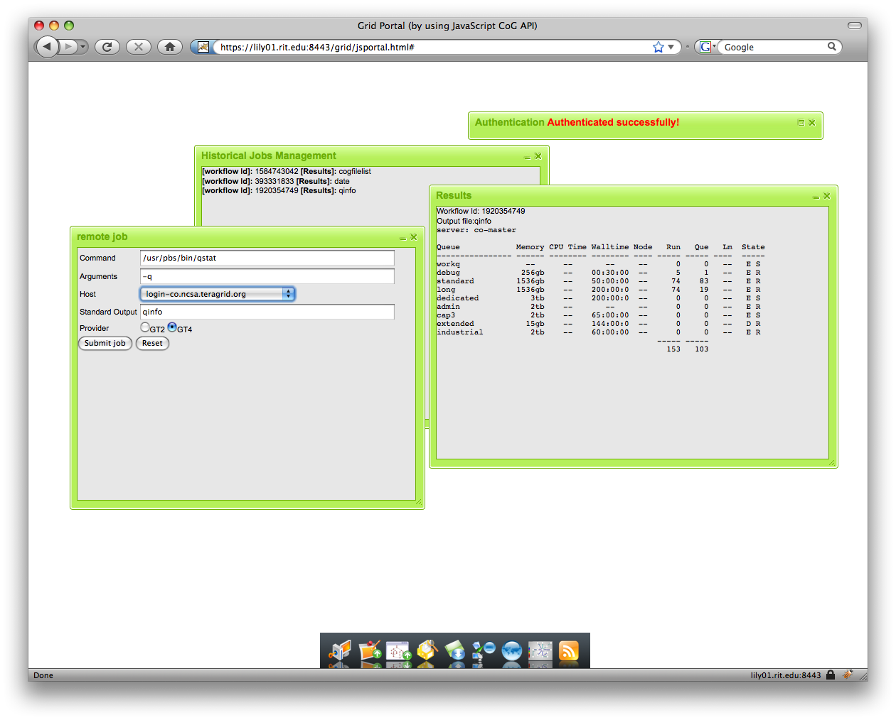
Job Management

Slide 128
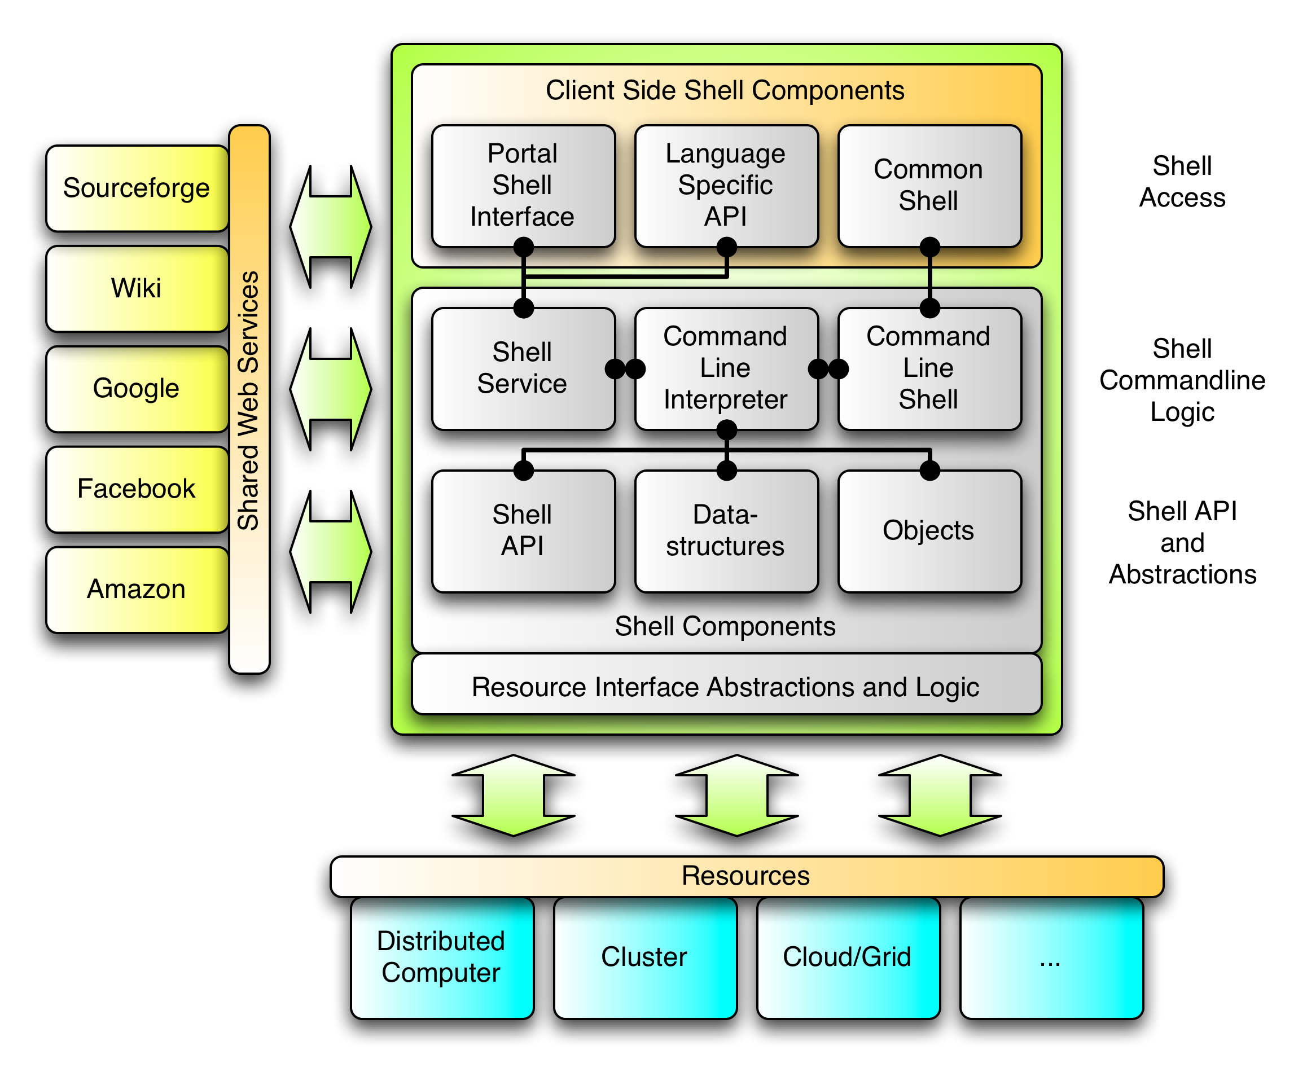
Cyberaide.org

