Slide 1
Investigation of Data Locality in MapReduce
Zhenhua Guo, Geoffrey Fox, Mo Zhou

Slide 2
Outline
Introduction
Analysis of Data Locality
Optimality of Data Locality
Experiments
Conclusions

Slide 3
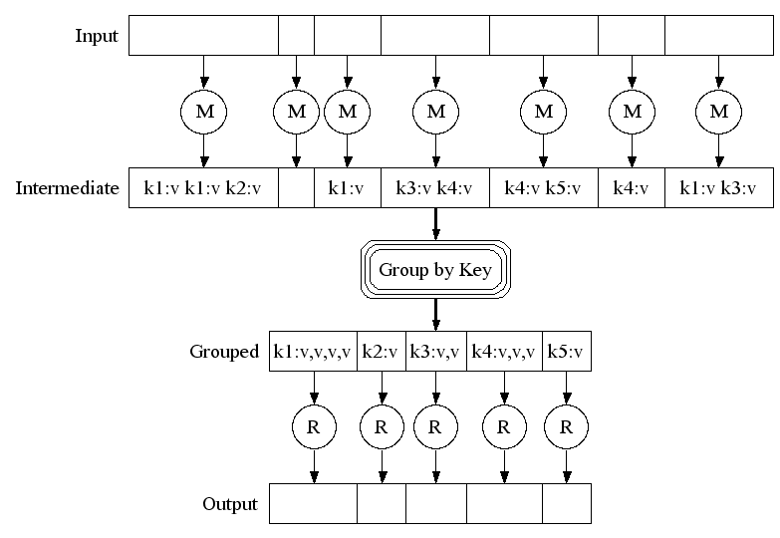
MapReduce Execution Overview
Google File System
Input file
block 0
1
2
Read input data Data locality
map tasks
Stored locally
Shuffle between map tasks and reduce tasks
reduce tasks
Stored in GFS
Google File System

Slide 4
Hadoop Implementation
Metadata mgmt.
Task scheduler
Storage: HDFS
- Files are split into blocks.
- Each block has replicas.
- All blocks are managed by central name node.
HDFS
Name node
MapReduce
Job tracker
Replication mgmt.
Fault tolerance
Block placement
……
Compute: MapReduce
- Each node has map and reduce slots - Tasks are scheduled to task slots
# of tasks <= # of slots
Hadoop
Hadoop
……
Operating System
Operating System
task slot
data block
Worker node 1
Worker node N

Slide 5
Data Locality
“Distance” between compute and data
Different levels: node-level, rack-level, etc.
For data-intensive computing, data locality is important
Energy
Network traffic
Research goals
Evaluate how system factors impact data locality and theoretically deduce their relationship
Analyze state-of-the-art scheduling algorithms in MapReduce
Propose a scheduling algorithm achieving optimal data locality
Mainly theoretical study

Slide 6
Outline
Introduction
Analysis of Data Locality
Optimality of Data Locality
Experiments
Conclusions

Slide 7
The Goodness of Data Locality (1/3)
Theoretical deduction of relationship between system factors and data locality
Symbol | Description
N | the number of nodes
S | the number of map slots on each node
I | the ratio of idle slots
T | the number of tasks to be executed
C | replication factor
IS | the number of idle map slots (N * S * I)
p(k, T) | the probability that k out of T tasks can gain data locality
goodness of data locality | the percent of map tasks that gain node-level data locality
The goodness of data locality depends on scheduling strategy, dist. of input, resource availability, etc.

Slide 8
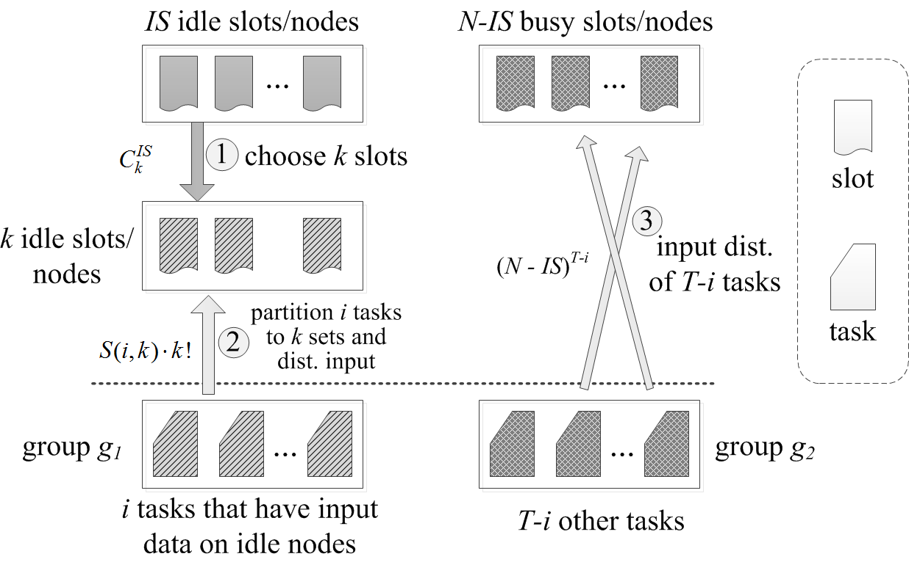
The Goodness of Data Locality (2/3)
Hadoop scheduling is analyzed
data are randomly placed across nodes
Idle slots are randomly chosen from all slots
Idle and busy slots
k out of T tasks can achieve data locality
Split tasks into two groups

Slide 9
The Goodness of Data Locality (3/3)
For simplicity
Replication factor C is 1
# of slots on each node S is 1
T tasks, N nodes, IS idle slots
The prob. that k out of T tasks gain data locality
The expectation
The goodness of data locality
Working on the general cases where C and S are not 1

Slide 10
Outline
Introduction and Motivation
Analysis of Data Locality
Optimality of Data Locality (Scheduling)
Experiments
Conclusions

Slide 11
Non-optimality of default Hadoop sched.
Problem: given a set of tasks and a set of idle slots, assign tasks to idle slots
Hadoop schedules tasks one by one
Consider one idle slot each time
Given an idle slot, schedule the task that yields the “best” data locality(from task queue)
Achieve local optimum; global optimum is not guaranteed
Each task is scheduled without considering its impact on other tasks

Slide 12
Optimal Data Locality
All idle slots need to be considered at once to achieve global optimum
We propose an algorithm lsap-sched which yields optimal data locality
Reformulate the problem
Use a cost matrix to capture data locality information
Find a similar mathematical problem: Linear Sum Assignment Problem (LSAP)
Convert the scheduling problem to LSAP (not directly mapped)
Prove the optimality

Slide 13
Optimal Data Locality – Reformulation
m idle map slots {s₁,…s_{m}} and n tasks {T₁,…T_{n}}
Construct a cost matrix C
Cell C_{i,j} is the incurred cost if task T_{i} is assigned to idle slot s_{j} 0: if compute and data are co-located 1: otherwise * Reflects data locality
Represent task assignment with a function Φ
Given task i, Φ(i) is the slot where it is assigned
Cost sum:
Find an assignment to minimize C_{sum}
 | s₁ | s₂ | … | s_{m-1} | s_{m}
T₁ | 1 | 1 | … | 0 | 0
T₂ | 0 | 1 | … | 0 | 1
… | … | … | … | … | …
T_{n-1} | 0 | 1 | … | 0 | 0
T_{n} | 1 | 0 | … | 0 | 1

Slide 14
Optimal Data Locality – LSAP
LSAP: matrix C must be square
When a cost matrix C is not square, cannot apply LSAP
Solution 1: shrink C to a square matrix by removing rows/columns û
Solution 2: expand C to a square matrix ü
If n < m, create m-n dummy tasks, and use constant cost 1
Apply LSAP, and filter out the assignment of dummy tasks
If n > m, create n-m dummy slots, and use constant cost 1
Apply LSAP, and filter our the tasks assigned to dummy slots
 | s₁ | s₂ | … | s_{m-1} | s_{m}
T₁ | 1 | 1 | 0 | 0 | 0
… | … | … | … | … | …
T_{n} | 0 | 1 | 1 | 0 | 0
T_{n+1} | 1 | 1 | 1 | 1 | 1
… | … | … | … | … | …
T_{m} | 1 | 1 | 1 | 1 | 0
 | s₁ | … | s_{m} | s_{m+1} | … | s_{n}
T₁ | 1 | … | 0 | 1 | … | 1
… | … | … | … | … | … | …
T_{i} | 0 | … | 1 | 1 | … | 1
T_{i+1} | 1 | … | 1 | 1 | … | 1
… | … | … | … | … | … | …
T_{n} | 1 | … | 0 | 1 | … | 1
dummy tasks
(a) n < m
(b) n > m
dummy slots
Notes:
For solution 1, need to decide which rows/columns to purge without impacting the optimality.
Linear Sum Assignment Problem: Given n items and n workers, the assignment of an item to a worker incurs a known cost. Each item is assigned to one worker and each worker has one item assigned. Find the assignment that minimizes the sum of cost.

Slide 15
Optimal Data Locality – Proof
Do our transformations preserve optimality? Yes!
Assume LSAP algorithms give optimal assignments (for square matrices)
Proof sketch (by contradiction):
The assignment function found by lsap-sched is φ-lsap. Its cost sum is C_{sum}(φ-lsap)
The total assignment cost given by LSAP algorithms for the expanded square matrix is C_{sum}(φ-lsap) + |n - m| The key point is that the total assignment cost of dummy tasks is |n-m| no matter where they are assigned.
Assume that φ-lsap is not optimal. Another function φ-opt gives smaller assignment cost. C_{sum}(φ-opt) < C_{sum}(φ-lsap).
We extend function φ-opt, cost sum is C_{sum}(φ-opt) + |n-m| C_{sum}(φ-opt) < C_{sum}(φ-lsap) ⇨ C_{sum}(φ-opt) + |n-m| < C_{sum}(φ-lsap) + |n-m| ⇨ The solution given by LSAP algorithm is not optimal. ⇨ This contradicts our assumption

Slide 16
Outline
Introduction
Analysis of Data Locality
Optimality of Data Locality
Experiments
Conclusions

Slide 17
Experiment – The Goodness of DL
Measure the relationship between system factors and data locality and verify our simulation
In each test, one factor is varied while others are fixed.
System configuration
Parameter | Default value | Range (used when a factor is tested) | Env. in Delay Sched. Paper
num. of nodes | 1000 | [300, 5000]; step 100 | 1500
Num. of slots per node | 2 | [1, 32]; step 1 | 2
num. of tasks | 300 | (2⁰, 2¹, …, 2¹³) | (2⁴, …, 2¹³)
ratio of idle slots | 0.1 | [0.01, 1]; step 0.02 | 0.01
replication factor | 3 | [1, 20]; step 1 | 3

Slide 18
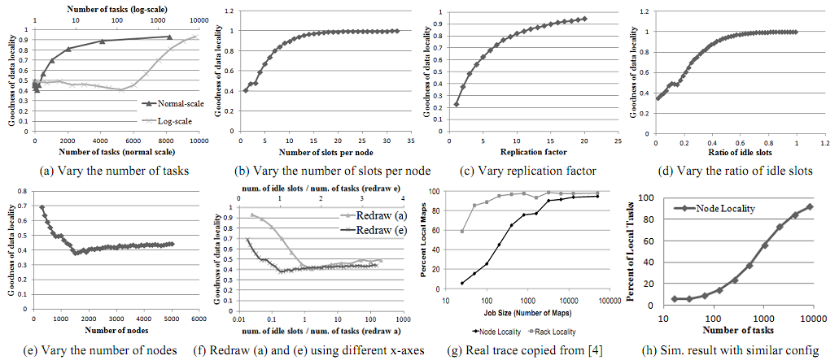
Experiment – The Goodness of DL
y-axis: the ratio of map tasks that achieve data locality.
better
Number of tasks (log scale)
(a) Number of tasks (normal scale)
(b) Number of slots per node
(c) Replication factor
(d) Ratio of idle slots
Num. of idle slots / num. of tasks (redraw e)
(e) Number of nodes
(f) Num. of idle slots / num. of tasks (redraw a and e)
(g) Real Trace*
(h) Simu. Results w/ similar config.
relevance of simulation
* M. Zaharia, et al, “Delay scheduling: a simple technique for achieving locality and fairness in cluster scheduling,” EuroSys 2010

Slide 19
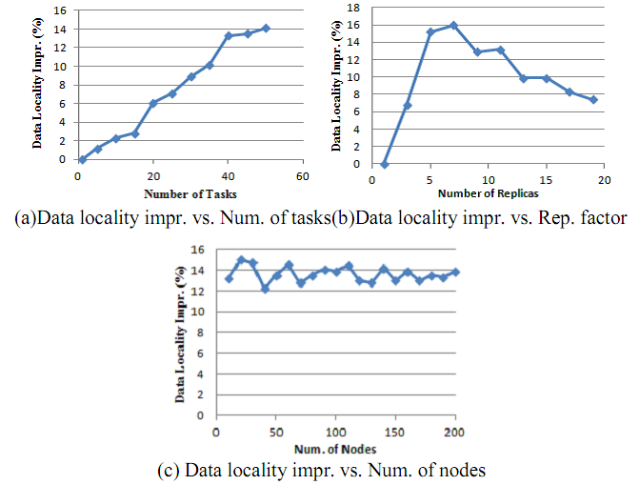
Experiment – lsap-sched
Measure the performance advantage of our proposed algorithm
y-axis: data locality improvement (%) over native Hadoop
# of tasks ≤ # of idle slot*
# of nodes: 100
# of idle slots: 50
Ratio of idle slots: 50%
Vary
# of tasks
replication factor
# of nodes
Notes:
Randomly generate tasks.
For (a) and (b), 1 slot per node. For (c), 4 slots per node.
For (a), rep factor is 5. For (c), rep factor is 1.

Slide 20
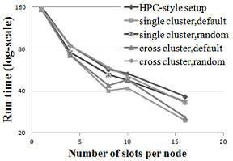
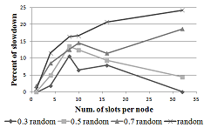
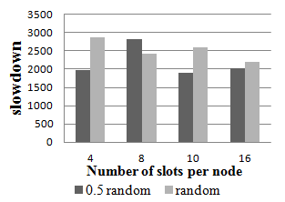
Experiment – Measurement on FutureGrid
Measure the impact of DL on job exec.
Dev. a random scheduler. Parameter randomness
0: degenerates to default sched.
1: randomly schedule all tasks
0.5: half random, half default sched.
Compare efficiency on FutureGrid clusters
Cross-cluster performance
Single-cluster performance
1-10Gbps
(a) with high-speed cross-cluster net
1-10Mbps
(b) with drastically heterogeneous net
Notes:
Application: input-sink. IO-intensive, read input data and throw them away.
Cross-cluster: 5 nodes in Hotel, and 5 nodes in India. Each node has 8 cores.
HPC-style: 10 nodes in Hotel (HDFS), and 10 nodes in India (MapReduce)
ViNe 1 – 10Mbps cross-cluster bandwidth

Slide 21
Conclusions
Hadoop scheduling favors data locality
Deduced closed-form formulas to depict the relationship between system factors and data locality
Hadoop scheduling is not optimal
We propose a new algorithm yielding optimal data locality
Conducted experiments to demonstrate the effectiveness.
More practical evaluation is part of future work

Slide 22
Questions?

Slide 23
Backup slides

Slide 24
MapReduce Model
Input & Output: a set of key/value pairs
Two primitive operations
map: (k₁,v₁) → list(k₂,v₂)
reduce: (k₂,list(v₂)) → list(k₃,v₃)
Each map operation processes one input key/value pair and produces a set of key/value pairs
Each reduce operation
Merges all intermediate values (produced by map ops) for a particular key
Produce final key/value pairs
Operations are organized into tasks
Map tasks: apply map operation to a set of key/value pairs
Reduce tasks: apply reduce operation to intermediate key/value pairs
Each MapReduce job comprises a set of map and reduce (optional) tasks.
Use Google File System to store data
Optimized for large files and write-once-read-many access patterns
HDFS is an open source implementation

