Slide 1
Designing Efficient Programming Environment Toolkits for Big Data: Integrating Parallel and Distributed Computing
Ph.D. Thesis Proposal
Supun Kamburugamuve
Advisor: Prof. Geoffrey Fox
Committee: Prof. Judy Qiu, Prof. Martin Swany, Prof. Minje Kim, Prof. Ryan Newton

Slide 2
Problem Statement
Design a dataflow event-driven framework running across application and geographic domains. Use interoperable common abstractions but multiple polymorphic implementations.

Slide 3

Motivation
Trillion Devices?

Slide 4
Motivation
Explosion of Internet of Things and Cloud Computing
  Clouds will continue to grow and will include more use cases
Edge Computing is adding an additional dimension to Cloud Computing
  Device --- Fog --- Cloud
Event driven computing is becoming dominant
  Signal generated by a Sensor is an edge event
  Accessing a HPC linear algebra function could be event driven and replace traditional libraries by FaaS
Services will be packaged as a powerful Function as a Service FaaS
Applications will span from Edge to Multiple Clouds

Slide 5
Motivation
Results from GraphX Paper
Gonzales et al. 2014
PR 20 Iterations | Cores | Twitter_rv | Uk_2007_05
Spark | 128 | 857s | 1759s
Giraph | 128 | 596s | 1235s
GraphLab | 128 | 249s | 833s
GraphX | 128 | 419s | 462s
Laptop | 1 | 110s | 256s
Connectivity | Cores | Twitter_rv | Uk_2007_05
Spark | 128 | 1784s | 8000+
Giraph | 128 | 200s | 8000+
GraphLab | 128 | 242s | 714s
GraphX | 128 | 251s | 800s
Laptop | 1 | 15s | 30s
The serial implementation on Laptop ran much better
Talk by Frank McSherry (Microsoft Naiad architect)
Too simple programming models?
Sub performing implementations?
https://www.youtube.com/watch?v=OcoYFFVNp1o

Slide 6
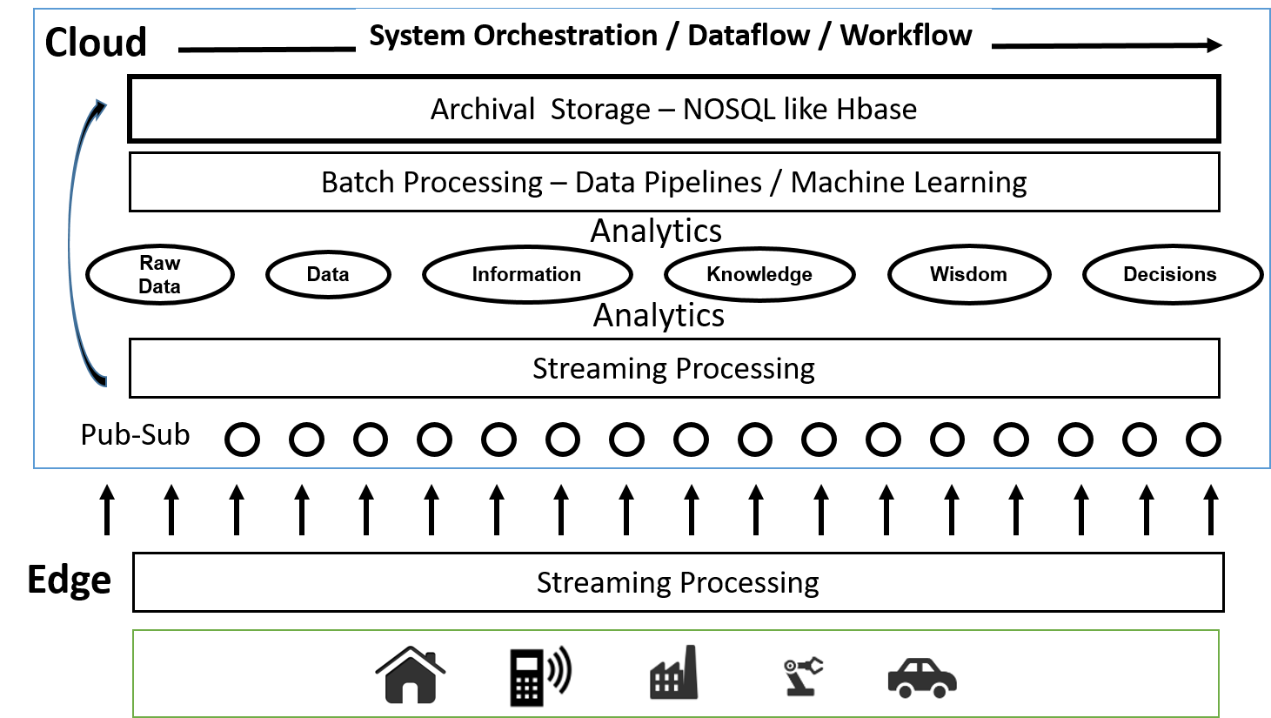
Cloud Architecture

Slide 7
Programming Toolkit for BigData
Tackle big data with common abstractions but different implementations
Modular approach for building a runtime with different components
Current big data systems are monolithic
  Everything coupled together
  Hard to intergrade different functions
Components can be switched from Cloud to HPC
  RDMA Communications
  TCP Communications
Ability to support big data analytics as well as applications
  Function as a service (FaaS)

Slide 8
Big Data Applications
Big Data
  Large data
  Heterogeneous sources
    Unstructured data in raw storage
    Semi-structured data in NoSQL databases
    Raw streaming data
Important characteristics affecting processing requirements
  Data can be too big to load into even a large cluster
  Data may not be load balanced
  Streaming data needs to be analyzed before storing to disk

Slide 9
Big Data Applications
Streaming applications
  High rate of data
  Low latency processing requirements
  Simple queries to complex online analytics
Data pipelines
  Raw data or semi structured data in NoSQL databases
  Extract, transform and load (ETL) operations
Machine learning
  Mostly deal with curated data
  Complex algebraic operations
  Iterative computations with tight synchronizations

Slide 10
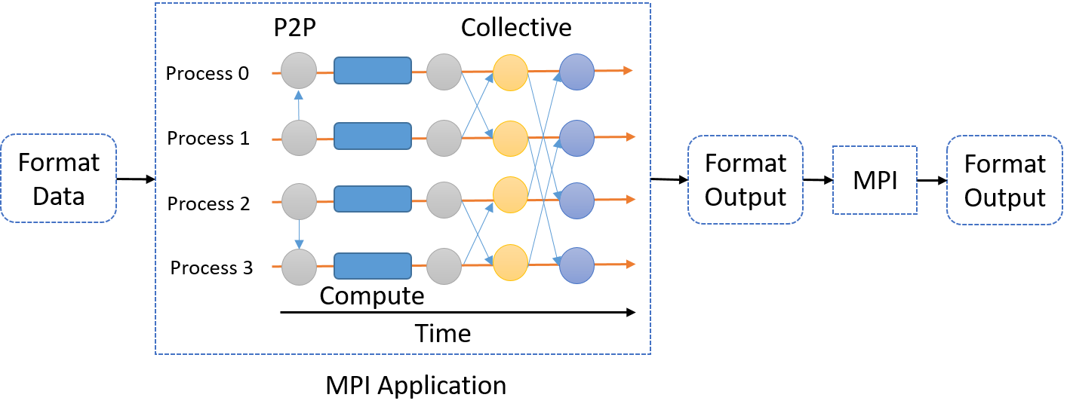
MPI Applications
Tightly synchronized parallel operations
Efficient communications (µs latency)
  Use of advanced hardware
In place communications and computations
  Process scope state
HPC applications are orchestrated by workflow engines
Can expect curated, balanced data
User is required to manage threads, caches, NUMA boundaries
HPC application with components written in MPI and orchestrated by a workflow engine

Slide 11
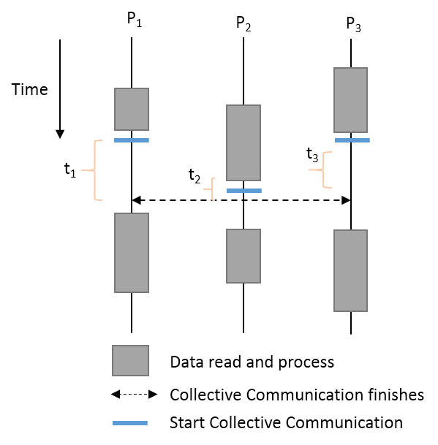
Load Imbalance & Velocity
Data in raw form are not load balanced
  HDFS, NoSQL, Streaming data
MPI style tightly synchronized operations need sophisticated load balancing?
Asynchronous Many Task Runtime suitable?

Slide 12
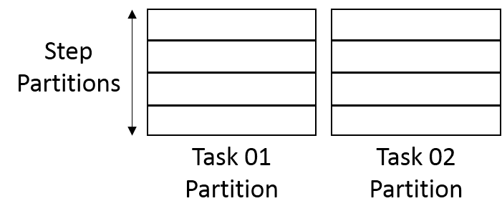
Data Partitioning
Cannot process the complete data set in memory
Data partitioned across the tasks
  Each task partitions the data further
Need to program specifically to handle such partitioning
Sometimes need to align partitions of different datasets
  Supported in past by HPF but not now?
Need this type of partitioning to overlap computations and IO

Slide 13
Dataflow Applications
S
W
G
Model a computation as a graph
  Nodes does computations - Task
  Edges communications
A computation is activated when its input data dependencies are satisfied
  Data driven
Asynchronous execution of tasks
Tasks can only communicate through their input and output edges
  To preserve asynchronous nature of computation
  Otherwise become MPI
User focus on application logic rather than low level details of the computer architecture
Logical Graph
W
S
W
G
S
W
Execution Graph

Slide 14
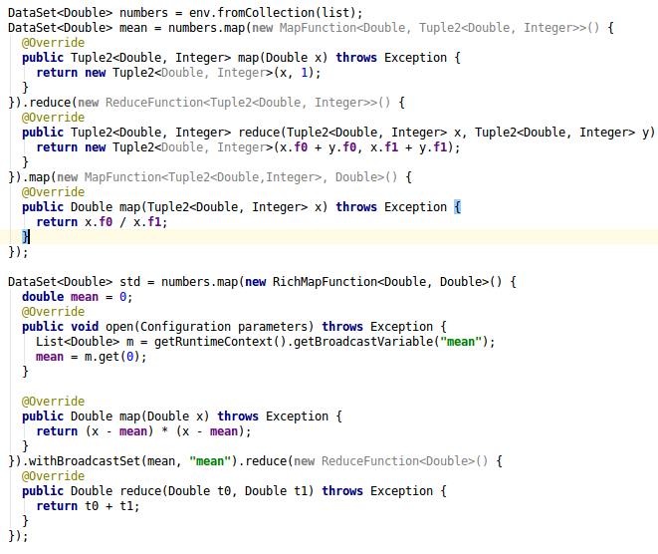
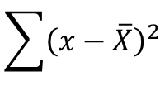
Dataflow
Calculate
$$\sum{{\left(x−\overline{X}\right)}^{2}}$$
Numbers
Map
Reduce
Map
Mean
Broadcast
Map
Reduce
Mean
Flink Program

Slide 15
Calculate
$$\sum{{\left(x−\overline{X}\right)}^{2}}$$
MPI
List<Double> numbers = loadPartition(rank);
double localAverage = 0, std = 0, globalAverage = 0;
for (int i = 0; i < numbers.size(); i++) {
localAverage += numbers.get(i);
}
localAverage = localAverage / numbers.size();
MPI.allReduce(globalAverage, localAverage, SUM);
globalAverage /= worldSize;
for (int i = 0; i < numbers.size(); i++) {
std += (globalAverage - numbers.get(i)) * (globalAverage - numbers.get(i));
}
This simple program can get complicated when used with threads

Slide 16
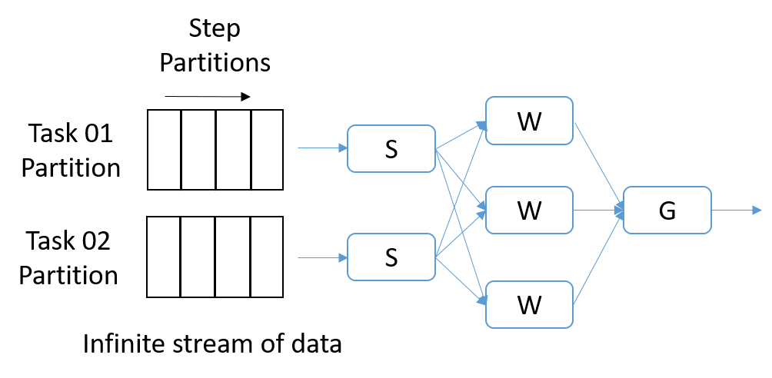
Streaming - Dataflow Applications
Streaming is a natural fit for dataflow
Partitions of the data is called Streams
Streams are unbounded, ordered data tuples
Order of events important
Group data into windows
  Count based
  Time based
Types of windows
  Sliding Windows
  Tumbling Windows
Continuously Executing Graph

Slide 17
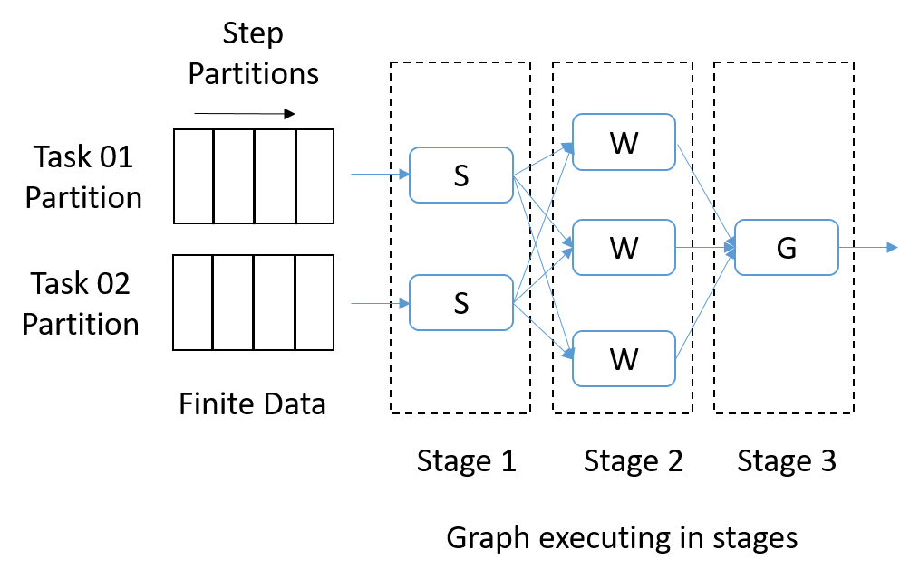
Data Pipelines – Dataflow Applications
Similar to streaming applications
Finite amount of data
  Partitioned hierarchically similar to streaming
Mostly pleasingly parallel, but some form of communications can be required
  Reduce, Join

Slide 18
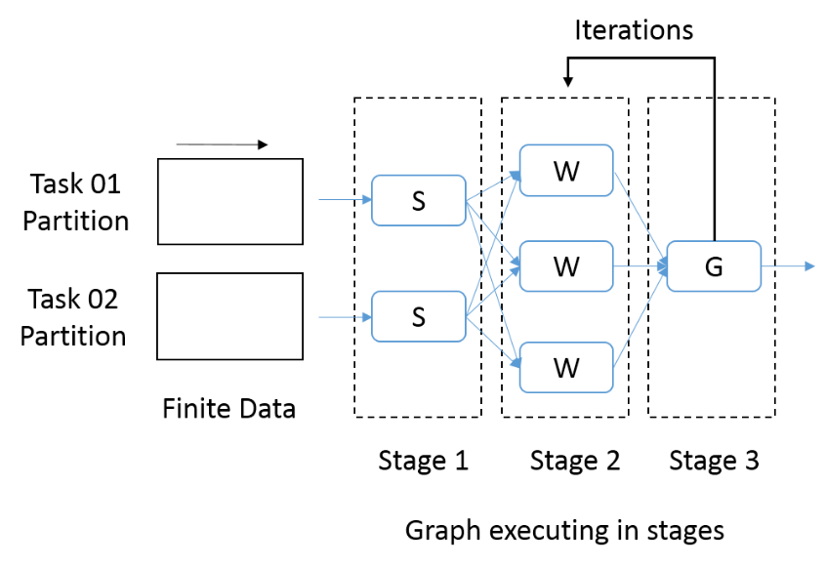
Machine Learning – Dataflow Applications
Need fine grain control of the graph to express complex operations
Iterative computations
Model vs Data, only communicate model
Complex communication operations such as AllReduce
Harp has shown value of Map-Collective for Machine Learning and how to get good performance.
We focus on making programming environment a toolkit with common abstractions but different implementations that reduces to Harp for ML

Slide 19
Data Transformation API
The operators in API define the computation as well how nodes are connected
  For example lets take map and reduce operators and our initial data set is A
  Map function produces a distributed dataset B by applying the user defined operator on each partition of A. If A had N partitions, B can contain N elements.
  The Reduce function is applied on B, producing a data set with a single partition.
A
Map
B
Reduce
C
Logical graph
a_1
Map 1
b_1
B = A.map() {
User defined code to execute on a partition of A
};
C = B.reduce() {
User defined code to reduce two elements in B
}
C
Reduce
a_n
Map n
b_n
Execution graph

Slide 20
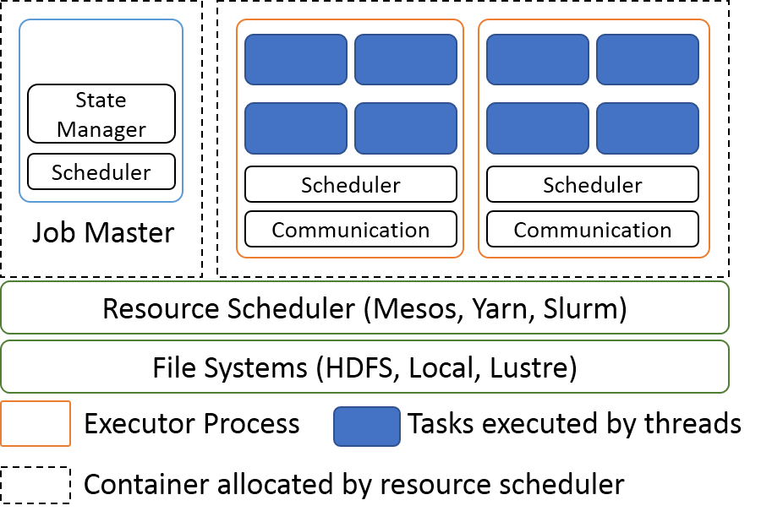
Dataflow Runtime General Architecture
Resource scheduler allocates resources
A Master program controls the deployment and monitoring of the application
A centralized scheduler or distributed scheduler schedules the tasks of the dataflow graph
An executor process runs the tasks using threads
A communication layer manages the inter-process and inter-node communications
User Graph API
Execution Graph
Executors
State
DSM, Local
Task Scheduler
Network Communication
Resource Scheduling (Yarn, Mesos)
File Systems (HDFS, Local, Lustre)
Layered Architecture
Process View of Dataflow Engine

Slide 21
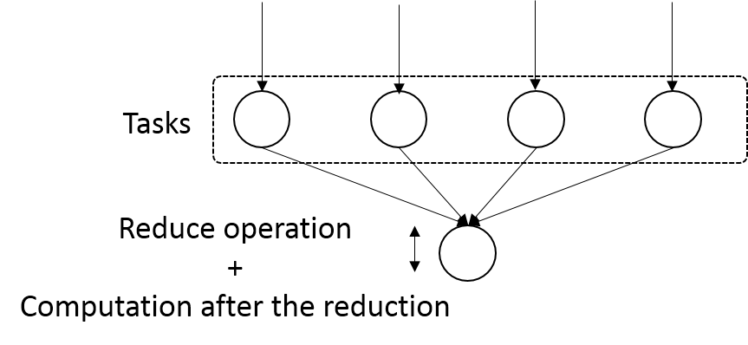
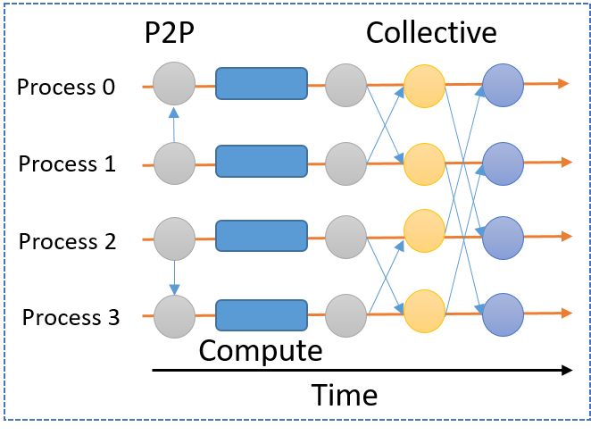
Communications
P2P Communications
Collective Communications
  Can involve more than 2 parties
  Can be optimized with algorithms for latency and throughput
MPI Communications
  In place communications
  Asynchronous and Synchronous
  One sided communications
Dataflow
  A computation in a task activated upon its input dependencies are satisfied
  A Task communicates after it finishes computation
Dataflow Communications
MPI Communications

Slide 22
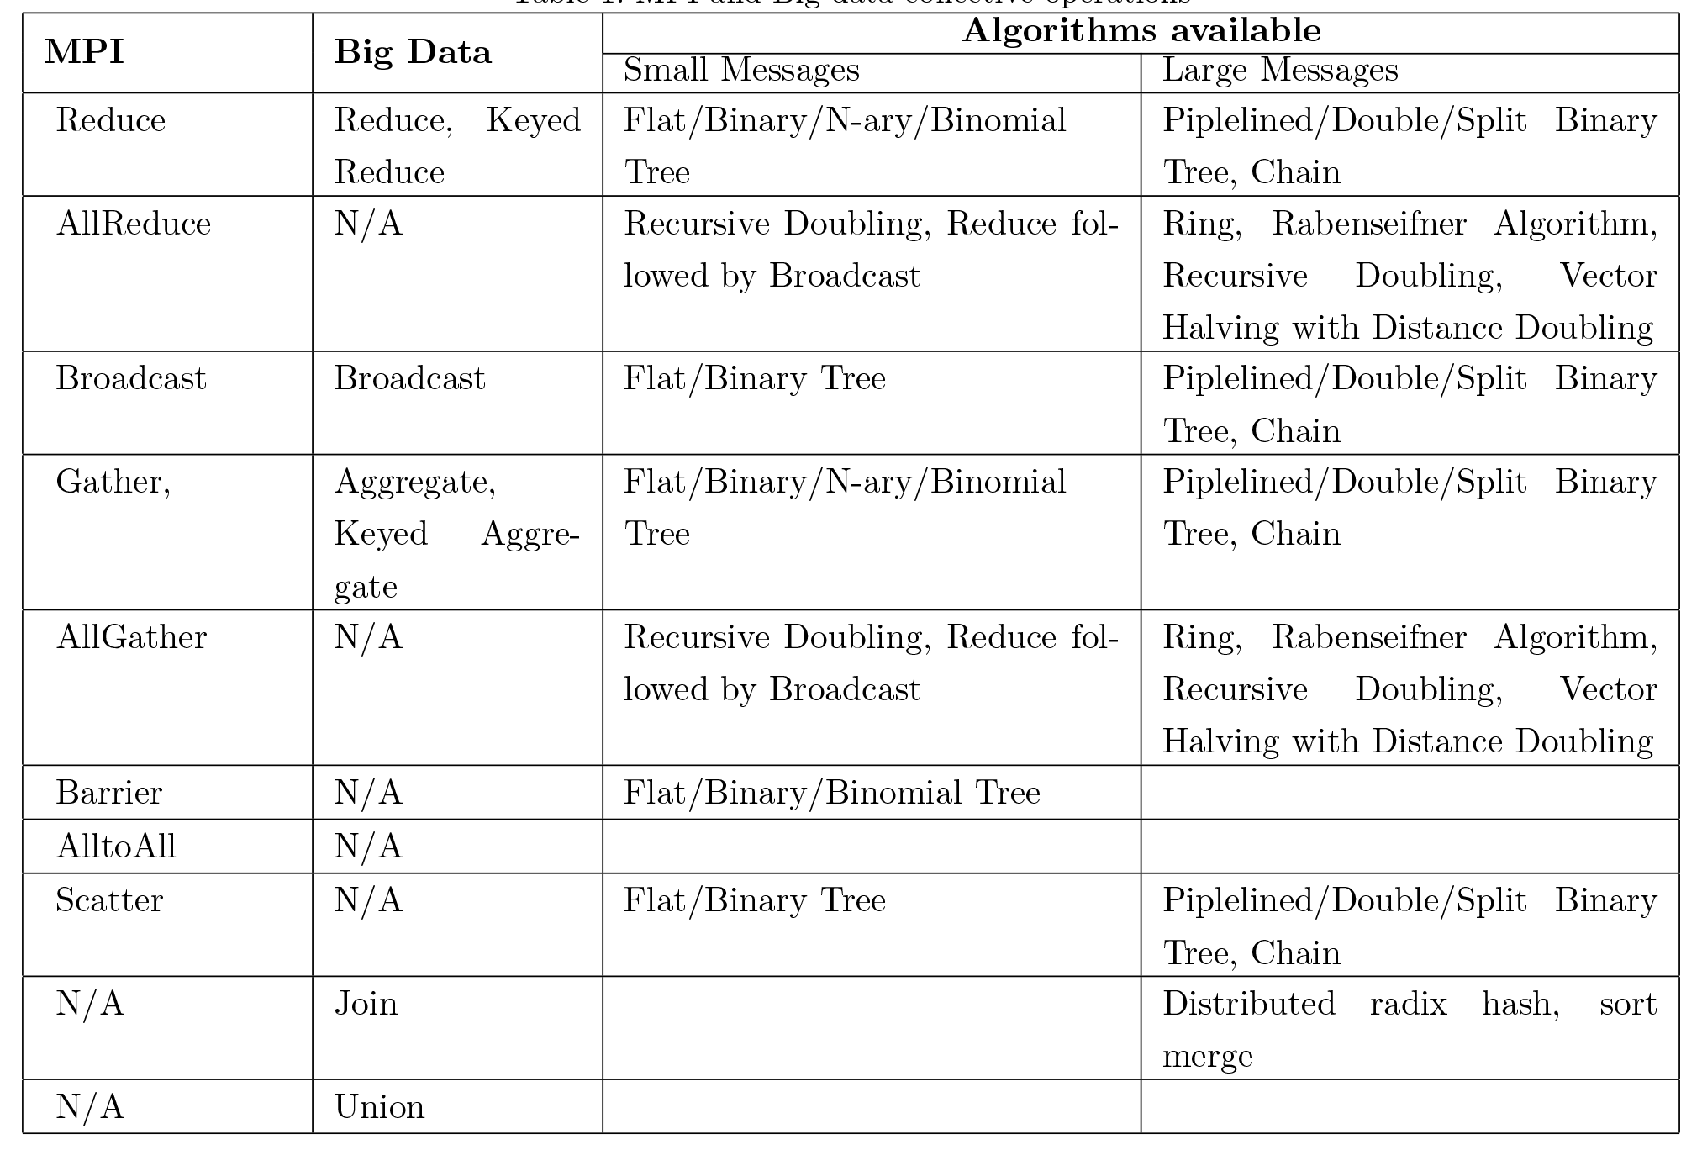
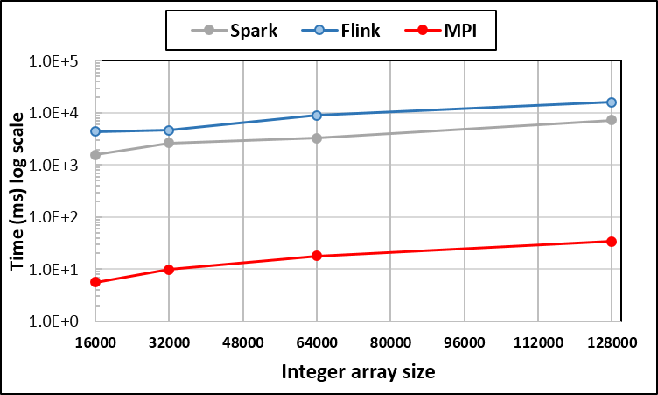
Communication Primitives
Big data systems do no implement optimized communications
It is interesting to see no AllReduce implementations
  AllReduce has to be done with Reduce + Broadcast
No consideration of RDMA
Reduce, 640 parallel tasks in 32 nodes. Integer Array

Slide 23
High Performance Interconnects
MPI excels in RDMA (Remote direct memory access) communications
Big data systems have not taken RDMA seriously
  There are some implementations as plugins to existing systems
Different hardware and protocols
  Infiniband
  Intel Omni-Path
  Aries interconnect
Open source High Performance Libraries such as Libfabric and Photon should make the integration smooth

Slide 24
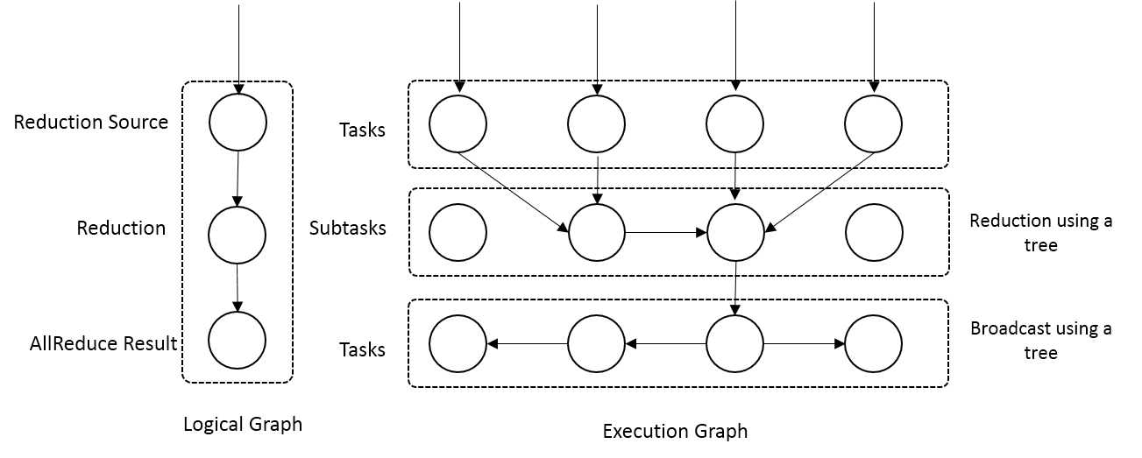
Proposed Optimized Dataflow Communications
Optimize the dataflow graph to facilitate different algorithms
Example - Reduce
  Add subtasks and arrange them according to a optimized algorithm
  Trees, Pipelines
Preserves the asynchronous nature of dataflow computation
Reduce communication as a dataflow graph modification

Slide 25
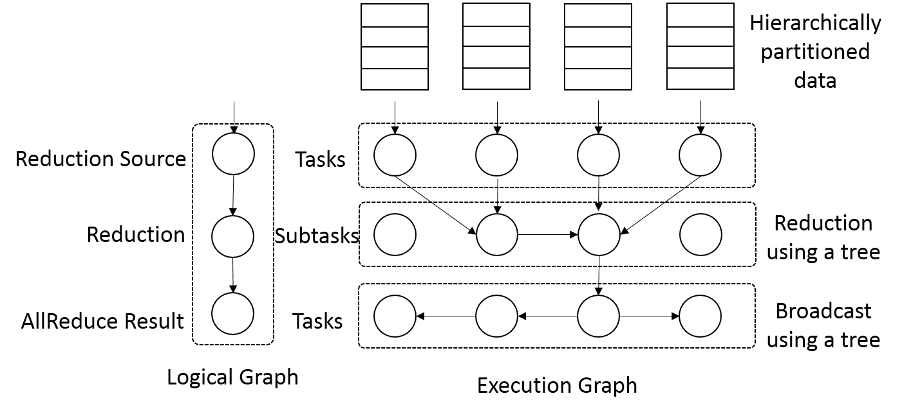
Optimized Communications
AllReduce Communication
  As a Reduce + Broadcast
  More algorithms available
AllReduce Communication

Slide 26
Requirements of Dataflow Collectives
The communication and the underlying algorithm should be driven by data
The algorithm should be able to use disks when the amount of data is larger than the available memory
The collective communication should handle hierarchical partitions of data
  In batch case the communication should finish after the partitions are handled

Slide 27
Dataflow Graph State & Scheduling
State is a key issue and handled differently in systems
  CORBA, AMT, MPI and Storm/Heron have long running tasks that preserve state
  Spark and Flink preserve datasets across dataflow node
  All systems agree on coarse grain dataflow; only keep state in exchanged data.
Scheduling is one key area where dataflow systems differ
  Dynamic Scheduling
    Fine grain control of dataflow graph
    Graph cannot be optimized
  Static Scheduling
    Less control of the dataflow graph
    Graph can be optimized

Slide 28
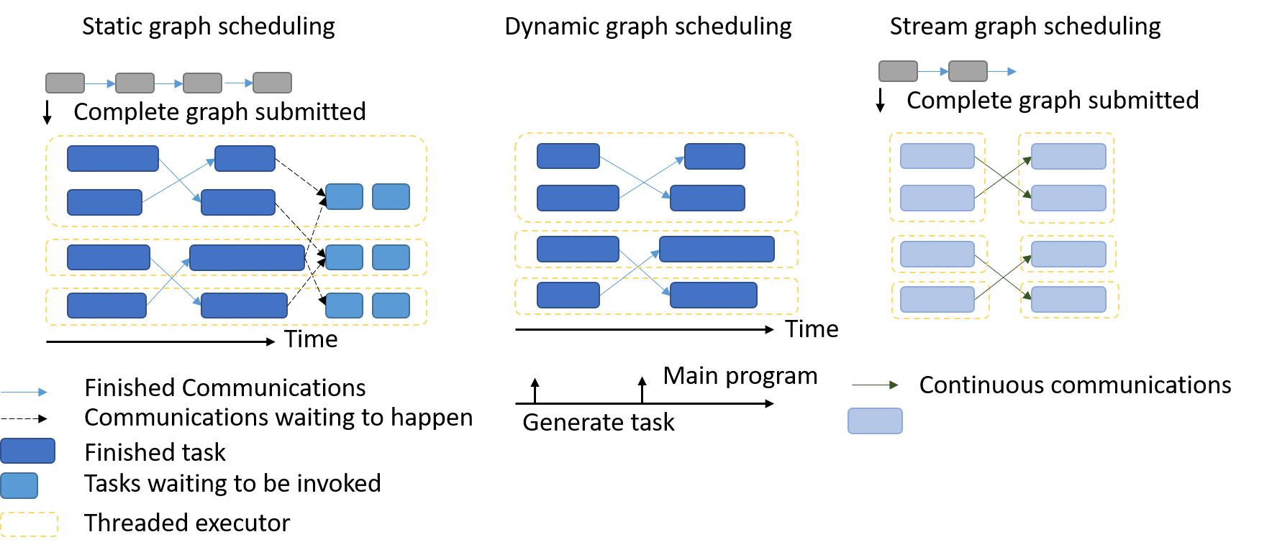
Dataflow Graph Task Scheduling

Slide 29
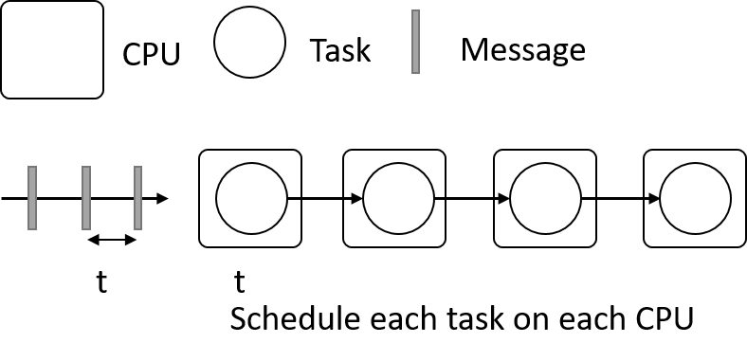
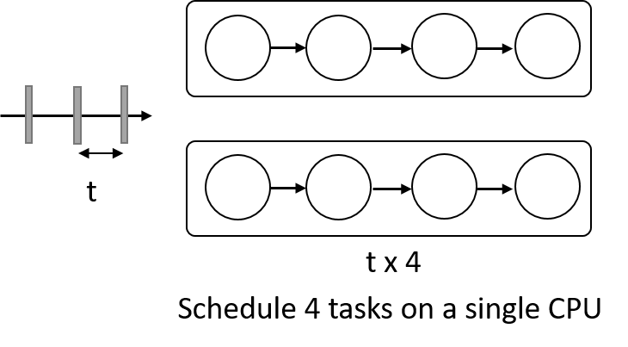
Difference between Stream & Batch Analytics
Stream analytics
  Latency vs Throughput
  Often latency is more important
Example
  Assume message rate of 1 msg per t Units of CPU time
  Assume we have 4 tasks to be executed on an incoming message each consuming t units of CPU time
  Now lets say we have a machine with 4 CPUs.
  There are two possible schedules of the tasks
    Schedule each task on each CPU
    For each message run the 4 tasks one after other on a CPU and load balance between CPUsC
  Can process the stream with 4 CPUs, preserve task locality
  Cannot run the stream on single CPU, need to load balance between the 4 CPUs, preserve data locality, but out of order processing of stream

Slide 30
Distributed Shared Memory
AMT systems support fully featured distributed shared memory (DSM)
  Partitioned Global Address Space (PGAS)
Big data systems use relaxed version of DSM
  Only coarse grained operations are allowed
  Immutable DSM
  Examples include Spark RDD and Flink DataSet
Resilient Distributed Data
  In memory representation of the partitions of a distributed data set
  RDD is created using coarse grain dataflow operations
  Once created they cannot be changed
  Has a high level language type (Integer, Double, custom Class)
  Lazy loading
  Partitions are loaded in the tasks
Partitioned Data Set
Tasks
Partitioned Data Set

Slide 31
Fault Tolerance
Form of check-pointing mechanism is used
  MPI, Flink, Spark
  MPI is a bit harder due to richer state
Checkpoint possible after each stage of the dataflow graph
  Natural synchronization point
  Generally allows user to choose when to checkpoint
Tasks don’t have external state, can be considered as coarse grained operations

Slide 32
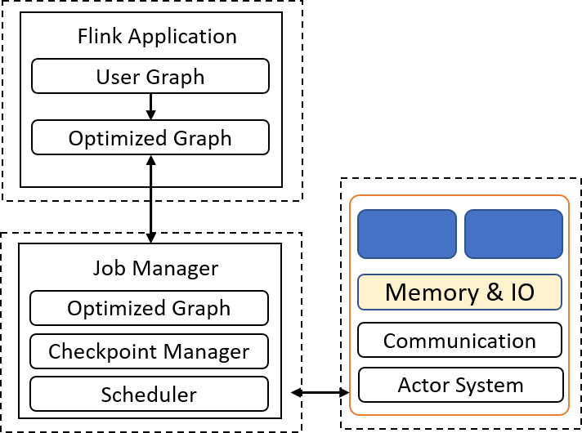
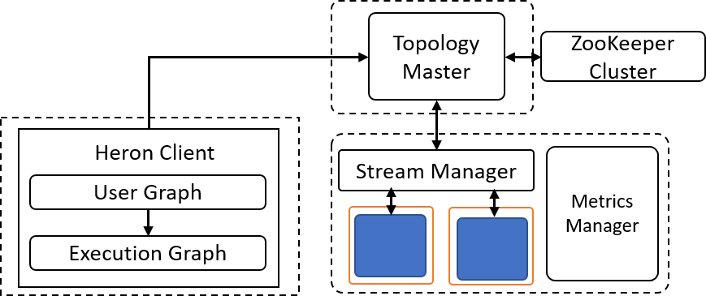
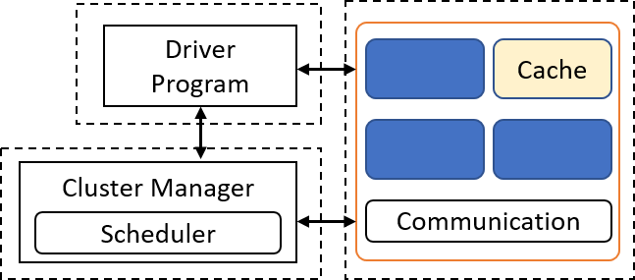
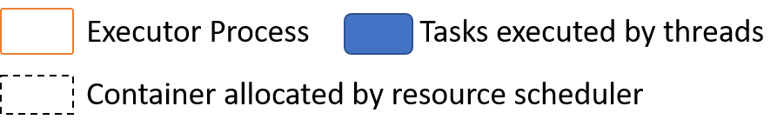
Runtime Architectures
Spark
Flink
Heron

Slide 33
Dataflow for a linear algebra kernel
Typical target of HPC AMT System
Danalis 2016

Slide 34
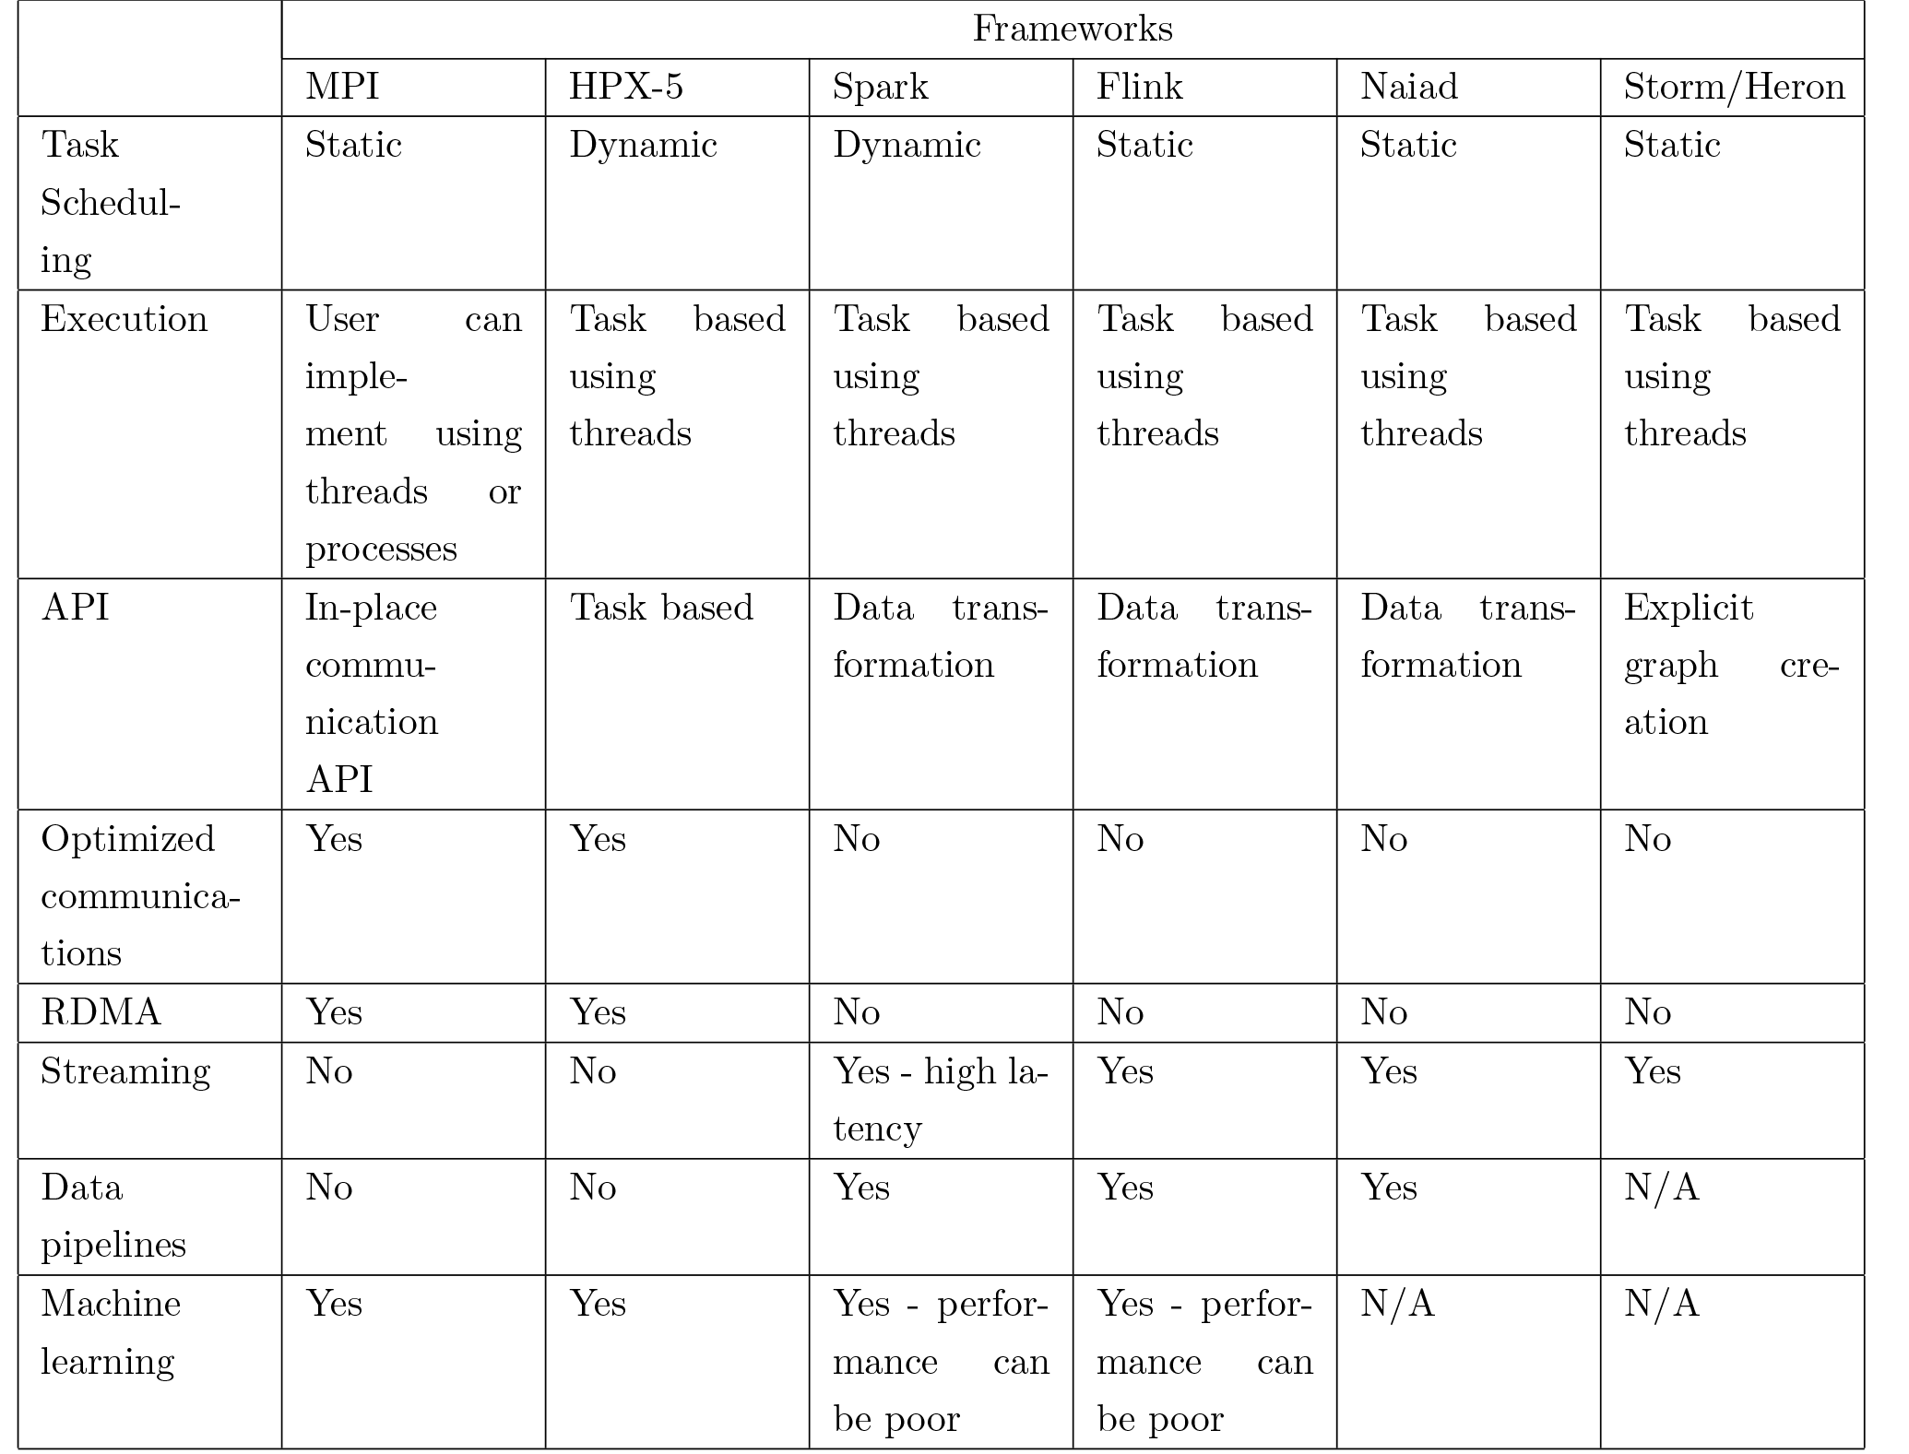
Dataflow Frameworks
Every major big data framework is designed according to dataflow model
Batch Systems
  Hadoop, Spark, Flink, Apex
Streaming Systems
  Storm, Heron, Samza, Flink, Apex
HPC AMT Systems
  Legion, Charm++, HPX-5, Dague, COMPs
Design choices in dataflow
  Efficient in different application areas

Slide 35
Dataflow Toolkit
User Graph API
Data transformation API, Task based API
Most important aspects
  Collective communication
  Scheduler
  State/Data management
  Executors
Execution Graph
Graph optimizer
Executors
User Threads, Kernel Threads
State
Coarse Grain DSM
Fine Grain DSM
No DSM
Task Scheduler
Static Batch, Static Streaming, Dynamic Batch
Network Communication
Harp, MPI Style, Dataflow Collectives
Types of applications | Capabilities
 | Scheduling | Communications | State
Streaming | Static Streaming | Optimized Dataflow Collectives | Coarse Grain DSM, Local
Data Pipelines | Static or Dynamic | Optimized Dataflow Collectives | Coarse Grain DSM, Local
Machine Learning | Dynamic | Harp, MPI, Optimized Dataflow Collectives | Fine Grain DSM, Local
Resource Scheduling (Yarn, Mesos)
File Systems (HDFS, Local, Lustre)

Slide 36
MPI, Spark and Flink
Three algorithms implemented in three runtimes (MPI, Spark, Flink)
  Multidimensional Scaling (MDS)
  K-Means
  Terasort
Implementation in Java
MDS is the most complex algorithm - three nested parallel loops
K-Means - one parallel loop
Terasort - no iterations

Slide 37



Multidimensional Scaling
MDS execution time on 16 nodes with 20 processes in each node with varying number of points
MDS execution time with 32000 points on varying number of nodes. Each node runs 20 parallel tasks
Flink data alignment issues
No support of nested iterations

Slide 38

Flink MDS Dataflow Graph
Hard to reason about the performance of applications
Easy to develop, compared to MPI, surprisingly less number of bugs once developed

Slide 39
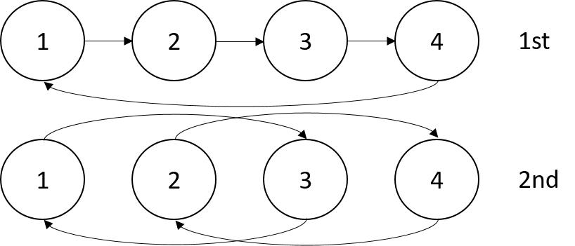


Terasort
Sorting 1TB of data records
Transfer data using MPI
Partition the data using a sample and regroup
Terasort execution time in 64 and 32 nodes. Only MPI shows the sorting time and communication time as other two frameworks doesn't provide a viable method to accurately measure them. Sorting time includes data save time. MPI-IB - MPI with Infiniband

Slide 40
K-Means
Point data set is partitioned and loaded to multiple map tasks
  Custom input format for loading the data as block of points
Full centroid data set is loaded at each map task
Iterate over the centroids
  Calculate the local point average at each map task
  Reduce (sum) the centroid averages to get a global centroids
  Broadcast the new centroids back to the map tasks
Data Set <Points>
Data Set <Initial Centroids>
Map (nearest centroid calculation)
Reduce (update centroids)
Data Set <Updated Centroids>
Broadcast

Slide 41
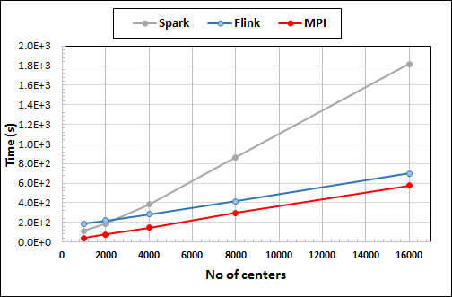
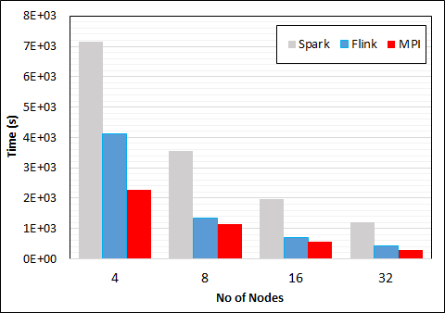
K-Means Clustering in Spark, Flink, MPI
Data Set <Points>
Dataflow for K-means
Data Set <Initial Centroids>
Map (nearest centroid calculation)
Reduce (update centroids)
Data Set <Updated Centroids>
Broadcast
K-Means execution time on 16 nodes with 20 parallel tasks in each node with 10 million points and varying number of centroids. Each point has 100 attributes.
K-Means execution time on varying number of nodes with 20 processes in each node with 10 million points and 16000 centroids. Each point has 100 attributes.
Notes:
Note the differences in communication architectures
Note times are in log scale
Bars indicate compute only times, which is similar across these frameworks
Overhead is dominated by communications in Flink and Spark

Slide 42
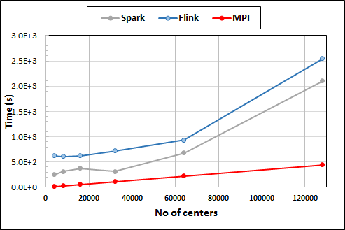
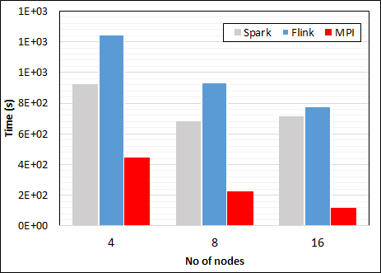

K-Means Clustering in Spark, Flink, MPI
K-Means execution time on 8 nodes with 20 processes in each node with 1 million points and varying number of centroids. Each point has 2 attributes.
K-Means execution time on varying number of nodes with 20 processes in each node with 1 million points and 64000 centroids. Each point has 2 attributes.
K-Means performed well on all three platforms when the computation time is high and communication time is low as illustrated in 10 million points and 10 iterations case. After lowering the computation and increasing the communication by setting the points to1 million and iterations to 100, the performance gap between MPI and the other two platforms increased.
Optimized Dataflow AllReduce
Notes:
Note the differences in communication architectures
Note times are in log scale
Bars indicate compute only times, which is similar across these frameworks
Overhead is dominated by communications in Flink and Spark

Slide 43
Heron Architecture
Each topology runs as a single standalone Job
Topology Master handles the Job
Can run on any resource scheduler (Mesos, Yarn, Slurm)
Each task run as a separate Java Process (Instance)
Stream manager acts as a network router/bridge between tasks in different containers
Every task in a container connects to a stream manager running in that container

Slide 44
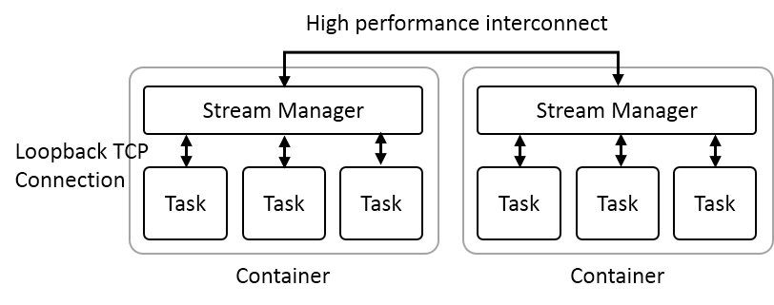
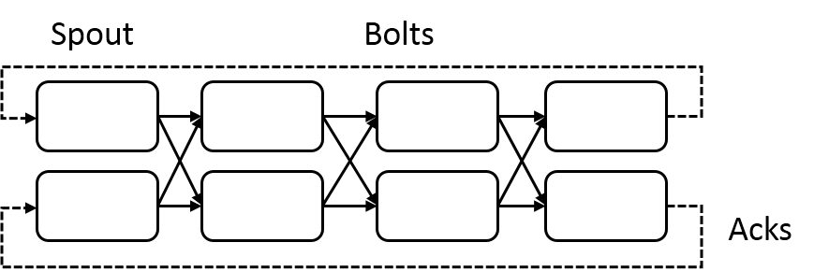
Heron Streaming Architecture
System Management
Add HPC
Infiniband
Omnipath
Inter node
Intranode
Typical Dataflow Processing Topology
User Specified Dataflow
All Tasks Long running
No context shared apart from dataflow
Parallelism 2; 4 stages

Slide 45
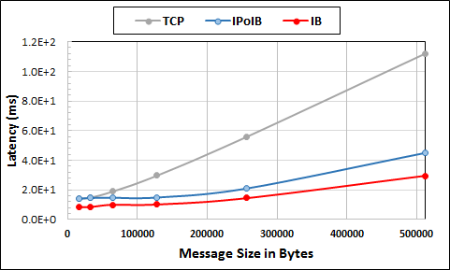
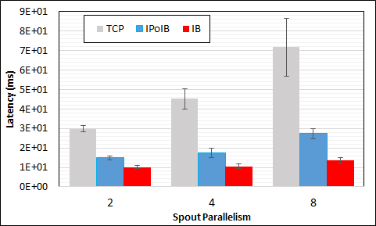
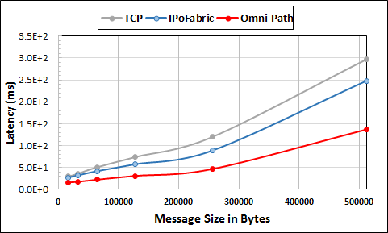
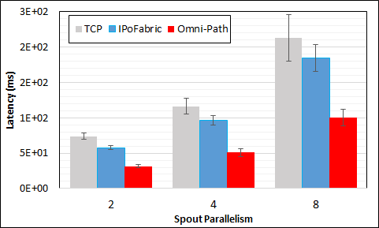
Heron High Performance Interconnects
Infiniband & Intel Omni-Path integrations
Using Libfabric as a library
Natively integrated to Heron through Stream Manager without needing to go through JNI
8 Nodes

Slide 46
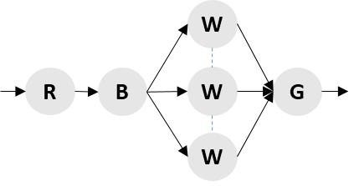
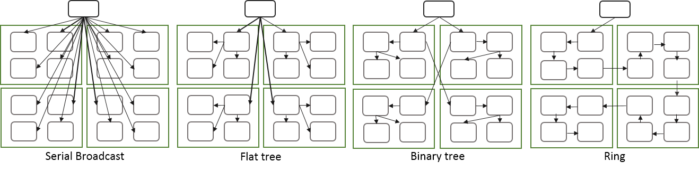
Apache Storm Broadcast
Three broadcast algorithms implemented as an optimization of dataflow graph
  Flat tree
  Binary tree
  Ring
Measure performance for latency and throughput

Slide 47
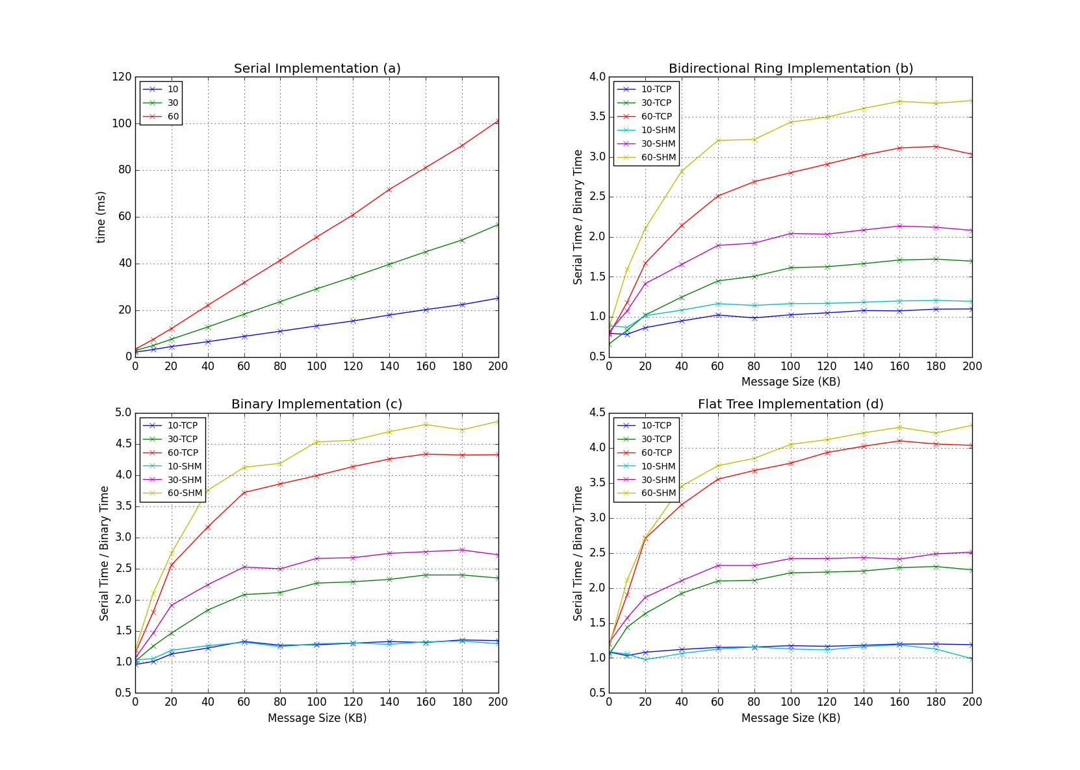
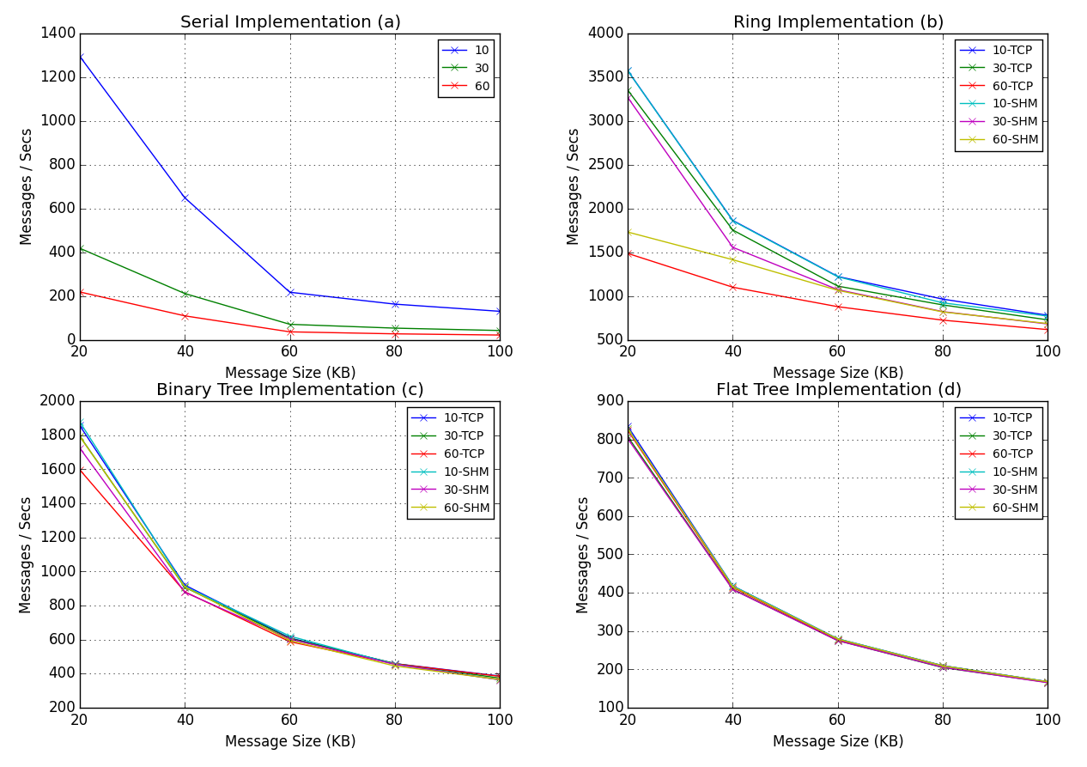
Latency & Throughput of the System
Latency
Throughput
8 Nodes with 32 executors, parallelism 10, 30, 60

Slide 48
Proposed Dataflow Collectives
Implement collective operations for Heron streaming engine
  Broadcast
  Reduce, AllReduce
  Gather, AllGather
Implement various algorithms and testing methodologies for measuring the effectiveness

Slide 49
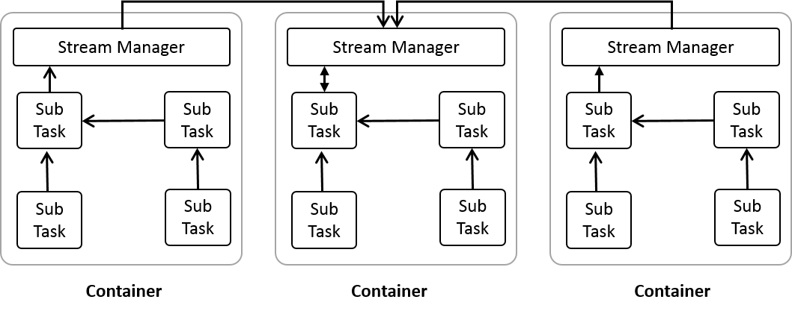
Heron Optimized Collective Implementation
Initial stages
Reduce implementation
Reduction on 16 nodes with 128 parallel tasks

Slide 50
Research Plan
Research into efficient architectures for Big data applications
  Scheduling
  Distributed Shared Memory
  State management
  Fault tolerance
  Thread management
  Collective communication
Collective Communications
  Research into the applicability and semantics of various parallel communication patterns involving many tasks in dataflow programs.
  Research into algorithms that can make such communications efficient in a dataflow setting, especially focusing on streaming/edge applications.
  Implement and measure the performance characteristics of such algorithms to improve dataflow engine performance

