Slide 1

Scalable Parallel Computing on Clouds
(Dissertation Proposal)
Thilina Gunarathne (tgunarat@indiana.edu)
Advisor : Prof.Geoffrey Fox (gcf@indiana.edu)
Committee : Prof.Judy Qui, Prof.Beth Plale, Prof.David Leake

Slide 2
Research Statement
Cloud computing environments can be used to perform large-scale parallel computations efficiently with good scalability, fault-tolerance and ease-of-use.
Notes:
Reliability vs fault-tolerance? Are they two side of the same coin?

Slide 3
Outcomes
Understanding the challenges and bottlenecks to perform scalable parallel computing on cloud environments
Proposing solutions to those challenges and bottlenecks
Development of scalable parallel programming frameworks specifically designed for cloud environments to support efficient, reliable and user friendly execution of data intensive computations on cloud environments.
Implement data intensive scientific applications using those frameworks and demonstrate that these applications can be executed on cloud environments in an efficient scalable manner.

Slide 4
Outline
Motivation
Related Works
Research Challenges
Proposed Solutions
Research Agenda
Current Progress
Publications

Slide 5







Clouds for scientific computations
No upfront cost
Horizontal scalability
Zero maintenance
Compute, storage and other services
Loose service guarantees
Not trivial to utilize effectively ☹
Notes:
The utility computing model introduced by cloud computing combined with the rich set of cloud infrastructure services offers a very viable environment for the scientists to process massive amounts of data. Absence of upfront infrastructure spending and zero maintenance cost coupled with the ability to horizontally scale makes scientists very happy.
However, clouds offer unique reliability and sustained performance challenges for large scale parallel computations due to the
virtualization,
multi-tenancy,
non-dedicated commodity connectivity and etc..
Also the cloud services offer unique loose services guarantees such as eventual consistency.
This makes it necessary to have specialized distributed parallel computing frameworks build specifically for cloud characteristics to harness the power of clouds both easily and effectively.

Slide 6
Application Types
(a) Pleasingly Parallel
(b) Classic MapReduce
(c) Data Intensive Iterative Computations
(d) Loosely Synchronous
Input
Input
Iterations
Input
map
map
map
P_{ij}
reduce
reduce
Output
BLAST Analysis
Smith-Waterman Distances
Parametric sweeps
PolarGrid Matlab data analysis
Distributed search
Distributed sorting
Information retrieval
Expectation maximization clustering e.g. Kmeans
Linear Algebra
Multimensional Scaling
Page Rank
Many MPI scientific applications such as solving differential equations and particle dynamics
Slide from Geoffrey Fox Advances in Clouds and their application to Data Intensive problems University of Southern California Seminar February 24 2012
6
Notes:
Currently most of the cloud usage is for pleasingly parallel and MapReduce workloads..
MPI more low level interface..More flexible… but Makes things more complex.. Fault tolerance issues. More susceptible to jitter, etc…
Cloud : no guarantee things will deploy nearby..or communicaitpon time.
There are lot of applications that fall in between MR and MPI..
Iterative with map reduce is ineficient.. Programmer have to manually issue multiple MR jobs uisig drivers..
We believe there is a need to fill this gap and come up with solutions specifically designed for clouds, taking in to account the unique characteristis of clouds.

Slide 7
Scalable Parallel Computing on Clouds
Programming Models
Scalability
Performance
Fault Tolerance
Monitoring
Notes:
We believe there is a need for scalable parallel programming frameworks specifically designed for cloud environments to support efficient, reliable and user friendly execution of data intensive iterative computations.
This includes designing suitable programming models,
achieving good scalability and good performance,
providing framework managed fault tolerance ensuring eventual completion of the computations and
having good monitoring tools to perform scalable parallel computing on clouds.

Slide 8
Outline
Motivation
Related Works
  MapReduce technologies
  Iterative MapReduce technologies
  Data Transfer Improvements
Research Challenges
Proposed Solutions
Current Progress
Research Agenda
Publications
Notes:
Others such as MPI on cloud, other frameworks?

Slide 9
Feature | Programming Model | Data Storage | Communication | Scheduling & Load Balancing
Hadoop | MapReduce | HDFS | TCP | Data locality, Rack aware dynamic task scheduling through a global queue, natural load balancing
Dryad ^{[1]} | DAG based execution flows | Windows Shared directories | Shared Files/TCP pipes/ Shared memory FIFO | Data locality/ Network topology based run time graph optimizations, Static scheduling
Twister^{[2]} | Iterative MapReduce | Shared file system / Local disks | Content Distribution Network/Direct TCP | Data locality, based static scheduling
MPI | Variety of topologies | Shared file systems | Low latency communication channels | Available processing capabilities/ User controlled

Slide 10
Feature | Failure Handling | Monitoring | Language Support | Execution Environment
Hadoop | Re-execution of map and reduce tasks | Web based Monitoring UI, API | Java, Executables are supported via Hadoop Streaming, PigLatin | Linux cluster, Amazon Elastic MapReduce, Future Grid
Dryad^{[1]} | Re-execution of vertices |  | C# + LINQ (through DryadLINQ) | Windows HPCS cluster
Twister^{[2]} | Re-execution of iterations | API to monitor the progress of jobs | Java, Executable via Java wrappers | Linux Cluster, FutureGrid
MPI | Program level Check pointing | Minimal support for task level monitoring | C, C++, Fortran, Java, C# | Linux/Windows cluster

Slide 11
Iterative MapReduce Frameworks
Twister^{[1]}
  Map->Reduce->Combine->Broadcast
  Long running map tasks (data in memory)
  Centralized driver based, statically scheduled.
Daytona^{[3]}
  Iterative MapReduce on Azure using cloud services
  Architecture similar to Twister
Haloop^{[4]}
  On disk caching, Map/reduce input caching, reduce output caching
iMapReduce^{[5]}
  Async iterations, One to one map & reduce mapping, automatically joins loop-variant and invariant data
Notes:
iMapReduce, Twister -> single wave..
Iterative MapReduce: Haloop, Twister @IU, Spark
Map-Reduce-Merge: enable processing heterogeneous data sets
MapReduce online: online aggregation, and continuous queries

Slide 12
Other
Mate-EC2^{[6]}
  Local reduction object
Network Levitated Merge^{[7]}
  RDMA/infiniband based shuffle & merge
Asynchronous Algorithms in MapReduce^{[8]}
  Local & global reduce
MapReduce online^{[9]}
  online aggregation, and continuous queries
  Push data from Map to Reduce
Orchestra^{[10]}
  Data transfer improvements for MR
  Spark^{[11]}
  Distributed querying with working sets
CloudMapReduce^{[12]} & Google AppEngine MapReduce^{[13]}
  MapReduce frameworks utilizing cloud infrastructure services
Notes:
Orchestra : Broadcast and shuffle improvements…

Slide 13
Outline
Motivation
Related works
Research Challenges
  Programming Model
  Data Storage
  Task Scheduling
  Data Communication
  Fault Tolerance
Proposed Solutions
Research Agenda
Current progress
Publications

Slide 14
Programming model
Express a sufficiently large and useful subset of large-scale data intensive computations
Simple, easy-to-use and familiar
Suitable for efficient execution in cloud environments
Notes:
Related Works
MapReduce, Dryad, Twister, Mate-EC2,

Slide 15
Data Storage
Overcoming the bandwidth and latency limitations of cloud storage
Strategies for output and intermediate data storage.
  Where to store, when to store, whether to store
Choosing the right storage option for the particular data product
Notes:
Related Works
Twister, Daytona : In-memory data caching
Haloop : On disk caching
Amazon EMR
S3 for input/output data , instance storage for intermediate
Overcoming the bandwidth and latency limitations, when accessing large data products from cloud and other storages.
Strategies (where to store, when to store, whether to store) for output and intermediate data storage.
Clouds offer a variety of storage options. We need to choose the storage option best-suited for the particular data product and the particular use case.

Slide 16
Task Scheduling
Scheduling tasks efficiently with an awareness of data availability and locality.
Support dynamic load balancing of computations and dynamically scaling of the compute resources.
Notes:
Related Works
Twister, Haloop, Daytona
Centralized controller based static scheduling

Slide 17
Data Communication
  Cloud infrastructures exhibit inter-node I/O performance fluctuations
  Frameworks should be designed with considerations for these fluctuations.
    Minimizing the amount of communication required
    Overlapping communication with computation
    Identifying communication patterns which are better suited for the particular cloud environment, etc.
Notes:
Related Works
Mate-EC2, Hadoop Network levitated Merge, Asynchronous MapReduce
Orchestra

Slide 18
Fault-Tolerance
Ensuring the eventual completion of the computations through framework managed fault-tolerance mechanisms.
  Restore and complete the computations as efficiently as possible.
Handling of the tail of slow tasks to optimize the computations.
Avoid single point of failures when a node fails
  Probability of node failure is relatively high in clouds, where virtual instances are running on top of non-dedicated hardware.
Notes:
Related Works
Google MapReduce, Hadoop, Dryad
Twister

Slide 19
Scalability
Computations should scale well with increasing amount of compute resources.
  Inter-process communication and coordination overheads needs to scale well.
Computations should scale well with different input data sizes.

Slide 20
Efficiency
Achieving good parallel efficiencies for most of the commonly used application patterns.
Framework overheads needs to be minimized relative to the compute time
  scheduling, data staging, and intermediate data transfer
Maximum utilization of compute resources (Load balancing)
Handling slow tasks
Notes:
Related Works
Dynamic scheduling vs static scheduling

Slide 21
Other Challenges
Monitoring, Logging and Metadata storage
  Capabilities to monitor the progress/errors of the computations
  Where to log?
    Instance storage not persistent after the instance termination
    Off-instance storages are bandwidth limited and costly
  Metadata is needed to manage and coordinate the jobs / infrastructure.
    Needs to store reliably while ensuring good scalability and the accessibility to avoid single point of failures and performance bottlenecks.
Cost effective
  Minimizing the cost for cloud services.
  Choosing suitable instance types
  Opportunistic environments (eg: Amazon EC2 spot instances)
Ease of usage
  Ablity to develop, debug and deploy programs with ease without the need for extensive upfront system specific knowledge.
* We are not focusing on these research issues in the current proposed research. However, the frameworks we develop provide industry standard solutions for each issue.
Notes:
Main focus is on the previous once…

Slide 22
Outline
Motivation
Related Works
Research Challenges
Proposed Solutions
  Iterative Programming Model
  Data Caching & Cache Aware Scheduling
  Communication Primitives
Current Progress
Research Agenda
Publications

Slide 23





Map Reduce
Programming Model
Moving Computation to Data
Scalable
Fault Tolerance
  Simple programming model
  Excellent fault tolerance
  Moving computations to data
  Works very well for data intensive pleasingly parallel applications
  Ideal for data intensive pleasingly parallel applications
Notes:
MapReduce provides a easy to use programming model together with very good fault tolerance and scalability for large scale applications. MapReduce model is proving to be Ideal for data intensive pleasingly parallel applications in commodity hardware and in clouds.

Slide 24
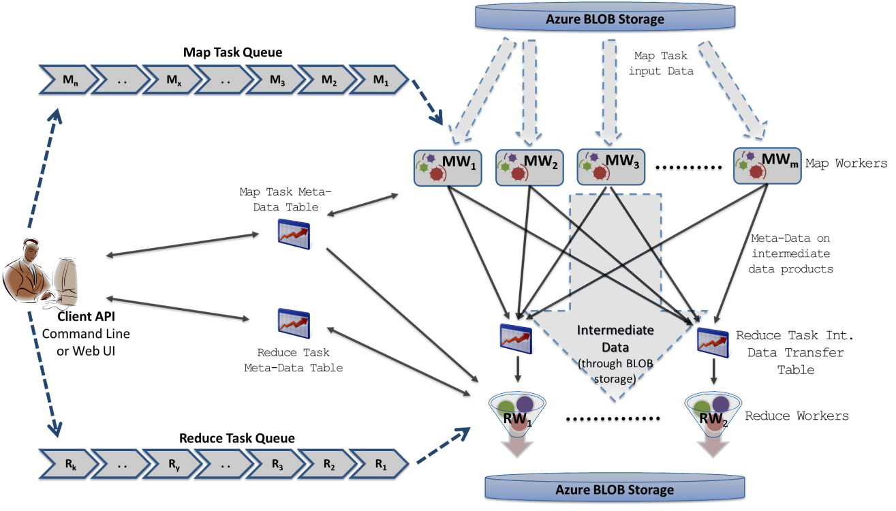
Decentralized MapReduce Architecture on Cloud services
Cloud Queues for scheduling, Tables to store meta-data and monitoring data, Blobs for input/output/intermediate data storage.
Notes:
Ability to dynamically scale up/down
Fault Tolerance
Avoids Single Point of Failure
Global queue based dynamic scheduling
Barrier implementation with eventual consistent services..
Azure Cloud Services
Highly-available and scalable
Utilize eventually-consistent , high-latency cloud services effectively
Minimal maintenance and management overhead
Decentralized
Avoids Single Point of Failure
Global queue based dynamic scheduling
Dynamically scale up/down
MapReduce
First pure MapReduce for Azure
Typical MapReduce fault tolerance
Easy testing and deployment
Combiner step
Web based monitoring console

Slide 25
Data Intensive Iterative Applications
Growing class of applications
  Clustering, data mining, machine learning & dimension reduction applications
  Driven by data deluge & emerging computation fields
  Lots of scientific applications
k ← 0;
MAX ← maximum iterations
δ^{[0]} ← initial delta value
while ( k< MAX_ITER || f(δ^{[k]}, δ^{[k-1]}) )
foreach datum in data
β[datum] ← process (datum, δ^{[k]})
end foreach
δ^{[k+1]} ← combine(β[])
k ← k+1
end while
Notes:
Iterative computations are at the core of the vast majority of data intensive scientific computations.
need to process massive amounts of data and the emergence of data intensive computational fields, such as bioinformatics, chemical informatics and web mining.

Slide 26
Data Intensive Iterative Applications
Compute
Communication
Reduce/ barrier
Smaller Loop-Variant Data
Broadcast
New Iteration
Larger Loop-Invariant Data
Growing class of applications
  Clustering, data mining, machine learning & dimension reduction applications
  Driven by data deluge & emerging computation fields
Notes:
Most of these applications consists of iterative computation and communication steps where single iterations can easily be specified as MapReduce computations.
Large input data sizes which are loop-invariant and can be reused across iterations.
Loop-variant results.. Orders of magnitude smaller…
While these can be performed using traditional MapReduce frameworks, Traditional is not efficient for these types of computations. MR leaves lot of room for improvements in terms of iterative applications.

Slide 27
Iterative MapReduce
MapReduceMerge
Extensions to support additional broadcast (+other) input data
      Map(<key>, <value>, list_of <key,value>)
      Reduce(<key>, list_of <value>, list_of <key,value>)
      Merge(list_of <key,list_of<value>>,list_of <key,value>)
Map
Combine
Shuffle
Sort
Reduce
Merge
Broadcast
Notes:
Goal : from Haloop paper
* keep scalability, ease of use and fault tolerance of map reduce.. Support more patterns..
Loop invariant data (static data) – traditional MR key-value pairs
Comparatively larger sized data
Cached between iterations
Loop variant data (dynamic data) – broadcast to all the map tasks in beginning of the iteration
Comparatively smaller sized data
Map(Key, Value, List of KeyValue-Pairs(broadcast data) ,…)
Can be specified even for non-iterative MR jobs

Slide 28
Merge Step
Extension to the MapReduce programming model to support iterative applications
  Map -> Combine -> Shuffle -> Sort -> Reduce -> Merge
Receives all the Reduce outputs and the broadcast data for the current iteration
User can add a new iteration or schedule a new MR job from the Merge task.
  Serve as the “loop-test” in the decentralized architecture
    Number of iterations
    Comparison of result from previous iteration and current iteration
  Possible to make the output of merge the broadcast data of the next iteration

Slide 29
Multi-Level Caching
In-Memory/Disk caching of static data
In-Memory Caching of static data
Programming model extensions to support broadcast data
Merge Step
Hybrid intermediate data transfer
Caching BLOB data on disk
Caching loop-invariant data in-memory
  Cache-eviction policies?
  Effects of large memory usage on computations?
Notes:
Loop invariant data (static data) – traditional MR key-value pairs
Comparatively larger sized data
Cached between iterations
Avoids the data download, loading and parsing cost between iterations
support in-memory caching of static loop-invariant data between iterations. We achieved this by having cacheable input formats, requiring no changes to the map reduce programming model.
Often input data needs to be uploaded to cloud. Which is not valuable if it’s for a single pass..
We can optimize workflows, where the outputs of the previous Jobs can be cached and used in the next. But we do not focus on such optimizations as they are obvious.

Slide 30
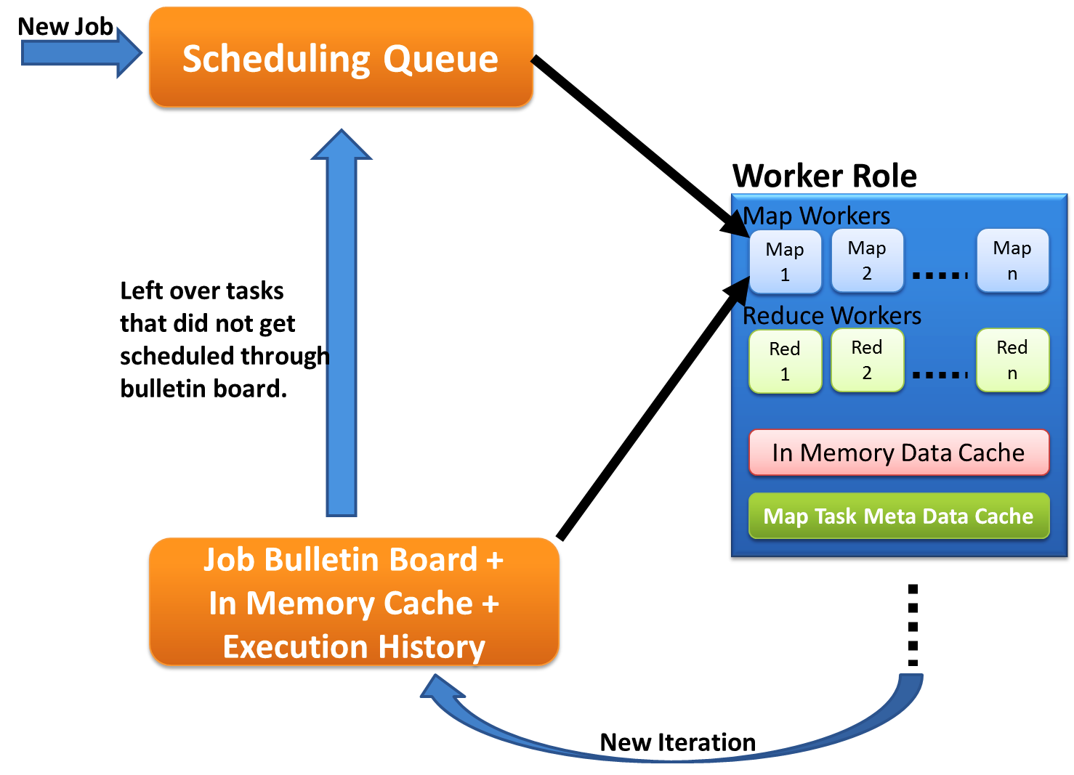
Cache Aware Task Scheduling
First iteration through queues
Cache aware hybrid scheduling
Decentralized
Fault tolerant
Multiple MapReduce applications within an iteration
Load balancing
Multiple waves
Left over tasks
Data in cache + Task meta data history
New iteration in Job Bulleting Board
Notes:
Map tasks need to be scheduled with cache awareness
Map task which process data ‘X’ needs to be scheduled to the worker with ‘X’ in the Cache
Nobody has global view of the data products cached in workers
Decentralized architecture
Impossible to do cache aware assigning of tasks to workers
Solution: workers pick tasks based on the data they have in the cache and the execution histories
Job Bulletin Board : advertise the new iterations
First iteration load balanced. Rest is a challenge.
Multiple MapReduce applications within an iteration supporting much richer application patterns..
Supports multiple waves..

Slide 31
Intermediate Data Transfer
In most of the iterative computations tasks are finer grained and the intermediate data are relatively smaller than traditional map reduce computations
Hybrid Data Transfer based on the use case
  Blob storage based transport
  Table based transport
  Direct TCP Transport
    Push data from Map to Reduce
Optimized data broadcasting
Notes:
The tasks of iterative computations are much finer grained and the intermediate data are relatively smaller than typical map reduce computations. We added support for hydrid transfer of intermediate data.

Slide 32
Fault Tolerance For Iterative MapReduce
Iteration Level
  Role back iterations
Task Level
  Re-execute the failed tasks
Hybrid data communication utilizing a combination of faster non-persistent and slower persistent mediums
  Direct TCP (non persistent), blob uploading in the background.
Decentralized control avoiding single point of failures
Duplicate-execution of slow tasks
Notes:
Duplicate execution can be slow as data needs to be downloaded.. Cache sharing?

Slide 33
Collective Communication Primitives for Iterative MapReduce
Supports common higher-level communication patterns
Performance
  Framework can optimize these operations transparently to the users
    Multi-algorithm
  Avoids unnecessary steps in traditional MR and iterative MR
Ease of use
  Users do not have to manually implement these logic (eg: Reduce and Merge tasks)
  Preserves the Map & Reduce API’s
AllGather
OpReduce
  MDS StressCalc, Fixed point calculations, PageRank with shared PageRank vector, Descendent query
Scatter
  PageRank with distributed PageRank vector

Slide 34
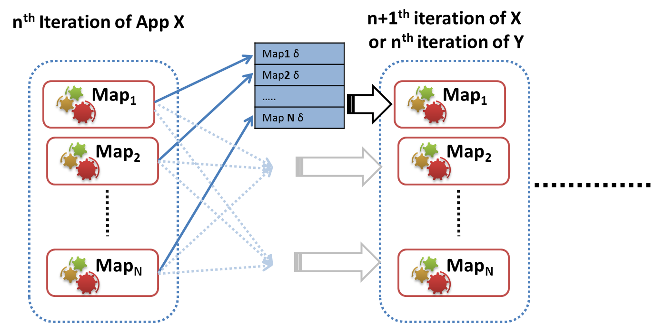
AllGather Primitive
AllGather
  MDS BCCalc, PageRank (with in-links matrix)
Notes:
Add more examples…
Multi OpReduce…
We can pipeline.. But we don’t focus that in our current research as the gains are less for our applications.

Slide 35
Outline
Motivation
Related works
Research Challenges
Proposed Solutions
Research Agenda
Current progress
  MRRoles4Azure
  Twister4Azure
  Applications
Publications

Slide 36
Pleasingly Parallel Frameworks
HDFS
Input Data Set
Cap3 Sequence Assembly
Data File
exe
exe
Map()
Map()
Executable
Optional
Reduce
Phase
Reduce
HDFS
Results
Classic Cloud Frameworks
Map Reduce
Notes:
Out first step was to build a pleasingly computing framework for cloud environments to process embarrassingly parallel applications. This would be similar to a simple job submission framework.
We implemented several applications including sequence assembly, Blast sequence search and couple of dimensional scaling interpolation algorithms . We were able to achieve comparable performance. This motivated us to go a step further and extend our work to MapReduce type applications..

Slide 37
MRRoles4Azure
Azure Cloud Services
Highly-available and scalable
Decentralized
Avoids Single Point of Failure
Utilize eventually-consistent , high-latency cloud services effectively
Minimal maintenance and management overhead
Dynamically scale up/down
Global queue based dynamic scheduling
MapReduce
First pure MapReduce for Azure
Typical MapReduce fault tolerance
Notes:
Distributed, highly scalable & highly available services
Minimal management / maintenance overhead
Reduced footprint

Slide 38
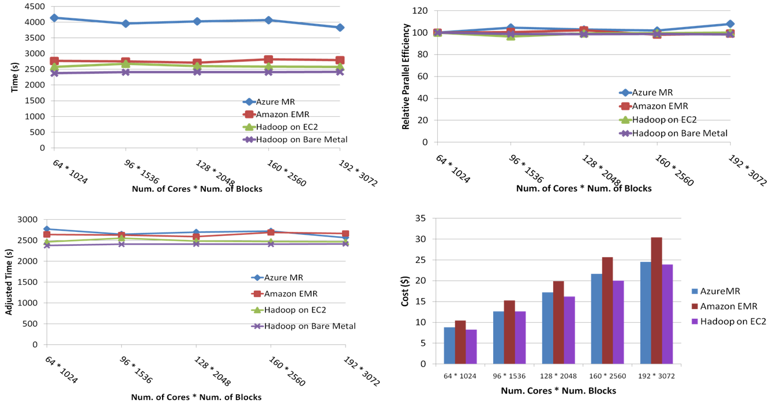
SWG Sequence Alignment
Smith-Waterman-GOTOH to calculate all-pairs dissimilarity
Notes:
~123 million sequence alignments, for under 30$ with zero up front hardware cost,
Add call-outs

Slide 39
Twister4Azure – Iterative MapReduce
Decentralized iterative MR architecture for clouds
  Utilize highly available and scalable Cloud services
Extends the MR programming model
Multi-level data caching
  Cache aware hybrid scheduling
Multiple MR applications per job
Collective communication primitives
Outperforms Hadoop in local cluster by 2 to 4 times
Sustain features of MRRoles4Azure
  dynamic scheduling, load balancing, fault tolerance, monitoring, local testing/debugging
http://salsahpc.indiana.edu/twister4azure/
Thilina Gunarathne, Tak-lon Wu, Judy Qui, Geoffrey Fox
Notes:
Collective communications increasing the performance and giving users more easy options to perform their computations.

Slide 40

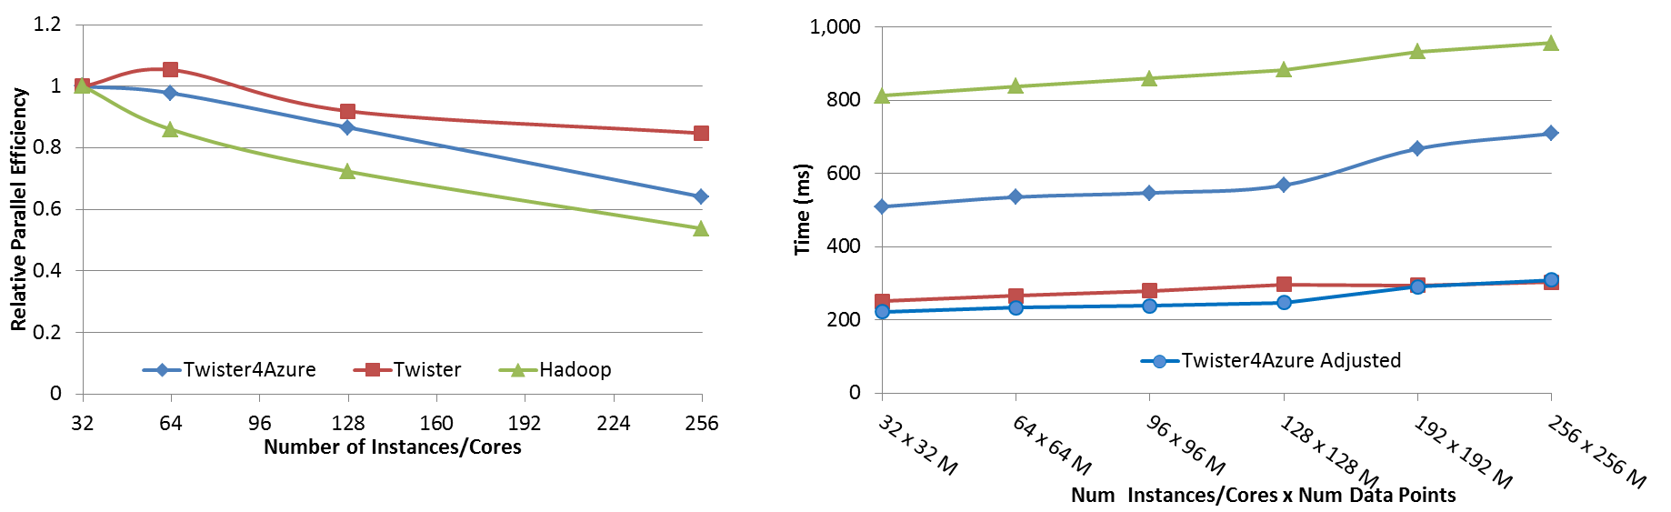




Performance – Kmeans Clustering
Overhead between iterations
First iteration performs the initial data fetch
Task Execution Time Histogram
Number of Executing Map Task Histogram
Scales better than Hadoop on bare metal
Strong Scaling with 128M Data Points
Weak Scaling
Performance with/without
data caching
Speedup gained using data cache
Scaling speedup
Increasing number of iterations
Notes:
Right(c): Twister4Azure executing Map Task histogram for 128 million data points in 128 Azure small instances
Figure 5. KMeansClustering Scalability. Left(a): Relative parallel efficiency of strong scaling using 128 million data points.
Center(b): Weak scaling. Workload per core is kept constant (ideal is a straight horizontal line).

Slide 41
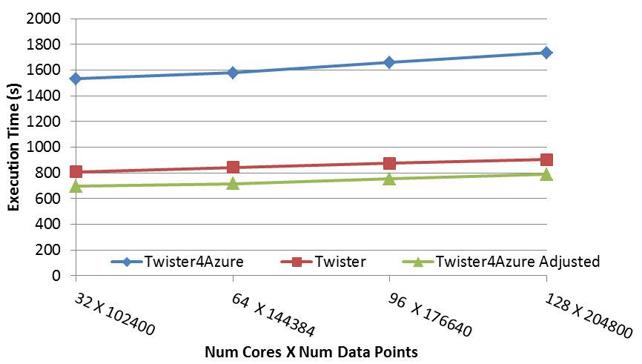
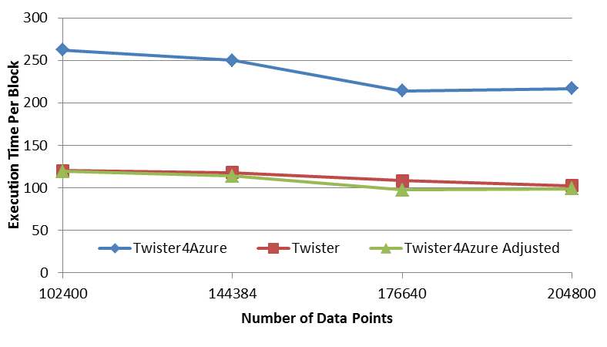
Performance – Multi Dimensional Scaling
BC: Calculate BX
X: Calculate invV (BX)
Calculate Stress
Map
Reduce
Merge
Map
Reduce
Merge
Map
Reduce
Merge
New Iteration
Performance adjusted for sequential performance difference
Weak Scaling
Data Size Scaling
Scalable Parallel Scientific Computing Using Twister4Azure. Thilina Gunarathne, BingJing Zang, Tak-Lon Wu and Judy Qiu. Submitted to Journal of Future Generation Computer Systems. (Invited as one of the best 6 papers of UCC 2011)
Notes:
The Java HPC Twister experiment was performed in a dedicated large-memory cluster of Intel(R) Xeon(R) CPU E5620 (2.4GHz) x 8 cores with 192GB memory per compute node and with Gigabit Ethernet on Linux. Java HPC Twister results do not include the initial data distribution time.
Azure large instances with 4 workers per instances is used. Memory mapped based caching and AllGather primitive are used.
Left: Weak scaling where workload per core is ~constant. Ideal is a straight horizontal line. X axis is
Right: Data size scaling with 128 Azure small instances/cores, 20 iterations.
The Twister4Azure adjusted (t_{a}) depicts the performance of Twister4Azure normalized according to the sequential MDS BC calculation and Stress calculation performance ratio between the Azure(t_{sa}) and Cluster(t_{sc}) environments used for Java HPC Twister. It is calculated using t_{a} x (t_{sc}/t_{sa}). This estimation however does not account for the overheads that remain constant irrespective of the computation time. Hence Twister4Azure seems to perform better, but in reality when the task execution times become smaller, twister4Azure overheads will become relatively larger and the performance would not be as good as shown in the adjusted curve.

Slide 42

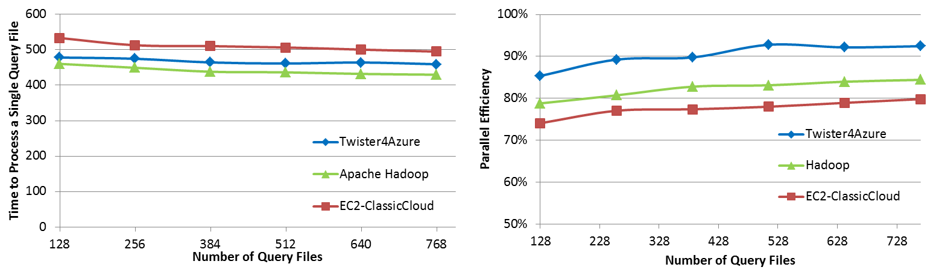
Performance Comparisons
BLAST Sequence Search
BLAST

Slide 43
Applications
Current Sample Applications
  Multidimensional Scaling
  KMeans Clustering
  PageRank
  SmithWatermann-GOTOH sequence alignment
  WordCount
  Cap3 sequence assembly
  Blast sequence search
  GTM & MDS interpolation
Under Development
  Latent Dirichlet Allocation
  Descendent Query

Slide 44
Outline
Motivation
Related Works
Research Challenges
Proposed Solutions
Current Progress
Research Agenda
Publications

Slide 45
Research Agenda
Implementing collective communication operations and the respective programming model extensions
Implementing the Twister4Azure architecture for Amazom AWS cloud.
Performing micro-benchmarks to understand bottlenecks to further improve the performance.
Improving the intermediate data communication performance by using direct and hybrid communication mechanisms.
Implement/evaluate more data intensive iterative applications to confirm our conclusions/decisions hold for them.

Slide 46
Thesis Related Publications
Thilina Gunarathne, BingJing Zang, Tak-Lon Wu and Judy Qiu. Portable Parallel Programming on Cloud and HPC: Scientific Applications of Twister4Azure. 4th IEEE/ACM International Conference on Utility and Cloud Computing (UCC 2011), Mel., Australia. 2011.
Gunarathne, T.; Tak-Lon Wu; Qiu, J.; Fox, G.; MapReduce in the Clouds for Science, 2010 IEEE Second International Conference on Cloud Computing Technology and Science (CloudCom), Nov. 30 2010-Dec. 3 2010. doi: 10.1109/CloudCom.2010.107
Gunarathne, T., Wu, T.-L., Choi, J. Y., Bae, S.-H. and Qiu, J. Cloud computing paradigms for pleasingly parallel biomedical applications. Concurrency and Computation: Practice and Experience. doi: 10.1002/cpe.1780
Ekanayake, J.; Gunarathne, T.; Qiu, J.; , Cloud Technologies for Bioinformatics Applications, Parallel and Distributed Systems, IEEE Transactions on , vol.22, no.6, pp.998-1011, June 2011. doi: 10.1109/TPDS.2010.178
Thilina Gunarathne, BingJing Zang, Tak-Lon Wu and Judy Qiu. Scalable Parallel Scientific Computing Using Twister4Azure. Future Generation Computer Systems. 2012 Feb (under review – Invited as one of the best papers of UCC 2011)
Short Papers / Posters
Gunarathne, T., J. Qiu, and G. Fox, Iterative MapReduce for Azure Cloud, Cloud Computing and Its Applications, Argonne National Laboratory, Argonne, IL, 04/12-13/2011.
Thilina Gunarathne (adviser Geoffrey Fox), Architectures for Iterative Data Intensive Analysis Computations on Clouds and Heterogeneous Environments. Doctoral Show case at SC11, Seattle November 15 2011.

Slide 47
Other Selected Publications
Thilina Gunarathne, Bimalee Salpitikorala, Arun Chauhan and Geoffrey Fox. Iterative Statistical Kernels on Contemporary GPUs. International Journal of Computational Science and Engineering (IJCSE). (to appear)
Thilina Gunarathne, Bimalee Salpitikorala, Arun Chauhan and Geoffrey Fox. Optimizing OpenCL Kernels for Iterative Statistical Algorithms on GPUs. In Proceedings of the Second International Workshop on GPUs and Scientific Applications (GPUScA), Galveston Island, TX. Oct 2011.
Jaiya Ekanayake, Thilina Gunarathne, Atilla S. Balkir, Geoffrey C. Fox, Christopher Poulain, Nelson Araujo, and Roger Barga, DryadLINQ for Scientific Analyses. 5th IEEE International Conference on e-Science, Oxford UK, 12/9-11/2009.
Gunarathne, T., C. Herath, E. Chinthaka, and S. Marru, Experience with Adapting a WS-BPEL Runtime for eScience Workflows. The International Conference for High Performance Computing, Networking, Storage and Analysis (SC'09), Portland, OR, ACM Press, pp. 7, 11/20/2009
Judy Qiu, Jaliya Ekanayake, Thilina Gunarathne, Jong Youl Choi, Seung-Hee Bae, Yang Ruan, Saliya Ekanayake, Stephen Wu, Scott Beason, Geoffrey Fox, Mina Rho, Haixu Tang. Data Intensive Computing for Bioinformatics, Data Intensive Distributed Computing, Tevik Kosar, Editor. 2011, IGI Publishers.
Thilina Gunarathne, et al. BPEL-Mora: Lightweight Embeddable Extensible BPEL Engine. Workshop in Emerging web services technology (WEWST 2006), ECOWS, Zurich, Switzerland. 2006.

Slide 48
Questions

Slide 49
Thank You!

Slide 50
References
M. Isard, M. Budiu, Y. Yu, A. Birrell, D. Fetterly, Dryad: Distributed data-parallel programs from sequential building blocks, in: ACM SIGOPS Operating Systems Review, ACM Press, 2007, pp. 59-72
J.Ekanayake, H.Li, B.Zhang, T.Gunarathne, S.Bae, J.Qiu, G.Fox, Twister: A Runtime for iterative MapReduce, in: Proceedings of the First International Workshop on MapReduce and its Applications of ACM HPDC 2010 conference June 20-25, 2010, ACM, Chicago, Illinois, 2010.
Daytona iterative map-reduce framework. http://research.microsoft.com/en-us/projects/daytona/.
Y. Bu, B. Howe, M. Balazinska, M.D. Ernst, HaLoop: Efficient Iterative Data Processing on Large Clusters, in: The 36th International Conference on Very Large Data Bases, VLDB Endowment, Singapore, 2010.
Yanfeng Zhang , Qinxin Gao , Lixin Gao , Cuirong Wang, iMapReduce: A Distributed Computing Framework for Iterative Computation, Proceedings of the 2011 IEEE International Symposium on Parallel and Distributed Processing Workshops and PhD Forum, p.1112-1121, May 16-20, 2011
Tekin Bicer, David Chiu, and Gagan Agrawal. 2011. MATE-EC2: a middleware for processing data with AWS. In Proceedings of the 2011 ACM international workshop on Many task computing on grids and supercomputers (MTAGS '11). ACM, New York, NY, USA, 59-68.
Yandong Wang, Xinyu Que, Weikuan Yu, Dror Goldenberg, and Dhiraj Sehgal. 2011. Hadoop acceleration through network levitated merge. In Proceedings of 2011 International Conference for High Performance Computing, Networking, Storage and Analysis (SC '11). ACM, New York, NY, USA, , Article 57 , 10 pages.
Karthik Kambatla, Naresh Rapolu, Suresh Jagannathan, and Ananth Grama. Asynchronous Algorithms in MapReduce. In IEEE International Conference on Cluster Computing (CLUSTER), 2010.
T. Condie, N. Conway, P. Alvaro, J. M. Hellerstein, K. Elmleegy, and R. Sears. Mapreduce online. In NSDI, 2010.
M. Chowdhury, M. Zaharia, J. Ma, M.I. Jordan and I. Stoica, Managing Data Transfers in Computer Clusters with Orchestra SIGCOMM 2011, August 2011
M. Zaharia, M. Chowdhury, M.J. Franklin, S. Shenker and I. Stoica. Spark: Cluster Computing with Working Sets, HotCloud 2010, June 2010.
Huan Liu and Dan Orban. Cloud MapReduce: a MapReduce Implementation on top of a Cloud Operating System. In 11th IEEE/ACM International Symposium on Cluster, Cloud and Grid Computing, pages 464–474, 2011
AppEngine MapReduce, July 25th 2011; http://code.google.com/p/appengine-mapreduce.
J. Dean, S. Ghemawat, MapReduce: simplified data processing on large clusters, Commun. ACM, 51 (2008) 107-113.

Slide 51
Backup Slides

Slide 52
Contributions
Highly available, scalable decentralized iterative MapReduce architecture on eventual consistent services
More natural Iterative programming model extensions to MapReduce model
Collective communication primitives
Multi-level data caching for iterative computations
Decentralized low overhead cache aware task scheduling algorithm.
Data transfer improvements
  Hybrid with performance and fault-tolerance implications
  Broadcast, All-gather
Leveraging eventual consistent cloud services for large scale coordinated computations
Implementation of data mining and scientific applications for Azure cloud
Notes:
Performance comparison of applications in Clouds, VM environments and in bare metal.
Exploration of the effect of data inhomogeneity for different map reduce run times

Slide 53
Future Planned Publications
Thilina Gunarathne, BingJing Zang, Tak-Lon Wu and Judy Qiu. Scalable Parallel Scientific Computing Using Twister4Azure. Future Generation Computer Systems. 2012 Feb (under review)
Collective Communication Patterns for Iterative MapReduce, May/June 2012
IterativeMapReduce for Amazon Cloud, August 2012

Slide 54
Broadcast Data
Loop invariant data (static data) – traditional MR key-value pairs
  Comparatively larger sized data
  Cached between iterations
Loop variant data (dynamic data) – broadcast to all the map tasks in beginning of the iteration
  Comparatively smaller sized data
  Map(Key, Value, List of KeyValue-Pairs(broadcast data) ,…)
Can be specified even for non-iterative MR jobs

Slide 55
In-Memory Data Cache
Caches the loop-invariant (static) data across iterations
  Data that are reused in subsequent iterations
Avoids the data download, loading and parsing cost between iterations
  Significant speedups for data-intensive iterative MapReduce applications
Cached data can be reused by any MR application within the job

Slide 56
Cache Aware Scheduling
Map tasks need to be scheduled with cache awareness
  Map task which process data ‘X’ needs to be scheduled to the worker with ‘X’ in the Cache
Nobody has global view of the data products cached in workers
  Decentralized architecture
  Impossible to do cache aware assigning of tasks to workers
Solution: workers pick tasks based on the data they have in the cache
  Job Bulletin Board : advertise the new iterations

Slide 57
Multiple Applications per Deployment
Ability to deploy multiple Map Reduce applications in a single deployment
Possible to invoke different MR applications in a single job
Support for many application invocations in a workflow without redeployment

Slide 58
Data Storage – Proposed Solution
Multi-level caching of data to overcome latencies and bandwidth issues of Cloud Storages
Hybrid Storage of intermediate data on different cloud storages based on the size of data.
Notes:
Overcoming the bandwidth and latency limitations, when accessing large data products from cloud and other storages.
Strategies (where to store, when to store, whether to store) for output and intermediate data storage.
Clouds offer a variety of storage options. We need to choose the storage option best-suited for the particular data product and the particular use case.

Slide 59
Task Scheduling – Proposed Solution
Decentralized scheduling
  No centralized entity with global knowledge
Global queue based dynamic scheduling
Cache aware execution history based scheduling
Communication primitive based scheduling

Slide 60
scalability
Proposed Solution
  Primitives optimize the inter-process data communication and coordination.
  Decentralized architecture facilitates dynamic scalability and avoids single point bottlenecks.
  Hybrid data transfers to overcome Azure service scalability issues
  Hybrid scheduling to reduce scheduling overhead with increasing amount of tasks and compute resources.

Slide 61
Efficiency – Proposed Solutions
Execution history based scheduling to reduce scheduling overheads
Multi-level data caching to reduce the data staging overheads
Direct TCP data transfers to increase data transfer performance
Support for multiple waves of map tasks improving load balancing as well as allows the overlapping communication with computation.

Slide 62
Data Communication
Hybrid data transfers using either or a combination of Blob Storages, Tables and direct TCP communication.
Data reuse across applications, reducing the amount of data transfers

