Slide 1
MapReduce for Data Intensive Scientific Analyses
Jaliya Ekanayake
Shrideep Pallickara
Geoffrey Fox
Department of Computer Science
Indiana University Bloomington, IN, 47405

Slide 2
Presentation Outline
Introduction
MapReduce and the Current Implementations
Current Limitations
Our Solution
Evaluation and the Results
Future Work and Conclusion

Slide 3
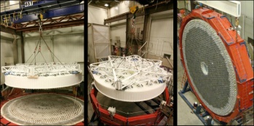
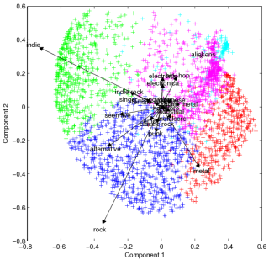
Data/Compute Intensive Applications
Computation and data intensive applications are increasingly prevalent
The data volumes are already in peta-scale
High Energy Physics (HEP)
Large Hadron Collider (LHC) - Tens of Petabytes of data annually
Astronomy
Large Synoptic Survey Telescope -Nightly rate of 20 Terabytes
Information Retrieval
Google, MSN, Yahoo, Wal-Mart etc..
Many compute intensive applications and domains
HEP, Astronomy, chemistry, biology, and seismology etc..
Clustering
Kmeans, Deterministic Annealing, Pair-wise clustering etc…
Multi Dimensional Scaling (MDS) for visualizing high dimensional data

Slide 4
Composable Applications
How do we support these large scale applications?
Efficient parallel/concurrent algorithms and implementation techniques
Some key observations
Most of these applications are:
A Single Program Multiple Data (SPMD) program
or a collection of SPMDs
Exhibits the composable property
Processing can be split into small sub computations
The partial-results of these computations are merged after some post-processing
Loosely synchronized (Can withstand communication latencies typically experienced over wide area networks)
Distinct from the closely coupled parallel applications and totally decoupled applications
With large volumes of data and higher computation requirements, even closely coupled parallel applications can withstand higher communication latencies?

Slide 5
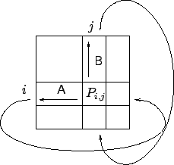
The Composable Class of Applications
Tightly synchronized (microseconds)
Input
SPMDs
Set of TIF files
Loosely synchronized (milliseconds)
PDF Files
Totally decoupled
application
Cannon’s Algorithm for
matrix multiplication –
tightly coupled application
Composable application
Composable class can be implemented in high-level
programming models such as MapReduce and Dryad

Slide 6
MapReduce
“MapReduce is a programming model and an associated implementation for processing and generating large data sets. Users specify a map function that processes a key/value pair to generate a set of intermediate key/value pairs, and a reduce function that merges all intermediate values associated with the same intermediate key.”
MapReduce: Simplified Data Processing on Large Clusters Jeffrey Dean and Sanjay Ghemawat

Slide 7
MapReduce
3
Data is split into m parts
A hash function maps the results of the map tasks to r reduce tasks
1
D1
map
reduce
O1
5
D2
A combine task may be necessary to combine all the outputs of the reduce functions together
Data
map
reduce
O2
Dm
map
2
data split
map
reduce
map function is performed on each of these data parts concurrently
4
Once all the results for a particular reduce task is available, the framework executes the reduce task
The framework supports:
Splitting of data
Passing the output of map functions to reduce functions
Sorting the inputs to the reduce function based on the intermediate keys
Quality of services

Slide 8
Hadoop Example: Word Count
E.g. Word Count
map(String key, String value):
// key: document name
// value: document contents
reduce(String key, Iterator values):
// key: a word
// values: a list of counts
Task Trackers Execute Map tasks
Output of map tasks are written to local files
Retrieve map results via HTTP
Sort the outputs
Execute reduce tasks
M
M
1
2
R
R
2
1
DN
TT
DN
TT
Data/Compute Nodes
M
M
3
4
4
3
R
DN
TT
DN
TT

Slide 9
Current Limitations
The MapReduce programming model could be applied to most composable applications but;
Current MapReduce model and the runtimes focus on “Single Step” MapReduce computations only
Intermediate data is stored and accessed via file systems
Inefficient for the iterative computations to which the MapReduce technique could be applied
No performance model to compare with other high-level or low-level parallel runtimes

Slide 10
CGL-MapReduce
Content Dissemination Network
M
Map Worker
Worker Nodes
R
Reduce Worker
D
D
MR
Driver
User
Program
M
M
M
M
D
MRDeamon
R
R
R
R
Data Read/Write
File System
Communication
Data Split
Architecture of CGL-MapReduce
A streaming based MapReduce runtime implemented in Java
All the communications(control/intermediate results) are routed via a content dissemination network
Intermediate results are directly transferred from the map tasks to the reduce tasks – eliminates local files
MRDriver
Maintains the state of the system
Controls the execution of map/reduce tasks
User Program is the composer of MapReduce computations
Support both single step and iterative MapReduce computations

Slide 11
CGL-MapReduce – The Flow of Execution
Initialization
Start the map/reduce workers
Configure both map/reduce tasks (for configurations/fixed data)
Fixed Data
1
Initialize
Variable Data
map
reduce
Iterative MapReduce
2
Map
Execute map tasks passing <key, value> pairs
combine
Terminate
3
Reduce
Execute reduce tasks passing <key, List<values>>
Content Dissemination Network
4
Combine
Combine the outputs of all the reduce tasks
Worker Nodes
D
D
MR
Driver
User
Program
M
M
M
M
5
Termination
Terminate the map/reduce workers
R
R
R
R
Data Split
File System
CGL-MapReduce, the flow of execution

Slide 12
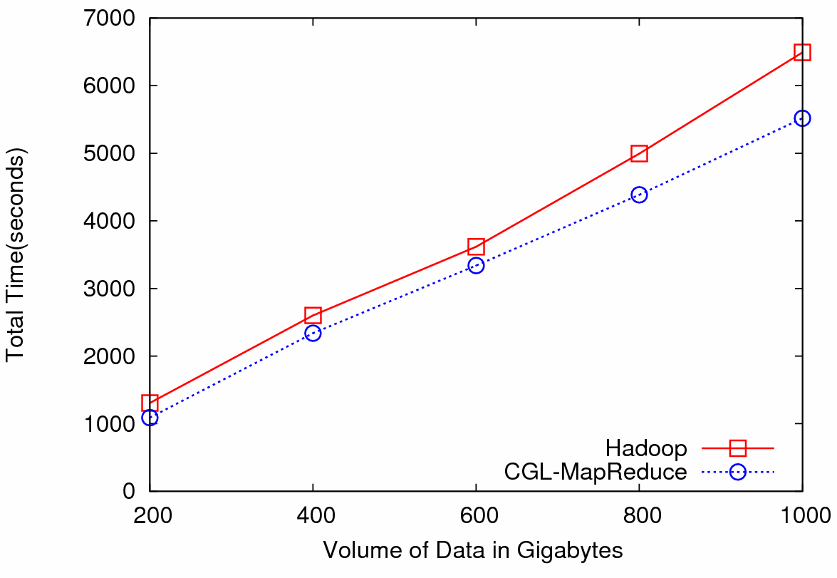
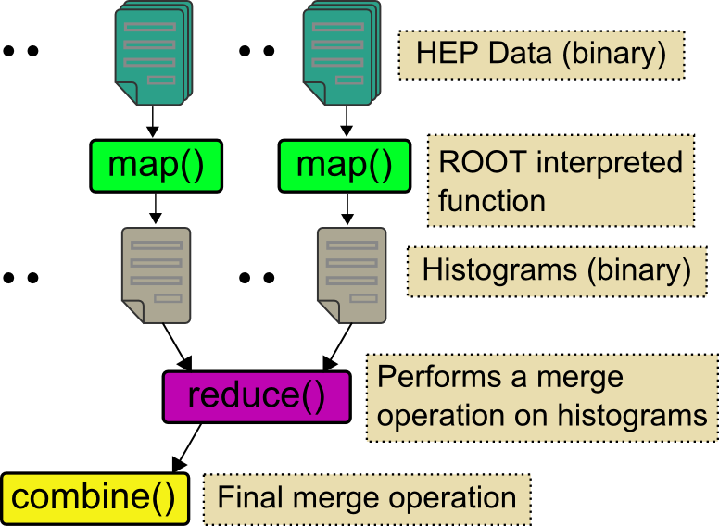
HEP Data Analysis
Data: Up to 1 terabytes of data, placed in IU Data Capacitor
Processing:12 dedicated computing nodes from Quarry (total of 96 processing cores)
MapReduce for HEP data analysis
HEP data analysis, execution time vs. the volume of data (fixed compute resources)
Hadoop and CGL-MapReduce both show similar performance
The amount of data accessed in each analysis is extremely large
Performance is limited by the I/O bandwidth
The overhead induced by the MapReduce implementations has negligible effect on the overall computation

Slide 13
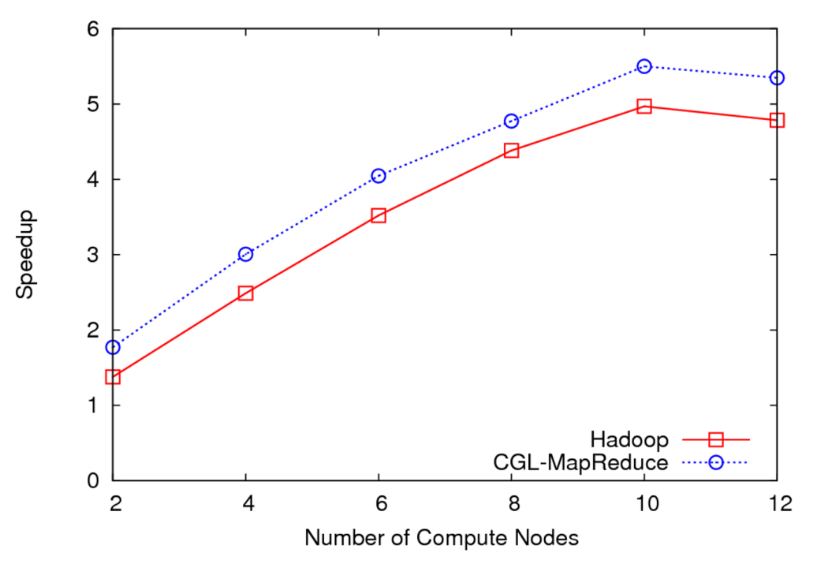
HEP Data Analysis Scalability and Speedup
Execution time vs. the number of compute nodes (fixed data)
Speedup for 100GB of HEP data
100 GB of data
One core of each node is used (Performance is limited by the I/O bandwidth)
Speedup = MapReduce Time / Sequential Time
Speed gain diminish after a certain number of parallel processing units (after around 10 units)

Slide 14
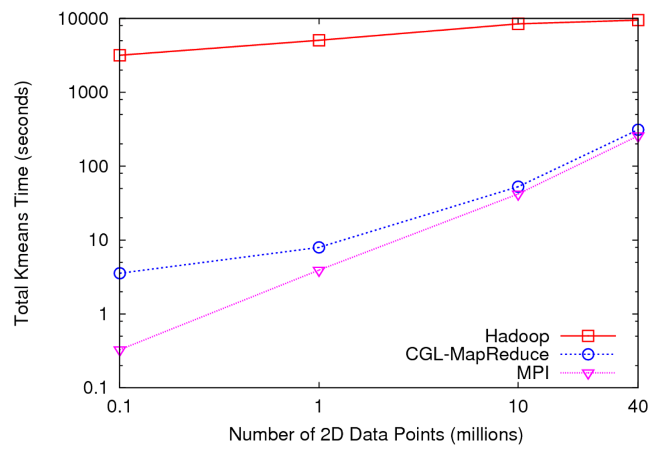
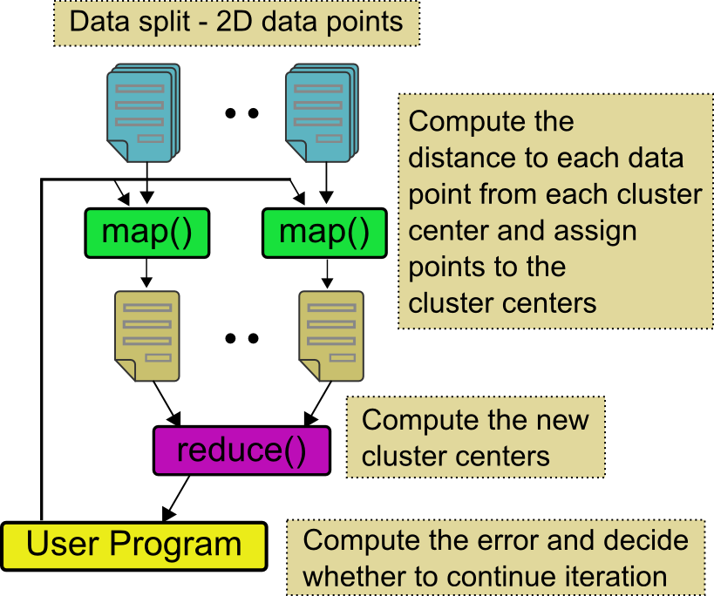
Kmeans Clustering
MapReduce for Kmeans Clustering
Kmeans Clustering, execution time vs. the number of 2D data points (Both axes are in log scale)
All three implementations perform the same Kmeans clustering algorithm
Each test is performed using 5 compute nodes (Total of 40 processor cores)
CGL-MapReduce shows a performance close to the MPI implementation
Hadoop’s high execution time is due to:
Lack of support for iterative MapReduce computation
Overhead associated with the file system based communication

Slide 15
Overheads of Different Runtimes
Overhead f(P)= [P T(P)–T(1)]/T(1)
P - The number of hardware processing units
T(P) – The time as a function of P
T(1) – The time when a sequential program is used (P=1)
Overhead diminishes with the amount of computation
Loosely synchronous MapReduce (CGL-MapReduce) also shows overheads close to MPI for sufficiently large problems
Hadoop’s higher overheads may limit its use for these types(iterative MapReduce) of computations

Slide 16
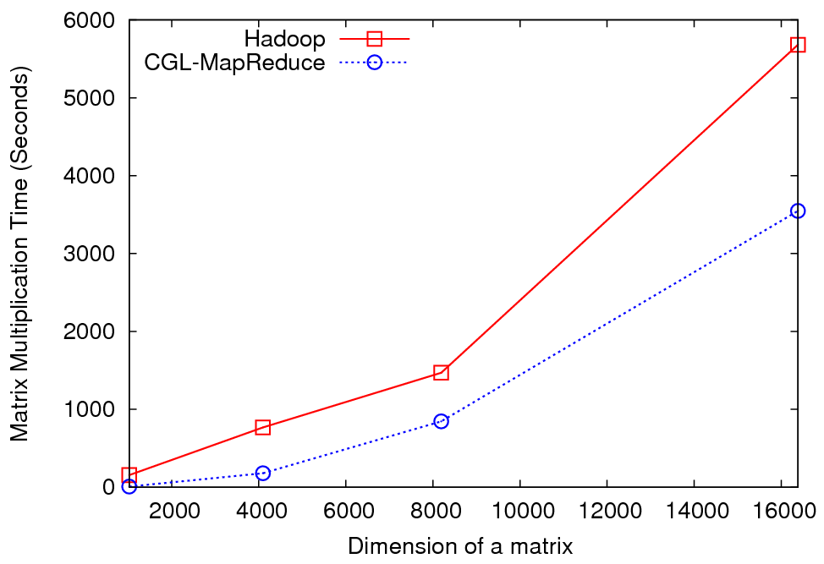
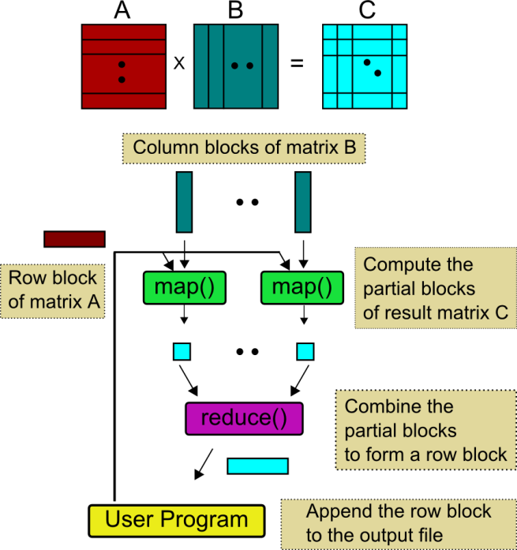
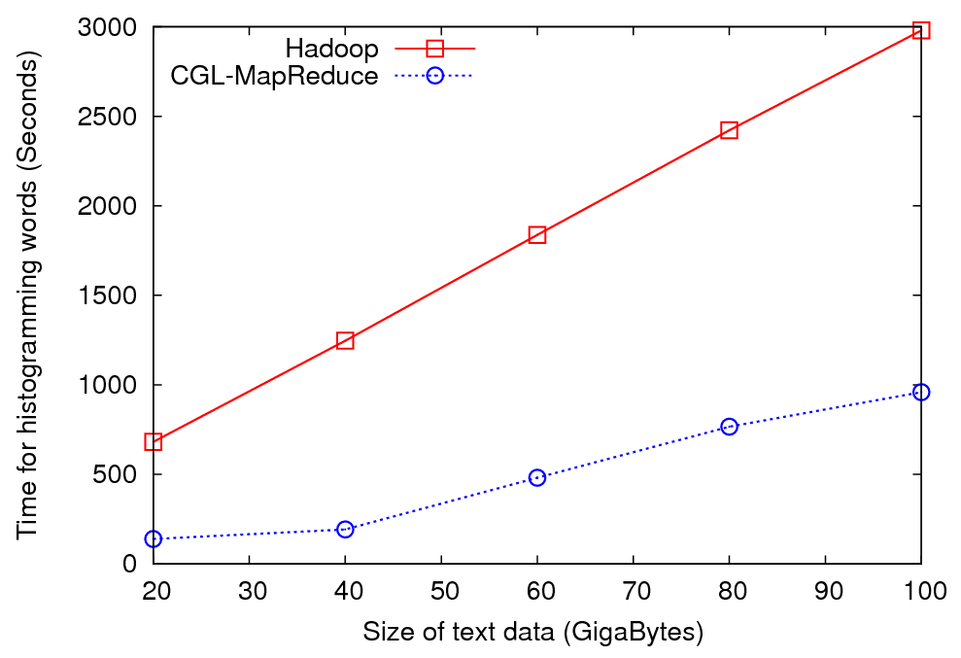
More Applications
Matrix Multiply
MapReduce for Matrix Multiplication
Histogramming Words
Matrix multiplication -> iterative algorithm
Histogramming words -> simple MapReduce application
Streaming approach provide better performance in both applications

Slide 17
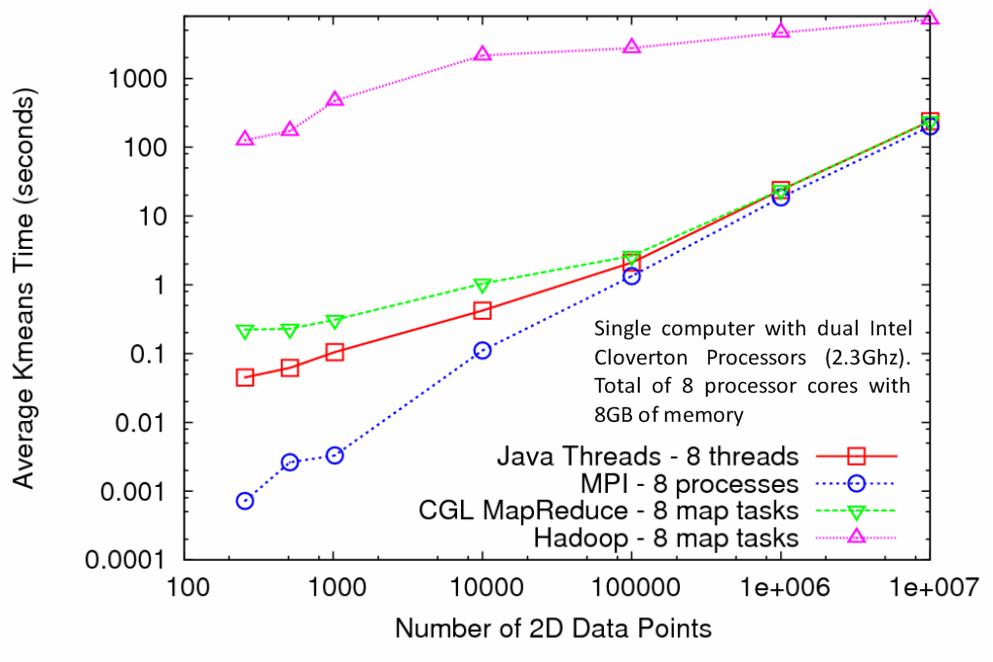
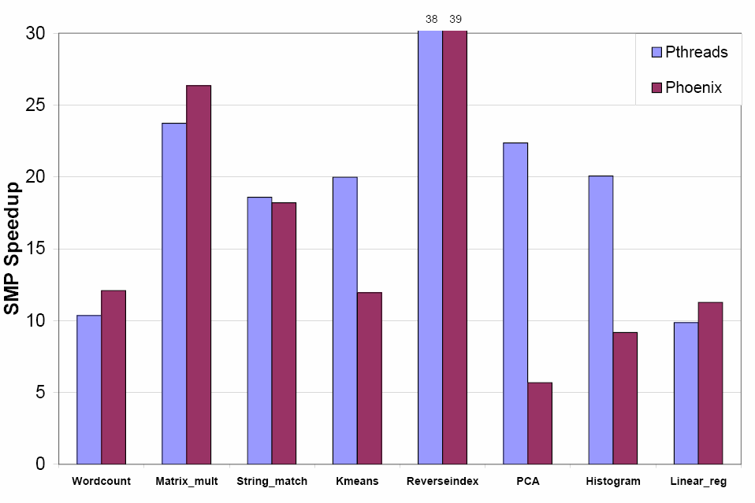
Multicore and the Runtimes
The papers [1] and [2] evaluate the performance of MapReduce using Multicore computers
Our results show the converging results for different runtimes
The right hand side graph could be a snapshot of this convergence path
Easiness to program could be a consideration
Still, threads are faster in shared memory systems
[1] Evaluating MapReduce for Multi-core and Multiprocessor Systems. By C. Ranger et al.
[2] Map-Reduce for Machine Learning on Multicore by C. Chu et al.

Slide 18
Conclusions
MapReduce /Cloud
Parallel Algorithms with:
Fine grained sub computations
Tight synchronization constraints
Parallel Algorithms with:
Corse grained sub computations
Loose synchronization constraints
Given sufficiently large problems, all runtimes converge in performance
Streaming-based map reduce implementations provide faster performance necessary for most composable applications
Support for iterative MapReduce computations expands the usability of MapReduce runtimes

Slide 19
Future Work
Research on different fault tolerance strategies for CGL-MapReduce and come up with a set of architectural recommendations
Integration of a distributed file system such as HDFS
Applicability for cloud computing environments

Slide 20
Questions?
Thank You!

Slide 21
Links
Hadoop vs. CGL-MapReduce
Is it fair to compare Hadoop with CGL-MapReduce ?
DRYAD
Fault Tolerance
Rootlet Architecture
Nimbus vs. Eucalyptus

Slide 22
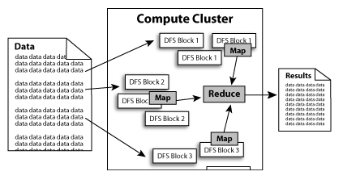
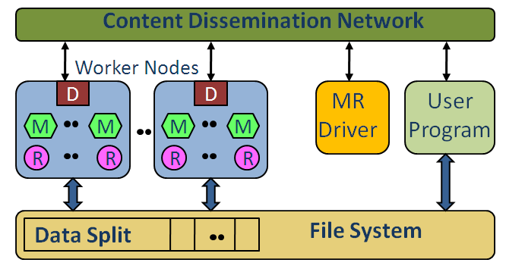
Hadoop vs. CGL-MapReduce
Feature | Hadoop | CGL-MapReduce
Implementation Language | Java | Java
Other Language Support | Uses Hadoop Streaming (Text Data only) | Requires a Java wrapper classes
Distributed File System | HDFS | Currently assumes a shared file system between nodes
Accessing binary data from other languages | Currently only a Java interface is available | Shared file system enables this functionality
Fault Tolerance | Support failures of nodes | Currently does not support fault tolerance
Iterative Computations | Not supported | Supports Iterative MapReduce
Daemon Initialization | Requires ssh public key access | Requires ssh public key access

Slide 23
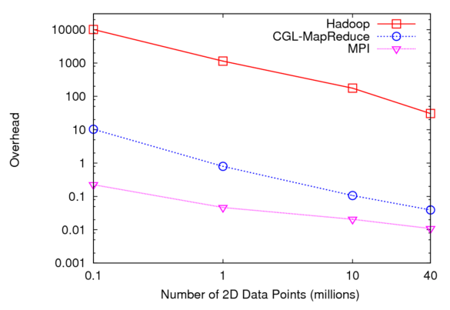
Is it fair to compare Hadoop with CGL-MapReduce ?
Hadoop access data via a distributed file system
Hadoop stores all the intermediate results in this file system to ensure fault tolerance
Is this is the optimum strategy?
Can we use Hadoop for only “single pass” MapReduce computations?
Writing the intermediate results at the Reduce task will be a better strategy?
Considerable reduction in data from map -> reduce
Possibility of using duplicate reduce tasks

Slide 24
Fault Tolerance
Hadoop/Google Fault Tolerance
Data (input, output, and intermediate) are stored in HDFS
HDFS uses replications
Task tracker is a single point of failure (Checkpointing)
Re-executing failed map/reduce tasks
CGL-MapReduce
Integration of HDFS or similar parallel file system for input/output data
MRDriver is a single point of failure (Checkpointing)
Re-executing failed map tasks (Considerable reduction in data from map -> reduce)
Redundant reduce tasks
Amazon model S3, EC2 and SQS
Reliable Queues

Slide 25
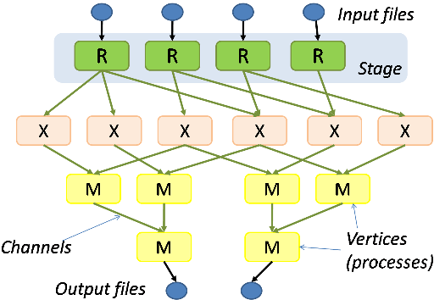
DRYAD
The computation is structured as a directed graph
A Dryad job is a graph generator which can synthesize any directed acyclic graph
These graphs can even change during execution, in response to important events in the computation
Dryad handles job creation and management, resource management, job monitoring and visualization, fault tolerance, re-execution, scheduling, and accounting
How to support iterative computations?

