Slide 1
Programming Abstractions
for Multicore Clouds
eScience 2008 Conference
Workshop on Abstractions for Distributed Applications and Systems
December 11 2008
Indianapolis, Indiana
Geoffrey Fox
gcf@indiana.edu, http://www.infomall.org
Community Grids Laboratory, School of Informatics
Indiana University

Slide 2
Acknowledgements to
SALSA Multicore (parallel datamining) research Team (Service Aggregated Linked Sequential Activities)
Judy Qiu
Scott Beason
Seung-Hee Bae
Jong Youl Choi
Jaliya Ekanayake
Yang Ruan
Huapeng Yuan
Bioinformatics at IU Bloomington
Haixu Tang , Mina Rho
IU Medical School
Gilbert Liu, Shawn Hoch

Slide 3
Changes and Similarities
Parallel and Distributed Computing revolutionized by
Hardware: Multicore and cost-realistic data centers
Software: Industry is not supporting what we expected
We can have various hardware
Multicore – Shared memory, low latency
High quality Cluster – Distributed Memory, Low latency
Standard distributed system – Distributed Memory, High latency
We can program the coordination of these units by
Threads on cores
MPI on cores and/or between nodes
MapReduce/Hadoop/Dryad../AVS for dataflow
Workflow linking services
These can all be considered as some sort of execution unit exchanging messages with some other unit

Slide 4
Data Parallel Run Time Architectures
CCR Ports
Trackers
CCR Ports
Pipes
MPI
Disk HTTP
CCR Ports
Trackers
CCR Ports
Pipes
MPI
Disk HTTP
CCR Ports
Trackers
CCR Ports
Pipes
MPI
Disk HTTP
CCR Ports
Trackers
CCR Ports
Pipes
MPI
Disk HTTP
CGL MapReduce is long running processing with asynchronous distributed
Rendezvous
synchronization
CCR (Multi Threading) uses short or long
running threads communicating via shared memory and
Ports (messages)
Microsoft DRYAD uses short running processes communicating via pipes, disk or shared memory between cores
MPI is long running processes with Rendezvous for message exchange/
synchronization
CCR (Multi Threading) uses short or long
running threads communicating via shared memory and
Ports (messages)
Yahoo Hadoop uses short running processes communicating via disk and tracking processes

Slide 5
Data Analysis Architecture I
Distributed or “centralized
Filter 1
MPI, Shared Memory
Disk/Database
Compute
(Map #1)
Disk/Database
Memory/Streams
Compute
(Reduce #1)
Disk/Database
Memory/Streams
Typically workflow
Filter 2
Disk/Database
Compute
(Map #2)
Disk/Database
Memory/Streams
Compute
(Reduce #2)
Disk/Database
Memory/Streams
etc.
Typically one uses “data parallelism” to break data into parts and process parts in parallel so that each of Compute/Map phases runs in (data) parallel mode
Different stages in pipeline corresponds to different functions
“filter1” “filter2” ….. “visualize”
Mix of functional and parallel components linked by messages

Slide 6
Data Analysis Architecture II
LHC Particle Physics analysis: parallel over events
Filter1: Process raw event data into “events with physics parameters”
Filter2: Process physics into histograms
Reduce2: Add together separate histogram counts
Information retrieval similar parallelism over data files
Bioinformatics study Gene Families: parallel over sequences but more than pleasingly parallel BLAST
Filter1: Align Sequences
Filter2: Calculate similarities (distances) between sequences
Filter3a: Calculate cluster centers
Reduce3b: Add together center contributions
Filter 4: Apply Dimension Reduction to visualize in 3D
Filter5: Visualize
Iterate

Slide 7
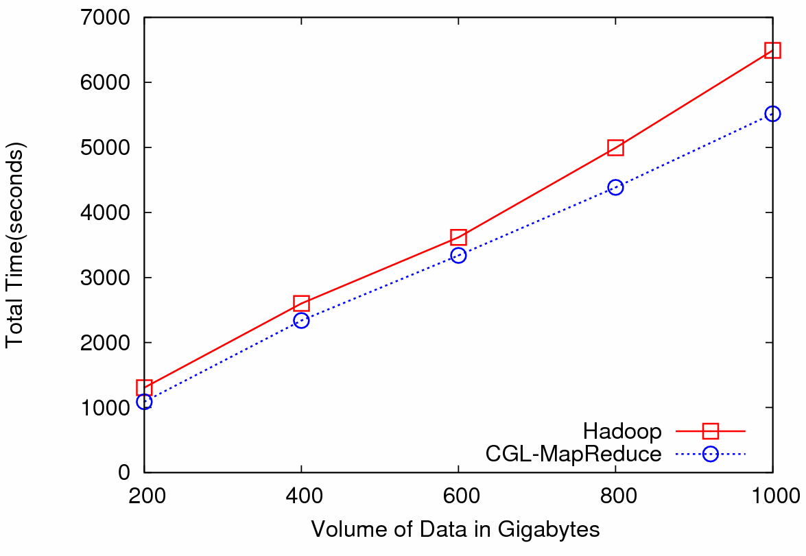
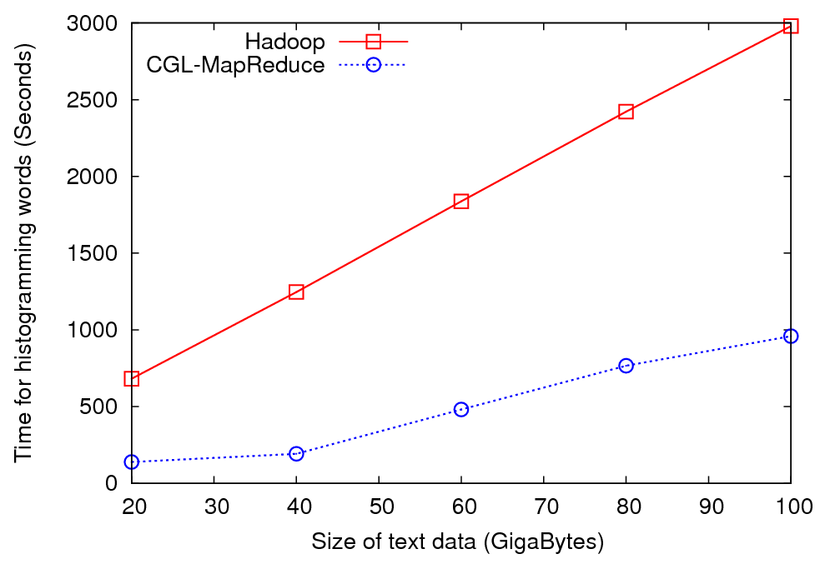
LHC Application Illustrated
LHC Histogramming
Word Histogramming

Slide 8
Various Sequence Clustering Results
4500 Points : Pairwise Aligned
3000 Points : Clustal MSA Kimura2 Distance
4500 Points : Clustal MSA
Map distances to 4D Sphere before MDS

Slide 9
Obesity Patient ~ 20 dimensional data
Will use our 8 node Windows HPC system to run 36,000 records
Working with Gilbert Liu IUPUI to map patient clusters to environmental factors
2000 records 6 Clusters
4000 records 8 Clusters
Refinement of 3 of clusters to left into 5

Slide 10
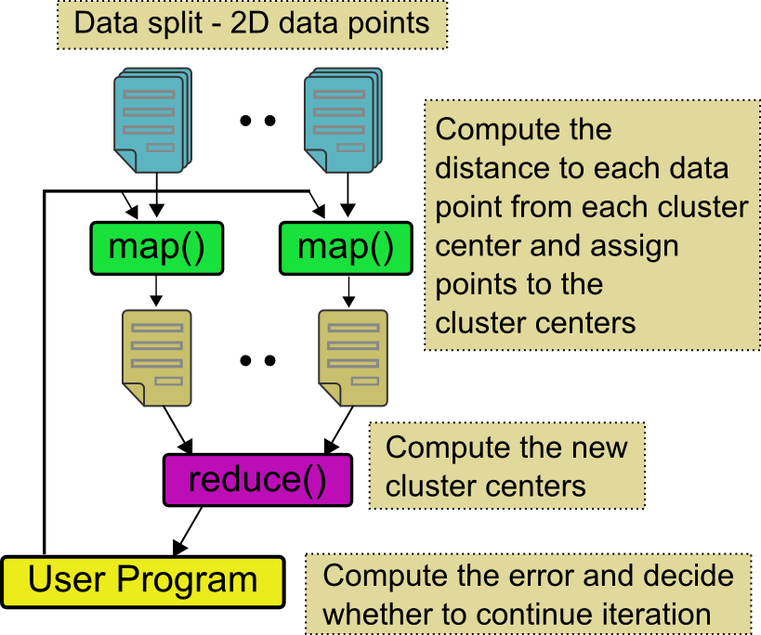
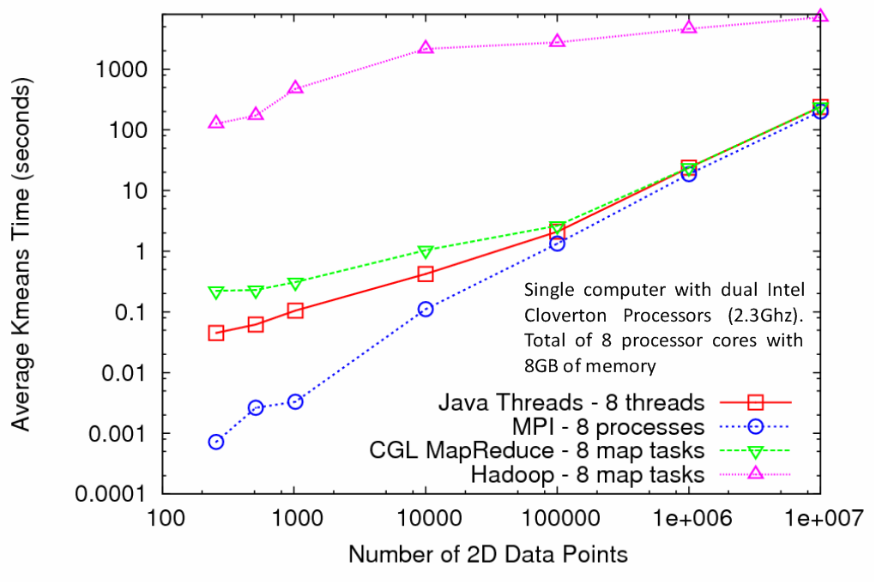
Kmeans Clustering
MapReduce for Kmeans Clustering
Kmeans Clustering, execution time vs. the number of 2D data points (Both axes are in log scale)
All three implementations perform the same Kmeans clustering algorithm
Each test is performed using 5 compute nodes (Total of 40 processor cores)
CGL-MapReduce shows a performance close to the MPI and Threads implementation
Hadoop’s high execution time is due to:
Lack of support for iterative MapReduce computation
Overhead associated with the file system based communication

Slide 11
CCR Performance on Multicore
Parallel Overhead ≈ 1-efficiency
= (PT(P)/T(1)-1)
On P processors
= (1/efficiency)-1
1 2 4 8 16 24 cores
Dell Intel 6 core chip with 4 sockets : PowerEdge R900, 4x E7450 Xeon Six Cores, 2.4GHz, 12M Cache 1066Mhz FSB , Intel core about 25% faster than Barcelona AMD core
4-core Laptop
Precision M6400, Intel Core 2 Dual Extreme Edition QX9300 2.53GHz, 1067MHZ, 12M L2
Use Battery 1 Core Speed up 0.78
2 Cores Speed up 2.15
3 Cores Speed up 3.12
4 Cores Speed up 4.08
Curiously performance per core is
(on 2 core Patient2000) Dell 4 core Laptop 21 minutes Then Dell 24 core Server 27 minutes Then my current 2 core Laptop 28 minutes Finally Dell AMD based 34 minutes

Slide 12
Data Driven Applications
1) Data starts on some disk/sensor/instrument
It needs to be partitioned
2) One runs a filter of some sort extracting data of interest and (re)formatting
Pleasingly parallel
3) Using same (or map to a new) decomposition, one runs a parallel application that requires iterative steps between communicating processes
Looking inside 3) one sees a set of linked parallel processes
Workflow links 1) 2) 3) with multiple instances of 2) 3)
Pipeline or more complex graphs

Slide 13
Functionalities needed
Manage partitioned “original data” on backend “disks”
Tools that make, read and write (output of data driven applications is often partitioned data)
“Disk-Memory-Maps” model to associate data with filters
MPI style parallel applications requiring long running processes and rendezvous communication
Workflow that links multiple instances of filters
Dynamic redistribution of computing for fault-tolerance, or need to reduce or move computing from one platform to another (e.g. laptop to cloud)

Slide 14
Performance Issues
Support both “rendezvous” and “spawn” style of parallelism
Spawning supports dynamic redistribution
Rendezvous unimportant for shared memory (inside multicore CPU) but often has huge performance advantages for distributed memory
Deltaflow versus dataflow
Synchronizing data to disk allows
Dynamic redistribution without difficult correctness (what is state of system) or format (can I move between different OS) issues
Fault Tolerance (if disk/database fault tolerant)

Slide 15
Disk-Memory-Maps Paradigm
MPI supports classic owner computes rule but not clearly the data driven disk-memory-maps rule
Hadoop and Dryad have an excellent disk→memory model but MPI is much better on iterative CPU ←>CPU deltaflow
CGLMapReduce (Granules) addresses iteration within a MapReduce model
Hadoop and Dryad could also support functional programming (workflow) as can Taverna, Pegasus, Kepler, PHP (Mashups) ….
“Workflows of explicitly parallel kernels” is a good model for all parallel computing

Slide 16
DataFlow versus DeltaFlow
For functional parallelism, dataflow natural as one moves from one step to another
For much data parallel one needs “deltaflow” – send change messages to long running processes/threads as in MPI or any rendezvous model
Potentially huge reduction in communication cost
Overhead is Communication/Computation
Dataflow overhead proportional to problem size N per process
For solution of PDE’s
Deltaflow overhead is N^{1/3} and computation like N
So dataflow not popular in scientific computing
For matrix multiplication, deltaflow and dataflow both O(N) and computation N^{1.5}

Slide 17
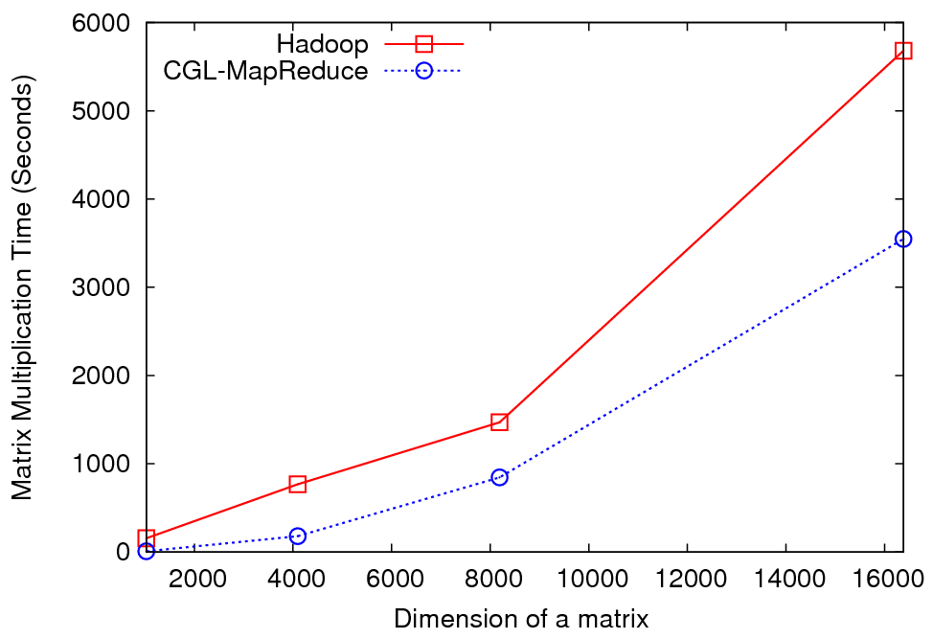
Matrix Multiplication
5 nodes of Quarry cluster at IU each of which has the following configurations. 2 Quad Core Intel Xeon E5335 2.00GHz with 8GB of memory

Slide 18
Scientific Computing environment
My laptop using a dynamic number of cores for runs
Threading (CCR) parallel model allows such dynamic switches if OS told application how many it could – we use short-lived NOT long running threads
Very hard with MPI as would have to redistribute data
The cloud for dynamic service instantiation including ability to launch:
(MPI) engines for large closely coupled computations
Petaflops for million particle clustering/dimension reduction?
Analysis programs like MDS and clustering will run OK for large jobs with “millisecond” (as in Granules) not “microsecond” (as in MPI, CCR) latencies
Implies current VM overheads on MPI probably acceptable
Must build on commercially supported software

Slide 19
User Generated Decompositions
In parallel computing world, MPI is used extensively but has a bad reputation as too “low level”
User needs to generate decomposition and code to manipulate decomposed data
Automate somehow with OpenMP/HPCS …
In multicore, one does not need equivalent of MPI SEND/RECV as can efficiently access shared memory
So write threaded code implementing decomposed algorithm
If use processes need equivalent of PGAS to avoid SEND/RECV
However all the buzz in cloud/distributed world is around systems like Hadoop/MapReduce/Dryad with user generated decompositions
Note in a typical workflow decompositions are typically functionally NOT data parallel
User needs to generate/control data parallel decomposition
Functional decomposition usually natural

Slide 20
Proposed Programming Model
Integrate in as loosely coupled fashion as possible:
Owner Computes paradigm extended to Disk-Memory-Maps paradigm
Some mixture of MPI/CCR/Hadoop/Dryad/Workflow
Support key abstractions like SENDRECV, Reduce
Performance Advantages of Rendezvous messaging between long running processes with dynamic/ fault tolerance advantages of disk based communication between spawned threads/processes
Workflow support of functional parallelism
Dynamic redistribution internally to machines (e.g. laptop) and between clients, web servers and clouds
Include support of fault tolerance
Support of Parallel computing as “workflows of lovingly parallelized kernels” i.e.
as Service Aggregated Linked Sequential Activities

