Slide 1
Multicore for Science
Multicore Panel at eScience 2008
December 11 2008
Geoffrey Fox
Community Grids Laboratory, School of informatics Indiana University
gcf@indiana.edu, http://www.infomall.org
1
Notes:
1

Slide 2
Lessons
Not surprising scientific programs will run very well on multicore systems
We need to exploit commodity software environments so not clear that MPI best
Multicore best practice and large scale distributed processing not scientific computing will drive
Although MPI will get good performance
On node we can replace MPI by threading which has several advantages:
Avoids explicit communication MPI SEND/RECV in node
Allows very dynamic implementation with # threads changing with time
Asynchronous algorithms
Between nodes, we need to combine the best of MPI and Hadoop/Dryad

Slide 3
Threading (CCR) Performance: 8-24 core servers
Parallel Overhead ≈ 1-efficiency
= (PT(P)/T(1)-1)
On P processors
= (1/efficiency)-1
1 2 4 8 16 cores
1 2 4 8 16 24 cores
Dell Intel 6 core chip with 4 sockets : PowerEdge R900,
4x E7450 Xeon Six Cores, 2.4GHz, 12M Cache 1066Mhz FSB, 48 Gigabytes memory Intel core about 25% faster than Barcelona AMD core
Clustering of Medical Informatics data
4000 records – scaling for fixed problem size

Slide 4
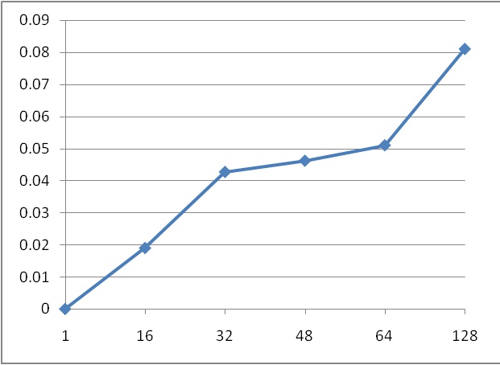
MPI.Net on cluster of 8 16 core AMD systems
Scaled Speed up
Parallel Overhead ≈ 1-efficiency
= (PT(P)/T(1)-1)
On P processors
= (1/efficiency)-1
Cores
4-core Laptop
Precision M6400, Intel Core 2 Dual Extreme Edition QX9300 2.53GHz, 1067MHZ, 12M L2
Use Battery 1 Core Speed up 0.78
2 Cores Speed up 2.15
3 Cores Speed up 3.12
4 Cores Speed up 4.08
Curiously performance for fixed number of cores is (on 2 core Patient2000)
Dell 4 core Laptop 21 minutes Then Dell 24 core Server 27 minutes Then my current 2 core Laptop 28 minutes Finally Dell 8/16 core AMD 34 minutes
Fixed Problem size speed up on Laptops

Slide 5
Data Driven Architecture
Distributed or “centralized
Filter 1
MPI, Shared Memory
Disk/Database
Compute
(Map #1)
Disk/Database
Memory/Streams
Compute
(Reduce #1)
Disk/Database
Memory/Streams
Typically workflow
Filter 2
Disk/Database
Compute
(Map #2)
Disk/Database
Memory/Streams
Compute
(Reduce #2)
Disk/Database
Memory/Streams
etc.
Typically one uses “data parallelism” to break data into parts and process parts in parallel so that each of Compute/Map phases runs in (data) parallel mode
Different stages in pipeline corresponds to different functions
“filter1” “filter2” ….. “visualize”
Mix of functional and parallel components linked by messages

Slide 6
Programming Model Implications I
The distributed world is revolutionized by new environments (Hadoop, Dryad) supporting explicitly decomposed data parallel applications
There can be high level languages
However they “just” pick parallel modules from library – most realistic near term approach to parallel computing environments
Party Line Parallel Programming Model: Workflow (parallel--distributed) controlling optimized library calls
Mashups, Hadoop and Dryad and their relations are likely to replace current workflow (BPEL ..)
Note no mention of automatic compilation
Recent progress has all been in explicit parallelism

Slide 7
Programming Model Implications II
Generalize owner-computes rule
if data stored in memory of CPU-i, then CPU-i processes it
To the disk-memory-maps rule
CPU-i “moves” to Disk-i and uses CPU-i’s memory to load disk’s data and filters/maps/computes it
Embodies data driven computation and move computing to the data
MPI has wonderful features but it will be ignored in real world unless simplified
CCR from Microsoft – only ~7 primitives – is one possible commodity multicore messaging environment
It is roughly active messages
Both threading CCR and process based MPI can give good (and similar) performance on multicore systems

Slide 8
Programming Model Implications III
MapReduce style primitives really easy in MPI
Map is trivial owner computes rule
Reduce is “just”
globalsum = MPI_communicator. Allreduce(partialsum, Operation<double>.Add);
With partialsum a sum calculated in parallel in CCR thread or MPI process
Threading doesn’t have obvious reduction primitives?
Here is a sequential version globalsum = 0.0; // globalsum often an array; for (int ThreadNo = 0; ThreadNo < Count; ThreadNo++) { globalsum += partialsum[ThreadNo] }
Could exploit parallelism over indices of globalsum
There is a huge amount of work on MPI reduction algorithms – can this be retargeted to MapReduce and Threading

Slide 9
Programming Model Implications IV
MPI complications comes from Send or Recv not Reduce
Here thread model is much easier as “Send” in MPI (within node) is just a memory access with shared memory
PGAS model could address but not likely to be practical in near future
One could link PGAS nicely with systems like Dryad/Hadoop
Threads do not force parallelism so can get accidental Amdahl bottlenecks
Threads can be inefficient due to cacheline interference
Different threads must not write to same cacheline
Avoid with artificial constructs like:
partialsumC[ThreadNo] = new double[maxNcent + cachelinesize]
Windows produces runtime fluctuations that give up to 5-10% synchronization overheads

Slide 10
Components of a Scientific Computing environment
My laptop using a dynamic number of cores for runs
Threading (CCR) parallel model allows such dynamic switches if OS told application how many it could – we use short-lived NOT long running threads
Very hard with MPI as would have to redistribute data
The cloud for dynamic service instantiation including ability to launch:
MPI engines for large closely coupled computations
Petaflops for million particle clustering/dimension reduction?
Many parallel applications will run OK for large jobs with “millisecond” (as in Granules) not “microsecond” (as in MPI, CCR) latencies
Workflow/Hadoop/Dryad will link together “seamlessly”

