Slide 1
Distributed and parallel PROGRAMMING ENVIRONMENTS AND THEIR PERFORMANCE
Microsoft eScience Workshop December 7-9 2008 Indianapolis, Indiana
Geoffrey Fox
gcf@indiana.edu, http://www.infomall.org
Community Grids Laboratory, School of Informatics
Indiana University

Slide 2
Acknowledgements to
SALSA Multicore (parallel datamining) research Team (Service Aggregated Linked Sequential Activities)
Judy Qiu
Scott Beason
Seung-Hee Bae
Jong Youl Choi
Jaliya Ekanayake
Yang Ruan
Huapeng Yuan
Bioinformatics at IU Bloomington
Haixu Tang
Mina Rho
IU Medical School
Gilbert Liu
Shawn Hoch

Slide 3
Consider a Collection of Computers
We can have various hardware
  Multicore – Shared memory, low latency
  High quality Cluster – Distributed Memory, Low latency
  Standard distributed system – Distributed Memory, High latency
We can program the coordination of these units by
  Threads on cores
  MPI on cores and/or between nodes
  MapReduce/Hadoop/Dryad../AVS for dataflow
  Workflow linking services
  These can all be considered as some sort of execution unit exchanging messages with some other unit
And there are higher level programming models such as OpenMP, PGAS, HPCS Languages

Slide 4
Old Issues
Essentially all “vastly” parallel applications are data parallel including algorithms in Intel’s RMS analysis of future multicore “killer apps”
  Gaming (Physics) and Data mining (“iterated linear algebra”)
So MPI works (Map is normal SPMD; Reduce is MPI_Reduce) but may not be highest performance or easiest to use
Some new issues
What is the impact of clouds?
There is overhead of using virtual machines (if your cloud like Amazon uses them)
There are dynamic, fault tolerance features favoring MapReduce Hadoop and Dryad
No new ideas but several new powerful systems
Developing scientifically interesting codes in C#, C++, Java and using to compare cores, nodes, VM, not VM, Programming models

Slide 5
Intel’s Application Stack

Slide 6
Data Parallel Run Time Architectures
CCR Ports
Trackers
CCR Ports
Pipes
MPI
Disk HTTP
CCR Ports
Trackers
CCR Ports
Pipes
MPI
Disk HTTP
CCR Ports
Trackers
CCR Ports
Pipes
MPI
Disk HTTP
CCR Ports
Trackers
CCR Ports
Pipes
MPI
Disk HTTP
CGL MapReduce is long running processing with asynchronous distributed
Rendezvous
synchronization
CCR (Multi Threading) uses short or long
running threads communicating via shared memory and
Ports (messages)
Microsoft DRYAD
uses short running processes communicating via pipes, disk or shared memory between cores
MPI is long running processes with Rendezvous for message exchange/
synchronization
CCR (Multi Threading) uses short or long
running threads communicating via shared memory and
Ports (messages)
Yahoo Hadoop uses short running processes communicating via disk and tracking processes

Slide 7
Data Analysis Architecture I
Distributed
or “centralized
Filter 1
MPI, Shared Memory
Disk/Database
Compute
(Map #1)
Disk/Database
Memory/Streams
Compute
(Reduce #1)
Disk/Database
Memory/Streams
Typically workflow
Filter 2
Disk/Database
Compute
(Map #2)
Disk/Database
Memory/Streams
Compute
(Reduce #2)
Disk/Database
Memory/Streams
etc.
Typically one uses “data parallelism” to break data into parts and process parts in parallel so that each of Compute/Map phases runs in (data) parallel mode
Different stages in pipeline corresponds to different functions
    “filter1” “filter2” ….. “visualize”
Mix of functional and parallel components linked by messages

Slide 8
Data Analysis Architecture II
LHC Particle Physics analysis: parallel over events
  Filter1: Process raw event data into “events with physics parameters”
  Filter2: Process physics into histograms
  Reduce2: Add together separate histogram counts
  Information retrieval similar parallelism over data files
Bioinformatics study Gene Families: parallel over sequences
  Filter1: Align Sequences
  Filter2: Calculate similarities (distances) between sequences
  Filter3a: Calculate cluster centers
  Reduce3b: Add together center contributions
  Filter 4: Apply Dimension Reduction to 3D
  Filter5: Visualize
Iterate

Slide 9
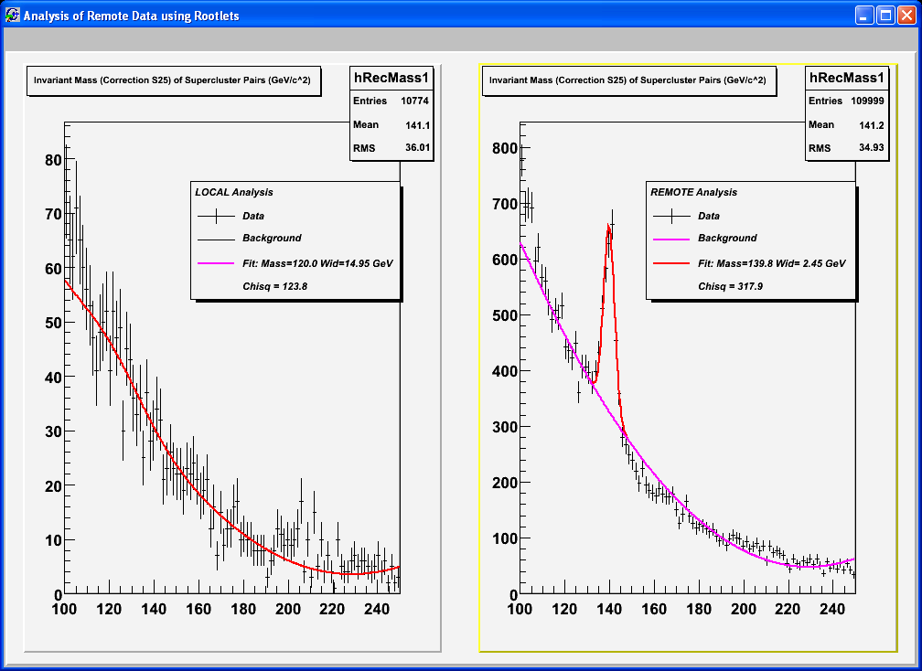
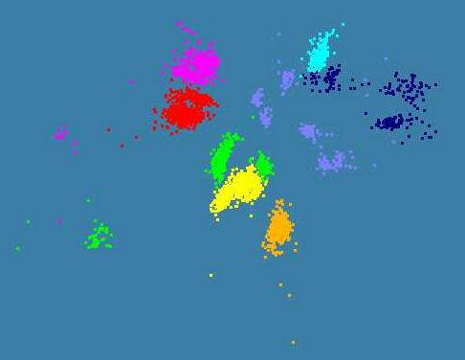
Applications Illustrated
LHC Monte Carlo with Higgs
4500 ALU Sequences with 8 Clusters mapped to 3D and projected by hand to 2D

Slide 10
MapReduce implemented
by Hadoop
H
map(key, value)
reduce(key, list<value>)
Y
n
Y
U
U
S
4n
S
Example: Word Histogram
Start with a set of words
Each map task counts number of occurrences in each data partition
Reduce phase adds these counts
M
4n
M
D
n
D
X
n
X
Dryad supports general dataflow
U
N
U
N

Slide 11
CGL-MapReduce
Content Dissemination Network
Map Worker
M
Reduce Worker
Worker Nodes
D
D
MR
Driver
User
Program
R
MRDeamon
M
M
M
M
D
Data Read/Write
R
R
R
R
Communication
Data Split
File System
Architecture of CGL-MapReduce
A streaming based MapReduce runtime implemented in Java
All the communications(control/intermediate results) are routed via a content dissemination (publish-subscribe) network
Intermediate results are directly transferred from the map tasks to the reduce tasks – eliminates local files
MRDriver
  Maintains the state of the system
  Controls the execution of map/reduce tasks
User Program is the composer of MapReduce computations
Support both stepped (dataflow) and iterative (deltaflow) MapReduce computations
All communication uses publish-subscribe “queues in the cloud” not MPI

Slide 12
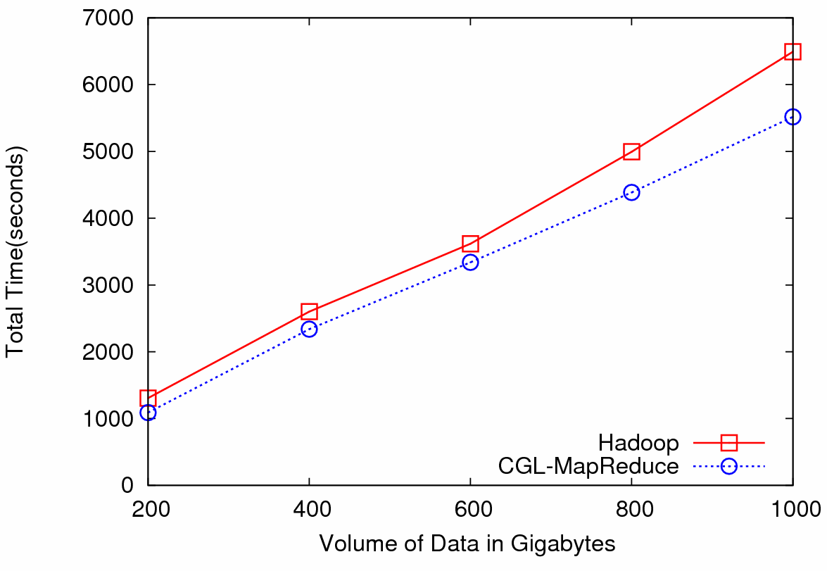

Particle Physics (LHC) Data Analysis
Data: Up to 1 terabytes of data, placed in IU Data Capacitor
Processing:12 dedicated computing nodes from Quarry (total of 96 processing cores)
MapReduce for LHC data analysis
LHC data analysis, execution time vs. the volume of data (fixed compute resources)
Hadoop and CGL-MapReduce both show similar performance
The amount of data accessed in each analysis is extremely large
Performance is limited by the I/O bandwidth (as in Information Retrieval applications?)
The overhead induced by the MapReduce implementations has negligible effect on the overall computation

Slide 13
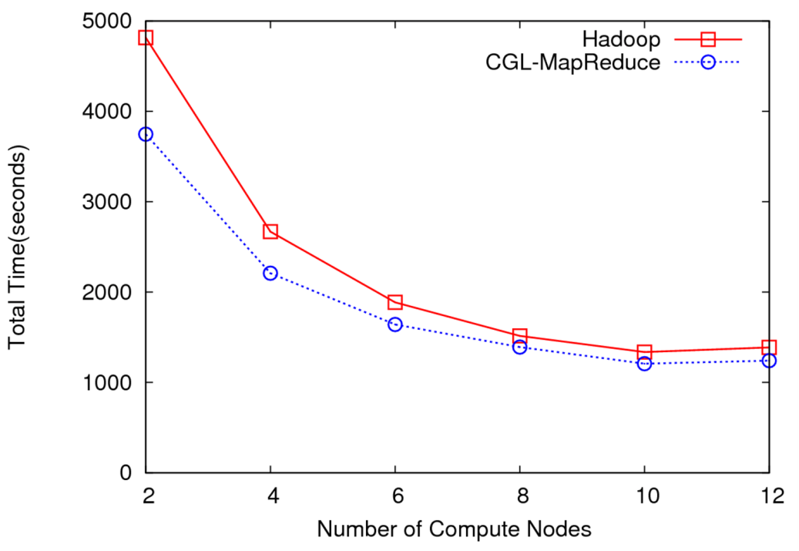
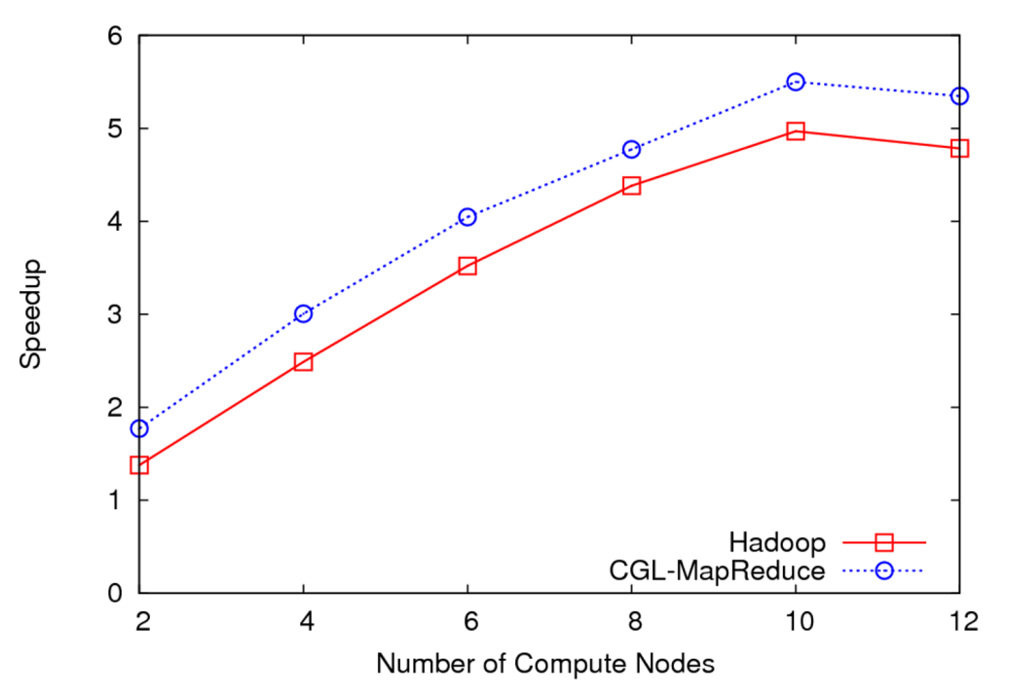
LHC Data Analysis Scalability and Speedup
Execution time vs. the number of compute nodes (fixed data)
Speedup for 100GB of HEP data
100 GB of data
One core of each node is used (Performance is limited by the I/O bandwidth)
Speedup = MapReduce Time / Sequential Time
Speed gain diminish after a certain number of parallel processing units (after around 10 units)
Computing brought to data in a distributed fashion
Will release this as Granules at http://www.naradabrokering.org

Slide 14
Notes on Performance
Speed up = T(1)/T(P) = ε (efficiency ) P
  with P processors
Overhead f = (PT(P)/T(1)-1) = (1/ε -1)
is linear in overheads and usually best way to record results if overhead small
For communication f ∝ ratio of data communicated to calculation complexity = n^{-0.5} for matrix multiplication where n (grain size) matrix elements per node
Overheads decrease in size as problem sizes n increase (edge over area rule)
Scaled Speed up: keep grain size n fixed as P increases
Conventional Speed up: keep Problem size fixed n ∝ 1/P

Slide 15
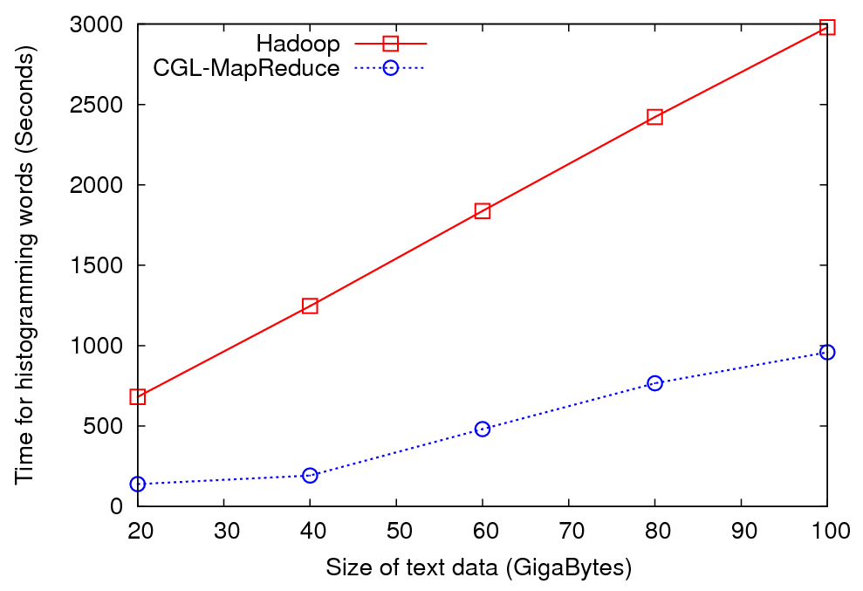
Word Histograming

Slide 16
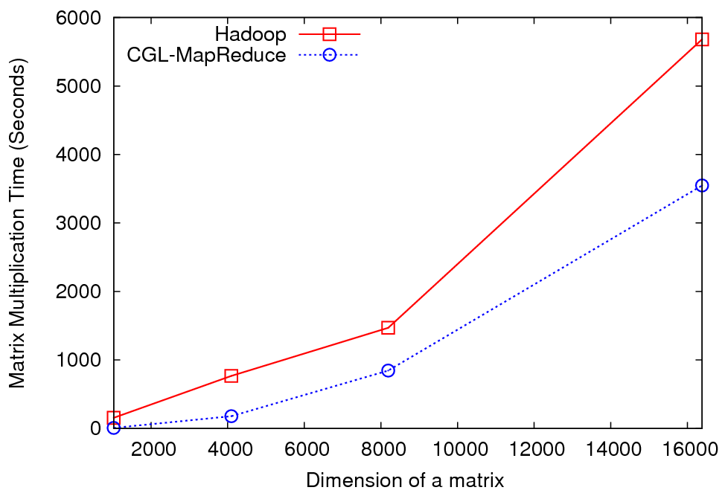
Matrix Multiplication
5 nodes of Quarry cluster at IU each of which has the following configurations. 2 Quad Core Intel Xeon E5335 2.00GHz with 8GB of memory

Slide 17
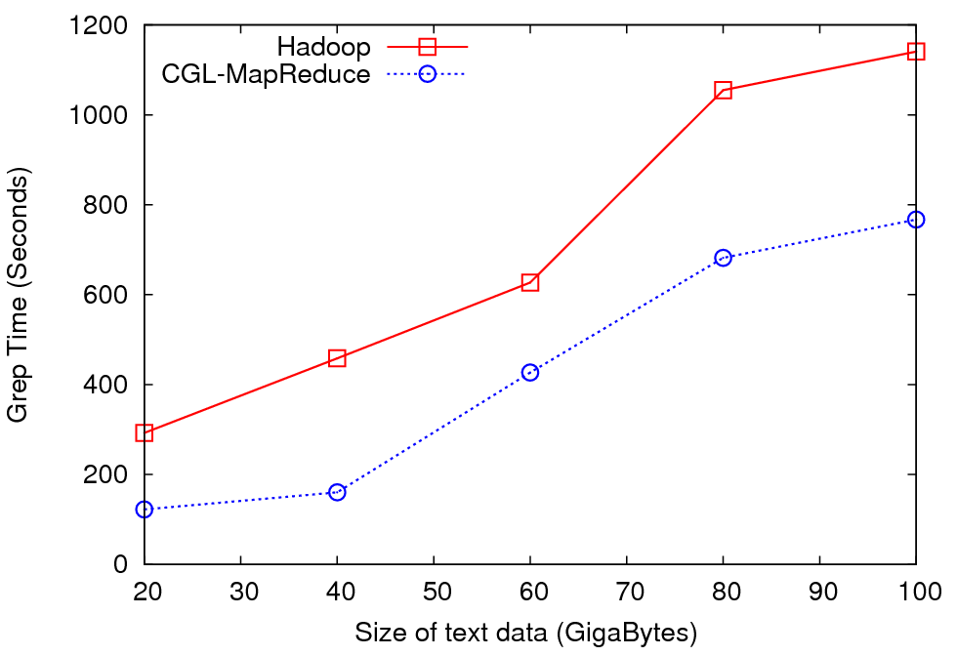
Grep Benchmark

Slide 18

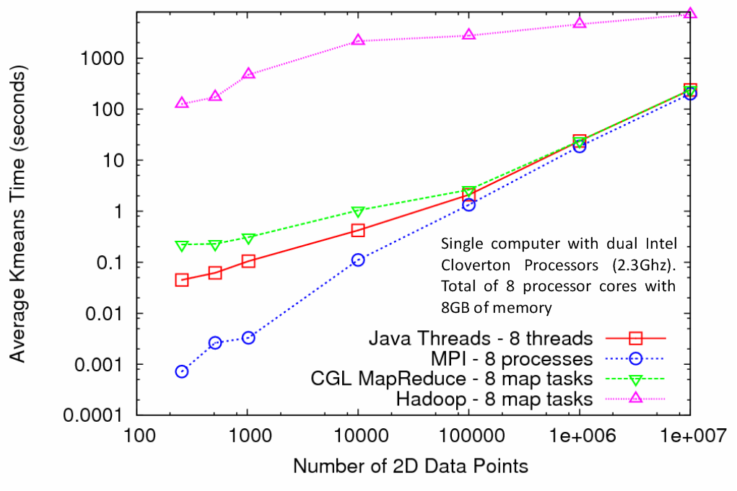
Kmeans Clustering
MapReduce for Kmeans Clustering
Kmeans Clustering, execution time vs. the number of 2D data points (Both axes are in log scale)
All three implementations perform the same Kmeans clustering algorithm
Each test is performed using 5 compute nodes (Total of 40 processor cores)
CGL-MapReduce shows a performance close to the MPI and Threads implementation
Hadoop’s high execution time is due to:
  Lack of support for iterative MapReduce computation
  Overhead associated with the file system based communication

Slide 19
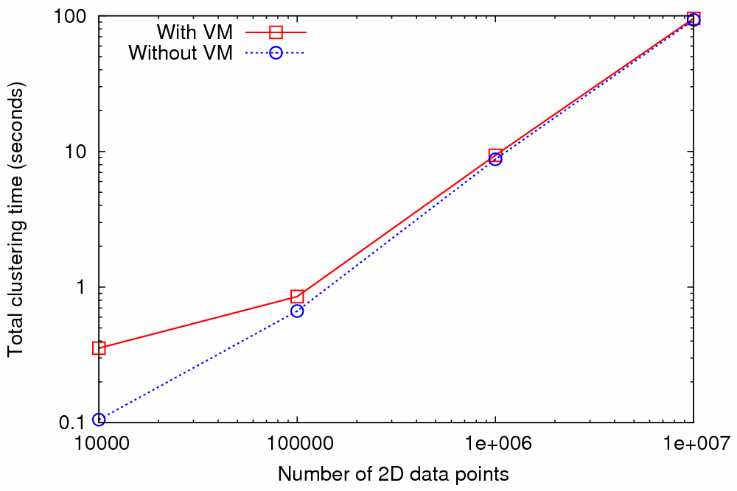
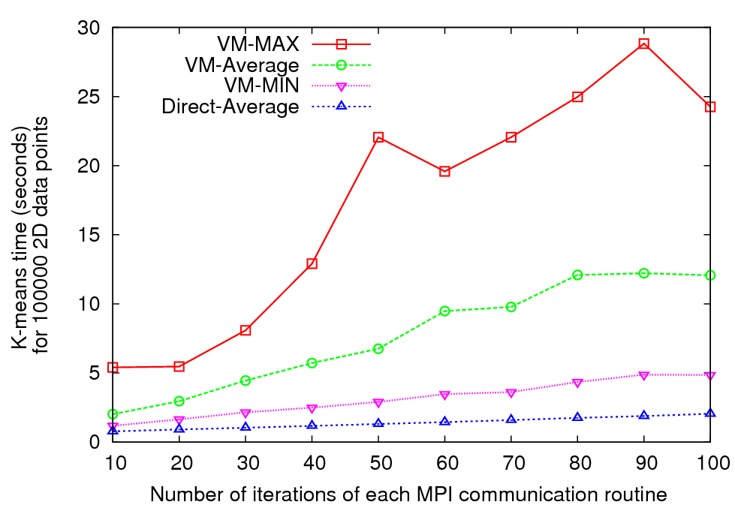
Nimbus Cloud – MPI Performance
Kmeans clustering time vs. the number of 2D data points.
(Both axes are in log scale)
Kmeans clustering time (for 100000 data points) vs. the number of iterations of each MPI communication routine
Graph 1 (Left) - MPI implementation of Kmeans clustering algorithm
Graph 2 (right) - MPI implementation of Kmeans algorithm modified to perform
each MPI communication up to 100 times
Performed using 8 MPI processes running on 8 compute nodes each with AMD Opteron™ processors (2.2 GHz and 3 GB of memory)
Note large fluctuations in VM-based runtime – implies terrible scaling

Slide 20
Nimbus Kmeans Time in secs for 100 MPI calls
Setup 1
Setup 1
VM_MIN | 4.857
VM_Average | 12.070
VM_MAX | 24.255
Setup 3
VM_MIN | 7.736
VM_Average | 17.744
VM_MAX | 32.922
Setup 2
VM_MIN | 5.067
VM_Average | 9.262
VM_MAX | 24.142
Direct
MIN | 2.058
Average | 2.069
MAX | 2.112
Setup 2
Direct
Setup 3
Test Setup | # of cores to the VM OS (domU) | # of cores to the host OS (dom0)
1 | 2 | 2
2 | 1 | 2
3 | 1 | 1

Slide 21
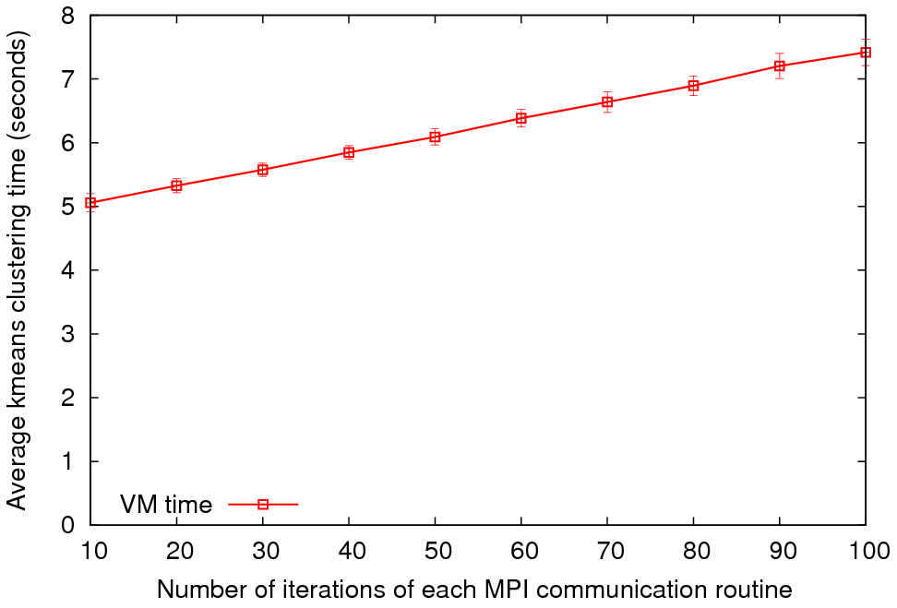
MPI on Eucalyptus Public Cloud
Kmeans Time for 100 iterations
Average Kmeans clustering time vs. the number of iterations of each MPI communication routine
4 MPI processes on 4 VM instances were used
Variable | MPI Time
VM_MIN | 7.056
VM_Average | 7.417
VM_MAX | 8.152
Configuration | VM
CPU and Memory | Intel(R) Xeon(TM) CPU 3.20GHz, 128MB Memory
Virtual Machine | Xen virtual machine (VMs)
Operating System | Debian Etch
gcc | gcc version 4.1.1
MPI | LAM 7.1.4/MPI 2
Network | -
We will redo on larger dedicated hardware
Used for direct (no VM), Eucalyptus and Nimbus

Slide 22
Is Dataflow the answer?
For functional parallelism, dataflow natural as one moves from one step to another
For much data parallel one needs “deltaflow” – send change messages to long running processes/threads as in MPI or any rendezvous model
  Potentially huge reduction in communication cost
For threads no difference but for processes big difference
Overhead is Communication/Computation
Dataflow overhead proportional to problem size N per process
For solution of PDE’s
  Deltaflow overhead is N^{1/3} and computation like N
  So dataflow not popular in scientific computing
For matrix multiplication, deltaflow and dataflow both O(N) and computation N^{1.5}
MapReduce noted that several data analysis algorithms can use dataflow (especially in Information Retrieval)

Slide 23
Programming Model Implications
The multicore/parallel computing world reviles message passing and explicit user decomposition
  It’s too low level; let’s use automatic compilers
The distributed world is revolutionized by new environments (Hadoop, Dryad) supporting explicitly decomposed data parallel applications
  There are high level languages but I think they “just” pick parallel modules from library (one of best approaches to parallel computing)
Generalize owner-computes rule
  if data stored in memory of CPU-i, then CPU-i processes it
To the disk-memory-maps rule
  CPU-i “moves” to Disk-i and uses CPU-i’s memory to load disk’s data and filters/maps/computes it

Slide 24
Deterministic Annealing for Pairwise Clustering
Clustering is a standard data mining algorithm with K-means best known approach
Use deterministic annealing to avoid local minima – integrate explicitly over (approximate) Gibbs distribution
Do not use vectors that are often not known or are just peculiar – use distances δ(i,j) between points i, j in collection –
N=millions of points could be available in Biology;
algorithms go like N² . Number of clusters
Developed (partially) by Hofmann and Buhmann in 1997 but little or no application (Rose and Fox did earlier vector based one)
Minimize H_{PC} = 0.5 ∑_{i=1}^{N} ∑_{j=1}^{N} δ(i, j) ∑_{k=1}^{K} M_{i}(k) M_{j}(k) / C(k)
M_{i}(k) is probability that point i belongs to cluster k
C(k) = ∑_{i=1}^{N} M_{i}(k) is number of points in k’th cluster
M_{i}(k) ∝ exp( -ε_{i}(k)/T ) with Hamiltonian ∑_{i=1}^{N} ∑_{k=1}^{K} M_{i}(k) ε_{i}(k)
Reduce T from large to small values to anneal

Slide 25
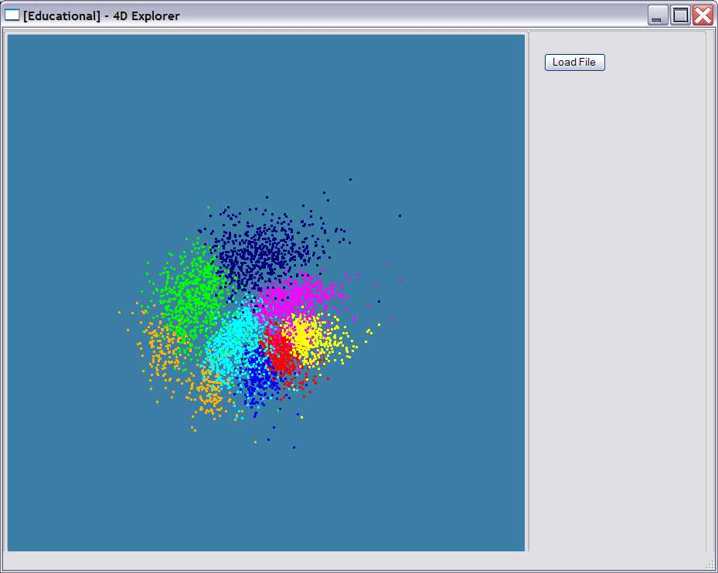
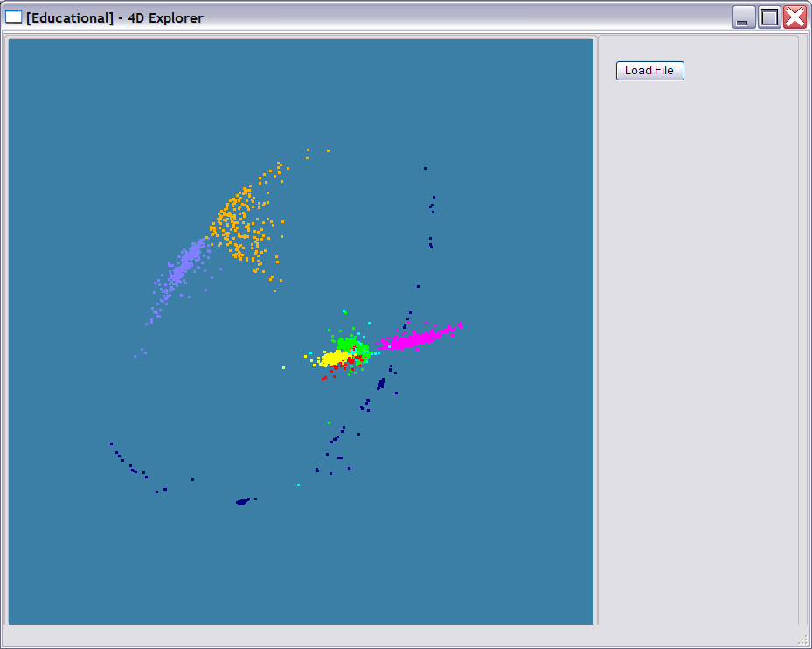
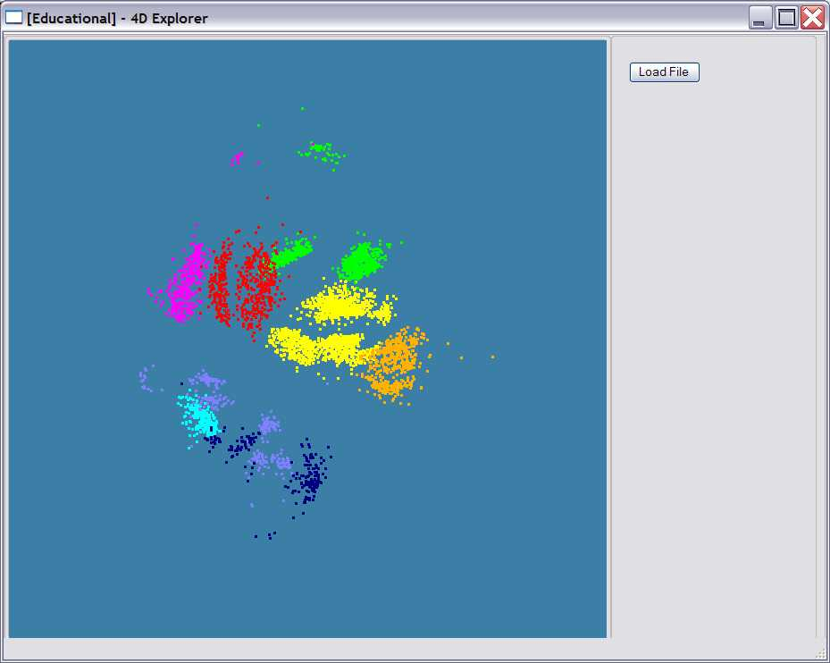
Various Sequence Clustering Results
4500 Points : Pairwise Aligned
3000 Points : Clustal MSA Kimura2 Distance
4500 Points : Clustal MSA
Map distances to 4D Sphere before MDS

Slide 26
Multidimensional Scaling MDS
Map points in high dimension to lower dimensions
Many such dimension reduction algorithm (PCA Principal component analysis easiest); simplest but perhaps best is MDS
Minimize Stress
σ(X) = Σ_{i<j=1}^{n} weight(i,j) (δ_{ij} - d(X_{i} , X_{j}))²
δ_{ij} are input dissimilarities and d(X_{i} , X_{j}) the Euclidean distance squared in embedding space (3D usually)
SMACOF or Scaling by minimizing a complicated function is clever steepest descent (expectation maximization EM) algorithm
Computational complexity goes like N². Reduced Dimension
There is an unexplored deterministic annealed version of it
Could just view as non linear χ² problem (Tapia et al. Rice)
All will/do parallelize with high efficiency

Slide 27
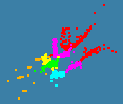

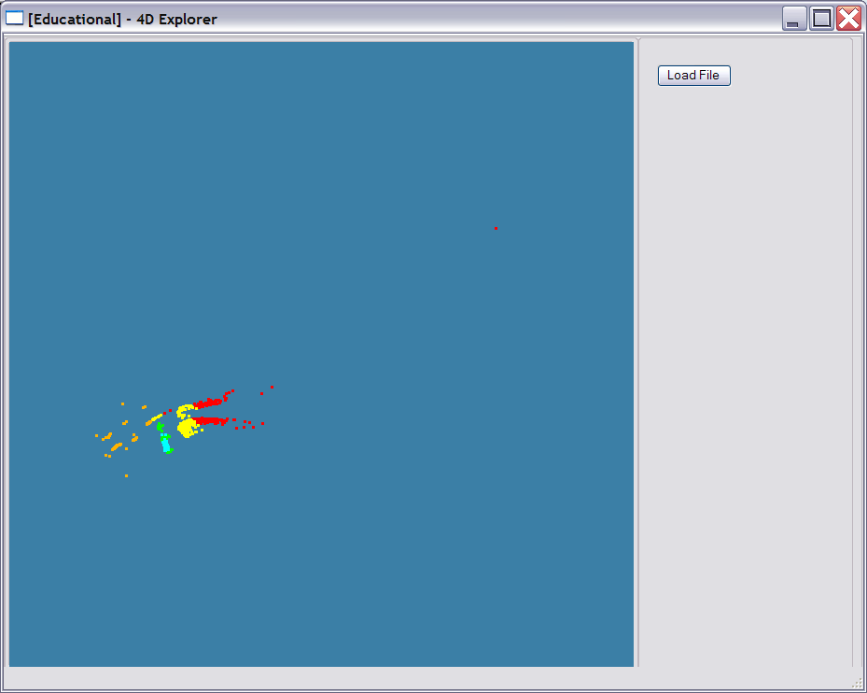
Obesity Patient ~ 20 dimensional data
Will use our 8 node Windows HPC system to run 36,000 records
Working with Gilbert Liu IUPUI to map patient clusters to environmental factors
2000 records 6 Clusters
4000 records 8 Clusters
Refinement of 3 of
clusters to left into 5

Slide 28
Windows Thread Runtime System
We implement thread parallelism using Microsoft CCR
(Concurrency and Coordination Runtime) as it supports both MPI rendezvous and dynamic (spawned) threading style of parallelism http://msdn.microsoft.com/robotics/
CCR Supports exchange of messages between threads using named ports and has primitives like:
FromHandler: Spawn threads without reading ports
Receive: Each handler reads one item from a single port
MultipleItemReceive: Each handler reads a prescribed number of items of a given type from a given port. Note items in a port can be general structures but all must have same type.
MultiplePortReceive: Each handler reads a one item of a given type from multiple ports.
CCR has fewer primitives than MPI but can implement MPI collectives efficiently
Can use DSS (Decentralized System Services) built in terms of CCR for service model
DSS has ~35 µs and CCR a few µs overhead

Slide 29
MPI Exchange Latency in µs (20-30 µs computation between messaging)
Machine | OS | Runtime | Grains | Parallelism | MPI Latency
Intel8c:gf12 (8 core 2.33 Ghz) (in 2 chips) | Redhat | MPJE(Java) | Process | 8 | 181
 |  | MPICH2 (C) | Process | 8 | 40.0
 |  | MPICH2:Fast | Process | 8 | 39.3
 |  | Nemesis | Process | 8 | 4.21
Intel8c:gf20 (8 core 2.33 Ghz) | Fedora | MPJE | Process | 8 | 157
 |  | mpiJava | Process | 8 | 111
 |  | MPICH2 | Process | 8 | 64.2
Intel8b (8 core 2.66 Ghz) | Vista | MPJE | Process | 8 | 170
 | Fedora | MPJE | Process | 8 | 142
 | Fedora | mpiJava | Process | 8 | 100
 | Vista | CCR (C#) | Thread | 8 | 20.2
AMD4 (4 core 2.19 Ghz) | XP | MPJE | Process | 4 | 185
 | Redhat | MPJE | Process | 4 | 152
 |  | mpiJava | Process | 4 | 99.4
 |  | MPICH2 | Process | 4 | 39.3
 | XP | CCR | Thread | 4 | 16.3
Intel(4 core) | XP | CCR | Thread | 4 | 25.8
Messaging CCR versus MPI C# v. C v. Java
SALSA
Notes:
29

Slide 30
MPI is outside the mainstream
Multicore best practice and large scale distributed processing not scientific computing will drive
Party Line Parallel Programming Model: Workflow (parallel--distributed) controlling optimized library calls
  Core parallel implementations no easier than before; deployment is easier
MPI is wonderful but it will be ignored in real world unless simplified; competition from thread and distributed system technology
CCR from Microsoft – only ~7 primitives – is one possible commodity multicore driver
  It is roughly active messages
  Runs MPI style codes fine on multicore
Mashups, Hadoop and Multicore and their relations are likely to replace current workflow (BPEL ..)

Slide 31
CCR Performance: 8 and 16 core AMD
Parallel
Overhead
≈ 1-efficiency
= (PT(P)/T(1)-1)
On P processors
= (1/efficiency)-1
1 2 4 8 16 cores
Patient Record Clustering by pairwise O(N²) Deterministic Annealing
“Real” (not scaled) speedup of 14.8 on 16 cores on 4000 points

Slide 32
Parallel Deterministic Annealing Clustering
Scaled Speedup Tests on four 8-core Systems
(10 Clusters; 160,000 points per cluster per thread)
Parallel
Overhead
≈ 1-efficiency
= (PT(P)/T(1)-1)
On P processors
= (1/efficiency)-1
Parallel Overhead
32-way
16-way
8-way
4-way
2-way
(1,1,1)
(CCR thread,
MPI process,
node)
(1,1,2)
(1,2,1)
(2,1,1)
(1,2,2)
(1,4,1)
(2,1,2)
(2,2,1)
(4,1,1)
(1,4,2)
(1,8,1)
(2,2,2)
(2,4,1)
(4,1,2)
(4,2,1)
(8,1,1)
(2,4,2)
(2,8,1)
(4,2,2)
(4,4,1)
(8,2,1)
(1,8,4)
(2,8,2)
(4,4,2)
(8,2,2)
Parallel Patterns
1, 2, 4, 8, 16, 32-way parallelism
C# Deterministic annealing Clustering Code with MPI and/or CCR threads

Slide 33
Parallel Deterministic Annealing Clustering
Scaled Speedup Tests on two 16-core Systems
(10 Clusters; 160,000 points per cluster per thread)
Parallel Overhead
8-way
32-way
48-way
2-way
4-way
(4,4,1)
(1,8,6)
(8,1,2)
(8,2,1)
(16,1,1)
(1,1,1)
(1,16,2)
(1,1,2)
(1,2,1)
(2,1,1)
(1,2,2)
(1,4,1)
(2,1,2)
(2,2,1)
(4,1,1)
(1,4,2)
(1,8,1)
(2,2,2)
(2,4,1)
(4,1,2)
(4,2,1)
(8,1,1)
(1,8,2)
(1,16,1)
(2,4,2)
(2,8,1)
(4,2,2)
(2,8,2)
(4,4,2)
(CCR thread,
MPI process,
node)
(8,2,2)
(16,1,2)
Parallel Patterns
1, 2, 4, 8, 16, 32, 48-way parallelism
48 way is 8 processes running on 4 8-core and 2 16-core systems
MPI always good. CCR deteriorates for 16 threads – probably bad software
MPI forces parallelism; threading allows

Slide 34
Some Parallel Computing Lessons I
Both threading CCR and process based MPI can give good performance on multicore systems
MapReduce style primitives really easy in MPI
  Map is trivial owner computes rule
  Reduce is “just”
globalsum = MPI_communicator.Allreduce(processsum, Operation<double>.Add)
Threading doesn’t have obvious reduction primitives?
  Here is a sequential version
  globalsum = 0.0; // globalsum often an array; address cacheline interference
  for (int ThreadNo = 0; ThreadNo < Program.ThreadCount; ThreadNo++)
  { globalsum+= partialsum[ThreadNo,ClusterNo] }
Could exploit parallelism over indices of globalsum
There is a huge amount of work on MPI reduction algorithms – can this be retargeted to MapReduce and Threading

Slide 35
Some Parallel Computing Lessons II
MPI complications comes from Send or Recv not Reduce
  Here thread model is much easier as “Send” in MPI (within node) is just a memory access with shared memory
  PGAS model could address but not likely in near future
Threads do not force parallelism so can get accidental Amdahl bottlenecks
Threads can be inefficient due to cacheline interference
  Different threads must not write to same cacheline
  Avoid with artificial constructs like:
  partialsumC[ThreadNo] = new double[maxNcent + cachelinesize]
Windows produces runtime fluctuations that give up to 5-10% synchronization overheads
Not clear that either if or when threaded or MPIed parallel codes will run on clouds – threads should be easiest

Slide 36
Run Time Fluctuations for Clustering Kernel
This is average of standard deviation of run time of the 8 threads between messaging synchronization points

Slide 37
Disk-Memory-Maps Rule
MPI supports classic owner computes rule but not clearly the data driven disk-memory-maps rule
Hadoop and Dryad have an excellent disk→memory model but MPI is much better on iterative CPU ←>CPU deltaflow
  CGLMapReduce (Granules) addresses iteration within a MapReduce model
Hadoop and Dryad could also support functional programming (workflow) as can Taverna, Pegasus, Kepler, PHP (Mashups) ….
“Workflows of explicitly parallel kernels” is a good model for all parallel computing

Slide 38
Components of a Scientific Computing environment
My laptop using a dynamic number of cores for runs
  Threading (CCR) parallel model allows such dynamic switches if OS told application how many it could – we use short-lived NOT long running threads
  Very hard with MPI as would have to redistribute data
The cloud for dynamic service instantiation including ability to launch:
MPI engines for large closely coupled computations
  Petaflops for million particle clustering/dimension reduction?
Analysis programs like MDS and clustering will run OK for large jobs with “millisecond” (as in Granules) not “microsecond” (as in MPI, CCR) latencies

