Slide 1
Design of the FutureGrid Experiment Management Framework
Gregor von Laszewski*,
Geoffrey C. Fox, Fugang Wang, Andrew Younge, Archit Kulshrestha, Greg Pike (IU),
Warren Smith, (TACC) Jens Vöckler (ISI), Renato J. (USC), Figueiredo (UF), The FG Team
* Pervasive Technology Institute
Indiana University
Bloomington, IN 47408
laszewski@gmail.com
http://www.futuregrid.org
This document was developed with support from the National Science Foundation (NSF) under Grant No. 0910812.

Slide 2
Overview of FG

Slide 3
FutureGrid key Issues
FutureGrid will provide an experimental testbed with a wide variety of computing services to its users.
The testbed provides to its users:
A rich development and testing platform for middleware and application users allowing comparisons in functionality and performance.
A variety of environments, many be instantiated dynamically, on demand. Available resources include, VMs, cloud, grid systems …
The ability to reproduce experiments at a later time (an experiment is the basic unit of work on the FutureGrid).
A rich education an teaching platform for advanced cyberinfrastructure
The ability to collaborate with the US industry on research projects.
Web Page: www.futuregrid.org
E-mail: help@futuregrid.org.

Slide 4
FutureGrid Partners and Resources
HW Resources at: Indiana University, SDSC, UC/ANL, TACC, University of Florida, Purdue,
Software Partners: USC ISI, University of Tennessee Knoxville, University of Virginia, Technische Universtität Dresden
However, users of FG do not have to be from these partner organizations. Furthermore, we hope that new organizations in academia and industry can partner with the project in the future.

Slide 5
Current HW Overview
FutureGrid has dedicated network (except to TACC) and a network fault and delay generator
Can isolate experiments on request; IU runs Network for NLR/Internet2
(Many) additional partner machines will run FutureGrid software and be supported (but allocated in specialized ways)
(*) IU machines share same storage; (**) Shared memory and GPU Cluster in year 2

Slide 6
Storage and Interconnect Hardware
System Type | Capacity (TB) | File System | Site | Status
DDN 9550 (Data Capacitor) | 339 | Lustre | IU | Existing System
DDN 6620 | 120 | GPFS | UC | New System
SunFire x4170 | 72 | Lustre/PVFS | SDSC | New System
Dell MD3000 | 30 | NFS | TACC | New System
Machine | Name | Internal Network
IU Cray | xray | Cray 2D Torus SeaStar
IU iDataPlex | india | DDR IB, QLogic switch with Mellanox ConnectX adapters Blade Network Technologies & Force10 Ethernet switches
SDSC iDataPlex | sierra | DDR IB, Cisco switch with Mellanox ConnectX adapters Juniper Ethernet switches
UC iDataPlex | hotel | DDR IB, QLogic switch with Mellanox ConnectX adapters Blade Network Technologies & Juniper switches
UF iDataPlex | foxtrot | Gigabit Ethernet only (Blade Network Technologies; Force10 switches)
TACC Dell | alamo | QDR IB, Mellanox switches and adapters Dell Ethernet switches

Slide 7
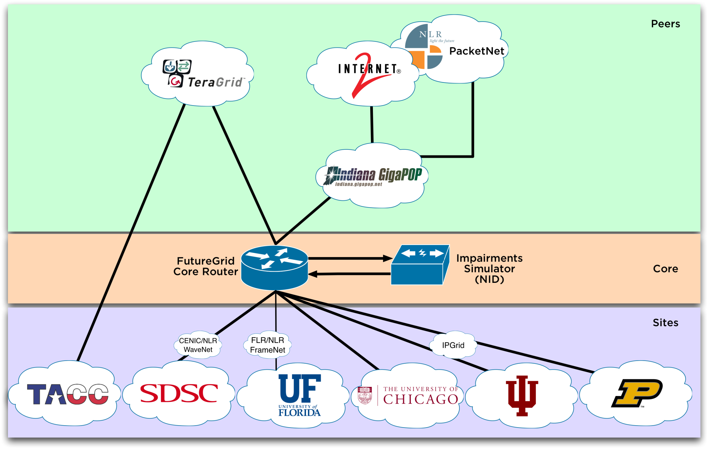
Logical Diagram

Slide 8
Network Impairment Device
Spirent XGEM Network Impairments Simulator for jitter, errors, delay, etc
Full Bidirectional 10G w/64 byte packets
up to 15 seconds introduced delay (in 16ns increments)
0-100% introduced packet loss in .0001% increments
Packet manipulation in first 2000 bytes
up to 16k frame size
TCL for scripting, HTML for manual configuration
Need exciting proposals to use!!

Slide 9
Scope
Projects & Experiments

Slide 10
Terminology
Project
Elementary unit of “request” for a users. It is similar to an allocation in a supercomputing center. A user could have many projects.
Experiment.
Elementary unit of “execution” to be used to verify goals of the project.
Experiments may be organized in a tree or direct acyclic Graph (DAG) and contain other experiments.
Experiment metadata:
experiment session,
the resource configuration ,
the resources used (apparatus),
the images used,
deployment specific attributes,
the application used,
the results of the experiments (typically files and data), and
the expected duration of the experiment.
An example of an experiment is running a Hadoop job as part of an academic class. If we view the class as a project, then each submitted student job could be viewed as an experiment.

Slide 11
Terminology (cont.)
Experiment Apparatus
Often it is desirable to conduct parameter studies or repetitive experiments with the same setup in regards to resources used. We refer to such a configuration as an ``experiment apparatus''. Such an apparatus allows the users to conveniently reuse the same setup without reconfiguration of the FutureGrid resources for different experiments.
Experiment Session
Besides the apparatus we often find that the apparatus can be used for executing a number of experiments. In addition, the instantiation of experiments may require additional configuration in order to address runtime issues. Together the apparatus and the configuration parameters are building an experiment session that as mentioned can also be used for multiple experiments.

Slide 12
Experiment Management Requirements

Slide 13
User Requirements
We have different communities with different requirements
FG Experiment Developer
Records his experiments for reuse by others
FG Experiment User
Replicates experiments from others.
FG Job Use
does not care about any of the issues and just want to run jobs.
FG Experiment Project Manager
Managing a group of users working on a project (includes teachers), concerned about reporting
FG System Administrators
Needs information about the FG and operation
FG Management,
Concerned about reporting and auditing

Slide 14
Functionality Requirements
Organize projects and experiments
Provide a uniform structure so that organization of experiments is possible
Annotate the experiments so they can be cataloged and shared (if desired)
Annotate what the experiment is about
Annotate which resources are being used
Annotate which results are produced by the experiment
Provide information about the nature of the projects and experiments to the FG management
Encourage collaboration
Provide a mechanism in which multiple users can easily collaborate as part of projects or even individual experiments
Conduct Experiments
Provision resources to conduct the experiments
Execute an experiment
Monitor the execution of experiments (irrespective of owner being individual, group, or management)
Record all required information for replication of the experiment
Reproduce the experiment with the help of the recorded information

Slide 15
Usecase Example: Class
Creating a Project
Teacher decides to use FutureGrid for the class
Teacher applied for project
The teacher is busy he delegates the management of students joining to his assistant
Joining the project
Students can join his project
Creating Experiments
Each week the teacher prepares a new experiment is conducted with a new apparatus and shares it
Students upload results into the publication section, including presentations.
Sharing Results
Teacher shares his results with others in community
Experiments can be repeated by others
Supported by
convenient interfaces this experiment management system and the data associated with it.
a Web portal,
a command line tool,
a REST interface,
an API in python (other scripting language interfaces could be derived from that).

Slide 16
Dynamic Provisioning
Supporting Experiments through dynamic provisioning

Slide 17
Classical Dynamic Provisioning
dynamically partition a set of resources
dynamically allocate the resources to users
dynamically define the environment that the resource use
dynamically assign them based on user request
deallocate the resources so they can be dynamically allocated again

Slide 18
Use cases of dynamic provisioning
Static provisioning:
Resources in a cluster may be statically reassigned based on the anticipated user requirements, part of an HPC or cloud service. It is still dynamic, but control is with the administrator. (Note some call this also dynamic provisioning.)
Automatic Dynamic provisioning:
Replace the administrator with intelligent scheduler.
Queue-based dynamic provisioning:
provisioning of images is time consuming, group jobs using a similar environment and reuse the image. User just sees queue.
Deployment:
dynamic provisioning features are provided by a combination of using XCAT and Moab

Slide 19
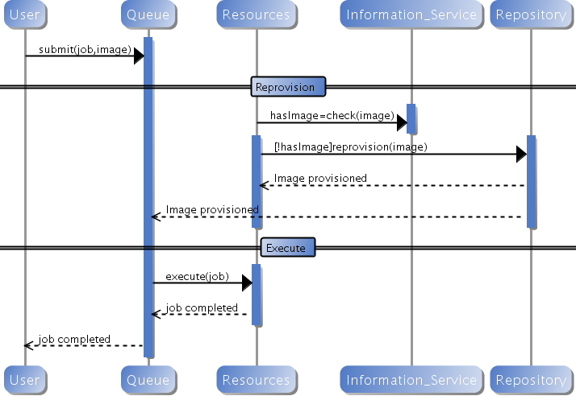
Generic Reprovisioning

Slide 20
Dynamic provisioning Examples
Give me a virtual cluster with 30 nodes based on Xen
Give me 15 KVM nodes each in Chicago and Texas linked to Azure and Grid5000
Give me a Eucalyptus environment with 10 nodes
Give 32 MPI nodes running on first Linux and then Windows
Give me a Hadoop environment with 160 nodes
Give me a 1000 BLAST instances linked to Grid5000
Run my application on Hadoop, Dryad, Amazon and Azure … and compare the performance

Slide 21
From Dynamic Provisioning to “RAIN”
In FG dynamic provisioning goes beyond the services offered by common scheduling tools that provide such features.
Dynamic provisioning in FutureGrid means more than just providing an image
adapts the image at runtime and provides besides IaaS, PaaS, also SaaS
We call this “raining” an environment
Rain = Runtime Adaptable INsertion Configurator
Users want to ``rain'' an HPC, a Cloud environment, or a virtual network onto our resources with little effort.
Command line tools supporting this task.
Integrated into Portal
Example ``rain'' a Hadoop environment defined by an user on a cluster.
fg-hadoop -n 8 -app myHadoopApp.jar …
Users and administrators do not have to set up the Hadoop environment as it is being done for them

Slide 22
FG RAIN Command
fg-rain –h hostfile –iaas nimbus –image img
fg-rain –h hostfile –paas hadoop …
fg-rain –h hostfile –paas dryad …
fg-rain –h hostfile –gaas gLite …
fg-rain –h hostfile –image img
Authorization is required to use fg-rain without virtualization.

Slide 23
Rain in FutureGrid

Slide 24
Experiment Management

Slide 25
Experiment Management Framework Design
Goal: organize projects and experiments
Closely integrated with image management, our dynamic provisioning

Slide 26
Data Structure related to Experiment Management
Hierarchical
PROJECT+
APPLICATION INFORMATION
DESCRIPTION
PERSON ID
...
ACCOUNT ADMINISTRATORS
PERSON ID+
USERS
PERSON ID+
(cont.)
EXPERIMENT+
MANAGER
PERSON ID+
STAFF
PERSON ID+
APPARATUS+
ID
RESOURCE+
EXPERIMENT+
APPARATUS: ID
DATE
TIME
JOB+
SERVICE+
ALLOCATION
RESOURCE+
PUBLICATIONS
ARTICLE+
REPORT+
TALK+
DEMO+

Slide 27
Image Management

Slide 28
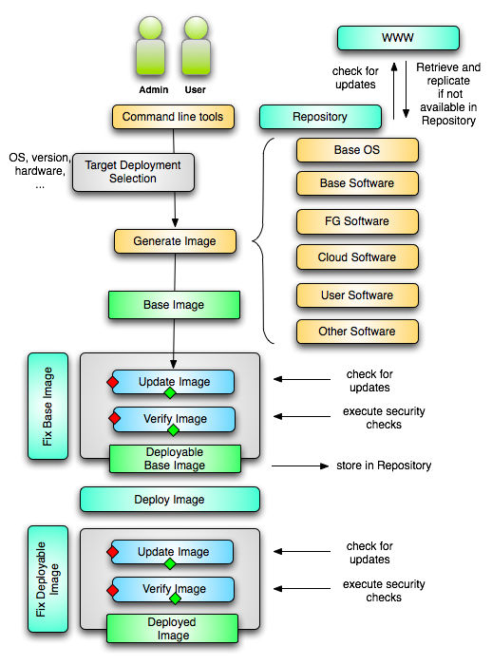
Image Creation
Creating deployable image
User chooses one base mages
User decides who can access the image; what additional software is on the image
Image gets generated; updated; and verified
Image gets deployed
Deployed image gets continuously
Updated; and verified
Note: Due to security requirement an image must be customized with authorization mechanism
We are not creating NxN images as many users will only need the base image
Administrators will use the same process to create the images that are vetted by them
An image gets customized through integration via a CMS process

Slide 29
Image Repository

Slide 30
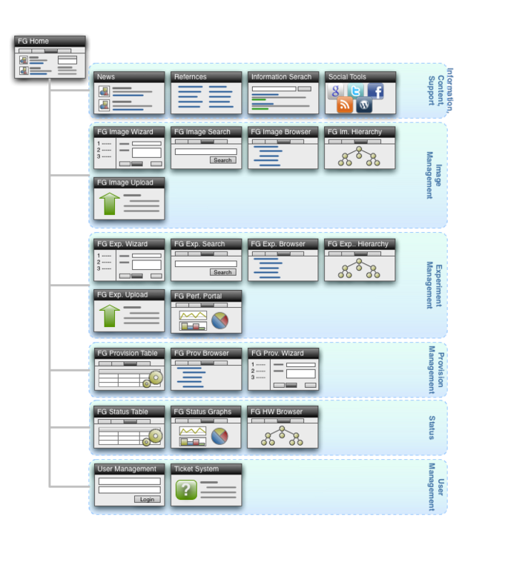
Portal Subsystem

Slide 31
Information Management

Slide 32
Information Services
What is happening on the system?
System administrator
User
Project Management & Funding agency
Remember FG is not just an HPC queue!
Which software is used?
Which images are used?
Which FG services are used (Nimbus, Eucalyptus, …?)
Is the performance we expect reached?
What happens on the network

Slide 33
Simple Overview

Slide 34
FG Cloud Monitor

Slide 35
Development Milestones
Acceptance tests
Phase I
Phase II
Phase III

Slide 36
Conclusion
Introduced FG Resource overview
Introduced design of the FG experiment management framework.
Described how experiments are managed
Described reproducibility goal
Provided details on how we
Creating, managing, organizing, images and how the images can be created and accessed while supporting the experiment execution.
Status
System is ready for use in Phase I.
Phase I is static and does not include experiment management capabilities introduced here.
We are working now on Phase II
Demos in Booth show progress in Experiment management (e.g. image creation, repository, …, rain)
Stop by the IU booth
send mail to: laszewski@gmail.com
Not available Tuesday morning

