Slide 1
A Dynamic Provisioning System for Federated Cloud and Bare-metal Environments
Gregor von Laszewski
laszewski@gmail.com
Geoffrey C. Fox, Fugang Wang

Slide 2
Acknowledgement
NSF Funding
Reuse of Slides
The FutureGrid project is funded by the National Science Foundation (NSF) and is led by Indiana University with University of Chicago, University of Florida, San Diego Supercomputing Center, Texas Advanced Computing Center, University of Virginia, University of Tennessee, University of Southern California, Dresden, Purdue University, and Grid 5000 as partner sites.
If you reuse the slides you must properly cite this slide deck and its associated publications.
Please contact Gregor von Laszewski
  laszewski@gmail.com

Slide 3

About the Presenter
Gregor von Laszewski
laszewski@gmail.com
is an Assistant Director of CGL and DSC at Indiana University and an Adjunct Associate Professor in the Computer Science department. He is currently conducting research in Cloud computing as part of the FutureGrid project in which he also serves as software architect. He held a position at Argonne National Laboratory from Nov. 1996 – Aug. 2009 where he was last a scientist and a fellow of the Computation Institute at University of Chicago. During the last two years of that appointment he was on sabbatical and held a position as Associate Professor and the Director of a Lab at Rochester Institute of Technology focusing on Cyberinfrastructure. He received a Masters Degree in 1990 from the University of Bonn, Germany, and a Ph.D. in 1996 from Syracuse University in computer science. He was involved in Grid computing since the term was coined. Current research interests are in the areas of Cloud computing. He has been the lead of the Java Commodity Grid Kit (http://www.cogkit.org and jglobus) which provide till today a basis for many Grid related projects including the Globus toolkit. His Web page is located at http://gregor.cyberaide.org.

Slide 4
Outline
FutureGrid
  Key Concepts
  Overview of Hardware
  Overview of Software
Cloudmesh
  Provisioning Management
    Dynamic Provisioning
    Use Cases
    RAIN
    Image Management
    RAIN Move
CloudMesh (cont.)
  Information Services
  Virtual Machine Management
  Experiment Management
  Accounting
  User On-Ramp
Next Steps
Summary

Slide 5
Key Concepts

Slide 6
Summary of Essential and
Differentiating Features of FutureGrid
Feature | FG | Vs AWS, Azure, …
Reproducibility | Reproducible performance, Selectable resources location | Difficult to reproduce Scheduler determined
Access to HPC | Includes also clusters | Includes also clusters (AWS)
Multiple Clouds | OpenStack, Eucalyptus, Nimbus, (OpenNebula) | One IaaS Framework
Target Users | Scientists, Researchers, Users, Technologists | Users, Technologists
Diverse Services | Integrates AWS, OpenStack, Hadoop, provisioning software for IaaS and PaaS, Integrate better with HPC, Integrated metrics/accounting between IaaS Integrated Account Management | One Framework

Slide 7
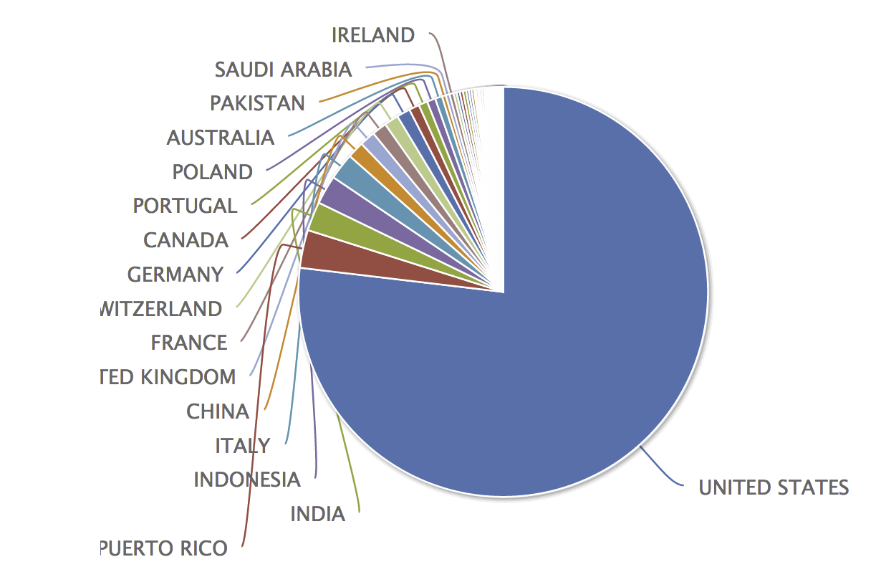
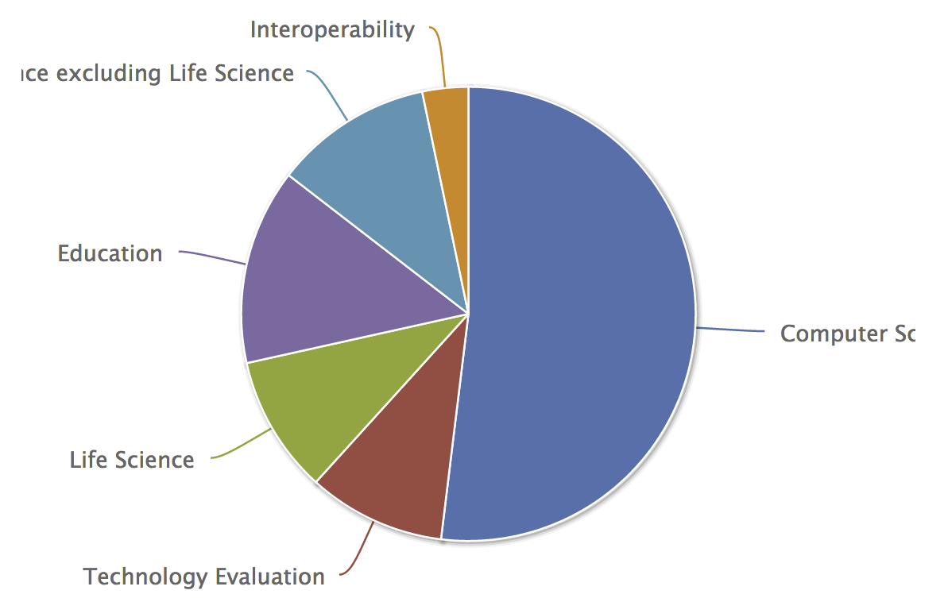
Uses for FutureGrid TestbedaaS
337 approved projects (1970 users) Sept 9 2013
  Users from 53 Countries
  USA (77%), Puerto Rico (3%), Indonesia (2.3%)
Computer Science and Middleware (55.2%)
  Core CS and Cyberinfrastructure (51.9%); Interoperability (3.3%) for Grids and Clouds such as Open Grid Forum OGF Standards
Domain Science applications (20.4%)
  Life science highlighted (9.8%), Non Life Science (11.3%)
Training Education and Outreach (13.9%)
  Semester and short events; interesting outreach to HBCU
Computer Systems Evaluation (9.8%)
  XSEDE (TIS, TAS), OSG, EGI; Campuses

Slide 8

FutureGrid Operating Model
Rather than just loading images onto VM’s, FutureGrid also supports Cloud, Grid and Parallel computing environments by provisioning software as needed onto “bare-metal” or VM’s/Hypervisors
  Image library for MPI, OpenMP, MapReduce (Hadoop, (Dryad), Twister), gLite, Unicore, Globus, Xen, ScaleMP (distributed Shared Memory), Nimbus, Eucalyptus, OpenNebula, KVM, Windows …..
  Either statically or dynamically
Image1
Image2
…
ImageN
Load
Choose
Run
VM or baremetal

Slide 9
Overview of Hardware

Slide 10
Hardware & Support
Computing
  Distributed set of clusters at
    IU, UC, SDSC, UFL
  Diverse specifications
    See portal
Networking
  WAN 10GB/s
  Many Clusters Infiniband
  Network fault generator
Storage
  Sites maintain their own shared file server
  Has been upgraded on one cluster to 12TB per server due to user request
Support
  Portal
  Ticket System
  Integrated Systems and Software Team

Slide 11

FutureGrid: a Grid/Cloud/HPC Testbed
12TF Disk rich + GPU 512 cores
NID: Network Impairment Device
Private
Public
FG Network

Slide 12
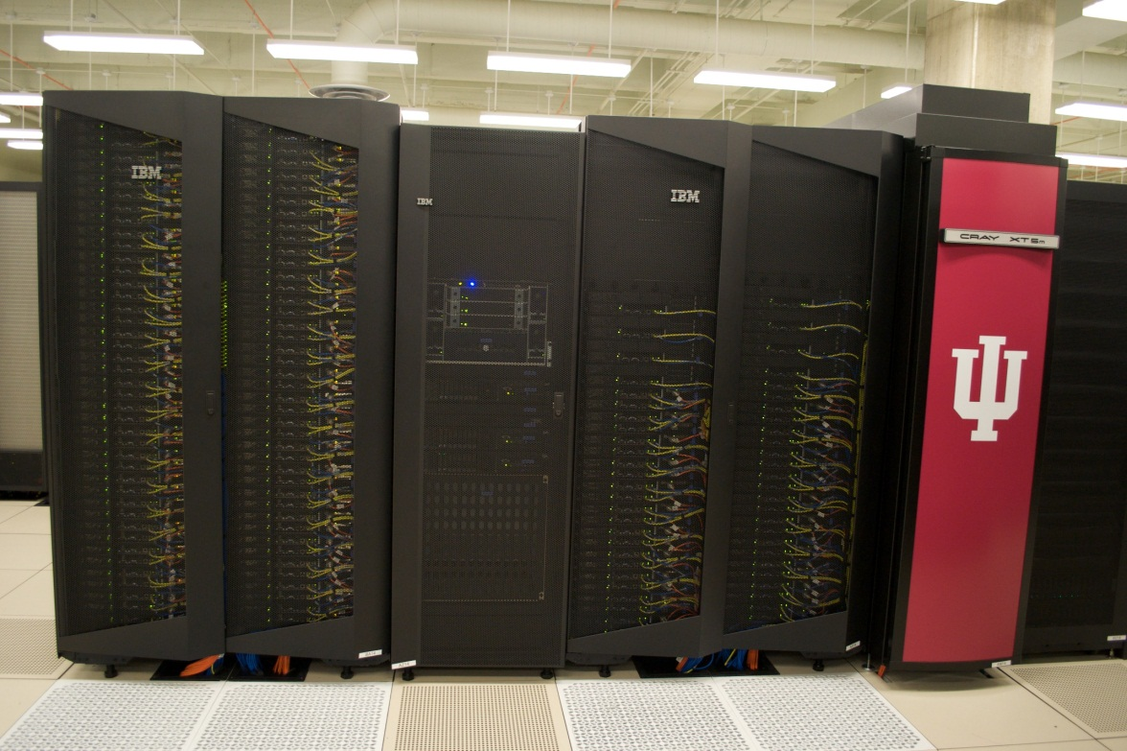
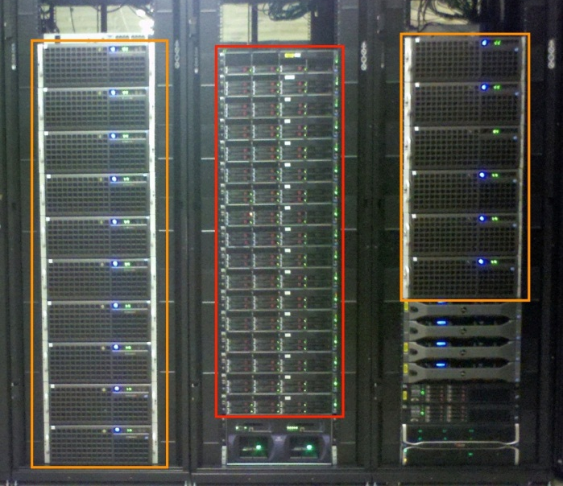
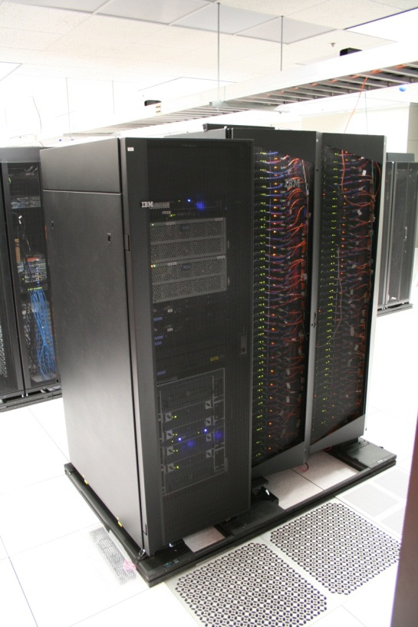
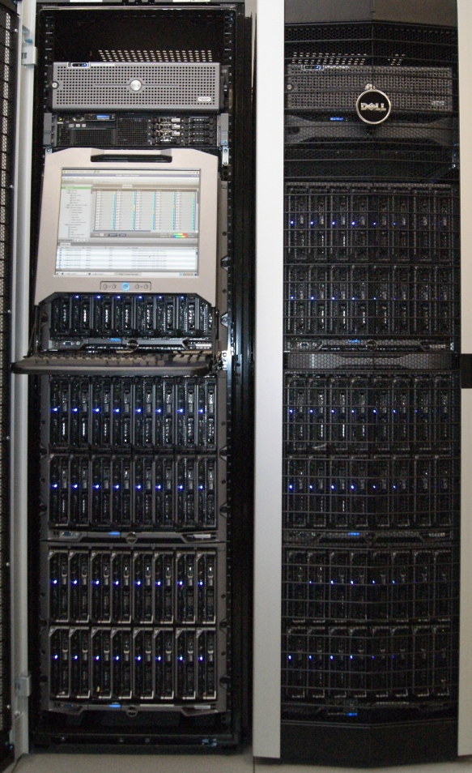
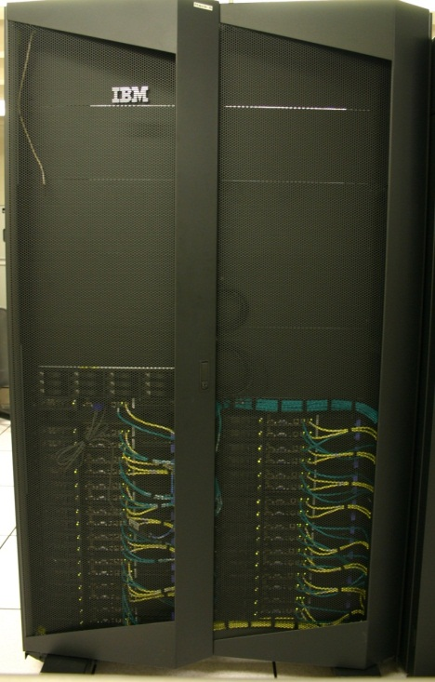
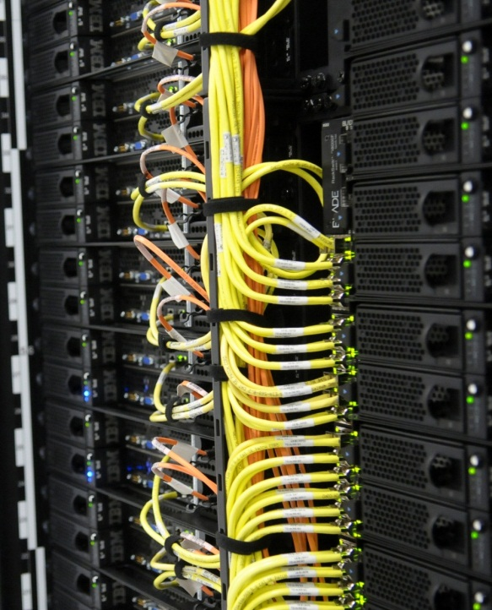
FutureGrid Clusters
FutureGrid Distributed Testbed-aaS
Bravo Delta (IU)
India (IBM) and Xray (Cray) (IU)
Hotel (Chicago)
Foxtrot (UF)
Sierra (SDSC)
Alamo (TACC)

Slide 13
Heterogeneous Systems Hardware
Name | System type | # CPUs | # Cores | TFLOPS | Total RAM (GB) | Secondary Storage (TB) | Site | Status
India | IBM iDataPlex | 256 | 1024 | 11 | 3072 | 512 | IU | Operational
Alamo | Dell PowerEdge | 192 | 768 | 8 | 1152 | 30 | TACC | Operational
Hotel | IBM iDataPlex | 168 | 672 | 7 | 2016 | 120 | UC | Operational
Sierra | IBM iDataPlex | 168 | 672 | 7 | 2688 | 96 | SDSC | Operational
Xray | Cray XT5m | 168 | 672 | 6 | 1344 | 180 | IU | Operational
Foxtrot | IBM iDataPlex | 64 | 256 | 2 | 768 | 24 | UF | Operational
Bravo | Large Disk & memory | 32 | 128 | 1.5 | 3072 (192GB per node) | 192 (12 TB per Server) | IU | Operational
Delta | Large Disk & memory With Tesla GPU’s | 32 CPU 32 GPU’s | 192 | 9 | 3072 (192GB per node) | 192 (12 TB per Server) | IU | Operational
Lima | SSD Test System | 16 | 128 | 1.3 | 512 | 3.8 (SSD) 8 (SATA) | SDSC | Operational
Echo | Large memory ScaleMP | 32 | 192 | 2 | 6144 | 192 | IU | Beta
TOTAL |  | 1128 + 32 GPU | 4704 +14336 GPU | 54.8 | 23840 | 1550

Slide 14
Overview of Software

Slide 15
Selected Software Services Categories
PaaS
IaaS
Infrastructure as a Service
Deliver a compute infrastructure as a service
GridaaS
Deliver services to support the creation of virtual organizations contributing resources
HPCaaS
Platform as a Service:
High Performance Computing
Delivery of a computing platform and solution stack
Traditional high performance computing cluster environment
Hardware
Clusters, Networking, Impairment Device
TestbedaaS =TaaS
Other Services
  Other services useful for the users as part of the FG service offerings

Slide 16
Selected List of Services Offered
IaaS
Nimbus
Cloud PaaS
Hadoop
Iterative MapReduce
HDFS
Hbase
Swift Object Store
MPI
TaaS (Testbed as a Service)
Infrastructure: Inca, Ganglia
Eucalyptus
OpenStack
ViNE
HPCaaS
OpenMP
CUDA
GridaaS
Unicore
SAGA
Globus
Genesis
Provisioning: RAIN, CloudMesh
VMs: Phantom, CloudMesh
Experiments: Pegasus, Precip
Cloudmesh
Accounting: FG, XSEDE
FutureGrid

Slide 17
Simplified TaaS Software Architecture

Slide 18
TaaS Software Architecture

Slide 19
Services Offered
 | India | Sierra | Hotel | Foxtrot | Alamo | Xray | Bravo | Delta | Echo
myHadoop | ✔ | ✔ |  |  | ✔
Nimbus |  | ✔ | ✔ | ✔ | ✔
OpenStack | ✔ | ✔ |  |  | ✔ |  |  | ✔
Eucalyptus | ✔ | 
ViNe¹ | ☑ | ✔ | ☑ | ✔ | ☑
Genesis II | ✔ | ✔ |  |  | ✔ | ✔
Unicore | ✔ | ✔ |  |  |  | ✔
MPI | ✔ | ✔ | ✔ | ✔ | ✔ | ✔ | ✔
OpenMP |  |  |  |  |  | ✔
ScaleMP |  |  |  |  |  |  |  |  | ✔
Ganglia | ✔ | ✔ | ✔ | ✔ | ✔
Pegasus³ | ☑ | ☑ | ☑ | ☑ | ☑
Inca | ✔ | ✔ | ✔ | ✔ | ✔ | ✔
Portal² | ☒ | ☒ | ☒ | ☒ | ☒ | ☒
PAPI |  |  |  |  |  | ✔
Globus |  |  |  |  | ✔
ViNe can be installed on the
other resources via Nimbus ☑
Access to the resource is requested through the portal ☒
Pegasus available via Nimbus and Eucalyptus images
.. deprecated

Slide 20
Which Services should we install?
We look at statistics on what users request
We look at interesting projects as part of the project description
We look for projects which we intend to integrate with: e.g. XD TAS, XSEDE
We look at community activities

Slide 21
Technology Requests per Quarter
(c) It is not permissible to publish the above graph in a paper or report without permission and potential co-authorship to avoid misinterpretation. Please contact laszewski@gmail.com

Slide 22
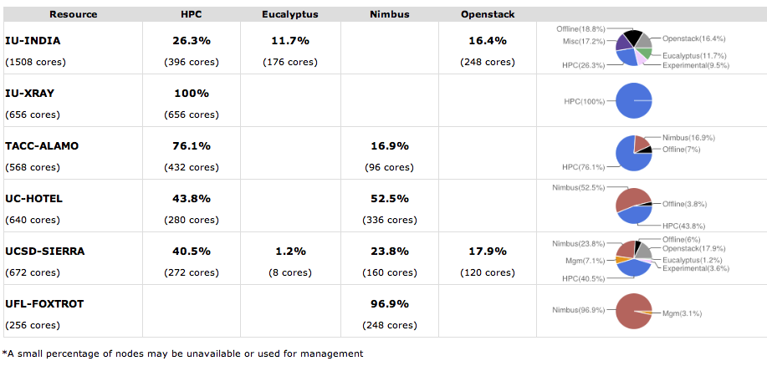
Flexible Service Partitioning

Slide 23
Selected List of Services Offered
IaaS
Nimbus
Cloud PaaS
Hadoop
Iterative MapReduce
HDFS
Hbase
Swift Object Store
MPI
TestbedaaS
Infrastructure: Inca, Ganglia
Eucalyptus
OpenStack
ViNE
HPCaaS
OpenMP
CUDA
GridaaS
Unicore
SAGA
Globus
Genesis
Provisioning: RAIN, CloudMesh
VMs: Phantom, CloudMesh
Experiments: Pegasus, Precip,
Cloudmesh
Accounting: FG, XSEDE
FutureGrid

Slide 24
Cloudmesh
An evolving toolkit and service to
build and interface with
a testbed so that users can conduct advanced reproducible experiments

Slide 25
Cloudmesh Functionality View
Virtual Machine
Management
  IaaS Abstraction
Provisioning Management
  Rain
  Cloud Shifting
  Cloud Bursting
Experiment
Management
  Shell
  IPython
Information Services
  CloudMetrics
Accounting
  FG Portal
  XSEDE Portal
Future Grid
TaaS
User On-Ramp
Amazon, Azure, FutureGrid, XSEDE,
OpenCirrus, ExoGeni, Other Science Clouds

Slide 26
Cloudmesh Layered Architecture View
Notes:
Multiple components are part of cloudmesh. Cloudmesh is an umbrella for it. We are still debating about its name as we aslo could have used RAIN. But rain was initially just a small component and deals predominantly so far with templated image management

Slide 27
Provisioning Management
Virtual Machine
Management
  IaaS Abstraction
Provisioning Management
  Rain
  Cloud Shifting
  Cloud Bursting
Experiment
Management
  Shell
  IPython
Information Services
  CloudMetrics
Accounting
  FG Portal
  XSEDE Portal
Future Grid
TaaS
User On-Ramp
Amazon, Azure, FutureGrid, XSEDE,
OpenCirrus, ExoGeni, Other Science Clouds

Slide 28
Dynamic Provisioning
Dynamically partition a set of resources
Dynamically allocate resources to users
Dynamically define the environment that a resource is going to use
Dynamically assign them based on user request
Deallocate the resources so they can be dynamically allocated again

Slide 29
Use Cases
Static provisioning:
  Resources in a cluster may be statically reassigned based on the anticipated user requirements, part of an HPC or cloud service. It is still dynamic, but control is with the administrator. (Note some call this also dynamic provisioning.)
Automatic Dynamic provisioning:
  Replace the administrator with intelligent scheduler.
Queue-based dynamic provisioning:
  provisioning of images is time consuming, group jobs using a similar environment and reuse the image. User just sees queue.
Deployment:
  Use dynamic provisioning to deploy services and tools. Integrate with baremetal provisioning

Slide 30
Observation
What do users get:
    Provisioning of OS
What do users want:
    Provisioning of advanced services
    Flexibility in creating the baremetal OS and services
    Provisioning the same image on VM and baremetal
Confusion exists:
    Different use of term Dynamic Provisioning dependent on Vendor, Project, …

Slide 31
Avoid Confusion
To avoid confusion with the overloaded term
  Dynamic Provisioning
we will use the term
  RAIN

Slide 32
What is RAIN?
Templates
&
Services
Virtual Cluster
Virtual
Machine
Hadoop
OS Image
Other
Resources

Slide 33
RAIN/RAINING is a Concept
Cloudmesh is a framework implementing RAIN
It includes a component called Rain

Slide 34
RAIN Terminology
Image Management provides the low level software to create, customize, store, share and deploy images needed to achieve Dynamic Provisioning and coordinate it with RAIN
Image Provisioning is referred to as providing machines with the requested OS
RAIN is our highest level component that uses
  Image Management to provide custom environments that may have to be created. Therefore, a Rain request may involve the
  (1) creating, (2) deploying, and (3) provisioning
  of one or more images in a set of machines on demand
  Service Management to provide runtime adaptations to provisioned images on servers and to register the services into a mesh of services

Slide 35
Motivating Use Cases for RAIN
Redeploy my cluster on nodes I have used previously for IaaS
Give me a virtual cluster with 30 nodes based on Xen
Give me 15 KVM nodes each in SDSC and IU linked to Azure
Give me a Eucalyptus environment with 10 nodes
Give 32 MPI nodes running on first Linux and then Windows
Give me a Hadoop environment with 160 nodes
Give me a 1000 BLAST instances
Run my application on Hadoop, Dryad, Amazon and Azure … and compare the performance

Slide 36
RAIN Dynamic Resourcing
Capability Use Cases
Cloud/HPC Bursting
Resource(Cloud/HPC) Shifting or
Dynamic Resource Provisioning
Move workload (images/jobs) to other clouds (or HPC Clusters) in case your current resource gets over utilized.
Users do this
Providers do this
Schedulers do this
Add more resources to a cloud or HPC capability from resources that are not used or are underutilized.
Now doing this by hand
We are automatizing this
  PhD thesis
We want to integrate this with Cloud Bursting
Requires Access to Resources

Slide 37
Distribution Use Cases
Deployment. Deploy custom services onto Resources including IaaS, PaaS, Queuing System aaS, Database aaS, Application/Software aaS, Address bare metal provisioning
Runtime. Smart services that act on-demand changes for resource assignment between Iaas, PaaS, A/SaaS
Interface. Simple interfaces following Gregor’s CAU-Principle: equivalence between
Command line, API and User interface

Slide 38
CAU Vision
  cm-rain –h hostfile –iaas openstack –image img
  cm-rain –h hostfile –paas hadoop …
  cm-rain –h hostfile –paas virtual-slurm-cluster …
  cm-rain –h hostfile –gaas genesisII …
  cm-rain –h hostfile –image img
Command
Shell
API
User Portal/
User Interface
Gregor’s CAU principle

Slide 39
Summary of Design Goals of Cloudmesh
Requirements
Initial Release Capabilities
Support Shifting and Bursting
Support User-OnRamp
Supports general commercial/academic cloud federation
Bare metal and Cloud provisioning
Extensible architecture
Plugin mechanism
Security
Provide Service RAINing
Delivers API, services, command line, command shell that supports the tasks needed to conduct provisioning and shifting
Uniform API to multiple clouds via native protocol
  Important for scalability tests
  EC2 compatible tools and libraries are not enough (experience from FG)

Slide 40
Rain Implementation v.1

Slide 41
Cloudmesh v2.0
Current Features
Under Development
Manages images on VMs & Bare metal
  templated images
Uses low-level client libraries
  important for testing
Command shell
Moving of resources
  Eucalyptus, OpenStack, HPC
Independent baremetal provisioning
Provisioning via AMQP
Provisioning multiple clusters
  Provisioning Inventory for FG
  Provisioning Monitor
Provisioning command shell plugins
Provisioning Metrics

Slide 42
Image Management

Slide 43
Motivation
  The goal is to create and maintain platforms in custom VMs that can be retrieved, deployed, and provisioned on demand.
  A unified Image Management system to create and maintain VM and bare-metal images.
  Integrate images through a repository to instantiate services on demand with RAIN.
  Essentially enables the rapid development and deployment of platform services on FutureGrid infrastructure.

Slide 44
What happens internally?
Generate a Centos image with several packages
  cm-image-generate –o centos –v 5.6 –a x86_64 –s emacs, openmpi –u gregor
  > returns image: centosgregor3058834494.tgz
Deploy the image on HPC (-x)
  cm-image-register -x im1r –m india -s india -t /N/scratch/ -i centosgregor3058834494.tgz -u gregor
Submit a job with that image
  qsub -l os=centosgregor3058834494 testjob.sh

Slide 45
Lifecycle of Images

Slide 46
Image Management
Major Services
Goal
Image Repository
Image Generator
Image Deployment
Dynamic provisioning
External Services
Create and maintain platforms in custom images that can be retrieved, deployed, and provisioned on demand
Use case:
  cm-image-generate –o ubuntu –v maverick -s openmpi-bin,gcc,fftw2,emacs\
  –n ubuntu-mpi-dev –label mylabel
  cm-image-deploy –x india.futuregrid.org –label mylabel
  cm-rain –provision -n 32 ubuntu-mpi-dev

Slide 47
Design of the Image Generation
  Users who want to create a new FG image specify the following:
    OS type
    OS version
    Architecture
    Kernel
    Software Packages
  Image is generated, then deployed to specified target.
  Deployed image gets continuously scanned, verified, and updated.
  Images are now available for use on the target deployed system.

Slide 48
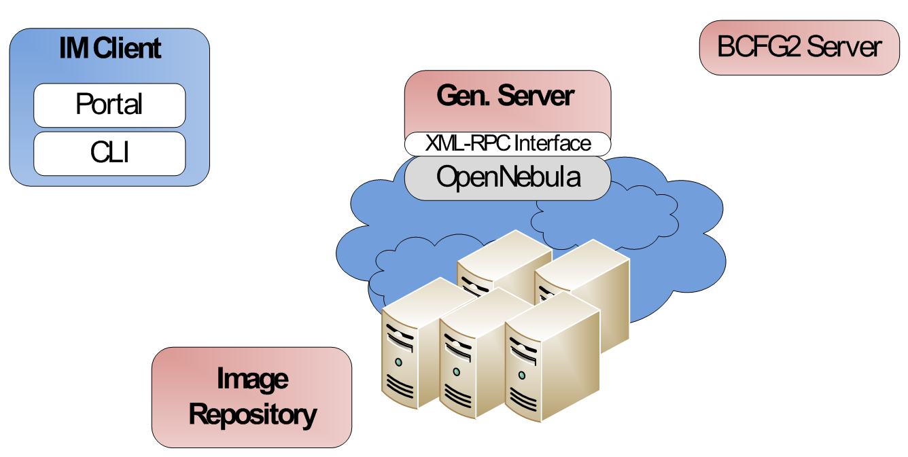
Generate an Image
cm-generate -o centos -v 5 -a x86_64
–s python26,wget (returns id)
Generate img
Deploy VM
And
Gen. Img
1
2
3
Store in the Repo
or
Return it to user

Slide 49
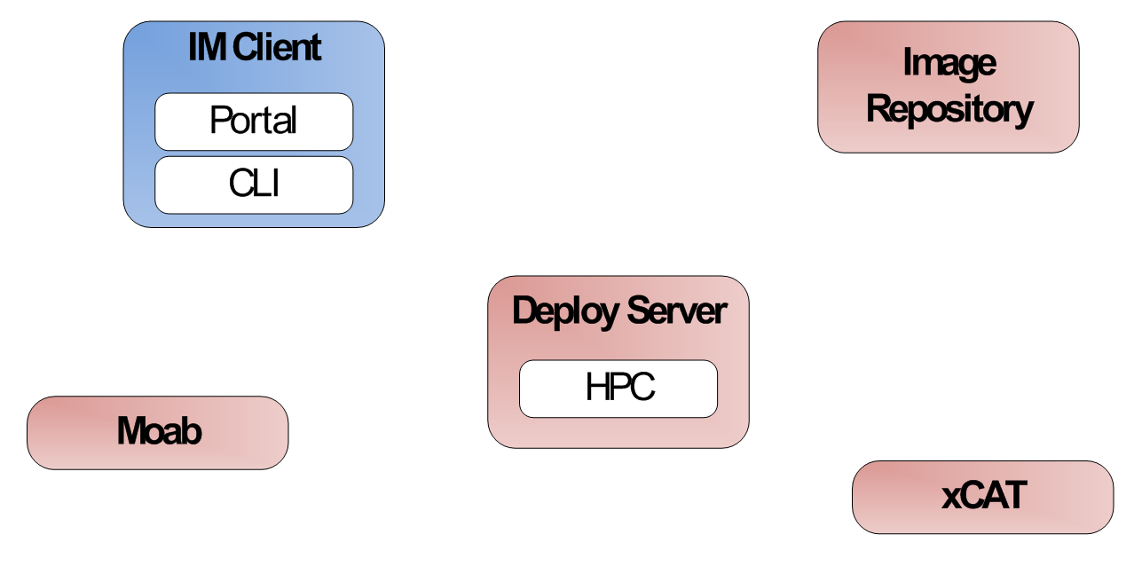
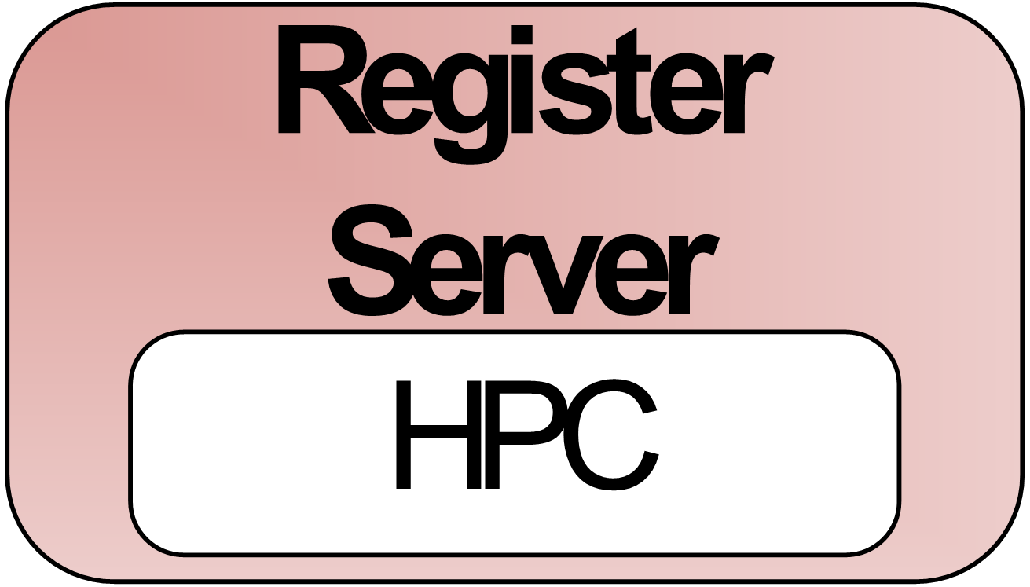
Register an Image for HPC
cm-register -r 2131235123 -x india
Register img from Repo
Get img from Repo
1
2
Register img in Moab and recycle sched
5
Customize img
6
3
Return info about the img
Register img in xCAT (cp files/modify tables)
4

Slide 50
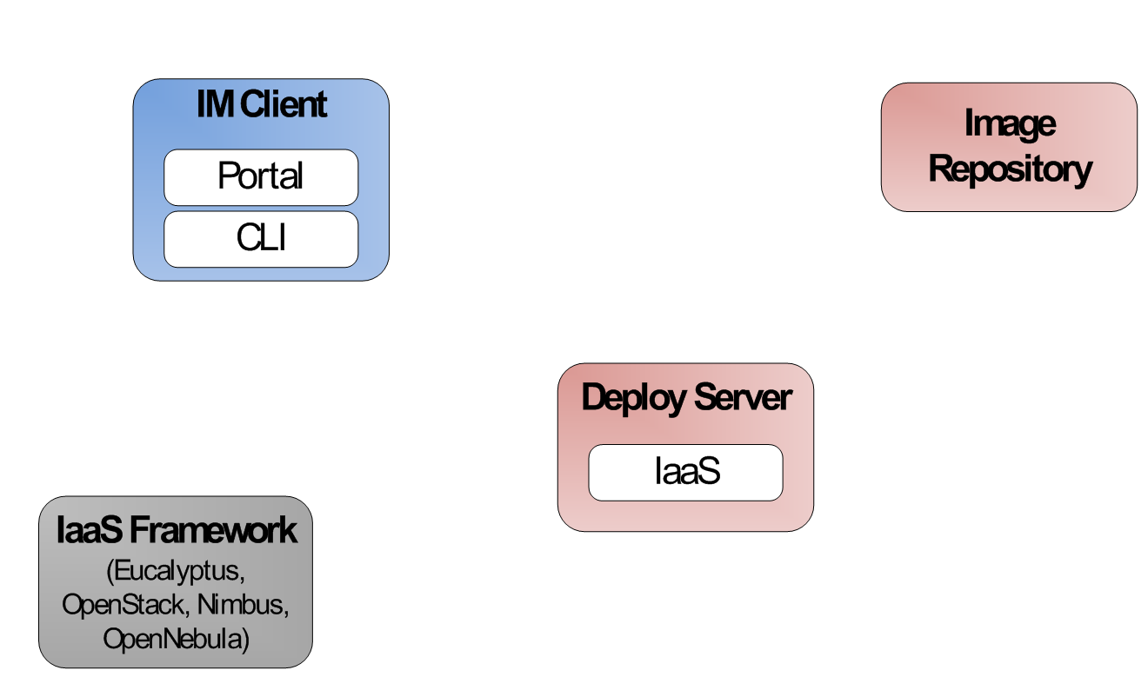
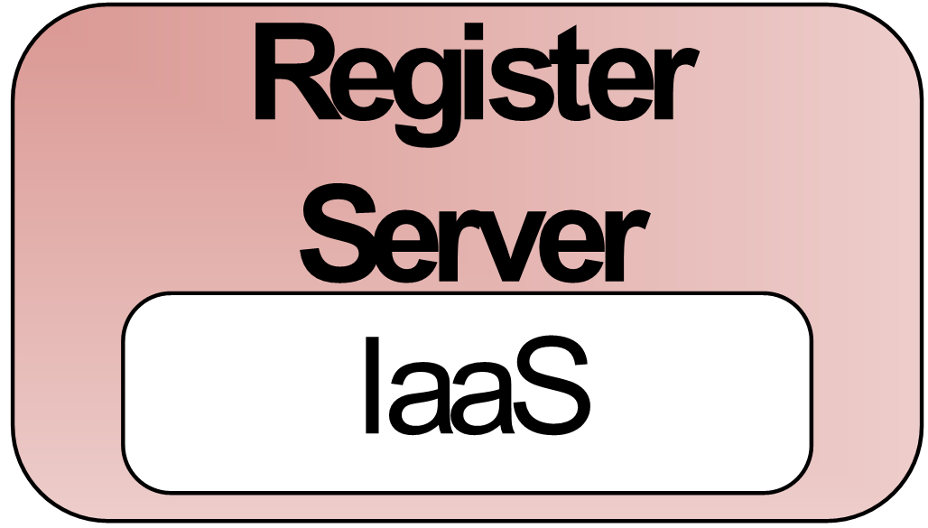
Register an Image stored in the Repository into OpenStack
cm-register -r 2131235123 -s india
Deploy img from Repo
Get img from Repo
1
2
Upload the img to the Cloud
Customize img
5
4
Return img to client
3

Slide 51
List of Registered Images for xCAT/Moab
cm-register –u $USER -l –x india
List deployed Images
1
Return Images both know about
4
Tell me what images you know
Tell me what images you know
3
2

Slide 52
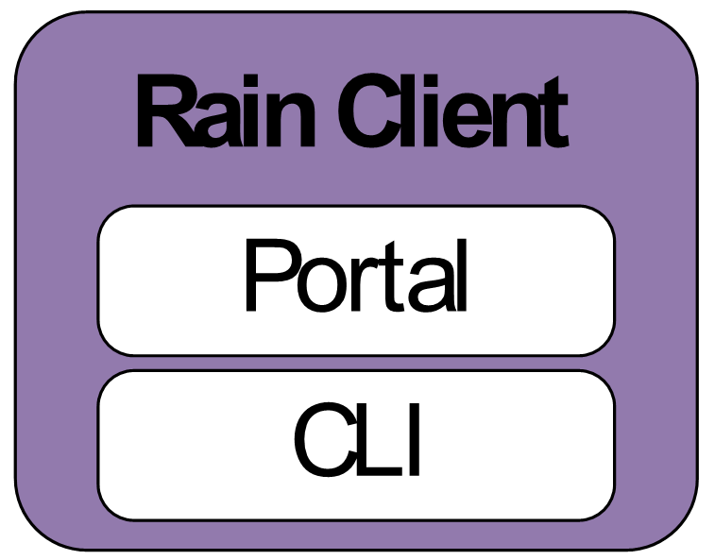
Rain an Image and execute a task (baremetal)
cm-rain -r 123123123 -x india -j testjob.sh -m 2
Run job in my image stored in the repo
7
qsub, monitor status, completion status and indiacate output files
1
Register img
2
Register img from Repo
Get img from Repo
3
4
Register img in Moab and recycle sched
7
Customize img
8
5
Return info about the img
Register img in xCAT (cp files/modify tables)
6

Slide 53
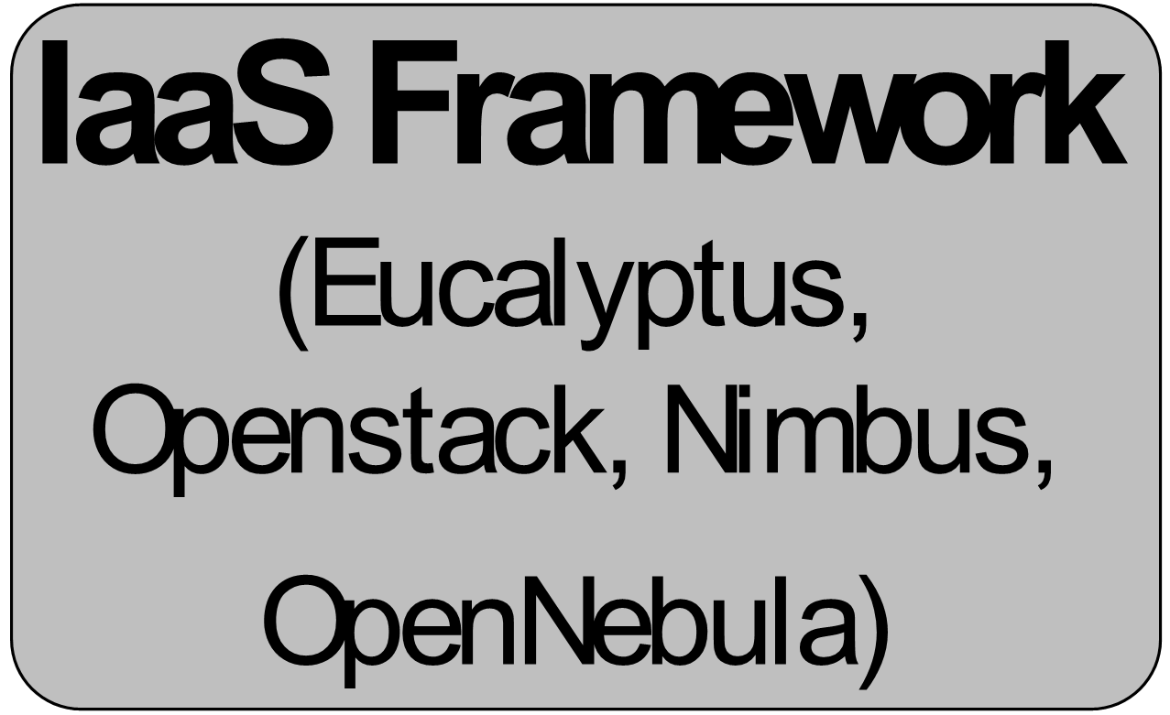
Rain a Hadoop environment in Interactive mode
cm-rain -i ami-00000017 -s india -v ~/OSessex-india/novarc --hadoop --inputdir ~/inputdir1/ --outputdir ~/outputdir/ -m 3 -I
Start VM
2
VMs Running
3
Install/Configure Hadoop
1
4
Deploy Hadoop Environment
Login User in Hadoop Master
5

Slide 54
Rain a Hadoop environment and execute Word count 1/2
As example we use the word count application to count the words of several books
Create script with the hadoop command (hadoopword.sh)
Download books in txt
Uncompress books
hadoop jar $HADOOP_CONF_DIR/../hadoop-examples*.jar wordcount inputdir1 outputdir
$ wget i120/test-image/books-example.tgz
$ mkdir ~/inputdir1
$ tar xvfz books-example.tgz –C ~/inputdir1

Slide 55
Rain a Hadoop environment and execute Word count 2/2
Execute rain
Once the job is done
The output is in the file part-r-00000
$ cm-rain -u gregor -i ami-00000017 -s india -v ~/OSessex-india/novarc –j ~/hadoopword.sh --hadoop --inputdir ~/inputdir1/ --outputdir ~/outputdir/ -m 3
$ ls ~/outputdir/outputdir/
_logs part-r-00000 _SUCCESS

Slide 56
Rain a Virtual Cluster
cm-cluter run -i ami-00000017 -n 3 -t m1.medium -a mycluster
Start VM
2
VMs Running
3
Install/Configure SLURM
1
4
Login User in Frontend
Deploy Virtual Cluster
5

Slide 57
Some Performance Numbers

Slide 58
Recall: Lifecycle of Images

Slide 59
Time for Phase (a) & (b)
Create Image
Store Image

Slide 60
Time for Phase (c)
(c) Register Image

Slide 61
Time for Phase (a & b & c & d)
a, b, c, d) Entire Lifecycle

Slide 62
Why is bare metal slower
HPC bare metal is slower as time is dominated in last phase, including a bare metal boot
In clouds we do lots of things in memory and avoid bare metal boot by using an in memory boot.

Slide 63
Cloudmesh
RAIN Move

Slide 64
Cloudmesh RAIN Move
Orchestrates resource re-allocation among different infrastructures
Command Line interface to ease the access to this service
Exclusive access to the service to prevent conflicts
Keep status information about the resources assigned to each infrastructure as well as the historical to be able to make predictions about the future needs
Scheduler that can dynamically re-allocate resources and support manually planning future re-allocations

Slide 65
Use Case: Move Resources
Autonomous Runtime Services
CM
CM
CM
CM
CM
CM
CM

Slide 66
Use Case: Move Resources
Autonomous Runtime Services

Slide 67
Use Case: Move Resources
Autonomous Runtime Services
CM
CM
CM
CM
CM
CM
CM
2
1

Slide 68
Use Case: Move Resources
Autonomous Runtime Services
CM
CM
CM
CM
CM
CM
CM
2
1

Slide 69
Information Services
Virtual Machine
Management
  IaaS Abstraction
Provisioning Management
  Rain
  Cloud Shifting
  Cloud Bursting
Experiment
Management
  Shell
  IPython
Information Services
  CloudMetrics
Accounting
  FG Portal
  XSEDE Portal
Future Grid
TaaS
User On-Ramp
Amazon, Azure, FutureGrid, XSEDE,
OpenCirrus, ExoGeni, Other Science Clouds

Slide 70
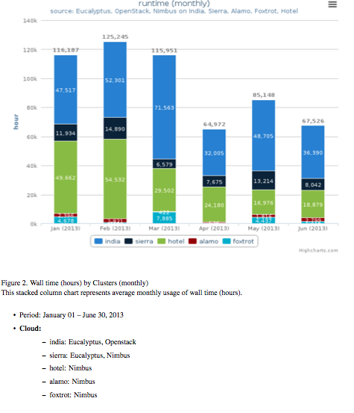
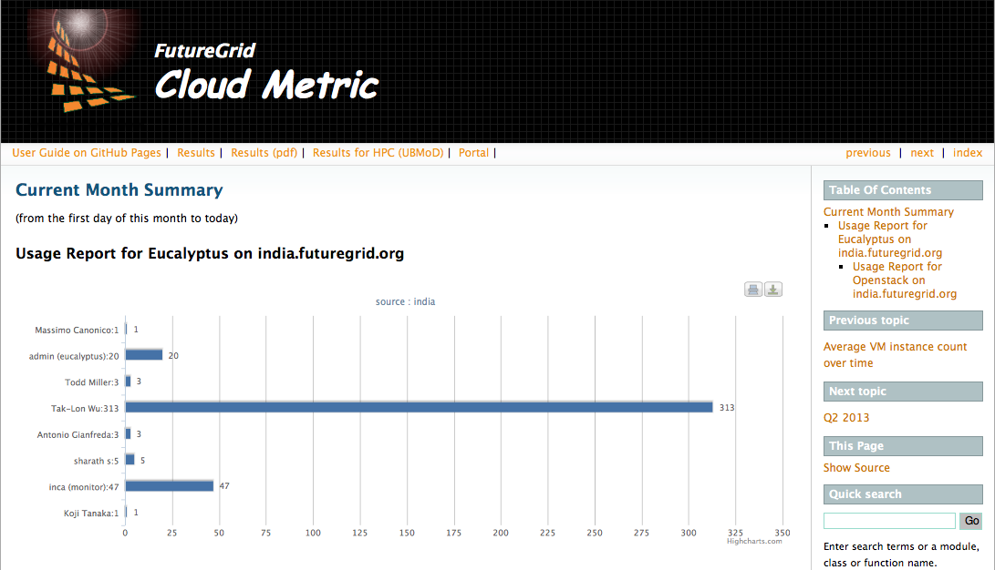
Information Services
Information Services
  Cloudmesh
  CloudMetrics
    Accounting integration (XSEDE)
    all events (logged)
    OpenStack, Eucalyptus, Nimbus
  Leveraging existing services:
    Ganglia, Nagios, Ohai, Inca, Inca
Cloudmesh
CloudMetrics
  Report
  Portal
  CLI:
  cm> generate report
  API
  generate_report

Slide 71
Virtual Machine Management
Virtual Machine
Management
  IaaS Abstraction
Provisioning Management
  Rain
  Cloud Shifting
  Cloud Bursting
Experiment
Management
  Shell
  IPython
Information Services
  CloudMetrics
Accounting
  FG Portal
  XSEDE Portal
Future Grid
TaaS
User On-Ramp
Amazon, Azure, FutureGrid, XSEDE,
OpenCirrus, ExoGeni, Other Science Clouds

Slide 72
Virtual machine management
Provide uniform library that
  integrates with many clouds
  can be used for the CAU principle
  Retrieves as much information about the objects as we can (standards and user library limit that access including boto and libcloud). Provide wrapper and use native protocols.
    This has been proven to be important for debugging evolving software
  Command line interface
  User Interface

Slide 73
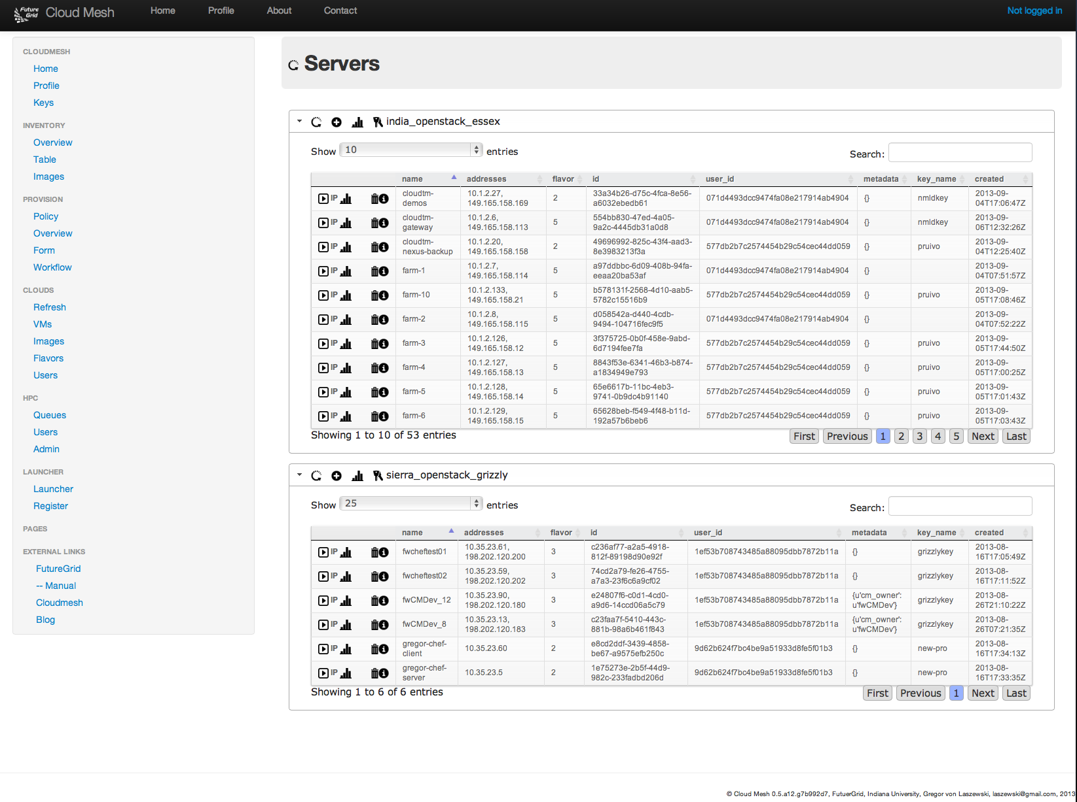
User Side Federation with
Cloud Mesh UI

Slide 74
Experiment Management
Virtual Machine
Management
  IaaS Abstraction
Provisioning Management
  Rain
  Cloud Shifting
  Cloud Bursting
Experiment
Management
  Shell
  IPython
Information Services
  CloudMetrics
Accounting
  FG Portal
  XSEDE Portal
Future Grid
TaaS
User On-Ramp
Amazon, Azure, FutureGrid, XSEDE,
OpenCirrus, ExoGeni, Other Science Clouds

Slide 75
Portal Subsystem
http://futuregrid.org

Slide 76
CloudMesh: Command Line Interface invoking dynamic provisioning
$ cm
FutureGrid - Cloud Mesh Shell
------------------------------------------------------
____ _ _ __ __ _
/ ___| | ___ _ _ __| | | \/ | ___ ___| |__
| | | |/ _ \| | | |/ _` | | |\/| |/ _ \/ __| '_ \
| |___| | (_) | |_| | (_| | | | | | __/\__ \ | | |
\____|_|\___/ \__,_|\__,_| |_| |_|\___||___/_| |_|
======================================================
cm> help
Documented commands (type help <topic>):
========================================
EOF dot2 graphviz inventory open project quit timer verbose
clear edit help keys pause py rst use version
cloud exec info man plugins q script var vm
cm>
Also REST interface
Python API
provision b-001 openstack

Slide 77
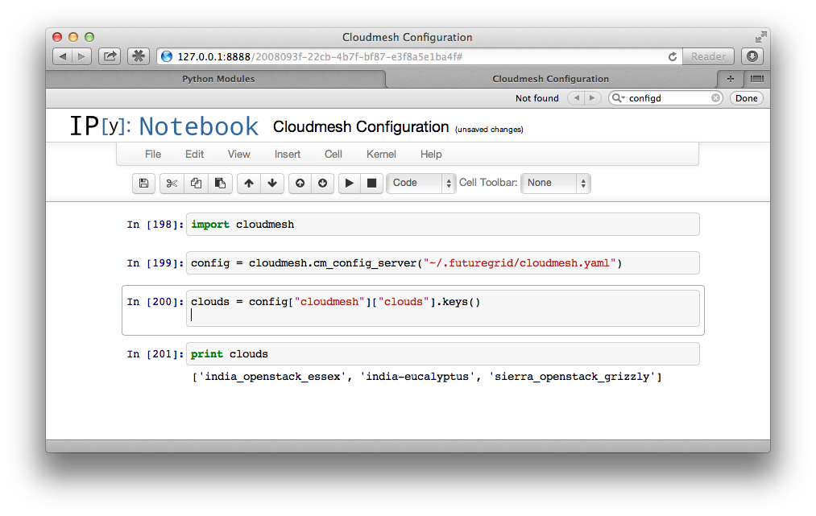
Interactive Cloudmesh with IPython

Slide 78
User Side Federation with
Cloud Mesh UI

Slide 79
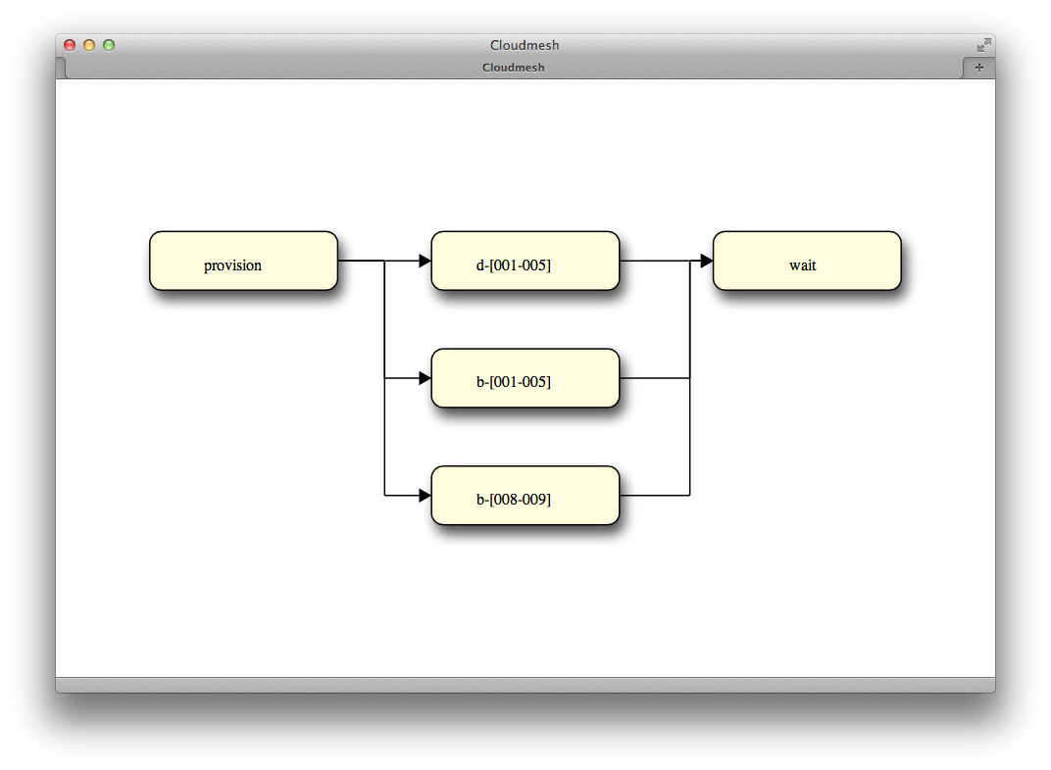
Cloudmesh Workflow DAG

Slide 80
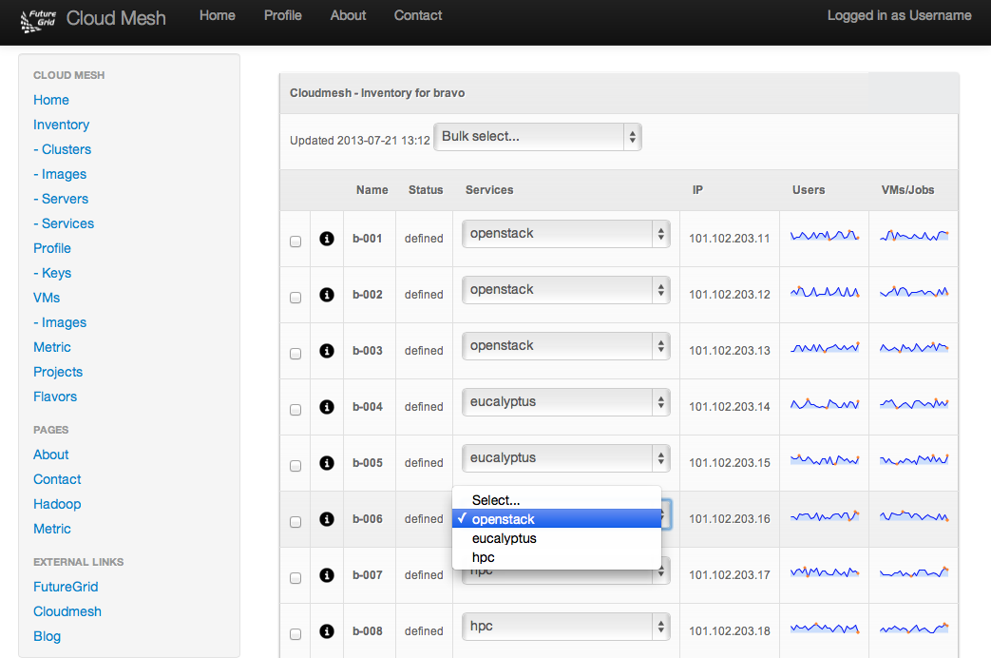
CloudMesh:
Example of Moving a Service

Slide 81
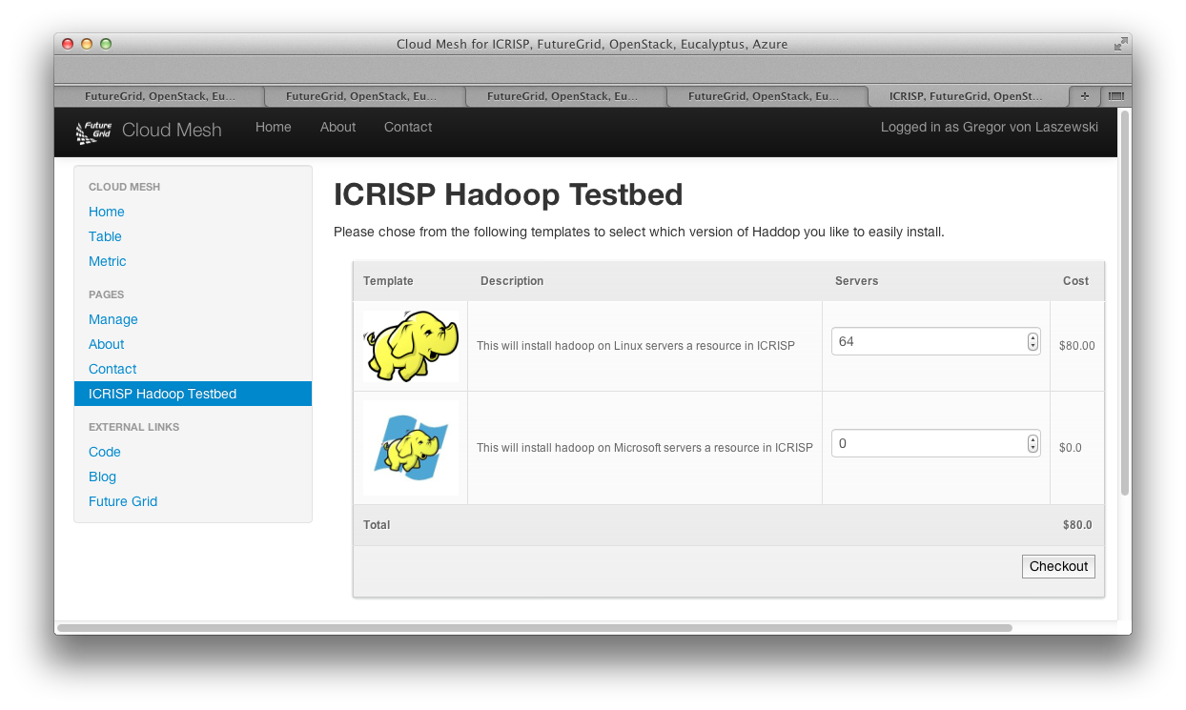
Cloudmesh One Click Install
Hadoop one-click Install

Slide 82
Account and Accounting Management
Virtual Machine
Management
  IaaS Abstraction
Provisioning Management
  Rain
  Cloud Shifting
  Cloud Bursting
Experiment
Management
  Shell, DaG
  IPython Noteebooks
Information Services
  CloudMetrics
Accounting
  FG Portal
  XSEDE Portal
Future Grid
TaaS
User On-Ramp
Amazon, Azure, FutureGrid, XSEDE,
OpenCirrus, ExoGeni, Other Science Clouds

Slide 83
Account Management and Accounting
Observations
Solution
Various systems have their own account and accounting management
  We need uniform access
For Clouds we see evolution of systems, which require adaptations
Role based system for Projects and Users (not all IaaS support projects)
Uniform account management by leveraging LDAP
  OpenID registration
United Accounting system based on log and event parsing across IaaS
Integration of HPC Accounting system
Integration with external IaaS via user-controlled proxies

Slide 84
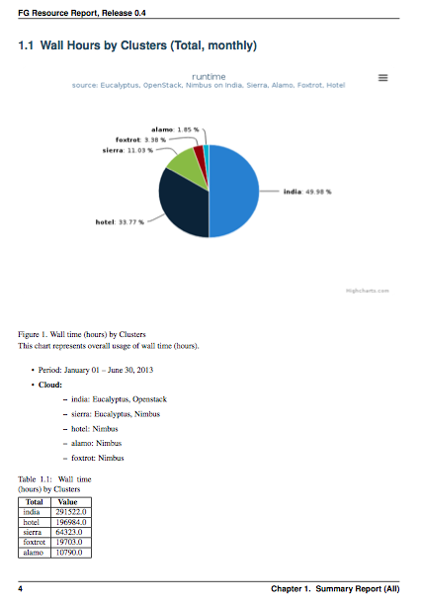
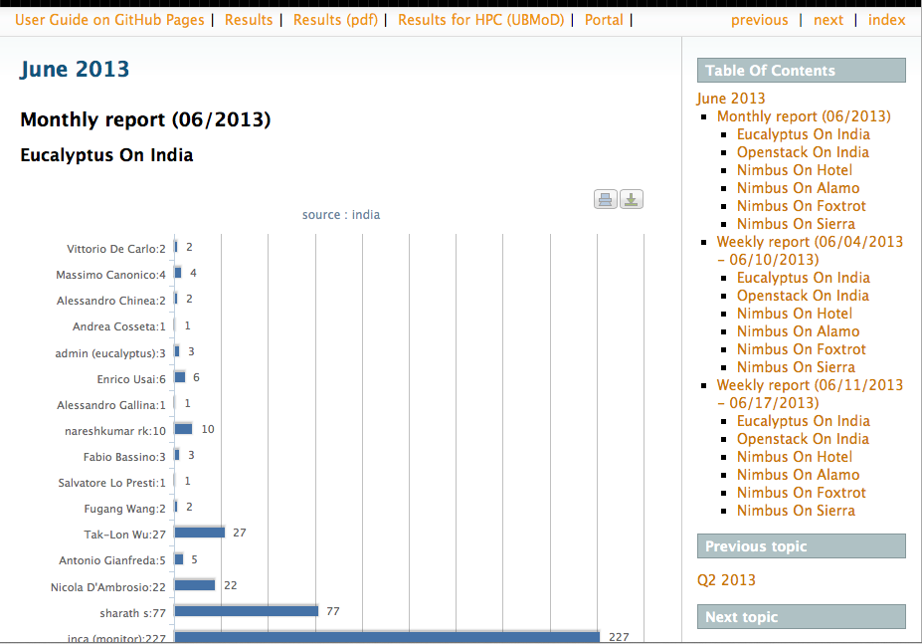
Integrated Report Generation
Written Report in PDF
Online Report via Portal

Slide 85
User On-Ramp
Virtual Machine
Management
  IaaS Abstraction
Provisioning Management
  Rain
  Cloud Shifting
  Cloud Bursting
Experiment
Management
  Shell
  IPython
Information Services
  CloudMetrics
Accounting
  FG Portal
  XSEDE Portal
Future Grid
TaaS
User On-Ramp
Amazon, Azure, FutureGrid, XSEDE,
OpenCirrus, ExoGeni, Other Science Clouds

Slide 86
Features
Users
  Uniform interface to clouds
  Registers external clouds
    Simplify account management
  Use similar images on testbed and external cloud
  Use multiple clouds at the same time
  Use testbed before moving to production cloud
Providers
  Cloud Bursting
  Cost considerations
  Access to traditional HPC

Slide 87
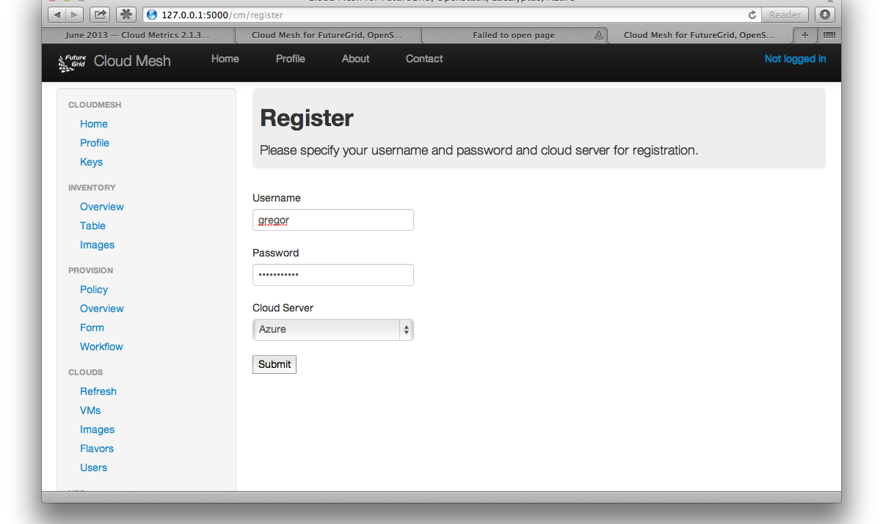
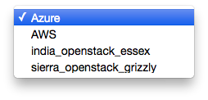
Registering External Clouds

Slide 88
Next Steps

Slide 89
Next Steps: CloudMesh
CloudMesh Software
  First release soon
  Deploy on FutureGrid
  Provide documentation
  Develop intelligent scheduler
    Ph.D. thesis
  Integrate with Chef
    Part of another thesis
Other bare-metal provisioners: OpenStack
Extend User On-Ramp features
Other frameworks can use CloudMesh

Slide 90
Summary

Slide 91
Cloudmesh Functionality View
Supporting TaaS and User on-Ramp
Virtual Machine
Management
  IaaS Abstraction
Provisioning Management
  Rain
  Cloud Shifting
  Cloud Bursting
Experiment
Management
  Shell
  IPython
Information Services
  CloudMetrics
Accounting
  FG Portal
  XSEDE Portal
Future Grid
TaaS
User On-Ramp
Amazon, Azure, FutureGrid, XSEDE,
OpenCirrus, ExoGeni, Other Science Clouds

Slide 92
Cloudmesh Layered Architecture View
Notes:
Multiple components are part of cloudmesh. Cloudmesh is an umbrella for it. We are still debating about its name as we aslo could have used RAIN. But rain was initially just a small component and deals predominantly so far with templated image management

Slide 93
Cloud Mesh
Simplify access across clouds.
Some aspects similar to OpenStack Horizon, but for multiple clouds while integrating framework for bare-metal provisioning
While using RAIN it will be able to do
  one-click template & image install on various IaaS & baremetal
  templated workflow management involving VMs and bare metal

Slide 94
Advantages
Native cloud libraries have been proven to be of advantage for debugging.
  Standard based libraries were less useful as the do not access the full capabilities of the cloud
The CAU principal Command line-API-User interface provides to be useful for development and users
RAIN can do VM and baremetal provisioning
We find it useful to rain higher level services
We can use the same resources for HPC and clouds

Slide 95
Contact
laszewski@gmail.com

