Slide 1
Good Ole Hadoop! How We Love Thee!
Jerome E. Mitchell
Indiana University

Slide 2
Outline
Why Should You Care about Hadoop?
What Exactly is Hadoop?
Overview of Hadoop MapReduce and Hadoop Distributed File System (HDFS)
Workflow
Conclusions and References
Getting Started with Hadoop

Slide 3
Why Should You Care? – Lots of Data
LOTS OF DATA
EVERYWHERE

Slide 4
Why Should You Care? – Even Grocery Stores Care
September 2, 2009
Tesco, British Grocer, Uses Weather to Predict Sales
By Julia Werdigier
LONDON — Britain often conjures images of unpredictable weather, with downpours sometimes followed by sunshine within the same hour — several times a day.
“Rapidly changing weather can be a real challenge,” Jonathan Church, a Tesco spokesman, said in a statement. “The system successfully predicted temperature drops during July that led to a major increase in demand for soup, winter vegetables and cold-weather puddings.”

Slide 5
What is Hadoop?
At Google MapReduce operation are run on a special file system called Google File System (GFS) that is highly optimized for this purpose.
GFS is not open source.
Doug Cutting and Yahoo! reverse engineered the GFS and called it Hadoop Distributed File System (HDFS).
The software framework that supports HDFS, MapReduce and other related entities is called the project Hadoop or simply Hadoop.
This is open source and distributed by Apache.

Slide 6
What Exactly is Hadoop?
A growing collection of subprojects

Slide 7
Why Hadoop for BIG Data?
Most creditable open source toolkit for large scale, general purpose computing
Backed by ,
Used by , , and many others
Increasing support from web services
Hadoop closely imitates infrastructure developed by
Hadoop processes petabytes daily, right now

Slide 8
Motivation for MapReduce
Large-Scale Data Processing
Want to use 1000s of CPUs
But, don’t want the hassle of managing things
MapReduce Architecture provides
Automatic Parallelization and Distribution
Fault Tolerance
I/O Scheduling
Monitoring and Status Updates

Slide 9
MapReduce Model
Input & Output: a set of key/value pairs
Two primitive operations
map: (k₁,v₁) → list(k₂,v₂)
reduce: (k₂,list(v₂)) → list(k₃,v₃)
Each map operation processes one input key/value pair and produces a set of key/value pairs
Each reduce operation
Merges all intermediate values (produced by map ops) for a particular key
Produce final key/value pairs
Operations are organized into tasks
Map tasks: apply map operation to a set of key/value pairs
Reduce tasks: apply reduce operation to intermediate key/value pairs

Slide 10
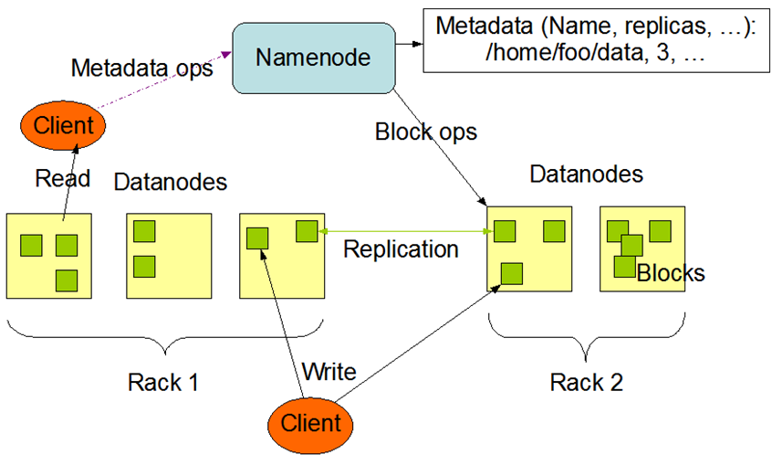
HDFS Architecture
Notes:
Hardware failure – detection of faults and quick, automatic recovery
Streaming data access – more for batch processing then interactive use; emphasis on high throughput of data access rather on low latency
Large data sets – supports tens of millions of files in a single instance
Simple coherency model – write once read many times
Moving computation is cheaper than moving data

Slide 11
The WorkFlow
Load data into the Cluster (HDFS writes)
Analyze the data (MapReduce)
Store results in the Cluster (HDFS)
Read the results from the Cluster (HDFS reads)

Slide 12
Hadoop Server Roles
Client
Distributed Data Processing
Distributed Data Storage
MapReduce
HDFS
Name Node
Secondary Name Node
Job Tracker
Master
Data Nodes &
Task Tracker
Data Nodes &
Task Tracker
Data Nodes &
Task Tracker
Data Nodes &
Task Tracker
Data Nodes &
Task Tracker
Data Nodes &
Task Tracker
Slaves
Notes:
The three major categories of machine roles in a Hadoop deployment are Client machines, Masters nodes, and Slave nodes. The Master nodes oversee the two key functional pieces that make up Hadoop: storing lots of data (HDFS), and running parallel computations on all that data (Map Reduce). The Name Node oversees and coordinates the data storage function (HDFS), while the Job Tracker oversees and coordinates the parallel processing of data using Map Reduce. Slave Nodes make up the vast majority of machines and do all the dirty work of storing the data and running the computations. Each slave runs both a Data Node and Task Tracker daemon that communicate with and receive instructions from their master nodes. The Task Tracker daemon is a slave to the Job Tracker, the Data Node daemon a slave to the Name Node.

Slide 13
Hadoop Cluster
Switch
Switch
Switch
Switch
Switch
Switch
DN + TT
DN + TT
DN + TT
DN + TT
DN + TT
DN + TT
DN + TT
DN + TT
DN + TT
DN + TT
DN + TT
DN + TT
DN + TT
DN + TT
DN + TT
DN + TT
DN + TT
Rack 1
Rack 2
Rack 3
Rack N

Slide 14
Hadoop Rack Awareness – Why?
Switch
Name Node
Switch
Switch
Switch
metatadata
Rack Aware
Results.txt =
BLK A: DN1, DN5, DN6
BLK B:
DN7, DN1, DN2
BLK C
DN5, DN8, DN9
Data Node 1
Data Node 5
Data Node 5
Rack 1: Data Node 1 Data Node 2 Data Node 3
Rack 1:
Data Node 5
Data Node 6
Data Node 7
Data Node 2
Data Node 6
Data Node 10
Data Node 3
Data Node 7
Data Node 11
Data Node 5
Data Node 8
Data Node 12
Rack 1
Rack 5
Rack 9
Notes:
Hadoop has the concept of “Rack Awareness”. As the Hadoop administrator you can manually define the rack number of each slave Data Node in your cluster. Why would you go through the trouble of doing this? There are two key reasons for this: Data loss prevention, and network performance. Remember that each block of data will be replicated to multiple machines to prevent the failure of one machine from losing all copies of data. Wouldn’t it be unfortunate if all copies of data happened to be located on machines in the same rack, and that rack experiences a failure? Such as a switch failure or power failure. That would be a mess. So to avoid this, somebody needs to know where Data Nodes are located in the network topology and use that information to make an intelligent decision about where data replicas should exist in the cluster. That “somebody” is the Name Node.

Slide 15
Sample Scenario
How many times did our customers type the word refund into emails sent to Indiana University?
Huge file containing all emails sent to Indiana University…
File.txt

Slide 16
Writing Files to HDFS
File.txt
BLK A
BLK B
BLK C
NameNode
Client
Data Node 1
Data Node 5
Data Node 6
Data Node N
BLK A
BLK B
BLK C
Notes:
The Client breaks File.txt into (3) Blocks. For each block, the Client consults the Name Node (usually TCP 9000) and receives a list of (3) Data Nodes that should have a copy of this block. The Client then writes the block directly to the Data Node (usually TCP 50010). The receiving Data Node replicates the block to other Data Nodes, and the cycle repeats for the remaining blocks. The Name Node is not in the data path. The Name Node only provides the map of where data is and where data should go in the cluster (file system metadata).

Slide 17
Data Node Reading Files From HDFS
Switch
Name Node
Rack Aware
metatadata
Switch
Switch
Switch
Rack 1: Data Node 1 Data Node 2 Data Node 3
Rack 1:
Data Node 5
Results.txt =
BLK A: DN1, DN5, DN6
BLK B:
DN7, DN1, DN2
BLK C
DN5, DN8, DN9
Data Node 1
Data Node 1
Data Node 1
Data Node 2
Data Node 2
Data Node 2
Data Node
Data Node
Data Node
Data Node
Data Node
Data Node
Rack 1
Rack 5
Rack 9
Notes:
There are some cases in which a Data Node daemon itself will need to read a block of data from HDFS. One such case is where the Data Node has been asked to process data that it does not have locally, and therefore it must retrieve the data from another Data Node over the network before it can begin processing.
While the Job Tracker will always try to pick nodes with local data for a Map task, it may not always be able to do so. One reason for this might be that all of the nodes with local data already have too many other tasks running and cannot accept anymore.

Slide 18
MapReduce: Three Phases
1. Map
2. Sort
3. Reduce

Slide 19
Data Processing: Map
Name Node
Job Tracker
Map Task
Map Task
Map Task
Data Node 1
BLK B
Data Node 5
BLK C
Data Node 9
BLK A
Refund = 3
Refund = 0
Refund= 11
File.txt

Slide 20
MapReduce: The Map Step
Input
key-value pairs
Intermediate
key-value pairs
k
v
map
k
v
k
v
map
k
v
k
v
…
…
k
v
k
v

Slide 21
The Map (Example)
inputs
tasks (M=3)
partitions (intermediate files) (R=2)
When in the course of human events it …
map
(when,1), (course,1) (human,1) (events,1) (best,1) …
(in,1) (the,1) (of,1) (it,1) (it,1) (was,1) (the,1) (of,1) …
It was the best of times and the worst of times…
Over the past five years, the authors and many…
map
(over,1), (past,1) (five,1) (years,1) (authors,1) (many,1) …
(the,1), (the,1) (and,1) …
This paper evaluates the suitability of the …
map
(this,1) (paper,1) (evaluates,1) (suitability,1) …
(the,1) (of,1) (the,1) …

Slide 22
Data Processing: Reduce
Client
Job Tracker
HDFS
Results.txt
Reduce Task
X
Y
Z
Data Node 3
Refund = 3
Refund = 11
Refund = 0
Map Task
Map Task
Map Task
BLK A
Data Node 1
BLK B
Data Node 5
BLK C
Data Node 9

Slide 23
MapReduce: The Reduce Step
Output
key-value pairs
Intermediate
key-value pairs
Key-value groups
reduce
k
v
k
v
v
v
k
v
reduce
k
v
k
v
v
k
v
group
k
v
…
…
…
k
v
k
v
k
v

Slide 24
The Reduce (Example)
partition (intermediate files) (R=2)
reduce task
(in,1) (the,1) (of,1) (it,1) (it,1) (was,1) (the,1) (of,1) …
sort
(the,1), (the,1) (and,1) …
(the,1) (of,1) (the,1) …
(and, (1)) (in,(1)) (it, (1,1)) (the, (1,1,1,1,1,1))
(of, (1,1,1)) (was,(1))
reduce
Note: only one of the two reduce tasks shown
(and,1) (in,1) (it, 2) (of, 3) (the,6) (was,1)

Slide 25
Clients Reading Files from HDFS
Client
NameNode
metatadata
Switch
Switch
Switch
Results.txt =
BLK A: DN1, DN5, DN6
BLK B:
DN7, DN1, DN2
BLK C
DN5, DN8, DN9
Data Node 1
Data Node 1
Data Node 1
Data Node 2
Data Node 2
Data Node 2
Data Node
Data Node
Data Node
Data Node
Data Node
Data Node
Rack 1
Rack 5
Rack 9

Slide 26
Conclusions
We introduced MapReduce programming model for processing large scale data
We discussed the supporting Hadoop Distributed File System
The concepts were illustrated using a simple example
We reviewed some important parts of the source code for the example.

Slide 27
References
Apache Hadoop Tutorial: http://hadoop.apache.org http://hadoop.apache.org/core/docs/current/mapred_tutorial.html
Dean, J. and Ghemawat, S. 2008. MapReduce: simplified data processing on large clusters. Communication of ACM 51, 1 (Jan. 2008), 107-113.
Cloudera Videos by Aaron Kimball:
http://www.cloudera.com/hadoop-training-basic

Slide 28
Finally, A Hands-on Assignment!

Slide 29
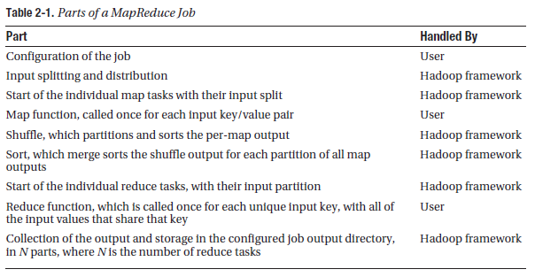

Slide 30
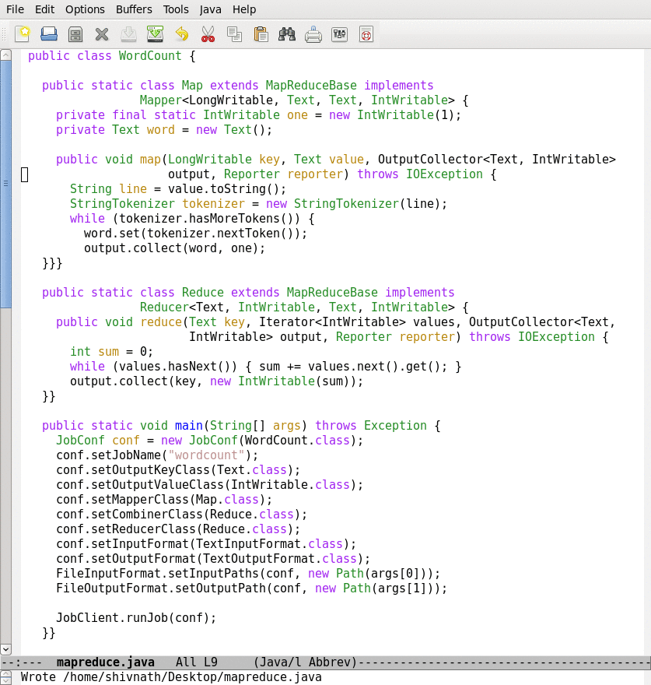
Lifecycle of a MapReduce Job
Map function
Reduce function
Run this program as a
MapReduce job

Slide 31
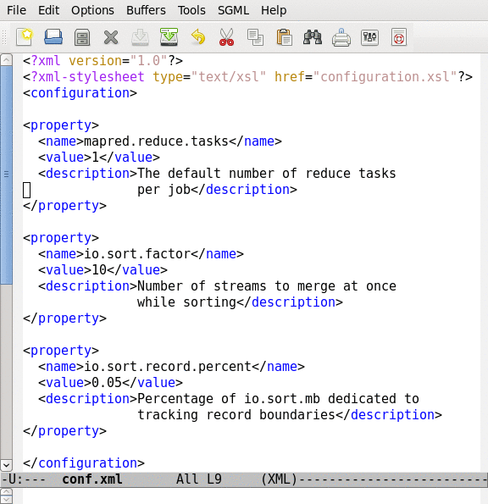
Job Configuration Parameters
190+ parameters in Hadoop
Set manually or defaults are used

Slide 32
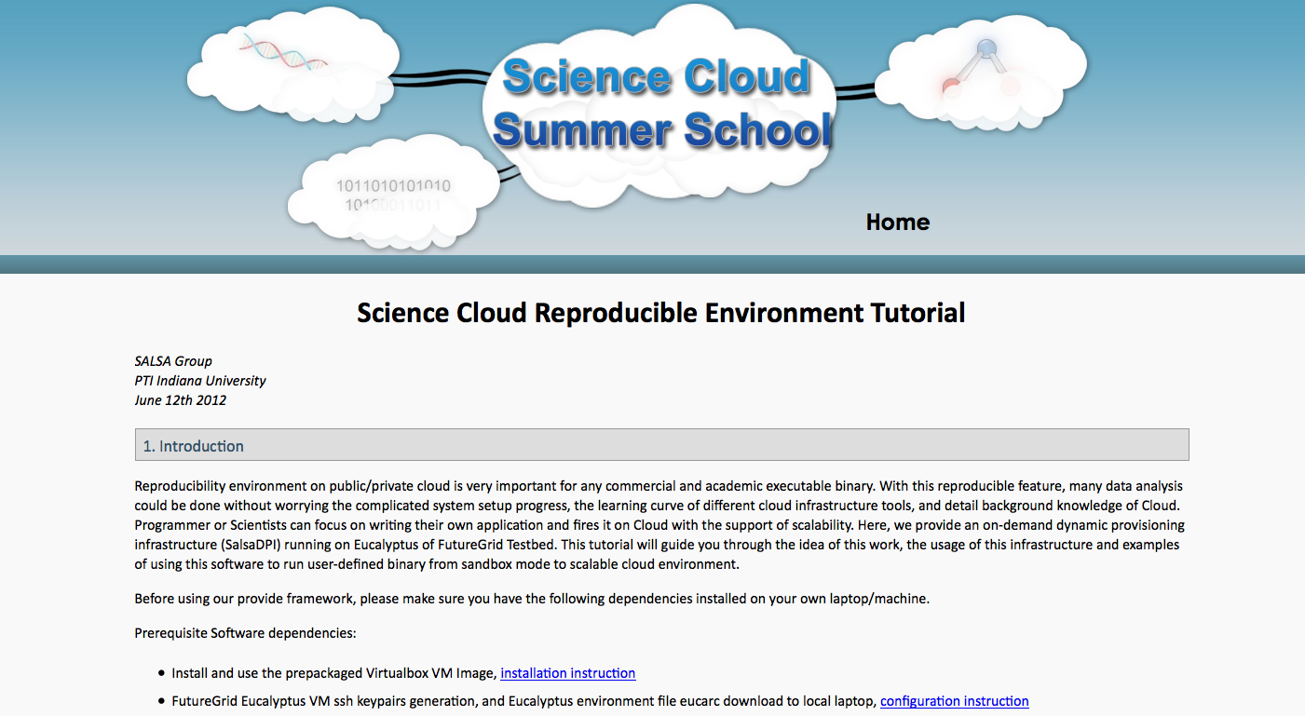

Slide 33
Even though the Hadoop framework is written in Java, programs for Hadoop need not to be coded in Java but can also be developed in other languages like Python or C++.
Creating a launching program for your application
The launching program configures:
– The Mapper and Reducer to use
– The output key and value types (input types are inferred from the InputFormat)
– The locations for your input and output
The launching program then submits the job and typically waits for it to complete
A Map/Reduce may specify how it’s input is to be read by specifying an InputFormat to be used
A Map/Reduce may specify how it’s output is to be written by specifying an OutputFormat to be used

Slide 34
HANDS – ON SESSION

Slide 35
Now, Your Turn…
Verify the output from the wordcount program
HINT: hadoop fs –ls output
View the output from the wordcount program
HINT: hadoop fs –cat output/part-00000

Slide 36
Hadoop – The Good/Bad/Ugly
Hadoop is Good – that is why we are all here
Hadoop is not Bad – else we would not be here
Hadoop is sometimes Ugly – why?
Out of the box configuration – not friendly
Difficult to debug
Performance – tuning/optimizations is a black magic

Slide 37
Number of Maps/Reducers
mapred.tasktracker.map/reduce.tasks.maximum
Maximum tasks (map/reduce) for a tasktracker
Default: 2
Suggestions
Recommended range – (cores_per_node)/2 to 2x(cores_per_node)
This value should be set according to the hardware specification of cluster nodes and resource requirements of tasks (map/reduce)

