Slide 1
GreenIT @ cyberaide.org
O
Motivation
GreenIT as a Service (GaaS)
Portal
Power Aware Task Placement
Power Aware VM Placement
Thermal Aware Scheduling
Animations
Portal
Power Aware Task Placement
Thermal Aware Task Placement
Demo
Portal
M
S
A
S
S
S
D
Gregor von Laszewski, Lizhe Wang, Jai Dayal, Bingjing Zhang
laszewski@gmail.com

Slide 2
What is Green IT?
Green IT also referred as Green computing is a study and practice of using computing resources in an efficient manner such that its impact on the environment is as less hazardous as possible.
least amount of hazardous materials are used
computing resources are used efficiently in terms of energy and to promote recyclability
http://en.wikipedia.org/wiki/Green_computing

Slide 3
Motivation
Cost:
A supercomputer with 360-Tflops with conventional processors requires 20 MW to operate, which is approximately equal to the sum of 22,000 US households power consumption
Servers consume 0.5 percent of the world’s total electricity usage
Energy usage will quadruple by 2020
The total estimated energy bill estimate for data centers in 2010 is $11.5 billion
Reliability:
Every 10C increase of temperature leads to a doubling of the system failure rate
Environment:
A typical desktop computer consumes 200-300W of power
This results in emission of about 220kg of CO2 per year
Data Centers produce 170 million metric tons of CO2 worldwide currently per year
670 million metric tons of CO2 are expected to be emitted by data centers worldwide annually by 2020
Utilization
32 percent of all servers are running at or below 3 percent peak and average utilizations, wasting energy spinning and cooling, and doing virtually no work.

Slide 4
A Typical Google Search
Google spends about 0.0003 kWh per search
1 kilo-watt-hour (kWh) of electricity = 7.12 x 10-4 metric tons CO2 = 0.712 kg or 712g of CO2
=> 213mg CO2 emitted
The number of Google searches worldwide amounts to 200-500 million per day.
total carbon emitted per day:
= 500 million x 0.000213 kg per search = 106500kg or 106.5 metric ton
Source: http://prsmruti.rediffiland.com/blogs/2009/01/19/How-much-cabondioxide-CO2-emitted.html
Notes:
ref:
http://www.globus.org/grid_software/security/voms.php – globus alliance ... basic definition
http://vdt.cs.wisc.edu/components/voms.html – virtual data toolkit (osg) – grid middleware
http://edg-wp2.web.cern.ch/edg-wp2/security/voms/voms.html – (datagrid)

Slide 5
A Typical Google Search
Google spends about 0.0003 kWh per search
1 kilo-watt-hour (kWh) of electricity = 7.12 x 10-4 metric tons CO2 = 0.712 kg or 712g of CO2
=> 213mg CO2 emitted
The number of Google searches worldwide amounts to 200-500 million per day.
total carbon emitted per day:
= 500 million x 0.000213 kg per search = 106500kg or 106.5 metric ton
Source: http://prsmruti.rediffiland.com/blogs/2009/01/19/How-much-cabondioxide-CO2-emitted.html
Notes:
ref:
http://www.globus.org/grid_software/security/voms.php – globus alliance ... basic definition
http://vdt.cs.wisc.edu/components/voms.html – virtual data toolkit (osg) – grid middleware
http://edg-wp2.web.cern.ch/edg-wp2/security/voms/voms.html – (datagrid)

Slide 6
What does it mean?
10282 times around the world with a 21mile/gal car

Slide 7
Green Computing

Slide 8
Green Aware Computing

Slide 9
GeenIT Portal Demo

Slide 10
Green Computing Portal
Resource:
Indiana Univ. : idataplex
Dortmund Univ. data center
CCR of SUNY @ Buffalo
Metrics (in progress)
Power
Temperature
Workload, e.g., CPU usage
CO2 emission
System utilization

Slide 17
GaaS: Green as a Service
Green computing portal (this demo)
Power aware parallel task scheduling in a cluster (submitted to CCGrid’10)
Power aware VM placement in a cluster (Cluster’09)
Thermal aware workload placement in a data center(i-SPAN’09 & IPCCC’09)
Green workload characterization in clusters, data centers and Grids (on-going work)

Slide 18
GreenIT as a Service (GaaS)

Slide 19
Research methodology
Green Application
support environment
Performance metrics
Power consumption, CO2, …
Resource operation
Virtual machine migration
Smart cooling system operation
Server consolidation
& power management
“Green” infrastructure
Low power & high density computing resource
Virtualized infrastructure
“Green” service & middleware
Auditing & insertion system
Power aware task scheduling
Temperature aware workload placement
“Green” application support environment
SDKs and APIs for energy aware programming
Interfaces for “green” performance tuning
Metrics
Green
service & middleware
Operation
Green Infrastructure

Slide 20
2. Power aware parallel task placement
Parallel task: a set of jobs with precedence constrained
Use Dynamic Voltage and Frequency Scaling (DVFS)
Best-effort scheduling
without increasing makespan, minimize power consumption
Energy-performance tradeoff scheduling
via a Green SLA negotiation with users, with tolerant makespan increase, minimize power consumption

Slide 21
2. Power aware parallel task placement: Best effort scheduling
(without increasing makespan, minimize power consumption)
If a PE is idle, set supplied voltage to lowest value
If there is communication in a PE then
set supplied voltage to lowest value
If non-critical job in a PE then
extend the execution time without violating the precedence constrained, then scale supplied voltage to a proper level
If a critical job in a PE, no change

Slide 22
2. Power aware parallel task placement: Energy-performance tradeoff scheduling
With Green SLA negotiation, users agree to extend the makespance to some extent, for example, 10%
Extend the critical path of parallel task
Execute the best effort scheduling algorithm while using the changed makespan

Slide 23
2. Power aware parallel task placement: Simulation result
Figure (left) shows that we can save up 44% energy saving with best effort scheduling
Figure (right) shows that
With tolerant makespan extension, much energy saving can be achieved
Green SLA negotiation is feasible

Slide 24
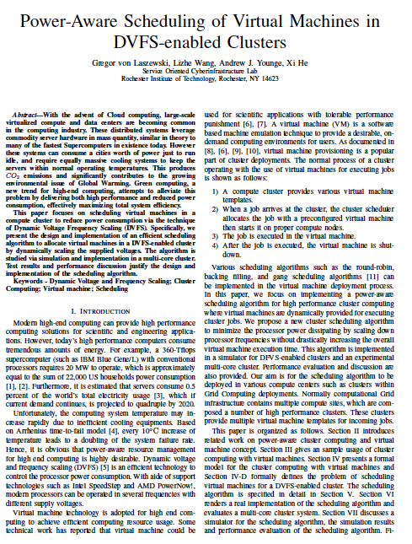
3. Power aware VM scheduling
Objective
reduce power consumption in a cluster for VM placement
Methodology
dynamically scale voltages of PEs for virtual machines in a cluster
Result
can reduce up to 34% in our simulation study
Cluster Aug. 2009

Slide 25
3. Power aware VM scheduling
job
Execute job in a vm
Start a vm
vm
vm
vm
vm
vm
vm
File
server
Head
node
Compute node
PE
Compute node
PE
PE
Scheduling
algorithm
PE
VM
PE
queue
PE
cluster

Slide 26
3. Power aware VM scheduling
Sort VMs in a decreasing order of required CPU speed (e.g. deadline requirement)
Set PEs to lowest voltages
put VMs to PEs
If cannot accommodate increase PE voltages
Reduce PE voltages whenever it is possible to accommodate VMs
Return to 3.

Slide 27
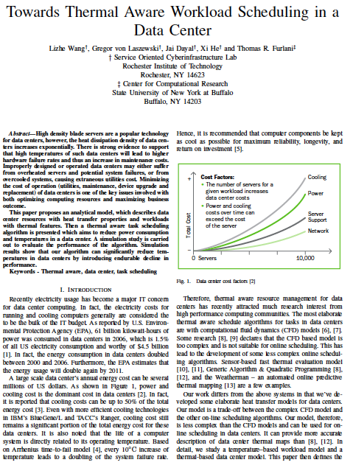
4. Thermal aware scheduling in data centers
Job-temperature model
Data center resource model
Thermal aware scheduling algorithm
Thermal aware workload scheduling framework
Simulation
I-SPAN’09 & IPCCC’09

Slide 28
4. Thermal aware scheduling framework
Profiling tool
Workload model
Workload placement
Online
task-temperature calculation
Thermal aware workload scheduling algorithm
Datacenter model
Cooling system control
Temperature prediction via ANN
Thermal map
Monitoring service

Slide 29
4. Thermal aware scheduling algorithm
Get thermal field of data center
Get compute node temperature
Put hottest job to coldest resources
Predict the compute node temperature after job execution
If a compute node temperature > “redline”, set it idle
thermal aware backfilling when it is possible

Slide 30
4. Simulation Result
Reduce max temperature: 6 F
Reduce average temperature: 15 F
Reduce power consumption 4000 kW/h
Reduce CO2 emission 19 000 kg/h
Response time increase 13%

Slide 31
Thermal aware task placement

Slide 32
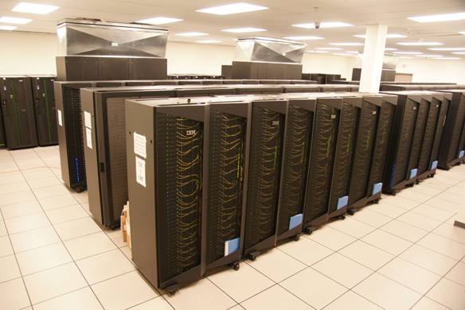
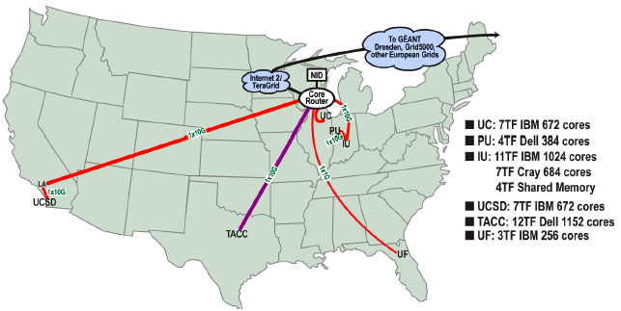
Indian iDataplex

Slide 33
Size: resource requirement
Color: temperature profile
job
Height: CPU load
Color: temperature
node

Slide 34
Power aware VM placement

Slide 35
job
job
vm
vm
File
server
Head
node
Compute node
Compute node
Compute node
Compute
node

Slide 36
vm
vm
File
server
Head
node
Compute node
Compute node
Compute node
Compute
node

Slide 37
vm
vm
vm
File
server
Head
node
Compute node
Compute node
Compute node
Compute
node

Slide 38
vm
vm
vm
vm
File
server
Head
node
Compute node
Compute node
Compute node
Compute
node

Slide 39
vm
vm
vm
vm
vm
vm
vm
vm
Compute node
vm
vm
vm
vm
File
server
Head
node
Compute node
Compute node
Compute
node

