Slide 1
Harp: Collective Communication on Hadoop
Bingjing Zhang, Yang Ruan, Judy Qiu

Slide 2
Outline
Motivations
Why do we bring collective communications to big data processing?
Collective Communication Abstractions
Our approach to optimize data movement
Hierarchical data abstractions and operations defined on top of them
MapCollective Programming Model
Extended from MapReduce model to support collective communications
Two Level BSP parallelism
Harp Implementation
A plugin on Hadoop
Component layers and the job flow
Experiments
Conclusion

Slide 3
Motivation
More efficient and much simpler!
K-means Clustering in (Iterative) MapReduce
K-means Clustering in Collective Communication
broadcast
M
M
M
M
M
M
M
M
shuffle
R
R
allreduce
gather
M: Compute local points sum R: Compute global centroids
M: Control iterations and compute local points sum

Slide 4
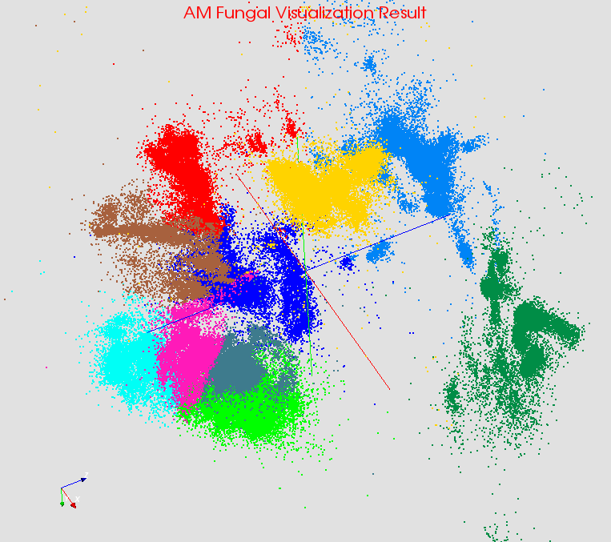
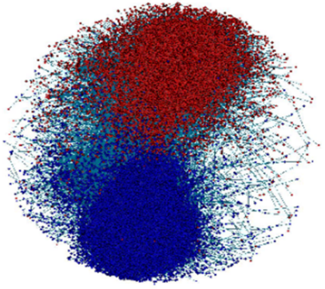
Large Scale Data Analysis Applications
Iterative Applications
Cached and reused local data between iterations
Complicated computation steps
Large intermediate data in communications
Various communication patterns
Bioinformatics
Computer Vision
Complex Networks
Deep Learning

Slide 5
The Models of Contemporary Big Data Tools
DAG Model
MapReduce Model
Graph Model
BSP/Collective Model
Hadoop
For Iterations/ Learning
HaLoop
Giraph
Twister
Hama
Spark
GraphLab
GraphX
Dryad
Harp
Stratosphere / Flink
For Streaming
S4
Samza
Many of them have fixed communication patterns!
Storm
Spark Streaming
For Query
DryadLINQ
Pig
Hive
Tez
Spark SQL
MRQL

Slide 6
Contributions
Parallelism Model
Architecture
MapReduce Model
MapCollective Model
MapReduce Applications
MapCollective Applications
M
M
M
M
Application
M
M
M
M
MapReduce V2
Harp
Shuffle
Framework
R
R
Collective Communication
Resource Manager
YARN

Slide 7
Collective Communication Abstractions
Hierarchical Data Abstractions
Basic Types
Arrays, key-values, vertices, edges and messages
Partitions
Array partitions, key-value partitions, vertex partitions, edge partitions and message partitions
Tables
Array tables, key-value tables, vertex tables, edge tables and message tables
Collective Communication Operations
Broadcast, allgather, allreduce
Regroup
Send messages to vertices, send edges to vertices

Slide 8
Hierarchical Data Abstractions
broadcast, allgather, allreduce, regroup, message-to-vertex…
Table
Array Table <Array Type>
Edge
Table
Message Table
Vertex Table
Key-Value Table
Partition
Array Partition <Array Type>
Edge Partition
Message Partition
Vertex Partition
Key-Value Partition
broadcast, send
Long Array
Int Array
Double Array
Byte Array
Vertices, Edges, Messages
Key-Values
Basic Types
Array
Object
broadcast, send
Transferable

Slide 9
Example: regroup
Process 0
Process 1
Process 2
Table
Table
Table
Partition 0
Partition 0
Partition 1
Partition 2
Partition 0
Partition 2
Partition 0
Partition 1
Partition 3
Partition 1
Partition 4
Partition 2
Partition 4
Partition 2
Partition 3
Regroup

Slide 10
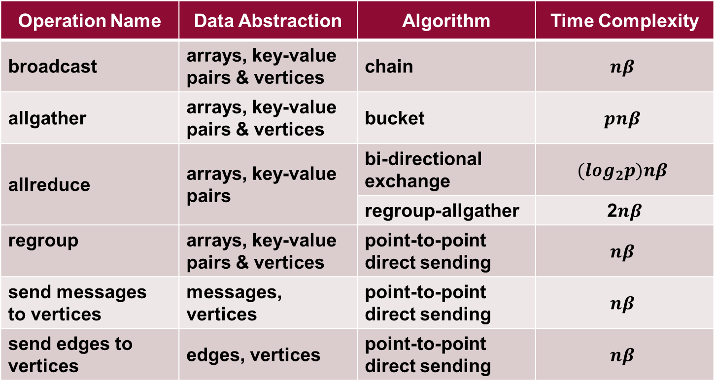
Operations
Operation Name | Data Abstraction | Algorithm | Time Complexity
broadcast | arrays, key-value pairs & vertices | chain | $$nβ$$
allgather | arrays, key-value pairs & vertices | bucket | $$pnβ$$
allreduce | arrays, key-value pairs | bi-directional exchange | $$(\log_{2}p)nβ$$
 |  | regroup-allgather | 2$nβ$
regroup | arrays, key-value pairs & vertices | point-to-point direct sending | $$nβ$$
send messages to vertices | messages, vertices | point-to-point direct sending | $$nβ$$
send edges to vertices | edges, vertices | point-to-point direct sending | $$nβ$$

Slide 11
MapCollective Programming Model
BSP parallelism
Inter node parallelism and inner node parallelism
Process Level
Thread Level
Process Level

Slide 12
The Harp Library
Hadoop Plugin which targets on Hadoop 2.2.0
Provides implementation of the collective communication abstractions and MapCollective programming model
Project Link
http://salsaproj.indiana.edu/harp/index.html
Source Code Link
https://github.com/jessezbj/harp-project

Slide 13
Component Layers
Applications: K-Means, WDA-SMACOF, Graph-Drawing…
MapReduce Applications
MapCollective Applications
MapCollective Interface
Collective Communication APIs
Array, Key-Value, Graph Data Abstraction
MapCollective Programming Model
MapReduce V2
Harp
Collective Communication Operators
Hierarchical Data Types (Tables & Partitions)
Memory Resource Pool
Collective Communication Abstractions
YARN
Task Management
MapReduce

Slide 14
A MapCollective Job
YARN Resource Manager
I. Launch AppMaster
II. Launch Tasks
Client
MapCollective AppMaster
CollectiveMapper
2. Read key-value pairs
MapCollective Container Allocator
setup
MapCollective Runner
mapCollective
3. Invoke collective communication APIs
MapCollective Container Launcher
cleanup
4. Write output to HDFS
1. Record Map task locations from original MapReduce AppMaster

Slide 15
Experiments
Applications
K-means Clustering
Force-directed Graph Drawing Algorithm
WDA-SMACOF
Test Environment
Big Red II
http://kb.iu.edu/data/bcqt.html

Slide 16
K-means Clustering
M
M
M
M
allreduce centroids

Slide 17
Force-directed Graph Drawing Algorithm
M
M
M
M
allgather positions of vertices
T. Fruchterman, M. Reingold. “Graph Drawing by Force-Directed Placement”, Software Practice & Experience 21 (11), 1991.

Slide 18
WDA-SMACOF
M
M
M
M
allgather and allreduce results in the conjugate gradient process
allreduce the stress value
Y. Ruan et al. “A Robust and Scalable Solution for Interpolative Multidimensional Scaling With Weighting”. E-Science, 2013.

Slide 19
Conclusions
Harp is an implementation designed in a pluggable way to bring high performance to the Apache Big Data Stack and bridge the differences between Hadoop ecosystem and HPC system through a clear communication abstraction, which did not exist before in the Hadoop ecosystem.
The experiments show that with Harp we can scale three applications to 128 nodes with 4096 CPUs on the Big Red II supercomputer, where the speedup in most tests is close to linear.

