Slide 1
A Tale of Two Data-Intensive Paradigms: Applications, Abstractions and Architectures
S Jha¹, J Qiu², A Luckow¹, P Mantha¹, Geoffrey Fox²
¹ Rutgers http://radical.rutgers.edu
² Indiana http://www.infomall.org
^{http://arxiv.org/abs/1403.1528}

Slide 2
Data-intensive Sciences
Geonomics:
High Energy Physics:
Data volume increasing with every new generation of sequence machine. A machine can produce TB/day.
LHC at CERN produces petabytes of data per day.
Astronomy:
Sloan Digital Sky Survey (80 TB over 7 years).
LSST will produce 40 TB per day (for 10 years).
Costs for Sequencing are decreasing.
Data is processed and distributed across Tier 1 and 2 sites.

Slide 3
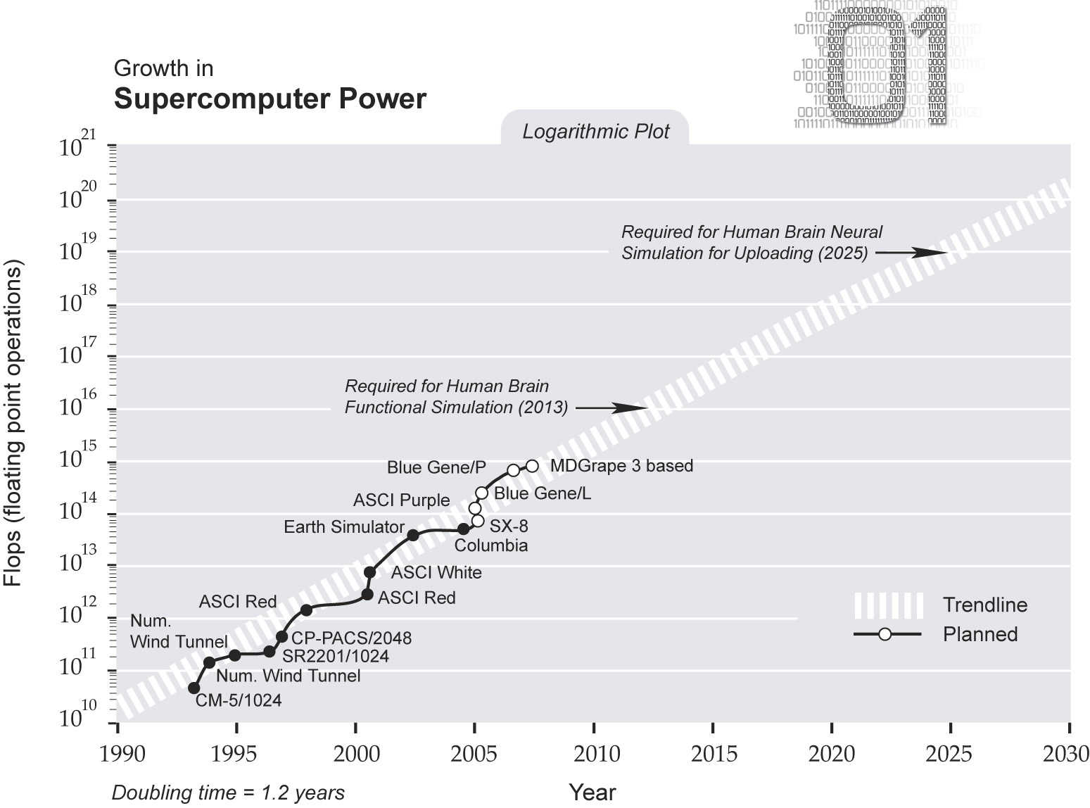
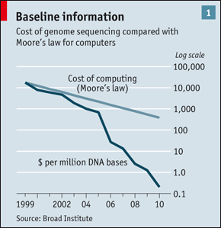
Compute & Data: Two sides of the same coin
An Interesting Observation

Slide 4
Outline
Motivation: Rich and diverse landscape of data-intensive architectures, applications and software systems, requires balanced, interoperable CI
    What might the architecture of such CI be? HPC or Grids or Clouds?
Approach: Best of two paradigms: HPC AND Apache Big Data Stack
  Architecture: HPBDS=HPC+ABDS
Our Contribution:
  Applications: Introduce BigData Ogres (mini-app, macro/micro patterns)
  Experiments: K-means Ogres study performance range of systems
Ongoing and Future Work
  Abstractions: SPIDAL and MIDAS which underpin HPBDS
    How to achieve consilience between HPC and Apache/Hadoop?

Slide 5
Grand Challenge Research Agenda
There is perhaps a broad consensus as to important issues in practical parallel computing as applied to large scale simulations; this is reflected in supercomputer architectures, algorithms, libraries, languages, compilers and best practice for application development.
However the same is not so true for data intensive problems even though commercial clouds presumably devote more resources to data analytics than supercomputers devote to simulations. We try to establish some principles that allow one to compare data intensive architectures and decide which applications fit which machines and which software.
We use a sample of over 50 big data applications to identify characteristics of data intensive applications and propose a big data version of the famous Berkeley dwarfs and NAS parallel benchmarks. We consider hardware from clouds to HPC. Our software analysis builds on the Apache software stack (ABDS) that is well used in modern cloud computing, which we enhance with HPC concepts to derive HPC-ABDS, aka HPBDS

Slide 6
The Case for an Integrating Apache/Hadoop Big Data Stack with HPC

Slide 7
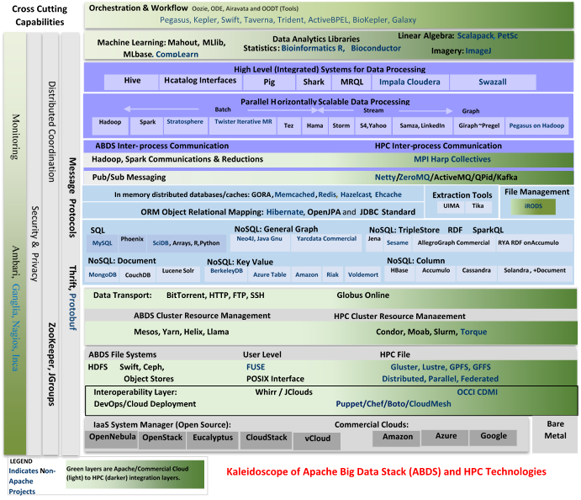

Slide 8
Hadoop/ABDS
  ~120 Capabilities
  >40 Apache
Green layers have strong HPC Integration opportunities
Goal
Functionality of ABDS
Performance of HPC

Slide 9
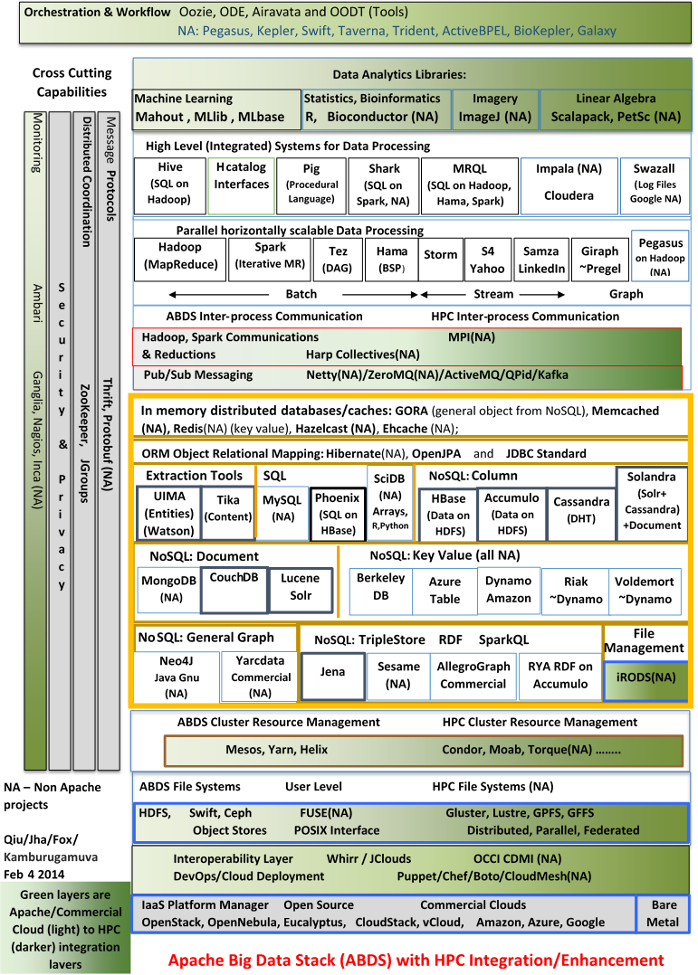

Slide 10
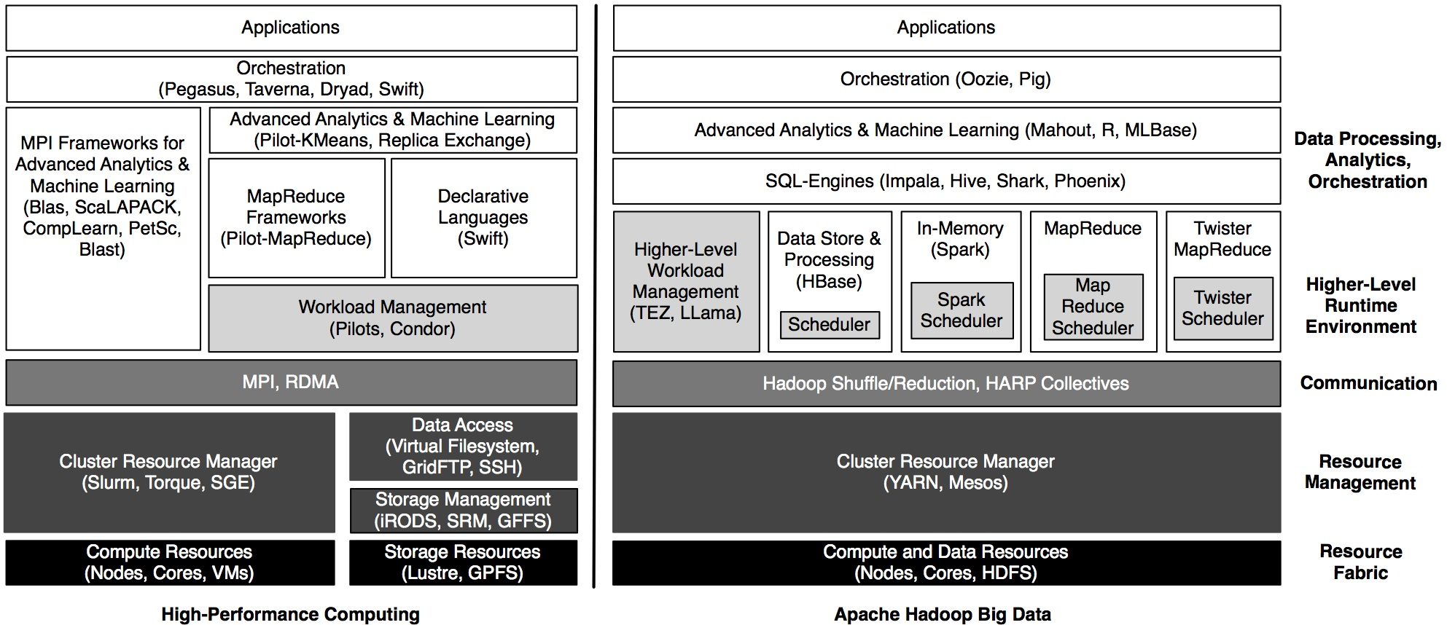

Slide 11
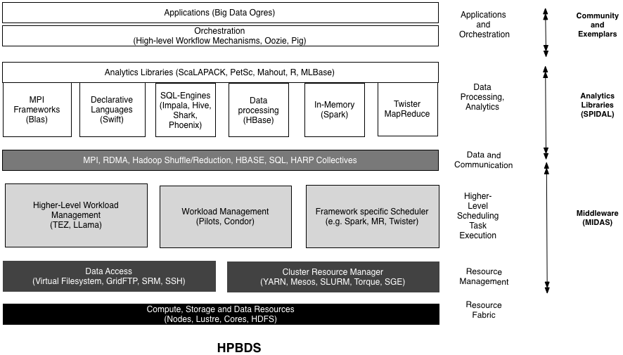

Slide 12
Bringing High Performance to Data Analytics
On the systems side, we have two principles
  The Apache Big Data Stack with ~120 projects has important broad functionality with a vital large support organization
  HPC including MPI has striking success in delivering high performance with however a fragile sustainability model
There are key systems abstractions which are levels in HPC-ABDS software stack where careful integration needed
  Resource management
  Resource Fabric: Storage and Compute
  Programming model -- horizontal scaling parallelism
  Collective and Point to Point communication
  Support of iteration
  Data interface (not just key-value)

Slide 13
From Dwarfs to Ogres: The Many Facets of BigData Ogres

Slide 14
Diversity of Data-Intensive Applications [slide source GCF]
http://bigdatawg.nist.gov/usecases.php
51 Detailed Use Cases: Contributed July-September 2013
Covers goals, data features such as 3 V’s, software, hardware
Government Operation(4): National Archives and Records Administration, Census Bureau
Commercial(8): Finance in Cloud, Cloud Backup, Mendeley (Citations), Netflix, Web Search, Digital Materials, Cargo shipping (as in UPS)
Defense(3): Sensors, Image surveillance, Situation Assessment
Healthcare and Life Sciences(10): Medical records, Graph and Probabilistic analysis, Pathology, Bioimaging, Genomics, Epidemiology, People Activity models, Biodiversity
Deep Learning and Social Media(6): Driving Car, Geolocate images/cameras, Twitter, Crowd Sourcing, Network Science, NIST benchmark datasets
The Ecosystem for Research(4): Metadata, Collaboration, Language Translation, Light source experiments
Astronomy and Physics(5): Sky Surveys including comparison to simulation, Large Hadron Collider at CERN, Belle Accelerator II in Japan

Slide 15
Data-Intensive Application Pattern (or Structure)
Capture “essence of these use cases”.. Classify applications into patterns, “small” kernels, mini-apps
  Focus on cases with detailed analytics
  Use for benchmarks of computers and software
In parallel computing, this is well established
  Linpack for measuring performance to rank machines in Top500
  NAS Parallel Benchmarks (originally a pencil and paper specification to allow optimal implementations; then MPI library)
  Other specialized Benchmark sets keep changing and used to guide procurements
    Last 2 NSF hardware solicitations had NO preset benchmarks – perhaps as no agreement on key applications for clouds and data intensive applications
  Berkeley dwarfs capture different structures that any approach to parallel computing must address
  Templates used to capture parallel computing patterns

Slide 16
HPC Benchmark Classics
Linpack or HPL: Parallel LU factorization for solution of linear equations
NPB version 1: Mainly classic HPC solver kernels
  MG: Multigrid
  CG: Conjugate Gradient
  FT: Fast Fourier Transform
  IS: Integer sort
  EP: Embarrassingly Parallel
  BT: Block Tridiagonal
  SP: Scalar Pentadiagonal
  LU: Lower-Upper symmetric Gauss Seidel

Slide 17
7 Original Berkeley Dwarfs (Colella)
Structured Grids (including locally structured grids, e.g. Adaptive Mesh Refinement)
Unstructured Grids
Fast Fourier Transform
Dense Linear Algebra
Sparse Linear Algebra
Particles
Monte Carlo
Note “vaguer” than NPB

Slide 18
13 Berkeley Dwarfs
Dense Linear Algebra
Sparse Linear Algebra
Spectral Methods
N-Body Methods
Structured Grids
Unstructured Grids
MapReduce
Combinational Logic
Graph Traversal
Dynamic Programming
Backtrack and Branch-and-Bound
Graphical Models
Finite State Machines
First 6 of these correspond to Colella’s original.
Monte Carlo dropped
N-body methods are a subset of Particle
Note a little inconsistent in that MapReduce is a programming model and spectral method is a numerical method
Need multiple facets!

Slide 19
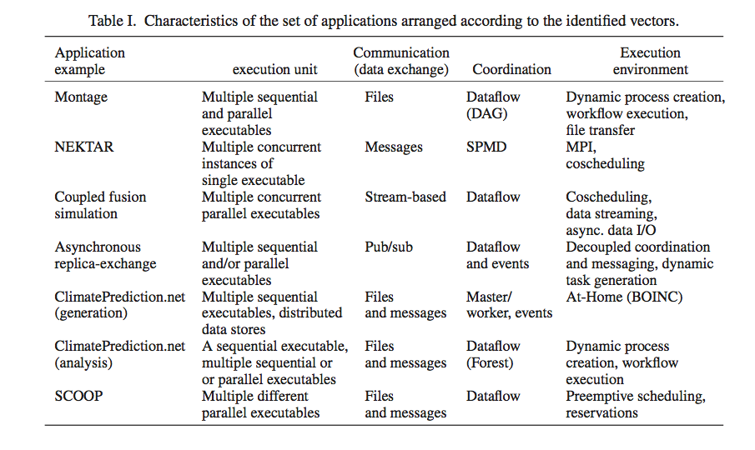
Distributed Computing MetaPatterns I
Jha, Cole, Katz, Parashar, Rana, Weissman

Slide 20
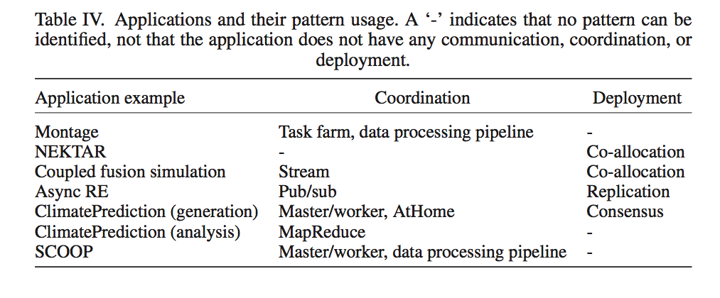
Distributed Computing MetaPatterns II
Jha, Cole, Katz, Parashar, Rana, Weissman

Slide 21
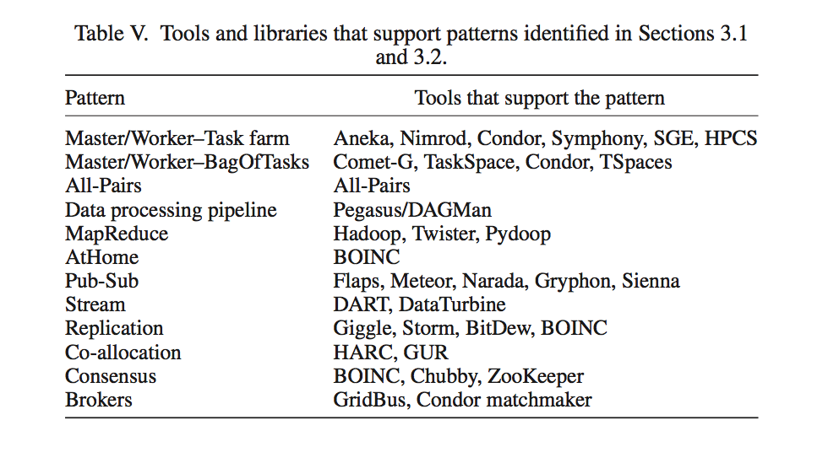
Distributed Computing MetaPatterns III

Slide 22
Comparison of Data Analytics with Simulation I
Pleasingly parallel often important in both
Both are often SPMD and BSP
  Non-iterative MapReduce is major big data paradigm
  not a common simulation paradigm except where “Reduce” summarizes pleasingly parallel execution
Big Data often has large collective communication
  Classic simulation has a lot of smallish point-to-point messages
Simulation dominantly sparse (nearest neighbor) data structures
  “Bag of words (users, rankings, images..)” algorithms are sparse, as is PageRank
  Important data analytics involves full matrix algorithms

Slide 23
Comparison of Data Analytics with Simulation II
There are similarities between some graph problems and particle simulations with a strange cutoff force.
  Both Map-Communication
Note many big data problems are “long range force” as all points are linked.
  Easiest to parallelize. Often full matrix algorithms
  e.g. in DNA sequence studies, distance δ(i, j) defined by BLAST, Smith-Waterman, etc., between all sequences i, j.
  Opportunity for “fast multipole” ideas in big data.
In image-based deep learning, neural network weights are block sparse (corresponding to links to pixel blocks) but can be formulated as full matrix operations on GPUs and MPI in blocks.
In HPC benchmarking, Linpack being challenged by a new sparse conjugate gradient benchmark HPCG, while I am diligently using non- sparse conjugate gradient solvers in clustering and Multi-dimensional scaling.

Slide 24
Problem Architecture Facet of Ogres (MacroPattern)
Pleasingly Parallel, e.g. BLAST, Protein docking, including Local Analytics or Machine Learning,
Classic MapReduce for Search and Query
Global Analytics or Machine Learning requiring iterative programming models
Problem set up as a graph as opposed to vector, grid
SPMD (Single Program Multiple Data)
Bulk Synchronous Processing: well-defined compute-communication phases
Fusion: Knowledge discovery often involves fusion of multiple methods.
Workflow (often used in fusion)
Note problem and machine architectures are related
Notes:
Big dwarfs are Ogres
Implement Ogres in ABDS+

Slide 25
Core Analytics Facet of Ogres (microPattern) I
Map-Only
Pleasingly parallel - Local Machine Learning
MapReduce: Search/Query
Summarizing statistics as in LHC Data analysis (histograms)
Recommender Systems (Collaborative Filtering)
Linear Classifiers (Bayes, Random Forests)
Global Analytics
Nonlinear Solvers (structure depends on objective function)
  Stochastic Gradient Descent SGD, Levenberg-Marquardt solver
Map-Collective I (need to improve/extend Mahout, MLlib)
Outlier Detection, Clustering (many methods),
Mixture Models, LDA (Latent Dirichlet Allocation), PLSI (Probabilistic Latent Semantic Indexing)

Slide 26
Core Analytics Facet of Ogres (microPattern) II
Map-Collective II
Use matrix-matrix,-vector operations, solvers (conjugate gradient)
SVM and Logistic Regression
PageRank, (find leading eigenvector of sparse matrix)
SVD (Singular Value Decomposition)
MDS (Multidimensional Scaling)
Learning Neural Networks (Deep Learning)
Hidden Markov Models
Map-Communication
Graph Structure (Communities, subgraphs/motifs, diameter, maximal cliques, connected components)
Network Dynamics - Graph simulation Algorithms (epidemiology)
Asynchronous Shared Memory
Graph Structure (Betweenness centrality, shortest path)

Slide 27
One Facet of Ogres has Computational Features
Flops per byte;
Communication Interconnect requirements;
Is application (graph) constant or dynamic?
Most applications consist of a set of interconnected entities; is this regular as a set of pixels or is it a complicated irregular graph?
Is communication BSP or Asynchronous? In latter case shared memory may be attractive;
Are algorithms Iterative or not?
Data Abstraction: key-value, pixel, graph, vector
  Are data points in metric or non-metric spaces?
Core libraries needed: matrix-matrix/vector algebra, conjugate gradient, reduction, broadcast

Slide 28
Data Lifecycle and Challenges
Application, Model, Insight
Heterogeneous data sources
Application-generated Data
Resource Requirements
Write I/O Bound
Scale-out for high data rates
Read I/O Bound
Scale-out for higher aggregate I/O
Compute/Memory Bound
Scale-out for higher aggregate I/O
Ingest
Preparation/Exploration
Advanced Analytics
Storage/Compute

Slide 29
Data Source and Style Facet of Ogres
(i) SQL
(ii) NOSQL based
(iii) Other Enterprise data systems (10 examples from Bob Marcus)
(iv) Set of Files (as managed in iRODS)
(v) Internet of Things
(vi) Streaming and
(vii) HPC simulations
(viii) Involve GIS (Geographical Information Systems)
Before data gets to compute system, there is often an initial data gathering phase which is characterized by a block size and timing. Block size varies from month (Remote Sensing, Seismic) to day (genomic) to seconds or lower (Real time control, streaming)
There are storage/compute system styles: Shared, Dedicated, Permanent, Transient
Other characteristics are needed for permanent auxiliary/comparison datasets and these could be interdisciplinary, implying nontrivial data movement/replication
Notes:
Big dwarfs are Ogres
Implement Ogres in ABDS+

Slide 30
SPIDAL: What is Parallelism Over?
People: either the users (but see below) or subjects of application and often both
Decision makers like researchers or doctors (users of application)
Items such as Images, EMR, Sequences below; observations or contents of online store
  Images or “Electronic Information nuggets”
  EMR: Electronic Medical Records (often similar to people parallelism)
  Protein or Gene Sequences;
  Material properties, Manufactured Object specifications, etc., in custom dataset
  Modelled entities like vehicles and people
Sensors – Internet of Things
Events such as detected anomalies in telescope or credit card data or atmosphere
(Complex) Nodes in RDF Graph
Simple nodes as in a learning network
Tweets, Blogs, Documents, Web Pages, etc.
  And characters/words in them
Files or data to be backed up, moved or assigned metadata
Particles/cells/mesh points as in parallel simulations

Slide 31
4 Forms of MapReduce
(a) Map Only
(b) Classic MapReduce
(c) Iterative MapReduce
(d) Loosely Synchronous
Input
Input
Iterations
Input
map
map
map
P_{ij}
reduce
reduce
Output
BLAST Analysis
Parametric sweep
Pleasingly Parallel
High Energy Physics (HEP) Histograms
Distributed search
Expectation maximization Clustering e.g. Kmeans
Linear Algebra, Page Rank
Classic MPI
PDE Solvers and particle dynamics
Domain of MapReduce and Iterative Extensions
Science Clouds
MPI
Giraph
MPI is Map followed by Point to Point or Collective Communication
– as in style c) plus d) [slide source Geoffrey Fox]

Slide 32
Increasing Communication
Identical Computation
Mahout and Hadoop MR – Slow due to MapReduce
Python slow as Scripting; MPI fastest
Spark Iterative MapReduce, non optimal communication
Harp Hadoop plug in with ~MPI collectives

Slide 33
Ongoing & Future Work: Towards HPBDS

Slide 34
Ongoing and Future Work
Applications:
  Formalizing and furthering Ogres
  Investigating science and engineering applications beyond Kmeans, e.g. MDS, trajectory analysis etc.
Abstractions: Design and Implementation of
  Analytics Library (SPIDAL)
    Collective communication implementation?
  Resource Management (MIDAS)
    In-memory abstractions implementations?
    General purpose task management?
System: SPIDAL and MIDAS working on Wrangler (Hadoop-based) and COMET (VM based, non-Hadoop)

Slide 35
Lessons / Insights
A fundamental need for abstractions to support diverse set of data-intensive applications
  Need for a balanced, interoperable data CI
Enhanced Apache Big Data Stack HPC-ABDS has ~120 members
  Opportunities at Resource management, Data/File, Streaming, Programming, monitoring, workflow layers for HPC and ABDS integration
Data intensive algorithms do not have the well developed high performance libraries familiar from HPC
Integrate (don’t compete) HPC with “Commodity Big data” (Google to Amazon to Enterprise Data Analytics)
  Towards High-performance Data-Intensive Computing
  Best of both
    i.e. improve Mahout; don’t compete with it
    e.g. Hadoop plug-ins rather than replacing Hadoop

