Slide 1
Biomedical
Cloud Computing
iDASH Symposium http://idash.ucsd.edu
San Diego CA
May 12 2011
Geoffrey Fox
gcf@indiana.edu
http://www.infomall.org http://www.futuregrid.org
Director, Digital Science Center, Pervasive Technology Institute
Associate Dean for Research and Graduate Studies, School of Informatics and Computing
Indiana University Bloomington

Slide 2
Philosophy of
Clouds and Grids
Clouds are (by definition) commercially supported approach to large scale computing (data-sets)
  So we should expect Clouds to replace Compute Grids
  Current Grid technology involves “non-commercial” software solutions which are hard to evolve/sustain
Public Clouds are broadly accessible resources like Amazon and Microsoft Azure – powerful but not easy to customize and data trust/privacy issues
Private Clouds run similar software and mechanisms but on “your own computers” (not clear if still elastic)
  Platform features such as Queues, Tables, Databases currently limited
Services still are correct architecture with either REST (Web 2.0) or Web Services
Clusters are still critical concept for either MPI or Cloud software

Slide 3
Clouds and Jobs
Clouds are a major industry thrust with a growing fraction of IT expenditure that IDC estimates will grow to $44.2 billion direct investment in 2013 while 15% of IT investment in 2011 will be related to cloud systems with a 30% growth in public sector.
Gartner also rates cloud computing high on list of critical emerging technologies with for example “Cloud Computing” and “Cloud Web Platforms” rated as transformational (their highest rating for impact) in the next 2-5 years.
Correspondingly there is and will continue to be major opportunities for new jobs in cloud computing with a recent European study estimating there will be 2.4 million new cloud computing jobs in Europe alone by 2015.
Cloud computing is an attractive for projects focusing on workforce and economic development. Note that the recently signed “America Competes Act” calls out the importance of economic development in broader impact of NSF projects

Slide 4
2 Aspects of Cloud Computing:
Infrastructure and Runtimes
Cloud infrastructure: outsourcing of servers, computing, data, file space, utility computing, etc.
  Handled through Web services that control virtual machine lifecycles.
Cloud runtimes or Platform: tools (for using clouds) to do data-parallel (and other) computations.
  Apache Hadoop, Google MapReduce, Microsoft Dryad, Bigtable, Chubby and others
  MapReduce designed for information retrieval but is excellent for a wide range of science data analysis applications
  Can also do much traditional parallel computing for data-mining if extended to support iterative operations
  Data Parallel File system as in HDFS and Bigtable

Slide 5
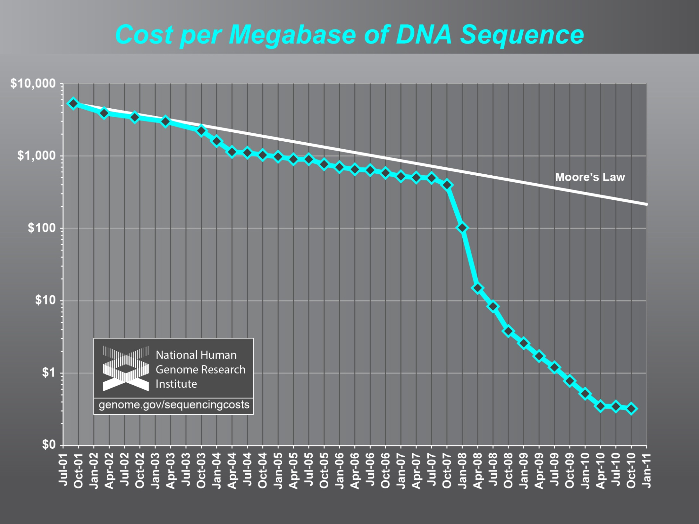

Slide 6
Cloud Issues
Operating cost of a large shared (public) cloud ~20% that of traditional cluster
Gene sequencing cost decreasing much faster than Moore’s law
Biomedical computing does not need low cost (microsecond) synchronization of HPC Cluster
  Amazon a factor of 6 less effective on HPC workloads than state of art HPC cluster
  i.e. Clouds work for biomedical applications if we can make convenient and address privacy and trust
Current research infrastructure like TeraGrid pretty inconsistent with cloud ideas
Software as a Service likely to be dominant usage model
  Paid by “credit card” whether commercial, government or academic
  “standard” services like BLAST plus services with your software
Standards needed for many reasons and significant activity here including IEEE/NIST effort
  Rich cloud platforms makes hard but infrastructure level standards like OCCI (Open Cloud Computing Interface) emerging
  We are still developing many new ideas (such as new ways of handling large data) so some standards premature
Communication performance – this issue will be solved if we bring computing to data

Slide 7
Trustworthy Cloud Computing
Public Clouds are elastic (can be scaled up and down) as large and shared
  Sharing implies privacy and security concerns; need to learn how to use shared facilities
Private clouds are not easy to make elastic or cost effective (as too small)
  Need to support public (aka shared) and private clouds
“Amazon is 100X more secure than your infrastructure” (Bio-IT Boston April 2011)
  But how do we establish this trust?
“Amazon is more or less useless as NIH will only let us run 20% of our genomic data on it so not worth the effort to port software to cloud” (Bio-IT Boston)
  Need to establish trust

Slide 8
Trustworthy Cloud Approaches
Rich access control with roles and sensitivity to combined datasets
Anonymization & Differential Privacy – defend against sophisticated datamining and establish trust that it can
Secure environments (systems) such as Amazon Virtual Private Cloud – defend against sophisticated attacks and establish trust that it can
Application specific approaches such as database privacy
Hierarchical algorithms where sensitive computations need modest computing on non-shared resources

Slide 9
Traditional File System?
S
Data
C
C
C
C
S
C
C
C
C
Archive
Data
S
C
C
C
C
Data
C
C
C
C
S
Data
Compute Cluster
Storage Nodes
Typically a shared file system (Lustre, NFS …) used to support high performance computing
Big advantages in flexible computing on shared data but doesn’t “bring computing to data”
So will be replaced by …..

Slide 10
Data Parallel File System?
Block1
Replicate each block
File1
Block2
……
Breakup
BlockN
C
C
C
C
Data
Data
Data
Data
C
C
C
C
Data
Data
Data
Data
C
C
C
C
Data
Data
Data
Data
C
C
C
C
Data
Data
Data
Data
Block1
File1
Block2
……
Breakup
Replicate each block
BlockN
No archival storage and computing brought to data

Slide 11
MapReduce
Data Partitions
Map(Key, Value)
A hash function maps the results of the map tasks to reduce tasks
Reduce(Key, List<Value>)
Reduce Outputs
Implementations (Hadoop – Java; Dryad – Windows; Twister – Java and Azure) support:
  Splitting of data
  Passing the output of map functions to reduce functions
  Sorting the inputs to the reduce function based on the intermediate keys
  Fault Tolerant and Dynamic

Slide 12

All-Pairs Using DryadLINQ
125 million distances
4 hours & 46 minutes
Calculate Pairwise Distances (Smith Waterman Gotoh)
Calculate pairwise distances for a collection of genes (used for clustering, MDS)
Fine grained tasks in MPI
Coarse grained tasks in DryadLINQ
Performed on 768 cores (Tempest Cluster)
Moretti, C., Bui, H., Hollingsworth, K., Rich, B., Flynn, P., & Thain, D. (2009). All-Pairs: An Abstraction for Data Intensive Computing on Campus Grids. IEEE Transactions on Parallel and Distributed Systems , 21, 21-36.

Slide 13
SWG Cost
Notes:
This is just the cost for the compute instances. In addition to this, there will be minor charges for the data storage for EMR & AzureMR. Also there will be additional minor charges for the queue service and table service for AzureMR.
Cost presented here are amortized for the actual time (time/3600 * num_instances * instance_price_per_hour), assuming the remaining time of the instance hour have been put to useful work.
Note: EMR & Hadoop-EC2 requires one extra node to act as the master node (included in the cost calculation)

Slide 14
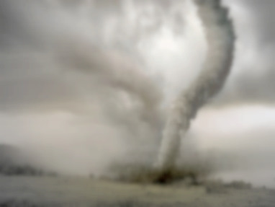
Twister v0.9
March 15, 2011
  New Interfaces for Iterative MapReduce Programming
  http://www.iterativemapreduce.org/
SALSA Group
Bingjing Zhang, Yang Ruan, Tak-Lon Wu, Judy Qiu, Adam Hughes, Geoffrey Fox, Applying Twister to Scientific Applications, Proceedings of IEEE CloudCom 2010 Conference, Indianapolis, November 30-December 3, 2010
Twister4Azure to be released May 2011
MapReduceRoles4Azure available now at
http://salsahpc.indiana.edu/mapreduceroles4azure/

Slide 15

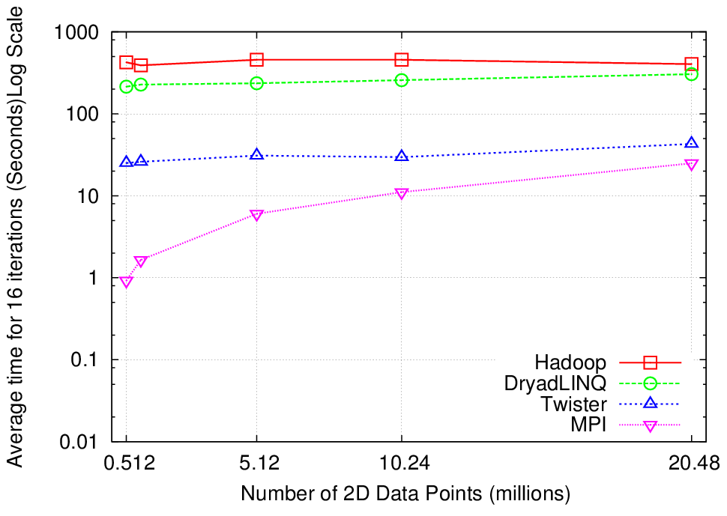
K-Means Clustering
Compute the distance to each data point from each cluster center and assign points to cluster centers
map
map
Time for 20 iterations
reduce
Compute new cluster
centers
User program
Compute new cluster centers
Iteratively refining operation
Typical MapReduce runtimes incur extremely high overheads
  New maps/reducers/vertices in every iteration
  File system based communication
Long running tasks and faster communication in Twister enables it to perform close to MPI

Slide 16
Twister4Azure early results

Slide 17
Twister4Azure
Architecture

Slide 18
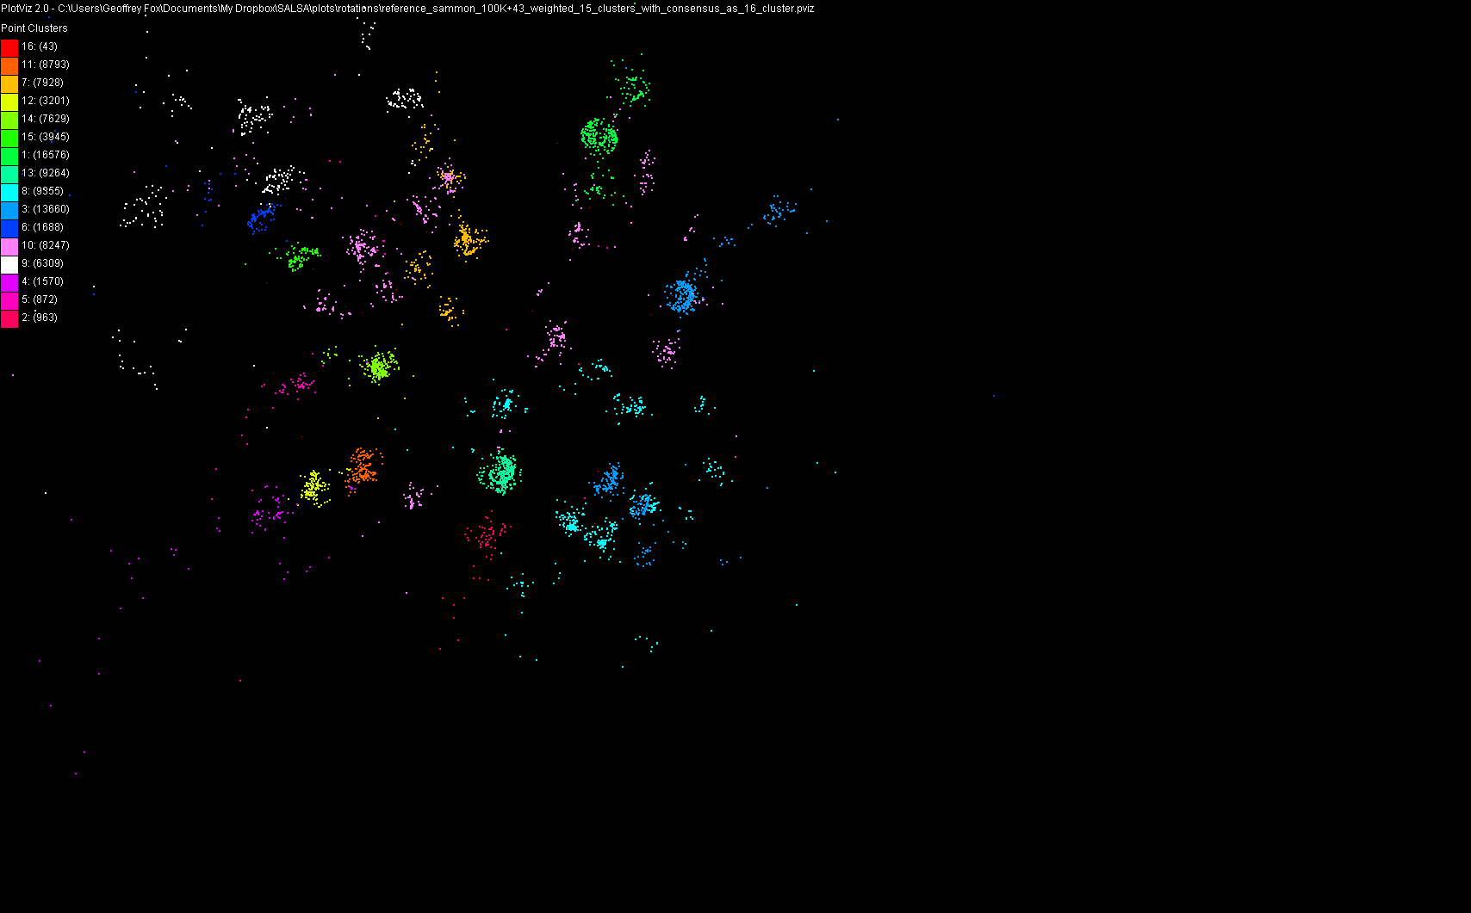
100,043 Metagenomics Sequences Scaling to 10’s of millions with Twister on cloud

Slide 19
US Cyberinfrastructure Context
There are a rich set of facilities
  Production TeraGrid facilities with distributed and shared memory
  Experimental “Track 2D” Awards
    FutureGrid: Clouds Grids and HPC Testbed
    Keeneland: Powerful GPU Cluster (Georgia Tech)
    Gordon: Large (distributed) Shared memory system with SSD aimed at data analysis/visualization (SDSC)
  Open Science Grid aimed at High Throughput computing and strong campus bridging

Slide 20
FutureGrid key Concepts I
FutureGrid is an international testbed modeled on Grid5000
Supporting international Computer Science and Computational Science research in cloud, grid and parallel computing (HPC)
  Industry and Academia
  Note much of current use Education, Computer Science Systems and Biology/Bioinformatics
The FutureGrid testbed provides to its users:
  A flexible development and testing platform for middleware and application users looking at interoperability, functionality, performance or evaluation
  Each use of FutureGrid is an experiment that is reproducible
  A rich education and teaching platform for advanced cyberinfrastructure (computer science) classes

Slide 21

FutureGrid: a Grid/Cloud/HPC Testbed
NID: Network Impairment Device
Private
Public
FG Network

Slide 22

FutureGrid key Concepts II
Rather than loading images onto VM’s, FutureGrid supports Cloud, Grid and Parallel computing environments by dynamically provisioning software as needed onto “bare-metal” using Moab/xCAT
  Image library for MPI, OpenMP, Hadoop, Dryad, gLite, Unicore, Globus, Xen, ScaleMP (distributed Shared Memory), Nimbus, Eucalyptus, OpenNebula, KVM, Windows …..
Growth comes from users depositing novel images in library
FutureGrid has ~4000 (will grow to ~5000) distributed cores with a dedicated network and a Spirent XGEM network fault and delay generator
Image1
Image2
…
ImageN
Choose
Load
Run

Slide 23
5 Use Types for FutureGrid
~110 approved projects over last 8 months
Training Education and Outreach
  Semester and short events; promising for non research intensive universities
Interoperability test-beds
  Grids and Clouds; Standards; Open Grid Forum OGF really needs
Domain Science applications
  Life sciences highlighted
Computer science
  Largest current category (> 50%)
Computer Systems Evaluation
  TeraGrid (TIS, TAS, XSEDE), OSG, EGI
Clouds are meant to need less support than other models; FutureGrid needs more user support …….

Slide 24

Typical FutureGrid Performance Study
Linux, Linux on VM, Windows, Azure, Amazon Bioinformatics

Slide 25
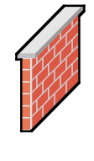
OGF’10 Demo from Rennes
SDSC
Rennes
Grid’5000 firewall
UF
Lille
UC
Sophia
ViNe provided the necessary inter-cloud connectivity to deploy CloudBLAST across 6 Nimbus sites, with a mix of public and private subnets.

Slide 26
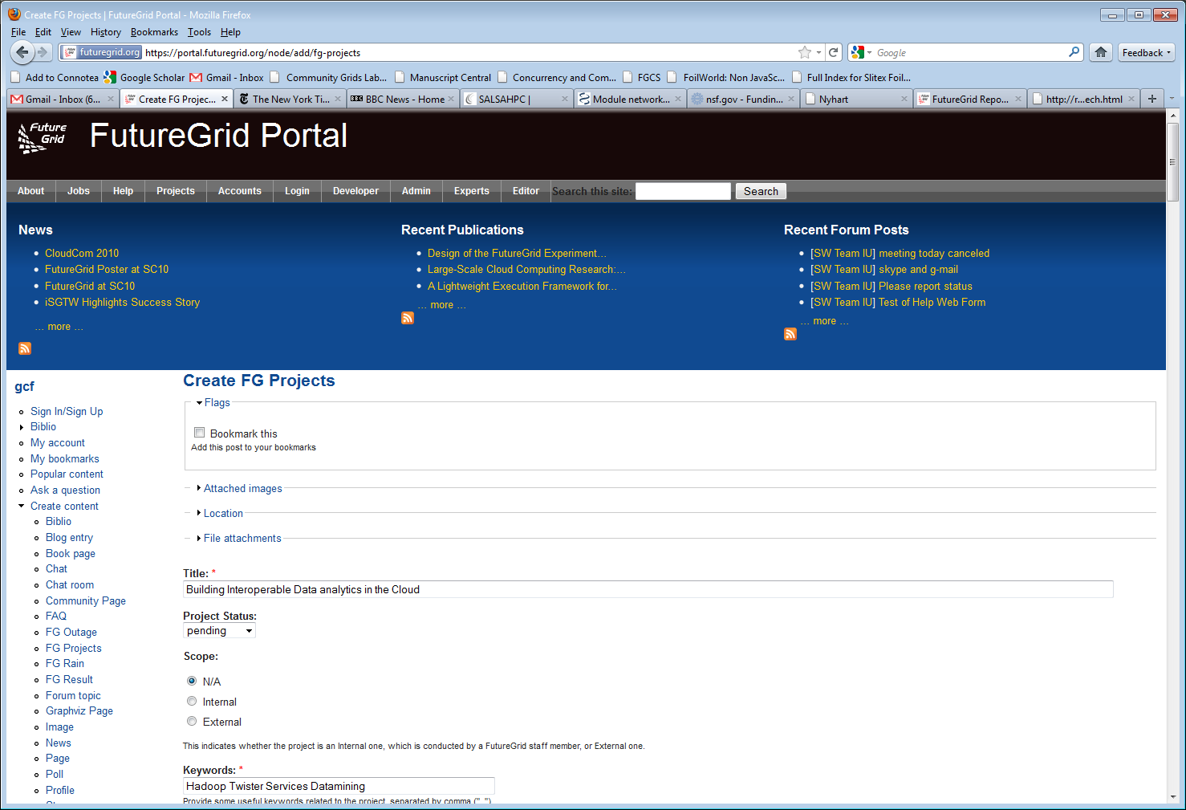
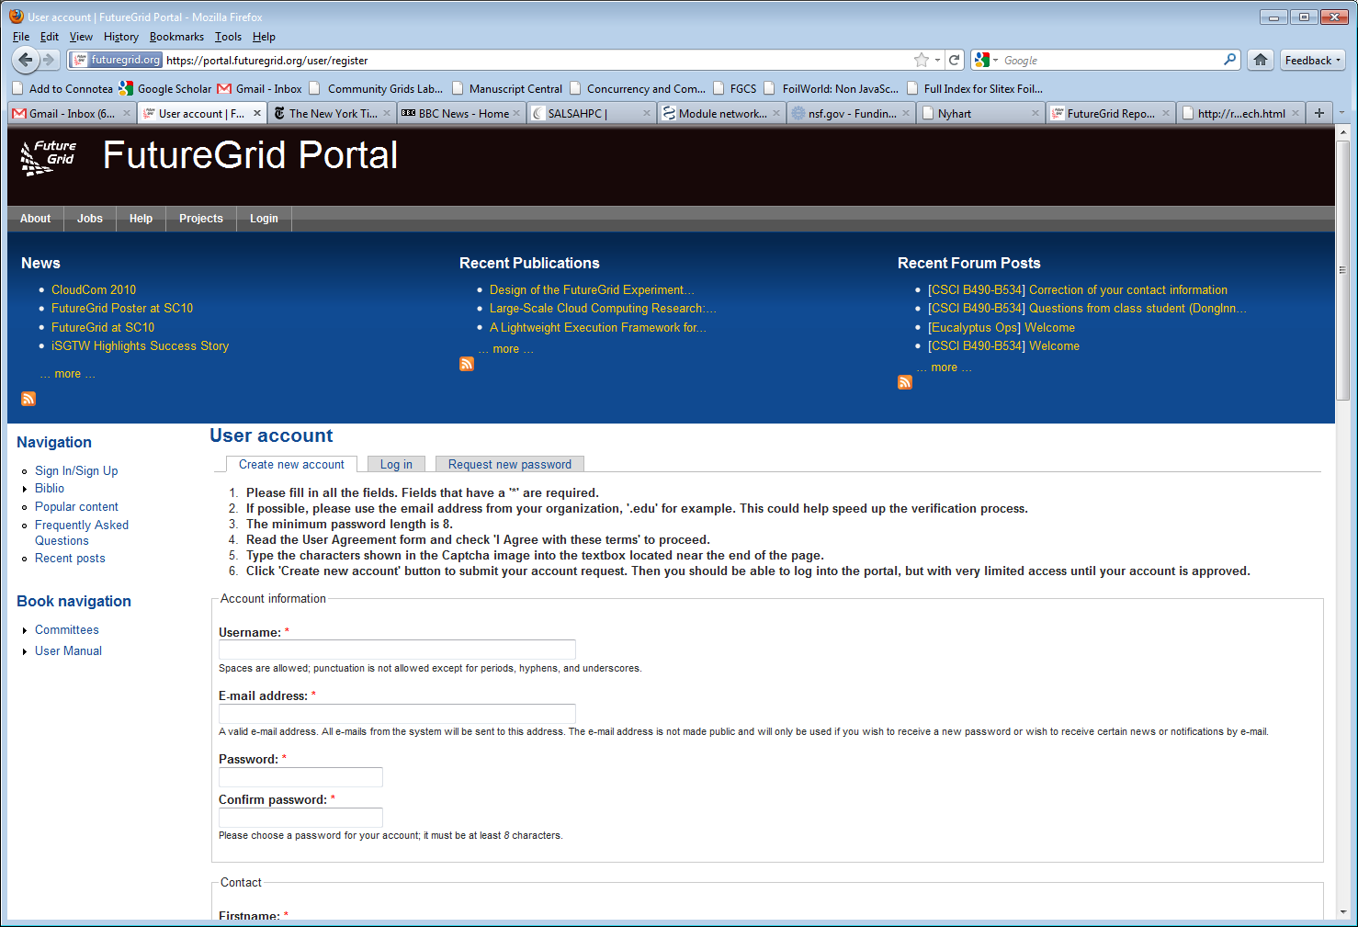
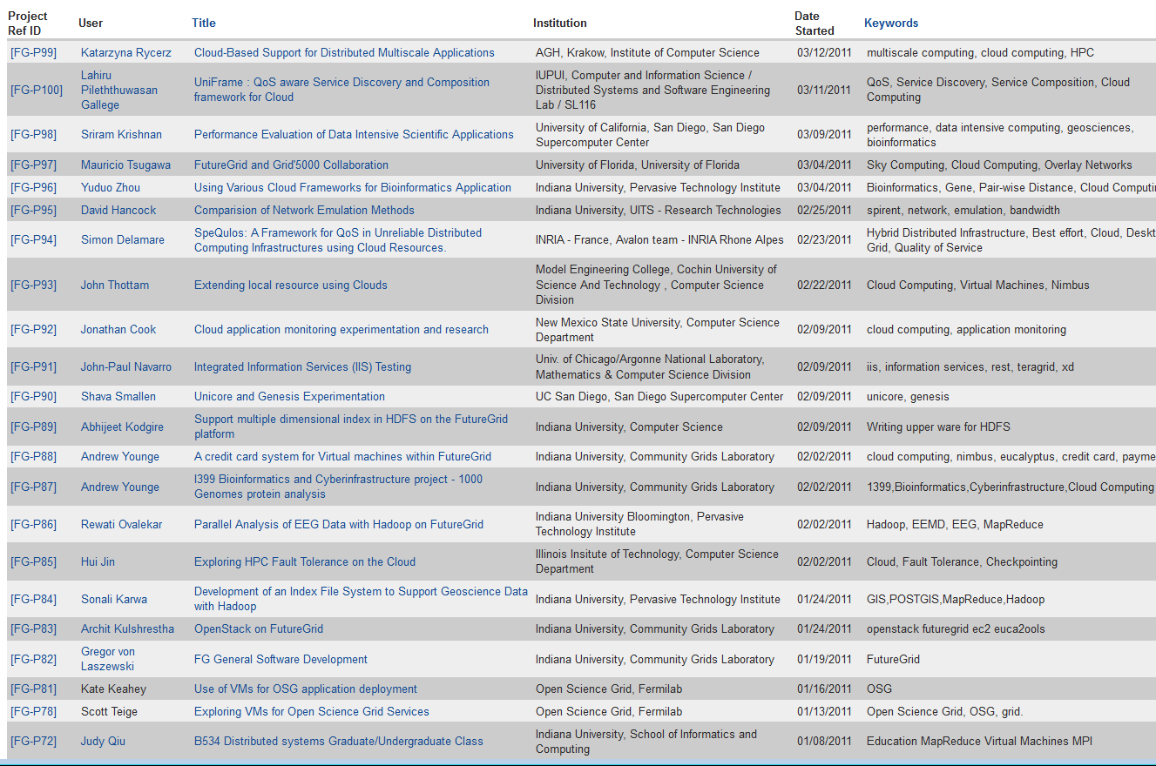
Create a Portal Account and apply for a Project

