Slide 1
Cloud-based Parallel Implementation of SLAM for Mobile Robots
Supun Kamburugamuve, Hengjing He, Geoffrey Fox, David Crandall
School of Informatics & Computing
Indiana University
USA
22 Mar 2016

Slide 2
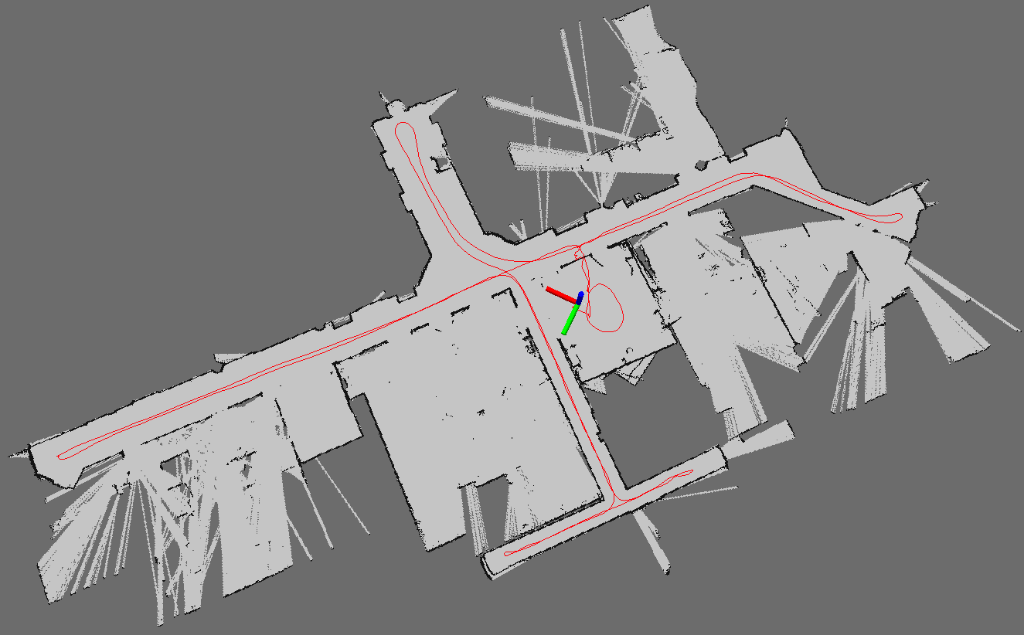
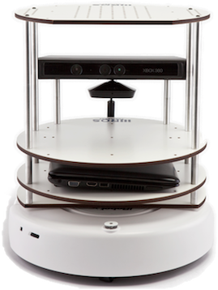
Simultaneous Localization and Mapping (SLAM)
Simultaneously Building a map and estimating the robot position with sensor errors
Map Built from Robot data
Robot with a Laser Range Finder

Slide 3
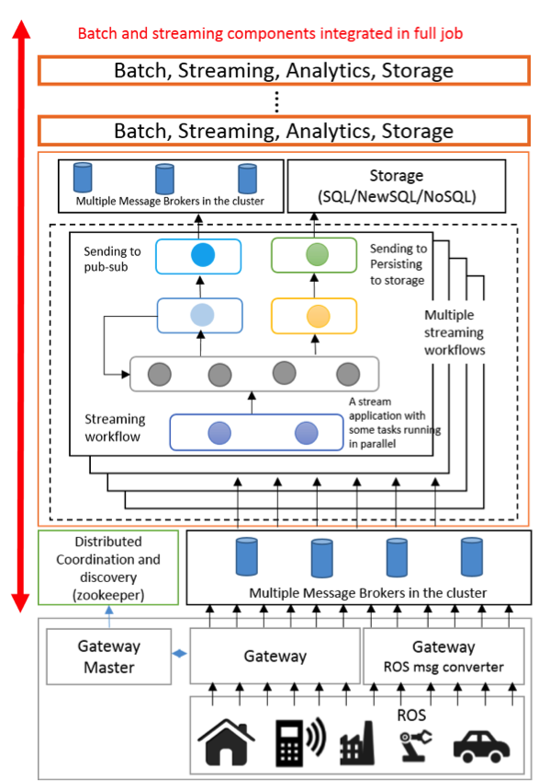
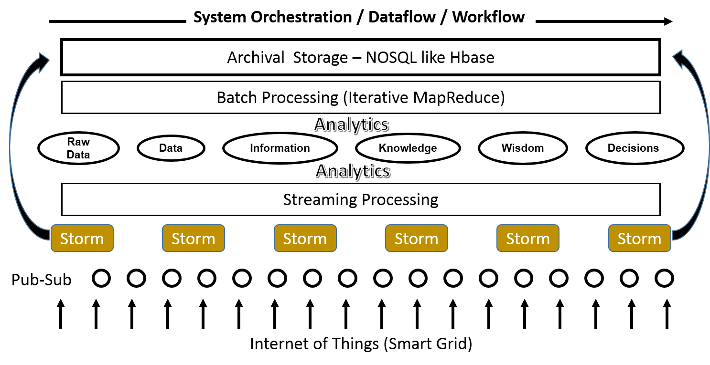
Cloud DIKW for Robotics (Data, Information, Knowledge and Wisdom)
High-level Architecture
Detailed Architecture

Slide 4
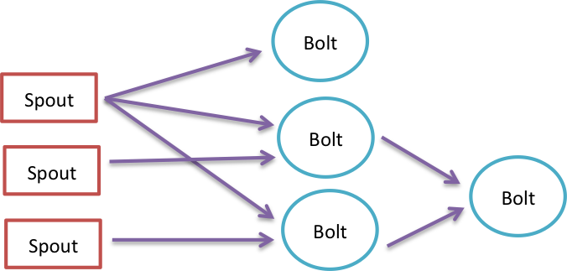
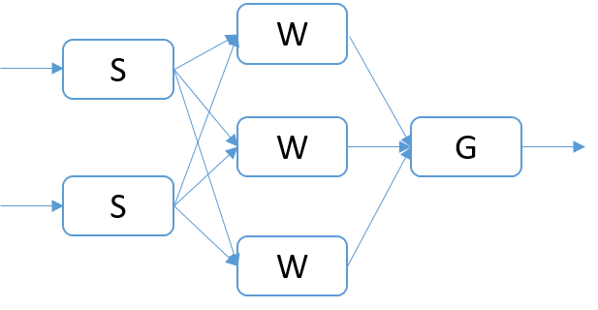
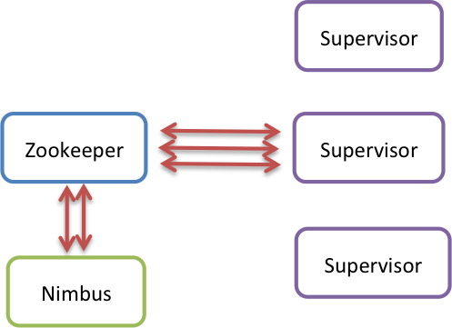
Apache Storm
The Stream processing model is a graph of stream processing nodes connected through streams of events.
Topology
User Graph
Storm Programming Model
Execution graph
http://storm.apache.org/
Architecture

Slide 5
Particle Filtering Based SLAM
Estimating the posterior$p(x_{1:t},m|z_{1:t},u_{1:t−1})$
where $x_{1:t}=x_{1},…, x_{t}$ is the trajectory of the robot
m is the map
$z_{1:t}=z_{1},…, z_{t}$ are the laser readings observed $u_{1:t−1}=u_{1},…, u_{t−1}$ are the odometer measurements.
$$p(x_{1:t},m|z_{1:t},u_{1:t−1})=p\left(m | x_{1:t}, z_{1:t}\right)p(x_{1:t}|z_{1:t},u_{1:t−1})$$
The above factorization first estimates the position of the robot given the observations, and then calculates the map using the trajectory of the robot.
Algorithm: Grisetti, Giorgio, Cyrill Stachniss, and Wolfram Burgard. "Improved techniques for grid mapping with rao-blackwellized particle filters." Robotics, IEEE Transactions on 23, no. 1 (2007): 34-46.

Slide 6
Algorithm
The particle filter maintains a set of particles, with each one containing a probable map of the environment and a possible trajectory of the robot.
For each particle:
Make an initial guess $x_{t}^{′(i)}=x_{t−1}^{′(i)}⊕u_{t−1}$, where $⊕$ is standard pose compounding operator. The algorithm incorporates the motion model parameters of the robot when calculating the initial guess.
Use the ScanMatching algorithm to optimize initial guess $x_{t}^{′(i)}$ using the $m_{t−1}^{(i)}$and laser reading $z_{t}$. If the ScanMatching fails, use the previous guess.
Update the weight of the particle
The map $m_{t}^{(i)}$ of the particle is updated with the new position $x_{t}^{(i)}$ and $z_{t}$.
Resample particles with replacement according to weights

Slide 7
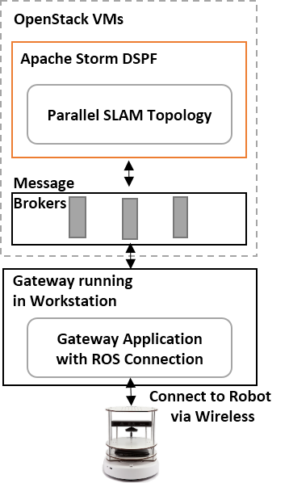
Streaming Application
System overview
Distributed Streaming Computation

Slide 8
Performance of Parallel vs Serial
Parallel behavior of the algorithm with 640 laser readings (left) and 180 readings (right). For each dataset, the top graph shows mean times and the bottom graph shows the speedup

Slide 9
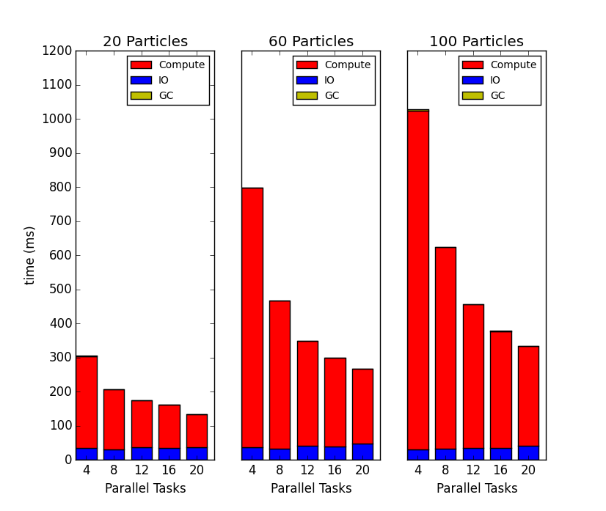
Analysis of Performance
I/O, garbage collection, and Compute time
Overhead of imbalanced parallel computation

Slide 10
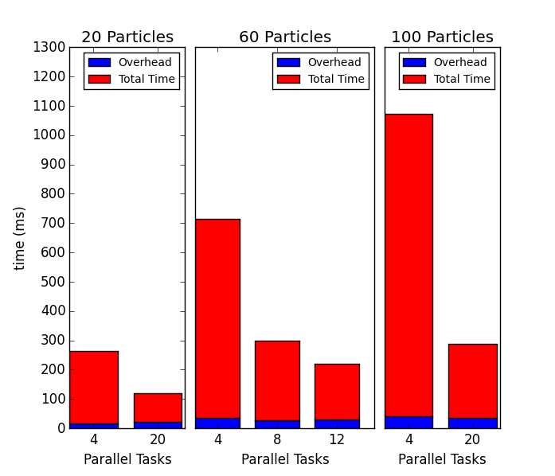
Improved Performance
Reduced parallel overhead
Improved performance

Slide 11
Challenges & Future Directions
Cloud based distributed streaming frameworks are not adequate
Improved communication to reduce overhead
Supun Kamburugamuve, Saliya Ekanayake, Milinda Pathirage, Geoffrey Fox, “Towards High Performance Processing of Streaming Data in Large Data Centers” Technical Report January 26 2016, to be published in proceedings of HPBDC 2016 IEEE International Workshop on High-Performance Big Data Computing in conjunction with The 30th IEEE International Parallel and Distributed Processing Symposium (IPDPS 2016),
Scheduling for real time applications
Scaling to thousands of applications is difficult because of APIs and scheduling
Applications
Hengjing He, Supun Kamburugamuve, and G.C. Fox, Cloud based real-time multi-robot collision avoidance for swarm robotics Technical Report, May 7, 2015. To be published in International Journal of Grid and Distributed Computing.

