Slide 1


Layer-finding in Radar Echograms using Probabilistic Graphical Models
David Crandall
Geoffrey C. Fox
School of Informatics and Computing
Indiana University, USA
John D. Paden
Center for Remote Sensing of Ice Sheets
University of Kansas, USA

Slide 2
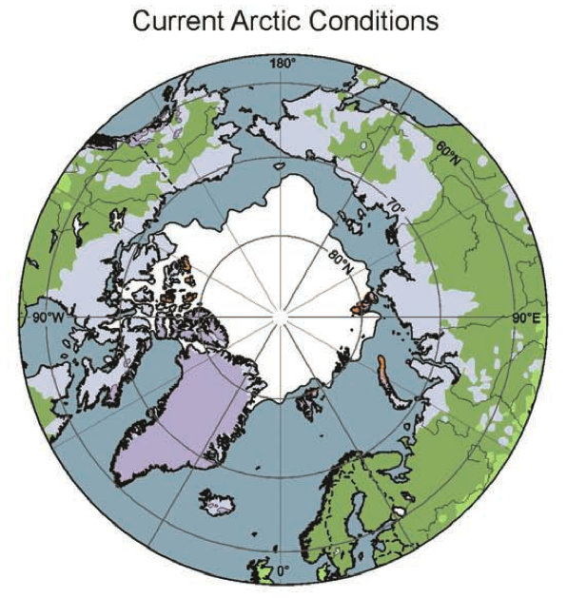
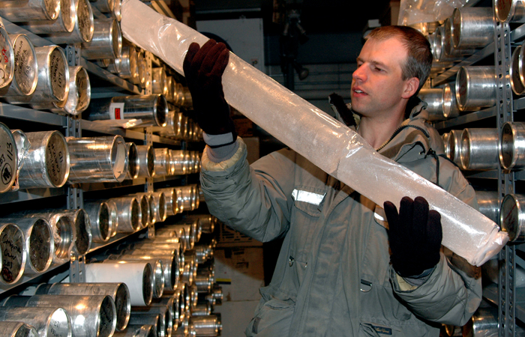
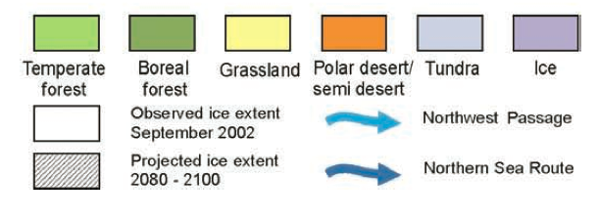
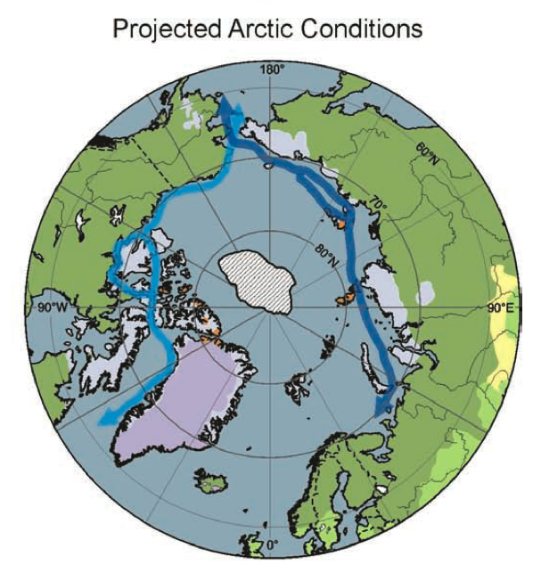
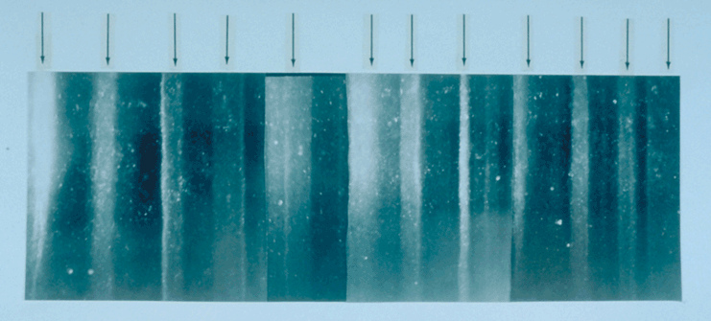
Ice and climate
Current conditions
U.S. Antarctica Program
Projected conditions, 2085
[IPCC 2007]
U.S. NOAA

Slide 3
Notes:
PolarGrid acts as a contractor to CReSIS to support the storage and processing needs of the field

Slide 4
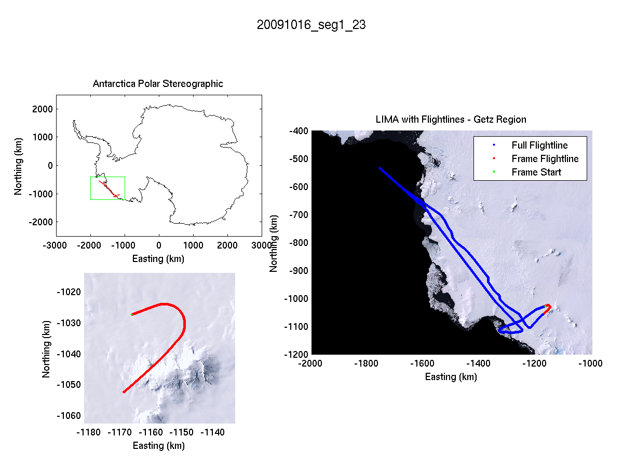
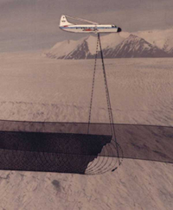
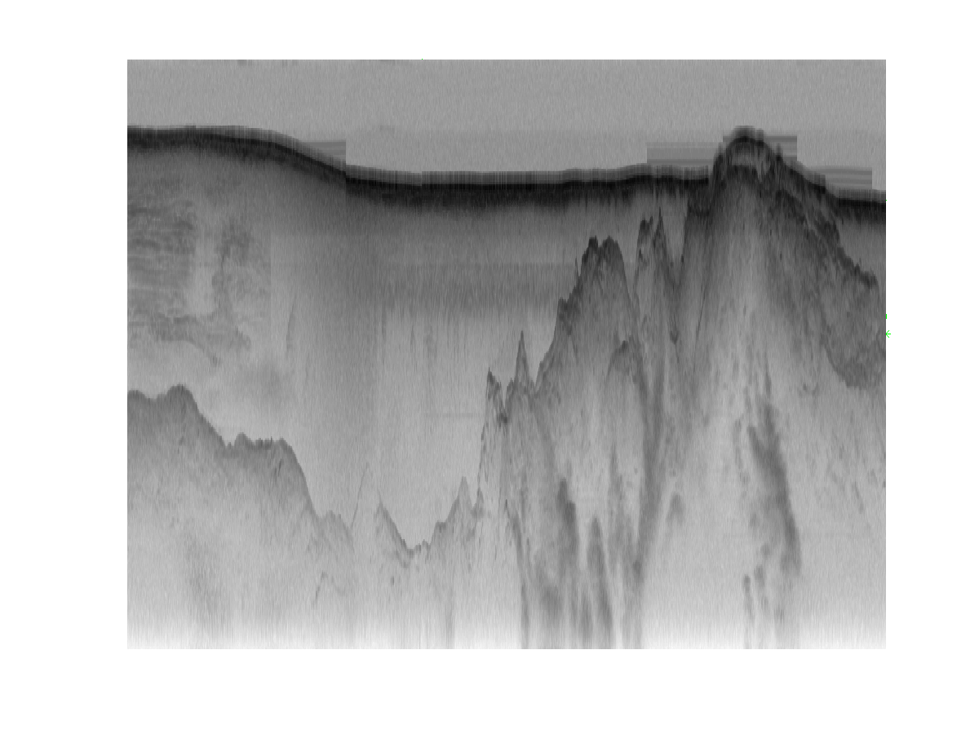
Ice sheet radar echograms
Distance along flight line
Distance below aircraft

Slide 5
Ice sheet radar echograms
Distance along flight line
Air
Distance below aircraft
Ice
Bedrock

Slide 6
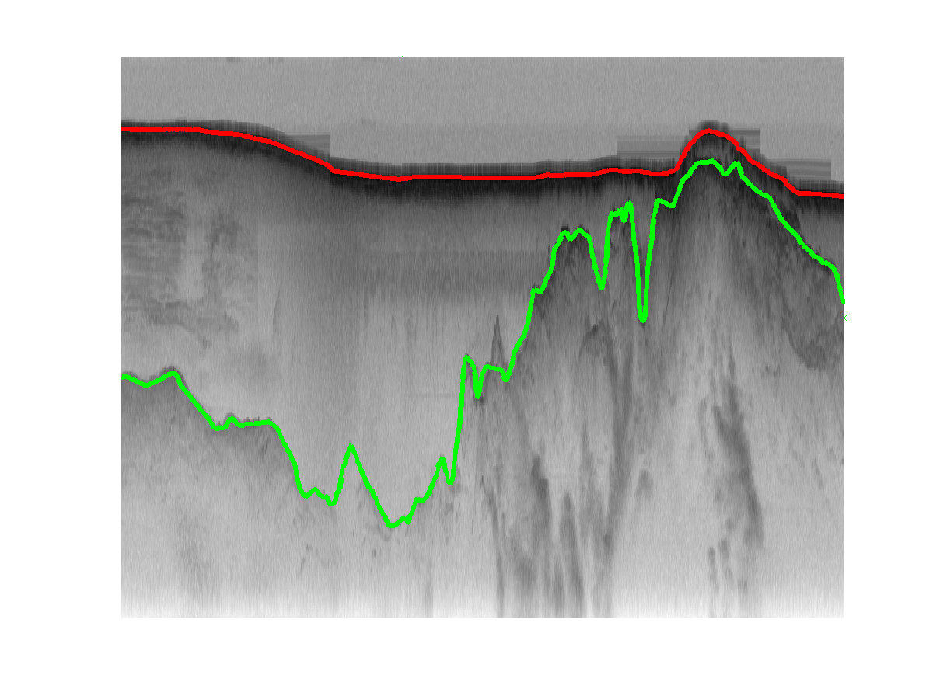
Ice sheet radar echograms
Distance along flight line
Air
Distance below aircraft
Ice
Bedrock

Slide 7
Related work
General-purpose image segmentation
  [Haralick1985], [Kass1998], [Shi2000], [Felzenszwalb2004], …
Subsurface imaging
  [Turk2011], [Allen2012], …
Buried object detection
  [Trucco1999], [Gader2001], [Frigui2005], …
Layer finding in ground-penetrating echograms
  [Freeman2010], [Ferro2011], …

Slide 8
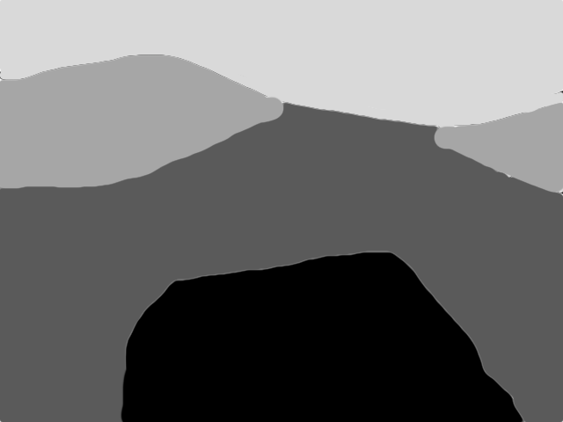

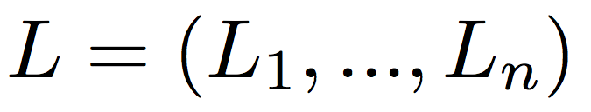
Tiered segmentation
Layer-finding is a tiered segmentation problem [Felzenszwalb2010]
  Label each pixel with one of [1, K+1], under the constraint that if y < y’, label of (x, y) ≤ label of (x, y’)
l_{i}¹
1
2
l_{i}²
2
l_{i}³
3
4
L_{i}
Equivalently, find K boundaries in each column
  Let denote the row indices of the K region boundaries in column i
  Goal is to find labeling of whole image,

Slide 9

Probabilistic formulation
Goal is to find most-likely labeling given image I,
Likelihood term models how well labeling agrees with image
Prior term models how well labeling agrees with typical ice layer properties

Slide 10
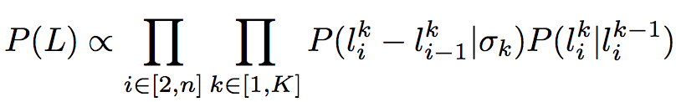

Prior term
Prior encourages smooth, non-crossing boundaries
Zero-mean Gaussian penalizes discontinuities in layer boundaries across columns
Repulsive term prevents boundary crossings; is 0 if
and uniform otherwise
l_{i}¹
₁
l_{i+1}
l_{i}²
₂
l_{i+1}
₃
l_{i}³
l_{i+1}

Slide 11
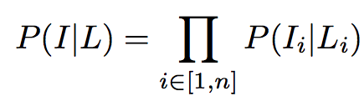
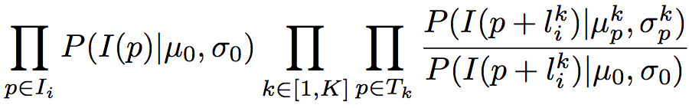
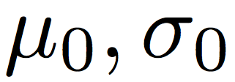
Likelihood term
Likelihood term encourages labels to coincide with layer boundary features (e.g. edges)
  Learn a single-column appearance template T_{k} consisting of Gaussians at each position p, with
  Also learn a simple background model, with
  Then likelihood for each column is,

Slide 12
Efficient inference
Finding L that maximizes P(L | I) involves inference on a Markov Random Field
  Simplify problem by solving each row of MRF in succession, using the Viterbi algorithm
  Naïve Viterbi requires O(Kmn²) time, for m x n echogram with K layer boundaries
  Can use min-convolutions to speed up Viterbi (because of the Gaussian prior), reducing time to O(Kmn) [Crandall2008]

Slide 13
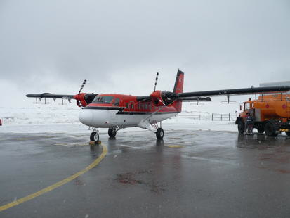
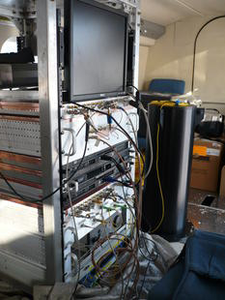
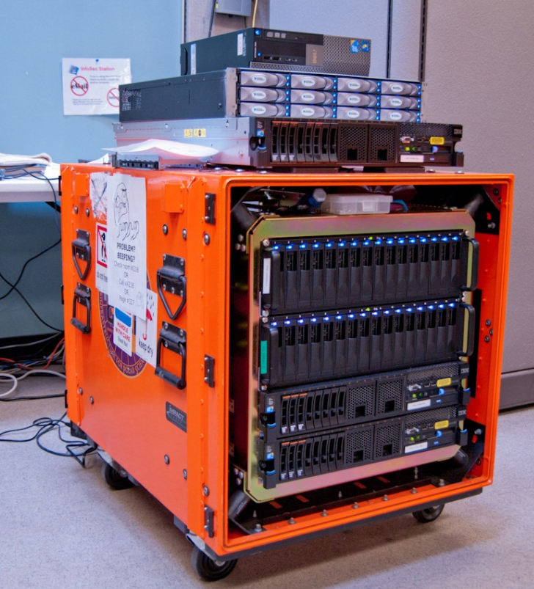
Experimental results
Tested with 827 echograms from Antarctica
  From Multichannel Coherent Radar Depth Sounder system in 2009 NASA Operation Ice Bridge [Allen12]
  About 24,810 km of flight data
  Split into equal-size training and test datasets

Slide 14
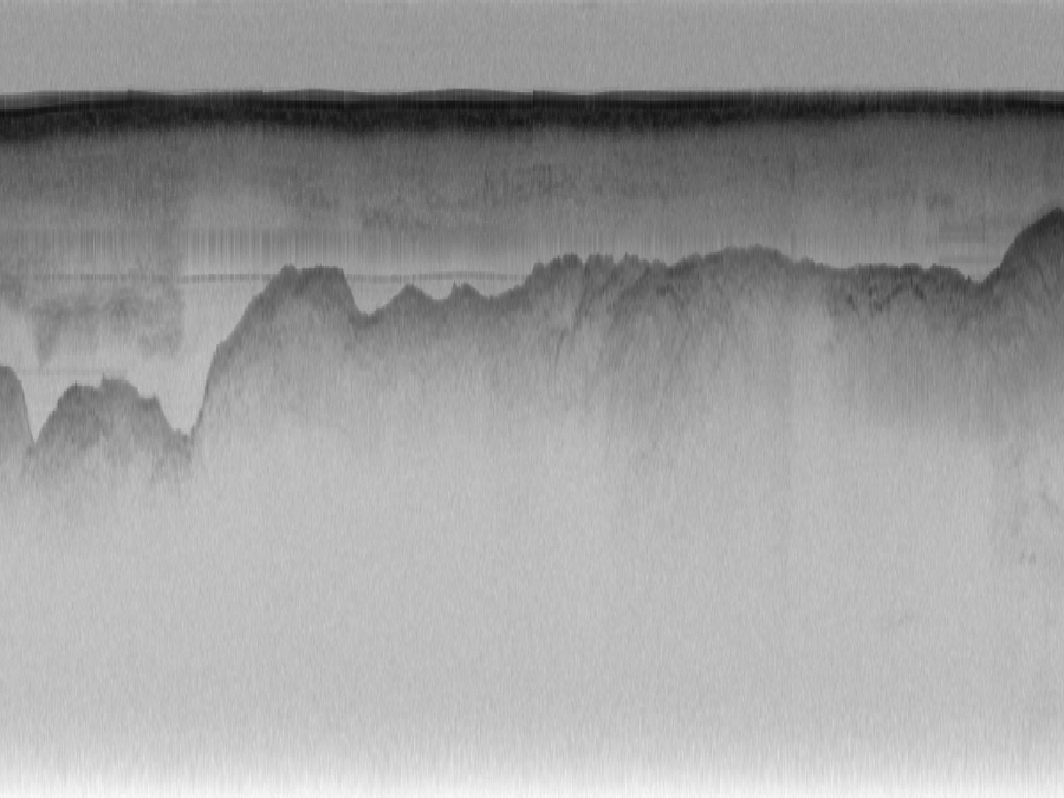
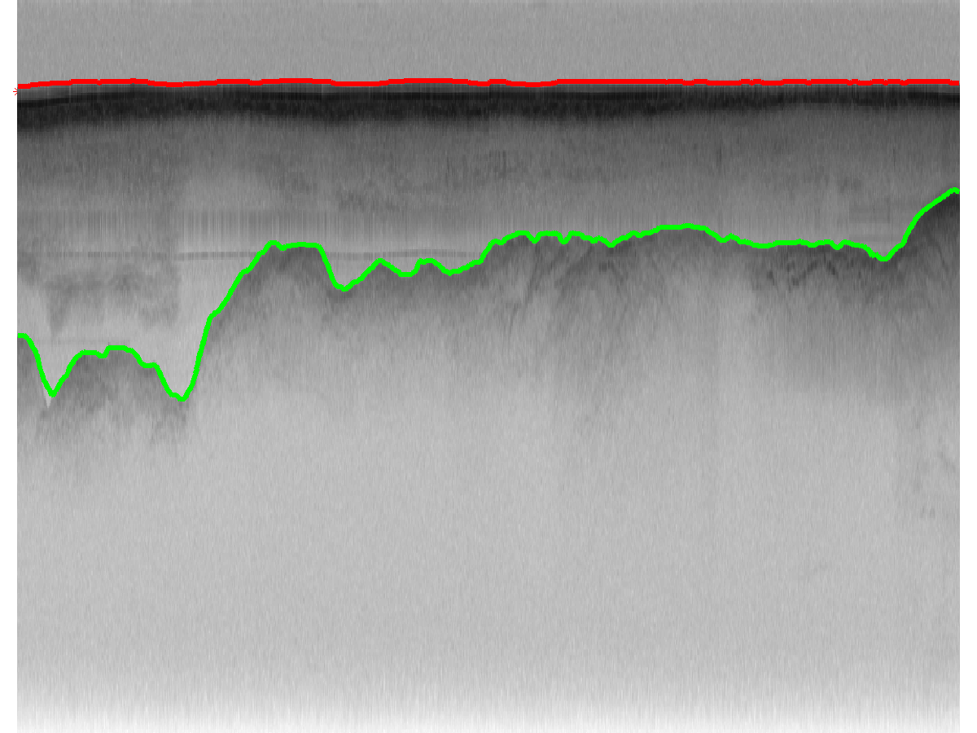
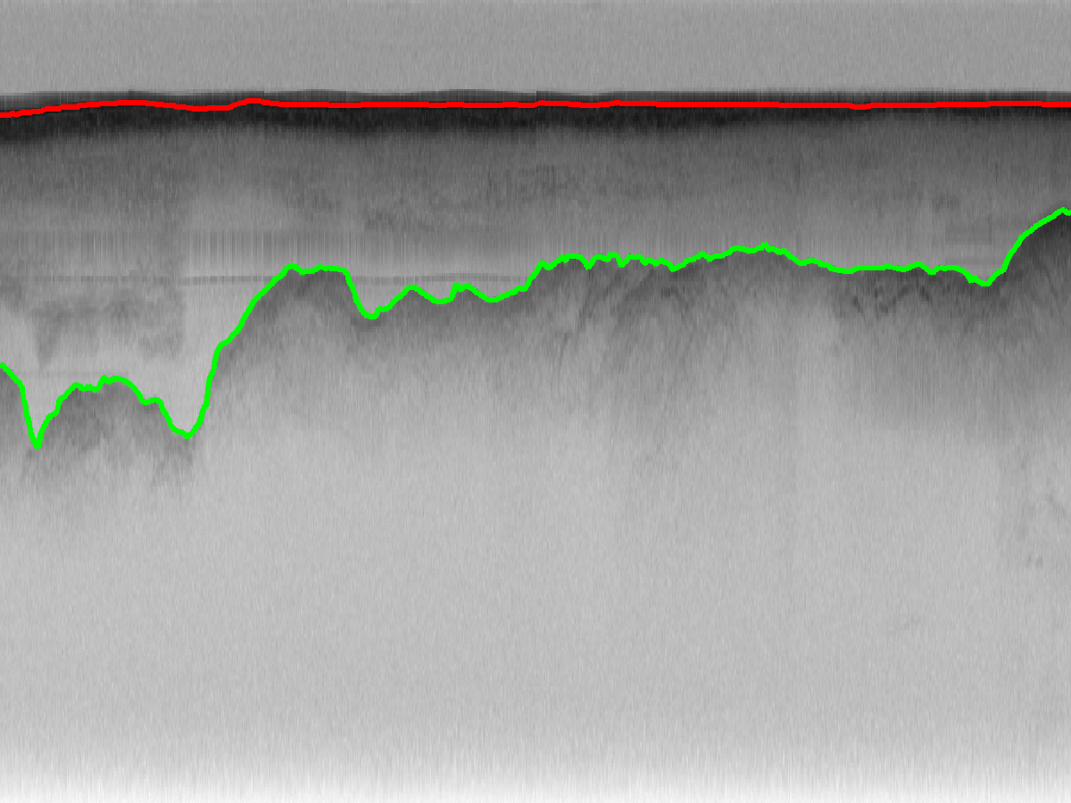
Original echogram
Automatic labeling
Ground truth

Slide 15
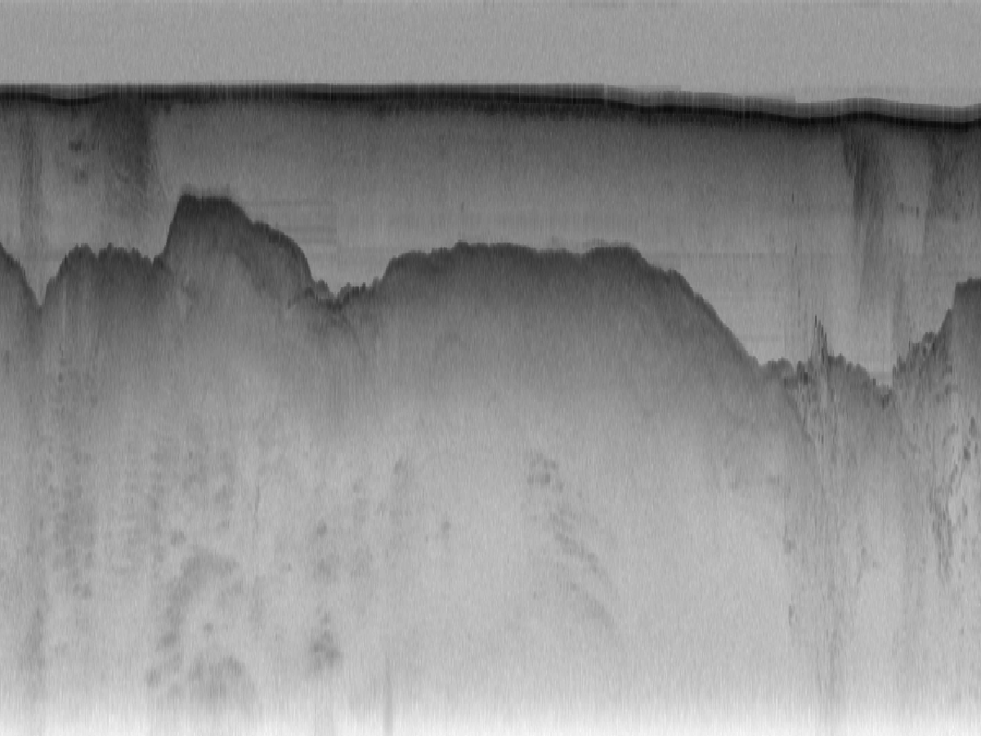
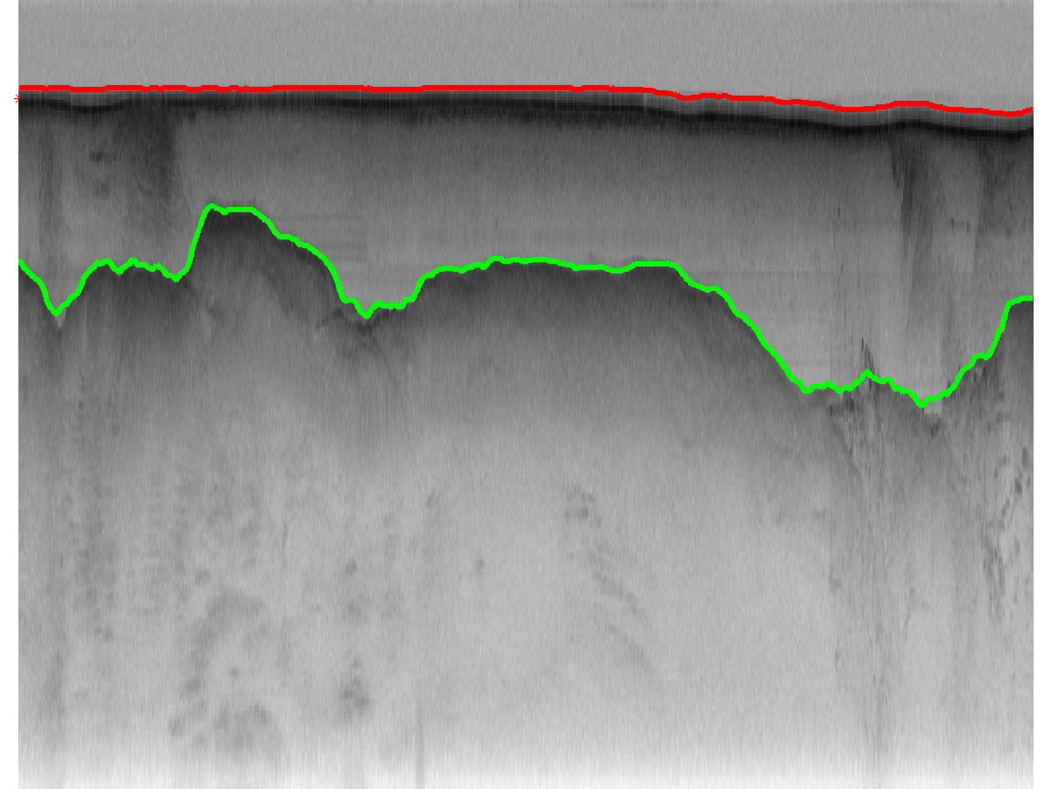
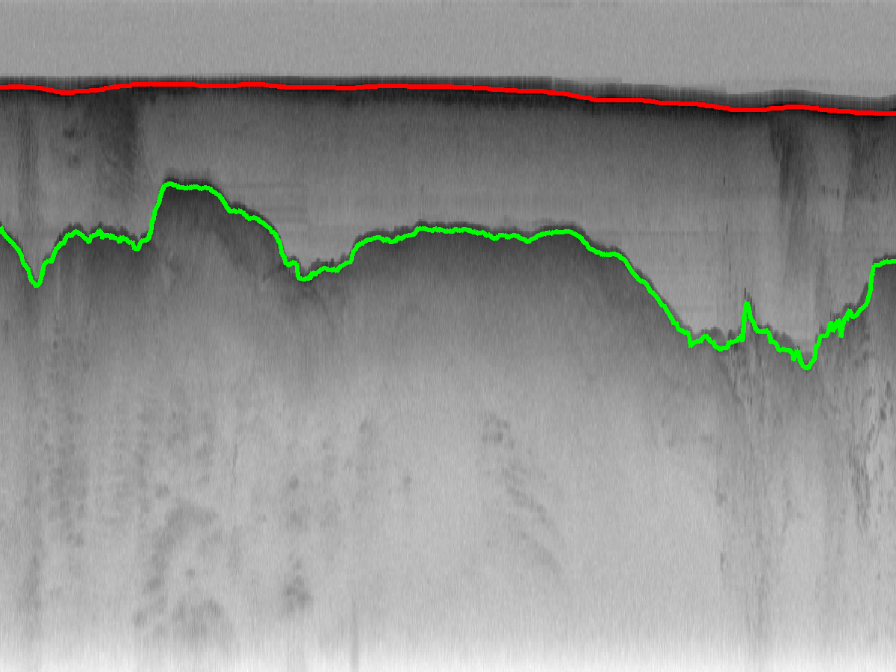
Original echogram
Automatic labeling
Ground truth

Slide 16
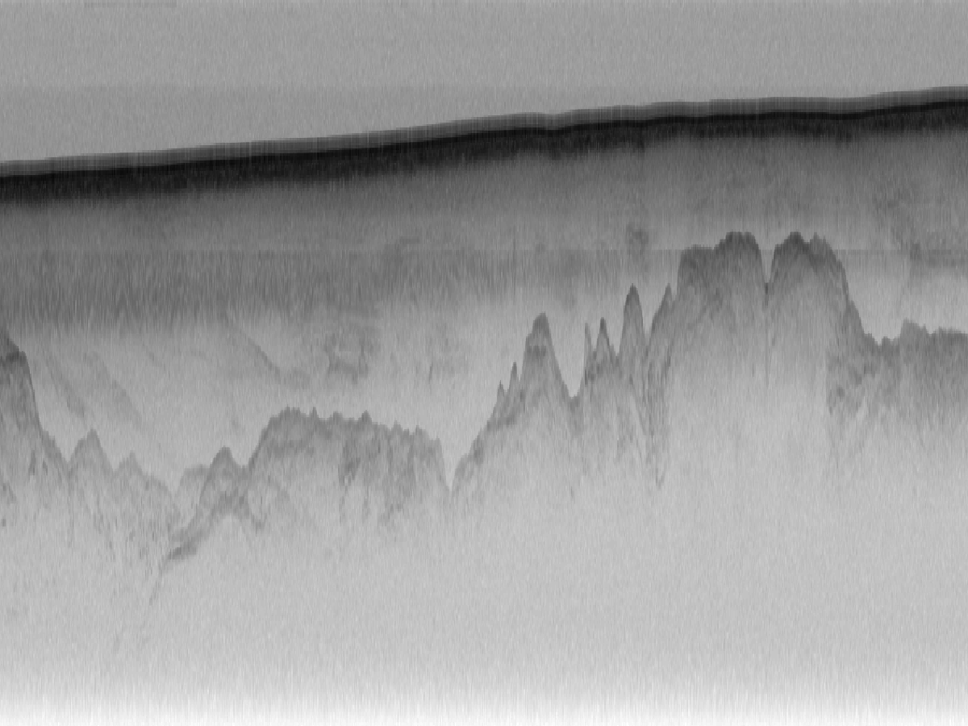
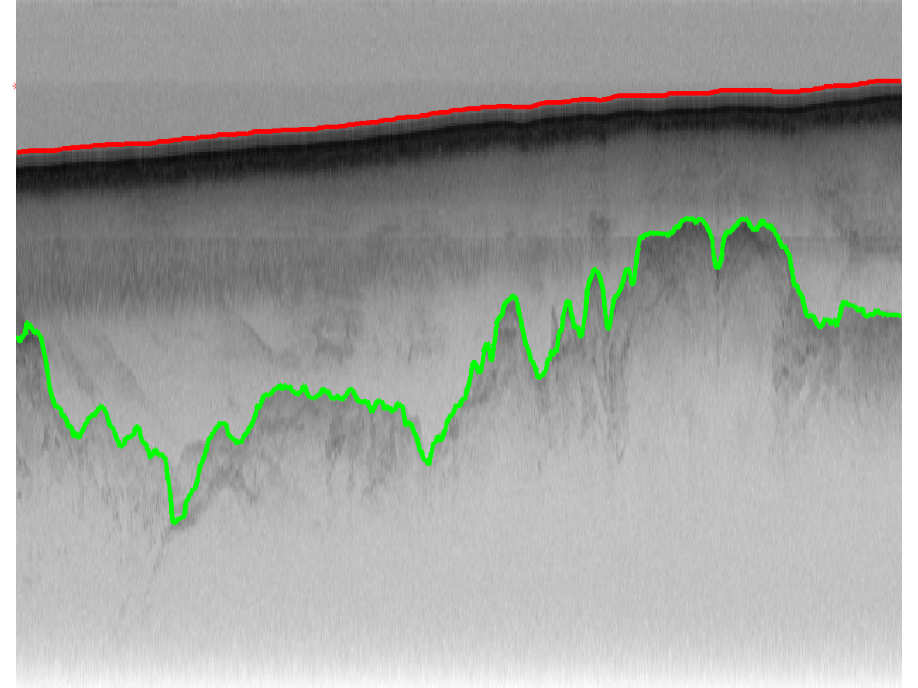
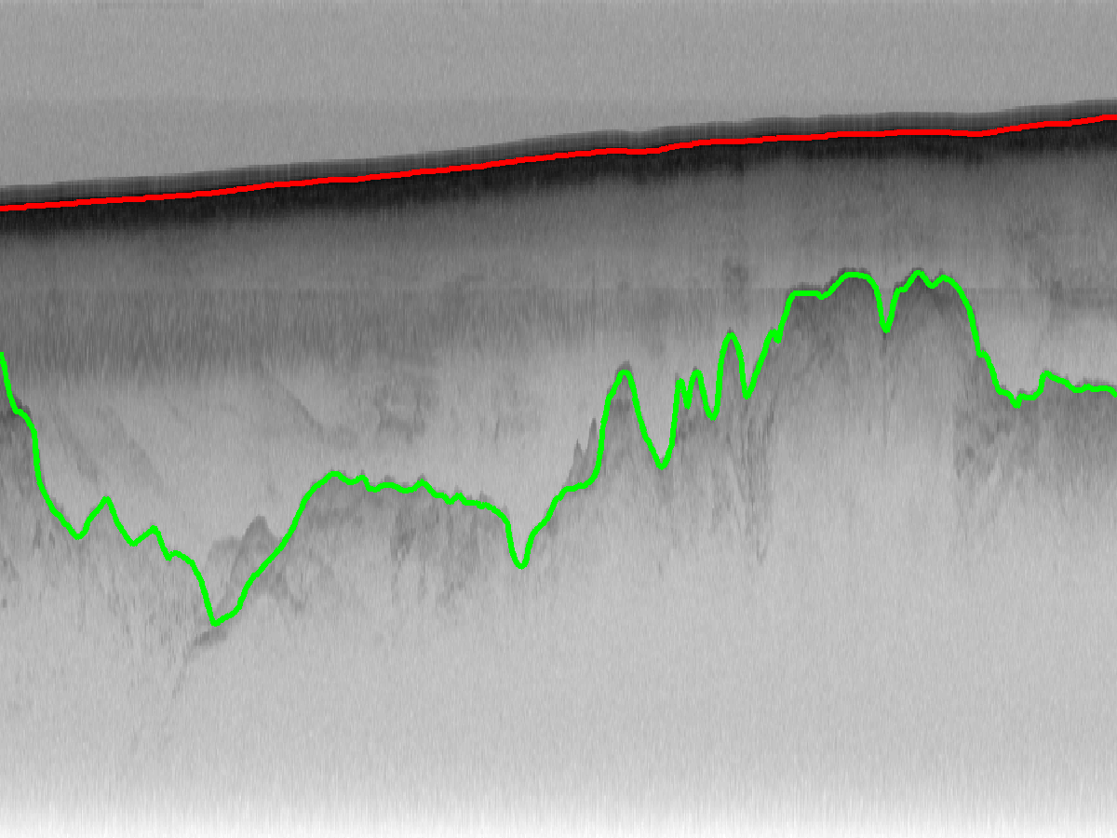
Original echogram
Automatic labeling
Ground truth

Slide 17

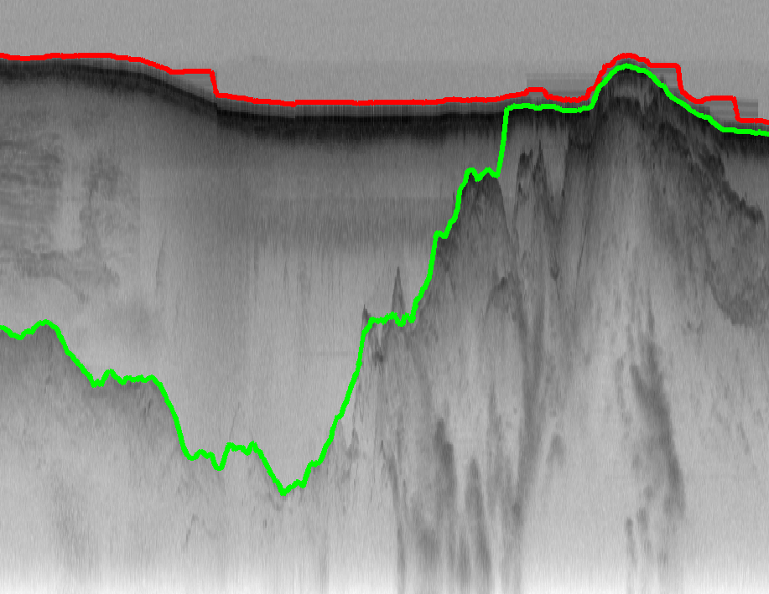
Original echogram
Automatic labeling
Ground truth

Slide 18
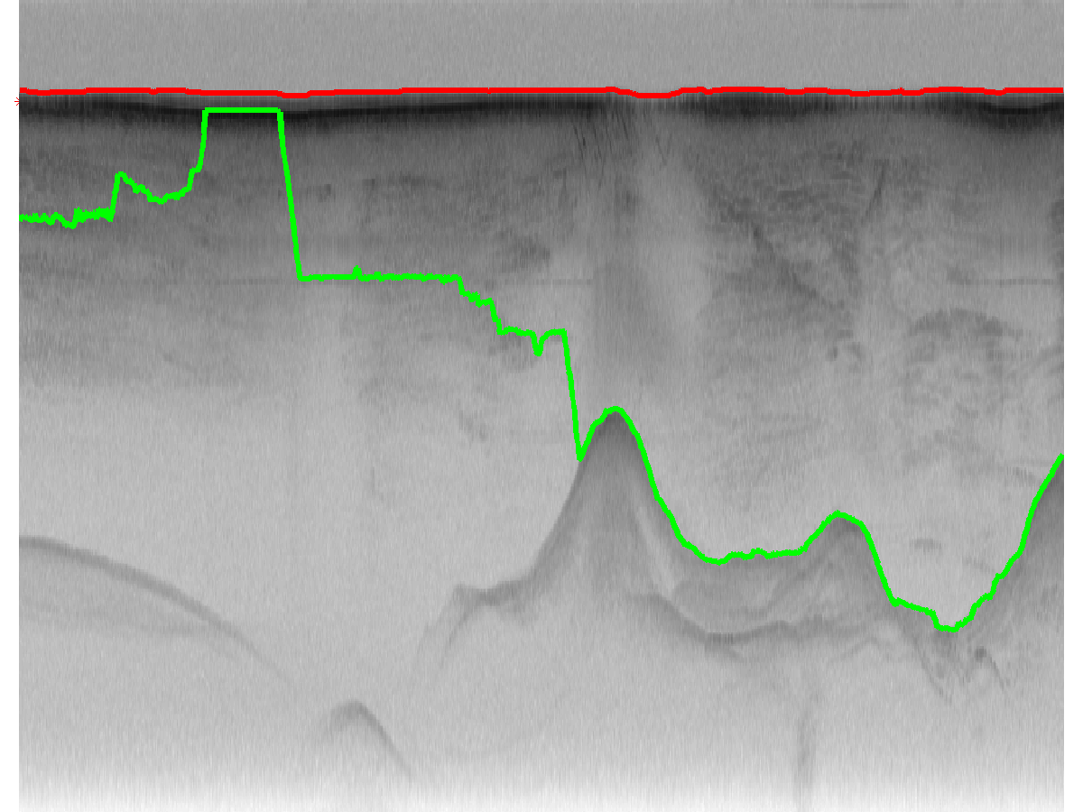
User interaction

Slide 19
User interaction
*
*

Slide 20
User interaction
*
*
Modify P(L) such that this label has probability 1

Slide 21
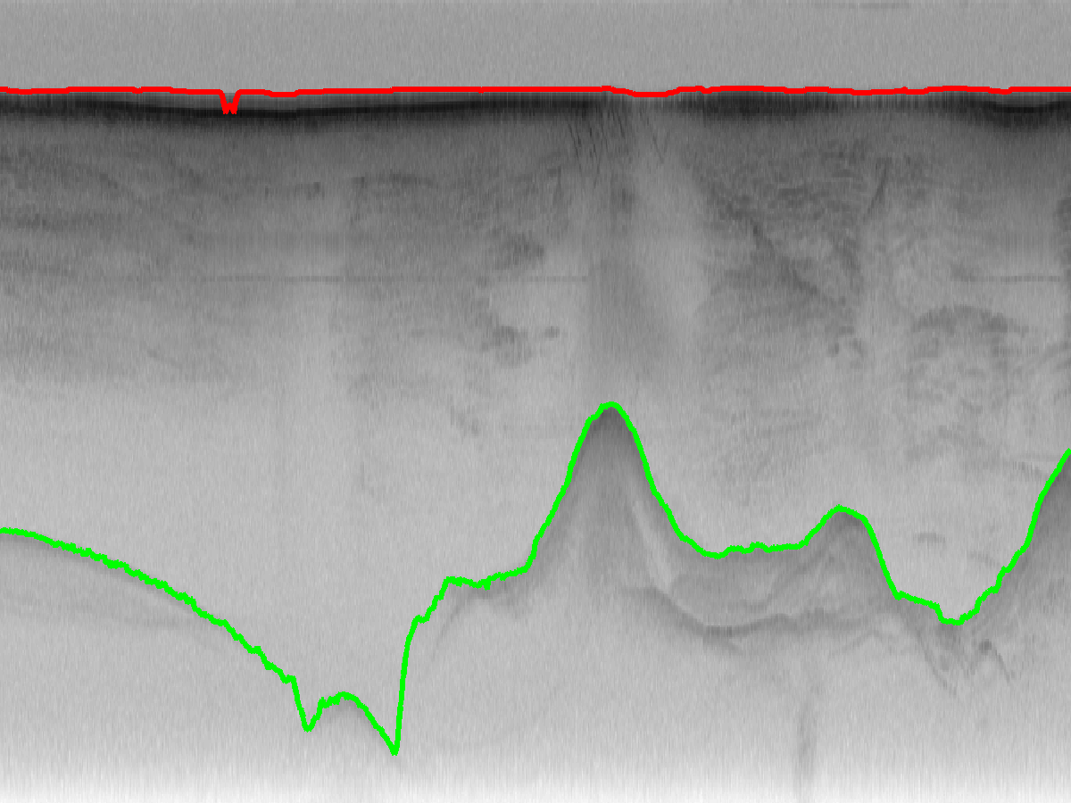
User interaction
*
*
Modify P(L) such that this label has probability 1

Slide 22
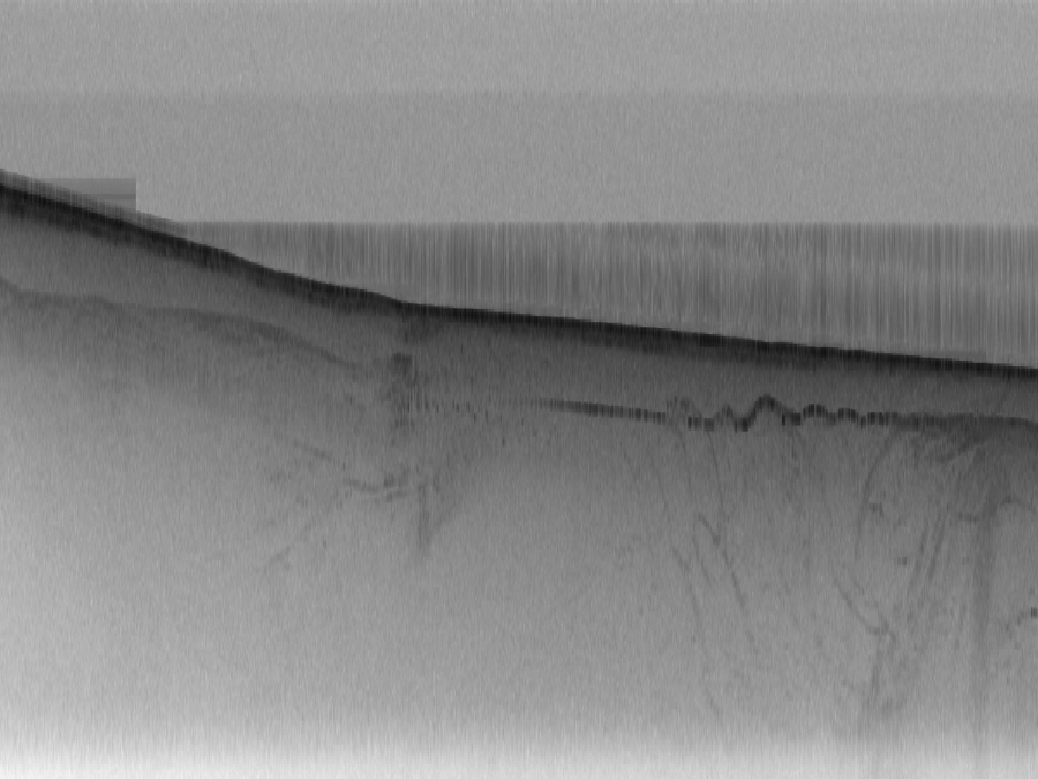
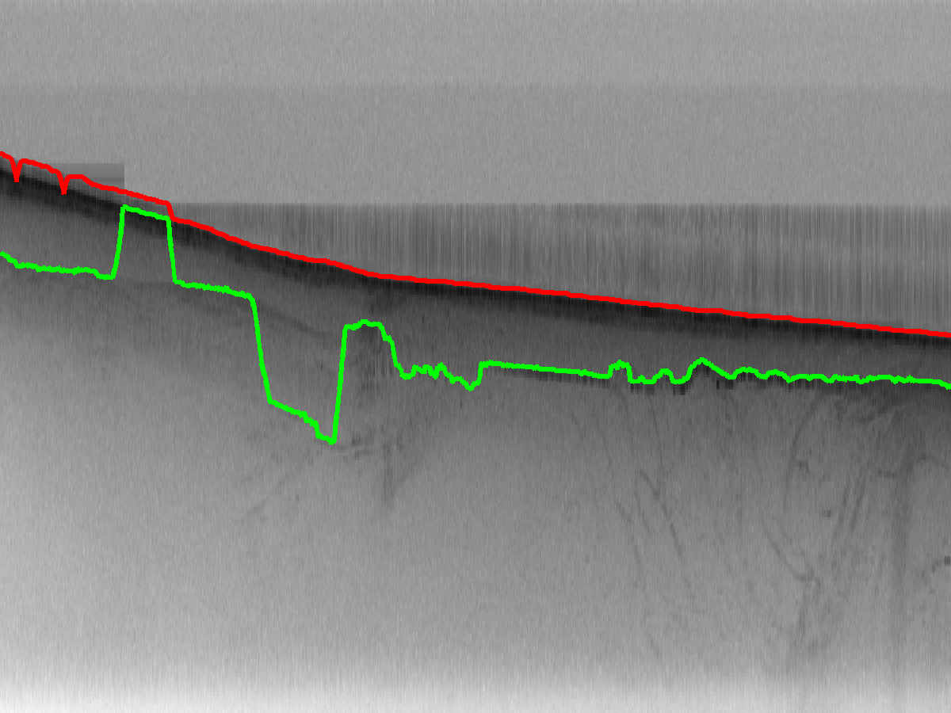
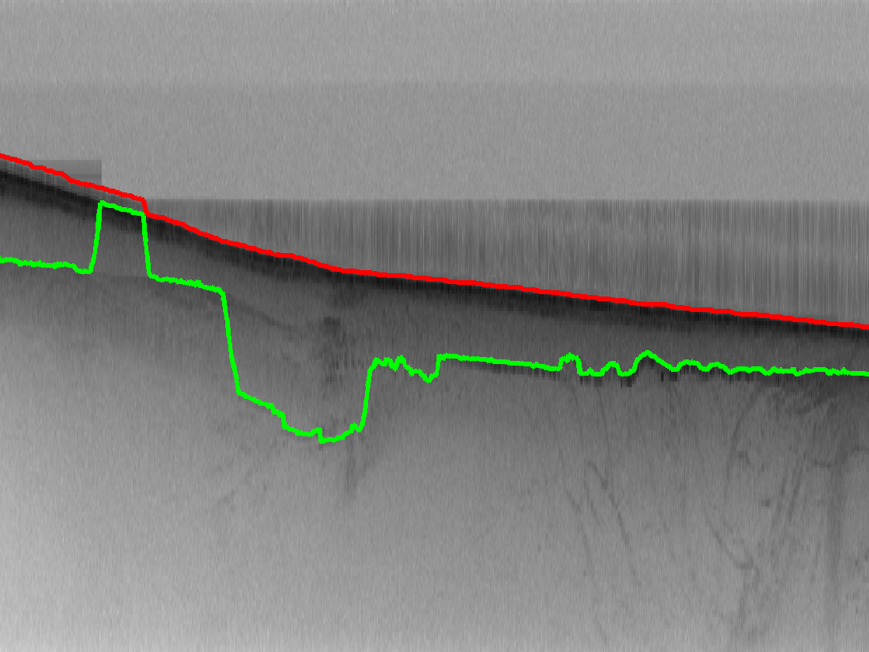
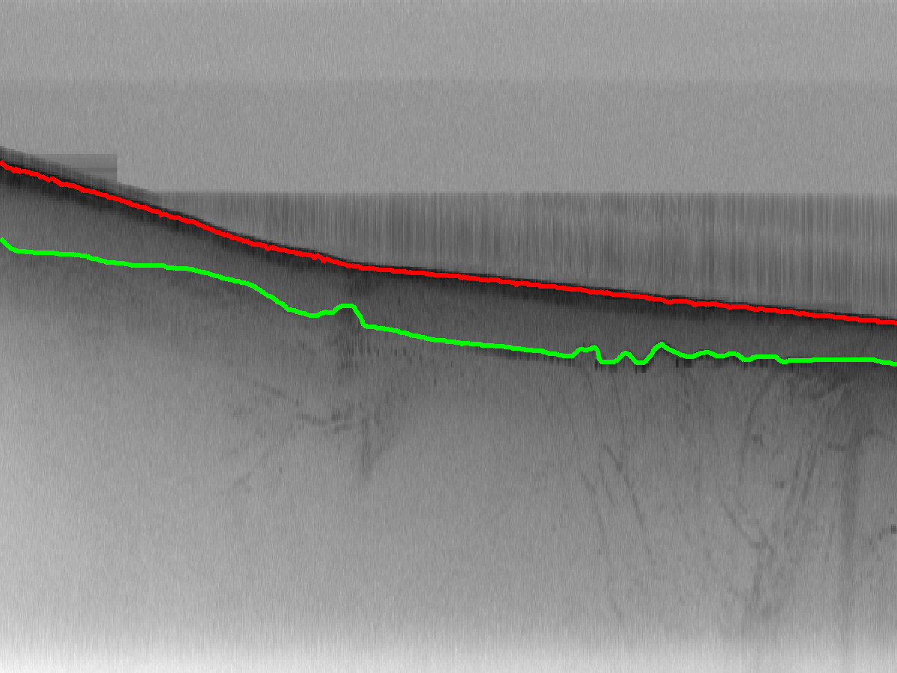
Sampling from the posterior
Instead of maximizing P(L|I), sample from it
Sample 1
Sample 2
Sample 3

Slide 23
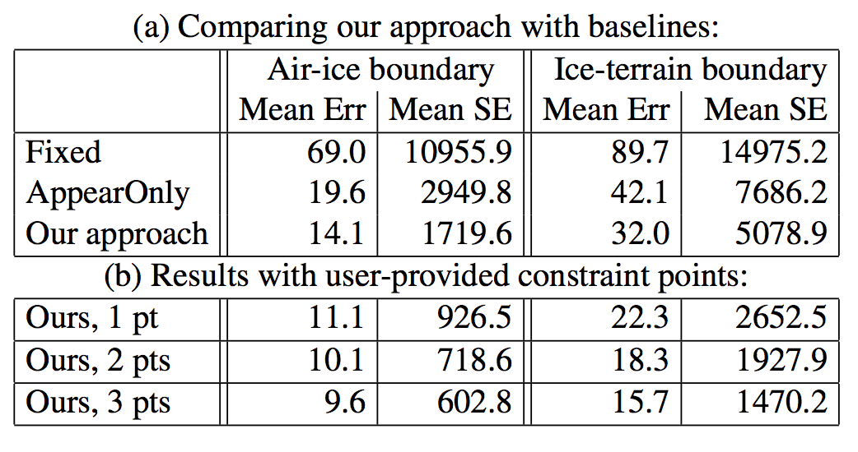
Quantitative results
Comparison against simple baselines:
  Fixed simply draws a straight line at mean layer depth
  AppearOnly maximizes likelihood term only

Slide 24
Quantitative results
Comparison against simple baselines:
  Fixed simply draws a straight line at mean layer depth
  AppearOnly maximizes likelihood term only
  Further improvement with human interaction:

Slide 25
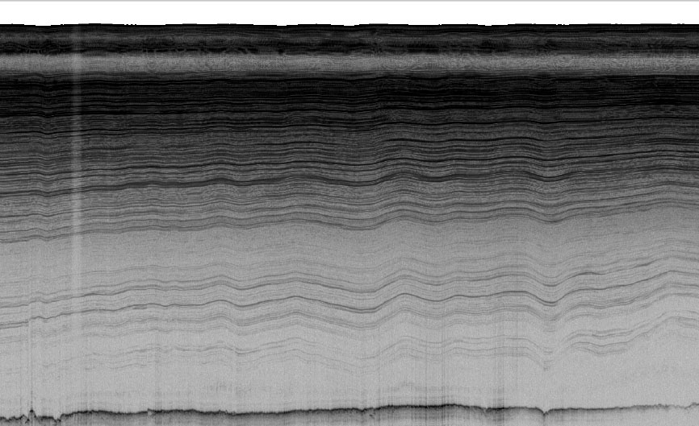
Summary and Future work
We present a probabilistic technique for ice sheet layer-finding from radar echograms
  Inference is robust to noise and very fast
  Parameters can be learned from training data
  Easily include evidence from external sources
Ongoing work: Internal layer-finding

Slide 26




Thanks!
More information available at:
http://vision.soic.indiana.edu/icelayers/
This work was supported in part by:

