Slide 1
We Need a Cloud, not a Mountain
Rich Wolski, U.C. Santa Barbara

Slide 2
“Mountain” Computing
Today, Cloud computing isn’t done in a cloud
Each cloud comprises O(10) “very large” data centers
One “logs in” to one or more of these to access resources
There is no cross cloud portability and little interoperability
Computational Mountains
Awe-inspiring, large and majestic
Understood and seen up close by very few
Very far apart
Only the brave truly scale them
I Love
Python!

Slide 3
Some Observations
The Internet operates more as a cloud than The Cloud does
Content providers used geodistributed ”Content Distribution Networks” to cache their data near where it will be consumed
Cable companies don’t want to pay for bandwidth
Result: Netflix keeps its content in AWS but most of its movies are served from Akamai and/or Level 3
Big data isn’t all that big (usually)
10s of millions of commercial Hadoop traces => 80% are single node

Slide 4
IoT: The Anti-web
On the Web, most content is write-once, read-everywhere
Data “publishing” is rare relative to data “consuming” (even for Snapchat)
The current Internet is highly optimized for this paradigm
Billions spent to allow billions of reads for every write
For IoT, the reverse is true
Data is “published” constantly
When it is consumed it is usually consumed once to create an aggregate
Billions of writes for every read
The Internet is super optimized for NOT-IoT

Slide 5
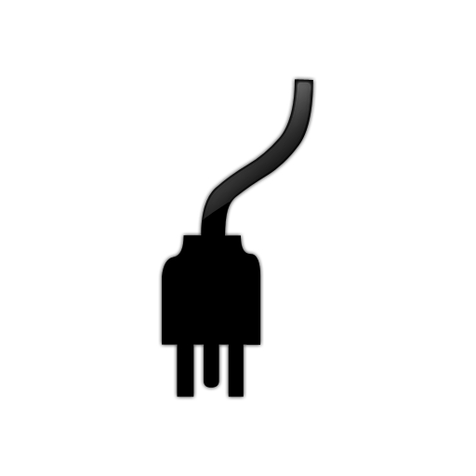
Behold! The Cloud
The future cloud will be “peered and tiered”
Edge -> Regional -> Public
Data moves only as far as it must
Service Distribution Network: Codes in containers anywhere
Edge Cloud
Regional Cloud
Public Cloud
Devices

Slide 6
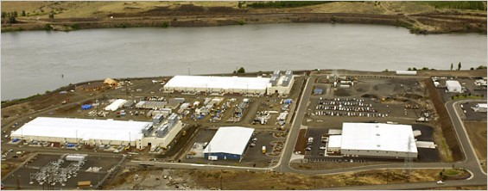
Just the Beginning
Cloud Computing
Now
Very Soon (IoT)
Search
Inference
Prediction

