Slide 1
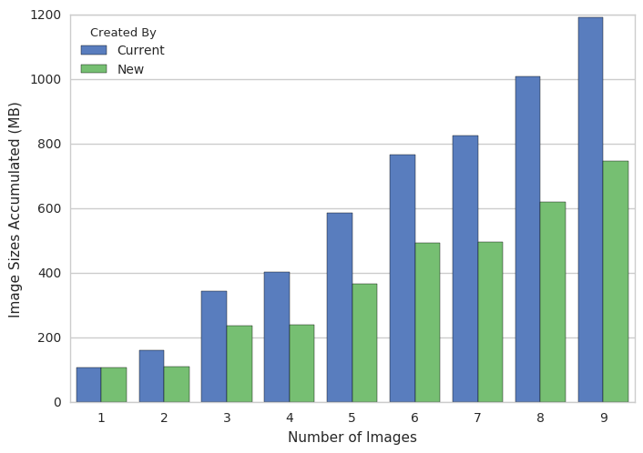
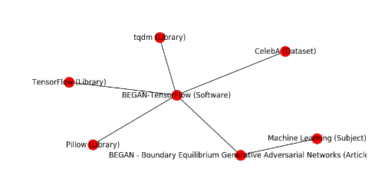
Software Defined Systems with DevOps Tools and Infrastructure Provisioning
Hyungro Lee, Geoffrey C. Fox
School of Informatics and Computing, Indiana University
2805 E. 10th St., Bloomington, IN 47408 U.S.A.
Introduction
DevOps Roles with Cloud Server Size Recommendation
Optimizing Software Deployment Using Package Dependency Map
Building compute environments needs to ensure reproducibility and constant deployment over time. Compute environments are usually supplied with several software packages and DevOps conducts a software deployment where comprehensive scripts have instructions to manage all dependencies but the execution of applications still need to be verified to confirm identical results.
Problem
Provisioning proper computing resources for an application is not feasible because virtual server provisioning by DevOps is not bound by the application deployment.
Our Approach
We 1) pair DevOps roles and infrastructure with a server size recommendation based on Benchmark Score, 2) deploy roles through community developed infrastructure, and 3) offer an infrastructure by tool profiling to find an optimal computing performance from various cloud server types.
Problem
Software packages have many dependencies especially if the packages are large and complex. Duplicates and conflicts among software need to be removed.
Our Approach
We build dependency graph to offer efficiencies in deploying software packages by extracting common libraries from package metadata.
NGINX Container Images Optimized by Common Dependencies
Common Packages for High Performance Computing Enhanced Apache Big Data Stack
(HPC-ABDS)
Approaches
Infrastructure Provisioning Template with Benchmark Score
systems:
roles:
- software A
. . .
infrastructure:
cpu-performance:
- geekbench:=>5000, medium
requirement:
- vcpu: 2, mem: 8gb
provider:
default: aws
options: gce, azure
Conclusions
Containerizing Software Deployment
Overview of Collecting Dependencies
Problem
A variety of operating systems and diverse source of packages are not able to construct equivalent environments across different platforms. Also, conflicts happen among existing packages and new one.
Our Approach
DevOps scripts are converted to deliver a same environment with installed software packages via container images. This ensures building equivalent compute environments with the latest security patches for vulnerable software, if any.
Snapshot images with versions are still viable to restore environments if the execution of applications is failed.
Results
Software Defined Systems built through automated deployments can perform efficiently using Linux containers. DevOps and Template infrastructure provisioning is an effective way of enabling big data software stacks on the cloud and HPC with these approaches.
Hadoop Comparison by Server Size Recommendation
References
Hyungro Lee, Geoffrey Fox, “Efficient Software Defined Systems using Common Core Components” 10th IEEE Conference on Cloud Computing
Badi’ Abdul-Wahid, Hyungro Lee, Gregor von Laszewski, and Geoffrey Fox, "Scripting Deployment of NIST Use Cases" Technical Report January 20 2017 DOI
Creating Container Images from Ansible Roles
Dependency Map Example for Tensorflow Implementation of ”BEGAN”

