Slide 1

Architectural Principles and Experimentation of Distributed High Performance Virtual Clusters
Andrew J. Younge
Ph.D Candidate
Indiana University
ajyounge@indiana.edu

Slide 2
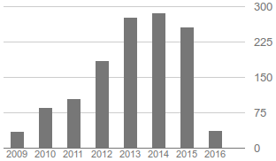

root@localhost:~/# whoami
Ph.D Candidate at Indiana University
  Advisor: Dr. Geoffrey C. Fox
  Persistent Systems Fellowship via SOIC
  @ IU since 2010
  Worked on the FutureGrid Project
Previously at Rochester Institute of Technology
  B.S. & M.S. in Computer Science in 2008, 2010
Visiting Researcher at USC/ISI East (2012 & 2013)
Google summer code with UC/ANL (2011)
Involved in Distributed Systems since 2006 @UMD
http://ajyounge.com

Slide 3
Outline
The FutureGrid Project
Cloud != HPC
Cloud infrastructure advancements
  Performance considerations
  hypervisor selection
  GPU Virtualization
  SR-IOV InfiniBand
HPC Application evaluation
  LAMMPS & HOOMD
High Performance Virtual Clusters

Slide 4
Cloud Infrastructure for mid-tier Scientific Computing
Can cloud infrastructure, which leverages virtualization technologies, support a wide range of scientific computing?
  High throughput computing, pleasingly parallel processing
  High Performance Computing, complex communication patterns
  Cloud platform services, big data systems
  Rent-a-workstation computing

Slide 5
FutureGrid
FutureGrid is part of XSEDE set up as a testbed with cloud focus
Operational since Summer 2010
  Support of Computer Science and Computational Science research
  A flexible development and testing platform for middleware and application users looking at interoperability, functionality, performance or evaluation
  FutureGrid is user-customizable, accessed interactively and supports Grid, Cloud and HPC software with and without VM’s
  A rich education and teaching platform for classes
Offers OpenStack, Eucalyptus, Nimbus, OpenNebula, LRMS on same hardware moving to software defined systems; supports both classic HPC and Cloud storage
500+ projects, over 3000 users from 53 countries.

Slide 6
Heterogeneous Systems Hardware
Name | System type | # CPUs | # Cores | TFLOPS | Total RAM (GB) | Secondary Storage (TB) | Site
India | IBM iDataPlex | 256 | 1024 | 11 | 3072 | 512 | IU
Alamo | Dell PowerEdge | 192 | 768 | 8 | 1152 | 30 | TACC
Hotel | IBM iDataPlex | 168 | 672 | 7 | 2016 | 120 | UC
Sierra | IBM iDataPlex | 168 | 672 | 7 | 2688 | 96 | SDSC
Xray | Cray XT5m | 168 | 672 | 6 | 1344 | 180 | IU
Foxtrot | IBM iDataPlex | 64 | 256 | 2 | 768 | 24 | UF
Bravo | Large Disk & memory | 32 | 128 | 1.5 | 3072 (192GB per node) | 192 (12 TB per Server) | IU
Delta | Large Disk & memory With Tesla GPU’s | 32 CPU 32 GPU’s | 192 | 9 | 3072 (192GB per node) | 192 (12 TB per Server) | IU
Lima | SSD Test System | 16 | 128 | 1.3 | 512 | 3.8(SSD) 8(SATA) | SDSC
Echo | Large memory ScaleMP | 32 | 192 | 2 | 6144 | 192 | IU
TOTAL |  | 1128 + 32 GPU | 4704 +14336 GPU | 54.8 | 23840 | 1550

Slide 7
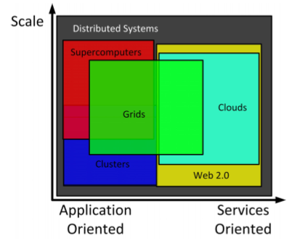
State of Distributed Systems
Distributed Systems encompasses a wide variety of technologies.
Per Foster et al, Grid computing spans most areas and is becoming more mature.
Clouds are an emerging technology, providing many of the same features as Grids without many of the potential pitfalls.
From “Cloud Computing and Grid Computing 360-Degree Compared” in 2008

Slide 8
HPC or Cloud?
HPC
Cloud
Fast, tightly coupled systems
Performance is paramount
Massively parallel applications
MPI for distributed memory computation & communication
  Require advanced interconnects
Leverage accelerator cards or co-processors (new)
Built on commodity PC components
User experience is paramount
Scalability and concurrency are key to success
Big Data applications to handle the Data Deluge
  4th Paradigm
  Long tail of science
Leverage virtualization
Idea: Combine the performance of HPC with usability of Clouds to support mid-tier scientific computation

Slide 9
Virtual Clusters
Virtual Clusters are just clusters, but deployed using virtual machines on Cloud infrastructure.
  Can provision cluster nodes dynamically
  Manage different guest OSs, environments
  Increases application flexibility
  VC’s share physical resources and keep application isolation
Virtual Clusters don’t take performance into consideration!
Image from: Distributed and Cloud Computing: From Parallel Processing to the Internet of Things.

Slide 10
Advancing Cloud Infrastructure
Already-known advantages
  Economies of scale, agility, manageability
  Customized user environment, multi-tenancy
  New programming paradigms for big data challenges
There could be more to be realized
  Leverage heterogeneous hardware
  Advanced scheduling for diverse workload support
  Runtime system to avoid synchronization barriers
  Check-pointing, snapshotting, enable fault tolerance
  Precise packaging and deployment, cloning
Notes:
Targeting usable performance, not stunt-machine

Slide 11
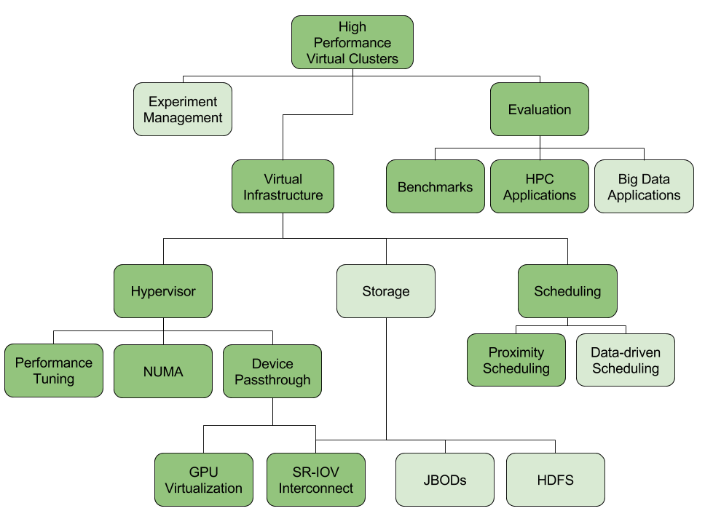
Notes:
Dark green = addressed
Light green = to be addressed

Slide 12
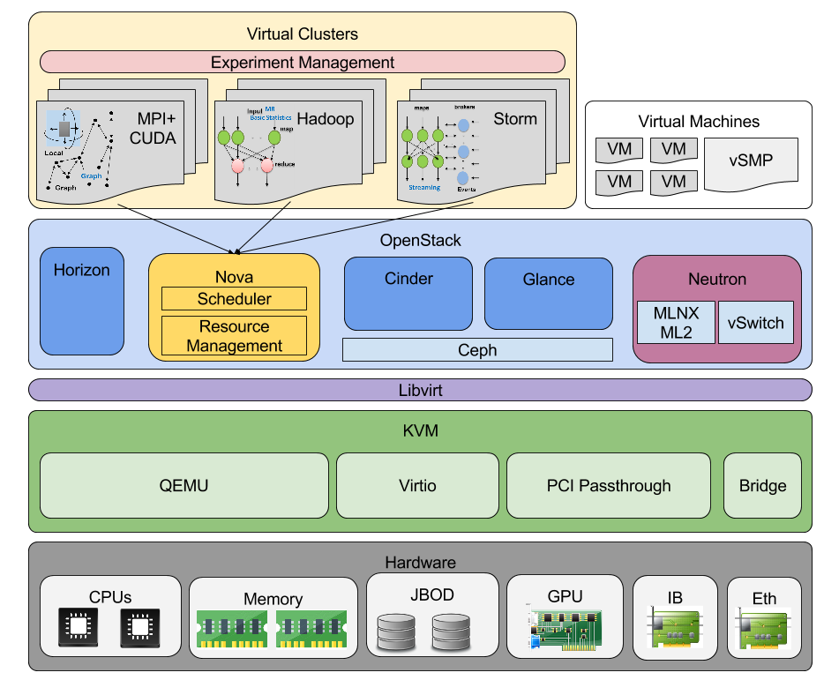

Slide 13
Virtualization Overhead
Ideally, virtualization can run with no overhead
  Stay in guest mode 100% of the time
  NO VM entry/exit, hypercalls, traps, shadow tables….
Need to pinpoint sources of overhead to overcome issues using both HW & SW
Recognize inherent limitations of virtualization when present
Start with base case FOSS & COTS solutions and optimize

Slide 14
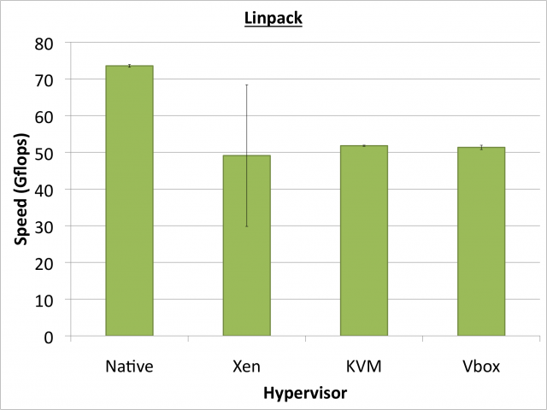
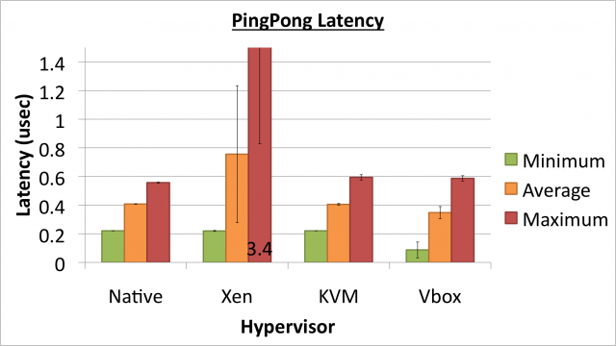
VM Performance
Initial Question: Does the overhead in the hypervisor VM model prohibit scientific HPC?
  Sometimes Yes
  Sometimes No
Feature set: All hypervisors are similar
In 2011, notable overhead in HPC benchmarks
  HPCC Linpack ~70% efficiency
  High workload variance
  Unpredictable latencies
** Analysis of Virtualization Technologies for High Performance Computing
Environments, A. J. Younge et al. IEEE Cloud 2011**
Notes:
Is the hypervisor vm model a prohibitive solution for sicentific hpc. Ie do overheads kill you?

Slide 15
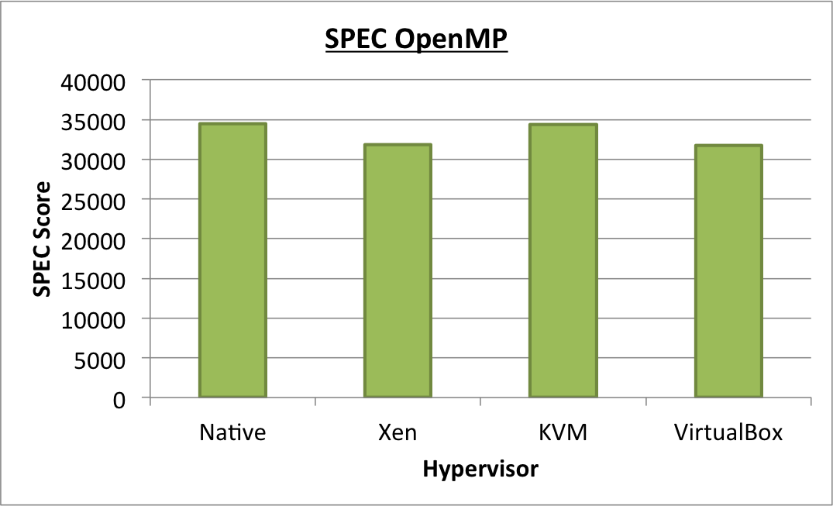
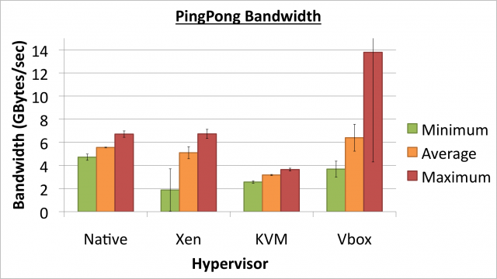
VM Performance
Initial Question: Does the overhead in the hypervisor VM model prohibit scientific HPC?
  Sometimes Yes
  Sometimes No
Performance: Hypervisors are not equal
  KVM very good, VirtualBox close, Xen good & bad
  Overall, we have found KVM to be the best hypervisor choice for HPC.
  Latest Xen results show improvements
** Analysis of Virtualization Technologies for High Performance Computing
Environments, A. J. Younge et al. IEEE Cloud 2011**
Notes:
Is the hypervisor vm model a prohibitive solution for scientific hpc? Ie do overheads kill you?

Slide 16
IaaS with HPC Hardware
Providing near-native hypervisor performance cannot solve all challenges of supporting parallel computing in cloud infrastructure.
Need to leverage HPC hardware
  Accelerator cards
  High speed, low latency I/O interconnects
  Others…
Need to characterize and actively minimize overhead wherever it exists

Slide 17
Direct GPU Virtualization
Allow VMs to directly access GPU hardware
Enables both CUDA and OpenCL codesets
Utilizes PCI Passthrough of device to guest VM
  Uses hardware directed I/O virt (VT-d or IOMMU)
  Provides direct isolation and security of device
  Removes host overhead entirely
Creates a direct 1-1 mapping between device and guest

Slide 18
Hardware Setup
 | Westmere + Fermi | Sandy Bridge + Kepler
Name | Delta (IU) | Bespin (ISI)
CPU (cores) | 2xX5660 (12) | 2xE5-2670 (16)
Clock Speed | 2.6 GHz | 2.6 GHz
RAM | 192 GB | 48 GB
NUMA Nodes | 2 | 2
GPU | 2xC2075 | 1xK20m
PCI-Express | 2.0 | 3.0 (with bug)
Release | ~2011 | ~2013

Slide 19
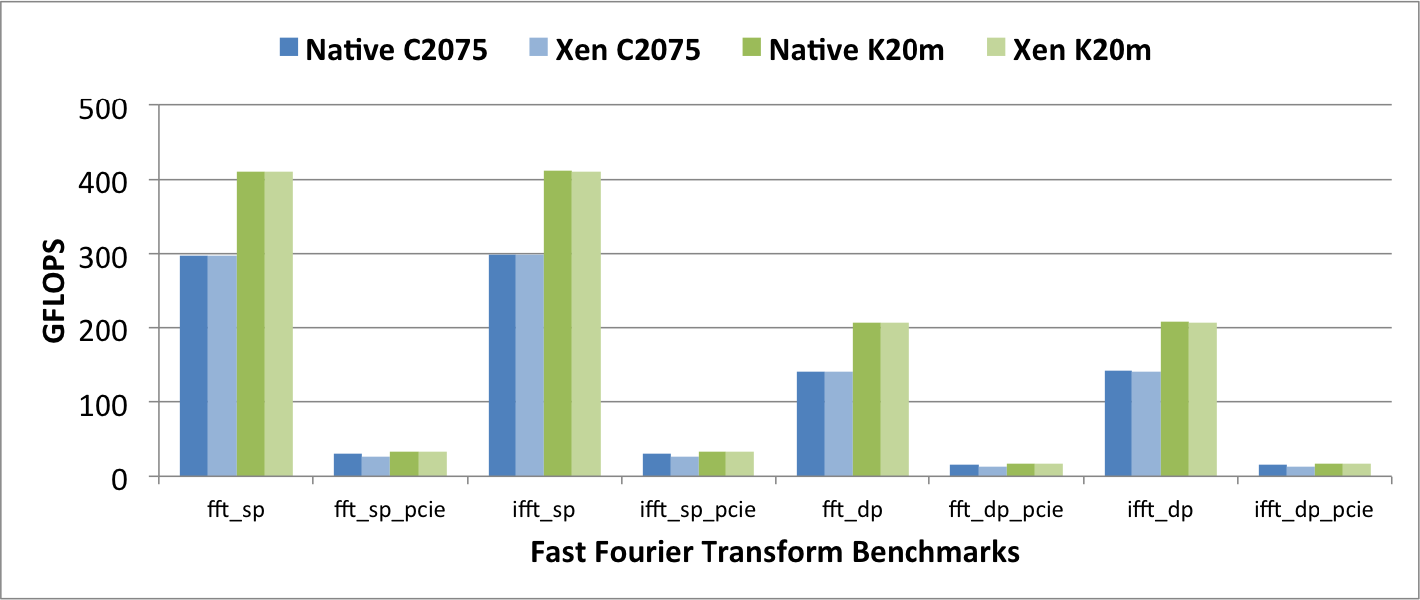
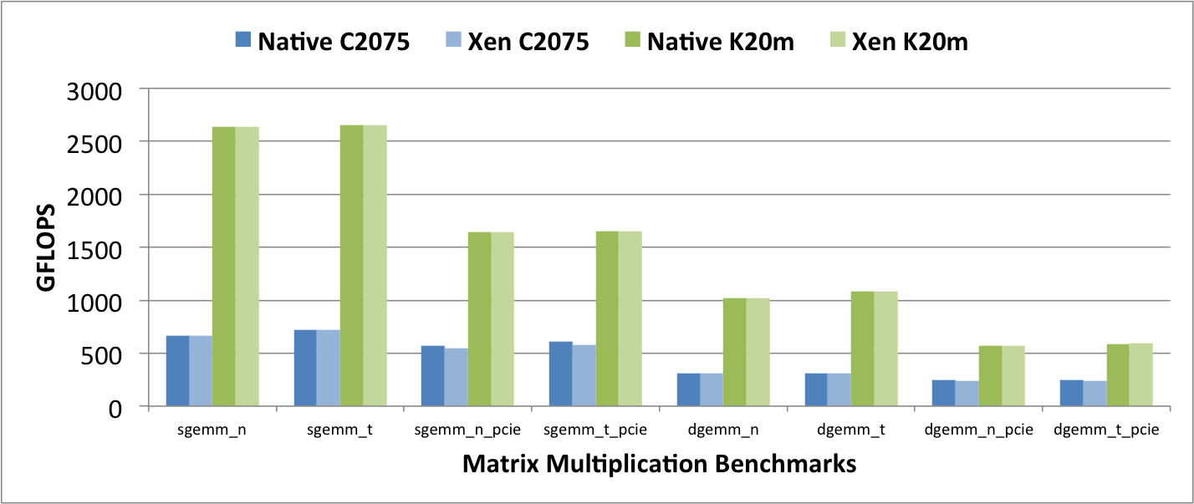
From: Andrew J. Younge, John Paul Walters, Stephen Crago, Geoffrey C. Fox, Evaluating GPU Passthrough in Xen for High Performance Cloud Computing, in High-Performance Grid and Cloud Computing Workshop at the 28th IEEE International Parallel and Distributed Processing Symposium. 2014
Notes:
Non-PCIe benchmarks = near- native performance using the Kepler GPUs and Fermi GPUs when compared to bare metal cases
overhead within Xen VMs is consistently less than 1%
some performance impact when calculating the total FLOPs with the pcie bus in the equation
With PCIE:
C2075 15% impact for FFT and 5% impact for Matrix Multi :/
K20m – only around 1% as worst, much better! ☺

Slide 20
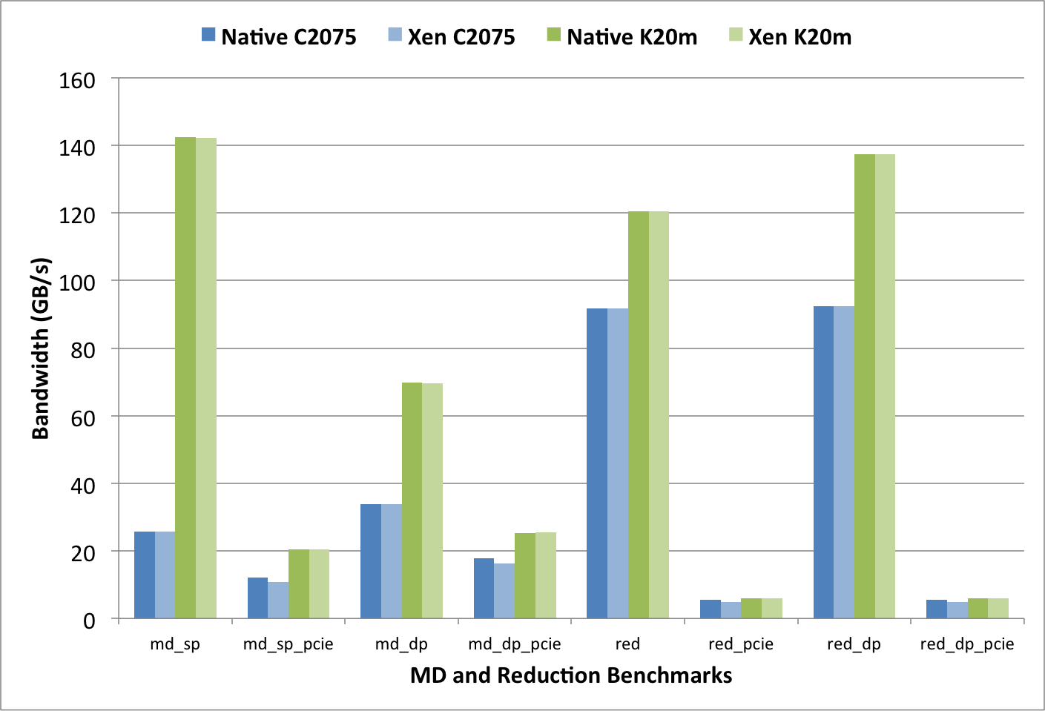
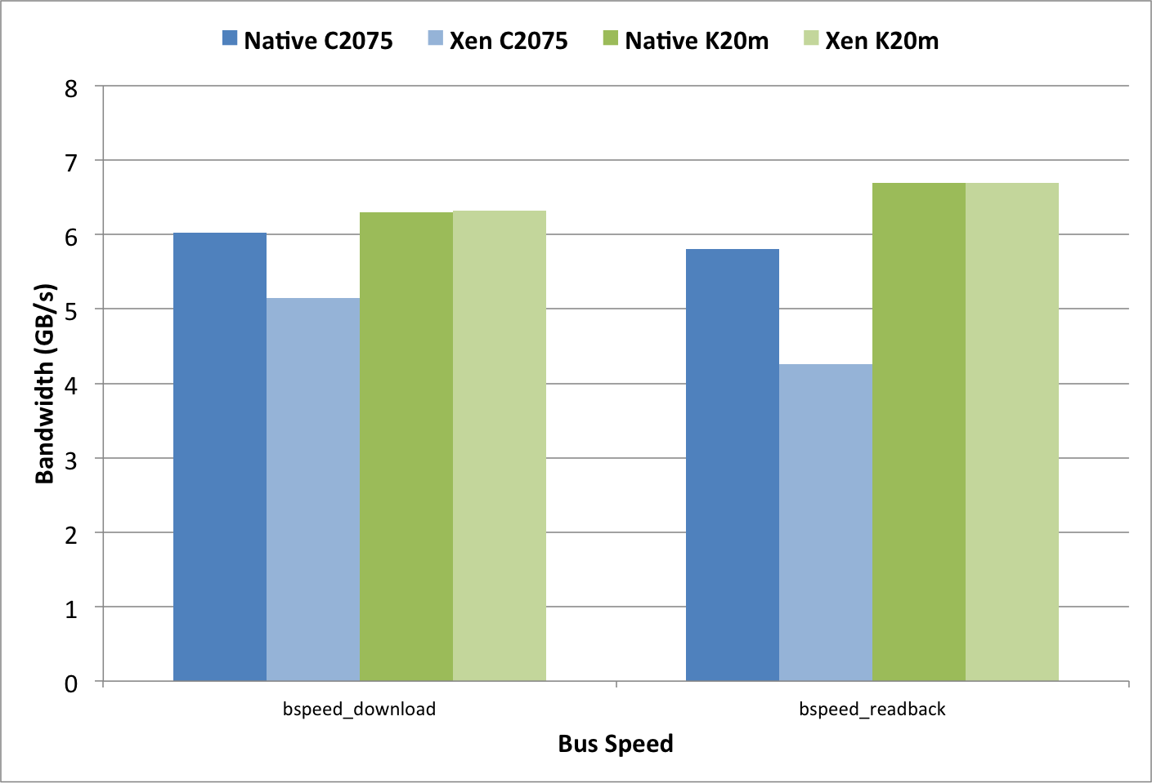
From: Andrew J. Younge, John Paul Walters, Stephen Crago, Geoffrey C. Fox, Evaluating GPU Passthrough in Xen for High Performance Cloud Computing, in High-Performance Grid and Cloud Computing Workshop at the 28th IEEE International Parallel and Distributed Processing Symposium. 2014
Notes:
consistent overhead in the Fermi C2075 VMs
-14.6% performance impact for download (to-device)
- 26.7% impact in readback (from- device).
Kepler K20 VMs do not experience the same overhead in the PCI-Express bus, and instead perform at near-native performance.
Results indicate that the overhead is minimal in the actual VT-d mechanisms, and instead due to other factors.

Slide 21
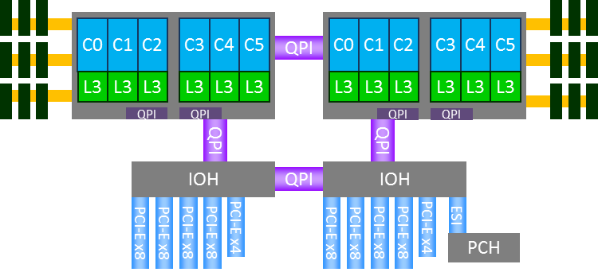
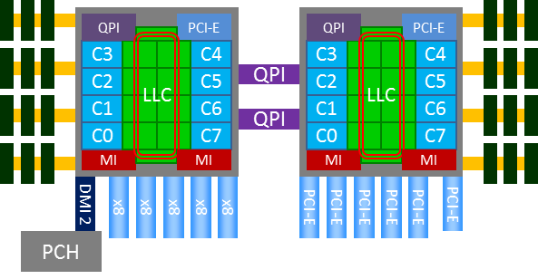
CPU Architecture
Westmere/Nehalem
Single QPI connection between NUMA sockets
Intel 5500 chipset for I/O Hub (IOH) with own QPI
  PCI-E from 2 IOHs
Sandy Bridge
Dual QPI connection between NUMA sockets
PCI-E built into processor
  If VMs pinned, no QPI traversal

Slide 22
GPUs in Virtual Machines
Need for GPUs in virtualization
  GPUs are commonplace in scientific computing
  GPUs > CPUs in performance/watt ratio
  Remote APIs for GPUs suboptimal
Solution: Direct GPU Passthrough within VM
Prototype GPU Passthrough with Xen
  Overhead is minimal for GPU computation
  Bespin (2013) has < 1.2% overall overhead
  Delta (2011) has 1% to 15% due to PCI-Express bus
  PCIE overhead likely due to VT-d mechanisms
  Our solution performs better than other front-end remote API solutions
Notes:
Can use remote GPUs, but all data goes over the network
Can be very inefficient for applications with non-trivial memory movement
Some implementations do not support CUDA extensions in C
Have to separate CPU and GPU code
Requires special decouple mechanism
Cannot directly drop in code with existing solutions.

Slide 23
GPU Hypervisor Experiment
In 2012, the Xen GPU Passthrough implementation was novel for Nvidia GPUs
Today GPUs available through most of the major hypervisors
  KVM, VMWare ESXi, Xen, LXC
Also developed similar methods in KVM
  Based on kvm/qemu VFIO in new kernel >= 3.9
Performance implications?
  Near-native performance possible?
Benchmarks
  Micro- benchmarks: SHOC OpenCL (70 total benchmarks)
  LAMMPS: hybrid multicore CPU+GPU
  GPU-LIBSVM: characteristic of big data applications
  LULESH: hydrodynamics application
Platforms
  Delta - Westmere with Fermi C2075
  Bespin - Sandy Bridge with Kepler K20m
From: John Paul Walters, Andrew J. Younge, Dong-In Kang, Ke-Thia Yao, Mikyung Kang, Stephen P. Crago, Geoffrey C. Fox, GPU-Passthrough Performance: A Comparison of KVM, Xen, VMWare ESXi, and LXC for CUDA and OpenCL Applications, in Proceedings of the 7th IEEE International Conference on Cloud Computing (CLOUD 2014).

Slide 24
Notes:
VMWare timing issues seen here! Likely TSC manipulation or vCPU swapping.
Overall both Fermi and Kepler systems perform near-native
KVM and LXC showed no notable performance degredation
Xen on the C2075 system shows some overhead
Likely because Xen couldn’t activate large page tables
VMWare results vary significantly between architecture
Kepler shows greater than base performance
Fermi shows largest overhead
Some unexpected performance improvement for Kepler Spmv

Slide 25
GPU-LIBSVM Results
Delta C2075 Results
Bespin K20m Results
Unexpected performance improvement for KVM on both systems
  Most pronounced on Westmere/Fermi platform
What caused performance improvement over bare metal?
  Not timing issues like with VMWare
From:John Paul Walters, Andrew J. Younge, Dong-In Kang, Ke-Thia Yao, Mikyung Kang, Stephen P. Crago, Geoffrey C. Fox, GPU-Passthrough Performance: A Comparison of KVM, Xen, VMWare ESXi, and LXC for CUDA and OpenCL Applications, in Proceedings of the 7th IEEE International Conference on Cloud Computing (CLOUD 2014).
Notes:
A Library for Support Vector Machines – GPU instance – looking at runtime

Slide 26
KVM libSVM Performance
KVM can outperform native solution!
This is likely due to the use of Transparent Hugepages (THP)
  Back the entire guest memory with hugepages (2M pages)
  Improves memory performance
    Separate TLB for 2M pages, less TLB misses total
    2M TLB miss => less page table walk
  GPU data access backed by 2M pages, decreasing TLB miss count & cost.
LibSVM a “Big Data” application, lots of CPU to GPU data movement
Notes:
NOTE: This performance is an exception, rather than a rule. But it shows the power of virtualization.

Slide 27
LULESH Hydrodynamics Performance
Bespin K20m Results
LULESH (K20m only)
Highly compute-intensive, little data movement
  Expect little virtualization overhead
Initially slight overhead from Xen
  Decreases as mesh resolution (N³) increases
From:John Paul Walters, Andrew J. Younge, Dong-In Kang, Ke-Thia Yao, Mikyung Kang, Stephen P. Crago, Geoffrey C. Fox, GPU-Passthrough Performance: A Comparison of KVM, Xen, VMWare ESXi, and LXC for CUDA and OpenCL Applications, in Proceedings of the 7th IEEE International Conference on Cloud Computing (CLOUD 2014).

Slide 28
Lessons Learned – GPU Hypervisor Performance
KVM consistently yields near-native performance across architectures
VMWare’s performance inconsistent
  Near-native on Sandy Bridge, high overhead on Westmere
Xen performed consistently average across both architectures
LXC performed closest to native
  Unsurprising, given LXC’s design
  Trades performance for flexibility
Given these results we see KVM as holding a slight edge for GPU passthrough
Virtualization of high performance GPU workloads historically controversial
  Westmere results suggest this was sometimes legitimate
  More than 10% overhead common
Recent architectures (e.g. Sandy Bridge) have nearly erased those overheads
  Lowest performing hypervisor (Xen) within 95% of native
  Improved CPU integration with PCI-Express bus

Slide 29
I/O Interconnect in Cloud
While hypervisor performances improves, I/O support in virtualized environments still suffer
  Bridged 1GbE or 10GbE often state-of-the-art for IaaS solutions (Amazon EC2)
  Latency also suffers with emulated drivers
Distributed memory applications rely on interconnects for distributing computation
Need for high performance, low latency interconnect
  InfiniBand - Not possible until recently

Slide 30
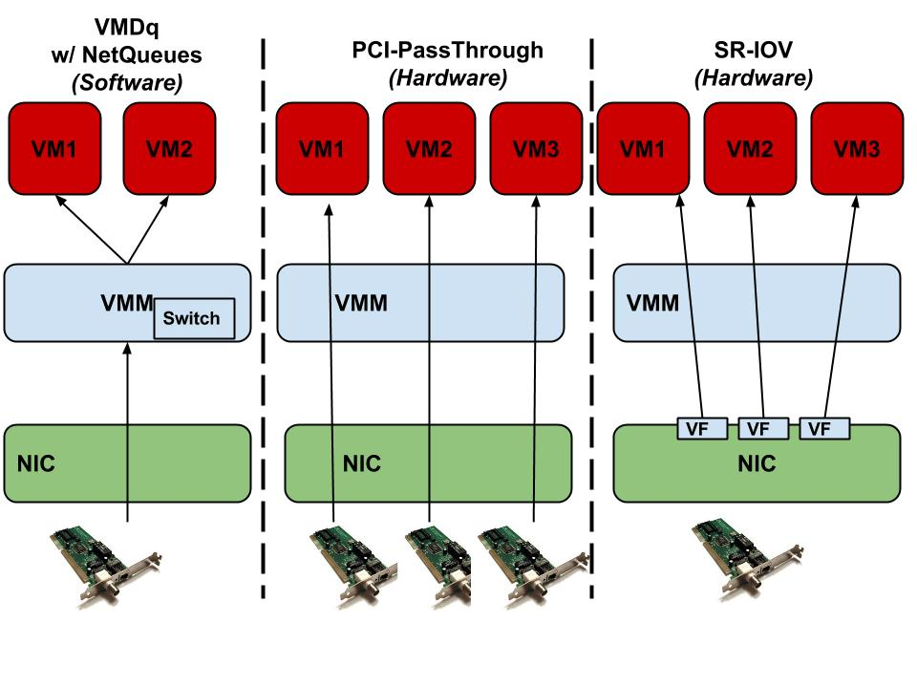


InfiniBand Virtualization
Overhead Reduction
Performance
Scalability
Performance
Scalability
Performance
Scalability
From: Malek Musleh, Vijay Pai, John Paul Walters, Andrew J. Younge, Stephen P. Crago, Bridging the Virtualization Performance Gap for HPC using SR-IOV for InfiniBand, in Proceedings of the 7th IEEE International Conference on Cloud Computing (CLOUD 2014).
Notes:
. The center block shows that only one VM has access
to a speciﬁc NIC at a time, whereas the rightmost part shows
how a single NIC can be shared across different VMs. In both
PCI-passthrough and SR-IOV the VMM is bypassed, which
eliminates the extra overhead mentioned earlier. This is in
contrast to the leftmost component of Figure 1 that illustrates
the: Virtual Machine Device Queue (VMDq) w/NetQueues
technique, that requires the VMM to route incoming packets
from the NIC to the correct VM.

Slide 31
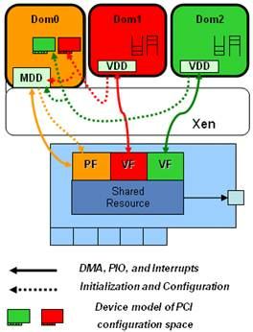
SR-IOV VM Support
Can use SR-IOV for 10GbE and InfiniBand
  Reduce host CPU utilization
  Maximize Bandwidth
  “Near native” performance
Maintains both VMM control and VM connectivity with Physical Functions (PF) and Virtual Functions (VF)
Requires extensive device driver support
  Mellanox now supports KVM
  SR-IOV for CX2 and CX3 cards
Image from “SR-IOV Networking in Xen: Architecture, Design and Implementation”

Slide 32
SR-IOV InfiniBand
SR-IOV enabled InfiniBand drivers now available
  OFED support with KVM for CX2 & CX3 cards
Initial evaluation shows promise for IB-enabled VMs
  SR-IOV Support for Virtualization on InfiniBand Clusters: Early Experience, Jose et al – CCGrid 2013
  Exploring Infiniband Hardware Virtualization in OpenNebula towards Efficient High-Performance Computing, Ruivo et al –CCGrid 2014
  ** Bridging the Virtualization Performance Gap for HPC Using SR-IOV for InﬁniBand, Musleh et al – IEEE CLOUD 2014 **
  SR-IOV: Performance Benefits for Virtualized Interconnects, Lockwood et al – XSEDE14

Slide 33
InfiniBand Optimizations
With InfiniBand SR-IOV, bandwidth is near-native, but high latency overhead remains high
  ~30% latency overhead for small messages
Observation: Native InfiniBand optimizations may be sub-optimal for SR-IOV
Possible Solution: Tune parameters for better performance with SR-IOV (~15% improvement)
  Interrupt Moderation & Coalescing
  IRQ Balancing
  Shared Receive Queue
From: Malek Musleh, Vijay Pai, John Paul Walters, Andrew J. Younge, Stephen P. Crago, Bridging the Virtualization Performance Gap for HPC using SR-IOV for InfiniBand, in Proceedings of the 7th IEEE International Conference on Cloud Computing (CLOUD 2014).
Notes:
SRQ – allows sharing of buffers across multiple connections

Slide 34
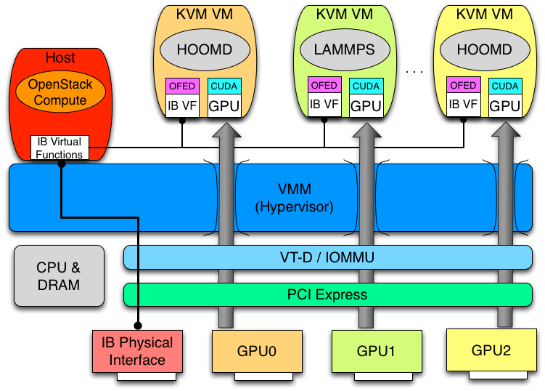
High Performance Virtualized Host

Slide 35
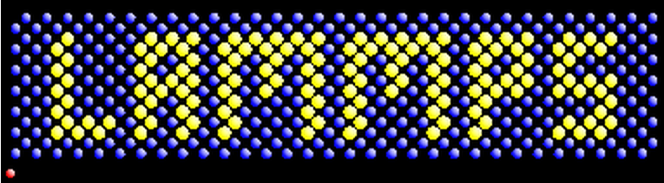

Real-world Applications – Molecular Dynamics Simulation
LAMMPS - "Large-scale Atomic/Molecular Massively Parallel Simulator“
Very common MD simulator
From Sandia National Laboratories
Uses MPI and has the GPU package for hybrid CPU and GPU computation
HOOMD-blue is a general-purpose particle simulation toolkit
From University of Michigan
It scales from a single CPU core to thousands of GPUs with MPI
HOOMD also has support for GPUDirect, introduced in CUDA 5

Slide 36
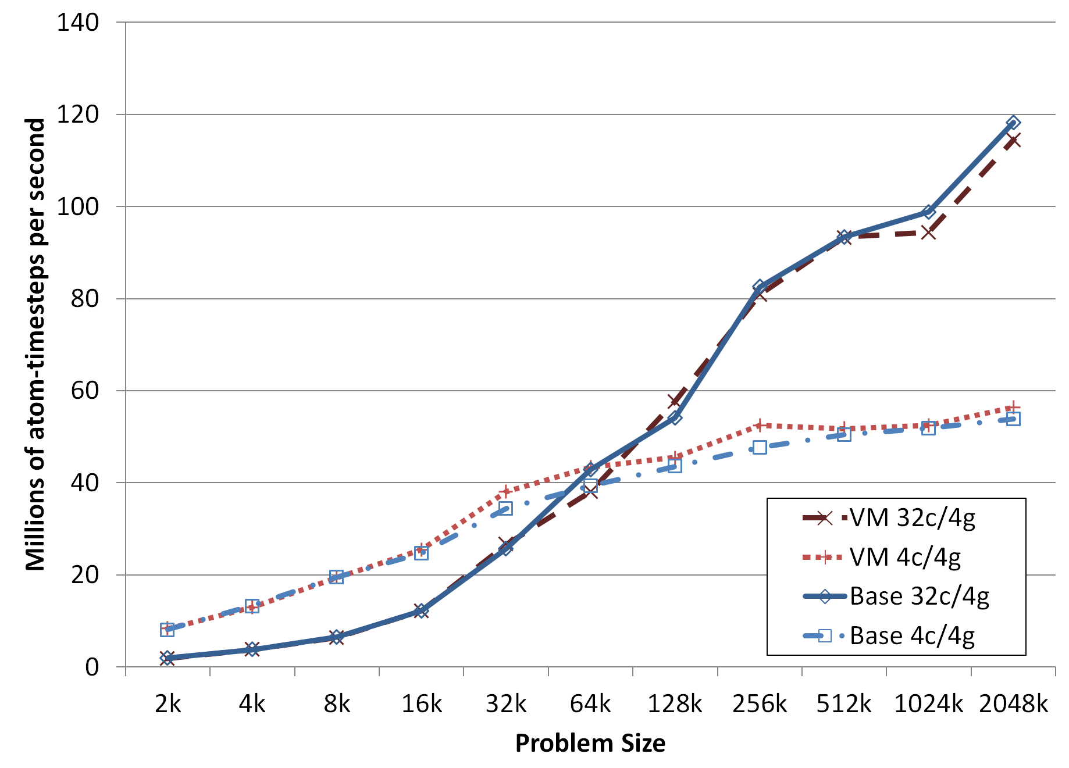
LAMMPS LJ
VMs running LAMMPs achieve near-native performance at 32 cores & 4GPUs
  99.3% efficiency for all LJ experiments.
  98.5% for multicore, ~100% for single core (due to THP)
Notes:
If the number of particles per MPI task is small (e.g. 100s of particles), it can be more efficient to run with fewer MPI tasks per GPU, even if you do not use all the cores on the compute node.

Slide 37
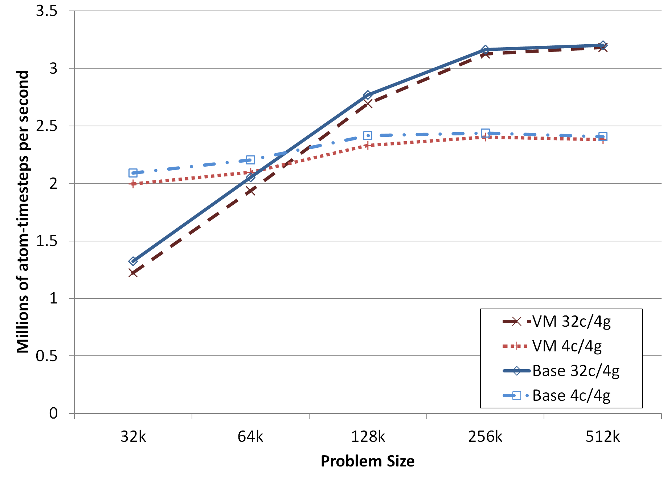
LAMMPS Rhodo
96.7% efficiency for Rhodo

Slide 38
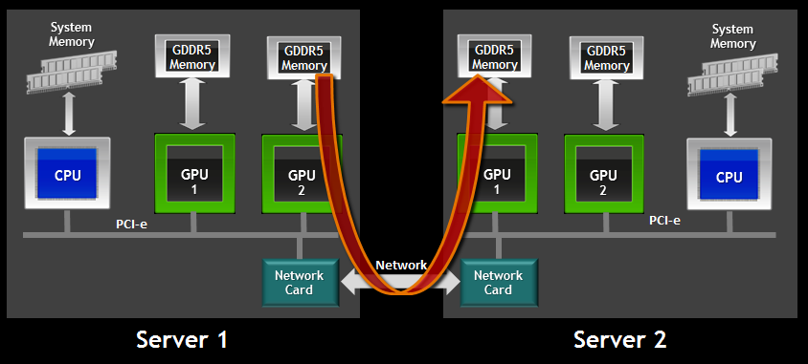
GPU Direct
GPUDirect facilitates multi-GPU computation
  v1 avoids dual CPU buffers (2010)
  v2 P2P communication between intra-GPUs (2011)
  v3 RDMA via InfiniBand (2013)
    Ideal solution for large scale MPI+CUDA applications

Slide 39
HOOMD-Blue
GPUDirect has small but noticeable improvement (~9%) in performance for MPI+CUDA applications.
Both HOOMD simulations, with and without GPUDirect, perform very near-native.
  GPUDirect 98.5% efficiency
  non-GPUDirect 98.4% efficiency

Slide 40
Discussion
Large potential in running MD simulations in virtualized infrastructure
Overhead remained low, effectively “near-native”
  LAMMPS – 1.9% overhead
  HOOMD – 1.5% overhead
GPUDirect RDMA provides 9% performance boost in HOOMD
Neither problem size or resource utilization increase virtualization overhead
  Hope this scales to thousands of cores!!

Slide 41
HPC Application Viability
Running high performance computing workloads in cloud infrastructure is feasible
HPC hardware such as Nvidia GPUs and InfiniBand interconnects now usable in virtualized environments
Current MPI+CUDA applications run with very little overhead
Need to evaluate scalability

Slide 42
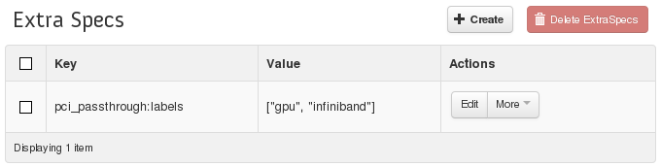
OpenStack Integration
Integrated into OpenStack “Havana” fork
  Xen support for full virtualization with libvirt
  Custom Libvirt driver for PCI-Passthrough
  Use instance_type_extra_specs to specify PCI devs
root@test-nvidia-xqcow2-vm-58 ~]# lspci
...
00:04.0 3D controller: NVIDIA Corporation Device 1028 (rev a1)
00:05.0 Network controller: Mellanox Technologies MT27500 Family [ConnectX-3]

Slide 43
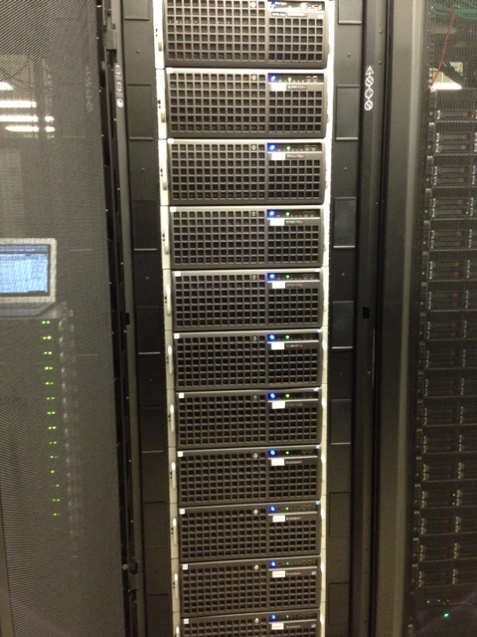
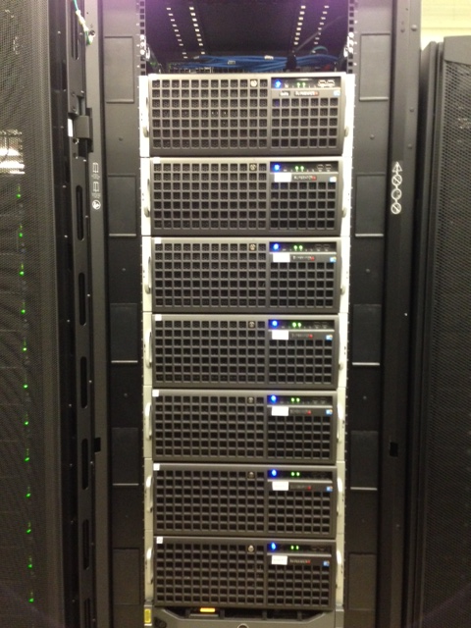
Experimental Deployment:
Delta
16x 4U nodes in 2 Racks
  2x Intel Xeon X5660
  192GB Ram
  Nvidia Tesla C2075 Fermi
  QDR InfiniBand - CX-2
Management Node
  OpenStack Keystone, Glance, API, Cinder, Nova-network
Compute Nodes
  Nova-compute, KVM/Xen, libvirt

Slide 44
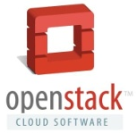
A. J. Younge, J. P. Walters, S. P. Crago, and G. C. Fox, Supporting high performance molecular dynamics in virtualized clusters using IOMMU, SR-IOV, and GPUdirect, VEE 2015
A. J. Younge et al., Analysis of Virtualization Technologies for High Performance Computing Environments, IEEE Cloud 2011
A. J. Younge, J. P. Walters, S. P. Crago, G. C. Fox, Evaluating GPU Passthrough in Xen for High Performance Cloud Computing, Workshop in IPDPS 2014
J. P. Walters, A. J. Younge et al., GPU-Passthrough Performance: A Comparison of KVM, Xen, VMWare ESXi, and LXC for CUDA and OpenCL Applications, IEEE CLOUD 2014.
M. Musleh, V. Pai, J.P. Walters, A. J. Younge, S. P. Crago, Bridging the Virtualization Performance Gap for HPC using SR-IOV for InfiniBand, IEEE CLOUD 2014

Slide 45
Will Virtualization Exascale?
First need to make work for current HPC
  Focus on current architectures first
  Work with hardware providers, target large deployment
Leverage advantages of virtualization
  Support “classic” HPC applications when necessary
  Move compute to data, live-migration fault tolerance & detection
    RDMA COW live-migration
    VM cloning
  Build new OS model & programming environment

Slide 46
Conclusion
Today’s hypervisors can support near-native performance for many workloads
  Careful configuration necessary for best performance
GPUs in VMs now a reality
  Promising performance via PCI Passthrough
  Some overhead, but best with new architectures
InfiniBand SR-IOV = leap in interconnect for IaaS
  Interrupt tuning or mitigation may help reduce latency overhead
Integrate work into OpenStack IaaS Cloud
** Many scientific applications can perform well in
High performance Virtual Clusters **
  Molecular Dynamics simulations

Slide 47
Future Work
Infrastructure scaling
  Scaling to hundreds of cores, but what about a million?
High Performance Virtual Cluster resource management
  Create one-click deployable HPVCs
  Reproducible experiment management
Leverage new and emerging hardware
  Intel Xeon Phi, FPGAs, EDR IB, virtual SMP
  Address storage gap
  Move beyond PCI Express?
Evaluate new distributed memory platforms
  HPC-APBDS on virtualized infrastructure (Hadoop, Spark, Storm)
  MPI, CUDA, new OS/Runtime deployments

Slide 48
Thanks!
Questions?

Slide 49
Backup slides

Slide 50
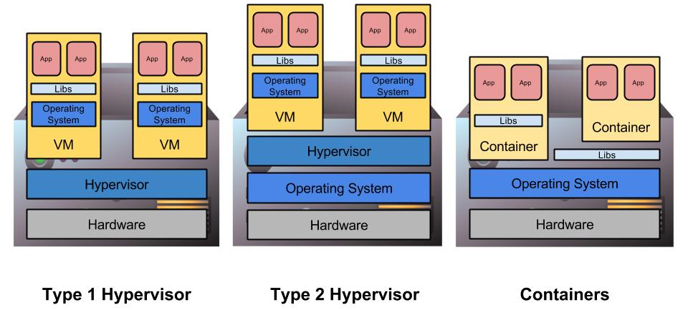
Virtualization
Virtual Machine (VM) is a software implementation of a machine that executes as if it was running on a physical resource directly.
Enables multiple operating systems & environments to run simultaneously on one physical machine.
…
…
…

Slide 51
Docker Containers for HPVC?
Docker provides the ability to easily package & ship containers (sudo-VMs) to various deployments
Shifter brings user-defined container images to HPC resources.
Linux containers (LXC) is fast and efficient, always at near-native performance.
  Dependent on host OS kernel, lack of flexibility
  “Containers don’t contain”
    Hardware availability, serious security concerns & considerations

Slide 52
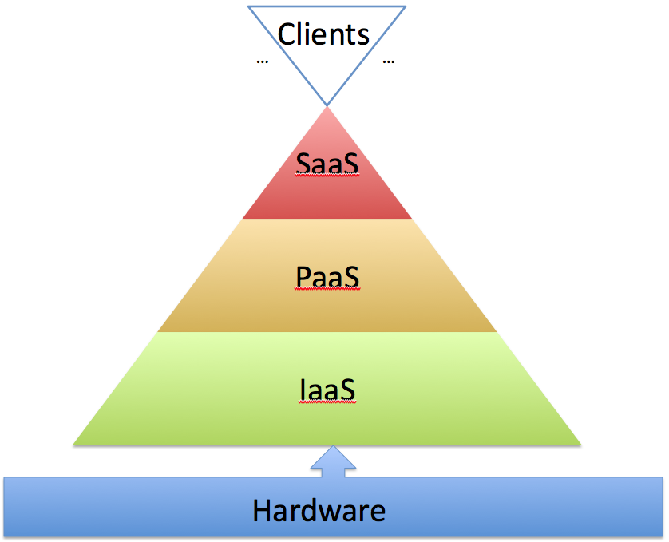
*-as-a-Service
Notes:
Clients – Browser
Saas – Google Docs
PaaS – Microsoft Azure, Google App Engine
IaaS – Amazon Elastic Compute Cloud

Slide 53
Cloud Computing
From: Cloud Computing and Grid Computing 360-Degree Compared, Foster et al.

Slide 54
Cloud Computing
High Performance Clouds
From: Cloud Computing and Grid Computing 360-Degree Compared, Foster et al.

Slide 55
Advantages of Virtualization and Cloud Infrastructure
Scalability
Resource Consolidation
Multi-tenancy
Elasticity
Manageability
Agility
Fault tolerance
Monitoring & control

Slide 56

FutureGrid: a Distributed Testbed
NID: Network Impairment Device
Private
Public
FG Network

Slide 57
GPU comparison
In 2012, the Xen GPU Passthrough implementation was first of its kind for Nvidia Tesla GPUs
Recently, more hypervisors added support
Developed similar methods in KVM (new)
  Userspace driver interface
  Based on kvm/qemu VFIO in new kernel >= 3.9
Can now make apples-to-apples comparison

Slide 58
THP EPT and TLB
THP – Transparent Huge Pages
  Allocate memory blocks in 2MB and 1GB sizes
  Easily allocation in userspace
EPT – second level address translation
  Intel technique to avoid multiple address lookups
  Treats guest addresses as host-virtual addresses (in hardware)
TLB – cache for virtual memory pages
  Want to minimize TLB misses whenever possible
  Each TLB miss requires hypervisor interaction (expensive)

Slide 59
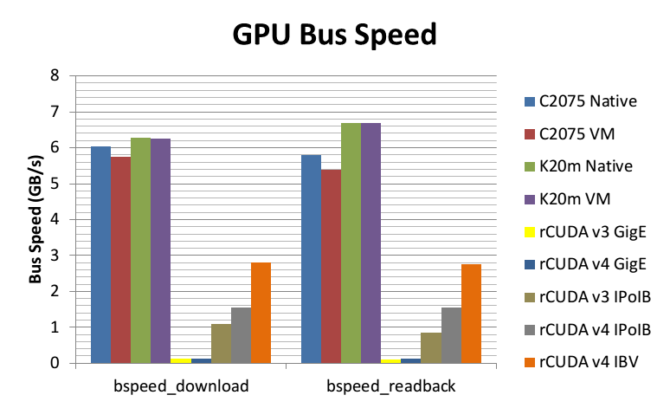

Slide 60
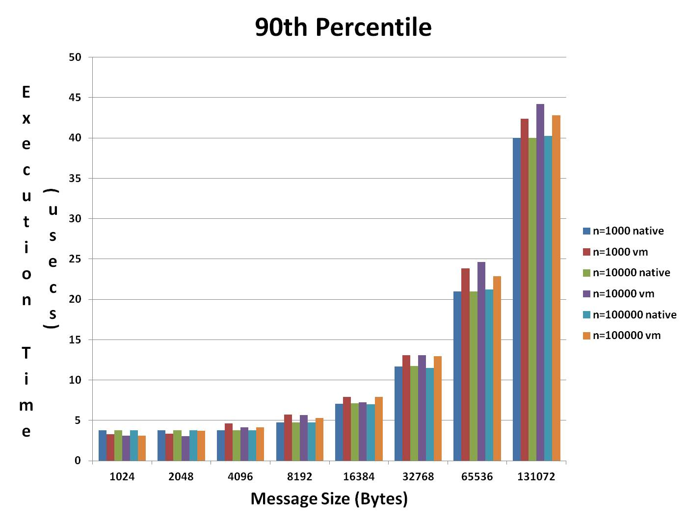
Results: Latency Distribution ib_write-lat (Network-Level)
~6%
n: # of messages
→ VM perf. Competitive with native

Slide 61
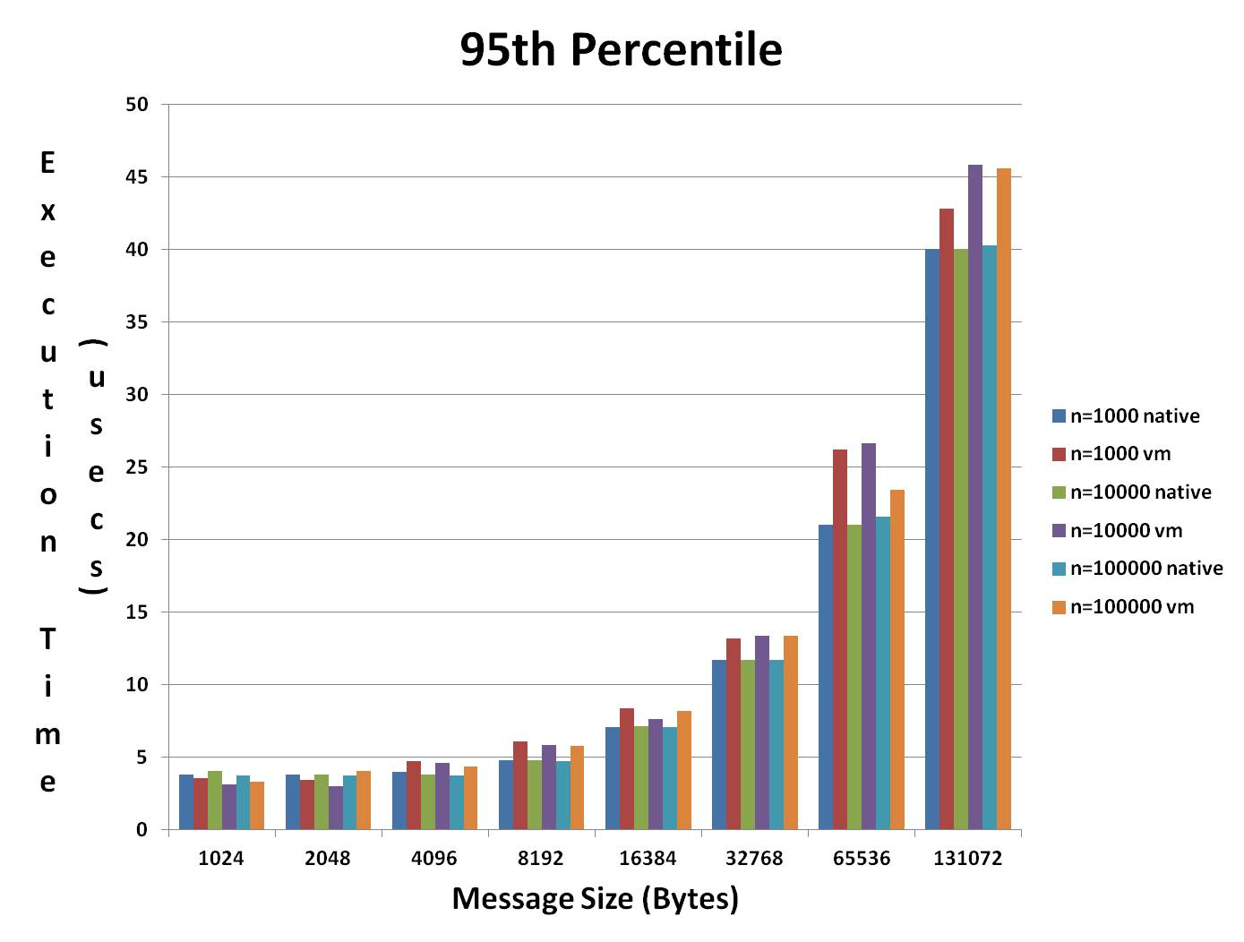
Results: Latency Distribution ib_write-lat (Network-Level)
~12%
n: # of messages
→ Majority of overhead in tail-latency

Slide 62
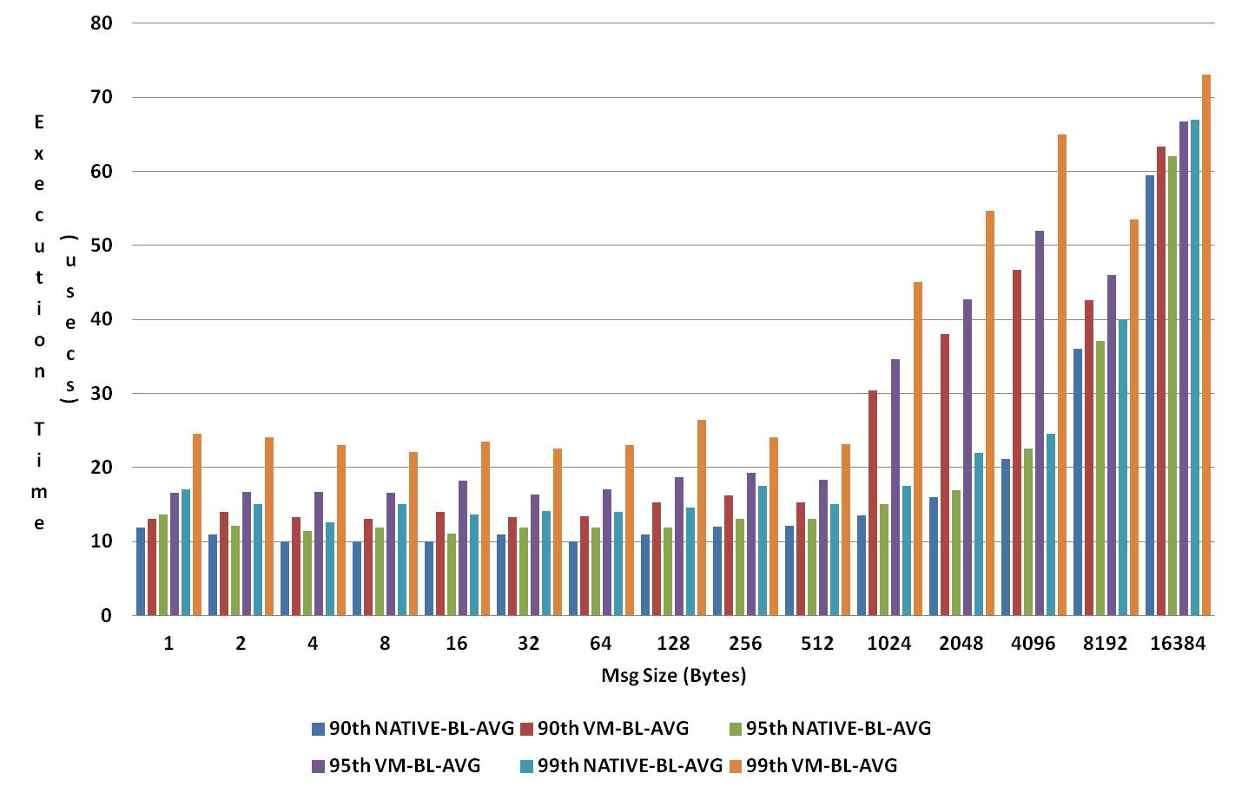
Results: Latency Distribution osu-AlltoAll (Micro-Level)
Majority of overhead in tail-latency
Overhead decreases with larger msg size

Slide 63
Results: Latency Distribution osu-AlltoAll (Micro-Level)
Majority of overhead in tail-latency
Overhead decreases with larger msg size

Slide 64
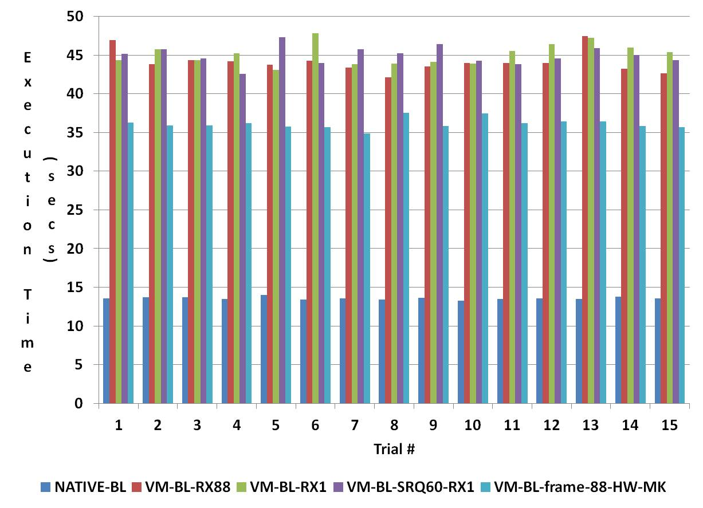
Results: Network Tuning
NPB-CG (Macro-Level)

Slide 65
Results: Network Tuning
NPB-CG (Macro-Level)
30%
Reduction
3x

Slide 66
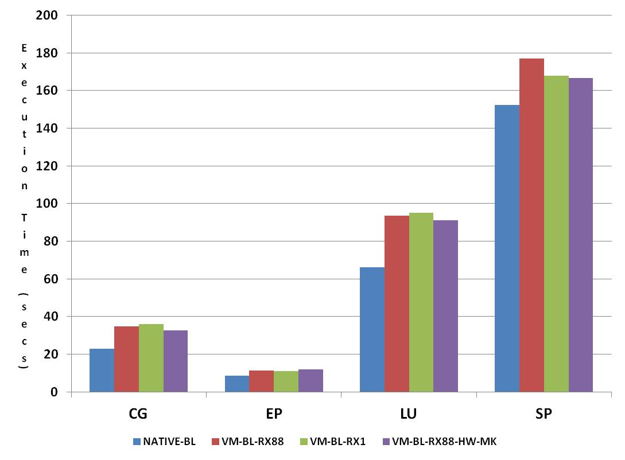
Results: Network Tuning
NPB (Macro-Level)

Slide 67
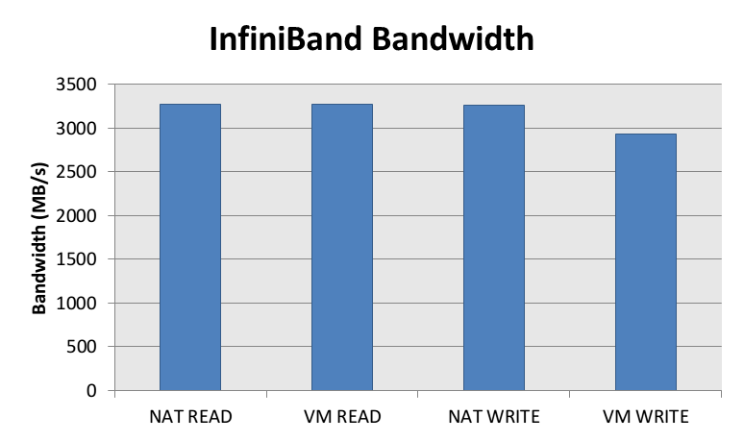

Slide 68
KVM can outperform native solution!
This is likely due to the use of Transparent Hugepages (THP)
  Back the entire guest memory with hugepages (2M pages)
  Improves memory performance
    Separate TLB for 2M pages, less TLB misses total
    2M TLB miss => less page table walk
  GPU data access backed by 2M pages, decreasing TLB miss count & cost.
LibSVM a “Big Data” application, lots of CPU to GPU data movement

