Slide 1
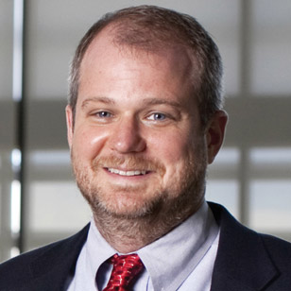
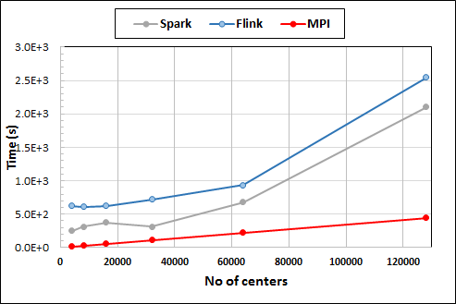
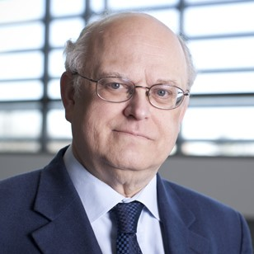
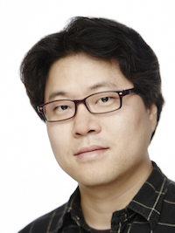
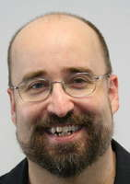
High Performance Computing HPC and Cyberinfrastructure in Department of Intelligent Systems Engineering
Martin Swany
Geoffrey Fox
Design of next generation of Supercomputers: Exascale Machines
New memory, CPU and Software Systems
Parallel Big Data systems that are orders of magnitude faster than R, Spark, Flink
30 optimized ML library codes
Embedded Edge systems: FPGA, Pi
Thomas Sterling
Lei Jiang
Gregor von Laszewski
Minje Kim
Integration of HPC, Cloud, parallel, networking, distributed and edge systems
High-Performance Big Data Computing
Twister2 to subsume Hadoop, Kubernetes, Spark, MPI (940 cites)
Teach Cloud, HPC, Deep Learning, HP ML online
Run optimized Big Data systems for research and teaching
Two major NSF grants $5M and $4M 5 year
Clint Whaley
Judy Qiu

