Slide 1
Low Latency Streaming: Heron on InfiniBand
Supun Kamburugamuve
supun@apache.org
Geoffrey Fox, Martin Swany
Karthik Ramasamy
@karthikz
Co-founder of Streamlio

Slide 2
Information Age
Real-time is key
á
K


Slide 3
Real Time Connected World
Internet of Things
Connected Vehicles
Ñ
30 B connected devices by 2020
Data transferred per vehicle per month
4 MB -> 5 GB
Health Care
Digital Assistants (Predictive Analytics)
+
153 Exabytes (2013) -> 2314 Exabytes (2020)

$2B (2012) -> $6.5B (2019) ^{[1]}
Siri/Cortana/Google Now
Machine Data
Augmented/Virtual Reality
40% of digital universe by 2020
>
$150B by 2020 ^{[2]}
Oculus/HoloLens/Magic Leap
[1] http://www.siemens.com/innovation/en/home/pictures-of-the-future/digitalization-and-software/digital-assistants-trends.html
[2] http://techcrunch.com/2015/04/06/augmented-and-virtual-reality-to-hit-150-billion-by-2020/#.7q0heh:oABw

Slide 4
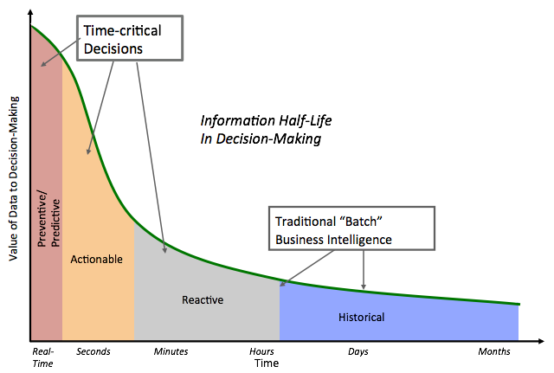
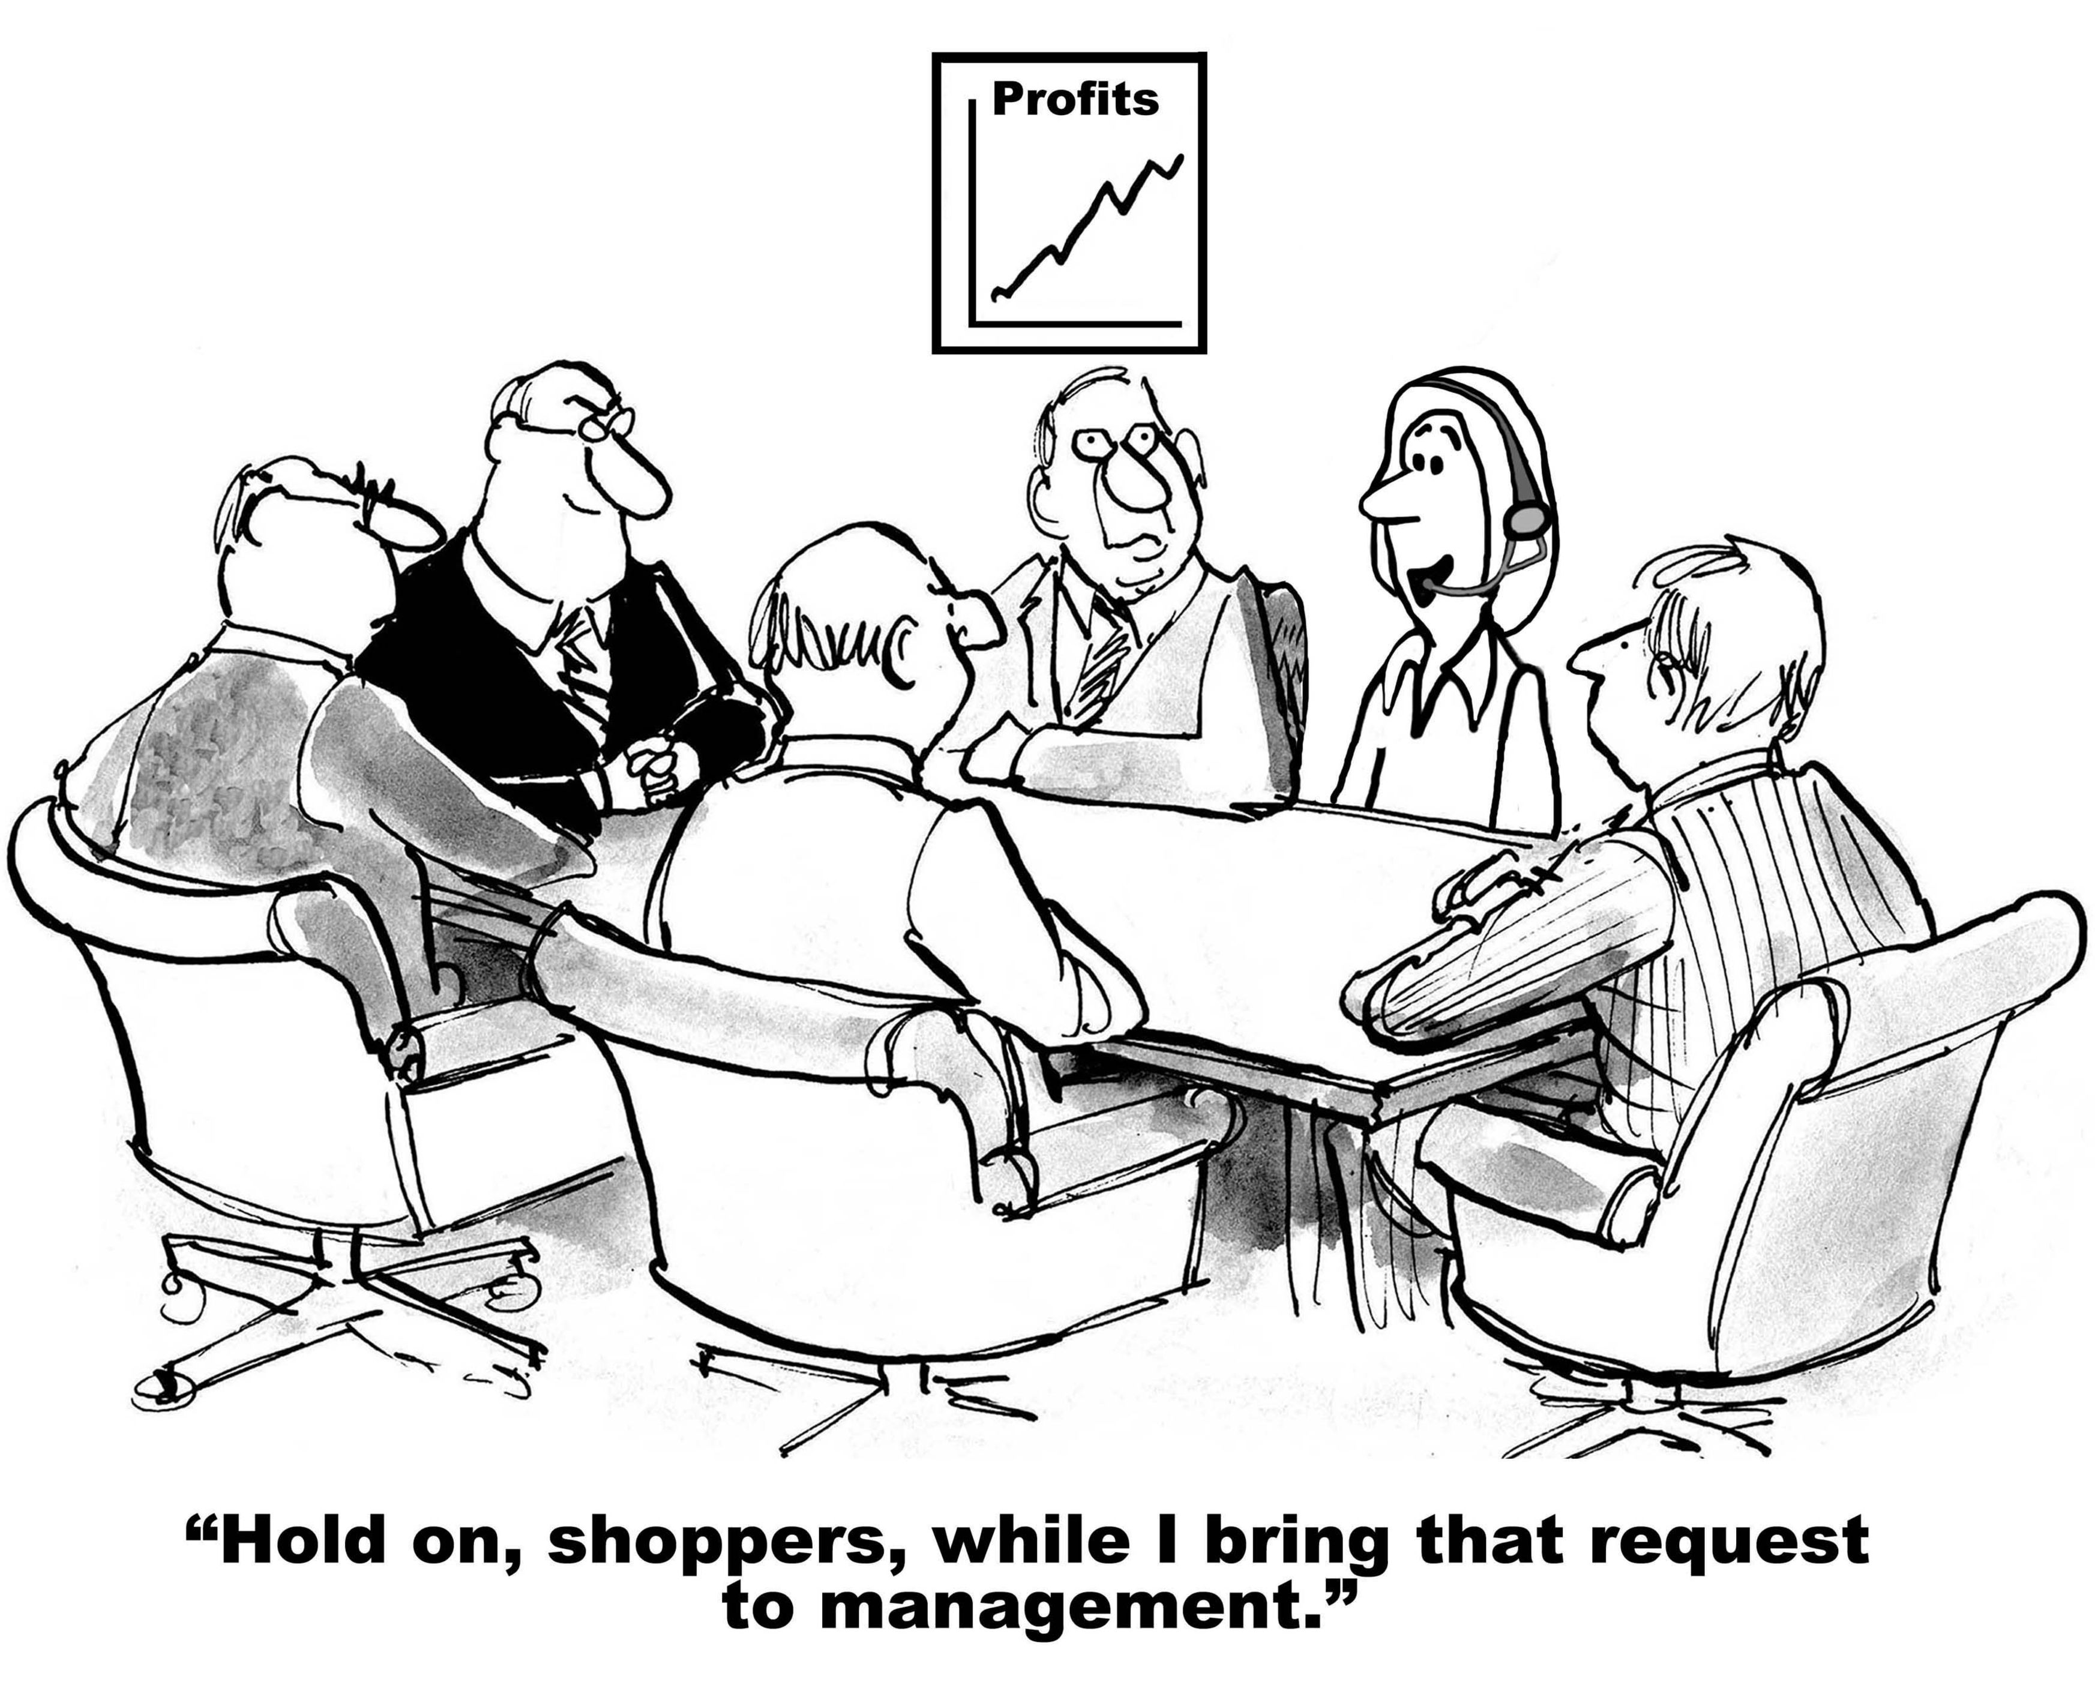
Value of Data
[1] Courtesy Michael Franklin, BIRTE, 2015.

Slide 5
Introducing Heron
Heron Design Goals
Consistent performance at scale
Easy to debug and tune
Fast/Efficient General purpose streaming engine
Storm API compatible
Latency/Throughput configurability
Flexible deployment modes
Achieving low latency for Financial & IoT applications

Slide 6
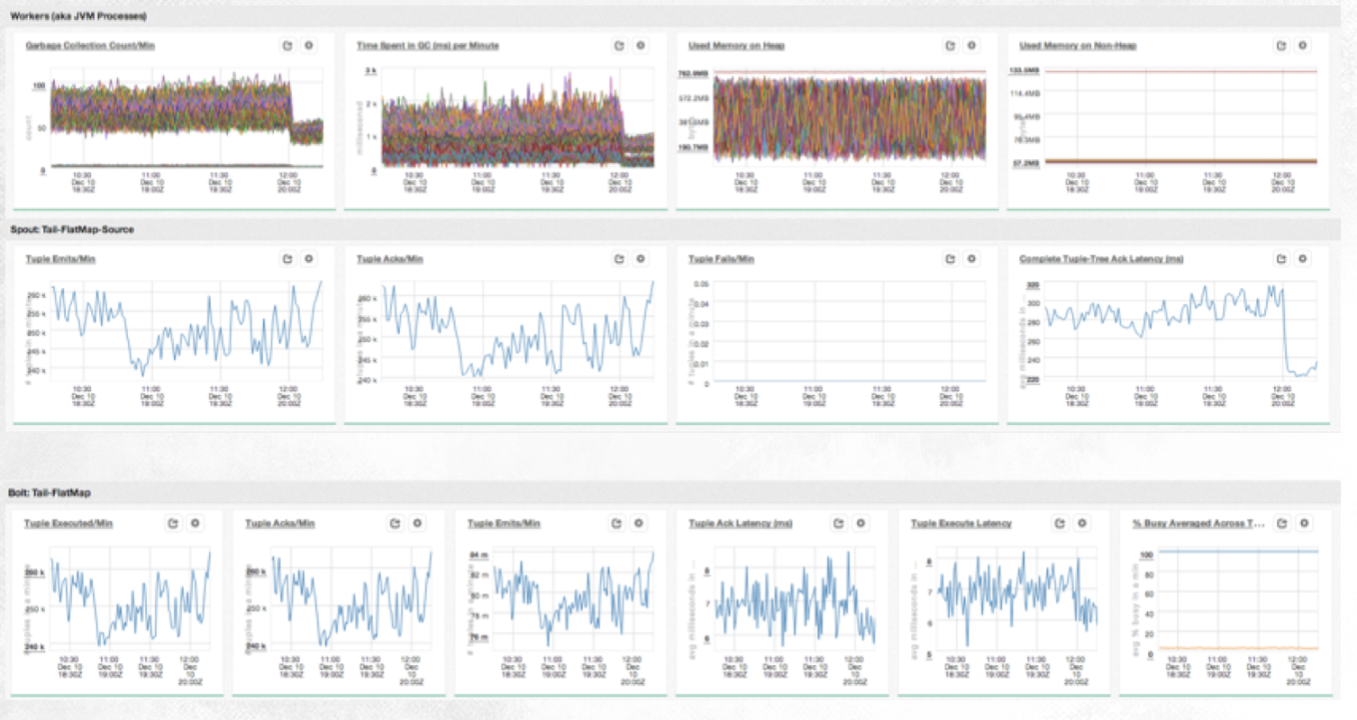
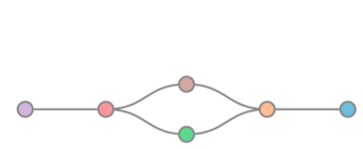
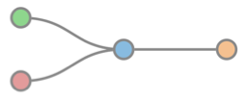
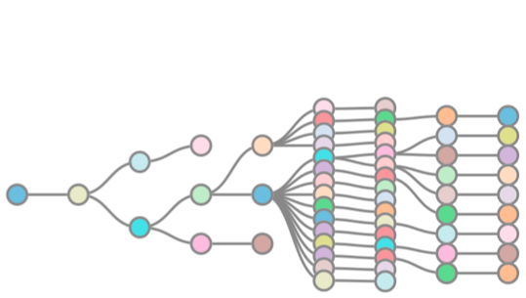
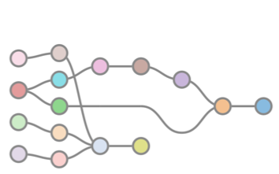
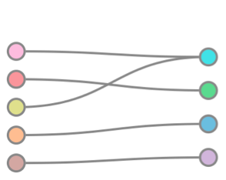
Heron in Production @ Twitter
Completely replaced Storm 3 years ago
3x reduction in cores and memory
Significantly reduced operational overhead
10x reduction in production incidents

Slide 7
Heron Use Cases
SPAM
DETECTION
REALTIME
ETL
REAL TIME
BI
REAL TIME
TRENDS
REALTIME
ML
REAL TIME OPS

Slide 8
Open Souring
https://github.com/twitter/heron
http://heron.io
Apache 2.0 License
Contributions from
Microsoft, Mesosphere, Google,
Wanda Group, WeChat, Fitbit and growing
open sourced
May 2016

Slide 9
Heron Core Concepts
Topology
Directed acyclic graph
vertices = computation, and
edges = streams of data tuples
Spouts
Sources of data tuples for the topology
Examples - Kafka/Kestrel/MySQL/Postgres
%
Bolts
Process incoming tuples, and emit outgoing tuples
Examples - filtering/aggregation/join/any function

Slide 10
Sample Heron Topology
%
%
Bolt 1
Spout 1
Bolt 4
%
Bolt 2
%
Spout 2
Bolt 5
%
Bolt 3

Slide 11
Topology Architecture
Logical Plan,
Physical Plan and
Execution State
Topology
Master
ZK
Cluster
Sync Physical Plan
Metrics
Manager
Stream
Manager
Stream
Manager
Metrics
Manager
I1
I2
I3
I4
I1
I2
I3
I4
CONTAINER
CONTAINER

Slide 12
Stream Manager - Design Goals
Ñ
Core logic in one centralized place
Transport (tcp sockets, unix sockets, shared memory)
+
Super Efficient

Interlanguage Data Format (Protobufs, Cap N’ Proto, etc)
Pluggable
>
Protocol (HTTP, gRPC, custom, etc)
Oculus/HoloLens/Magic Leap
Multilanguage Instances (C++, Java, Python)

Slide 13
Stream Manager - Current Implementation
Ñ
Implements at most once, at least once and exactly once
Transport using TCP Sockets
+
Written in C++ for efficiency

Protobuf data format
Custom protocol (very similar to gRPC)

Slide 14
High Performance Clusters
Computationally expensive massively parallel applications
Tightly synchronized parallel operations
Efficient low latency communications are critical
Even small amount of OS noise can affect performance at this scale
Message Passing Interface (MPI)
Less than 20µs latency for P2P communications
1,020 compute nodes, 21,824 cores, 43,648 GB of RAM

Slide 15
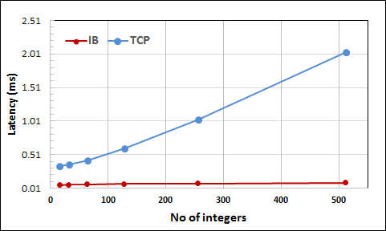
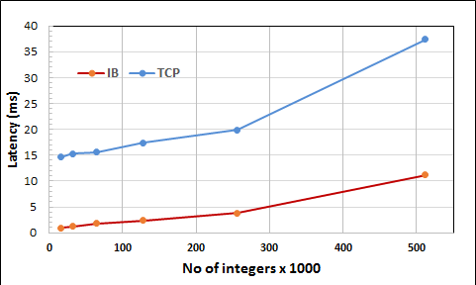
Putting into Context
15 – 20 Speedup
Example: All Reduce operation
Each parallel worker
Has an integer array of equal size
Calculate global sum of values at each array index
OpenMPI 3.0.0
Each process has an array with 4 Integers
Reduce
5 | 10 | 3 | 4
3 | 4 | 5 | 9
All Reduce
All Reduce
Broadcast
8 | 14 | 8 | 13
8 | 14 | 8 | 13
16 Nodes, 384 Parallel processes
P1
P2
TCP and Infiniband Performance of MPI

Slide 16
System Performance
Factors
Architecture
Efficient use of resources
Algorithmic enhancements
Special hardware
Measure
Throughput
Latency
Power Consumption
Scalability
Speedup

Slide 17
High Performance Interconnects
InfiniBand
Widely used interconnect
Dominant in HPC clusters
Intel Omni-Path
Cray Aries
Wide range of messaging capabilities
Reliable/Unreliable Send/Receive (Channel Semantics)
RDMA read/write (Memory Semantics)
Atomic operations
Infiniband | SDR | DDR | QDR | FDR | EDR
Years | 2001 – 2004 | 2005 – 2007 | 2008- 2010 | 2011-2013 | 2014
Bandwidth | 10Gb/s | 20Gb/s | 40Gb/s | 56Gb/s | 100Gb/s
Latency | 5 µsec | 2.5 µsec | 1.3 µsec | 0.7 µsec | .5 µsec

Slide 18
TCP Applications
Server
Client
socket
bind
listen
socket
connect
accept
Execution Loop
epoll
epoll
read(buf)
write(buf)
Copy bytes between kernel and user space
Copy bytes between kernel and user space
write(buf)
read(buf)
All are system calls

Slide 19
TCP Applications
CPU Usage Breakdown of Web Server (Lighttpd) Serving a 64 byte file Linux-3.10
Shared resources including file descriptors
Data locality is not preserved
Many system calls
Buffer copying from user space to kernel
Solutions based on Data Plane Development Kit (DPDK) to improve TCP stack performance
Fast User-level TCP Stack on DPDK
https://dpdksummit.com/Archive/pdf/2016Asia/DPDK-ChinaAsiaPacificSummit2016-Park-FastUser.pdf

Slide 20
InfiniBand Transport Modes
Wide range of capabilities
Datagram – Can send receive to any Queue Pair (Similar to UDP)
Unreliable – Data loss can occur
Operation | Unreliable Datagram | Unreliable Connection | Reliable Connection | Reliable Datagram
Send | Yes | Yes | Yes | Yes
Receive | Yes | Yes | Yes | Yes
RDMA Write |  | Yes | Yes | Yes
RDMA Read |  |  | Yes | Yes
Atomic |  |  | Yes | Yes
We chose Send/Receive with Reliable Connection

Slide 21
InfiniBand Applications
Initialization
Local
Remote
Need to pin the memory used by the network
Receive Queue
Transmit Queue
Establish a receive and transmit queue pair
Transmit Queue
Receive Queue
Completion Queues
Completion Queues
Post the receive buffers to receive queue
Post the receive buffers to receive queue
Execution Loop
Receive Queue
Receive Queue
Send Queue
Send Queue
Completion Queues
Completion Queues
Poll completion queue for request completion
Poll completion queue for request completion
Post the send buffer to transmit queue
Post the send buffer to transmit queue
All are user level functions

Slide 22
InfiniBand Applications
Post the receive buffers to receive queue
Post the receive buffers to receive queue
Execution Loop
Receive Queue
Receive Queue
Send Queue
Send Queue
Completion Queues
Completion Queues
Poll completion queue for request completion
Poll completion queue for request completion
Post the send buffer to transmit queue
Post the send buffer to transmit queue
The receive buffers need to be posted before a send can complete
Application level flow control (credit based)
The buffers are of fixed size
Need to register the buffer memory before start using them
Completion order

Slide 23
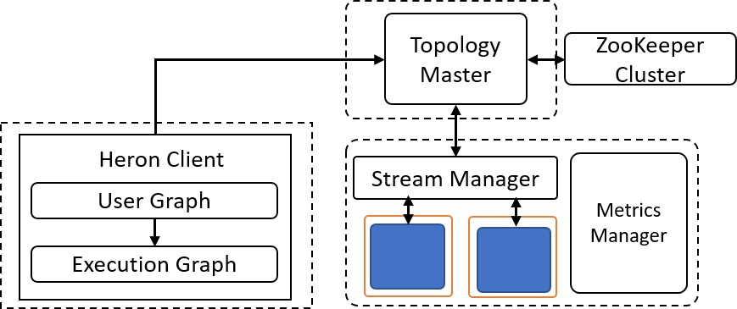
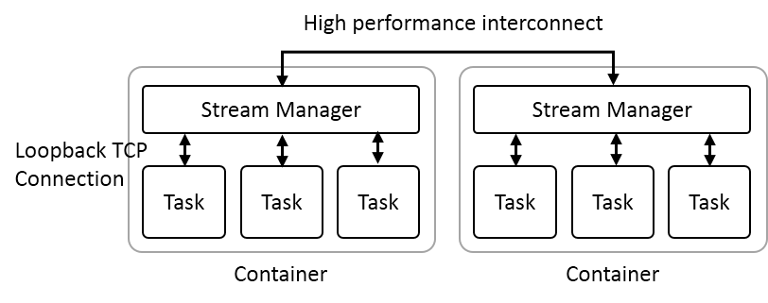
Heron InfiniBand Integration
Libfacbric for programming the interconnect
Heron Architecture
Heron Interconnect Integration

Slide 24
InfiniBand Integration
Bootstrapping the communication
Need to use out of band protocols to establish the communication
TCP/IP to transfer the bootstrap information
Buffer management
Fixed buffer pool for both sending and receiving
Break messages manually if the buffer size is less than message size
Flow control
Application level flow control using a standard credit based approach

Slide 25
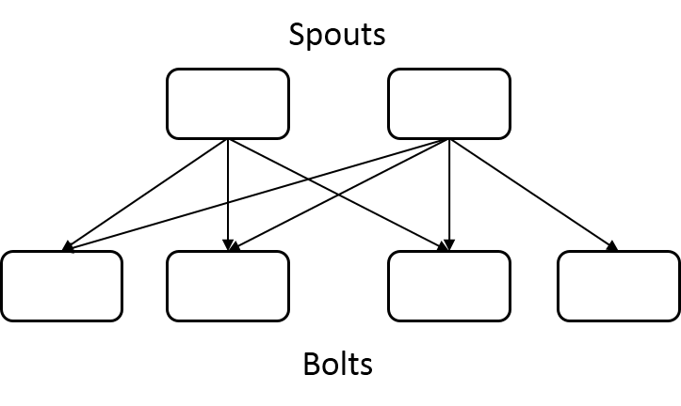
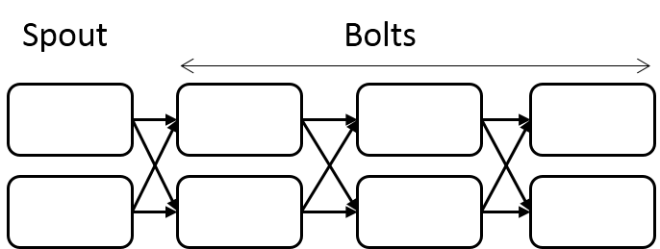
Experiment Topologies
Topology A. A long topology with 8 Stages
Topology B. A shallow topology with 2 Stages
Haswell Cluster:
Intel Xeon E5-2670 running at 2.30GHz.
24 cores (2 sockets x 12 cores each)
128GB of main memory
56Gbps Infiniband and 1Gbps dedicated Ethernet connection

Slide 26
Latency
Latency of the Topology B with 32 parallel bolt instances and varying number of spouts and message sizes. a) and b) are with 16 spouts and c) and d) are with 128k and 128bytes messages. The results are on Haswell cluster with IB.

Slide 27
Latency
Latency of the Topology A with 1 spout and 7 bolt instances arranged in a chain with varying parallelism and message sizes. a) and b) are with 2 parallelism and c) and d) are with 128k and 128bytes messages. The results are on Haswell cluster with IB.

Slide 28
Throughput
Throughput of the Topology B with 32 bolt instances and varying message sizes and spout instances. The message size varies from 16K to 512K bytes. The spouts are changed from 8 to 32. The experiments are conducted on Haswell cluster.

Slide 29
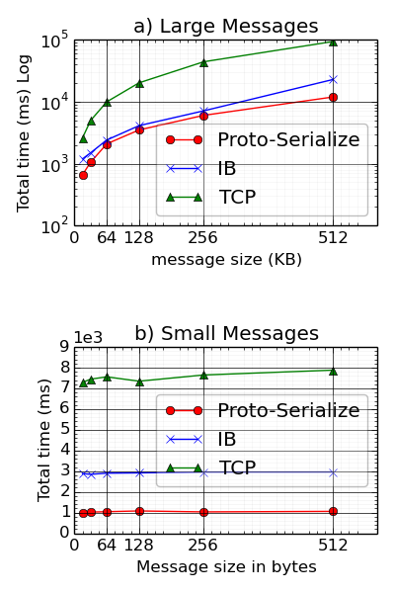
Message Serialization Overhead
Total time to finish messages
Total time to serialize messages
Topology B

Slide 30
Future Improvements
Get latency to less than quarter of a millisecond
Avoid message serialization costs
Streaming message pass through at stream managers
Can transfer message while it is receiving
Shared memory data transfer between Instances and Stream manager
Stream manager can directly use the shared memory for communication

Slide 31
Curious to Learn More?
http://dsc.soic.indiana.edu/publications/Heron_Infiniband.pdf
http://www.depts.ttu.edu/cac/conferences/ucc2017/

Slide 32
Curious to Learn More?

Slide 33
Curious to Learn More?

Slide 34
Thank You

