Slide 1


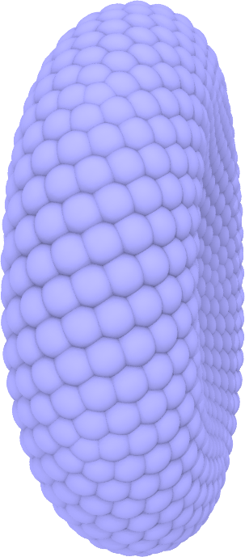
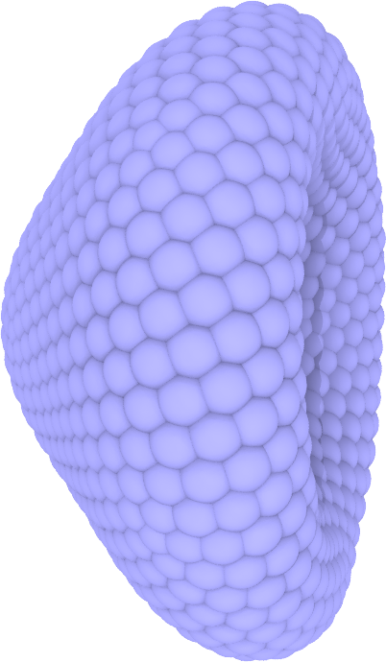
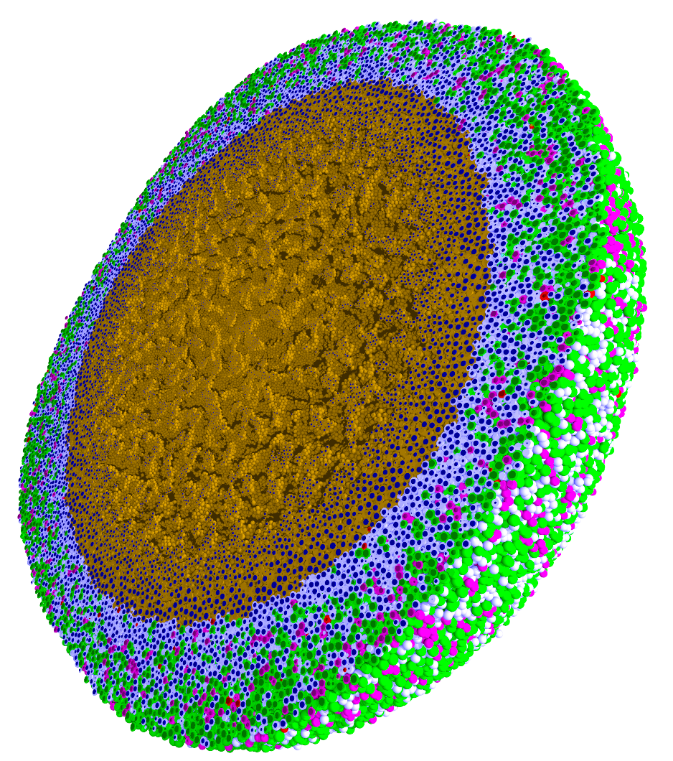
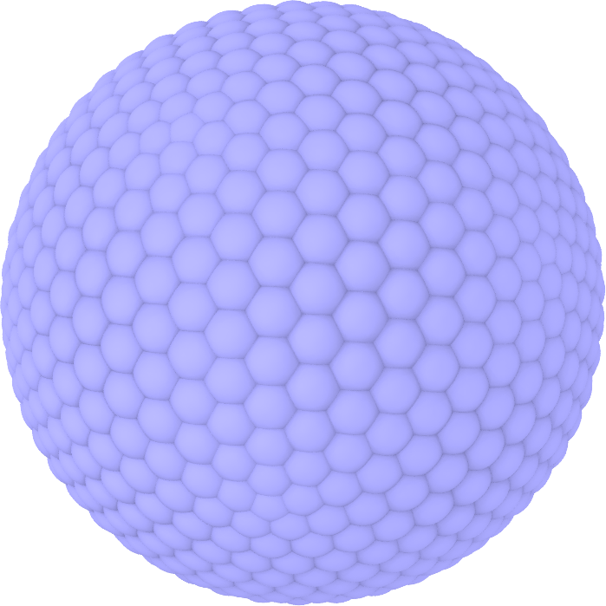
Engineered nanoBIO Node
Indiana University: Intelligent Systems Engineering, Chemistry, Science Gateways Community Institute
The Engineered nanoBIO node at Indiana University (IU) will develop a powerful set of integrated computational nanotechnology tools that facilitate the discovery of customized, efficient, and safe nanoscale devices for biological applications. Applications and Frameworks will be deployed and supported on nanoHUB.
Use in Undergraduate and masters programs in ISE for Nanoengineering and Bioengineering
  ISE (Intelligent Systems Engineering) as a new department developing courses from scratch (67 defined in first 2 years)
Research Experiences for Undergraduates throughout year
Annual engineered nanoBIO workshop
Summer Camps for Middle and High School Students
Online (nanoHUB and YouTube) courses with accessible content on nano and bioengineering
Research and Education tools build on existing simulations, analytics and frameworks: Physicell and CompuCell3D
PhysiCell
NP Shape Lab:

