Slide 1
An Overview of Grid, Cloud and related Database Technologies
Xiaoming Gao

Slide 2
Outline
Grid technologies
Cloud technologies
Database technologies related to clouds

Slide 3
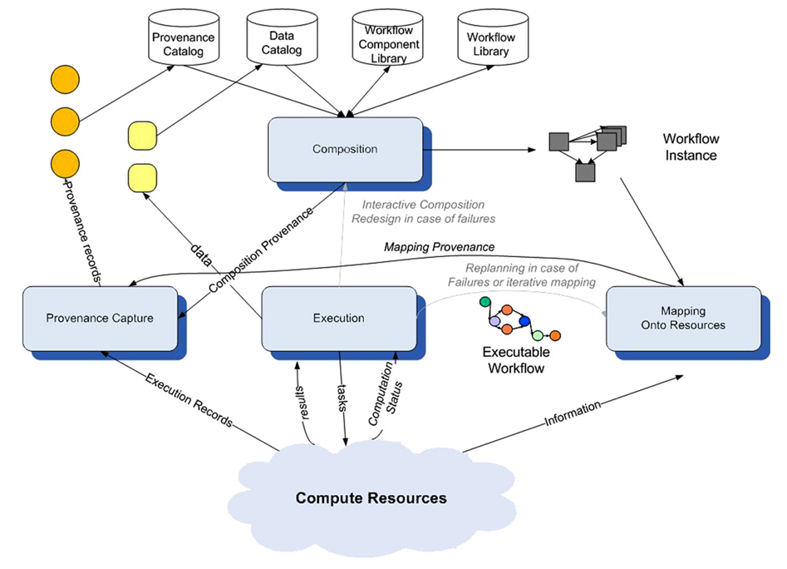
Grid technologies
Grid system structure
Distributed file systems
Resource management systems
Reference: Ewa Deelman, et. al. “Workflows and e-Science: An overview of workflow system features and capabilities”.

Slide 4
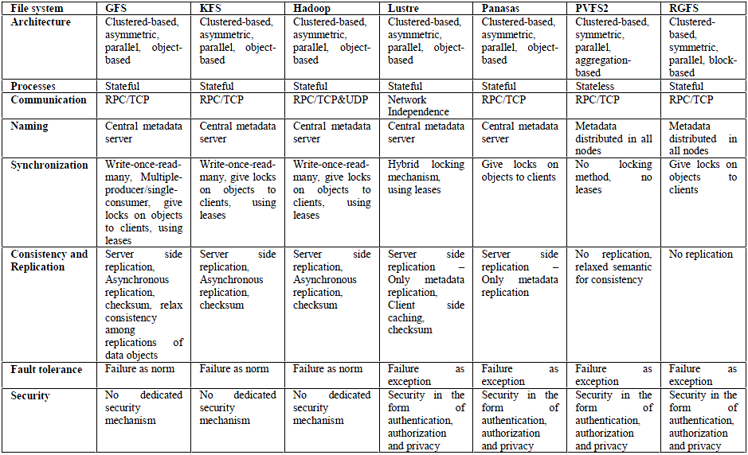
Distributed file systems
Reference: Tran Doan Thanh, et. al. “A Taxonomy and Survey on Distributed File Systems”.

Slide 5
Distributed file system - Lustre
Scale to petabytes of storage and hundreds of gigabytes of I/O throughput
Single metadata server
Failover mechanisms for metadata and object storage servers
Reference: Sun Microsystems, Inc. “Lustre File System white paper”.
Notes:
POSIX standard interface
Distributed architecture supporting parallel I/O

Slide 6
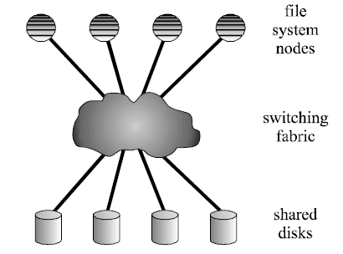
Distributed file system - GPFS
IBM General Parallel File System
Fully distributed architecture for both I/O and metadata operations
Distributed locking management using tokens for concurrent data and metadata access
Logging, failover, and replication mechanisms to handle node and disk failures
Reference: Frank Schmuck, et. al. “GPFS: A Shared-Disk File System for Large Computing Clusters”.

Slide 7
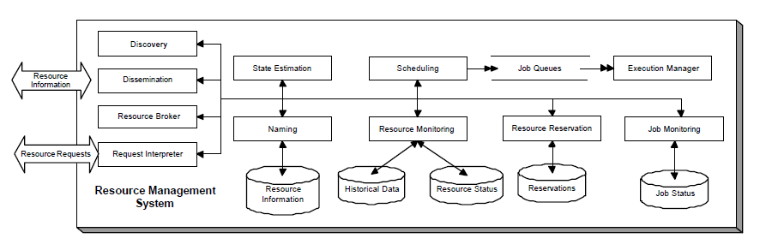
Grid resource management systems
Resource types: computing resources, network resource, storage resources, service resources
Resource management system abstract architecture:
: Application to RMS interfaces
: RMS to native operating system or hardware environment
: Internal RMS functions
Reference: Klaus Krauter, et. al. “A Taxonomy and Survey of Grid Resource Management Systems”.

Slide 8
Grid resource management systems
Design issues:
- Machine organization
- Resource model, resource information storage, discovery and dissemination, QoS
- Scheduler organization, scheduling policies
System | Grid type | Organization | Resources | Scheduling
Condor | Computational Grid | Flat | Extensible schema model, hybrid namespace, no QoS, other network directory store, centralized query based discovery, periodic push dissemination | Centralized scheduler
Globus | Grid Toolkit | Hierarchical Cells | Extensible schema model, hierarchical namespace, soft QoS, LDAP network directory store, distributed query based discovery, periodic push dissemination | Higher-level tools (like Nimrod/G) and services offer scheduling support
Reference: Klaus Krauter, et. al. “A Taxonomy and Survey of Grid Resource Management Systems”.
Notes:
Condor focuses on scheduling of jobs on clusters.
Globus focuses on integration of resources from different sites, and provides an abstract job execution interface. It relies on systems such as Nimrod/G to do the scheduling work.

Slide 9
Grid workflow systems
Definition of workflow:
“The automation of the processes, which involves the orchestration of a set of Grid services, agents and actors that must be combined together to solve a problem or to define a new service.”
Workflow derivation:
Categories in terms of complexity:
- Linear sequence of tasks
- Directed acyclic graph
- Cyclic graph: “composition in space” or “distributed static dataflow”
- Compact graph: “workflow of workflows”
- Implicit graph: workflows “expressed as a set of desired outcomes”
Dataflow model
Workflow
Distributed parallel programming
Reference: Geoffrey Fox, et. al. “Workflow in Grid Systems”.

Slide 10
Grid workflow systems
Workflow life cycle:
- Composition, representation and execution model description
- Mapping workflow to resources
- Execution
- Provenance in all stages of life cycle
An example - Triana:
- Compact graphical composition, Cyclic graph representation
- External broker based resource mapping
- Job level and service level execution, passive failure report, adaptive workflows
- Detailed provenance recording
Reference: Ewa Deelman, et. al. “Workflows and e-Science: An overview of workflow system features and capabilities”.

Slide 11
Cloud technologies
Definition of Cloud:
A large pool of easily accessible virtualized resources
Dynamically scalable to a variable load, allowing for optimum resource utilization
Provided in a pay-per-use model, with QoS specified with SLAs
Cloud Stack:
Software as a Service
Platform as a Service
Infrastructure as a Service
Reference: Luis M. Vaquero, et. al. “A Break in the Clouds: Towards a Cloud Definition”.

Slide 12
Cloud technologies
Contribution from Google:
Hadoop MapReduce,
Amazon Elastic MapReduce,
Azure MapReduce
Hadoop HBase,
Amazon SimpleDB,
Azure Table
MapReduce
BigTable
Google File System
Hadoop Distributed File System

Slide 13
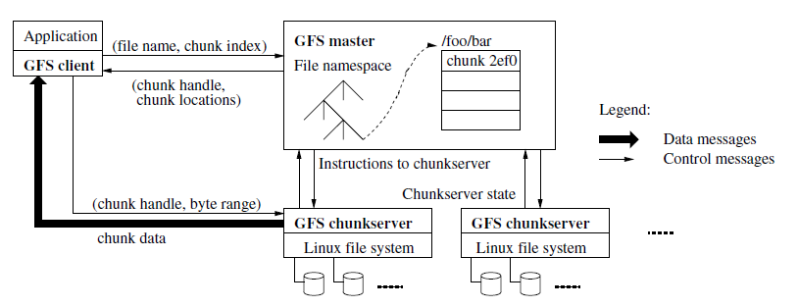
Google File System
Targets at large files and write-once-read-many access styles
Built on commodity hardware : failure as norm
Files divided into fixed-size chucks and duplicated
Logging, check-pointing and replication for fast recovery
Reference: Sanjay Ghemawat, et. al. “The Google File System”.
Notes:
API not totally compatible with POSIX standard
Relaxed data consistency model: atomic record append operation

Slide 14
Google MapReduce framework
MapReduce programming model:
map (k1, v1) -> list(k2, v2)
reduce (k2, list(v2)) -> list(v2)
Applications:
Wordcount
Inverted index
All-pair sequence alignment
K-means clustering (iterative MapReduce with Twister)
…

Slide 15
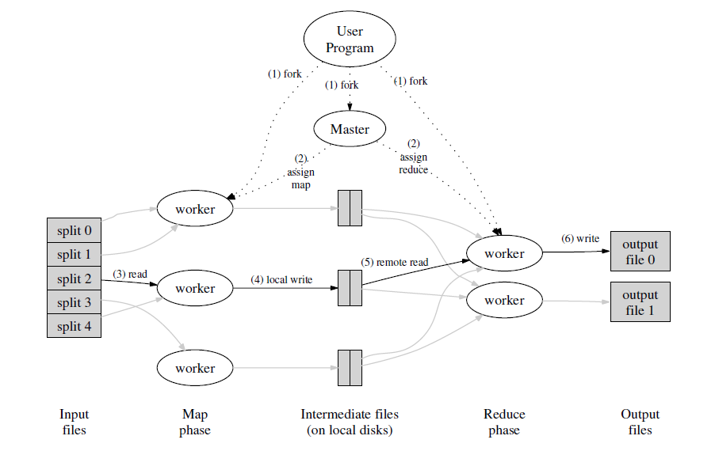
Google MapReduce framework
Task rescheduling and master checkpoints to handle failures
Backup tasks to deal with “stragglers”
Reference: Jeffrey Dean, et. al. “MapReduce: Simplified Data Processing on Large Clusters”.
Notes:
Use GFS for data storage
Built on commodity hardware

Slide 16
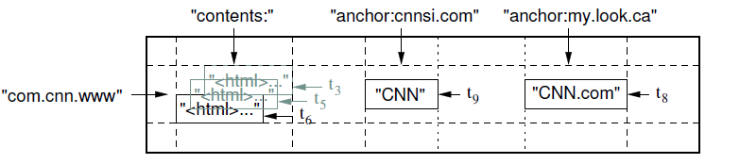
BigTable
Data Model:
A sparse, distributed, persistent multidimensional sorted map
A table can have multiple column families
A column family can have unbounded number of columns
System design:
Targeted at peta-scale structured data storage with flexible schemas
Provide row level atomic mutation
Tables are divided horizontally into tablets
One master server and multiple tablet servers
Uses Chubby for master election and partial metadata storage
Reference: Fay Chang, et. al. “Bigtable: A Distributed Storage System for Structured Data”.

Slide 17
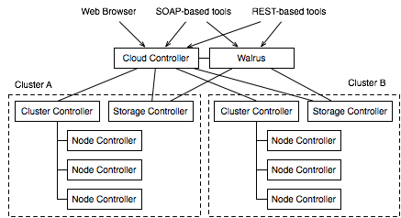
Infrastructure as a Service - Eucalyptus
Interfaces compatible with Amazon EC2, S3 and EBS
Eucalyputs S3 is used for VM image management
Provide virtual network overlay for constructing virtual clusters
Reference: Daniel Nurmi, et. al. “The Eucalyptus Open-source Cloud-computing System”.
Notes:
Provide Infrastructure as a Service in the form of virtual machines and virtual disk volumes
Deployed at the india site of FutureGrid

Slide 18
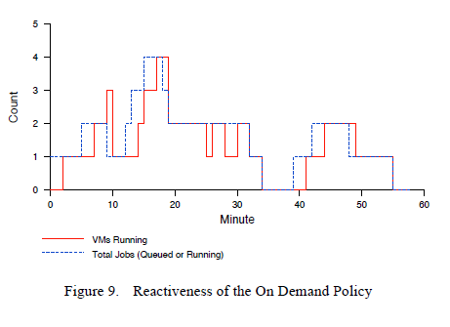
Dynamic scalability example – Elastic Site
Dynamic extension of Torque cluster with VMs from clouds
Resource provision based on Job queue status
Contextualization completed with Nimbus Context Broker
Reference: Paul Marshall, et. al. “Elastic Site: Using Clouds to Elastically Extend Site Resources”.

Slide 19
Comparison of Grids and Clouds
Aspect | Grids | Clouds
Business model | Collaborative project-oriented | Pay per use
Architecture | Application/Collective/Resource/Connectivity | SaaS/PaaS/IaaS
Resource management | Batch-scheduled compute model, distributed virtual data model, virtualized workspace and cluster, easy to monitor | Batch-scheduled as well as interactive compute model, coexistence of centralized and client data model, virtualized hardware and software, hard to monitor
Programming model | MPI, Grid RPC, workflow | MapReduce, declarative programming model, scripting, Web Service
Application model | HPC, HTC, scientific gateways, a wide range of applications | Gateways, Web 2.0, SaaS
Security | Security through credential delegations | Security through isolation
Standardization | Standardization and interoperability | Lack of standards for clouds interoperability
Reference: Luis M. Vaquero, et. al. “A Break in the Clouds: Towards a Cloud Definition”.
Reference: Ian Foster, et. al. “Cloud Computing and Grid Computing 360-Degree Compared”.

Slide 20
Database research opportunities related to Cloud
Revisiting database engines: data intensive applications such as media delivery, peta-scale OLAP systems, power awareness, etc.
Declarative programming for emerging platforms: LINQ, PigLatin, etc.
The interplay of structured and unstructured data: manage collection of structured, semi-structured and unstructured data, context management, etc.
Cloud data services: virtualized database consolidation, better manageability, etc.
Mobile applications and virtual worlds: synthesis of heterogeneous data streams from virtual worlds
Reference: Rakesh Agrawal, et. al. “The Claremont Report on Database Research”.

Slide 21
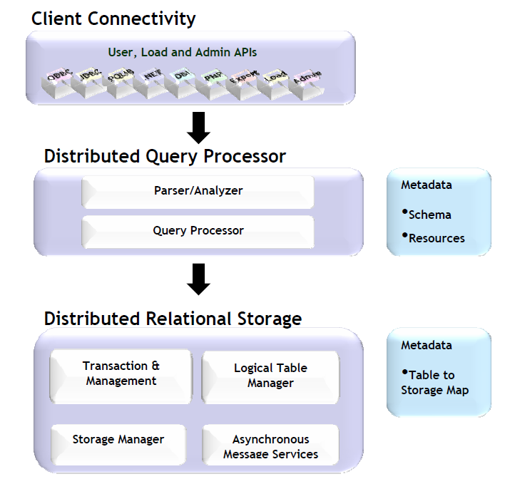
Peta-scale data warehousing at Yahoo!
Query cluster
Master cluster
Load cluster
Everest: a SQL compliant data warehousing engine for analytical applications
Built on commodity hardware: k-way mirroring for availability
Column based table storage for efficient analytical operations
Managing petabytes of data at Yahoo!
Reference: Mona Ahuja, et. al. “Peta-Scale Data Warehousing at Yahoo!”.

Slide 22
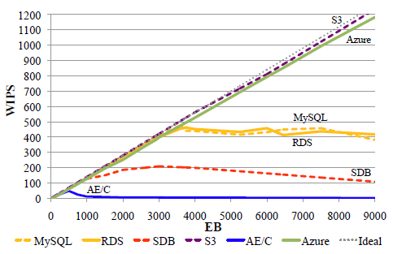
Database as a Service
Compare the performance and scalability of different Database as a Service implementations from cloud providers with TPC-W
Services tested: AWS MySQL, AWS MySQL/R, AWS RDS, AWS SimpleDB, AWS S3, Google AppEngine, Azure SQL Server
EB: Emulated browser requests
1EB: ~500 requests/hour
9000EB: ~1250 requests/second
Reference: Donald Kossmann, et. al. “An Evaluation of Alternative Architectures for Transaction Processing in the Cloud”.

Slide 23
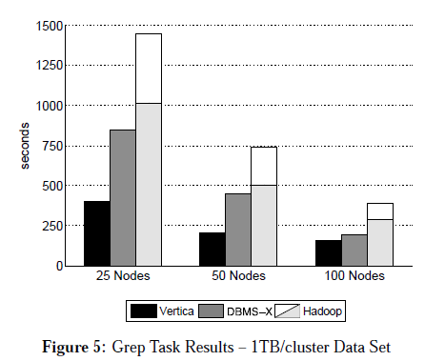
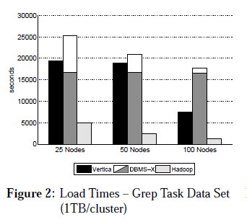
Parallel Database vs. MapReduce
Many MapReduce applications complete data manipulation or search tasks that could be done by parallel databases
Compare the performance of parallel databases and MapReduce framework for these data intensive applications
Reference: Donald Kossmann, et. al. “An Evaluation of Alternative Architectures for Transaction Processing in the Cloud”.

Slide 24
What I have done
VBS-Lustre: a distributed block storage system for cloud infrastructures
Implementation based on the Lustre file system
VBS-Lustre
Cloud environment
Snapshot s
/lost+found
/etc
/usr
…
LV1
Attachment
VM 1
VM 2
….
LV2
Attachment
….
LV: logical volume
VM: virtual machine
Snapshot: a static “copy” of a logical volume at a specific time point

Slide 25
VBS-Lustre architecture
Lustre servers
File 1
Obj 1
File 1
Obj 2
File 1
Obj n
File 2
Obj 1
……
File 2
Obj m
MDS
OSS
OSS
OSS
Vol 1
Vol 2
Volume Delegate
VBD
VBD
……
VM
VMM Delegate
VMM Delegate
VM
Volume Delegate
VMM Lustre Client
VMM Lustre Client
Non-VMM Lustre Client
Volume Metadata Database
VBSLustre
Service
: Data transmission
Client
: Invocation

Slide 26
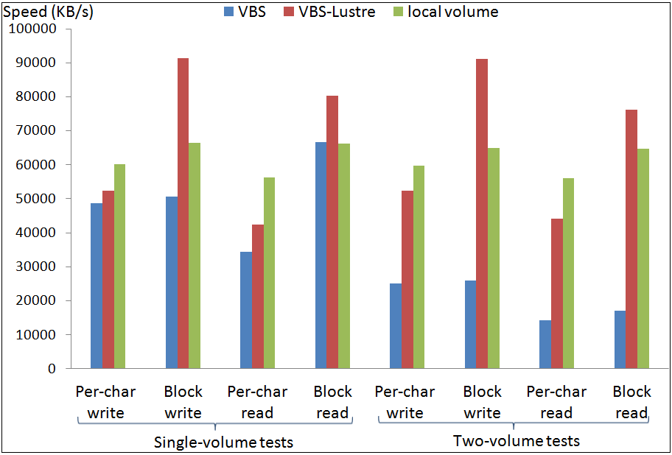
Preliminary performance test
I/O throughput tests done with Bonnie++

Slide 27
Conclusion
Cloud is a big step forward based on Grids.
Challenges in terms of security, virtualization, QoS, interoperability, etc.
Research opportunities for researchers from both distributed systems and database communities.

Slide 28
References
[1] Tran Doan Thanh, et. al. “A Taxonomy and Survey on Distributed File Systems”, 4th International Conference on Networked Computing and Advanced Information Management.
[2] Frank Schmuck, et. al. “GPFS: A Shared-Disk File System for Large Computing Clusters”, Proceedings of the FAST 2002 Conference on File and Storage Technologies.
[3] Sun Microsystems, Inc. “Lustre File System white paper”, 2008.
[4] Klaus Krauter, et. al. “A Taxonomy and Survey of Grid Resource Management Systems”, Software—Practice & Experience, Volume 32, Issue 2 (February 2002).
[5] Ewa Deelman, et. al. “Workflows and e-Science: An overview of workflow system features and capabilities”, Future Generation Computer Systems, Volume 25, No. 5 (10 May 2009).
[6] Geoffrey Fox, et. al. “Workflow in Grid Systems”, Concurrency and Computation: Practice & Experience, Volume 18, Issue 10 (August 2006).
[7] Sanjay Ghemawat, et. al. “The Google File System”, SOSP 2003.
[8] Jeffrey Dean, et. al. “MapReduce: Simplified Data Processing on Large Clusters”, OSDI 2004.
[9] Fay Chang, et. al. “Bigtable: A Distributed Storage System for Structured Data”, OSDI 2006.
[10] Luis M. Vaquero, et. al. “A Break in the Clouds: Towards a Cloud Definition”, ACM SIGCOMM Computer Communication Review, Volume 39, Number 1, January 2009.
[11] Ian Foster, et. al. “Cloud Computing and Grid Computing 360-Degree Compared”, GCE 2008.
[12] Daniel Nurmi, et. al. “The Eucalyptus Open-source Cloud-computing System”, Proceedings of Cloud Computing and Its Applications, October 2008.
[13] Paul Marshall, et. al. “Elastic Site: Using Clouds to Elastically Extend Site Resources”, CCGrid 2010.
[14] Rakesh Agrawal, et. al. “The Claremont Report on Database Research”, ACM SIGMOD Record, Volume 37, Issue 3 (September 2008).
[15] Stefan Aulbach, et. al. “A Comparison of Flexible Schemas for Software as a Service”, SIGMOD 2009.
[16] Andrew Pavlo, et. al. “A Comparison of Approaches to Large-Scale Data Analysis”, SIGMOD 2009.
[17] Mona Ahuja, et. al. “Peta-Scale Data Warehousing at Yahoo!”, SIGMOD 2009.
[18] Donald Kossmann, et. al. “An Evaluation of Alternative Architectures for Transaction Processing in the Cloud”, SIGMOD 2010.
[19] Jinbao Wang, et. al. “Indexing Multi-dimensional Data in a Cloud System”, SIGMOD 2010.
[20] Xiaoming Gao, et. al. “Building a Distributed Block Storage System for Cloud Infrastructure”, Proceedings of CloudCom 2010 Conference, IUPUI Conference Center, Indianapolis, November 30-December 3, 2010.

Slide 29

Thanks!

Slide 30
Distributed file systems
Design principles:
- Architecture: centralized vs. cluster based, symmetric vs. asymmetric, etc.
- File operation processes: stateful vs. stateless
- Communication protocols: RPC/TCP or UDP, InfiniBand, Elan, etc.
- Metadata management: central vs. distributed
- Synchronization: advisory vs. mandatory locks, segment vs. object locks, etc.
- Consistency and replication
- Fault tolerance: failure as norm vs. failure as exception
- Security: authentication, authorization, privacy

Slide 31
Grid resource management systems
Design principles:
Machine organization: flat, cells, hierarchical
Resource model: schema vs. object model, fixed vs. extensible
Resource namespace: relational, hierarchical, hybrid, graph
QoS support: none, soft, hard
Resource information organization: network directory vs. distributed objects
Resource discovery: query (centralized or distributed) based vs. agents based
Resource dissemination: batch/periodic vs. online/on-demand, push vs. pull
Scheduler organization: centralized, hierarchical, decentralized
State estimation: predictive vs. non-predictive
Scheduling policy: fixed vs. extensible, system oriented vs. application oriented
Rescheduling: periodic/batch vs. event-driven/online

Slide 32
Grid workflow systems
Workflow life cycle:
- Composition: textual, graphical, compact, semantic
- Representation: directed graphs, petri-nets, UML
- Execution control models: control flow vs. data flow
- Mapping workflow to resources: user-defined, scheduler and broker based, dynamic optimization
- Execution: execution models, fault tolerance, adaptive workflow
- Provenance: provenance in design stage, provenance for transformed workflow execution
- Interoperability
An example - Triana:
- Compact graphical composition, Cyclic graph representation, data flow execution model
- Scheduler and broker based resource mapping
- Job level and service level execution, passive failure report, adaptive workflows
- Detailed provenance recording

Slide 33
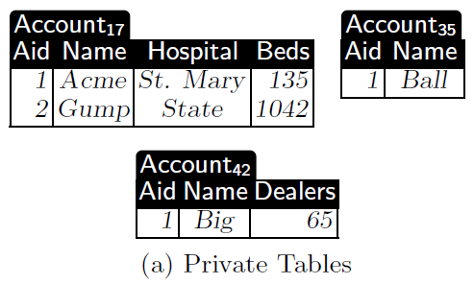
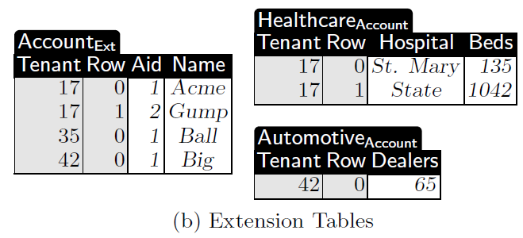
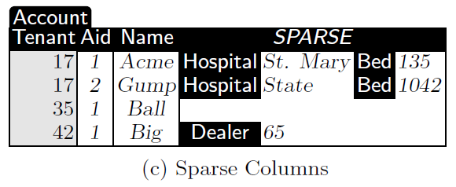
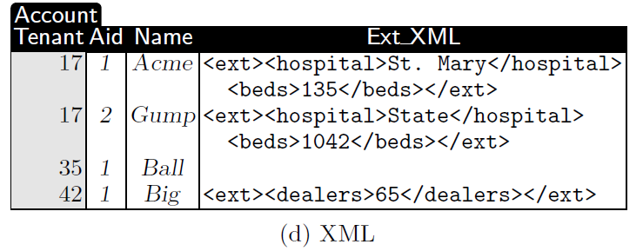
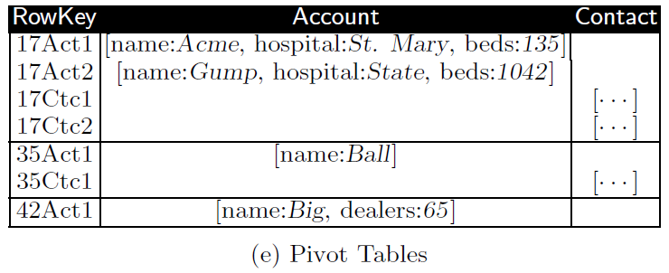
Database as a Service
Comparison of different database consolidation schemes
Database consolidation: provide virtual databases to multiple tenants with one shared physical database
(SQL Server)
(SQL Server)
(SQL Server)
(DB2)
(HBase)
Reference: Stefan Aulbach, et. al. “A Comparison of Flexible Schemas for Software as a Service”.

Slide 34
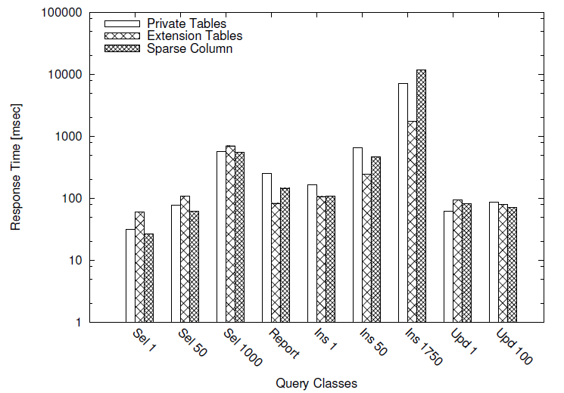
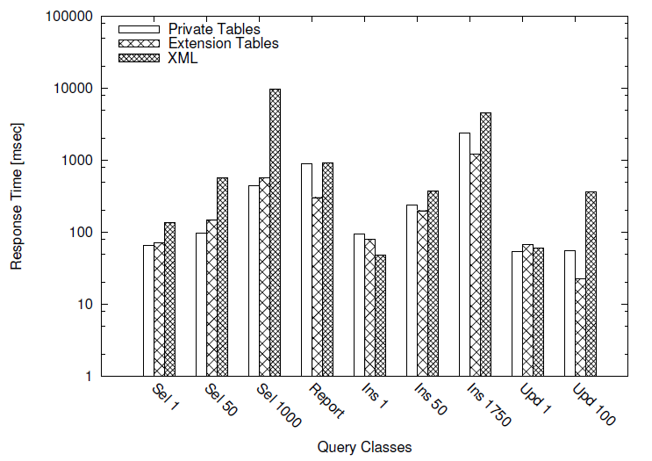
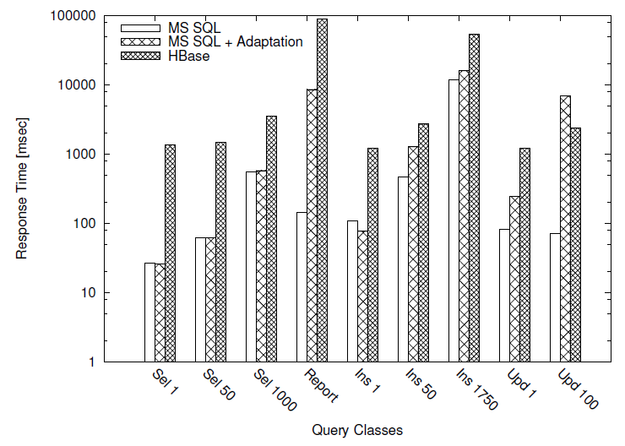
Database as a Service
Comparison of different database consolidation schemes
Reference: Stefan Aulbach, et. al. “A Comparison of Flexible Schemas for Software as a Service”.

Slide 35
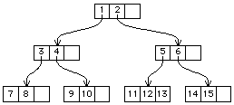
Indexing multi-dimensional data
Storage node
C² overlay network
Storage node
Storage node
Storage node
Local R-tree index
…
…
Storage node
C²: a hybrid of CAN and Chord with average hop number of log(N/4)
RT-CAN: a multi-dimensional indexing scheme for both analytical and transactional queries
Use a combination of content addressable network (CAN) and R-Tree to index multi-dimensional data
Does not consider dynamic provisioning and management of cloud resources
Reference: Mona Ahuja, et. al. “Peta-Scale Data Warehousing at Yahoo!”.

