Slide 1
Parallel Clustering of High-Dimensional Social Media Data Streams
Xiaoming Gao, Emilio Ferrara, Judy Qiu
School of Informatics and Computing
Indiana University

Slide 2
Outline
Background and motivation
Sequential social media stream clustering algorithm
Parallel algorithm
Performance evaluation
Conclusions and future work

Slide 3
Background
Important trend to combine both batch and streaming data but even streaming on its own is not well studied
Many commercial systems
Google Cloud Dataflow
Amazon Kinesis
Azure Stream Analytics
Plus open source from Twitter Apache Storm
New class of streaming algorithms needing both streaming and parallel synchronization
This paper discusses parallel streaming algorithm (each point looked at once) and parallel streaming runtime (starting with Apache Storm)

Slide 4
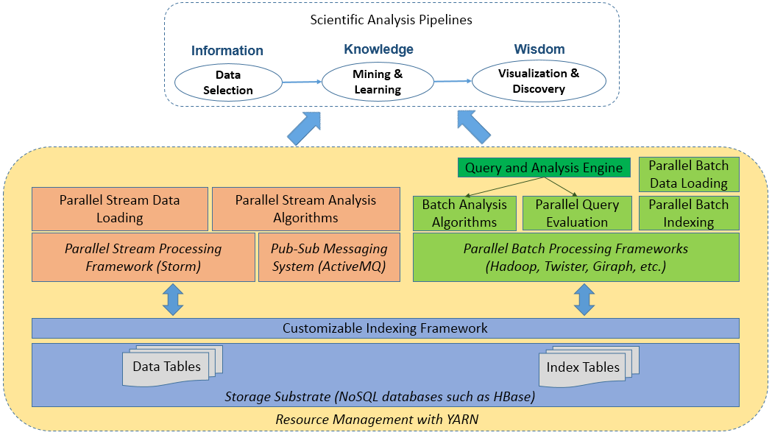
Background – Cloud DIKW
STREAM
BATCH
Streaming analysis module
Batch analysis module
Storage substrate
Supporting non-trivial streaming algorithms requiring global synchronization

Slide 5
DESPIC analysis pipeline for meme clustering and classification
IU DESPIC: Detecting Early Signatures of Persuasion in Information Cascades
Implement DIKW with Hbase + Hadoop (Batch) and Hbase + Storm + ActiveMQ (Streaming)

Slide 6
Social media data stream clustering
{
"text":"RT @sengineland: My Single Best... ",
"created_at":"Fri Apr 15 23:37:26 +0000 2011",
"retweet_count":0,
"id_str":"59037647649259521",
"entities":{
"user_mentions":[{
"screen_name":"sengineland",
"id_str":"1059801",
"name":"Search Engine Land"
}],
"hashtags":[],
"urls":[{
"url":"http:\/\/selnd.com\/e2QPS1",
"expanded_url":null
}]},
"user":{
"created_at":"Sat Jan 22 18:39:46 +0000 2011",
"friends_count":63,
"id_str":"241622902",
...},
"retweeted_status":{
"text":"My Single Best... ",
"created_at":"Fri Apr 15 21:40:10 +0000 2011",
"id_str":"59008136320786432",
...},
...
}
Group social messages sharing similar social meaning
Text
Hashtags
URL’s
Retweet
Users
Useful in meme detection, event detection, social bots detection, etc.

Slide 7
Social media data stream clustering
Recent progress in devising data representations and similarity metrics
Highest-quality clusters: must leverage both textual and network information and be represented by high dimensional vectors (bags)
Expensive similarity computation: 43.4 hours to cluster 1 hour’s data with sequential algorithm
Goal: meet real-time constraint through parallelization
Challenge: efficient global synchronization in DAG oriented parallel processing frameworks as given by Apache Storm map streaming environment

Slide 8
Map Streaming Computing Model
Apache Storm implements a dataflow computing model with spouts (data sources) and log running bolts (maps or computing)
See examples below (map == computing)
High Throughput Samza, S4 Urika, Galois
Computing Hadoop Spark, Harp MPI, Giraph Storm Ligra, GraphChi

Slide 9
Apache Storm Dataflow Topology
Storm project was originally developed at Twitter for processing Tweets from users and was donated to Apache in 2013.
Zookeeper for coordination and Kafka for Pub-Sub
Note parallel computing not well supported
Aurora, Borealis pioneering research projects
S4 (Yahoo), Samza (LinkedIn), Spark Streaming are also Apache Streaming systems
Google MillWheel, Amazon Kinesis, Azure Stream Analytics are commercial systems
A user defined arrangement of Spouts and Bolts
Bolt
Spout
Bolt
Bolt
Sequence of Tuples
Bolt
Spout
Bolt
The tuples are sent using messaging,
Storm uses Kryo to serialize the tuples
and Netty to transfer the messages
The topology defines how the bolts
receive their messages using Stream Grouping

Slide 10
Sequential algorithm for clustering tweet stream I
Online (streaming) K-Means clustering algorithm with sliding time window and outlier detection
Group tweets in a time window as protomemes:
Label protomemes (points in space to be clustered) by “markers”, which are Hashtags, User mentions, URLs, and phrases.
A phrase is defined as the textual content of a tweet that remains after removing the hashtags, mentions, URLs, and after stopping and stemming
In example, Number of tweets in a protomeme : Min: 1, Max :206, Average 1.33
Note a given tweet can be in more than one protomeme
In example, one tweet on average appears in 2.37 protomemes
And Number of protomemes is 1.8 times number of tweets

Slide 11
Defining Protomemes
Define protomemes as 4 high dimensional vectors or bags V_{T} V_{U} V_{C} V_{D}
A binary TID vector containing the IDs of all the tweets in this protomeme:
V_{T} = [tid1 : 1, tid2 : 1, …, tidT : 1];
A binary UID vector containing the IDs of all the users who authored the tweets in this protomeme
V_{U} = [uid1 : 1, uid2 : 1, …, uidU : 1];
A content vector containing the combined textual word frequencies (bag of words) for all the tweets in this protomeme
V_{C} = [w1 : f1, w2 : f2, …, wC : fC];
A binary vector containing the IDs of all the users in the diffusion network of this protomeme. The diffusion network of a protomeme is defined as the union of the set of tweet authors, the set of users mentioned by the tweets, and the set of users who have retweeted the tweets.
The diffusion vector is V_{D} = [uid1 : 1, uid2 : 1, …, uidD : 1].

Slide 12
Relations among protomemes, tweets, users, and tweet content. There is a many-to-many relationship between memes and tweets. A user may be connected to a tweet as its author, by being mentioned in the tweet, or from retweeting the message.
Users
Protomemes
Tweets
Content
Clustering memes in social media streams. Social Network Analysis and Mining 4(237):1-13, 2014

Slide 13
Sequential algorithm for clustering tweet stream II
Protomemes each defined by 4 bags or 4 sparse high dimension vectors in, tweet ID V_{T} user ID V_{U} Content V_{C} User diffusion ID V_{D}
Cluster protomemes using similarity (distance) measurement
Cluster centers from averaging protomeme vectors
Use Cosine Similarities
- Common user similarity:
- Common tweet ID similarity:
- Content similarity:
- Diffusion similarity:
- Combinations:
(Posting + mentioned + retweeting)
Optimal Combination
Use this

Slide 14
Online K-Means clustering
Slide time window by one time step
Delete old protomemes out of time window from their clusters
Generate protomemes for tweets in this step
For each new protomeme classify in old or new cluster (outlier)
#p2
#p2
If marker in common with a cluster member, assign to that cluster
Otherwise it is an outlier and a candidate new cluster
If near a cluster, assign to nearest cluster

Slide 15
Sequential clustering algorithm
Final step statistics for a sequential run over 6 minutes data:
Time Step Length (s) | Total Length of Centroids’ Content Vector | Similarity Compute time (s) | Centroids Update Time (s)
10 | 47749 | 33.305 | 0.068
20 | 76146 | 78.778 | 0.113
30 | 128521 | 209.013 | 0.213
Quite Long!
Dominates!
Notes:
120 clusters, time window length: 6 steps, outlier: 2 standard deviation

Slide 16
Parallelization with Storm - challenges
DAG organization of parallel workers: hard to synchronize cluster information
Worker Process
ActiveMQ
Broker
Clustering Bolt
…
Clustering Bolt
Synchronization Coordinator Bolt
Protomeme Generator Spout
…
tweet stream
Worker Process
Clustering Bolt
…
Clustering Bolt
Calculate Cluster Centers
Parallelize Similarity Calculation
Synchronization initiation methods:
Spout initiation by broadcasting INIT message
Clustering bolt initiation by local counting
Sync coordinator initiation by global counting (of #protomemes)
Suffer from variation of processing speed

Slide 17
Parallelization with Storm - challenges
Large size of high-dimensional vectors make traditional synchronization expensive
Data point 1:
Data point 2:
Content_Vector: [“step”:1, “time”:1, “nation”: 1,
“ram”:1]
Diffusion_Vector: …
…
Content_Vector: [“lovin”:1, “support”:1, “vcu”:1,
“ram”:1]
Diffusion_Vector: …
…
Centroid:
Content_Vector: [“step”:0.5, “time”:0.5, “nation”: 0.5, “ram”:1.0, “lovin”:0.5,
“support”:0.5, “vcu”:0.5]
Diffusion_Vector: …
…
Cluster
Cluster-delta synchronization strategy: transmit changes and not full vector

Slide 18
Messy Coordination Details I
During the run, protomemes are processed in small batches. A batch is defined as the number of protomemes to process together, which is normally configured to be much smaller than the total number of protomemes in a single time step. For each protomeme, the clustering bolt decides whether it is an outlier or if it should be assigned to a cluster.
Batch defines the time fuzziness in generating clusters
Time step defines protomeme calculation window
Time window defines interval over which clusters are generated
In evaluation runs
N_{clust}= 240 Clusters (reconciled every batch)
Time Window 600 seconds
Time Step 30 Seconds
Batch size ~10 seconds (6144 protomemes)
At reconciliation, ONLY keep N_{clust} clusters with latest time stamp and delete older clusters
Outliers viewed as candidate clusters

Slide 19
Totals at each Time step
max tids in final clusters: 3812, min: 1, avg: 68.1, total: 16337;
max tids in deleted clusters: 43, min: 1, avg: 1.19
max tids in final clusters: 7362, min: 1, avg: 125, total: 30086;
max tids in deleted clusters: 106, min: 1, avg: 2.06
max tids in final clusters: 11029, min: 1, avg: 182, total: 43700;
max tids in deleted clusters: 213, min: 1, avg: 2.25
max tids in final clusters: 14654, min: 1, avg: 233, total: 55940;
max tids in deleted clusters: 198, min: 1, avg: 2.45
...
max tids in final clusters: 61860, min: 1, avg: 824, total: 197841;
max tids in deleted clusters: 292, min: 1, avg: 2.36 FINAL (20th) Time Step
20% of tweets in final clusters come from “outlier started” clusters
tid = #tweets while total is total number of tweets summed over N_{clust} clusters

Slide 20
Solution – enhanced Storm topology
Coordination Messages
Worker Process
ActiveMQ
Broker
Clustering Bolt
…
SYNCINIT
CDELTAS
Clustering Bolt
PMADD
OUTLIER
SYNCREQ
Synchronization Coordinator Bolt
Protomeme Generator Spout
…
tweet stream
Worker Process
Clustering Bolt
…
Clustering Bolt
Get Clustering Started
Bootstrap Information
Sequential or Parallel Batch Clustering Algorithm

Slide 21
Messy Coordination Details II
These are types of messages sent between clustering bolt and sync coordinator.
PMADD tells sync coordinator that the protomeme can be added to a cluster;
OUTLIER tells sync coordinator that the protomeme is detected as an outlier;
The sync coordinator collects these messages and maintain a global view of the clusters. Meanwhile it also counts the total number of protomemes processed. When the batch size is reached, it broadcast SYNCINIT to all clustering bolts to tell them temporarily stop protomeme processing and do synchronization.
After receiving SYNCINIT, clustering bolt sends SYNCREQ to tell sync coordinator that it’s ready to receive synchronization data.
Finally after receiving all SYNCREQ from clustering bolts, sync coordinator constructs CDELTAS message, which contains the deltas of all cluster centers, and broadcasts it to the clustering bolts.
Only one copy of the CDELTAS message is sent to each host to save sync time. Clustering bolts on the same host will share the message.
Notes:
Basically to do synchronization, the clustering bolts will need to temporarily stop processing protomemes and wait for updating their copy of the global clusters. These are 3 different ways for clustering bolt to know "OK, it's time for me to stop processing and start synchronization".
(1) Spout initiation by broadcasting INIT message: the protomeme generator spout will count the number of protomemes sent to the clustering bolt, and when it reaches the batch size, it will send a SYNCINIT message through storm to all clustering bolts to tell them start synchronization.
(2) Clustering bolt initiation by local counting: each clustering bolt will count the number of protomemes processed, and when it reaches (batch size) / (number of clustering bolts), it will start synchronization (by sending SYNREQ to sync coordinator). This is similar to batch processing and no SYNCINIT is broadcasted.
(3) Sync coordinator initiation by global counting: sync coordinator counts the number of PMADD and OUTLIER messages received, which tells how many protomemes have been processed by all clustering bolts; when it reaches the batch size, sync coordinator will send a SYNCINIT through ActiveMQ to clustering bolts to tell them to start synchronization.
(1) and (2) suffer from variation of processing speed of clustering bolts. Because in (1), every clustering bolt has its buffer of incoming storm messages, and when SYNCINIT is broadcasted, it will be put at the end of the buffer. So before the clustering bolt finished processing data in the buffer, it won't see the SYNCINIT message. As a result different clustering bolts see the SYNCINIT notification at different time. In (2), different clustering bolts may take different amount time to process (batch size) / (number of clustering bolts) messages.
(3) directly counts the total number of protomemes that have already been processed, and ActiveMQ provides an "out of band" transmission channel for the small SYNCINIT message. So the clustering bolts receive the SYNCINIT notification at about the same time.

Slide 22
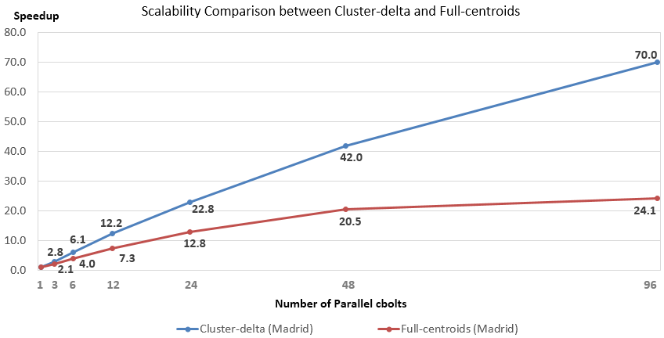
Scalability comparison
24.1 is reduced from 70.0 as communicate full cluster vectors rather than changes
1 hour’s data for testing, first 10 mins for bootstrap
33 mins to process 50 mins’ data. Time step: 30s, batch size: 6144.

Slide 23
Scalability comparison
Messages are compressed by ActiveMQ and transmitted size is about 6 times smaller
Full-centroids synchronization
Number of clustering bolts | Total processing time (sec) | Compute time / sync time | Sync time per batch (sec) | Avg. size of sync message bytes
3 | 67603 | 30.3 | 6.71 | 22,113,520
6 | 35207 | 15.1 | 6.71 | 21,595,499
12 | 19295 | 7.0 | 7.32 | 22,066,473
24 | 11341 | 3.2 | 8.24 | 22,319,413
48 | 7395 | 1.5 | 9.15 | 21,489,950
96 | 6965 | 0.7 | 12.93 | 21,536,799
Cluster-delta synchronization
Number of clustering bolts | Total processing time (sec) | Compute time / sync time | Sync time per batch (sec) | Avg. size of sync message bytes
3 | 50381 | 252.6 | 0.62 | 2,525,896
6 | 22949 | 96.4 | 0.73 | 2,529,779
12 | 11560 | 42.2 | 0.81 | 2,532,349
24 | 6221 | 21.7 | 0.81 | 2,544,095
48 | 3490 | 8.4 | 1.08 | 2,559,221
96 | 2494 | 2.5 | 2.17 | 2,590,857

Slide 24
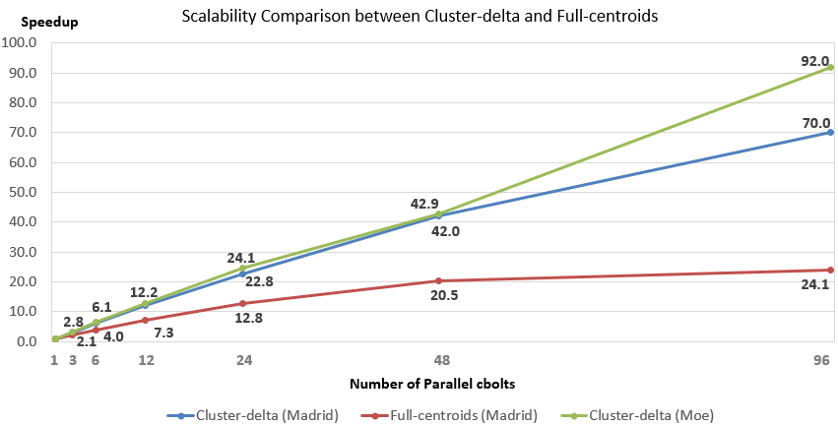
Scalability comparison
92 larger than 70 as “grain size” (protomemes per bolt) larger by factor of two
Madrid: non-peak time, 33 mins to process 50 mins’ data
Moe: peak-time, larger (~double) batch size, 39mins for 50 mins’ data
Notes:
Reason for the relatively low 70.0: lack of computation; each cbolt only processes about 64 protomemes per batch.
For longer time steps or faster data rate, near-linearscalability can be extended by increasing the batch size.
Results on Moe: peak-time data for 1-2 PM on 2014-08-29, batch size doubled.

Slide 25
Comparison with related work
Projected/subspace clustering, density-based approaches
Hard to apply to multiple high-dimensional vectors
Aggarwal, C. C., Han, J., Wang, J., Yu, P. S. A framework for projected clustering of high dimensional data streams. In Proceedings of the 30th International Conference on Very Large Data Bases (VLDB 2004).
Amini, A., Wah, T. Y. DENGRIS-Stream: a density-grid based clustering algorithm for evolving data streams over sliding window. In Proceedings of the 2012 International Conference on Data Mining and Computer Engineering (ICDMCE 2012).
Parallel sequential leader clustering over tweet streams
Only uses text information and no global synchronization
Wu, G., Boydell, O., Cunningham, P. High-throughput, Web-scale data stream clustering. In Proceedings of the 4th Web Search Click Data workshop (WSCD 2014).

Slide 26
Conclusions
Parallel Online clustering succeeds with modification of commodity stream processing with Apache Storm
For dynamic synchronization in online parallel clustering, additional coordination over dataflow needed
Synchronization strategies depend on data representation and similarity metrics,
Need delta (change)-based communication methods for high-dimensional data

Slide 27
Future work
Integrate Harp communication to allow parallel processing in map- streaming computation
Scale up to support processing at the speed of full Twitter stream
Experimenting with sketch table based methods that can be competitive for very large datasets
These hash bag keys to a smaller domain to decrease size of vectors
Aggarwal, C. C. A framework for clustering massive-domain data streams. In Proceedings of the 25th IEEE International Conference on Data Engineering (ICDE 2009).

Slide 28
Acknowledgements
NSF grant OCI-1149432 and DARPA grant W911NF-12-1-0037
Thank Mohsen JafariAsbagh, Onur Varol for help in the sequential algorithm
Thank Professors Alessandro Flammini, Geoffrey Fox (narrator) and Filippo Menczer for their support and advice

