Slide 1
SCALABLE AND ROBUST DATA CLUSTERING AND VISUALIZATION
Yang Ruan
PhD Candidate
Computer Science Department
Indiana University

Slide 2
Outline
Overview
Research Issues
Experimental Analysis
Conclusion and Futurework

Slide 3
Data Clustering and Visualization
  Deterministic Annealing Clustering and Interpolative Dimension Reduction Method (DACIDR)
  Dimension Reduction (Multidimensional Scaling)
  Clustering (Pairwise Clustering)
  Interpolative (Streaming)
Parallelized by Iterative MapReduce framework
Simplified Flow Chart of DACIDR
Pairwise Clustering
Visualization
Visualization
All-Pair Sequence Alignment
All-Pair Sequence Alignment
Interpolation
Interpolation
Multidimensional Scaling
Phylogenetic Analysis
Multidimensional Scaling
Phylogenetic Analysis
Yang Ruan, Saliya Ekanayake, et al. DACIDR: Deterministic Annealed Clustering with Interpolative Dimension Reduction using a Large Collection of 16S rRNA Sequences. Proceedings of ACM-BCB 2012, Orlando, Florida, ACM, Oct. 7-Oct. 10, 2012.

Slide 4
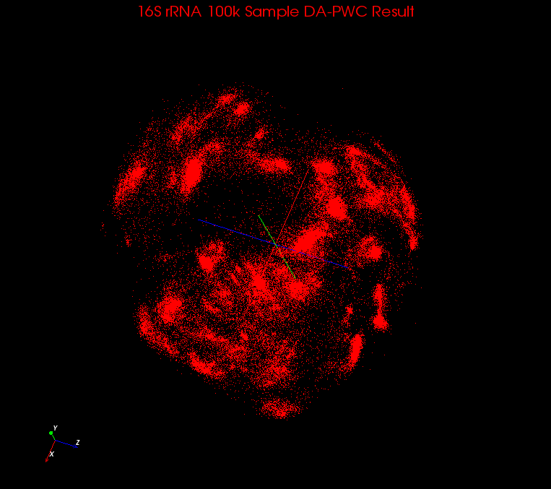
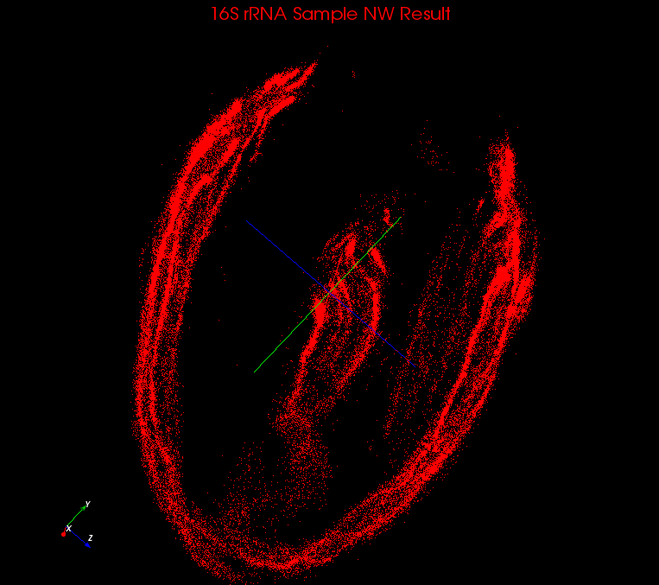
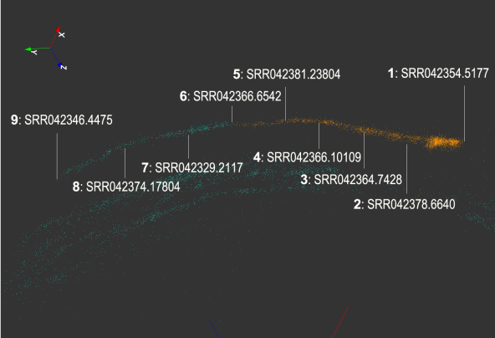
All Pair Sequence Alignment
Multiple Sequence Alignment (MSA)
Pairwise Sequence Alignment (PWA)
  Local Alignment: Smith Waterman Gotoh (SWG)
  Global Alignment: Needleman Wunsch (NW)
Global alignment suffers problem from various sequence lengths
Visualization result using SWG
Visualization result using NW
One “Cigar” selected from
NW visualization result

Slide 5
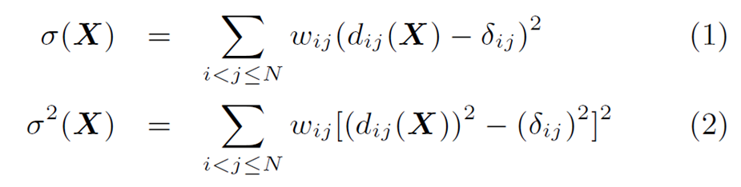
Multidimensional Scaling
Given proximity data in high dimension space.
Non-linear optimizing problem to find mapping in target dimension space by minimizing an object function.
Object function is often given as STRESS or SSTRESS:
  where X is the mapping in the target dimension, d_{ij}(X) is the dissimilarity between point and point in original dimension space, w_{ij} denotes the possible weight from each pair of points that , denotes the Euclidean distance between point and in target dimension.

Slide 6
Interpolation
Out-of-sample / Streaming / Interpolation problem
  Original MDS algorithm needs O(N²) memory.
  Given an in-sample data result, interpolate out-of-sample into the in-sample target dimension space.
Reduce space complexity and time complexity of MDS
  Select part of data as in-sample dataset, apply MDS on that
  Remaining data are out-of-sample dataset, and interpolated into the target dimension space using the result from in-sample space.
  Computation complexity is reduced to linear.
  Space complexity is reduced to constant.

Slide 7
Possible Issues
Local sequence alignment (SWG) could generate very low quality distances.
  E.g. For two sequences with original length 500, it could generate an alignment with length 10 and gives a pid of 1 (distance 0) even if these two sequences shouldn’t be near each other.
Sequence alignment is time consuming.
  E.g. To interpolate 100k out-of-sample sequences (average length of 500) into 10k in-sample sequences took around 100 seconds to finish on 400 cores, but to align them took around 6000 seconds to finish on same number of cores.
Phylogenetic Analysis separates from clustering
  Current phylogenetic tree displaying methods does NOT allow the display of tree seamlessly with clusters.

Slide 8
Contribution
MDS algorithm generalization with weight (WDA-SMACOF)
  Reduced time complexity to quadratic
  Solves problems with fixed part of points
Time Cost Reduction of Interpolation with Weighting
  W-MI-MDS that generalize interpolations with weighting
  Hierarchical MI-MDS that reduces the time cost
Enable seamless observation of Phylogenetic tree and clustering together.
  Cuboid Cladogram
  Spherical Phylogram

Slide 9
Outline
Motivation
Research Issues
  DA-SMACOF with Weighting
  Hierarchical Interpolation with Weighting
  3D Phylogenetic Tree Display with Clustering
Experimental Analysis
Conclusion and Futurework

Slide 10
WDA-SMACOF (background)
Scaling by Majorizing a Complicated Function (SMACOF)
  An EM-like algorithm that decreases STRESS iteratively
  Could be trapped in local optima
DA-SMACOF
  Use Deterministic Annealing to avoid local optima
  Introduce a computational temperature T.
  By lowering the temperature during the annealing process, the problem space gradually reveals to the original object function.
  Assume all weights equal 1.
Conjugate Gradient
  An iterative algorithm that solves linear equations.
  CG is used to solve Ax=b where x and b are both vectors of length N and A is an N * N symmetric positive definite (SPD) matrix.

Slide 11
WDA-SMACOF
  When distance is not reliable or missing, set the weight correspond to that distance to 0.
Similar to DA-SMACOF, the updated STRESS function is derived as
When T is smaller, is larger, so the original problem space is gradually revealed.
(3)
(4)
Yang Ruan, Geoffrey Fox. A Robust and Scalable Solution for Interpolative Multidimensional Scaling with Weighting. Proceedings of IEEE eScience 2013, Beijing, China, Oct. 22-Oct. 25, 2013.

Slide 12
WDA-SMACOF (2)
By deriving a majorizing function out of the STRESS function, the final formula is:
(5)
(6)
(7)
(8)
Notes:
CG makes last N a number that could be changed to a very small value.

Slide 13

WDA-SMACOF (3)
Pseudo-Inverse of V is given as (V+11’)⁻¹ – n⁻²11’
  Matrix Inversion has a time complexity of O(N³)
    Cholesky Decomposition, Singular Vector Decomposition…
    Traditional SMACOF matrix inversion is trivial for small dataset
Use Conjugate Gradient (CG) to solve VX=B(Z)Z
  X and B(Z)Z are both N * L matrix and V is N * N matrix.
Notes:
Equal weights, matrix inversion is trivial, with non equal weights, Analytic function

Slide 14
WDA-SMACOF (4)
Conjugate Gradient
  Denote r_{i} as the residual and d_{i} as the direction in ith iteration
  X can be updated using
  Only a number of iterations
  << N will are needed for
  approximation
  where
(9)
(10)
(11)
(12)
(13)

Slide 15
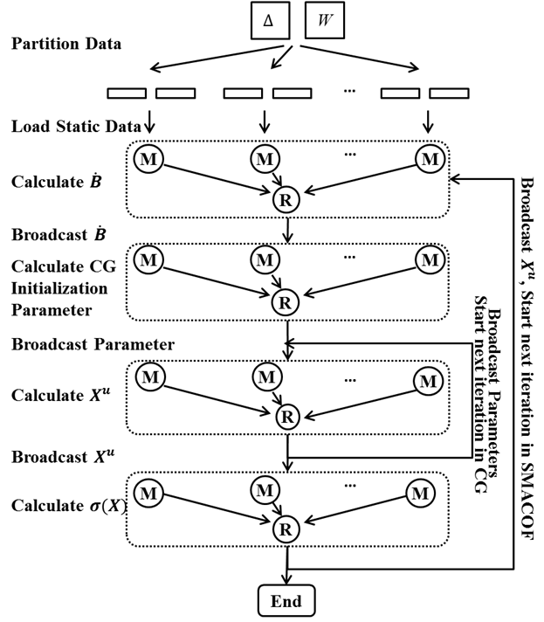
WDA-SMACOF (5)
Parallelization
  Parallelized using Twister, an iterative MapReduce runtime
  One outer loop is for one SMACOF iteration
  One inner loop is for one CG iteration
  Time complexity O(N * N * l₁ * l₂)

Slide 16
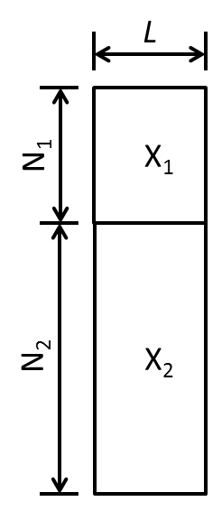
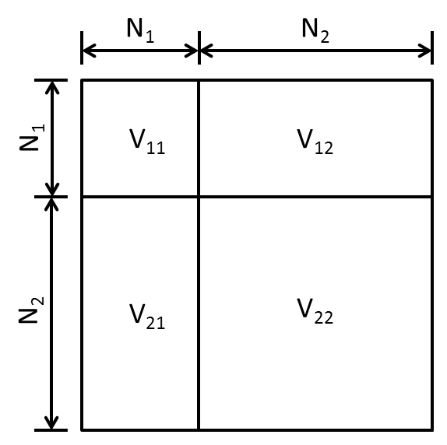
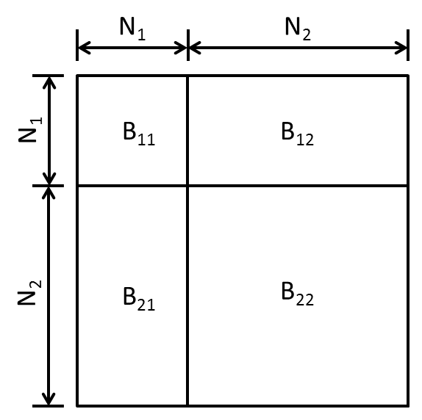
WDA-SMACOF (6)
Part of data (X₁) needs to be fixed.
Decompose the matrices and only varies X₂
Notes:
Many scientific applications, the problem is done in stages, fix result in one stage, and varies data in following stages.

Slide 17
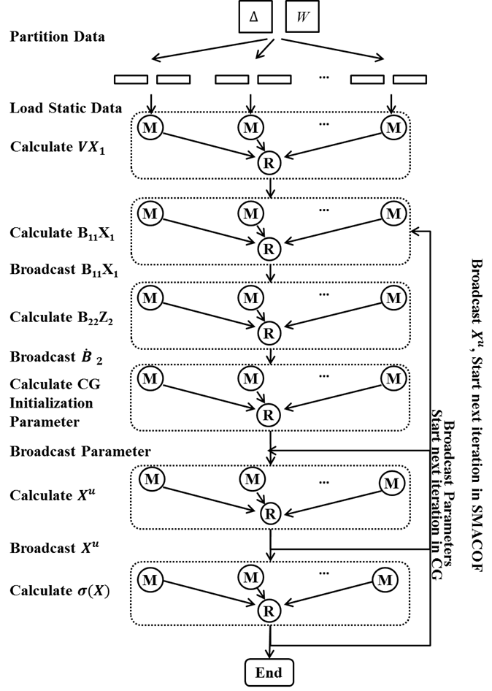
WDA-SMACOF (7)
Final Formula
Parallelization
  V₂₁X₁ is calculated and kept static
  B₁₁X₁ is calculated and broadcast in every SMACOF Iteration

Slide 18
Outline
Motivation
Research Issues
  DA-SMACOF with Weighting
  Hierarchical Interpolation with Weighting
  3D Phylogenetic Tree Display with Clustering
Experimental Analysis
Conclusion and Futurework

Slide 19
Interpolation (Background)
Majorizing Interpolation MDS (MI-MDS)
  Based on pre-mapped MDS result of n sample data.
  Find a new mapping of the new point based on the position of k nearest neighbors (k-NN) among n sample data.
  Iterative majorization method is used.
  Needed O(MN) distance computation.
  Assume all weights equal one.

Slide 20
Interpolation
MI-MDS with weighting
(W-MI-MDS)
  Adding weight to object function, where each weight correspond to a distance from an out-of-sample point to an in-sample point.
  Update STRESS function:
  Adding a computational temperature T as same as in DA-SMACOF
  Final formula is updated as
(14)
(15)
Yang Ruan, Geoffrey Fox. A Robust and Scalable Solution for Interpolative Multidimensional Scaling with Weighting. Proceedings of IEEE eScience 2013, Beijing, China, Oct. 22-Oct. 25, 2013.

Slide 21
Interpolation (2)
Hierarchical Interpolation
  Sample Sequence Partition Tree
    SSP-Tree is an octree to partition the in-sample sequence space in 3D.
An example for SSP-Tree in 2D with 8 points
i₀
i₁
e₄
e₅
i₂
E
F
e₀
e₁
e₂
e₃
e₆
e₇
A
B
C
D
G
H
a
Yang Ruan, Saliya Ekanayake, et al. DACIDR: Deterministic Annealed Clustering with Interpolative Dimension Reduction using a Large Collection of 16S rRNA Sequences. Proceedings of ACM-BCB 2012, Orlando, Florida, ACM, Oct. 7-Oct. 10, 2012.

Slide 22
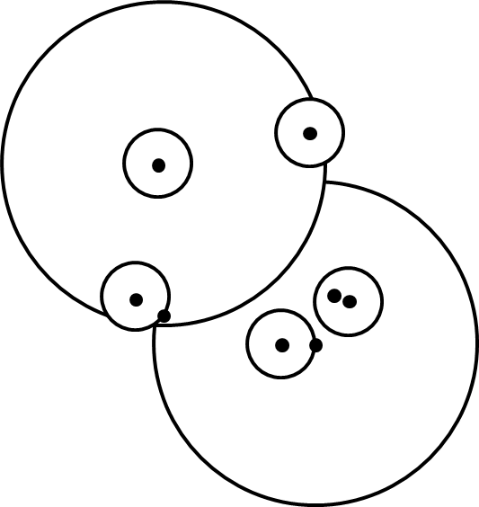
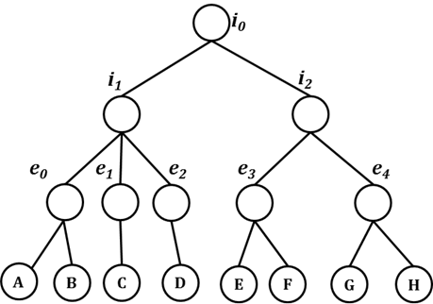
Interpolation (3)
Closest Neighbor Tree
  CN-Tree is a hyper space tree that partition the in-sample sequences by their original distances.
Notes:
They give similar answers for both of them.

Slide 23
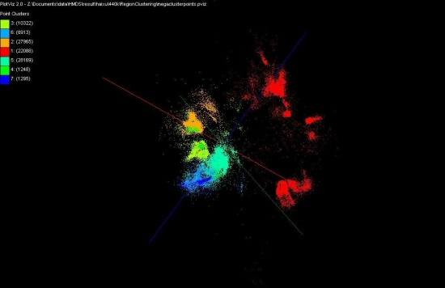
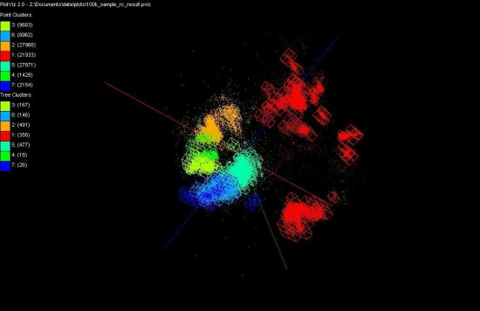
Interpolation (3)
HI-MI compare with each center point of each tree node, and searches k-NN points from top to bottom.
  Error between original distance and target dimension distance
HE-MI use more sophisticated heuristic
  Use a heuristic function to determine the quality of a tree node.
  May increase search levels in tree to reduce time cost.
Computation complexity
  MI-MDS: O(NM)
  HI-MI: O(MlogN)
  HE-MI: O(M(N^{T} + T))
100k data after dimension reduction in 3D
100k data with tree nodes displayed
Notes:
Better heuristic, more sophistic heursitc

Slide 24
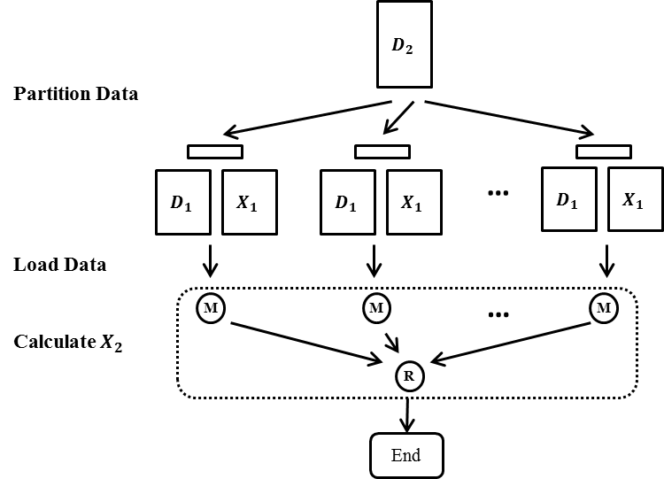
Interpolation (4)
Parallelization
  Pleasingly parallel application
  Can be parallelized by either Twister or Hadoop

Slide 25
Outline
Motivation
Research Issues
  DA-SMACOF with Weighting
  Hierarchical Interpolation with Weighting
  3D Phylogenetic Tree Display with Clustering
Experimental Analysis
Conclusion and Futurework

Slide 26
Phylogenetic Tree Display
Show the inferred evolutionary relationships among various biological species by using diagrams.
2D/3D display, such as rectangular or circular phylogram.
Preserves the proximity of children and their parent.
Example of a 2D Cladogram
Examples of a 2D Phylogram

Slide 27
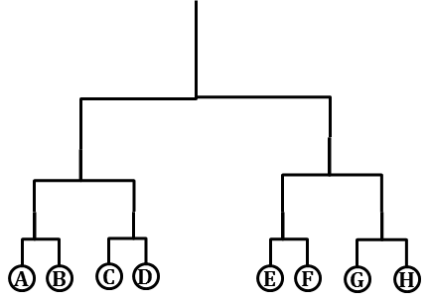
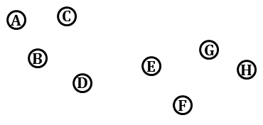
Cuboid Cladogram (1)
An example of 8 sequences and their dimension reduction result in 2D.

Slide 28
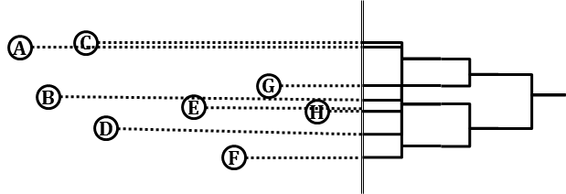
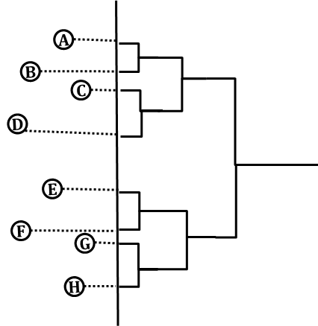
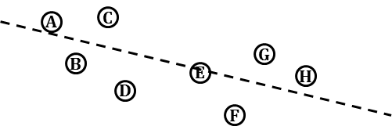
Cuboid Cladogram (2)
A naïve projection
A Projection done by using PCA

Slide 29
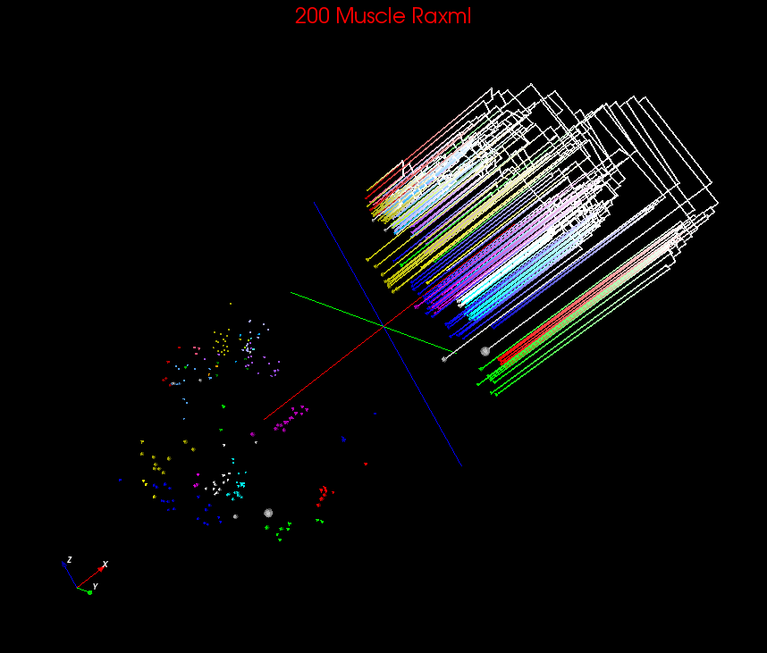
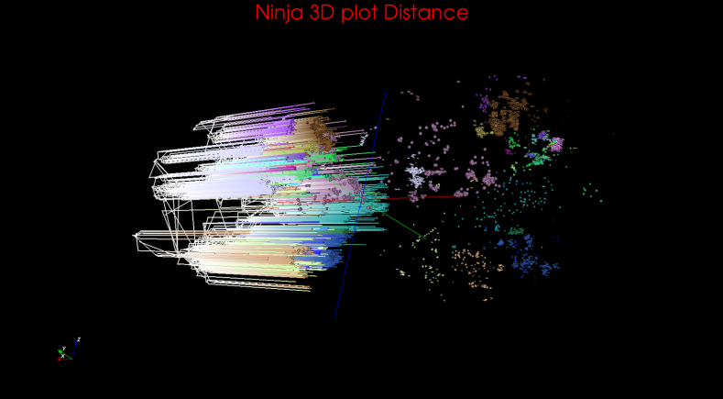
Cuboid Cladogram (3)
Phylogenetic Tree Generation
  Generate a phylogenetic tree, e.g. Multiple Sequence Alignment and RaXml, Pairwise Sequence Alignment and Ninja
Cubic Cladogram
  Use Principle Component Analysis (PCA) to select a plane which has the largest eigenvalue.
  For each point in the 3D space, project a point onto that plane
  Generate internal nodes of the tree by projecting them onto the edges from tree top to bottom.
Cuboid Cladogram Examples

Slide 30
Spherical Phylogram (1)
Spherical Phylogram
  Select a pair of existing nodes a and b, and find a new node c, all other existing nodes are denoted as k, and there are a total of r existing nodes. New node c has distance:
  The existing nodes are in-sample points in 3D, and the new node is an out-of-sample point, thus can be interpolated into 3D space.
(16)
(17)
(18)
Y Ruan, G House, S Ekanayake, U Schütte, JD Bever, H Tang, G Fox , Integration of Clustering and Multidimensional Scaling to Determine Phylogenetic Trees as Spherical Phylograms Visualized in 3 Dimensions, Proceedings of C4Bio 2014, 26-29

Slide 31
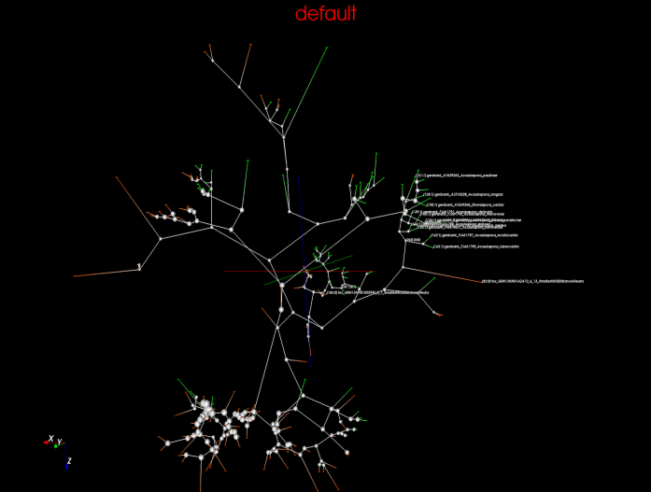
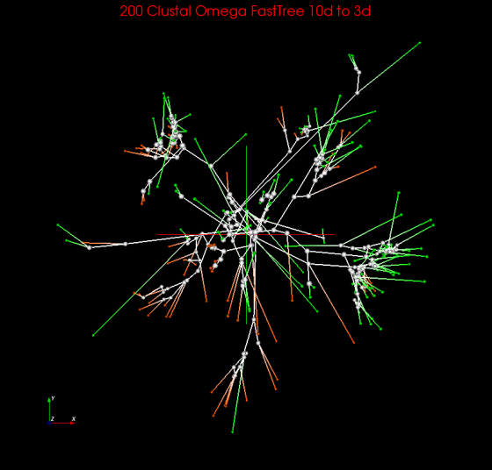
Spherical Phylogram (2)
Interpolative Joining
  For each pair of leaf nodes, compute the distance their parent to them and the distances of their parent to all other existing nodes.
  Interpolate the parent into the 3D plot by using that distance.
  Remove two leaf nodes from leaf nodes set and make the newly interpolated point an in-sample point.
  Tree determined by
    Existing tree, e.g. From RAxML
    Generate tree, i.e. neighbor joining
Spherical Phylogram Examples

Slide 32
Outline
Motivation
Background and Related Work
Research Issues
Experimental Analysis
  WDA-SMACOF and WDA-MI-MDS
  Hierarchical Interpolation
  3D Phylogenetic Tree Display
Conclusion and Futurework

Slide 33
Experimental Environment
Environment
  100 nodes (800 cores) of PolarGrid
  80 nodes (640 cores) of FutureGrid Xray
  128 nodes (4096 cores) of BigRed2
Dataset
  16S rRNA data with 680k unique sequences
  Artificial RNA data with 4640 unique sequences
  COG Protein data with 183k unique sequences
  AM Fungi Data with 446k unique sequences
Parallel Runtimes
  Hadoop, an open source MapReduce runtime
  Twister, an iterative MapReduce runtime
  Harp, an iterative MapReduce plugin for Hadoop

Slide 34
Algorithm Comparison
MDS Algorithm Comparison
Interpolation Algorithm Comparison
Phylogenetic Tree Algorithm Comparison
 | DA | EM
Weight | WDA-SMACOF | WEM-SMACOF
Non-Weight | NDA-SMACOF | NEM-SMACOF
 | DA | EM
Weight | WDA-MI-MDS | WEM-MI-MDS
Non-Weight | NDA-MI-MDS | NEM-MI-MDS
Hierarchical | HI-MI (SSP) | HE-MI (SSP) | HE-MI(CN) | MI-MDS
Alignment Methods | SWG | NW | MSA
MDS Methods | WDA-SMACOF | EM-SMACOF | EM-SMACOF

Slide 35
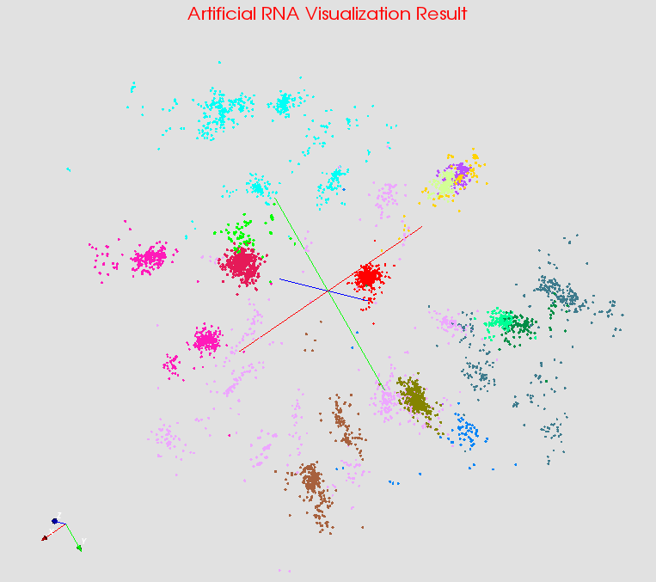
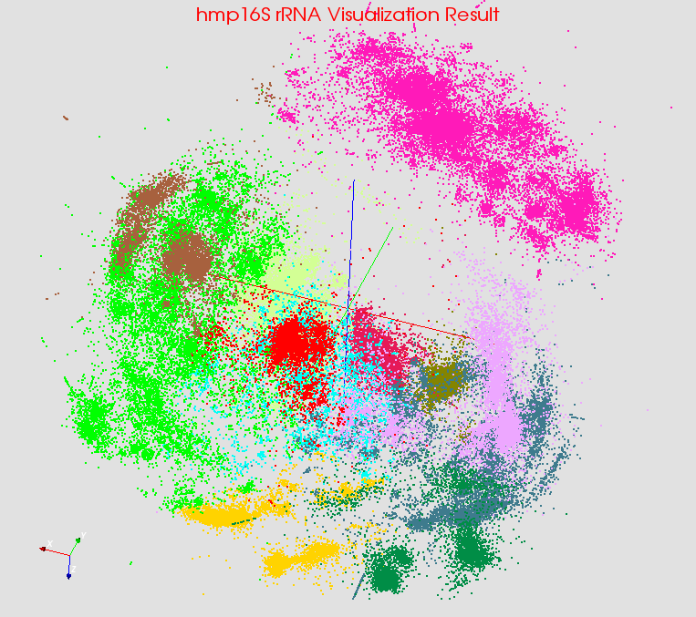
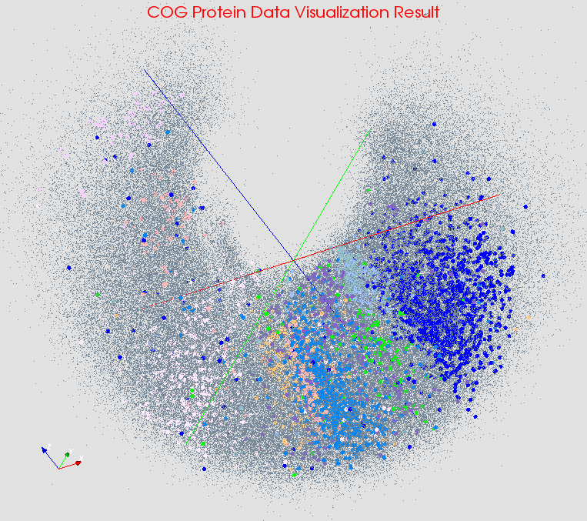
Visualization
Use PlotViz3 to visualize the result
Different colors are from clustering result
Artifical RNA
hmp16SrRNA
COG Protein

Slide 36
WDA-SMACOF (1)
Normalized STRESS of WDA-SMACOF vs DA-SMACOF and EM-SMACOF
  Input Data: 2k Metagenomics DNA, 10k hmp16SrRNA, and 4872 COG Protein sequences.
  Running Environment: FutureGrid Xray from 80 cores to 320 cores.
  10% of distances are considered missing

Slide 37
WDA-SMACOF (2)
Time Cost of CG vs Matrix Inversion (Cholesky Decomposition)
  Input Data: 1k to 8k hmp16SrRNA sequences
  Environment: Single Thread

Slide 38
WDA-SMACOF (3)
Number of CG iterations for WDA-SMACOF with Sammon’s Mapping
  Input Data: 20k to 100k AM Fungal sequences
  Environment: 600 cores on FutureGrid xRay
  Sammon’s Mapping: w_{ij} = 1 / δ_{ij} ; Equal Weights: w_{ij} = 1
Notes:
Add 250 cores, 500 cores, 750 cores

Slide 39
WDA-SMACOF (4)
Time Cost of Strong scale up for WDA-SMACOF
  Input Data: 100k to 400k AM Fungal sequences
  Environment: 32 nodes (1024 cores) to 128 nodes (4096 cores) on BigRed2.
Notes:
Add 250 cores, 500 cores, 750 cores

Slide 40
WDA-SMACOF (5)
Time Cost and Accuracy of Fixed-WDA-SMACOF vs Interpolation
  Input Data: 4640 Artificial RNA sequences
  Environment: Single Core
Notes:
Add 250 cores, 500 cores, 750 cores

Slide 41
Interpolation (1)
Normalized STRESS value of WDA-MI-MDS vs MI-MDS and other methods
  Input Data: 2640 out-of-sample Metagenomics Sequences to 2k in-sample sequences, 40k out-of-sample hmp16SrRNA sequences to 10k in-sample sequences, 95672 out-of-sample COG Protein sequences to 4872 in-sample sequences.
  Environment: FutureGrid Xray, 80 cores to 320 cores.
  10% of distances are missing

Slide 42
Interpolation (2)
Time cost of Weighted Interpolation vs Non-weighted Interpolation
  Input Data: Interpolate 40k out-of-sample into 10k in-sample hmp16SrRNA sequences.
  Increasing missing distance from 10% to 90%
  Fixed to 400 iterations

Slide 43
Interpolation (3)
Normalized STRESS and time cost of HE-MI vs HI-MI and MI-MDS
  Input set: 100k hmp16SrRNA sequences
  Environment: 32 nodes (256 cores) from PolarGrid

Slide 44
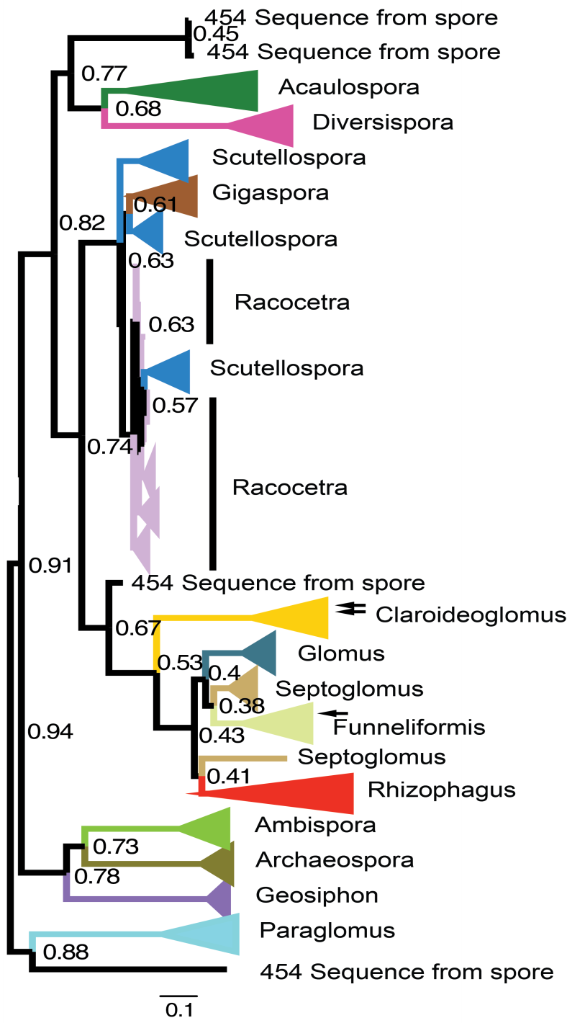
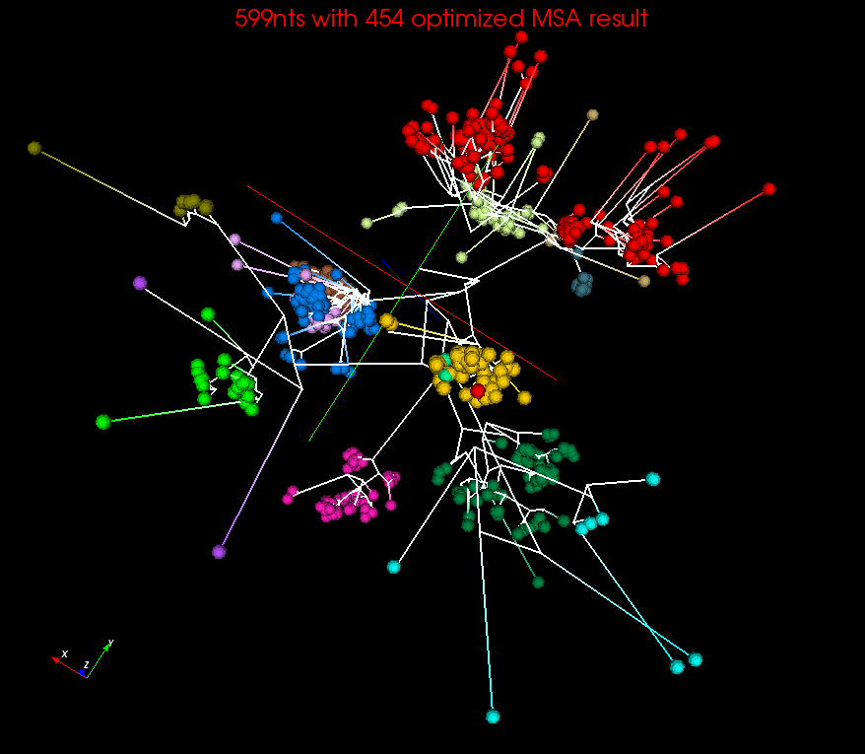
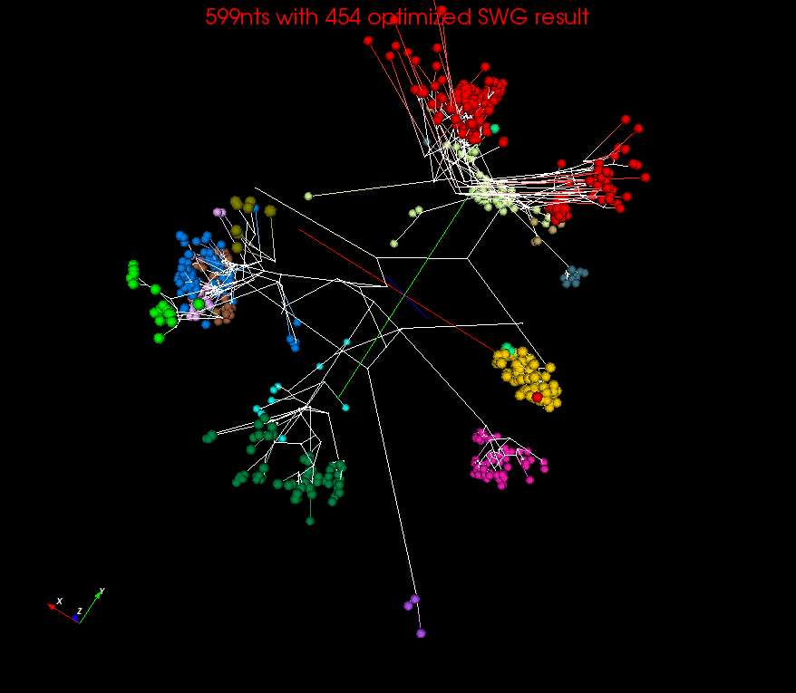
3D Phylogenetic Tree (1)
RAxML result visualized in FigTree.
Spherical Phylogram visualized in PlotViz

Slide 45
3D Phylogenetic Tree (2)
Distance values for MSA, SWG and NW used in DACIDR were compared to baseline RAxML pairwise distance values
Higher correlations from Mantel test better match RAxML distances. All correlations statistically significant (p < 0.001)
The comparison using Mantel between distances generated by three sequence alignment methods and RAxML

Slide 46
3D Phylogenetic Tree (3)
Sum of branch lengths will be lower if a better dimension reduction method is used.
WDA-SMACOF finds global optima
Sum of branch lengths of the SP generated in 3D space on 599nts dataset optimized with 454 sequences and 999nts dataset

Slide 47
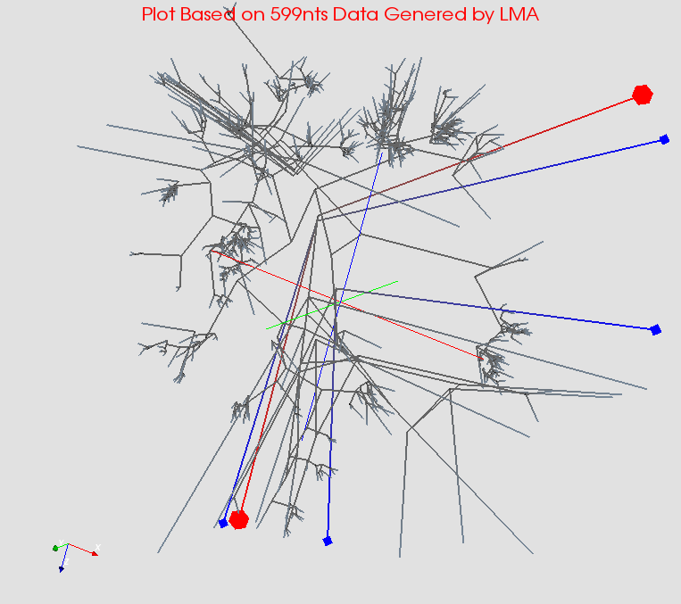
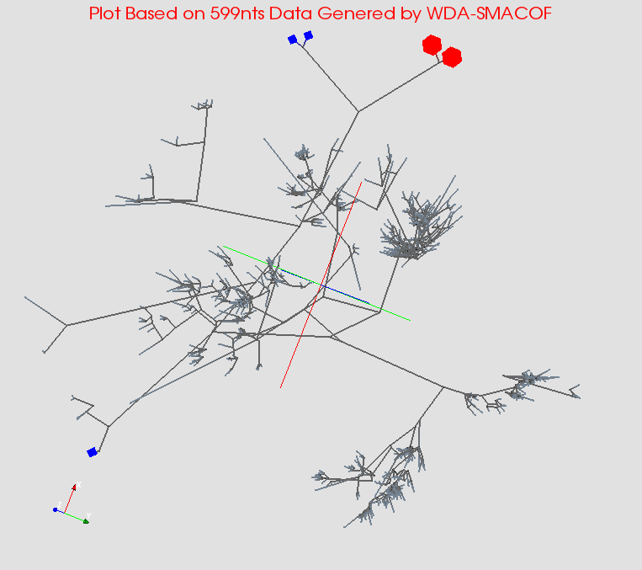
3D Phylogenetic Tree (3)
The two red points are supposed to be near each other in the tree.
MDS trapped under local optima
The MDS result with global optima.

Slide 48
Outline
Motivation
Background and Related Work
Research Issues
Experimental Analysis
Conclusion and Futurework

Slide 49
Conclusion
Choosing correct distance measurement is important.
WDA-SMACOF can has higher precision with sparse data much better than DA-SMACOF with time complexity of O(N²).
W-MI-MDS has higher precision with sparse data than MI-MDS.
HE-MI has a slight higher stress value than MI-MDS, but much lower time cost, which makes it suitable for massive scale dataset.
3D phylogenetic tree with clustering enables easy observation of data.

Slide 50
Futurework
Hybrid Tree Interpolation
  Combine the usage of SSP-Tree and CN-Tree and possibly eliminates the weakness of both methods.
Display Phylogenetic tree with million sequences
Enable faster execution of WDA-SMACOF with non-trivial weights.
  Need to investigate more about the CG iterations per SMACOF iteration
Write papers about new results, since WDA-SMACOF with Harp are so far best non-linear MDS.
Phylogenetic tree with clustering and make it available.

Slide 51
Reference
Y Ruan, G House, S Ekanayake, U Schütte, JD Bever, H Tang, G Fox , Integration of Clustering and Multidimensional Scaling to Determine Phylogenetic Trees as Spherical Phylograms Visualized in 3 Dimensions, Proceedings of C4Bio 2014, 26-29
Yang Ruan, Geoffrey Fox. A Robust and Scalable Solution for Interpolative Multidimensional Scaling with Weighting. Proceedings of IEEE eScience 2013, Beijing, China, Oct. 22-Oct. 25, 2013. (Best Student Innovation Award)
Yang Ruan, Saliya Ekanayake, et al. DACIDR: Deterministic Annealed Clustering with Interpolative Dimension Reduction using a Large Collection of 16S rRNA Sequences. Proceedings of ACM-BCB 2012, Orlando, Florida, ACM, Oct. 7-Oct. 10, 2012.
Yang Ruan, Zhenhua Guo, et al. HyMR: a Hybrid MapReduce Workflow System. Proceedings of ECMLS’12 of ACM HPDC 2012, Delft, Netherlands, ACM, Jun. 18-Jun. 22, 2012.
Adam Hughes, Yang Ruan, et al. Interpolative multidimensional scaling techniques for the identification of clusters in very large sequence sets, BMC Bioinformatics 2012, 13(Suppl 2):S9.
Jong Youl Choi, Seung-Hee Bae, et al. High Performance Dimension Reduction and Visualization for Large High-dimensional Data Analysis. to appear in the Proceedings of the The 10th IEEE/ACM International Symposium on Cluster, Cloud and Grid Computing (CCGrid 2010), Melbourne, Australia, May 17-20 2010.
Seung-Hee Bae, Jong Youl Choi, et al. Dimension Reduction Visualization of Large High-dimensional Data via Interpolation. to appear in the Proceedings of The ACM International Symposium on High Performance Distributed Computing (HPDC), Chicago, IL, June 20-25 2010.
Notes:
We have very good technology now
Streaming data
Basic N square with better result is essential
Initial interpolation doesn’t good

Slide 52
Questions?

Slide 53
Backup Slides

Slide 54
DACIDR Flow Chart
16S rRNA Data
Sample Set
Out-sample Set
All-Pair Sequence Alignment
Pairwise Clustering
Dissimilarity Matrix
Multidimensional Scaling
Sample Clustering Result
Heuristic Interpolation
Further Analysis
Target Dimension Result
Visualization

Slide 55
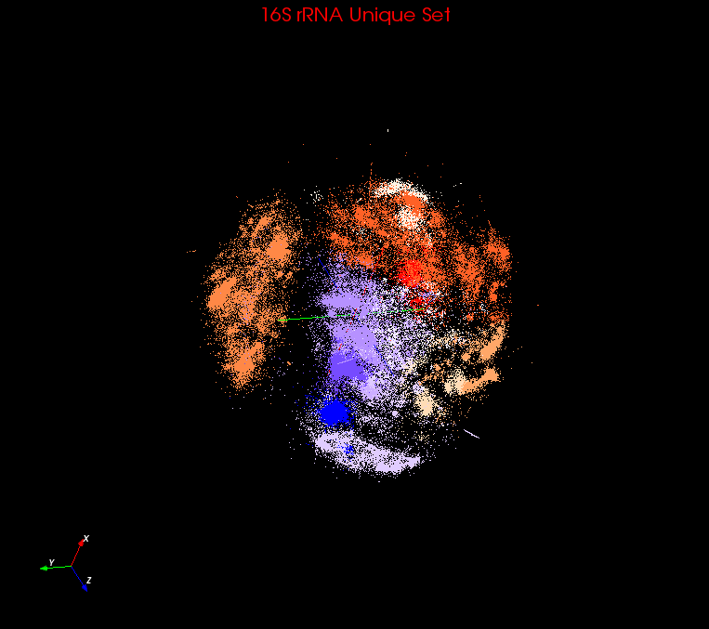
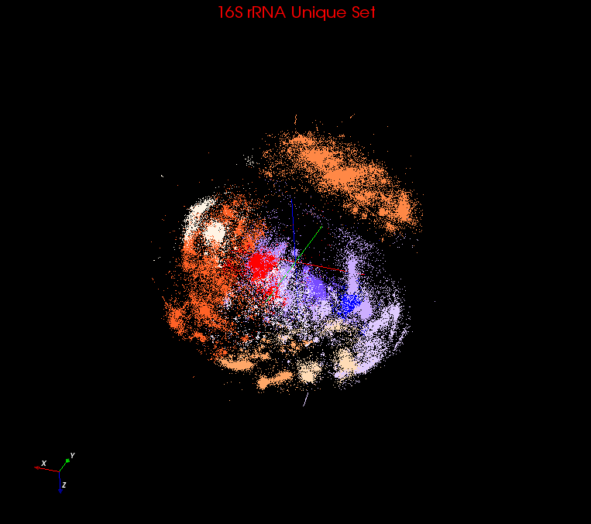
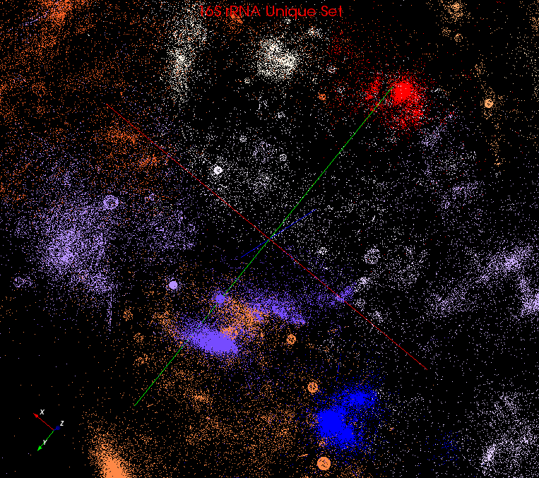
Visualization
Used PlotViz3 to visualize the 3D plot generated in previous step.
It can show the sequence name, highlight interesting points, even remotely connect to HPC cluster and do dimension reduction and streaming back result.
Rotate
Zoom in

Slide 56
All-Pair Sequence Analysis
Input: FASTA File
Output: Dissimilarity Matrix
Use Smith Waterman alignment to perform local sequence alignment to determine similar regions between two nucleotide or protein sequences.
Use percentage identity as similarity measurement.
-
ACATCCTTAACAA - - ATTGC-ATC - AGT - CTA
ACATCCTTAGC - - GAATT - - TATGAT - CACCA

Slide 57
Deterministic Annealing
Deterministic Annealing clustering is a robust pairwise clustering method.
Temperature corresponds to pairwise distance scale and one starts at high temperature with all sequences in same cluster. As temperature is lowered one looks at finer distance scale and additional clusters are automatically detected.
Multidimensional Scaling is a set of dimension reduction techniques. Scaling by Majorizing a Complicated Function (SMACOF) is a classic EM method and can be parallelized efficiently
Adding temperature from DA can help prevent local optima problem.

Slide 58
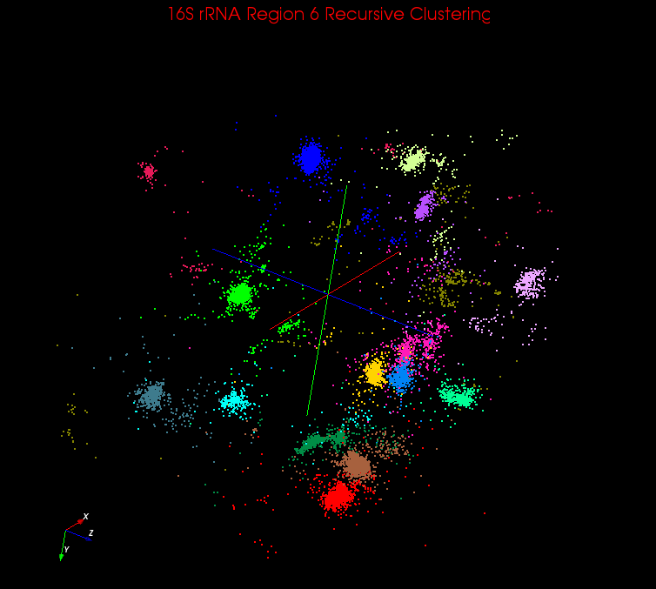
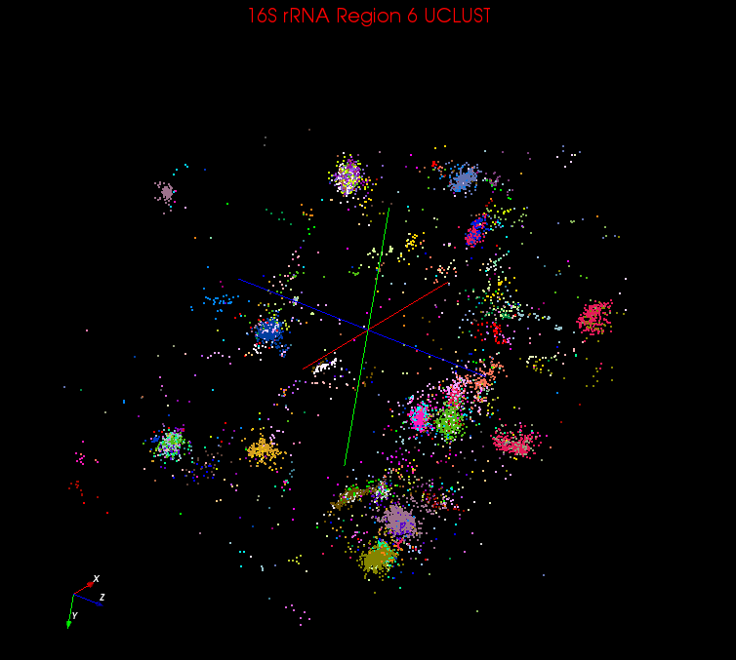
PWC vs UCLUST/CDHIT
 | PWC | UCLUST |  |  |  |  | CDHIT
Hard-cutoff Threshold | -- | 0.75 | 0.85 | 0.9 | 0.95 | 0.97 | 0.9 | 0.95 | 0.97
Number of A-clusters (number of clusters contains only one sequence) | 16 | 6 | 23 | 71(10) | 288(77) | 618(208) | 134(16) | 375(95) | 619(206)
Number of clusters uniquely identified | 16 | 2 | 9 | 8 | 9 | 4 | 3 | 2 | 1
Number of shared A-clusters | 0 | 4 | 2 | 1 | 0 | 0 | 0 | 0 | 0
Number of A-clusters in one V-cluster | 0 | 0 | 12 | 62(10) | 279(77) | 614(208) | 131(16) | 373(95) | 618(206)
PWC
UCLUST

Slide 59
Heuristic Interpolation
MI-MDS has to compare every out-sample point to every sample point to find k-NN points
HI-MI compare with each center point of each tree node, and searches k-NN points from top to bottom
HE-MI directly search nearest terminal node and find k-NN points within that node or its nearest nodes.
Computation complexity
  MI-MDS: O(NM)
  HI-MI: O(NlogM)
  HE-MI: O(N(N_{T} + M_{T}))

Slide 60
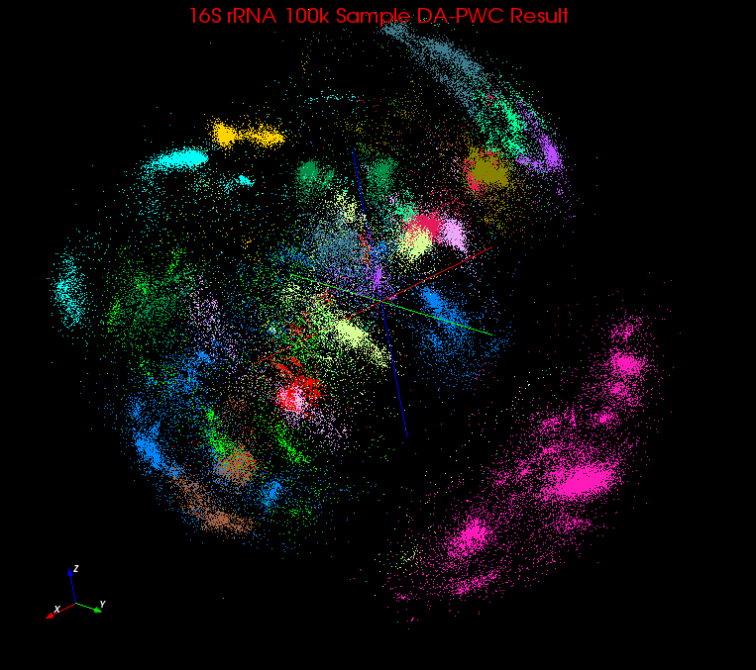
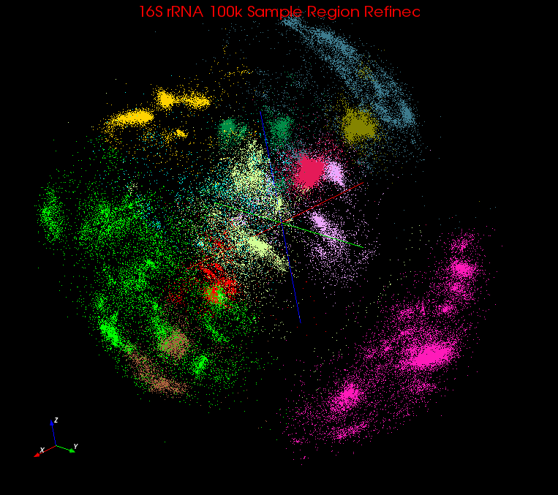
Region Refinement
Before
Terminal nodes can be divided into:
  V: Inter-galactic void
  U: Undecided node
  G: Decided node
Take a heuristic function H(t) to determine if a terminal node t should be assigned to V
Take a fraction function F(t) to determine if a terminal node t should be assigned to G.
Update center points of each terminal node t at the end of each iteration.
After

Slide 61
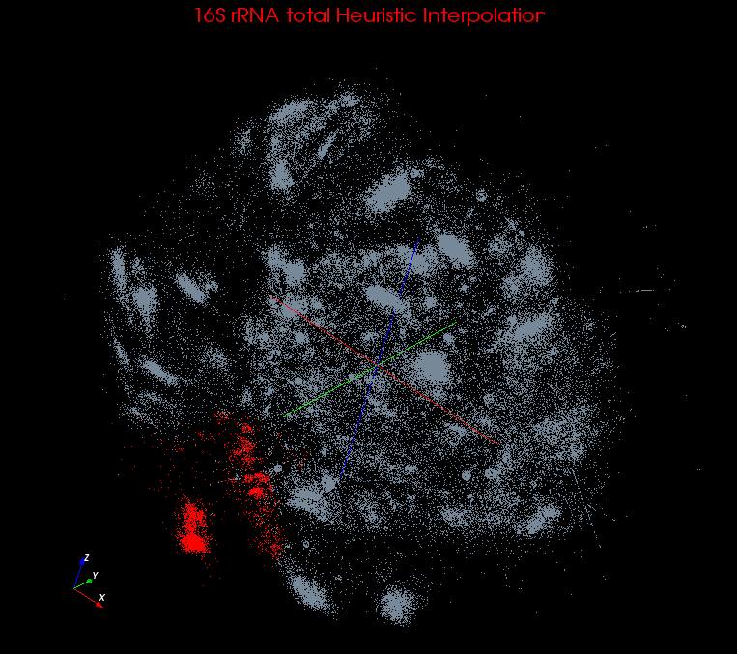
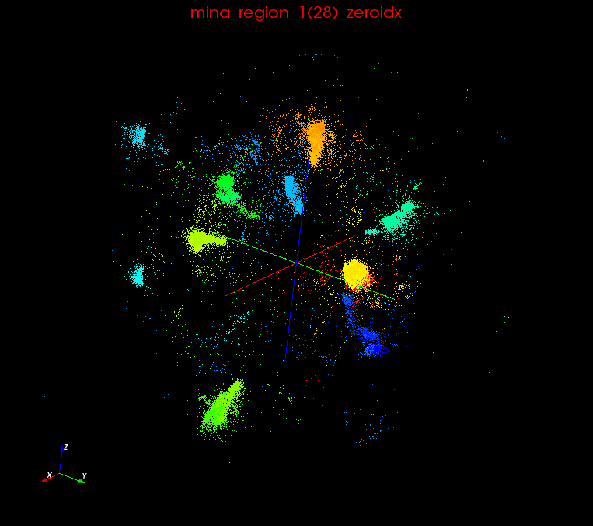
Recursive Clustering
DACIDR create an initial clustering result W = {w₁, w₂, w₃, … w_{r}}.
Possible Interesting Structures inside each mega region.
w₁ -> W₁’ = {w1₁’, w1₂’, w1₃’, …, w1_{r1}’};
w₂ -> W₂’ = {w2₁’, w2₂’, w2₃’, …, w2_{r2}’};
w₃ -> W₃’ = {w3₁’, w3₂’, w3₃’, …, w3_{r3}’};
…
w_{r} -> W_{r}’ = {wr₁’, wr₂’, wr₃’, …, wr_{rr}’};
Mega Region 1
Recursive Clustering

Slide 62
Multidimensional Scaling
Input: Dissimilarity Matrix
Output: Visualization Result (in 3D)
MDS is a set of techniques used in dimension reduction.
Scaling by Majorizing a Complicated Function (SMACOF) is a fast EM method for distributed computing.
DA introduce temperature into SMACOF which can eliminates the local optima problem.

Slide 63
Fixed-WDA-SMACOF (1)
Part of data needs to be fixed
  Interpolation is not accurate enough

Slide 64
Fixed-WDA-SMACOF (2)
Expand the STRESS function
  STRESS Function
  First Term is Constant
  Second Term:
  Third Term:

Slide 65
Fixed-WDA-SMACOF (3)
Take the inequality and set derivatives of X₂ to 0

