Slide 1
SCALABLE AND ROBUST DIMENSION REDUCTION AND CLUSTERING
Yang Ruan
Advised by Geoffrey Fox

Slide 2
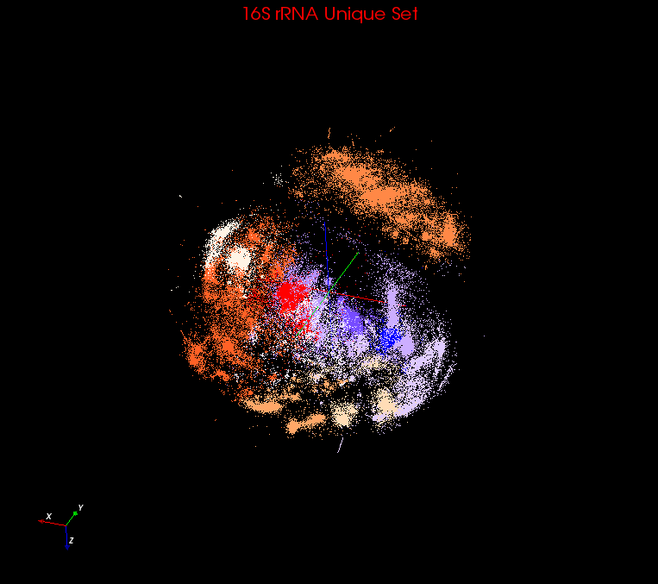
Motivation
Bioinformatics Data Deluge
Large Scale Data Clustering
Large Scale Date Visualization
Enable Faster Observation and Verification
>SRR042318.5
GAGTTTAGCCTTGCG…
>SRR042318.32
GAGTTTAGCCTTGCG…
…
…
>SRR042318.70
GAGTTTTAGCCTTGCGG…
>SRR042318.81
GTTTAGCCTTGC…
<- id
<- Sequence
DACIDR

Slide 3
Overview of DACIDR
Deterministic Annealing Clustering and Interpolative Dimension Reduction Method (DACIDR)
Split input set into in-samples and out-of-samples
Apply full pairwise clustering and multidimensional scaling on in-samples
Use in-sample result to interpolate out-of-samples.
Pairwise Clustering
All-Pair Sequence Alignment
Interpolation
Visualization
Multidimensional Scaling
Simplified Flow Chart of DACIDR

Slide 4
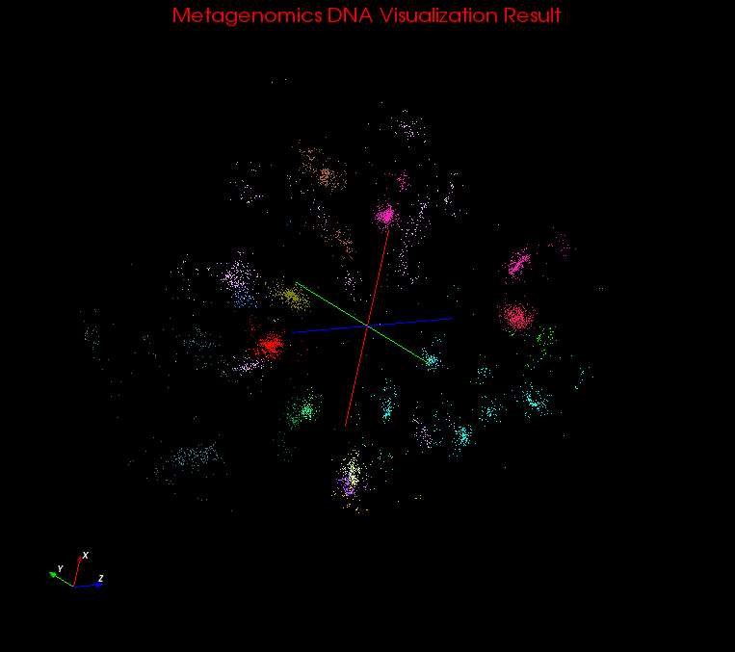
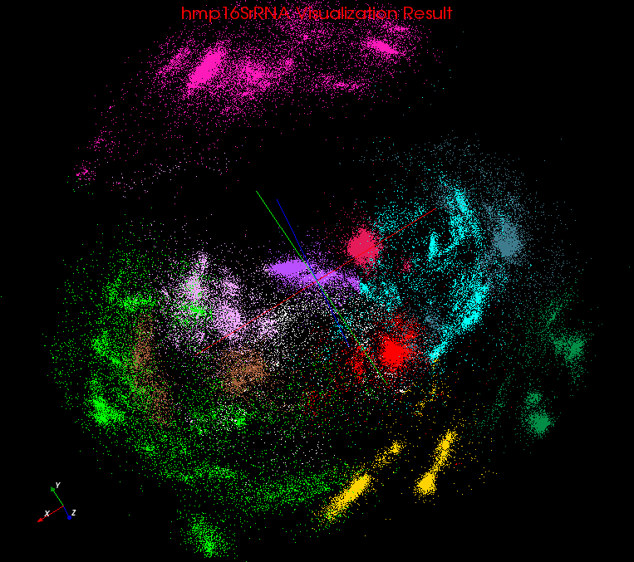
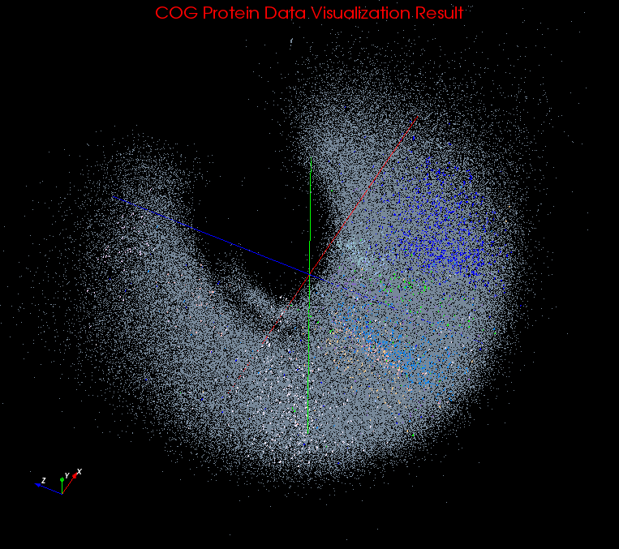
Clustering Visualization
Use PlotViz3 to visualize the result in 3D
Different identified cluster on in different color
DACIDR is parallelized using Twister and MPI
Metagenomics
hmp16SrRNA
COG Protein

Slide 5
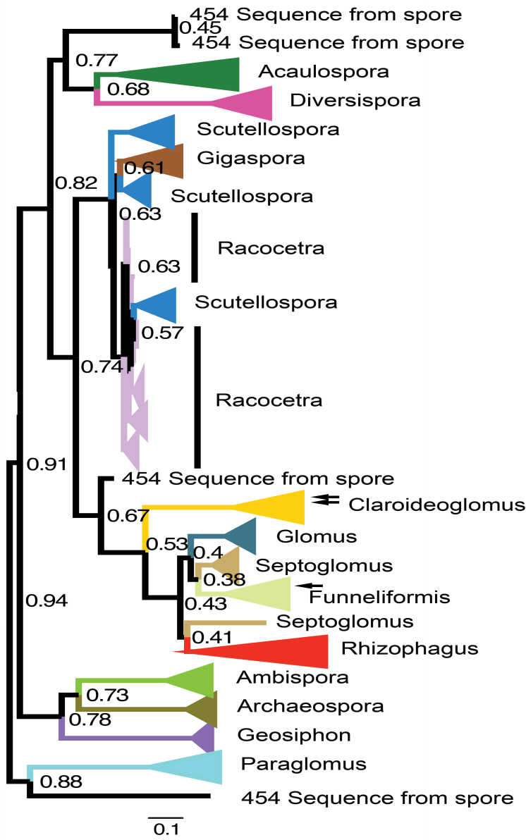
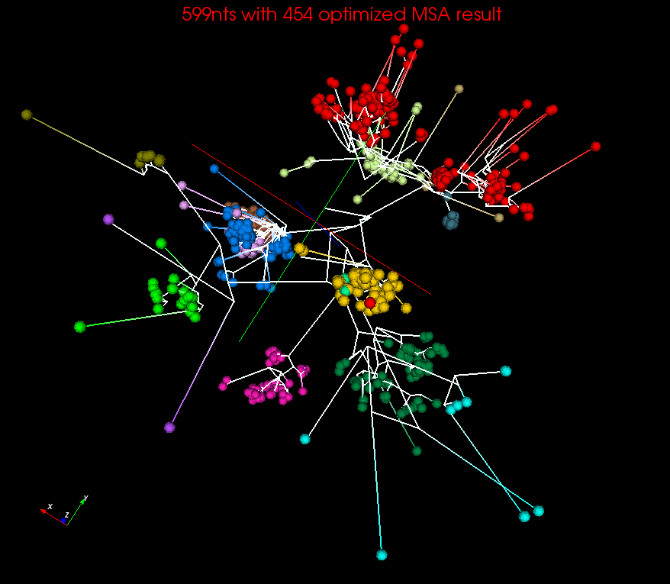
Phylogenetic Tree Visualization
Spherical Phylogram visualized using the phylogenetic tree generated by RaXml using the representative sequences and reference sequences, the color scheme is same as in left figure.
RaXml result visualized as Rectangular Phylogram shown in 2D
Notes:
Reorder the slides to new sections

Slide 6
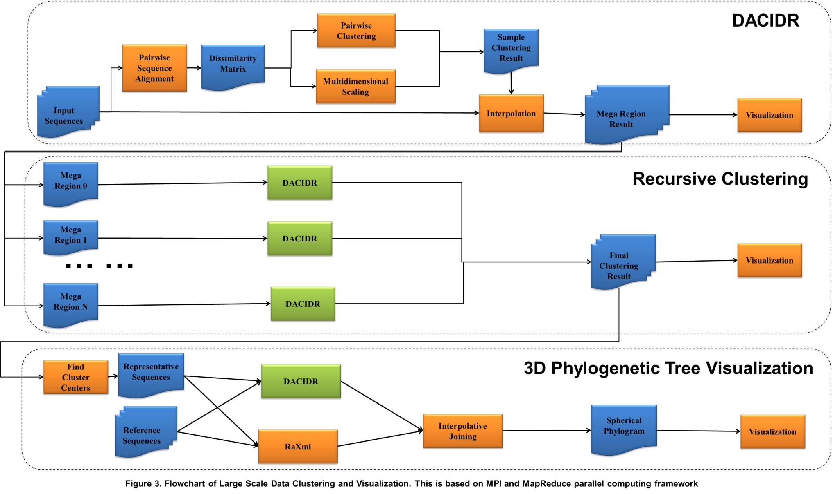
Flowchart of the Process to Generate Spherical Phylogram

