Slide 1
Co-processing SPMD Computation on GPUs and CPUs with MapReduce Interface on Shared Memory System
Date: 10/05/2012

Slide 2
Outline
Overview
  GPU and CPU Architectures
  Programming Tools on GPUs and CPUs
  Applications on GPUs and CPUs
Panda: MapReduce Framework on GPU’s and CPU’s
  Design
  Implementation
  Applications and Evaluation
Conclusion and Lessons

Slide 3
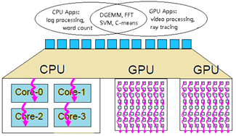
Research Goal
provide a MapReduce programming model that works on HPC Clusters or Virtual Clusters cores on traditional Intel architecture chip, cores on GPU.
Notes:
Traditional CPUs, whose cores are optimized for single-threaded performance, are not designed for work requiring lots of throughput
For that type of computing, much better energy efficiency can be delivered using simpler, slower, but more numerous cores. Both GPUs and the MIC adhere to this paradigm;

Slide 4
Overview
Parallel Programming Models on Shared Memory System
Task parallelism
Explicit parallel threads
Data parallelism
Operate simultaneously on bulk data (SPMD)
Multicore
Modest parallelism
SIMD, MIMD
Fast for threading code
OpenMP, Pthreads
GPU
Massive parallelism
SIMT
Fast for vector code
CUDA, MAGMA

Slide 5
Code Samples
SPMD
for (int tid = 0;tid<num_threads;tid++){
if (pthread_create(NULL,NULL,RunPandaCPUMapThread, panda_cpu_task_info[tid])!=0)
perror("Thread creation failed!\n");
}//for
for (int tid = 0;tid<num_threads;tid++){
void *exitstat;
if (pthread_join(d_g_state->panda_cpu_task[tid],&exitstat)!=0) perror("joining failed");
}//for
SIMD
void add(uint32_t *a, uint32_t *b, uint32_t *c, int n) {
for(int i=0; i<n; i+=4) {
//compute c[i], c[i+1], c[i+2], c[i+3]
uint32×4_t a4 = vld1q_u32(a+i);
uint32×4_t b4 = vld1q_u32(b+i);
uint32×4_t c4 = vaddq_u32(a4,b4);
vst1q_u32(c+i,c4);
}
}
SIMT
__global__ void add(float *a, float *b, float *c) {
int i = blockIdx.x * blockDim.x + threadIdx.x;
a[i]=b[i]+c[i]; //no loop!
}
Notes:
CPU can not meet throughput demand

Slide 6
Parallel Programming Tools of GPU and CPU on Shared Memory System
GPU Programming Tools
  Programming Language:
    Low Level: CUDA, OpenCL
    High Level: OpenACC, Accelerator, Haskell,
  Libraries: cuBLAS, MAGMA, PLASMA,
CPU Programming Tools
  Programming Language:
    Low Level: C/C++, Fortran, Java
    High Level: LINQ, Haskell, High-Performance Fortran
  Libraries: OpenMP, Pthreads

Slide 7
Features of GPU and CPU Applications
CPU:
  Modest parallelism
  Prefer task parallelism
  Computation complexity < Memory complexity
GPU:
  Massive parallelism
  Prefer data parallelism
  Computation complexity > Memory complexity

Slide 8
Sample: Matrix Algebra
Programming Model | Algorithm | Customized Libraries | User Implementation
Sequential | Naïve approach, tiles matrix multiply, BLAS, | Vendor supplied package (ie, Intel MKL), ATLAS | Fortran, C, C++, C#, Java
Shared memory system | Blocked algorithm | ATLAS CUBLAS Parallel MKL MAGMA | PThreads, CILK TPL, PLINQ, OpenMP, CUDA, OpenACC, OpenCL
Distributed memory system | BMR algorithm, 1D blocked, 2D blocked. | ScalePack PLASMA | MPI, Twister, Dryad, Hadoop
GPU Tools: CUBLAS, MAGMA, PLASMA, OpenACC, Accelerate, CUDA, OpenCL

Slide 9
Outline
Overview
Panda: MapReduce Framework on GPU’s and CPU’s
  Design
  Implementation
  Applications and Evaluation
    C-means
    Matrix Multiplication
    Word Count
Conclusion and Lessons

Slide 10
Panda: MapReduce Framework on GPU’s and CPU’s
Current Version 0.32
Features:
  Run on multiple GPUs
  Run on GPUs and CPUs simultaneously
  Region Based memory management
  Auto Tuning
  Iterative MapReduce
  Local Combiner
Applications:
  C-means clustering
  Matrix Multiplication
  Word count

Slide 11
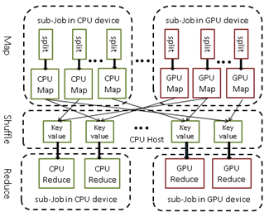
Heterogeneous MapReduce Programming Model

Slide 12
Panda Architecture 0.4
Heterogeneous MapReduce Interface (gpu_host_map, gpu_kernel_map(), cpu_host_map, cpu_thread_map)
Iterations
Meta-scheduler (split job into sub-jobs)
GPU Host Mappers
CUDA/MAGMA
GPU Kernel Mappers
Schedule map tasks
CPU Mappers
Schedule map tasks
3
16
5
6
10
12
13
7
2
11
4
15
9
16
8
1
Local
Combiner
Shuffle Intermediate Key/Value Pairs in CPU Memory
1
2
3
4
5
6
7
8
9
Meta-scheduler (split job into sub-jobs)
GPU Host Reducers
CUDA/MAGMA
GPU Reducers
Schedule reduce tasks
CPU Reducers
Schedule reduce tasks
Merge Output

Slide 13
API

Slide 14
Sample Code of Heterogeneous MapReduce
__device__ void gpu_reduce(void *KEY,…){
int count = 0;
for (int i=0;i<valCount;i++){
count += *(int *)(VAL[i].val);
}// calcualte word occurence
GPUEmitReduceOutput(KEY,&count,keySize,…);
}//gpu version of reduce function
void cpu_reduce(void *KEY, val_t *VAL…){
int count = 0;
for (int i=0;i<valCount;i++){
count += *(int *)(VAL[i].val);
}//calcualte word occurence
CPUEmitReduceOutput(KEY,&count,keySize,…);
}//cpu version of reduce function
Notes:
Figure 4: User Implemented Panda Reduce Functions for Word Count Applications for GPU and CPU Devices

Slide 15
Implementation Details
Threading and Memory Models
Tow-level scheduling strategy
Region-based memory management
Auto Tuning
Iterative Support
Local Combiner

Slide 16
Applications and Evaluation
C-means Clustering
  gpu_map() gpu_reduce()
  cpu_map() cpu_reduce()
Matrix Multiplication
  gpu_map()
  cpu_map()
Word Count
  gpu_map() gpu_combiner() gpu_reduce()
  cpu_map() cpu_combiner() cpu_reduce()

Slide 17
C-means MapReduce Algorithm
C-means MapReduce Algorithm:
Configure:
1) Copy data from the CPU to GPU memory
Map function:
2) Calculate the distance matrix
3) Calculate the membership matrix
4) Update the centers kernel
Reduce function:
5) Aggregate the partial cluster centers and compute final cluster centers.
6) Compute the difference between the current cluster centers and previous iteration.
Main program:
7) The iteration will stop when the difference is smaller than predefined threshold or it will go to next iteration.
8) Compute the cluster distance and memberships using final centers.

Slide 18
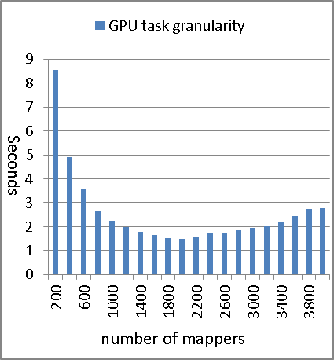
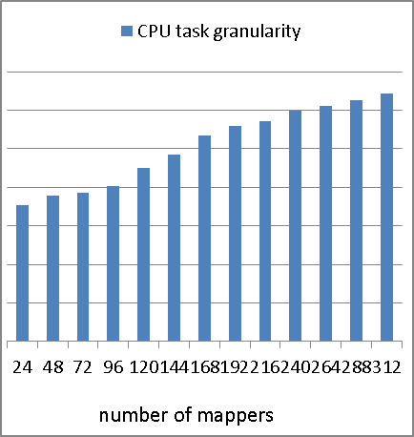
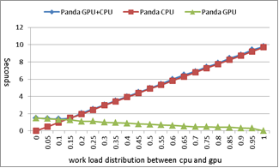
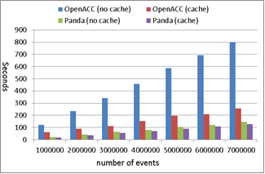
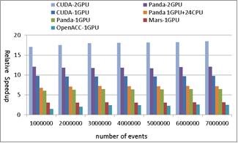
C-means results: 1) granularity, 2) workload balance, 3) cache static data, 4) performance compare

Slide 19
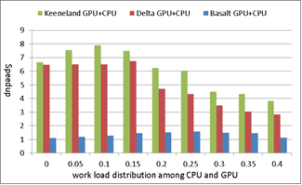
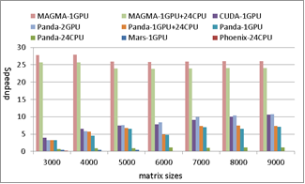
Matrix Multiplication: 1) auto tuning, 2) performance compare
Panda-1GPU achieves the speedup of 15.86x, and 7.68x over Phoenix-24CPU and Mars-1GPU respectively.
However, MAGAMA-1GPU is 3.4x faster than Panda-1GPU

Slide 20
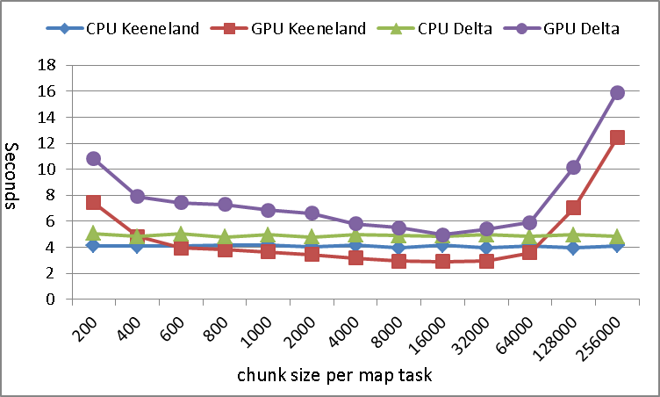
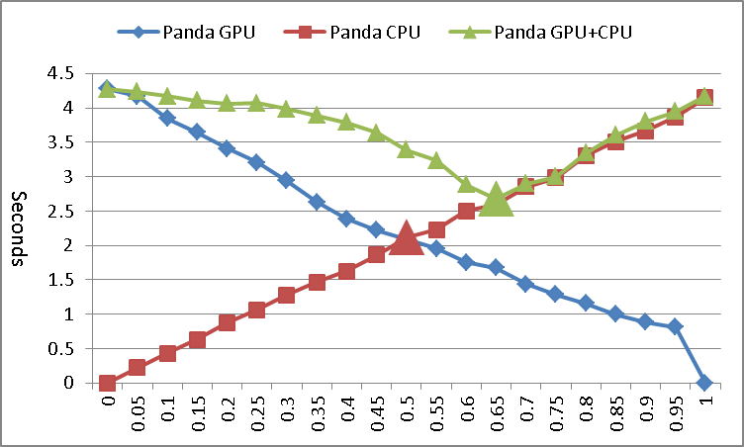
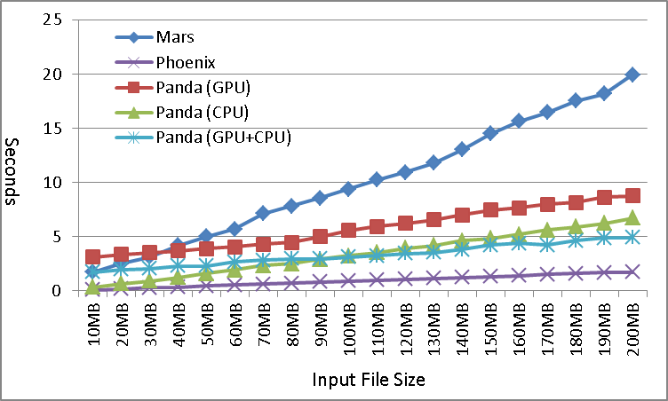
Word Count:1) granularity, 2) workload balance, 3) performance compare

Slide 21
Programmability: number of code lines of three applications using Panda
Apps | CUDA | Panda
C-means | CUDA 850+ | gpu_map 230+ cpu_map 190+ gpu_reduce 40 cpu_reduce 40
DGEMM | CUDA 310+ | gpu_map 110+ cpu_map 70+ gpu_reduce 0 cpu_reduce 0
Word Count | Mars 110+ | gpu_map 25 cpu_map 25 gpu_reduce 5 cpu_reduce 5 gpu_combine 5 cpu_combin 5

Slide 22
Conclusion and Lessons
Panda didn’t give good performance for matrix algebra related computation: such as C-means and DGEMM
co-processing SPMD on GPUs and CPUs is difficulty, programmability and performance are the two challenges. There tradeoff exist between programming interface and implementation details.
threading code should be processed by Pthreads and OpenMP on CPUs, vector code should be processed by cuBLAS and MAGMA. Simply using threading code to process matrix algebra applications will not give good performance

Slide 23
Acknowledgement
CReSIS Project
FutureGrid https://portal.futuregrid.org/
Keeneland http://keeneland.gatech.edu/overview
SALSA Group

Slide 24
Backup slides

Slide 25
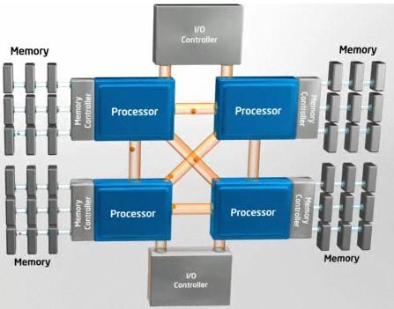
Multi Core Architecture
Sophisticated mechanism in optimizing instruction and caching
Current trends:
  Adding many cores, MIC, many integrated cores
  More SIMD: SSE3/AVX
  Application specific extensions: VT-x, AES-NI
Notes:
- Single core performance gains stagnating
- Focusing more on power optimizations, mobility

Slide 26
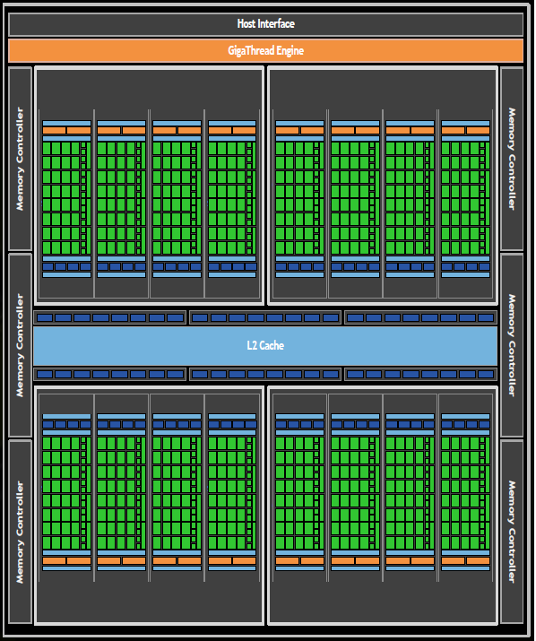
Fermi GPU Architecture
Generic many core GPU
Not optimized for single-threaded performance, are designed for work requiring lots of throughput
Low latency hardware managed thread switching
Large number of ALU per “core” with small user managed cache per core
Memory bus optimized for bandwidth

Slide 27
GPU Applications Classes
GPU Application Classes | Applications Samples | Applications Features
Linear Algebra/Numeric | BLAS (Basic Linear Algebra Subprograms), PDE (Partial Differential Equation), FFT (Fast Fourier Transform), Eigenvalue solvers | Computation intensive, basic matrix primitives
Data Mining Clustering/Classification | Kmeans; Cmeans; SVM; KNN; MDS; GTM; | Iterative, share global data among iterations
Simulation, Molecular Dynamics, | CFD (fluid dynamics) , N-Body, AMBER, NAMD, GROMACS, LAMMPS | Un-structure grid, complex internal data structure & algorithm GPU’s increase throughput & accelerate
Computation biology | Smith-Waterman-Gotoh (SWG) | Dynamical programming, high through demands
Statistics/Financial analysis/Optimizations | Monte Carlo, Neural computing, Genetic algorithm | Stochastic progress, iterative,
Graph and Image processing | Ray trace, Video, Audio rendering | Real-time

Slide 28
DGEMM using CPU and GPU
Performance of PMM using CPU and GPU matrix algebra tools on shared memory system
Performance of PMM using CPU and GPU matrix algebra tools on distributed memory system

Slide 29
CUDA Threading Model
Each thread uses indices to decide what data to work on
  blockIdx: 1D, 2D, or 3D (CUDA 4.0)
  threadIdx: 1D, 2D, or 3D

Slide 30
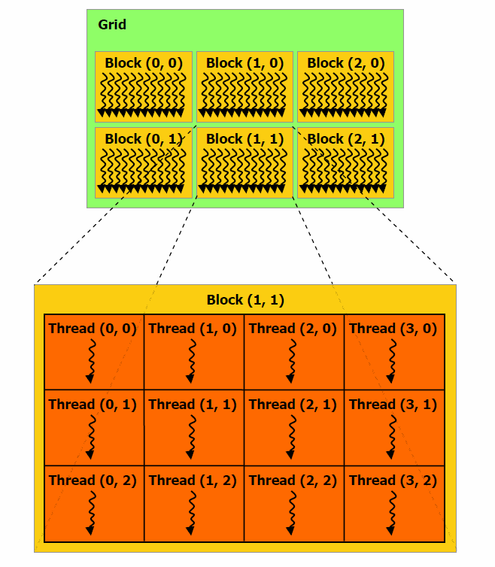
CUDA: Thread Model
Kernel
  A device function invoked by the host computer
  Launches a grid with multiple blocks, and multiple threads per block
Blocks
  Independent tasks comprised of multiple threads
  no synchronization between blocks
SIMT: Single-Instruction Multiple-Thread
  Multiple threads executing time instruction on different data (SIMD), can diverge if neccesary
Image from [3]

Slide 31
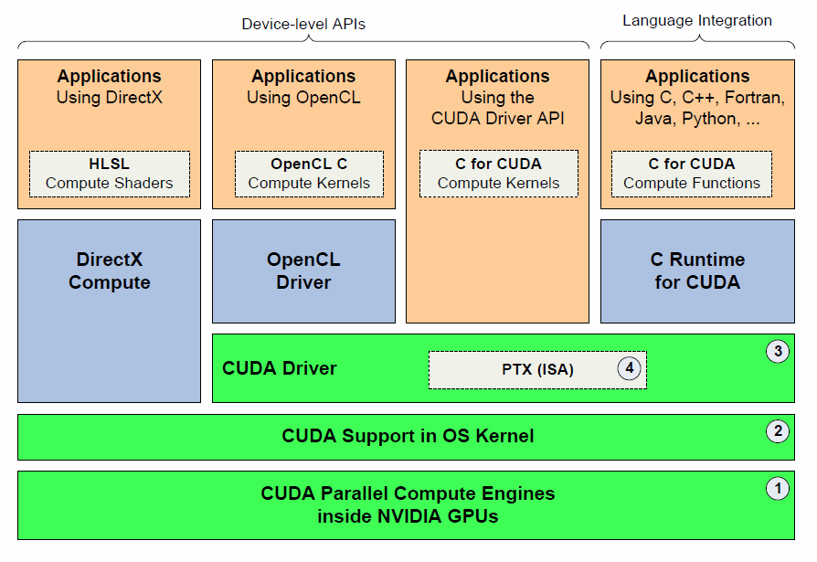
CUDA: Software Stack
Image from [5]

Slide 32
CUDA: Program Flow
Main Memory
CPU
Application Start
Search for CUDA Devices
Load data on host
Allocate device memory
Copy data to device
Launch device kernels to process data
Copy results from device to host memory
Host
PCI-Express
Device
GPU Cores
Device Memory

