Slide 1
Towards a Systematic Approach to Big Data Benchmarking
PhD Thesis Proposal
Saliya Ekanayake
School of Informatics and Computing
Indiana University, Bloomington
Committee: Professor Andrew Lumsdaine, Professor Judy Qiu, Professor Haixu Tang
Advisor: Professor Geoffrey C. Fox

Slide 2
Outline
The Problem
State of the Art
Proposed Solution
Current Results

Slide 3
The Problem

Slide 4
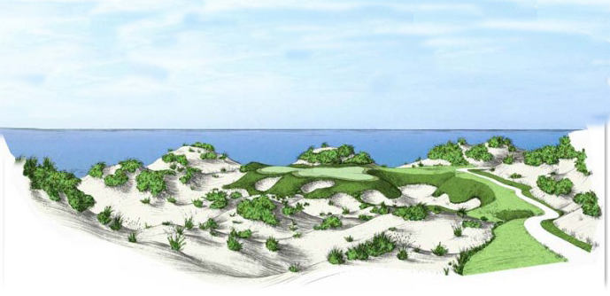
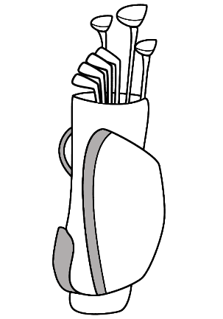
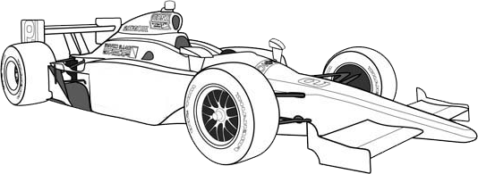
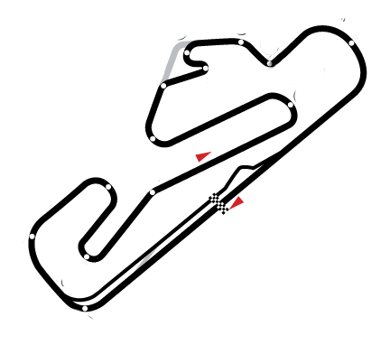
An Analogy
Uniform Landscape
Smooth track
Few turns
Closed Circuit
Purpose built track
Agreed Specifications
Engine / Chassis
Expensive
Need sponsors
Uneven Landscape
Sand patches
Slopes / Hills
Unpredictable
Wind / Trees
Variety of Clubs
Wood / Iron / Hybrid
Wedges / Putters
Length / Flex
Cheap
Anyone can play
Vs.
Big Data
HPC

Slide 5
Problem Statement
Big Data applications are diverse in nature and require a systematic approach to characterize and benchmark them across a range of facets, machines, and application areas
Multidimensional scaling (MDS) and clustering are important classes in machine learning, yet lacks a comprehensive study in the literature
Notes:
We highlight systematic approach because while there are efforts in the community to define Big Data benchmarks, they are mostly domain/requirement originated rather than based on a standard process

Slide 6
State of the Art

Slide 7
Big Data Benchmarks
BigDataBench
42 benchmarks targeting Internet services in 5 application domains
HiBench
Evaluates Hadoop and its ecosystem against a few micro-benchmarks and real applications
Graph500
Breadth first search (BFS) kernel on graph data
BigBench
End-to-end benchmark carrying 30 workloads against a synthetic retailer model
LinkBench
Benchmark to evaluate Facebook’s graph serving capabilities
MineBench
15 data mining applications covering 5 application areas
BG Benchmark
Benchmarks data stores for social interactive read/write actions satisfying a given service level agreement (SLA)
Berkeley Big Data Benchmark
A few relational queries against Redshift, Hive, SparkSQL, Impala, and Stinger/Tez
TPCx-HS
Vendor neutral Hadoop sort benchmark from TPC-BD working group
Yahoo Cloud Serving Benchmark (YCSB)
Evaluates a mix of read/write operations against PNUTS, BigTable, HBase, Cassandra, and Sharded MySQL
CloudSuite
A suite of benchmarks covering scale-out services like data analytics, data caching, data serving, graph analytics, media streaming, etc.

Slide 8
Big Data Benchmarks
Design Considerations
Component vs. end-to-end
Big Data Applications
Data sources
Scaling
Metrics
Types of Benchmarks
Micro
Functional
Genre-specific
Application level
References
Baru, C., et al., Setting the Direction for Big Data Benchmark Standards, in Selected Topics in Performance Evaluation and Benchmarking, R. Nambiar and M. Poess, Editors. 2013, Springer Berlin Heidelberg. p. 197-208; Available from: http://dx.doi.org/10.1007/978-3-642-36727-4_14
Baru, C. and T. Rabl. Big Data Benchmarking. 2014; Available from: http://cci.drexel.edu/bigdata/bigdata2014/IEEE2014TutorialBaruRabl.pdf
Notes:
Component Vs. End-to-end
Component
Evaluates one or few entities of the system
E.g. SPEC’s CPU and TeraSort
End-to-end
Harder to define and test compared to component benchmarks
Evaluates from data loading to data serving for different queries over a variety of data types with periodic updates
E.g. TPC-DS and BigBench
Big Data Applications
No single application to cover Big Data
Concrete applications over abstract models
Can relate to real world business workloads
Can provide detailed specifications
Need to understand key characteristics
Data Sources
Synthetic data over real data
Easy to generate
E.g. Parallel data generation framework (PDGF) and its extensions in BigBench
Real data may not reflect all the properties
Could incorporate characteristics of real data
E.g. BigBench and LinkBench data generation
Scaling
Scale of system under test (SUT) >> real installation for Big Data
Extrapolate SUT results to reason about the real system
Elasticity and failures, especially in clouds
Data and resources could grow and shrink dynamically
Metrics
Price per performance is important
Types of Benchmarks
Micro-benchmarks
Evaluate specific low level system operation
E.g. OSU benchmarks suite, and enhanced DFSIO in HiBench
Functional benchmarks
Evaluate a high level function
E.g. Sorting, and SQL select, project, join, etc.
Genre-specific benchmarks
Benchmarks related with the type of data
E.g. Graph500, and LinkBench
Application level benchmarks
Full applications evaluating hardware and software for a given data and workload
E.g. BigBench, and SPIDAL benchmarks

Slide 9
Big Data Benchmarks
Strengths
Variety of benchmarks
Suit for commercial use cases
Pitfalls
No systematic classification
Limited coverage
Sometimes overlapping
Lack of consensus
What to use when

Slide 10
Resources
Communities and Workshops
Big Data Benchmarking Community (BDBC) http://clds.sdsc.edu/bdbc
Workshops on Big Data Benchmarking (WBDB) http://clds.sdsc.edu/bdbc/workshops
Links
BigDataBench http://prof.ict.ac.cn/BigDataBench/wp-content/uploads/2014/12/BigDataBench-handbook-6-12-16.pdf
HiBench https://github.com/intel-hadoop/HiBench
Graph500 http://www.graph500.org/
BigBench http://blog.cloudera.com/blog/2014/11/bigbench-toward-an-industry-standard-benchmark-for-big-data-analytics/
LinkBench https://www.facebook.com/notes/facebook-engineering/linkbench-a-database-benchmark-for-the-social-graph/10151391496443920
MineBench http://cucis.ece.northwestern.edu/projects/DMS/MineBench.html
BG Benchmark http://www.bgbenchmark.org/BG/overview.html
Berkeley Big Data Benchmark https://amplab.cs.berkeley.edu/benchmark/
TPCx-HS http://www.tpc.org/tpcx-hs/
Yahoo Cloud Serving Benchmark (YCSB) https://github.com/brianfrankcooper/YCSB/
CloudSuite http://parsa.epfl.ch/cloudsuite/cloudsuite.html
Notes:
BDBC - Towards Industry Standard Big Data Benchmarks
Informal group of individuals and organizations (~80)
Efforts lead by Chaitan Baru at UCSD
Models end-to-end scenarios covering different data
E.g. graphs, streams, structured records, unstructured data, etc.
Organizes Workshop on Big Data Benchmarking (WBDB) series since 2012
Led to the specification of TPCx-HS express benchmark for Hadoop systems http://www.tpc.org/tpcbd/
Formation of a SPEC research group on Big Data benchmarking http://research.spec.org/working-groups/big-data-working-group.html
Biweekly Webinars http://clds.sdsc.edu/bdbc/community

Slide 11
Proposed Solution

Slide 12
Solution Statement
Apply the multidimensional multifaceted Ogre classification to characterize Big Data applications and benchmarks
Study the benchmarking process in existing Big Data benchmarks and apply the findings towards a comprehensive study of MDS and clustering classes
Notes:
We highlight the words multidimensional and multifaceted to show the systematic nature of Ogres

Slide 13
Research Contributions
A Systematic Approach to Big Data Benchmarking
Across a range of facets, machines, and application areas.
Illustration of Facet Coverage
In existing Big Data benchmarks.
In-Depth Study of MDS and Clustering Classes
On performance, speedup, scalability, and parallel efficiency
A Parallel Large Scale Data Analytics Library
SPIDAL https://github.com/DSC-SPIDAL

Slide 14
Big Data Ogres¹
Systematic
4 Dimensions – Problem architecture, Execution, Data source and style, and Processing
50 facets
Classes of Problems
Similar to Berkeley Dwarfs
Think of Diamonds ☺
Front View
Top View
Bottom View
1. Geoffrey C.Fox, S.J., Judy Qiu, Andre Luckow. Towards an Understanding of Facets and Exemplars of Big Data Applications. Available from: http://grids.ucs.indiana.edu/ptliupages/publications/OgrePaperv9.pdf
Notes:
If there were 8 more facets we could call it the brilliant cut Ogre :D

Slide 15
Ogre Views
Data Source and Style View
Data collection, storage, and access
Many of the Big Data benchmarks
Processing View
Classes of processing steps
Algorithms and kernels
Ogre Views
Execution View
Describes computational issues
Traditional HPC benchmarks
Impacts application performance
Problem Architecture View
“Shape” of the application
Relates to the machine architecture

Slide 16
14
$O\left(N^{2}\right)$ = NN / $O(N)$ = N
Shared / Dedicated / Transient / Permanent
13
Metric = M / Non-Metric = N
12
Data Abstraction
11
Iterative / Simple
Execution View
Regular = R / Irregular = I
10
Geospatial Information System
Archived/Batched/Streaming
9
Dynamic = D / Static = S
8
Communication Structure
Enterprise Data Model
SQL/NoSQL/NewSQL
7
Veracity
Metadata/Provenance
Variety
HDFS/Lustre/GPFS
6
HPC Simulations
5
Velocity
Internet of Things
4
Volume
Files/Objects
3
Execution Environment; Core libraries
Flops per Byte; Memory I/O
2
Flops/Byte
1
Performance Metrics
Ogre Views and Facets
8
10
11
12
1
2
3
4
5
6
7
9
10
9
8
7
6
5
4
3
2
1
Pleasingly Parallel
Classic MapReduce
Map-Collective
Map Point-to-Point
Map Streaming
Shared Memory
Single Program Multiple Data
Bulk Synchronous Parallel
Fusion
Dataflow
Agents
Workflow
Micro-benchmarks
1
Local Analytics
2
Global Analytics
3
Data Source and Style View
Optimization Methodology
4
Visualization
5
Alignment
6
Streaming
7
Basic Statistics
8
Problem Architecture View
Search / Query / Index
9
Recommender Engine
10
Classification
11
Deep Learning
12
Processing View
Graph Algorithms
13
Linear Algebra Kernels
14

Slide 17
Geospatial Information System
Shared / Dedicated / Transient / Permanent
HPC Simulations
Internet of Things
Metadata/Provenance
Archived/Batched/Streaming
Data Source and Style View
10
9
8
HDFS/Lustre/GPFS
7
Enterprise Data Model
6
Files/Objects
SQL/NoSQL/NewSQL
5
4
Local Analytics
Graph Algorithms
Micro-benchmarks
Classification
Search / Query / Index
Basic Statistics
Streaming
Alignment
Deep Learning
Global Analytics
Recommender Engine
Visualization
Linear Algebra Kernels
Optimization Methodology
3
2
1
Ogre Views and Facets
Execution View
Pleasingly Parallel
Classic MapReduce
1
2
3
4
5
6
7
8
9
10
11
12
13
14
Map-Collective
14
13
12
11
10
9
8
7
6
5
4
3
Map Point-to-Point
Single Program Multiple Data
2
1
Processing View
Bulk Synchronous Parallel
Map Streaming
1
Flops/Byte
Shared Memory
2
3
4
Volume
Dynamic = D / Static = S
$O\left(N^{2}\right)$ = NN / $O(N)$ = N
Velocity
Variety
Veracity
Communication Structure
Regular = R / Irregular = I
Data Abstraction
Performance Metrics
Iterative / Simple
Flops per Byte; Memory I/O
Metric = M / Non-Metric = N
5
Execution Environment; Core libraries
6
Fusion
7
Dataflow
8
Workflow
9
Agents
10
Problem Architecture View
11
12

Slide 18
Problem Architecture
Pleasingly Parallel
Parallelization over items
E.g. BLAST, protein docking, and local analytics
Classic MapReduce
E.g. search, index and query, and classification
Map Collective
Iterative maps + collective communications
E.g. PageRank, MDS, and clustering
Map Point-to-Point
Iterative maps + point-to-point communications
E.g. graph algorithms
Map Streaming
Maps with streaming data
E.g. Processing sensor data from robots
Shared Memory
E.g. Applications in MineBench
Input
Input
Map and
communicate
Brokers
Input
Maps
Map
Map
map
Shared Memory
Output
Reduce
Collective

Slide 19
Execution View
Performance Metric
Result of benchmarking
Volume
Ogre property – defines the amount of data
E.g. Scale factor in BigBench
Velocity
Data update rate
Veracity
Accuracy of results – relevant to application level benchmarks
Data Abstraction
Key-value, pixel, graph, vector, etc.
Notes:
Note. Data abstraction is usually hidden within benchmarks and Ogres bring it out as a first class facet in the classification

Slide 20
Data Source and Style View
SQL / NoSQL / NewSQL
SQL – traditional TPC benchmarks
NoSQL – document, column, key-value, graph, triple store – see YCSB benchmark
NewSQL – NoSQL performance with ACID for OLTP
See http://blog.altoros.com/newsql-featured-benchmarks-of-voltdb-nuodb-xeround-tokudb-clustrix-and-memsql.html
HDFS / Lustre / GPFS
Raw storage facet
Separated / collocated ?
Internet of Things (IoT)
Exponential growth – 20 to 50 billion by 2020
See IoTCloud effort https://github.com/iotcloud
HPC Simulations
Generated data

Slide 21
Processing View
Micro-benchmarks
Communication, disk I/O, CPU, and memory
E.g. EnhancedDFSIO, and OSU benchmarks
Global Analytics
Iterative models
See SPIDAL algorithms https://github.com/DSC-SPIDAL
Basic Statistics
Simple version of MapReduce
Search / Query / Index
E.g. BigBench, HiBench, LinkBench, etc.
Recommender Engine
Dominant in e-commerce and media businesses
E.g. Amazon and Netflix
Classification
Assigning items to categories
Covered in many benchmarks and libraries

Slide 22
Ogre Classification
Ogre $↔$ Benchmarks
Ogres form atomic or composite benchmarks
Benchmarks can be classified into Ogres
Identifying Facets
Ogre signature
E.g. Graph500’s BFS kernel
Execution
Legend:
{1=TEPS, 9D, 10I, 12=Graph}
– BFS Ogre
{[3| 4], [6]}
TEPS – Traversed Edges
Per Second
Data
Source & Style
Ogre Views
Problem
Architecture
{3-MC}
{3-GA,
13-GraphAlg}
Processing

Slide 23
MDS and Clustering
MDS
Name | Optimization Method | Language | Parallel Implementations | Target Environments
MDSasChisq | Levenberg–Marquardt algorithm | C# | MPI.NET and TPL | Windows HPC cluster
 |  | Java | OpenMPI Java binding and HJ-Lib | Linux cluster
Twister DA-SMACOF | Deterministic annealing | Java | Twister iterative MapReduce | Cloud / Linux cluster
Harp DA-SMACOF | Deterministic annealing | Java | Harp Map-Collective framework | Cloud / Linux cluster
Clustering
Name | Optimization Method | Space | Language | Parallel Implementations | Target Environments
DA-PWC | Deterministic annealing | Metric | Java | OpenMPI Java binding and HJ-Lib | Linux cluster
DA-VS | Deterministic annealing | Vector | Java | OpenMPI Java binding and HJ-Lib | Linux cluster

Slide 24
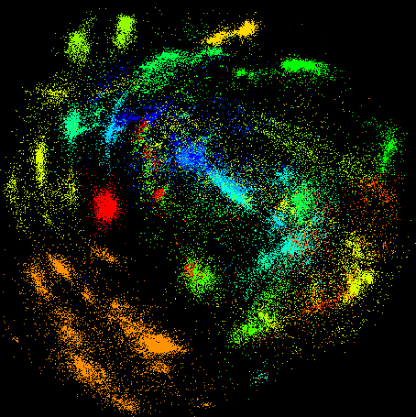
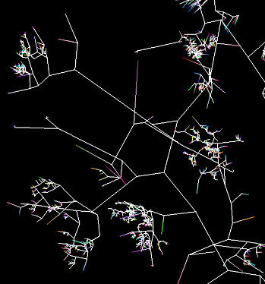
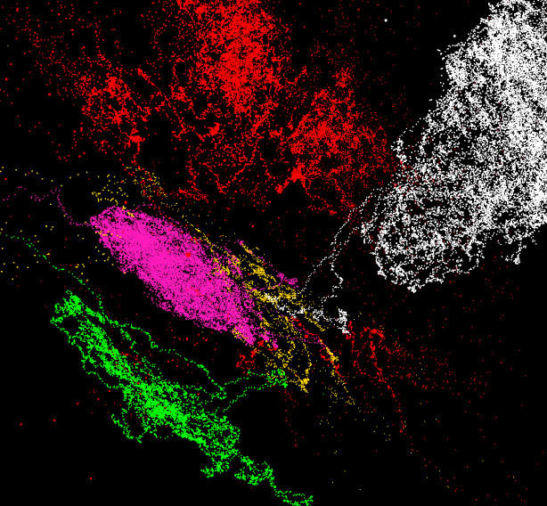
A Use Case
Processes P1 – Pairwise distance calculation P2 – Multi-dimensional scaling P3 – Pairwise clustering (DAPWC) P4 – Visualization | Data D1 – Input data D2 – Distance matrix D3 – 3D coordinates D4 – Cluster mapping D5 – Plot file
P2
D3
D1
P1
D2
P4
D5
P3
D4
100,000 fungi sequences
3D phylogenetic tree
3D plot of vector data

Slide 25
Research Plan
Research Task A
Identify a few prominent benchmarks in the literature.
Apply Ogre classification to 1.
Introduce MDS and clustering classes to 2.
Illustrate facets coverage and opportunities for future benchmarks.
Research Task B
Study the benchmarking process of existing Big Data applications
Apply the findings of 1 to evaluate MDS and clustering Ogres
Draw conclusions as to what runs well and when based on the results of 2.

Slide 26
Current Results

Slide 27
Status
Micro-benchmarks
Adopted OSU benchmarks for OpenMPI Java
Full Application Benchmarks
Deterministic annealing (DA) pairwise clustering (PWC)
DA vector sponge (VS)
SPIDAL
Initial version in GitHub https://github.com/DSC-SPIDAL
Includes MDS and clustering

Slide 28
Test Environments
Computer Systems
Tempest
32 nodes x 4 Intel Xeon E7450 CPUs at 2.40GHz x 6 cores → 768 cores
48 GB node memory
20Gbps Infiniband (IB) network connection.
Windows Server 2008 R2 HPC Edition – version 6.1 (Build 7601: Service Pack 1)
Madrid
8 nodes x 4 AMD Opteron 8356 at 2.30GHz x 4 cores → 128 cores
16GB node memory
1Gbps Ethernet network connection.
Red Hat Enterprise Linux Server release 6.5
India cluster on FutureGrid (FG)
128 nodes x 2 Intel Xeon X5550 CPUs at 2.66GHz x 4 cores → 1024 cores
24GB node memory
20Gbps IB network connection
Red Hat Enterprise Linux Server release 5.10.
Software
Windows
.NET 4.0
MPI.NET 1.0.0
Linux
Java 1.8
HJ-Lib 0.1.1
OpenMPI
OMPI-nightly → 1.9a1r28881
OMPI-trunk → r30301
OMPI-175 → v1.7.5
OMPI-18 → v1.8
OMPI-181 →v1.8.1
FastMPJ v1.0_6

Slide 29
Micro-benchmarks
MPI allreduce operation
MPI send/receive operations

Slide 30
Micro-benchmarks
MPI broadcast operation
MPI allgather operations

Slide 31
Micro-benchmarks
MPI allreduce on IB and Ethernet
MPI send/receive on IB and Ethernet

Slide 32
Full Application Benchmarks DA-PWC
Load Tests
Increase load while keeping constant parallelism
Strong Scaling Tests
Increase parallelism while keep constant load
Parameters
Parallelisms 1 to 256
Nodes 1 to 32
Per node parallelisms 1 to 8
Volume 10k, 12k, 20k, and 40k points
Clusters 10
$$Speedup \left(S_{p}\right)=\frac{T_{p}}{T_{b}}$$
$$Parallel Efficiency \left(E_{p}\right)=b∗\frac{S_{p}}{p}$$
$p$ – Tested parallelism
$b$ – The base parallelism
$T_{p}$– Time taken for $p$ parallelism
$T_{b}$– Time taken for the base case

Slide 33
Load Tests
Performance
Performance relative to 10k

Slide 34
Strong Scaling Tests
40k Performance
40k Speedup
40k Parallel Efficiency

Slide 35
Strong Scaling Tests
20k Performance
20k Speedup
20k Parallel Efficiency

Slide 36
Strong Scaling Tests
12k Performance
12k Speedup
12k Parallel Efficiency

Slide 37
Strong Scaling Tests
Speedup for all data sizes
Parallel efficiency for all data

Slide 38
Discussion on Performance
Java Communication Performance
Identical with C for OpenMPI
Data Structures
Arrays for computations
Direct buffers for communications
Avoid object serialization
If unavoidable use Kryo https://github.com/EsotericSoftware/kryo
Process Binding
Bind processes for better data locality
Dedicated Threads Over Work-sharing or Work-stealing
Important for compute intensive fixed partitioned workloads
Bind to isolated CPUs if available
Use Java-Affinity https://github.com/OpenHFT/Java-Thread-Affinity

Slide 39
Thank you!

