Slide 1
Architecture and Performance of Runtime Environments for Data Intensive Scalable Computing
SC09 Doctoral Symposium, Portland, 11/18/2009
Student: Jaliya Ekanayake
Advisor: Prof. Geoffrey Fox
Community Grids Laboratory,
Digital Science Center
Pervasive Technology Institute
Indiana University

Slide 2
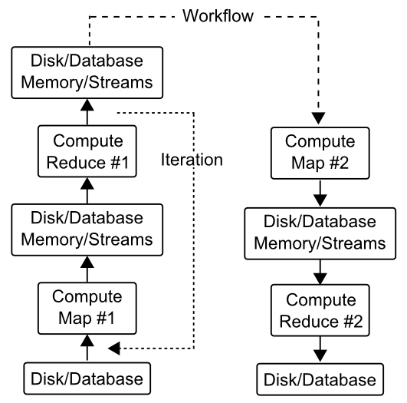
Cloud Runtimes for Data/Compute Intensive Applications
Cloud Runtimes
MapReduce
Dryad/DryadLINQ
Sector/Sphere
Moving Computation to Data
Simple communication topologies
MapReduce
Directed Acyclic Graphs (DAG)s
Distributed File Systems
Fault Tolerance
Data/Compute intensive Applications
Represented as filter pipelines
Parallelizable filters

Slide 3
Applications using Hadoop and DryadLINQ (1)
CAP3 [1] - Expressed Sequence Tag assembly to re-construct full-length mRNA
Input files (FASTA)
DryadLINQ
CAP3
CAP3
CAP3
Output files
“Map only” operation in Hadoop
Single “Select” operation in DryadLINQ
[1] X. Huang, A. Madan, “CAP3: A DNA Sequence Assembly Program,” Genome Research, vol. 9, no. 9, pp. 868-877, 1999.

Slide 4
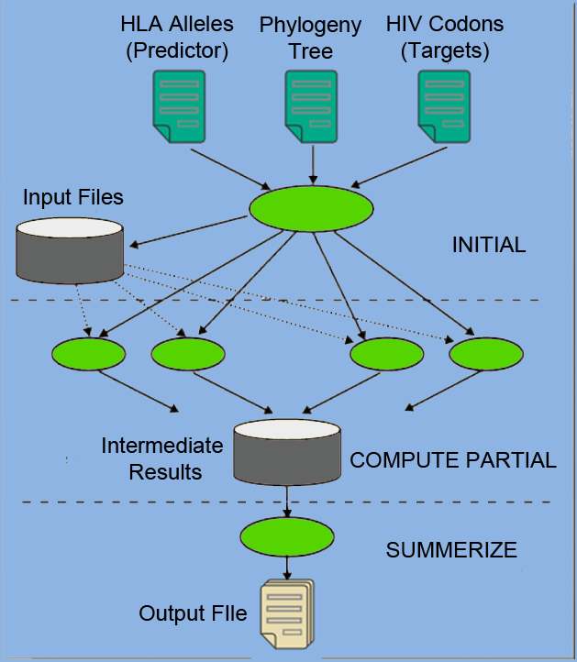
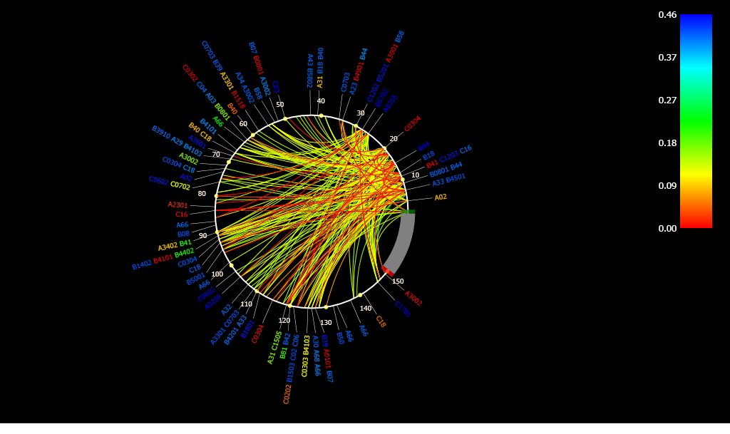
Applications using Hadoop and DryadLINQ (2)
PhyloD [1] project from Microsoft Research
Derive associations between HLA alleles and HIV codons and between codons themselves
DryadLINQ implementation
[1] Microsoft Computational Biology Web Tools, http://research.microsoft.com/en-us/um/redmond/projects/MSCompBio/

Slide 5
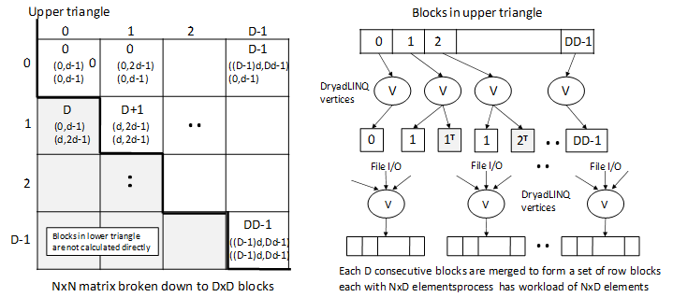
Applications using Hadoop and DryadLINQ (3)
125 million distances
4 hours & 46 minutes
Calculate Pairwise Distances (Smith Waterman Gotoh)
Calculate pairwise distances for a collection of genes (used for clustering, MDS)
Fine grained tasks in MPI
Coarse grained tasks in DryadLINQ
Performed on 768 cores (Tempest Cluster)

Slide 6
Applications using Hadoop and DryadLINQ (4)
High Energy Physics (HEP)
K-Means Clustering
Matrix Multiplication
Multi-Dimensional Scaling (MDS)

Slide 7
MapReduce for Iterative Computations
Classic MapReduce Runtimes
Google, Apache Hadoop, Sector/Sphere, DryadLINQ (DAG based)
Focus on Single Step MapReduce computations only
Intermediate data is stored and accessed via file systems
Better fault tolerance support
Higher latencies
Iterative MapReduce computations uses new maps/reduces in each iteration
Fixed data is loaded again and again
Inefficient for many iterative computations to which the MapReduce technique could be applied
Solution: MapReduce++

Slide 8
Applications & Different Interconnection Patterns
Map Only (Embarrassingly Parallel) | Classic MapReduce | Iterative Reductions MapReduce++ | Loosely Synchronous
CAP3 Gene Analysis Document conversion (PDF -> HTML) Brute force searches in cryptography Parametric sweeps PolarGrid Matlab data analysis | High Energy Physics (HEP) Histograms Distributed search Distributed sorting Information retrieval Calculation of Pairwise Distances for ALU Sequences | Expectation maximization algorithms Clustering - K-means Deterministic Annealing Clustering - Multidimensional Scaling MDS Linear Algebra | Many MPI scientific applications utilizing wide variety of communication constructs including local interactions - Solving Differential Equations and - particle dynamics with short range forces
Input
iterations
Input
Input
map
map
map
Pij
reduce
Output
reduce
Domain of MapReduce and Iterative Extensions
MPI

Slide 9
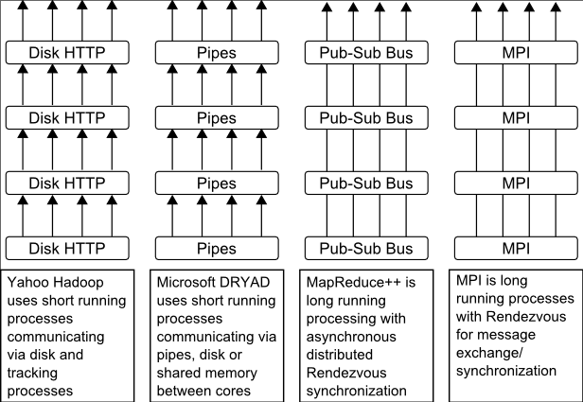
MapReduce++
In-memory MapReduce
Distinction on static data and variable data (data flow vs. δ flow)
Cacheable map/reduce tasks (long running tasks)
Combine operation
Support fast intermediate data transfers
Iterate
Static
data
Configure()
User Program
Map(Key, Value)
δ flow
Reduce (Key, List<Value>)
Combine (Key, List<Value>)
Close()
Different synchronization and intercommunication mechanisms used by the parallel runtimes

Slide 10
MapReduce++ Architecture
Pub/Sub Broker Network
M
Map Worker
Worker Nodes
R
Reduce Worker
D
D
MR
Driver
User
Program
M
M
M
M
D
MRDeamon
R
R
R
R
Data Read/Write
File System
Communication
Data Split
Streaming based communication
Eliminates file based communication
Cacheable map/reduce tasks
Static data remains in memory
User Program is the composer of MapReduce computations
Extends the MapReduce model to iterative computations
A limitation:
Assume that static data fits in to distributed memory

Slide 11
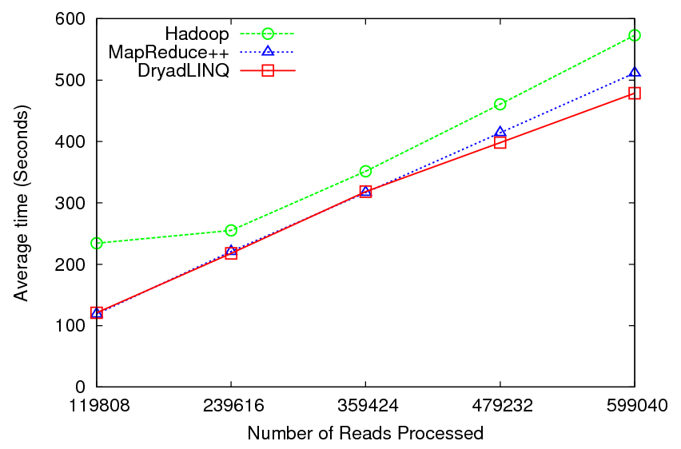
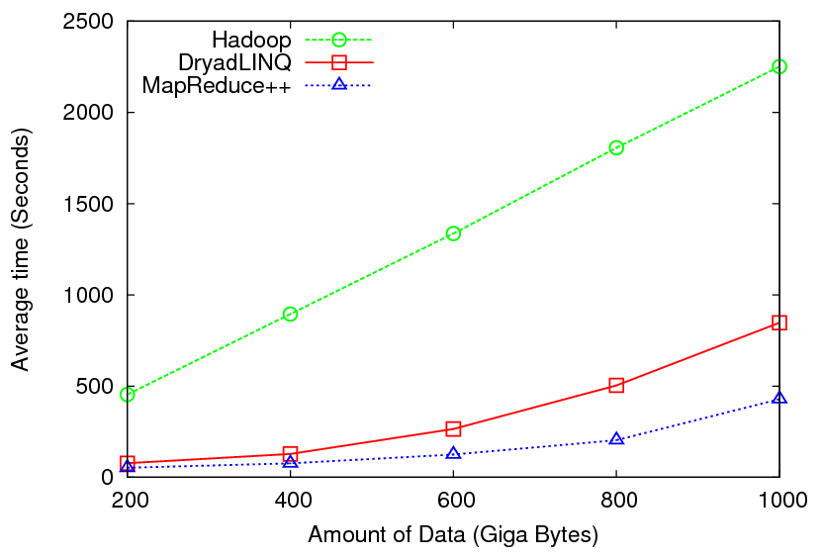
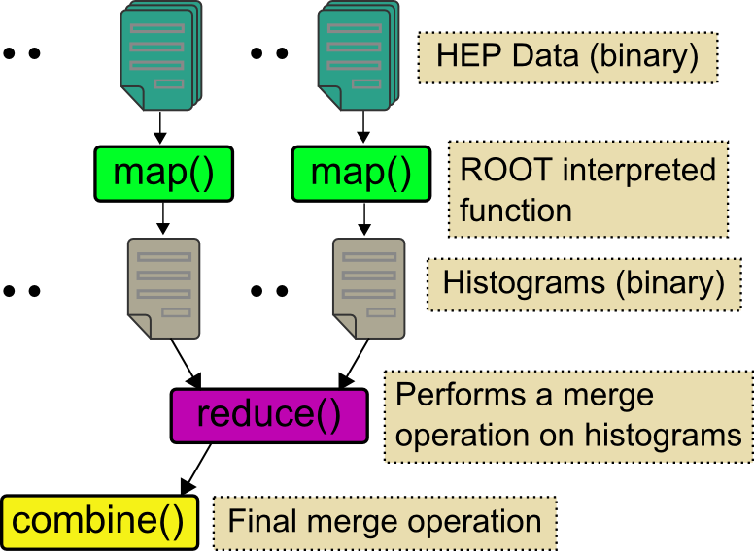
Applications – Pleasingly Parallel
Input files (FASTA)
CAP3 - Expressed Sequence Tagging
CAP3
CAP3
Output files
High Energy Physics (HEP) Data Analysis

Slide 12
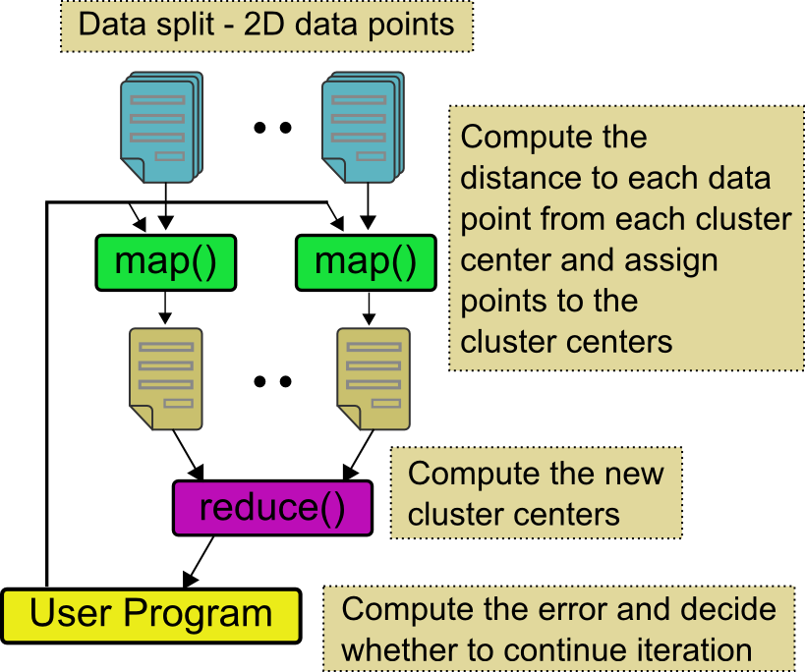
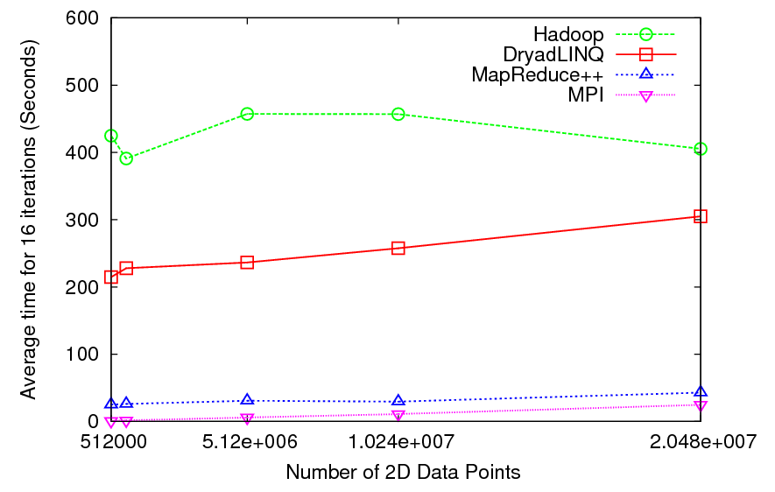
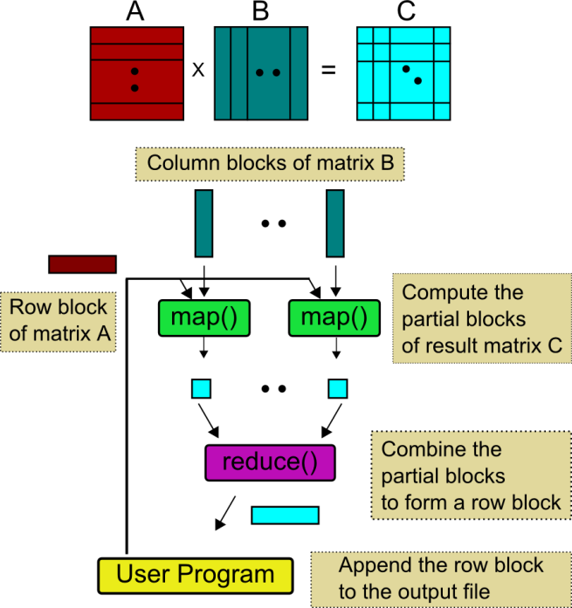
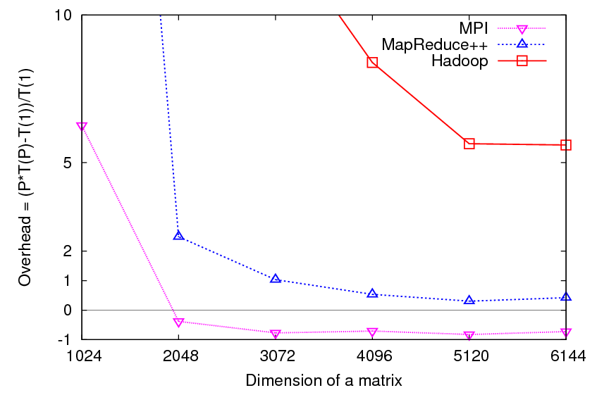
Applications - Iterative
Performance of K-Means
Clustering
Parallel Overhead of Matrix multiplication

Slide 13
Current Research
Virtualization Overhead
Applications more susceptible to latencies (higher communication/computation ratio) => higher overheads under virtualization
Hadoop shows 15% performance degradation on a private cloud
Latency effect on MapReduce++ is lower compared to MPI due to the coarse grained tasks?
Fault Tolerance for MapReduce++
Replicated data
Saving state after n iterations

Slide 14
Related Work
General MapReduce References:
Google MapReduce
Apache Hadoop
Microsoft DryadLINQ
Pregel : Large-scale graph computing at Google
Sector/Sphere
All-Pairs
SAGA: MapReduce
Disco

Slide 15
Contributions
Programming model for iterative MapReduce computations
MapReduce++ implementation
MapReduce algorithms/implementations for a series of scientific applications
Applicability of cloud runtimes to different classes of data/compute intensive applications
Comparison of cloud runtimes with MPI
Virtualization overhead of HPC Applications and Cloud Runtimes

Slide 16
Publications
Jaliya Ekanayake, (Advisor: Geoffrey Fox) Architecture and Performance of Runtime Environments for Data Intensive Scalable Computing, Accepted for the Doctoral Showcase, SuperComputing2009.
Xiaohong Qiu, Jaliya Ekanayake, Scott Beason, Thilina Gunarathne, Geoffrey Fox, Roger Barga, Dennis Gannon, Cloud Technologies for Bioinformatics Applications, Accepted for publication in 2nd ACM Workshop on Many-Task Computing on Grids and Supercomputers, SuperComputing2009.
Jaliya Ekanayake, Atilla Soner Balkir, Thilina Gunarathne, Geoffrey Fox, Christophe Poulain, Nelson Araujo, Roger Barga, DryadLINQ for Scientific Analyses, Accepted for publication in Fifth IEEE International Conference on e-Science (eScience2009), Oxford, UK.
Jaliya Ekanayake and Geoffrey Fox, High Performance Parallel Computing with Clouds and Cloud Technologies, First International Conference on Cloud Computing (CloudComp2009), Munich, Germany. – An extended version of this paper goes to a book chapter.
Geoffrey Fox, Seung-Hee Bae, Jaliya Ekanayake, Xiaohong Qiu, and Huapeng Yuan, Parallel Data Mining from Multicore to Cloudy Grids, High Performance Computing and Grids workshop, 2008. – An extended version of this paper goes to a book chapter.
Jaliya Ekanayake, Shrideep Pallickara, Geoffrey Fox, MapReduce for Data Intensive Scientific Analyses, Fourth IEEE International Conference on eScience, 2008, pp.277-284.
Jaliya Ekanayake, Shrideep Pallickara, and Geoffrey Fox, A collaborative framework for scientific data analysis and visualization, Collaborative Technologies and Systems(CTS08), 2008, pp. 339-346.
Shrideep Pallickara, Jaliya Ekanayake and Geoffrey Fox, A Scalable Approach for the Secure and Authorized Tracking of the Availability of Entities in Distributed Systems, 21st IEEE International Parallel & Distributed Processing Symposium (IPDPS 2007).

Slide 17
Acknowledgements
My Ph.D. Committee:
Prof. Geoffrey Fox
Prof. Andrew Lumsdaine
Prof. Dennis Gannon
Prof. David Leake
SALSA Team @ IU
Especially: Judy Qiu, Scott Beason, Thilina Gunarathne, Hui Li
Microsoft Research
Roger Barge
Christophe Poulain

Slide 18
Questions?
Thank you!

Slide 19
Parallel Runtimes – DryadLINQ vs. Hadoop
Feature | Dryad/DryadLINQ | Hadoop
Programming Model & Language Support | DAG based execution flows. Programmable via C# DryadLINQ Provides LINQ programming API for Dryad | MapReduce Implemented using Java Other languages are supported via Hadoop Streaming
Data Handling | Shared directories/ Local disks | HDFS
Intermediate Data Communication | Files/TCP pipes/ Shared memory FIFO | HDFS/ Point-to-point via HTTP
Scheduling | Data locality/ Network topology based run time graph optimizations | Data locality/ Rack aware
Failure Handling | Re-execution of vertices | Persistence via HDFS Re-execution of map and reduce tasks
Monitoring | Monitoring support for execution graphs | Monitoring support of HDFS, and MapReduce computations

Slide 20
Cluster Configurations
Feature | GCB-K18 @ MSR | iDataplex @ IU | Tempest @ IU
CPU | Intel Xeon CPU L5420 2.50GHz | Intel Xeon CPU L5420 2.50GHz | Intel Xeon CPU E7450 2.40GHz
# CPU /# Cores | 2 / 8 | 2 / 8 | 4 / 24
Memory | 16 GB | 32GB | 48GB
# Disks | 2 | 1 | 2
Network | Giga bit Ethernet | Giga bit Ethernet | Giga bit Ethernet / 20 Gbps Infiniband
Operating System | Windows Server Enterprise - 64 bit | Red Hat Enterprise Linux Server -64 bit | Windows Server Enterprise - 64 bit
# Nodes Used | 32 | 32 | 32
Total CPU Cores Used | 256 | 256 | 768
DryadLINQ
Hadoop / MPI
DryadLINQ / MPI

