Slide 1
Science in Clouds
SALSA Team
salsaweb/salsa
Community Grids Laboratory,
Digital Science Center
Pervasive Technology Institute
Indiana University

Slide 2
Science Clouds Architecture
Smith Waterman Dissimilarities, CAP-3 Gene Assembly, PhyloD Using DryadLINQ, High Energy Physics, Clustering, Multidimensional Scaling, Generative Topological Mapping
Applications
Runtimes
Apache Hadoop / MapReduce++ / MPI
Microsoft DryadLINQ / MPI
Linux Bare-system
Linux Virtual Machines
Windows Server 2008 HPC
Bare-system
Windows Server 2008 HPC
Infrastructure software
Xen Virtualization
Xen Virtualization
XCAT Infrastructure
Hardware
iDataplex Bare-metal Nodes
Virtual Cluster provisioning via XCAT
Supports both stateful and stateless OS images

Slide 3
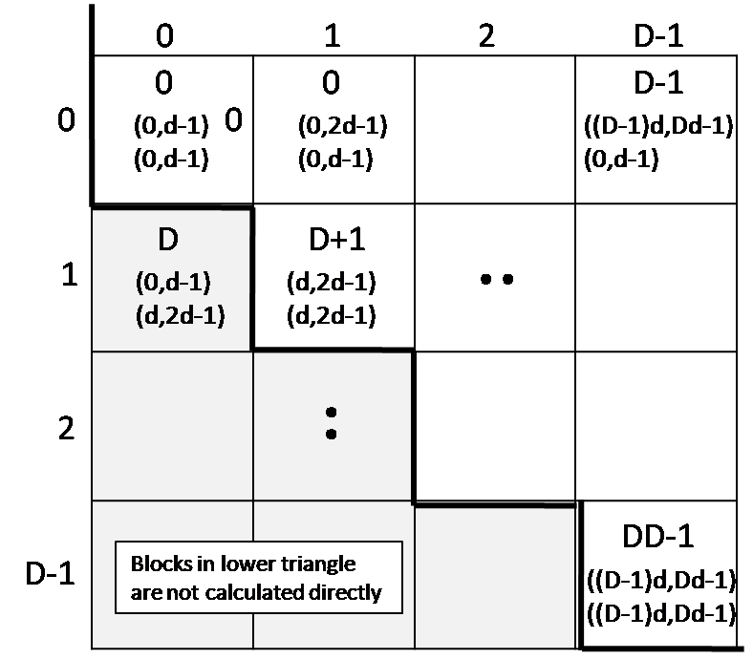
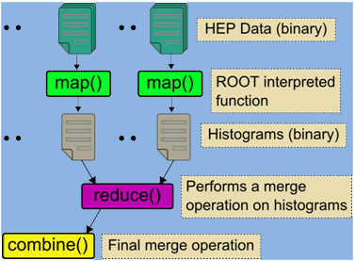
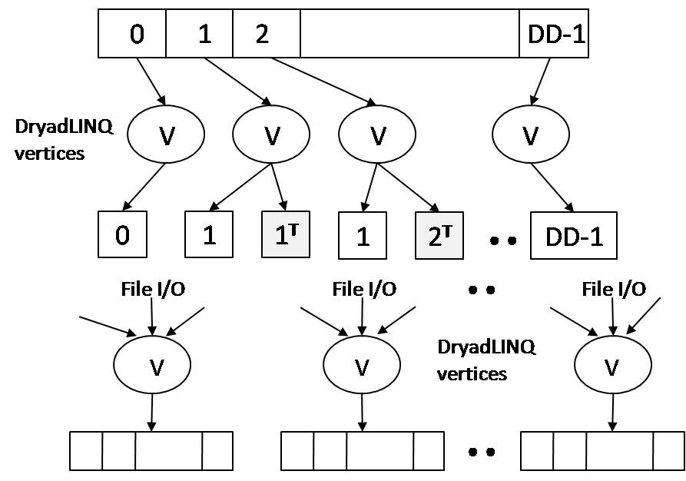
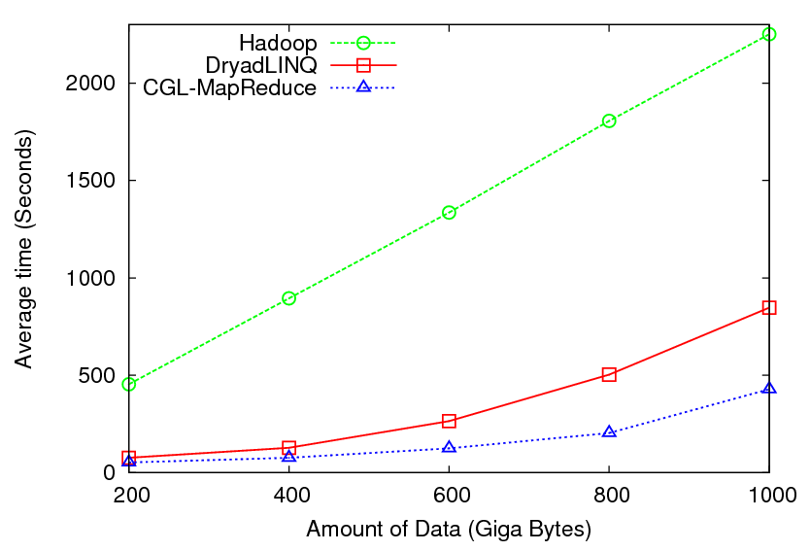
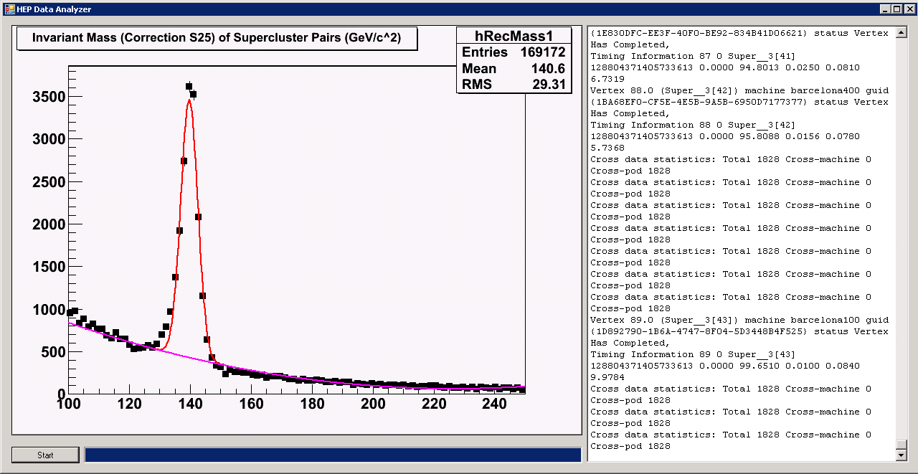
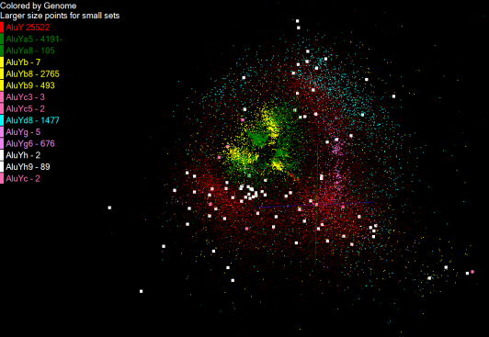
Pairwise Distances – Smith Waterman
High Energy Physics
Upper triangle
Blocks in upper triangle
HEP data analysis
DryadLINQ, Hadoop, MapReduce++ Implementations
0
1
2
D-1
0
1
2
D-1
Each D consecutive blocks are merged to form a set of row blocks ; each with NxD elements process has workload of NxD elements
NxN matrix broken down to DxD blocks
Calculate pairwise distances for a collection of genes (used for clustering, MDS)
Fine grained tasks in MPI
Coarse grained tasks in DryadLINQ
Performed on 768 cores (Tempest Cluster)
125 million distances
4 hours & 46 minutes

Slide 4
Scalability of Pairwise Distance Calculations
Performance degradation for 125 million distance calculations on VM 15.33%
DryadLinq on Windows HPC
Hadoop MapReduce on Linux bare metal
Hadoop MapReduce on Linux Virtual Machines running on Xen Hypervisor
Perf. Degradation = (T_{vm} – T_{baremetal})/T_{baremetal}
VM overhead decreases with the increase of block sizes
Memory bandwidth bound computation
Communication in bursts
Performed on IDataPlex Cluster using 32 nodes * 8 cores

Slide 5
Pairwise Distance Calculations Effect of Inhomogeneous Data
Calculation Time per Pair [A,B] α Length A * Length B
Inhomogeneity of data does not have a significant effect when the sequence lengths are randomly distributed
This shows the natural load balancing of Hadoop MR dynamic task assignment using a global pipe line in contrast to the DryadLinq static assignments

Slide 6
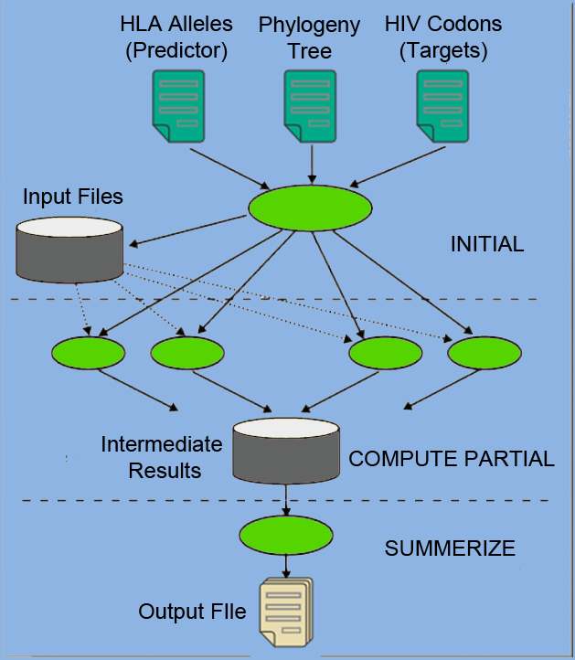
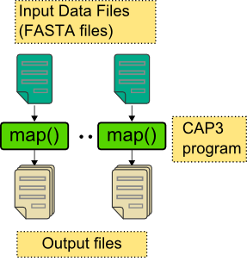
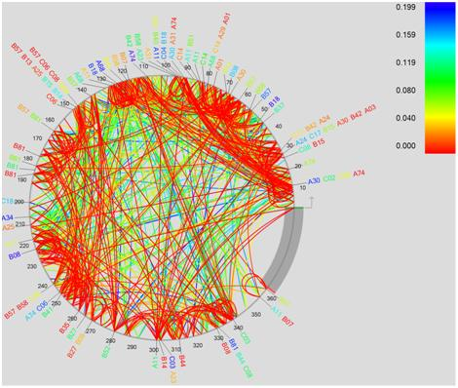
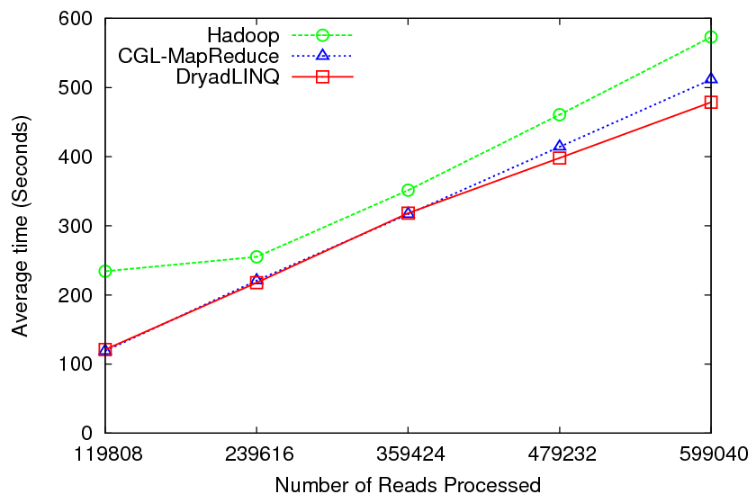
CAP3 – Gene Assembly
PhyloD using DryadLINQ
Performance of CAP3
Expressed Sequence Tag assembly to re-construct full-length mRNA
Perform using DryadLINQ, Apache Hadoop, MapReduce++ implementations
Derive associations between HLA alleles and HIV codons and between codons themselves
DryadLINQ
implementation

Slide 7
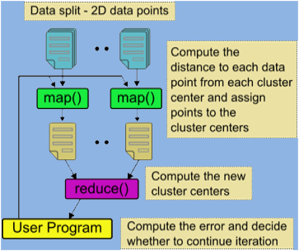
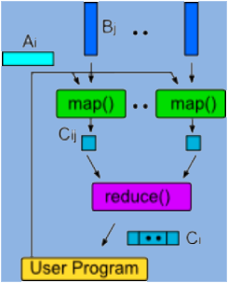
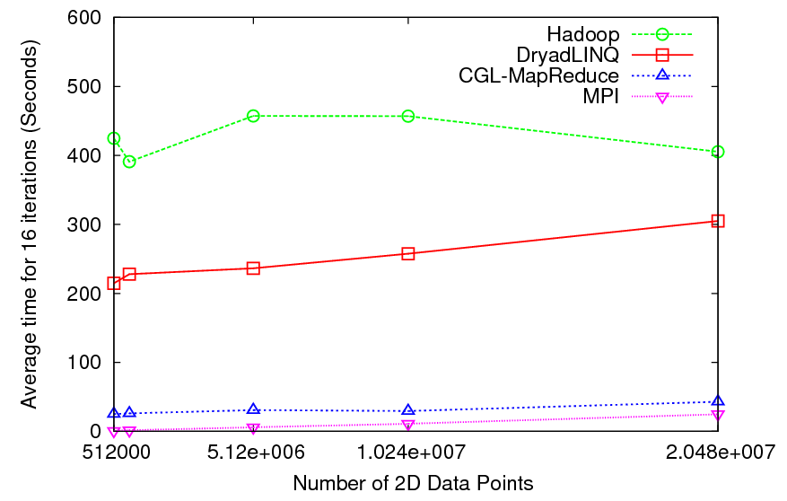
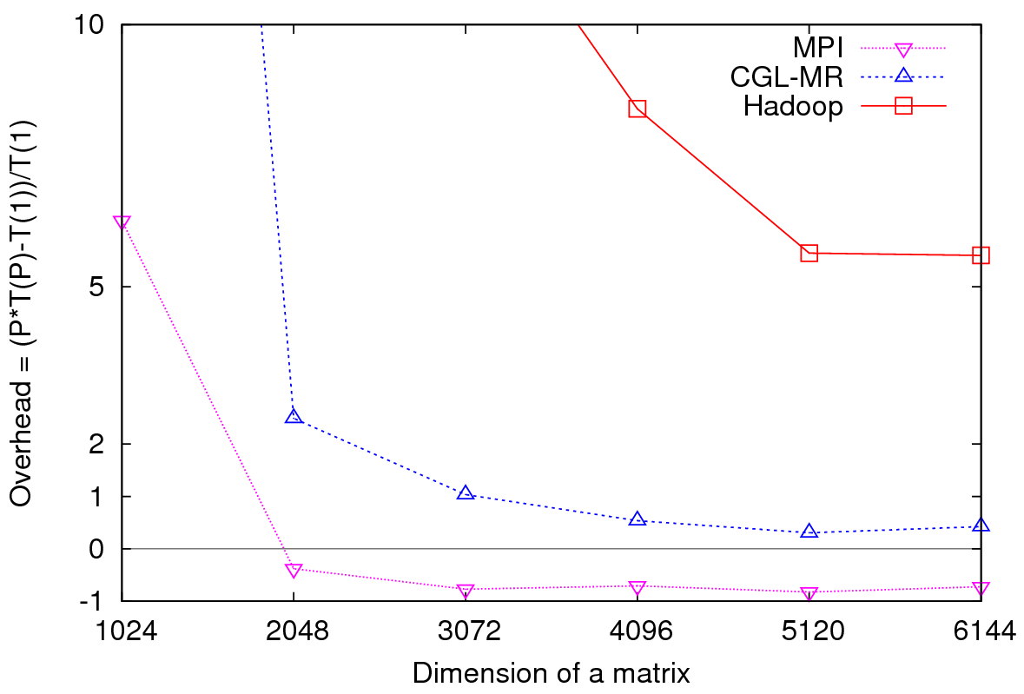
K-Means Clustering & Matrix Multiplication Using Cloud Technologies
Parallel Overhead
Matrix Multiplication
Performance of K-Means
K-Means clustering on 2D vector data
DryadLINQ, Hadoop, MapReduce++ and MPI implementations
MapReduce++ performs close to MPI
Matrix multiplication in MapReduce model
Hadoop, MapReduce++, and MPI
MapReduce++ perform close to MPI

Slide 8
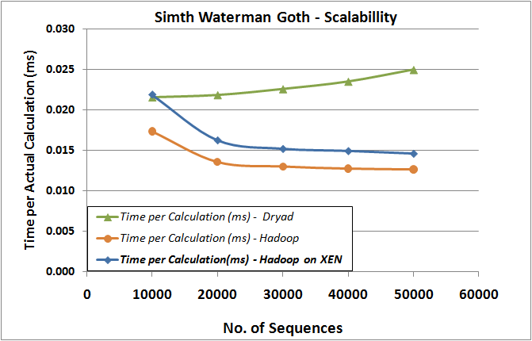
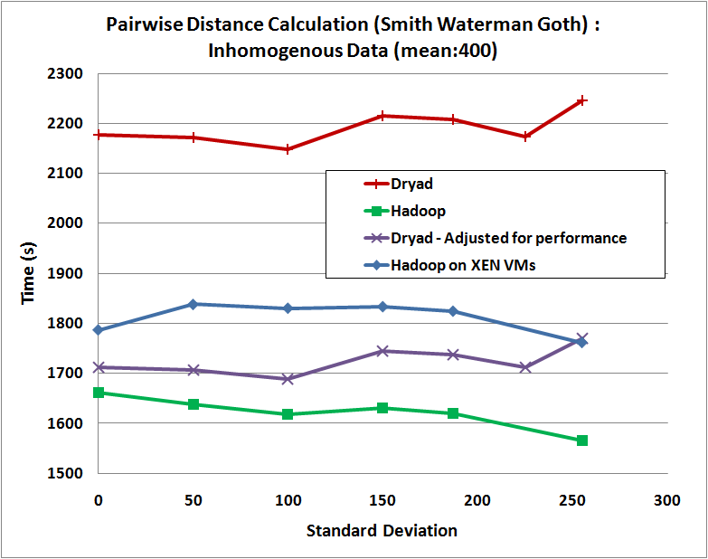
Virtualization Overhead – Cloud Technologies
Nearly 15% performance degradation in Hadoop on XEN VMs
Hadoop handles the inhomogeneous data better than Dryad
-- Dynamic Task Scheduling of Hadoop made this possible
Handling large data on VMs add more overhead
-- Especially if the data is accessed over the network

Slide 9
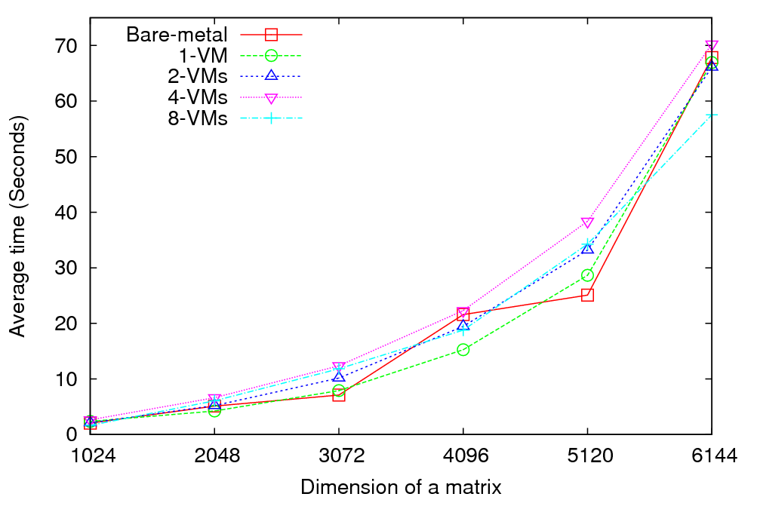
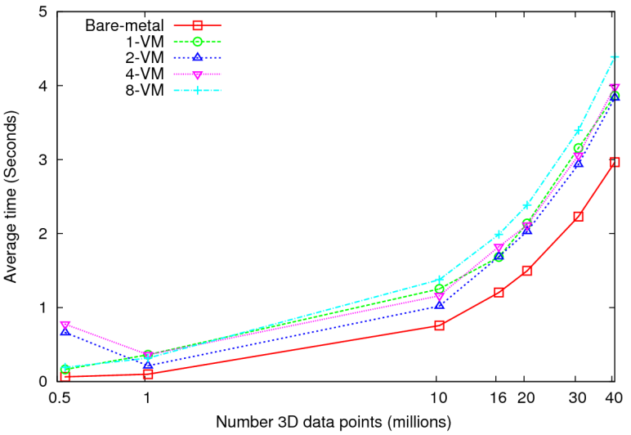
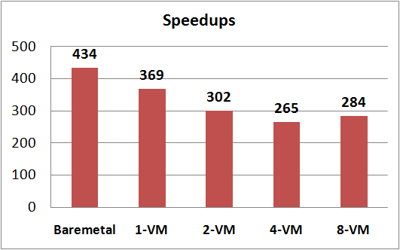
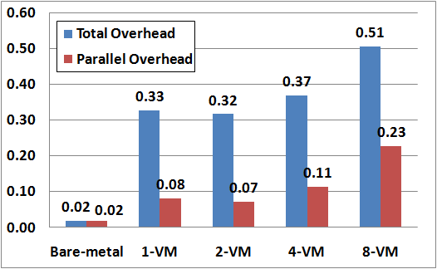
Virtualization Overhead - MPI
Performance - 64 CPU cores
Speedup – Fixed matrix size (5184x5184)
Performance – 128 CPU cores
Overhead = (P * T(P) –T(1))/T(1)
Up to 40 million 3D data points
Amount of communication depends only on the number of cluster centers
Amount of communication << Computation and the amount of data processed
At the highest granularity VMs show 33% or more total overhead
Extremely large overheads
for smaller grain sizes
Implements Cannon’s Algorithm [1]
Exchange large messages
More susceptible to bandwidth than latency
14% reduction in speedup between bare-system and 1-VM per node

Slide 10
MapReduce++
Iterate
Pub/Sub Broker Network
Map Worker
Map(Key, Value)
M
Worker Nodes
R
Reduce Worker
D
D
MR
Driver
User
Program
Reduce (Key, List<Value>)
User Program
D
MRDeamon
M
M
M
M
R
R
R
R
Data Read/Write
Communication
Combine (Key, List<Value>)
Data Split
File System
Streaming based communication
Intermediate results are directly transferred from the map tasks to the reduce tasks – eliminates local files
Cacheable map/reduce tasks
Static data remains in memory
Combine phase to combine reductions
User Program is the composer of MapReduce computations
Extends the MapReduce model to iterative computations
Disk HTTP
Pipes
Pub-Sub Bus
Disk HTTP
Pipes
Pub-Sub Bus
Disk HTTP
Pipes
Pub-Sub Bus
Different synchronization and intercommunication mechanisms used by the parallel runtimes
Disk HTTP
Pipes
Pub-Sub Bus
Yahoo Hadoop uses short running processes communicating via disk and tracking processes
Microsoft DRYAD uses short running processes communicating via pipes disk or shared memory between cores
MapReduce ++ is long running processing with asynchronous distributed Randezvous synchronization

Slide 11
High Performance Dimension Reduction and Visualization
Need is pervasive
Large and high dimensional data are everywhere: biology, physics, Internet, …
Visualization can help data analysis
Visualization with high performance
Map high-dimensional data into low dimensions.
Need high performance for processing large data
Developing high performance visualization algorithms: MDS(Multi-dimensional Scaling), GTM(Generative Topographic Mapping), DA-MDS(Deterministic Annealing MDS), DA-GTM(Deterministic Annealing GTM), …
Notes:
MDS (Multi-dimensional Scaling)
GTM (Generative Topographic Mapping)
DA-MDS(Deterministic Annealing MDS)
DA-GTM(Deterministic Annealing GTM)

Slide 12
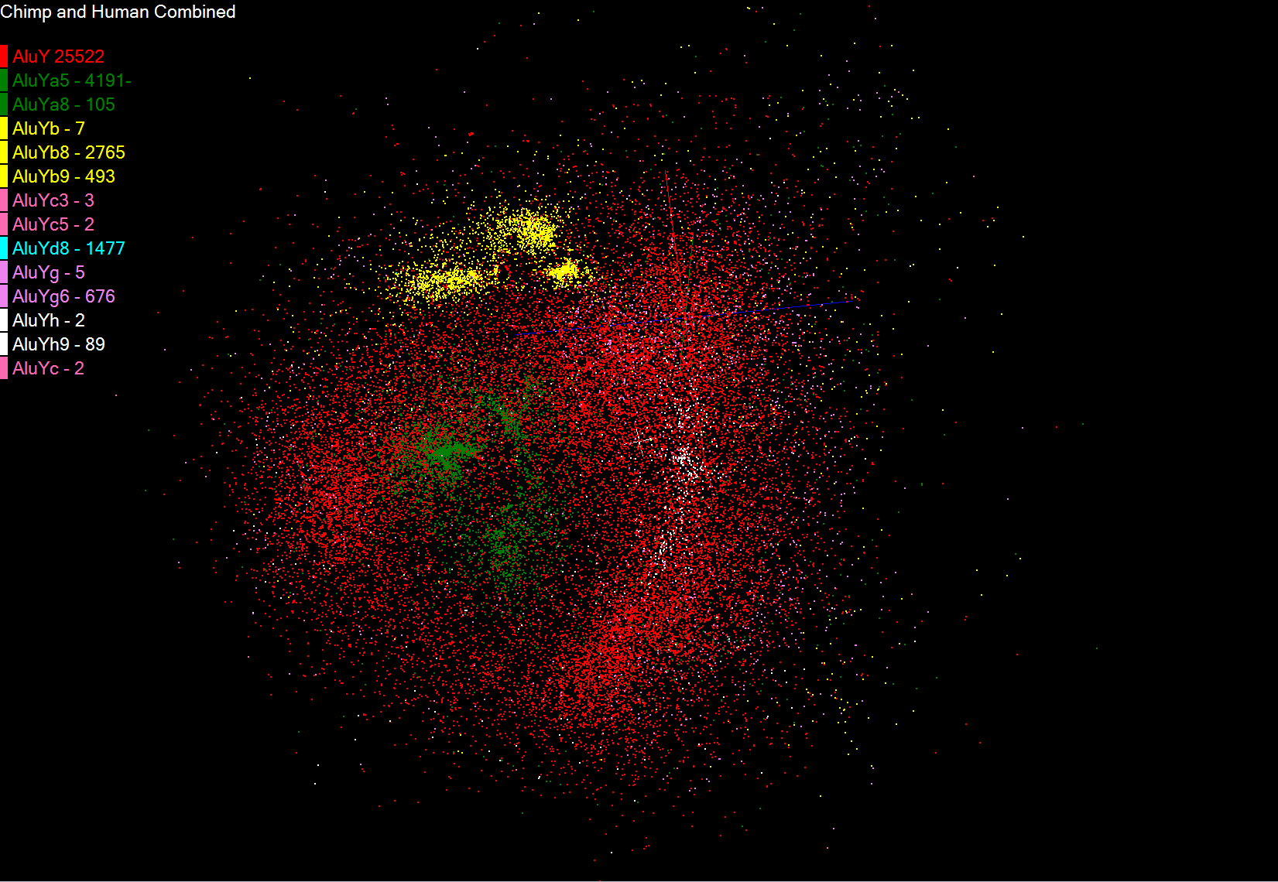
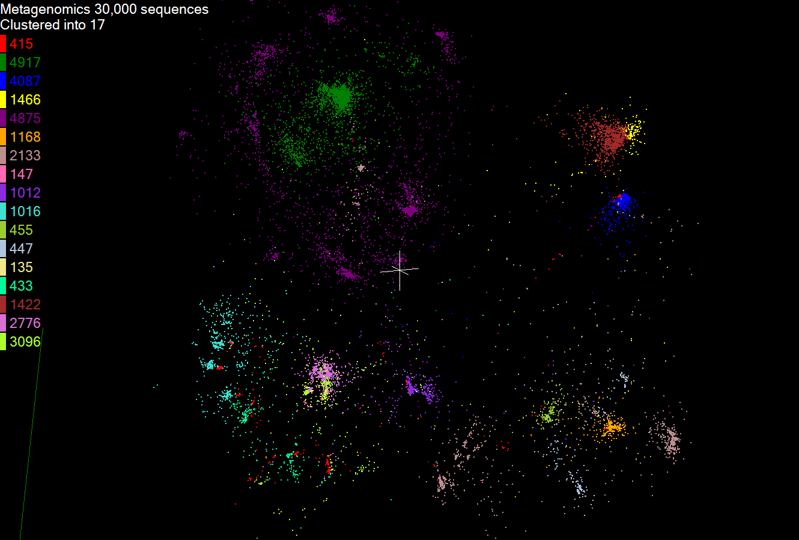
Biology Clustering Results
Alu families
Metagenomics

Slide 13
Analysis of 26 Million PubChem Entries
26 million PubChem compounds with 166 features
Drug discovery
Bioassay
3D visualization for data exploration/mining
Mapping by MDS(Multi-dimensional Scaling) and GTM(Generative Topographic Mapping)
Interactive visualization tool PlotViz
Discover hidden structures

Slide 14
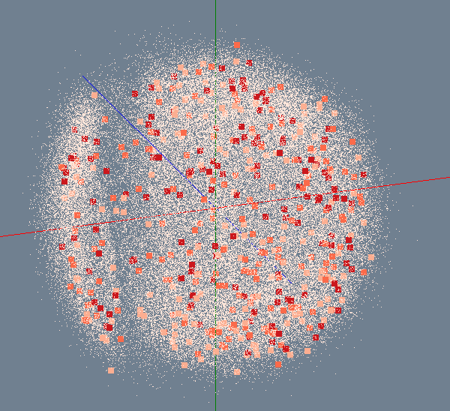
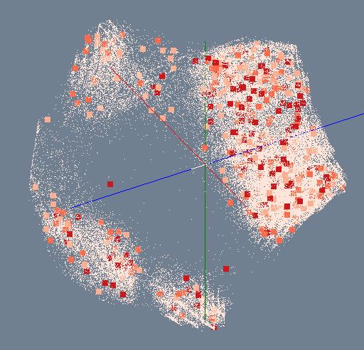
MDS/GTM for 100K PubChem
Number of Activity Results
> 300
200 ~ 300
100 ~ 200
< 100
MDS
GTM

Slide 15
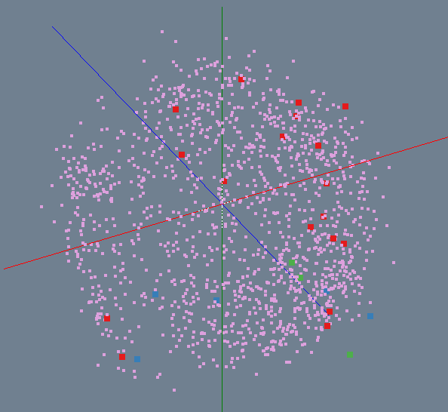
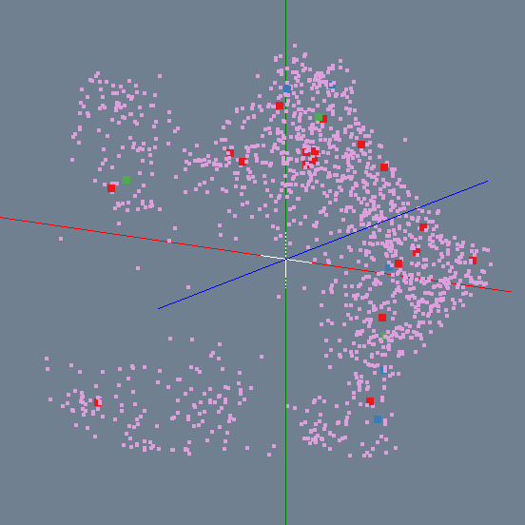
Bioassay activity in PubChem
Highly Active
Active
Inactive
Highly Inactive
MDS
GTM

Slide 16
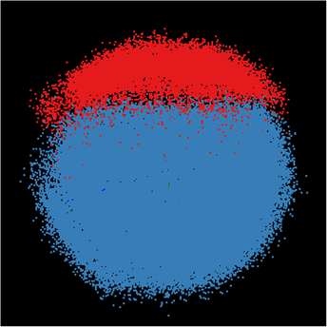
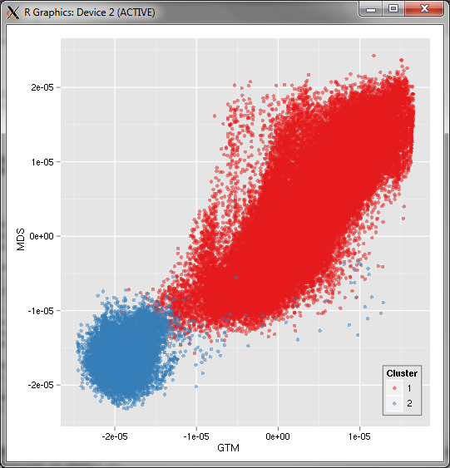
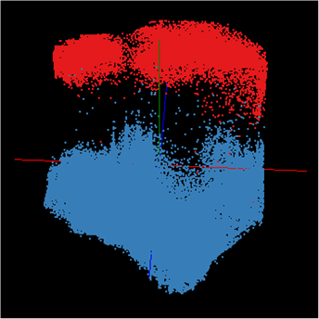
Correlation between MDS/GTM
MDS
GTM
Canonical Correlation between MDS & GTM
Notes:
Colors represent k-mean (k=2) results. Correlation is measured between MDS and GTM by using Canonical Correlation Analysis (CCA) and it shows high-correlation between them.

Slide 17
Child Obesity Study
Discover environmental factors related with child obesity
About 137,000 Patient records with 8 health-related and 97 environmental factors has been analyzed
Health data
Environment data
Genetic Algorithm
BMI
Blood Pressure
Weight
Height
…
Greenness
Neighborhood
Population
Income
…
Canonical Correlation Analysis
Visualization

Slide 18
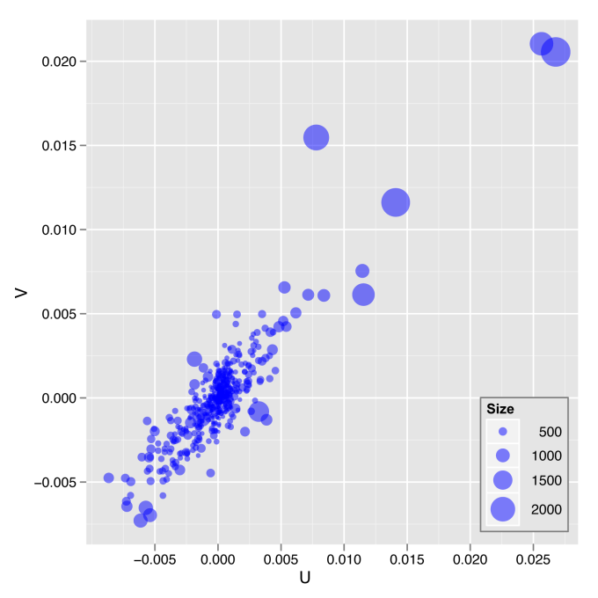
Canonical Correlation Analysis and Multidimensional Scaling
a)
b)
a) The plot of the first pair of canonical variables for 635 Census Blocks
b) The color coded correlation between MDS and first eigenvector of PCA decomposition

Slide 19
SALSA Dynamic Virtual Cluster Hosting
Monitoring Infrastructure
SW-G Using Hadoop
SW-G Using Hadoop
SW-G Using DryadLINQ
SW-G Using Hadoop
SW-G Using Hadoop
SW-G Using DryadLINQ
Linux
Bare-system
Linux on Xen
Windows Server 2008 Bare-system
Cluster Switching from Linux Bare-system to Xen VMs to Windows 2008 HPC
XCAT Infrastructure
iDataplex Bare-metal Nodes (32 nodes)
SW-G : Smith Waterman Gotoh Dissimilarity Computation
– A typical MapReduce style application

Slide 20
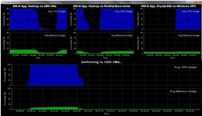
Monitoring Infrastructure
Monitoring Interface
Pub/Sub Broker Network
Virtual/Physical Clusters
Summarizer
XCAT Infrastructure
Switcher
iDataplex Bare-metal Nodes
(32 nodes)

Slide 21
SALSA HPC Dynamic Virtual Clusters

Slide 22
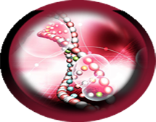
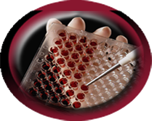
Life Science Demos
(Using Multicore and MapReduce)
Clustering to find multiple genes
Metagenomics
Visualization of ALU repetition alignment
(Chimp and Human data combined)
by using Smith Waterman dissimilarity.
Biology Data
Bioassay activity/inactivity classification
Visualization of PubChem data by using MDS and GTM
PubChem
Bioassay active counts

