Slide 1
Evaluation of SMP Shared Memory Machines for Use With In-Memory and OpenMP Big Data Applications
Andrew J. Younge ∗ , Christopher Reidy † , Robert Henschel ∗ , Geoffrey C. Fox ∗
∗ School of Informatics and Computing
Indiana University
901 E. 10th St, Bloomington, IN USA
{ajyounge, henschel, gcf}@indiana.edu
† Research Computing
University of Arizona
1077 N. Highland Ave, Tucson, AZ USA
chrisreidy@email.arizona.edu

Slide 2
Agenda
Introduction
Motivation
Thread parallelism vs large memory
Two SMP Machines:
ScaleMP vSMP @ Indiana University
SGI UV 1000 @ University of Arizona
Performance Evaluation
SPEC OpenMP benchmarks
Trinitiy De-novo Assembly
Discussion

Slide 3
Introduction
Natural desire for larger, more powerful computing components
Need for systems larger than a single node/board/chip can provide
Distributed memory systems fill this role, but can present a larger barrier of entry
Require special programming models
Code redesign
Explicit parallelism
Want the performance of distributed memory with the ease of a single resource

Slide 4
Symmetric Multiprocessing
Desire to treat distributed memory systems like a single, unified computing resource
Centralized shared memory under a single unified OS with many processing units
Historically SMP was multi-socket, now multi-node
Operate across a system bus
NUMA
Current implementations have complex cache coherency mechanisms

Slide 5
SMP Use Cases
Thread Parallelism
Large Memory
Applications can leverage more threads than what is commonly available from a single computing resource
Easy scaling to SMPs given today’s multi-core systems
Programming models include OpenMP, Pthreads, Cilk, etc
Amount of main memory needed can be more than what a single system can support
Allows for fast DRAM to be used instead of disk
Scaling databases, big data applications, in-memory data management
The goal is to avoid re-writing applications from scratch but still scale beyond single node performance

Slide 6
Role of SMPs for Big Data
There are many efforts that are not able to take advantage of distributed memory systems
Legacy code too hard to update
Proprietary code unable to be modified
Development effort exceeds application usability
SMPs enable the utilization of distributed systems in an environment that appears as a single entity
100s of cores, TBs of RAM
However SMP performance is often nondeterministic and lacking clarity for use with big data applications

Slide 7
ScaleMP vSMP
Aggregates commodity x86 servers to create a single, virtualized system.
Looks like a large VM with 1 OS with all cores & memory available
Can scale to 128 nodes (1024 cores, 128TB RAM)
vSMP Foundation
Runs via master/slave nodes
Leverage RDMA via InfiniBand interconnect
Data locality, CPU organization handled by vSMP and OS kernel scheduling & tools

Slide 8
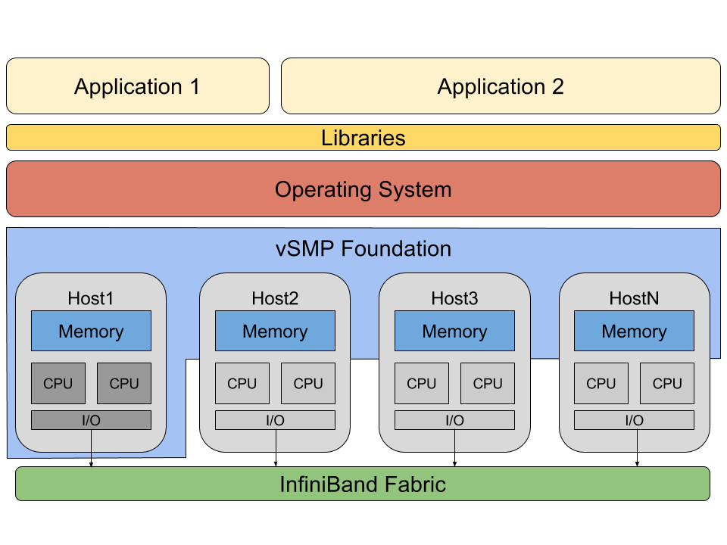
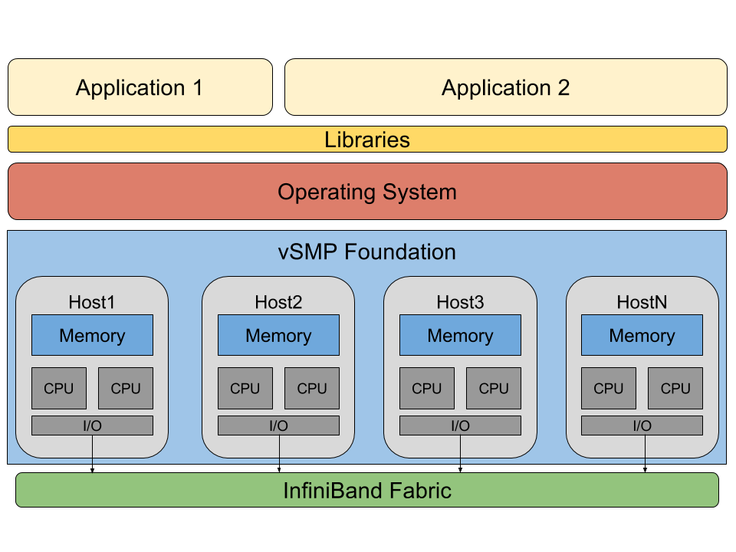
vSMP Expansion Modes
Memory Expansion
System Expansion

Slide 9
Echo @ IU
Echo is the vSMP installation as part of the NSF FutureGrid project (now FutureSystems) at Indiana University
16 nodes, 192 cores, 5.6TB RAM
Mellanox CX3 QDR InfiniBand
Purchased in late 2013, based on Intel Xeon Sandy-Bridge

Slide 10
SGI Ultraviolet (UV)
SGI has been providing SMP machines for many years
Design dates back to original Stanford DASH computer
Creates global shared memory system across many blades
Developed specialized NUMAlink interconnect
Global Register unit for Cache Coherency
Active Memory Unit for atomic operations
Socket based Intel QPI interface

Slide 11
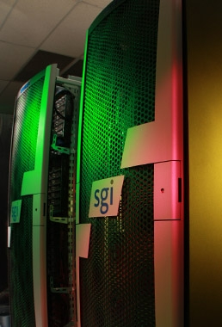
SGI UV
SGI UV installation at University of Arizona
UV 1000 – 58 nodes at 1776 cores, ~10 Tflops
16 nodes reserved exclusively for our experimentation
Purchased in 2011, based on Intel Xeon Westmere cores

Slide 12
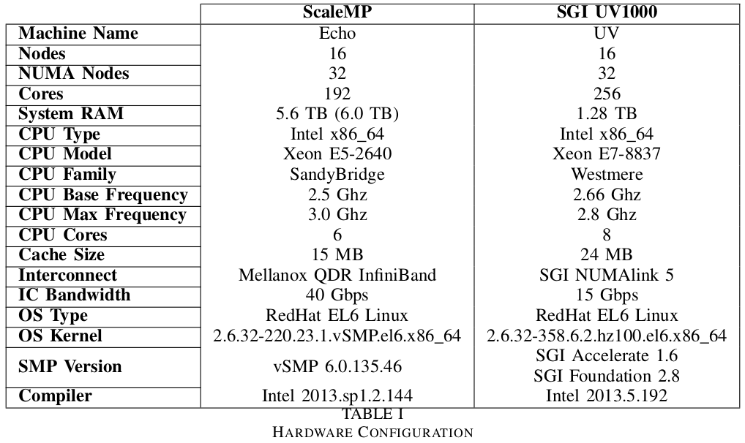
Hardware Comparison

Slide 13
Other SMP Solutions
We are evaluating 2 SMP solutions, but others exist
BullX SuperNode S6000 - 288 cores, 24TB RAM, IB
“Fat node” single server solution - ~2TB
Intel Xeon Phi - many cores, little RAM
IBM POWER8 8-way SMP

Slide 14
Performance Evaluation
Evaluating the performance of two dissimilar SMP machines: vSMP and SGI UV
Apples-to-apples comparison not possible, but want make best effort to keep as equal as possible
Same node count, similar OS & kernels, etc
Look at our two use cases: Task-level parallelism and in-memory big data apps

Slide 15
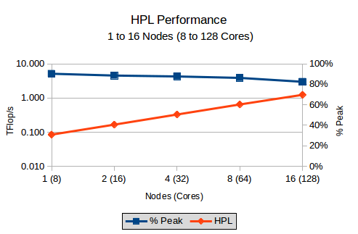
MPI on SMP?
While MPI not the target for SMP machines, both ScaleMP and SGI support MPI apps
ScaleMP provides MPICH2 build
SGI has specialized MPI offload engine
Overall, MPI performance on both SGI UV and vSMP are good
vSMP: 82.4% peak
HPL Performance on “India” test ScaleMP vSMP system (16 nodes)

Slide 16
SPEC OMP 2012
Standard Performance Evaluation Corporation (SPEC) is a consortium for systems benchmarking
Developed SPEC OMP 2012 as an OpenMP benchmark suite
Based on original OMP 2001 suite
Leverages HPC simulation applications
Ranges from MD, CFD, LU factorization, alignment…
Uses a reference system for result comparison
Sun FireX4140 with two AMD Opteron 2384 CPUs (quad core)

Slide 17
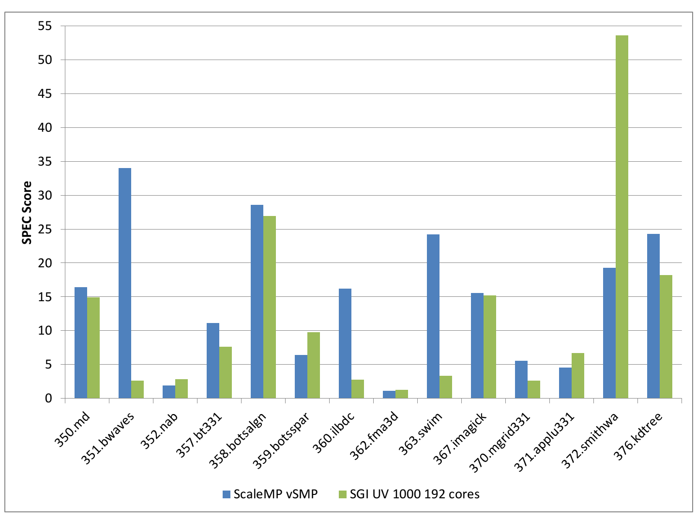

Slide 18
SPEC OMP Results
Immediately, no simple story across 14 OMP benchmarks
352.nab, 362.fma3d, 370.mgrid, and 371.applu331 do not scale well
350.md, 358.botsalgn, 372.smithwa, and 376.kdtree, scale well on both systems
SPEC Score: vSMP = 10.4 and SGI = 7.01
9 benchmarks comparable between both machines Adjusted score: 7.65 vs 7.44 (resp)
4 benchmarks where vSMP at least 2x better than SGI
1 benchmark where SGI 2.7x faster than vSMP
Notes:
SPEC score is a geometric mean of all benchmark scores

Slide 19
SPEC OMP on Architectures
Need to consider CPU architecture differences when comparing scores
SGI UV is E7-8837 Westmere, 8-cores/socket
vSMP is E5-2640 Sandy-Bridge, 6-cores/socket
Looking at SPEC CPU 2006, see ~17% raw difference between CPUs
E7-8837 = 39.3 vs E5-2640 = 46.0
However, 17% CPU improvement does not explain the 1.5x difference between vSMP and SGI
5.8x difference for large memory footprint OMP benchmarks
40Gbs QDR IB vs 7.5Gbs NUMAlink5
Difference is in the Interconnect bandwidth, exacerbated with benchmarks with high memory footprints.

Slide 20
Trinity de novo Assembly
A transcriptome is the set of all RNA molecules that are transcribed in a cell
Help identify genes, alternative splicing in genes, and differential expression of genes in distinct cell populations
RNA-Seq produces millions of short RNA sequence reads
Typically, these huge data sets are down-sampled to produce a smaller data and computed on commodity systems
Assembled full RNASeq data set of 370 million reads using the Trinity assembly package.
Two job types based on Crangon crangon (Shrimp)
gathered from an Illumina RNAseq dataset
100bp reads, ~50x coverage
Job1: only R1 reads
Job2: R1 and R2 reads

Slide 21
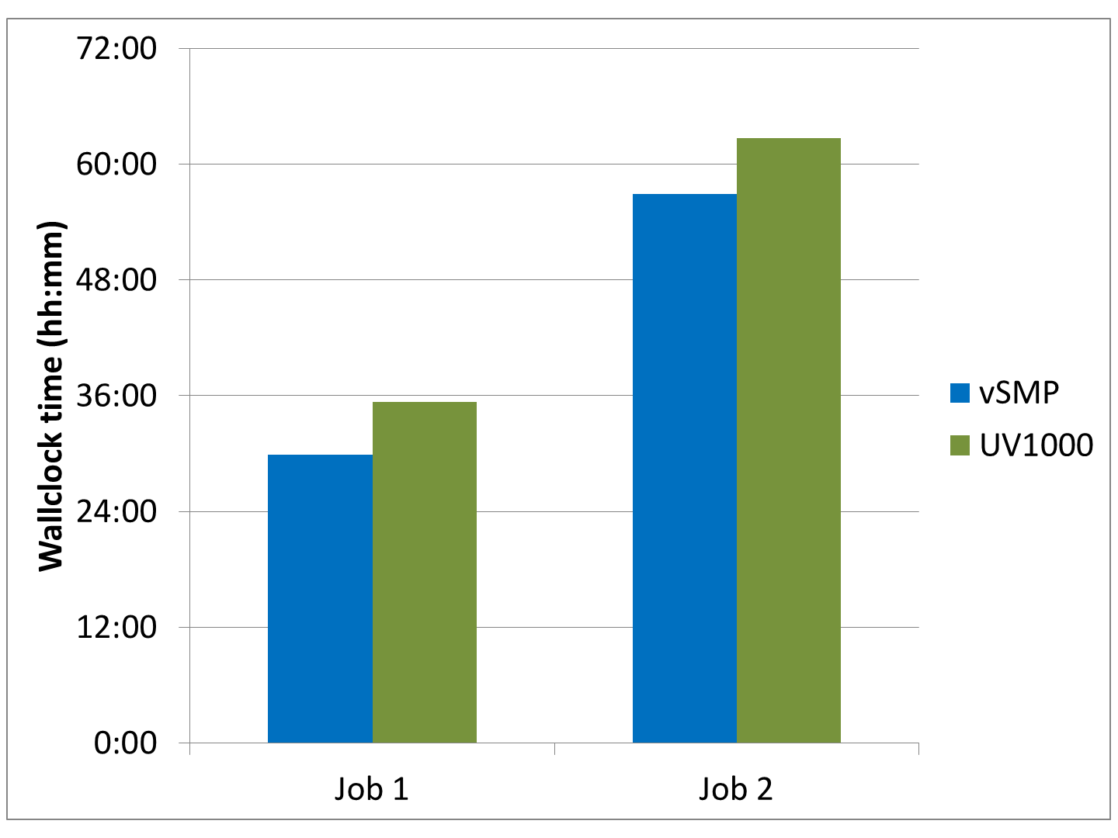
Trinity Wallclock time
vSMP outperforms SGI UV
15.6% for Job1
9.3% for Job2

Slide 22
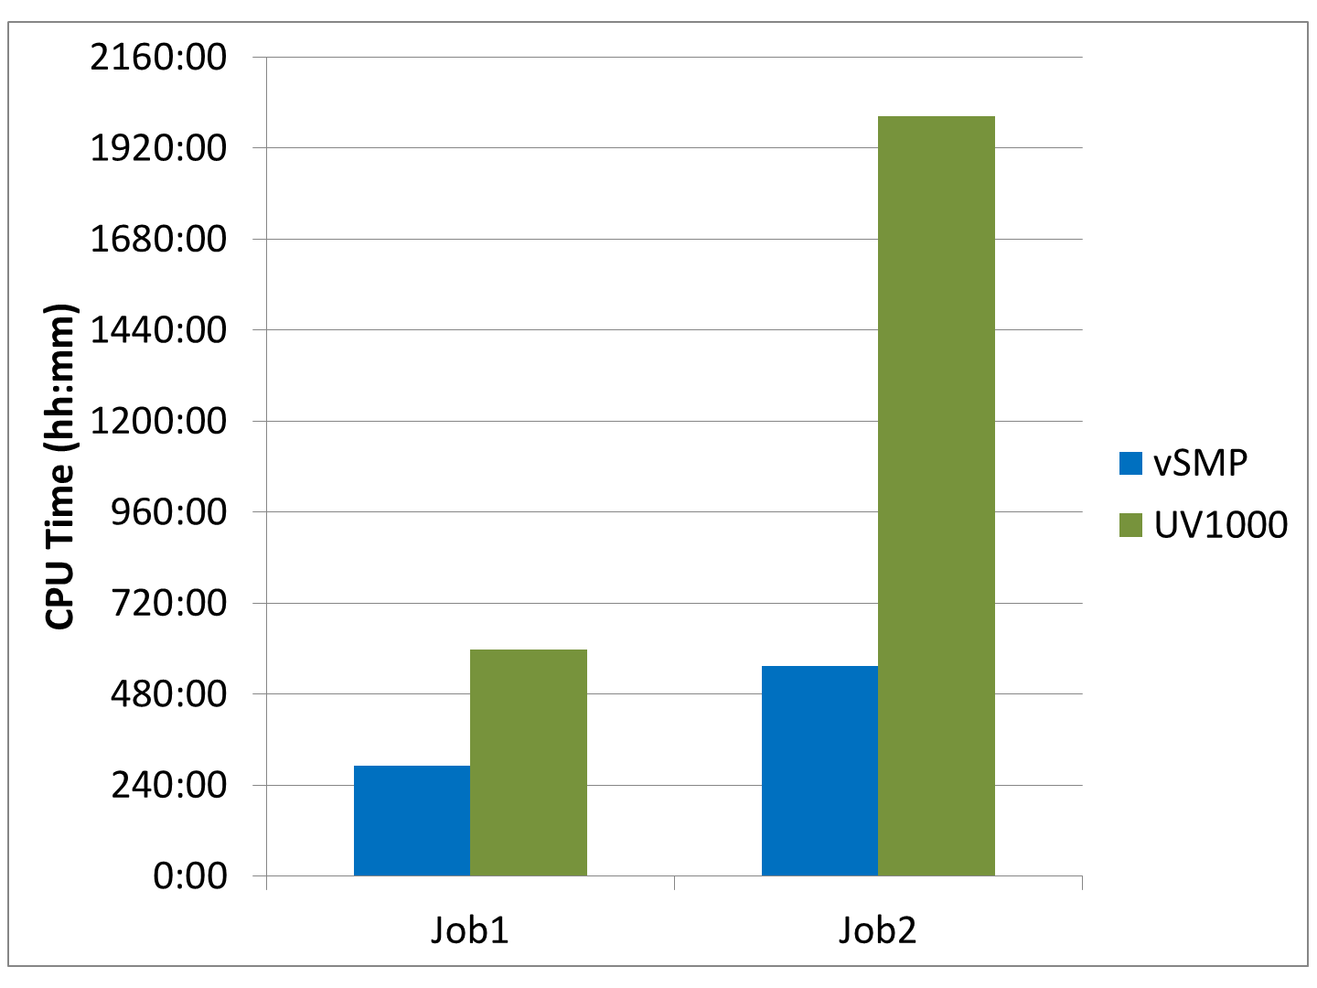
Trinity CPU time
CPU time not representative of Wallclock time
vSMP considers RDMA memory accesses to be I/O wait, not CPU time
Job2 shows high level of remote memory access compared to computation

Slide 23
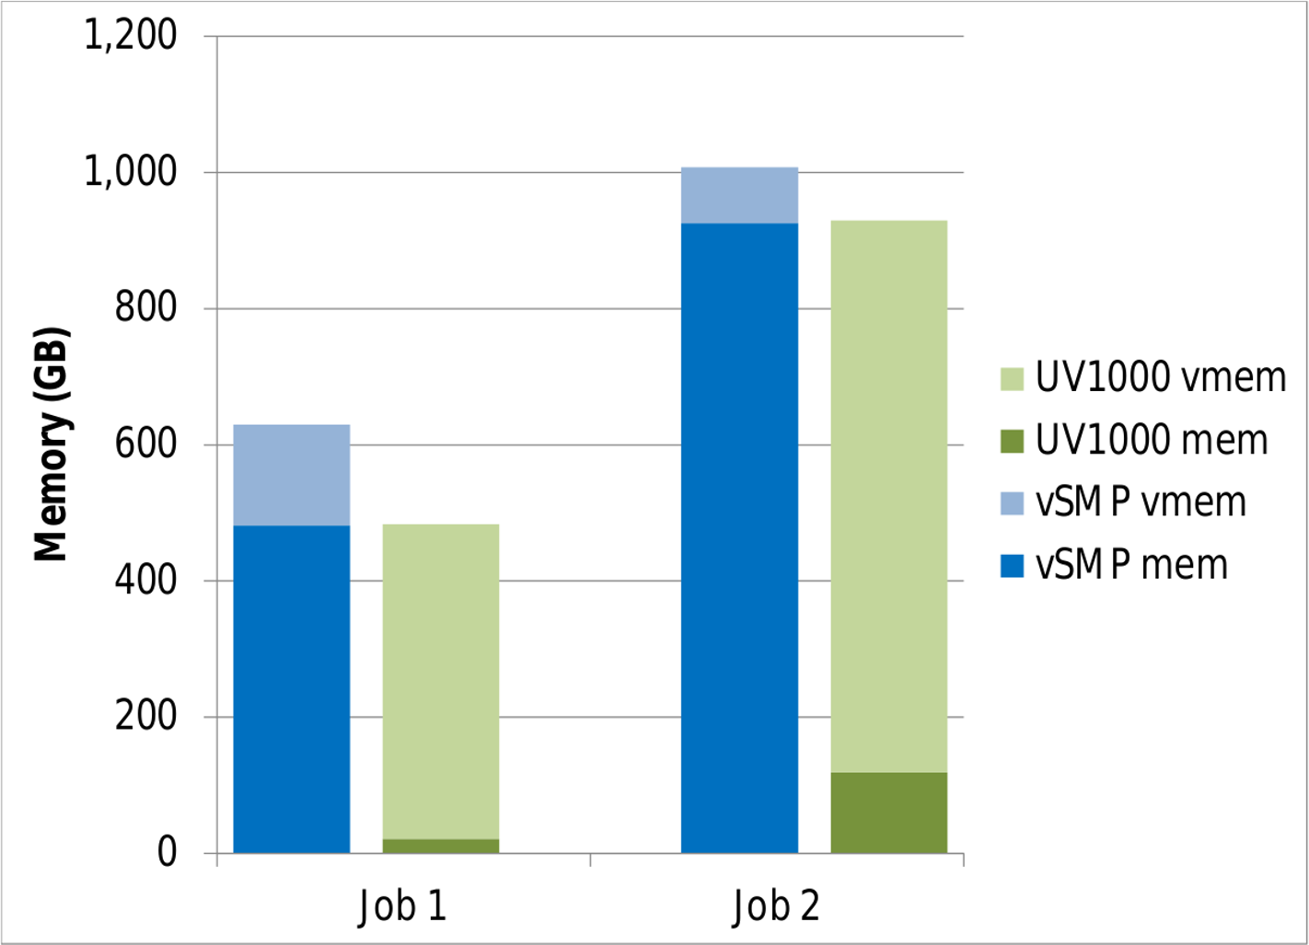
Trinity Memory Utilization
Job2 uses ~1TB RAM
SGI UV shows remote
memory as virtual
vSMP has memory
overhead
8.1%
23.6%

Slide 24
Performance Roundup
Using 192 cores, ScaleMP vSMP performs better than SGI UV 1000 for both SPEC OpenMP and Trinity app
Some performance increase simply due to newer CPUs
Interconnect bandwidth contention can be critical
NUMAlink in SGI UV is limited vs QDR InfiniBand in vSMP
Research confirms the overhead of remote memory accesses in SMP machines increases as the systems get larger
SGI UV outperforms vSMP when per-core mem usage is small and the app is cpu bound (cache size differences)
Both systems capable of handling 1TB+ memory footprints
vSMP slightly faster than SGI UV for Trinity, but requires larger memory footprint

Slide 25
SMP Usability
Overall SMP systems easy to use, especially compared to distributed memory clusters or accelerators
SMP systems still require tuning to get optimal performance
Pay attention to NUMA efficiencies, bandwidth, etc.
ScaleMP vSMP has added advantage of hardware re-provisioning between cluster and vSMP
Uses commodity servers with InfiniBand, can be rebooted into normal HPC cluster
Best suited for systems with variable workloads

Slide 26
Conclusion
SMP machines have many uses for big data computation due to their ease of use
We evaluate two compelling SMP options: ScaleMP vSMP and SGI UV1000 deployed at IU and UofA, respectively
Both machines perform well with 192-core OpenMP benchmarks and Trinity de novo assembler
vSMP system often faster, due to better hardware
Due to explosion of data and the complexity of distributed systems, we expect SMP system utilization to increase

Slide 27
Future Work
Evaluate other SMP systems – IBM POWER8 SMP
Expand to other Big Data applications
Apache Big Data Stack – shared memory/threading vs TCP communication
Many Bioinformatics apps
Proprietary applications
Graph processing
New ScaleMP deployment at Arizona
~8400core cluster, 9.4TB vSMP license

Slide 28
Questions?
ajyounge@indiana.edu ajyounge.com

Slide 29
