Slide 1
FutureGrid: an experimental, high-performance grid testbed
Craig Stewart
Executive Director, Pervasive Technology Institute
Indiana University
stewart@iu.edu
www.futuregrid.org
3 March 2010

Slide 2
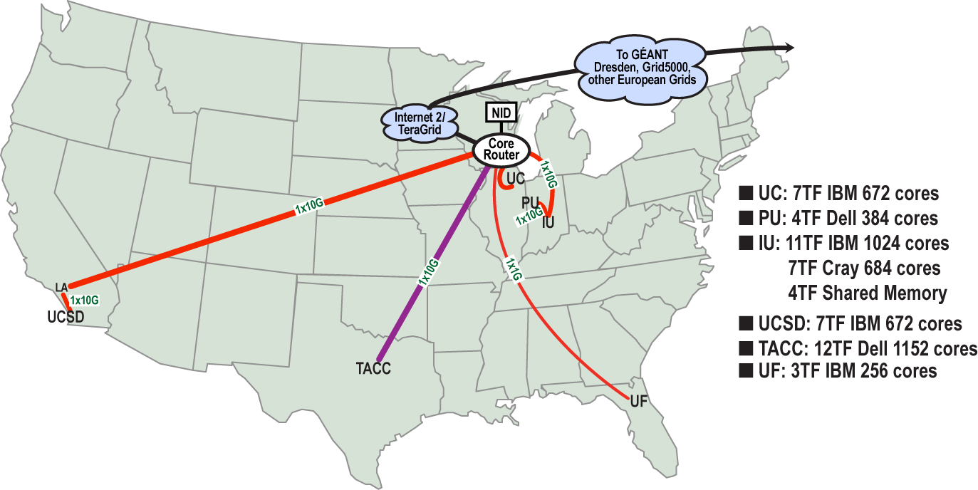
Geographic View

Slide 3
FutureGrid will…
put the “science” back in the computer science of grid computing by enabling replicable experiments
Be a grid testbed using virtualization technologies to be whatever you need, when you need (like a Shmoo, only instrumented…)
a robustly managed simulation environment or testbed to support the development and early use in science of new technologies at all levels of the software stack: from networking to middleware to scientific applications.

Slide 4
FutureGrid Partners
Indiana University
Purdue University
San Diego Supercomputer Center at University of California San Diego
University of Chicago/Argonne National Labs
University of Florida
University of Southern California Information Sciences Institute
University of Tennessee Knoxville
University of Texas at Austin/Texas Advanced Computing Center
University of Virginia
ZIH and GWT-TUD, Technische Universtität Dresden.

Slide 5
Other Important Collaborators
Early users from an application and computer science perspective and from both research and education
Grid5000/Aladin and D-Grid in Europe
Commercial partners such as
Eucalyptus
Microsoft (Dryad + Azure) – Note Azure external to FutureGrid

Slide 6
Key Management
PI. Geoffrey Fox is the PI, and have overall responsibility for the project as a whole. Fox will be the final arbiter of any decisions that cannot be reached by a consensus approach.
Co-PIs. Kate Keahey, Warren Smith, Jose Fortes, and Andrew Grimshaw
Executive Investigator. Craig Stewart will serve as executive director, responsible for operational management of FutureGrid.
Chief Architect. Gregor von Laszewski (who joined IU on 22 July 2009) will serve as the chief architect for FutureGrid.
RP Lead. Joe Rinkovsky will be the RP lead
Project Manager. Gary Miksik will serve 0.5 FTE as project manager for FutureGrid, and have management of the WBS, preparation of reports, and collection of responses to requests for information from the NSF as his primary job responsibilities.

Slide 7
FutureGrid Usage Scenarios
Developers of end-user applications who want to develop new applications in cloud or grid environments, including analogs of commercial cloud environments such as Amazon or Google.
Is a Science Cloud for me?
Developers of end-user applications who want to experiment with multiple hardware environments.
Grid middleware developers who want to evaluate new versions of middleware or new systems.
Networking researchers who want to test and compare different networking solutions in support of grid and cloud applications and middleware. (Some types of networking research will likely best be done via through the GENI program.)
Interest in performance requires ability to deploy outside VM environments

Slide 8
Compute Hardware
System type | # CPUs | # Cores | TFLOPS | Total RAM (GB) | Secondary Storage (TB) | Site | Status
Dynamically configurable systems
IBM iDataPlex | 256 | 1024 | 11 | 3072 | 339* | IU | New System
Dell PowerEdge | 192 | 1152 | 8 | 1152 | 15 | TACC | New System
IBM iDataPlex | 168 | 672 | 7 | 2016 | 120 | UC | New System
IBM iDataPlex | 168 | 672 | 7 | 2688 | 72 | SDSC | Existing System
Subtotal | 784 | 3520 | 33 | 8928 | 546
Systems not dynamically configurable
Cray XT5m | 168 | 672 | 6 | 1344 | 339* | IU | New System
Shared memory system TBD | 40 | 480 | 4 | 640 | 339* | IU | New System 4Q2010
Cell BE Cluster | 4 | 80 | 1 | 64 |  | IU | Existing System
IBM iDataPlex | 64 | 256 | 2 | 768 | 1 | UF | New System
High Throughput Cluster | 192 | 384 | 4 | 192 |  | PU | Existing System
Subtotal | 468 | 1872 | 17 | 3008 | 1
Total | 1252 | 5392 | 50 | 11936 | 547

Slide 9
Storage Hardware
System Type | Capacity (TB) | File System | Site | Status
DDN 9550 (Data Capacitor) | 339 | Lustre | IU | Existing System
DDN 6620 | 120 | GPFS | UC | New System
SunFire x4170 | 72 | Lustre/PVFS | SDSC | New System
Dell MD3000 | 30 | NFS | TACC | New System

Slide 10
Logical Diagram

Slide 11
Network Impairments Device
Spirent XGEM Network Impairments Simulator for jitter, errors, delay, etc
Full Bidirectional 10G w/64 byte packets
up to 15 seconds introduced delay (in 16ns increments)
0-100% introduced packet loss in .0001% increments
Packet manipulation in first 2000 bytes
up to 16k frame size
TCL for scripting, HTML for human configuration
More easily replicable than keeping teenagers around the house……

Slide 12
Selected FutureGrid Timeline
October 1 2009 Project Started
October 2-3 2009 First All Hands Meeting
November 16-19 SC09 Demo/F2F Committee Meetings
January 2010 First Science Board Meeting
March 2010 FutureGrid network complete
April – several major new systems have passed acceptance, doing some early work
September 2010 All hardware (except anticipated shared memory system) accepted
October 1 2011 FutureGrid allocatable via TeraGrid process – first two years by user/science board led by Andrew Grimshaw

Slide 13
System Milestones
New IBM Systems
Delivery: December 2009
Acceptance: March 2010 IU SYSTEM ACCEPTED
Available for Use: April 2010
Cray
Delivery: December 2009
Acceptance: March 2010 ACCEPTED
Dell System
Delivery: January 2010
Acceptance: March 2010
Available for Use: April 2010
Existing IU iDataPlex
Move to SDSC: January 2010 DONE
Available for Use: March 2010
Storage Systems (Sun & DDN)
Delivery: October 2009
Available for Use: December 2009

Slide 14
Future Grid Users
Application/Scientific users
System administrators
Software developers
Testbed users
Performance modelers
Educators
Students
Supported by
FutureGrid
Infrastructure & Software offerings

Slide 15
Objectives: Software
significant extensions to existing software
existing open-source software
open-source, integrated suite of software to
instantiate and execute grid and cloud experiments.
perform an experiment
collect the results
tools for instantiating a test environment,
Torque, MOAB, xCAT, bcfg, and Pegasus, Inca, ViNE, a number of other tools from our partners and the open source community
Portal to interact
Benchmarking

Slide 16
FG Stratosphere
Objective
Higher than a particular cloud
Provides all mechanisms to provision a cloud on a given FG hardware
Allows the management of reproducible experiments
Allows monitoring of the environment and the results
Risks
Lots of software
Possible multiple path to do the same thing
Good news
We know about different solutions and have identified a very good plan with risk mitigation plans

Slide 17
Rain Runtime Adaptable InsertioN Service
Objective
Provide dynamic provisioning
Running outside virtualization
Cloud neutral
Nimbus, Eucalyptus, …
Future oriented
Dryad
…
Risks
Some frameworks (e.g. MS) are more complex to provision

Slide 18
Dynamic Provisioning
Change underlying system to support current user demands
Linux, Windows, Xen, Nimbus, Eucalyptus
Stateless images
Shorter boot times
Easier to maintain
Stateful installs
Windows
Use moab to trigger changes and xCAT to manage installs

Slide 19
Command line
fg-deploy-image
host name
image name
start time
end time
label name
fg-add
label name
framework hadoop
version 1.0
Deploys an image on a host
Adds a feature to a deployed image

Slide 20
xCAT and Moab
xCAT
uses installation infrastructure to perform installs
creates stateless Linux images
changes the boot configuration of the nodes
remote power control and console (IPMI)
Moab
meta-schedules over resource managers
TORQUE and Windows HPC
control nodes through xCAT
changing the OS
remote power control

Slide 21
Experiment Manager
Objective
Manage the provisioning for reproducible experiments
Coordinate workflow of experiments
Share workflow and experiment images
Minimize space through reuse
Risk
Images are large
Users have different requirements and need different images

Slide 22
Integration within TeraGrid / TeraGrid XD
Sure it’s part of TeraGrid
Allocation: separate from TG processes for two years
It is a very exciting project, but IIWIIAIAWIA
We are looking for early adopters!

Slide 24
Thanks! Questions?

