Slide 1
Towards High Performance Processing of Streaming Data
May-27-2016
Supun Kamburugamuve, Saliya Ekanayake, Milinda Pathirage and Geoffrey C. Fox
Indiana University
Bloomington, USA

Slide 2
Outline
Research Motivation
Distributed stream processing systems (DSPFs)
Communication improvements
Results
Future work

Slide 3
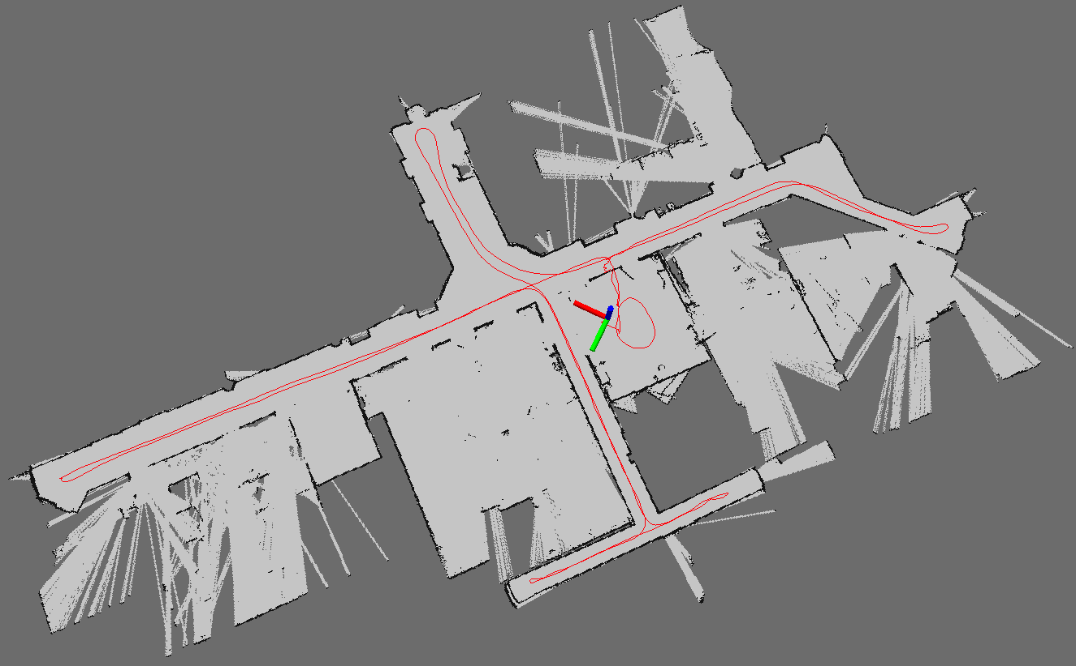
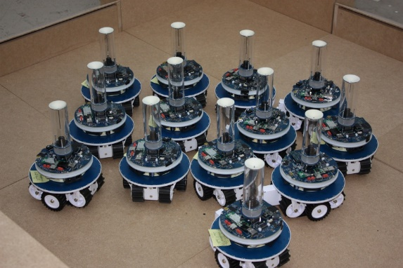
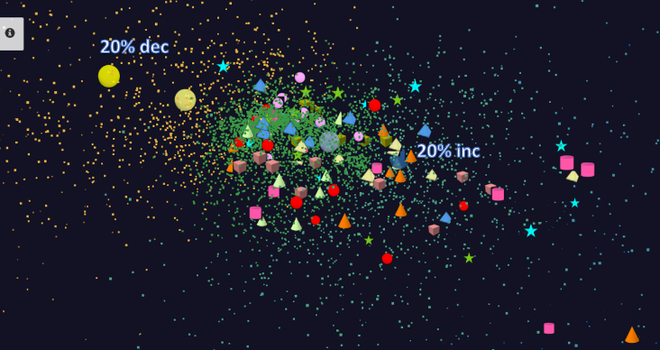
Background & Motivation
Robotics Applications
Simultaneous Localization and Mapping
N-Body Collision Avoidance
Time series data visualization in real time
Robot with a Laser Range Finder
Robots need to avoid collisions when they move
Work in progress
Map Built from Robot data
Cloud Applications
HPC Applications

Slide 4
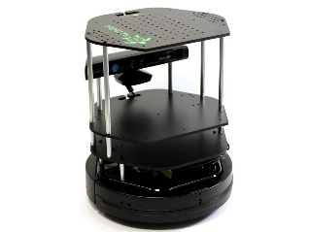
Data pipeline
Sending to
pub-sub
Sending to
Persisting
to storage
Multiple
streaming
workflows
Streaming
workflow
A stream application with some tasks running in parallel
Gateway
Message Brokers
RabbitMQ, Kafka
Streaming Workflows
Apache Storm
End to end delays without any processing is less than 10ms
Hosted in FutureSystems OpenStack cloud which is accessible through IU network

Slide 5
Improving communications
Broadcast communication
Shared memory communication between workers in a node

Slide 6
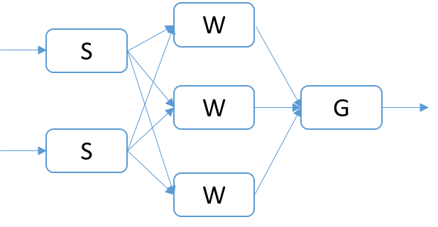
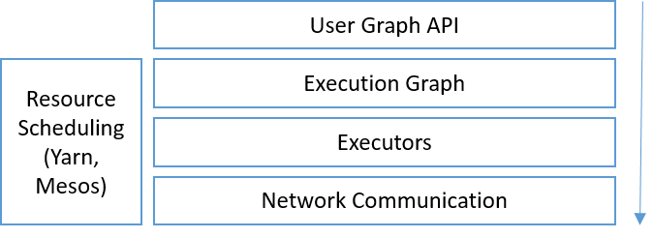
Streaming Application
Stream of events
Event processing logic
User Graph
Execution Graph
User graph is converted to an execution graph
Communication methods
Broadcast, Round Robin, Direct, Stream Partitioning

Slide 7
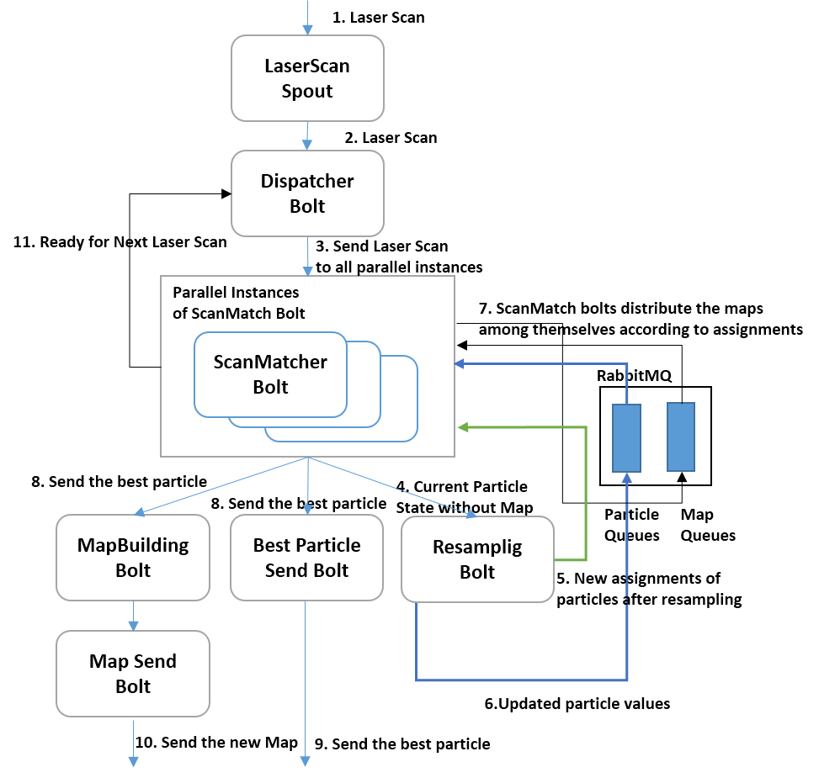
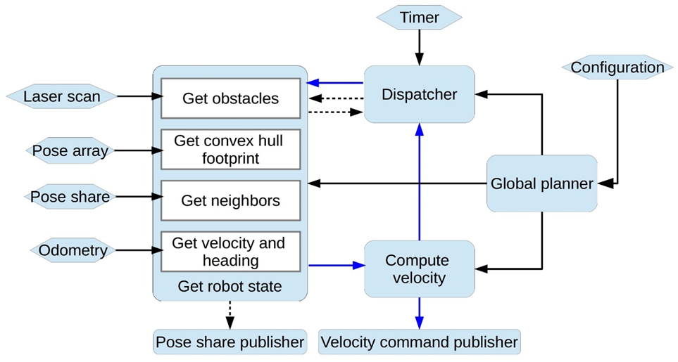
Example applications
SLAM
N-Body collision avoidance
Particles are distributed
in parallel tasks
Map building happens periodically

Slide 8
Execution Graph Distribution in the Storm Cluster
Node-1
Node-2
S
W
S
G
W
W
Worker
Worker
Worker
Worker
Two node cluster each running two workers. The tasks of the Topology is assigned to the workers

Slide 9
Communications in Storm
B
W
Node-1
Node-2
Node-1
Node-2
B-1
W-2
W-4
W-6
B-1
W-2
W-4
W-6
W-1
W-3
W-5
W-7
W-1
W-3
W-5
W-7
Worker
Worker
Worker
Worker
Worker
Worker
Worker
Worker
Worker and Task distribution of Storm
A worker hosts multiple tasks. B-1 is a task of component B and W-1 is a task of W
Communication links are between workers
These are multiplexed among the tasks

Slide 10
Default Broadcast
Node-1
Node-2
B-1
W-2
W-4
W-6
W-1
W-3
W-5
W-7
Worker
Worker
Worker
Worker
B-1 wants to broadcast a message to W, it sends 6 messages through 3 TCP communication channels and send 1 message to W-1 via memory

Slide 11
Optimized Broadcast
Binary tree
Workers arranged in a binary tree
Flat tree
Broadcast from the origin to 1 worker in each node sequentially. This worker broadcast to other workers in the node sequentially
Bidirectional Rings
Workers arranged in a line
Starts two broadcasts from the origin and these traverse half of the line

Slide 12
Three Algorithms for broadcast
Serial Broadcast
Flat tree
Binary tree
Ring
Example broadcasting communications for each algorithm in a 4 node cluster with each machine having 4 workers. The outer green boxes show cluster machines and inner small boxes show workers. The top box displays the broadcasting worker and arrows illustrate the communication among the workers

Slide 13
Shared memory based Communications
Inter process communications using shared memory for a single node
Multiple writer single reader design
Writer breaks the message in to packets and puts them to memory
Reader reads the packets and assemble the message

Slide 14
Shared Memory Communications
Read packet by packet sequentially
Write
Reader
Writer 01
Obtain the write location atomically and increment
write | Packet 1 | Packet 2 | Packet 3
Writer 02
Write
Shared File
Use a new file when the file size is reached
Reader deletes the files after it reads them fully
Fields
ID | No of Packets | Packet No | Dest Task | Content Length | Source Task | Stream Length | Stream | Content
16 | 4 | 4 | 4 | 4 | 4 | 4 | Variable | Variable
Bytes
Packet Structure

Slide 15
Experiments
11 Node cluster
1 Node – Nimbus & ZooKeeper
1 Node – RabbitMQ
1 Node – Client
8 Nodes – Supervisors with 4 workers each
Client sends messages with the current timestamp, the topology returns a response with the same time stamp. Latency = current time - timestamp
W
RabbitMQ
R
B
W
G
RabbitMQ
W
Client

Slide 16
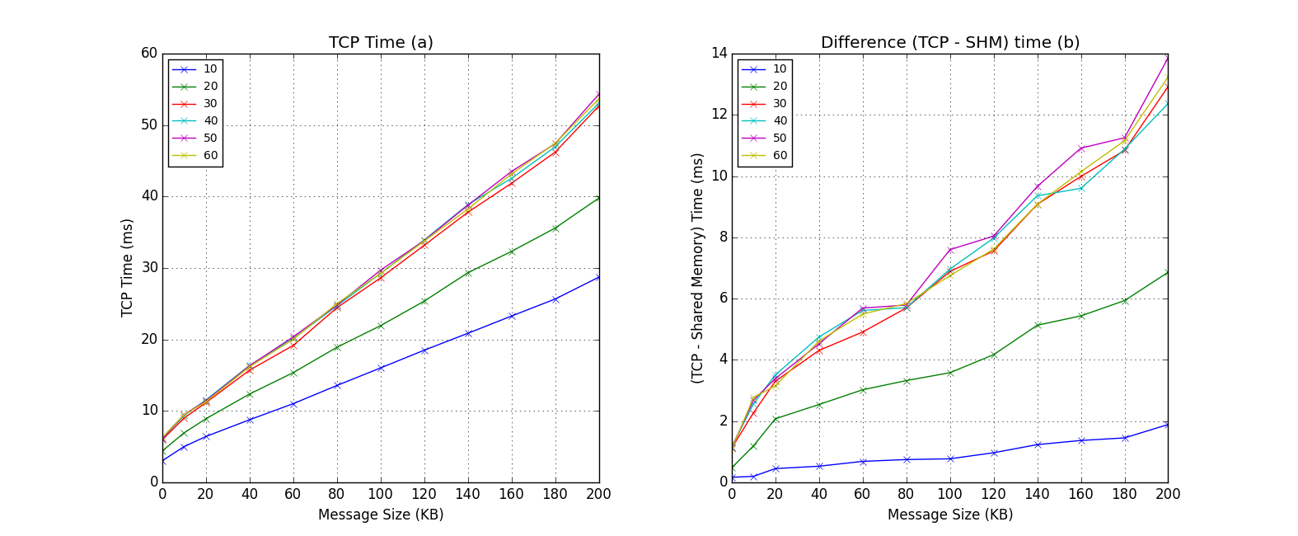
Memory Mapped Communications
Relative Importance of Shared Memory Communication to TCP
A topology with communications going through all the workers arranged in a line
No significant difference
because we are using all
the workers in the cluster beyond 30 workers
Default TCP implementation Latency
Y axis shows the difference in latency of default TCP implementation and shared memory based implementation (TCP - SHM)
About 25% reduction for 32 workers

Slide 17
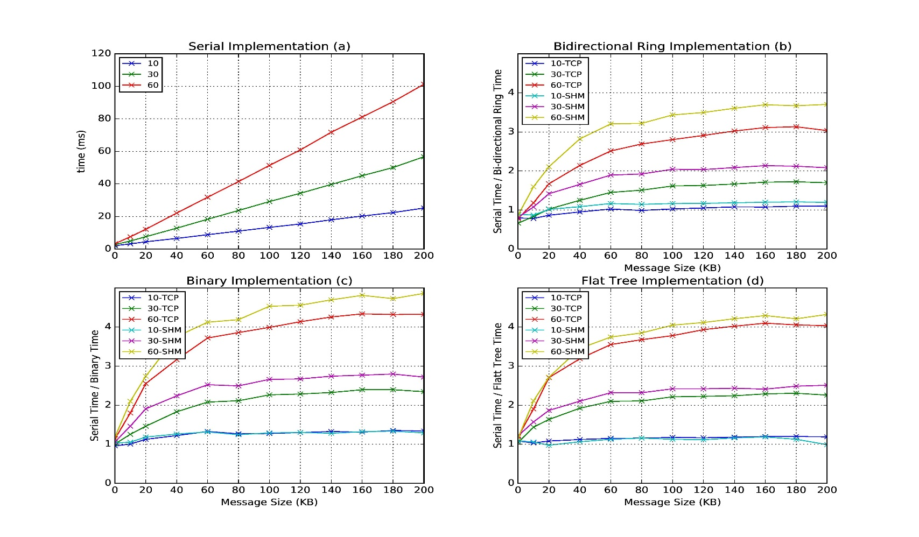
Broadcast Latency Improvement
Speedup of latency with both TCP based and Shared Memory based communications for different algorithms
Latency of binary tree, flat tree and bi-directional ring implementations compared to serial implementation. Different lines show varying parallel tasks with TCP communications and shared memory communications(SHM).

Slide 18
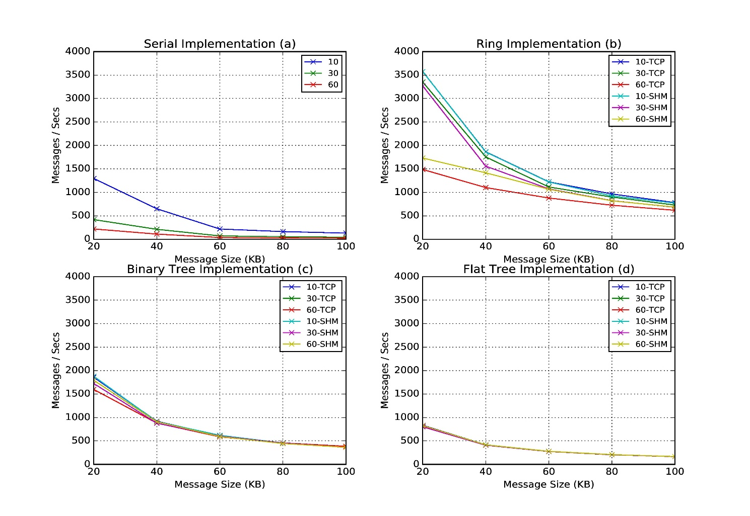
Throughput
Throughput of serial, binary tree, flat tree and ring implementations. Different lines show varying parallel tasks with TCP communications and shared memory communications (SHM)

Slide 19
Future Work
Implement the Shared memory and communication algorithms for other stream engines (Twitter Heron)
Experiment on larger clusters with applications
HPC Scheduler for Streaming applications (Slurm, Torque)
C++ APIs for data processing
High performance interconnects for high throughput low latency communications in HPC clusters
Scheduling to take advantage of the shared memory & collective communications

Slide 20
Summary
Communication algorithms reduce the network traffic and increases throughput
Ring gives the best throughput and binary tree best latency
Shared memory communications reduce the latency further but not throughput because TCP is the bottleneck
This work was partially supported by NSF CIF21 DIBBS 1443054 and AFOSR FA9550-13-1-0225 awards. We would also like to express our gratitude to the staff and system administrators at the Digital Science Center (DSC) at Indiana University for supporting us on this work.

Slide 21
References
Projects https://github.com/iotcloud
SLAM http://dl.acm.org/citation.cfm?id=2896433
Collision Avoidance http://goo.gl/xdB8LZ
Time series data visualization http://dsc.soic.indiana.edu/publications/tsmap3d.pdf
Apache Storm http://storm.apache.org/
Twitter Heron https://github.com/twitter/heron

