Slide 1
GreenIT Service Level Agreements
IN SERVICE LEVEL AGREEMENTS IN GRIDS WORKSHOP COLOCATED WITH IEEE/ACM GRID 2009 CONFERENCE, IN BANFF CANADA, OCTOBER 13, 2009
Gregor von Laszewski
Pervasive Technology Institute @ Indiana University
2729 E 10th St. Bloomington, IN 47408 U.S.A. laszewski@gmail.com

Slide 2
Outline
Introduction
Impact Factors
  Hardware, Software, Environment, Behavior
Service Level Agreements (SLA)
GreenIT & SLA
  Architecture
  Metrics
  SLA Speciﬁcations
  GreenIT Services
    Thermal aware task scheduling service
    Dynamic voltage frequency scheduling service
    Integration services
  Portal
Conclusion

Slide 3
What is Green IT?
Green IT also referred as Green computing is a study and practice of using computing resources in an efficient manner such that its impact on the environment is as less hazardous as possible.
  least amount of hazardous materials are used
  computing resources are used efficiently in terms of energy and to promote recyclability
http://en.wikipedia.org/wiki/Green_computing

Slide 4
Motivation
Cost:
  A supercomputer with 360-Tflops with conventional processors requires 20 MW to operate, which is approximately equal to the sum of 22,000 US households power consumption
  Servers consume 0.5 percent of the world’s total electricity usage
  Energy usage will quadruple by 2020
  The total estimated energy bill estimate for data centers in 2010 is $11.5 billion
Reliability:
  Every 10C increase of temperature leads to a doubling of the system failure rate
Environment:
  A typical desktop computer consumes 200-300W of power
  This results in emission of about 220kg of CO2 per year
  Data Centers produce 170 million metric tons of CO2 worldwide currently per year
  670 million metric tons of CO2 are expected to be emitted by data centers worldwide annually by 2020
Utilization
  32 percent of all servers are running at or below 3 percent peak and average utilizations, wasting energy spinning and cooling, and doing virtually no work.

Slide 5
A Typical Google Search
Google spends about 0.0003 kWh per search
  1 kilo-watt-hour (kWh) of electricity = 7.12 x 10-4 metric tons CO2 = 0.712 kg or 712g of CO2
  => 213mg CO2 emitted
The number of Google searches worldwide amounts to 200-500 million per day.
  total carbon emitted per day:
  = 500 million x 0.000213 kg per search = 106500kg or 106.5 metric ton
Source: http://prsmruti.rediffiland.com/blogs/2009/01/19/How-much-cabondioxide-CO2-emitted.html
Notes:
ref:
http://www.globus.org/grid_software/security/voms.php – globus alliance ... basic definition
http://vdt.cs.wisc.edu/components/voms.html – virtual data toolkit (osg) – grid middleware
http://edg-wp2.web.cern.ch/edg-wp2/security/voms/voms.html – (datagrid)

Slide 6
So what can we do?
Doing less google searches ;-)
Doing meaningful things ;-)
Create an infrastructure that supports use and monitoring of activities costing less environmental impact.
Seek services that advertise clearly their impact
=> SLA fro GreenIT

Slide 7
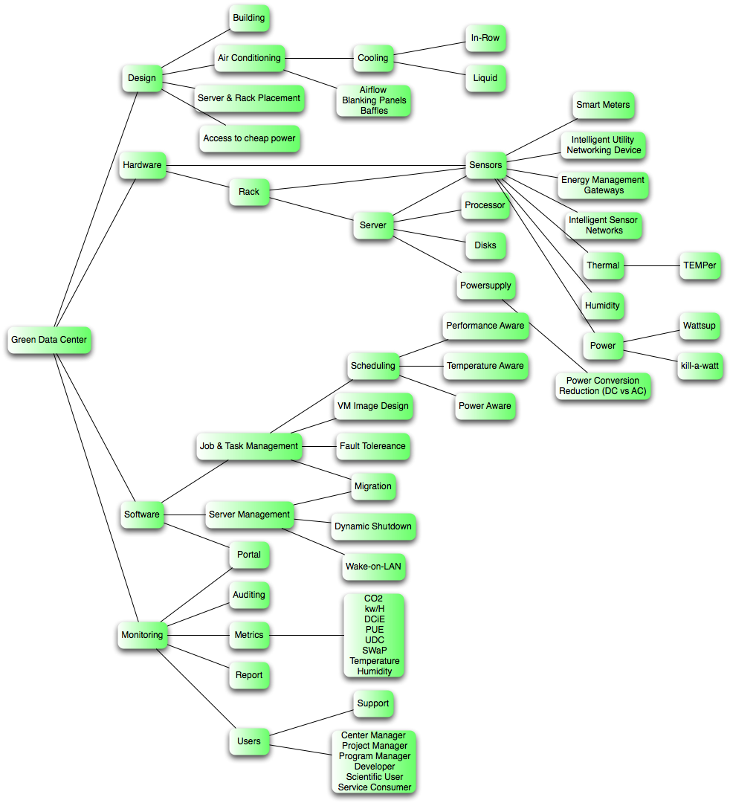
GreenIT Taxonomy
We are actively developing a Taxonomy
Helps assessing where to focus research activities
Will be resulting in
  What to Monitor?
  What Software?
  Which Services?
  What to Optimize?
  At what cost ($,CO2,perf)?

Slide 8
Green Aware Computing

Slide 9
Green Aware Computing
Metrics
  Power, Temperature, CO2, …
Computing system
  Many-cores, Clusters, GPGPU
Algorithms and models
  task scheduling, CFD model, …
Middleware
  auditing & insertion service, green resource management service, virtualization, Grids and Clouds, …

Slide 10
Green Aware Computing

Slide 11
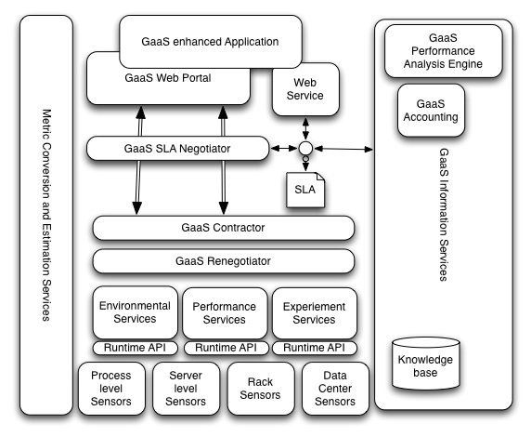
GreenIT SLA Architecture

Slide 12
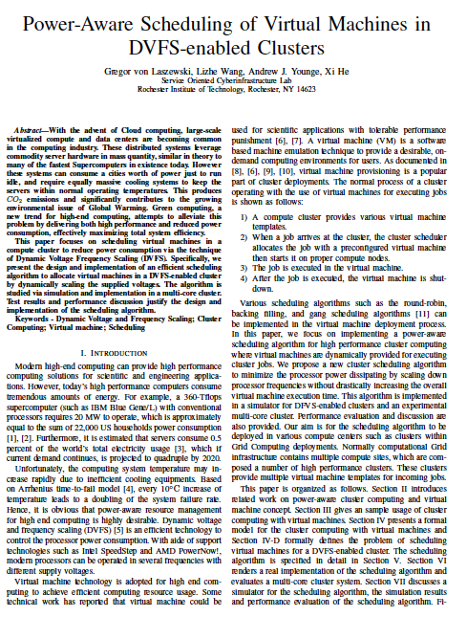
Green Aware DVFS Scheduling for VMs
How to reduce energy consumption?
  Many ways exist …
  Can we use dynamic voltages to reduce energy consumption
Objective: dynamically scale voltages for virtual machines in a cluster
  Dynamic Voltage Frequency Scheduling (DVFS)
Cluster Aug. 2009

Slide 13
Results
For compute intense calculations on a quad core machine
Although you get slower speed with more cores, the overall throughput is more efficient
  While the performance of each individual VM is only approximately 67% as fast when using 8 VMs instead of 4, there are twice as many VMs to contribute to an overall performance improvement of 34%
Put as much on the machine as you can

Slide 14
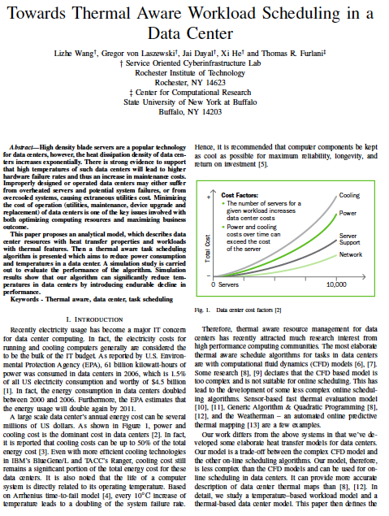
Thermal aware workload scheduling in data centers
Job-temperature model
Data center resource model
Thermal aware scheduling algorithm
Thermal aware workload scheduling framework
Simulation
To be submitted

Slide 15
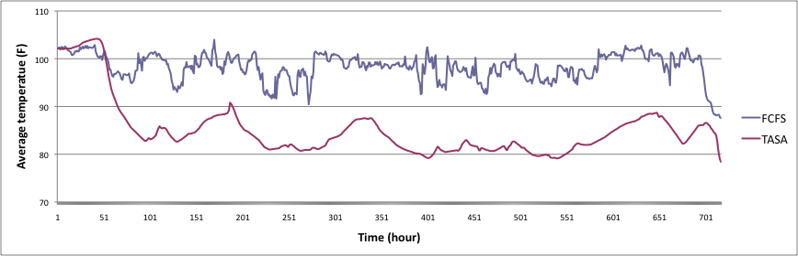
Simulation Result (1)
Reduce max temperature: 6 F
Reduce average temperature: 15 F
Reduce power consumption 4000 kW/h
Reduce CO2 emission 19 000 kg/h

Slide 16
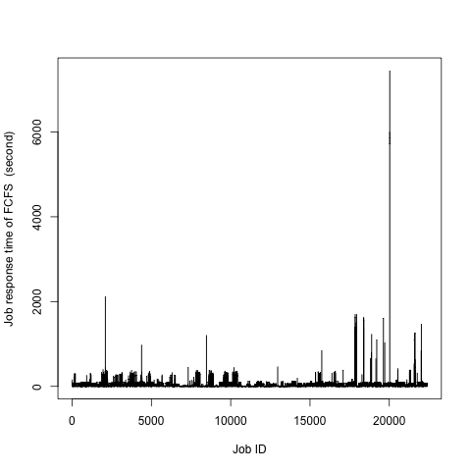
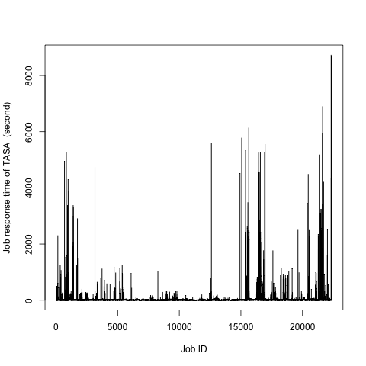
Simulation Result (2)
Response time increase 13%

Slide 17
Green Aware Computing

Slide 18
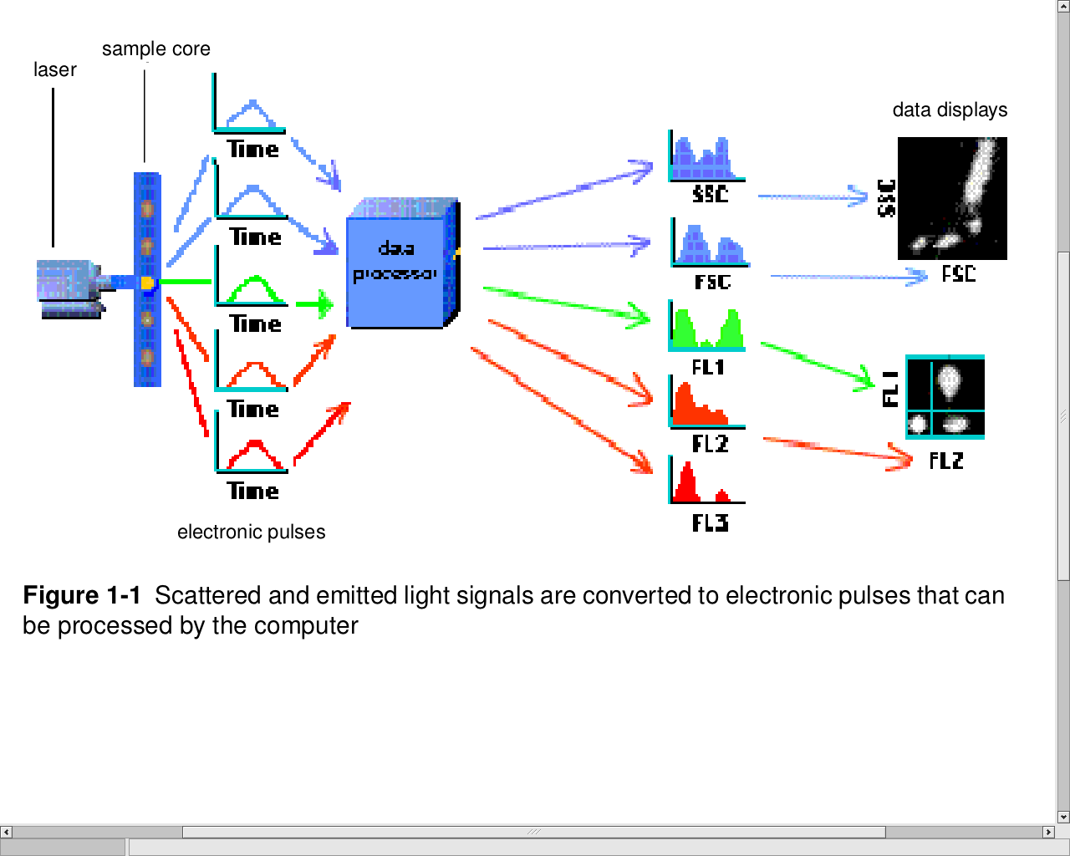
Clustering in flow cytometry
Flow cytometry (FC) is a technology in which optical measurements on fluorescently labeled cells are rapidly acquired (~ 10⁴ s⁻¹), giving datasets in ~20 dimensions and millions of events.
The dimensionality of the data is expected to continue to increase.
Current analysis methods commonly include manual sequential bivariate gating to narrow down populations of interest. This is unsatisfactory for many reasons.
From Introduction to Flow Cytometry:
A Learning Guide, BD Biosciences, 2004

Slide 19
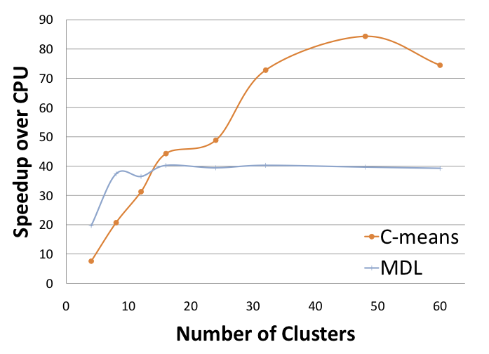
Speedup

Slide 20
Evaluation
A speedup of 40-70 will naturally be significant in reducing power and CO2
E.g. one server with CUDA cards vs.
70 single processors
Current work:
  Energy consumption
  Multi/many core systems vs. CUDA

Slide 21
Green Aware Computing

Slide 22
Changing Behavior
Making you aware of issues
Provide easy monitoring and comparison tools
Provide supporting tools to make it easy to not only do computing based on
  Performance vs. environmental impact

Slide 23
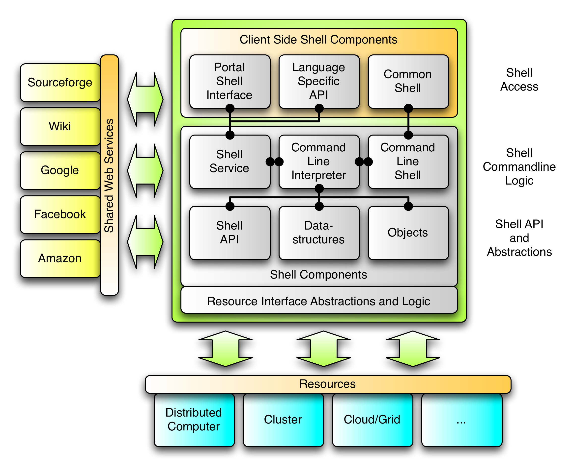
Cyberaide.org

Slide 24
FutureGrid
The goal of FutureGrid is to support the research that will invent the future of distributed, grid, and cloud computing.
FutureGrid will build a robustly managed simulation environment or testbed to support the development and early use in science of new technologies at all levels of the software stack: from networking to middleware to scientific applications.
The environment will mimic TeraGrid and/or general parallel and distributed systems
This test-bed will enable dramatic advances in science and engineering through collaborative evolution of science applications and related software.

Slide 25
FutureGrid Hardware

Slide 26
FutureGrid Hardware

Slide 27
FutureGrid Partners
Indiana University
Purdue University
San Diego Supercomputer Center at University of California San Diego
University of Chicago/Argonne National Labs
University of Florida
University of Southern California Information Sciences Institute, University of Tennessee Knoxville
University of Texas at Austin/Texas Advanced Computing Center
University of Virginia
Center for Information Services and GWT-TUD from Technische Universtität Dresden.

Slide 28
Other Important Collaborators
Early users from an application and computer science perspective and from both research and education
Grid5000/Aladin and D-Grid in Europe
Commercial partners such as
  Eucalyptus
  Microsoft (Dryad + Azure) – Note Azure external to FutureGrid like GPU systems
  We should identify other partners – should we have a formal Corporate Partners program?
TeraGrid
Open Grid Forum
NSF

Slide 29
FutureGrid Architecture

Slide 30
FutureGrid Architecture
Open Architecture allows to configure resources based on images
Shared images allows to create similar experiment environments
Experiment management allows management of reproducible activities
Through our “stratosphere” design we allow different clouds and images to be “rained” upon hardware.

Slide 31
FutureGrid Usage Scenarios
Developers of end-user applications who want to develop new applications in cloud or grid environments, including analogs of commercial cloud environments such as Amazon or Google.
  Is a Science Cloud for me?
Developers of end-user applications who want to experiment with multiple hardware environments.
Grid middleware developers who want to evaluate new versions of middleware or new systems.
Networking researchers who want to test and compare different networking solutions in support of grid and cloud applications and middleware. (Some types of networking research will likely best be done via through the GENI program.)
Interest in performance requires that bare metal important

Slide 32
Selected FutureGrid Timeline
October 1 2009 Project Starts
November 16-19 SC09 Demo/F2F Committee Meetings
March 2010 FutureGrid network complete
March 2010 FutureGrid Annual Meeting
September 2010 All hardware (except Track IIC lookalike) accepted
October 1 2011 FutureGrid allocatable via TeraGrid process – first two years by user/science board led by Andrew Grimshaw

