Slide 1
Scalable Architecture for Integrated Batch and Streaming Analysis of Big Data
Thesis Defense
Xiaoming Gao
Advisor: Prof. Judy Qiu
01/21/2015

Slide 2
Outline
Introduction - emerging Big Data characteristics and challenges
Storage substrate: challenge and contributions
Batch analysis module: challenge and contributions
Streaming analysis module: challenge and contributions
Summary

Slide 3
Introduction – Big Data Challenges
Large size of datasets (TBs, PBs, …).
Volume
Variety
Velocity
Data size is a function of time.
Moreover, speed may also be
a function of time.
Various types of structured and unstructured data.

Slide 4
Big Data - emerging characteristics
Velocity
Volume
Variety
Streaming data becoming more and more important
10s to 100s of millions of streaming social updates per day
Data subsets about social events/activities
Analyses focusing on “interesting” data subsets
Sensor data streams, stock price streams, etc.
Gene sequence analysis, news data analysis, etc.
Social media data (e.g. Twitter streaming API)

Slide 5
Social media data – an example data record
{
"text":"RT @sengineland: My Single Best... ",
"created_at":"Fri Apr 15 23:37:26 +0000 2011",
"retweet_count":0,
"id_str":"59037647649259521",
"entities":{
"user_mentions":[{
"screen_name":"sengineland",
"id_str":"1059801",
"name":"Search Engine Land"
}],
"hashtags":[],
"urls":[{
"url":"http:\/\/selnd.com\/e2QPS1",
"expanded_url":null
}]},
"user":{
"created_at":"Sat Jan 22 18:39:46 +0000 2011",
"friends_count":63,
"id_str":"241622902",
...},
"retweeted_status":{
"text":"My Single Best... ",
"created_at":"Fri Apr 15 21:40:10 +0000 2011",
"id_str":"59008136320786432",
...},
...
}

Slide 6
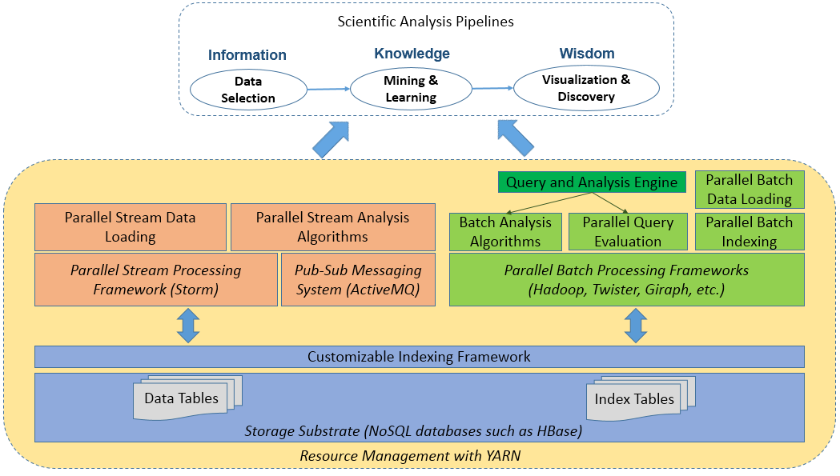
Introduction – thesis research goal
A scalable architecture in the Cloud to address related research challenges
Streaming analysis module
Batch analysis module
Storage substrate

Slide 7
Outline
Introduction - emerging Big Data characteristics and challenges
Storage substrate: challenge and contributions
Batch analysis module: challenge and contributions
Streaming analysis module: challenge and contributions
Summary

Slide 8
Storage substrate - requirements
Scalable storage solution based on data characteristics
- large size, high speed
- fine-grained data records with evolving structures
- mostly write-once-read-many
Proper indexing to support efficient queries:
- constraints on both text content and social context

Slide 9
Varied level of indexing support on NoSQL databases
Single-dimensional indices
Multidimensional indices
Sorted (B+ tree)
Unsorted (Hash)
Inverted index
(Lucene)
R tree
(PostGIS)
K-d tree
(SciDB)
Quad tree
Single-field
Composite
Single-field
Composite
Single-field
HBase
Cassandra
Yes
Yes
Riak
Yes
Yes
MongoDB
Yes
Yes
Yes
Yes
Yes

Slide 10
Storage substrate – query characteristics
A query q = {t, s, g}
- t: constraints on text content, e.g. #euro2012, @iusoic
- s: constraints on social context, e.g. [06/08/12, 07/01/12]
- g: a tag telling what social information to get, e.g. retweet network
Example queries:
- get-tweets-with-text(occupy*; [10/08/11, 12/01/11])
- meme-cooccurrence-count(#occupy; [10/08/11, 12/01/11])
- get-retweet-edges(occupyIN,occupyWS; [10/08/11, 12/01/11])
- user-post-count(occupyIN,occupyWS; [10/08/11, 12/01/11])

Slide 11
Query evaluation with traditional text indices
Text index
get_tweets_with_text(occupy*, time_window)
Time index
occupyIN:
1234
2346
… (tweet id)
occupyWS
…
2011-10-01:
7890
3345
… (tweet id)
2011-10-02:
…
Text index
Time index
IDs of tweets for occupy*
IDs of tweets for time window
10³ ~ 10⁴ per day
results
~10⁸ per day
Problem:
Complexity of query evaluation = O(max(|textIndex|, |timeIndex|))
Time window is normally in months – large
Stores frequency and position information for ranking top-N “most relevant” documents

Slide 12
More suitable index structure
occupyIN
2011-10-01|1234
userID: 333
occupyWS
2011-10-02|3417
2011-10-03|4532
userID: 444
userID: 555
…
Index on multiple (text and non-text) columns
Included columns
Index on computed columns
Customizability is necessary!

Slide 13
Customizable indexing framework
Abstract index structure:
key1
Entry ID
Entry ID
Entry ID
Field1
Field2
Field1
Field2
Field1
Field2
key2
Entry ID
Entry ID
Field1
Field2
Field1
Field2
key3
Entry ID
Entry ID
Entry ID
Entry ID
Field1
Field2
Field1
Field2
Field1
Field2
Field1
Field2
key4
Entry ID
Entry ID
Entry ID
Field1
Field2
Field1
Field2
Field1
Field2
…
A sorted list of index keys
Each key associated with multiple entries sorted by unique entry IDs
Each entry contains multiple additional fields
Key, entry ID, and entry fields are customizable through a configuration file

Slide 14
Demonstration of customizability
Inverted index for text data
- store frequency/position for ranking
Composite index on both text and non-text fields
- not supported by any current NoSQL databases
american
339330
doc id
doc id
occupyIN
339330
tweet id
tweet id
1
frequency
frequency
2012-09-24
time
time
outrage
339330
doc id
occupyWS
339330
tweet id
1
frequency
2012-09-24
time
…
…
Join index
Get-tweets-by-user-desc(iu*, [2014-05-01, 2014-05-28])
User-description-tweet Index
iusoic
123456
Uid 565
2014-04-02
ivy
228765
Tweet ID
Uid 676
2014-05-02
Uid
time
…

Slide 15
Implementation
Requirements for scalable index storage and efficient indexing speed
NoSQL databases: scalable storage and efficient random access for their data model
Mapping abstract index structure to underlying data model
Batch/online indexing mechanisms and parallel query evaluation strategies
Text Index Table
Text Index
entries
american
339330
Entry ID
Entry ID
2012-09-24
Field2
Field1
Field2
Field1
Field2
american
339330
Entry ID
Entry ID
2012-09-24
Filed2
Field1
Filed2
Field1
Filed2
outrage
339330
Entry ID
2012-09-24
Field2
Field1
Field2
339330
Entry ID
outrage
2012-09-24
Filed2
Field1
Filed2

Slide 16
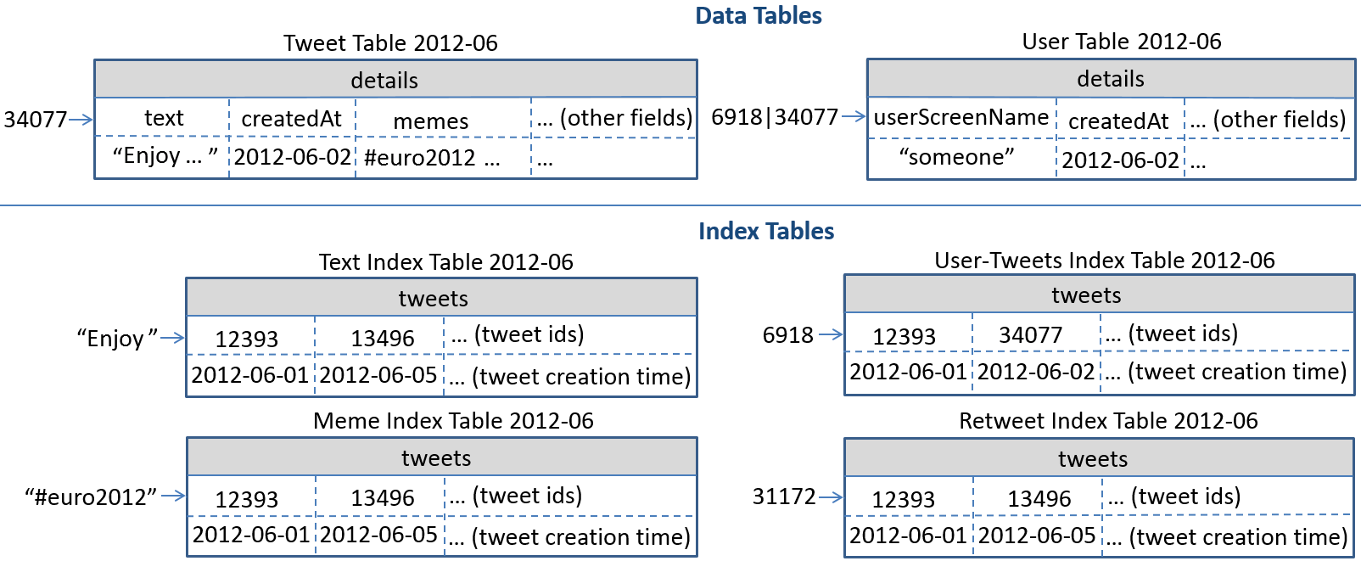
Data loading and query performance
Real Twitter data and queries from Truthy

Slide 17
Historical data loading comparison
One month’s data in .json.gz files
IndexedHBase: MapReduce program for parallel loading and indexing
Riak: distributed loaders using native text indexing support (distributed Lucene)
 | Loading time (hours) | Loaded total data size (GB) | Loaded index data size (GB)
Riak | 294.11 | 3258 | 667
IndexedHBase | 45.47 | 1167 | 212
Comparative ratio of Riak / IndexeHBase | 6.47 | 2.79 | 3.15
Notes:
Data model normalization by using tables – less redundant data
Tweets in JSON parsed twice on Riak, once on IndexedHBase
Customized index tables – no overheads from traditional inverted indices
Indexing overhead on Riak for frequency and position extraction

Slide 18
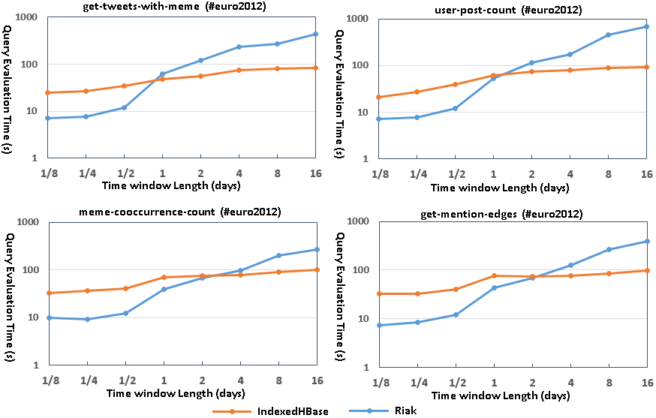
Query evaluation performance comparison
Notes:
Riak: implementation using original text indices and MapReduce on Riak
IndexedHBase more efficient at queries with large intermediate data and result sizes
Most queries involve time windows of weeks or months

Slide 19
Comparison with related work
Temporal-text queries, longitudinal analytics on web archives, etc.
Online text indexing and incremental index maintenance
O2, PostgreSQL, ANDA
Hadoop++, HAIL, Eagle-Eyed Elephant
Xiaoming Gao, Vaibhav Nachankar, Judy Qiu. Experimenting Lucene Index on HBase in an HPC Environment. Proc. 1st workshop on High-Performance Computing meets Databases (HPCDB 2011) at Supercomputing 2011.
Xiaoming Gao, Evan Roth, Karissa McKelvey, Clayton Davis, Andrew Younge, Emilio Ferrara, Filippo Menczer, and Judy Qiu. Supporting a Social Media Observatory with Customizable Index Structures - Architecture and Performance. Book chapter in Cloud Computing for Data Intensive Applications, Springer Publisher, 2015.

Slide 20
Outline
Introduction - emerging Big Data characteristics and challenges
Storage substrate: challenge and contributions
Batch analysis module: challenge and contributions
Streaming analysis module: challenge and contributions
Summary

Slide 21
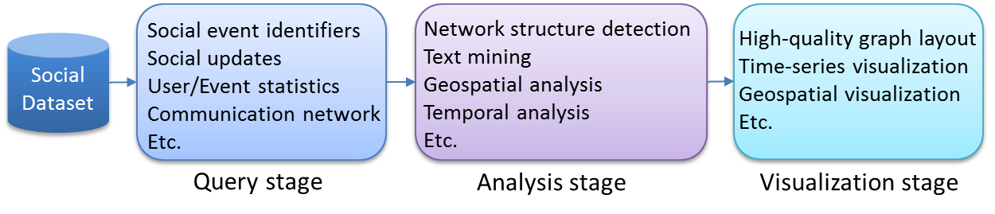
Efficient execution of integrated workflows
Characteristics of workflows:
- multiple stages and analysis tasks
- computation/communication patterns suitable for different frameworks
- requirement for dynamic adoption of various processing frameworks
- requirement for efficient individual algorithms

Slide 22
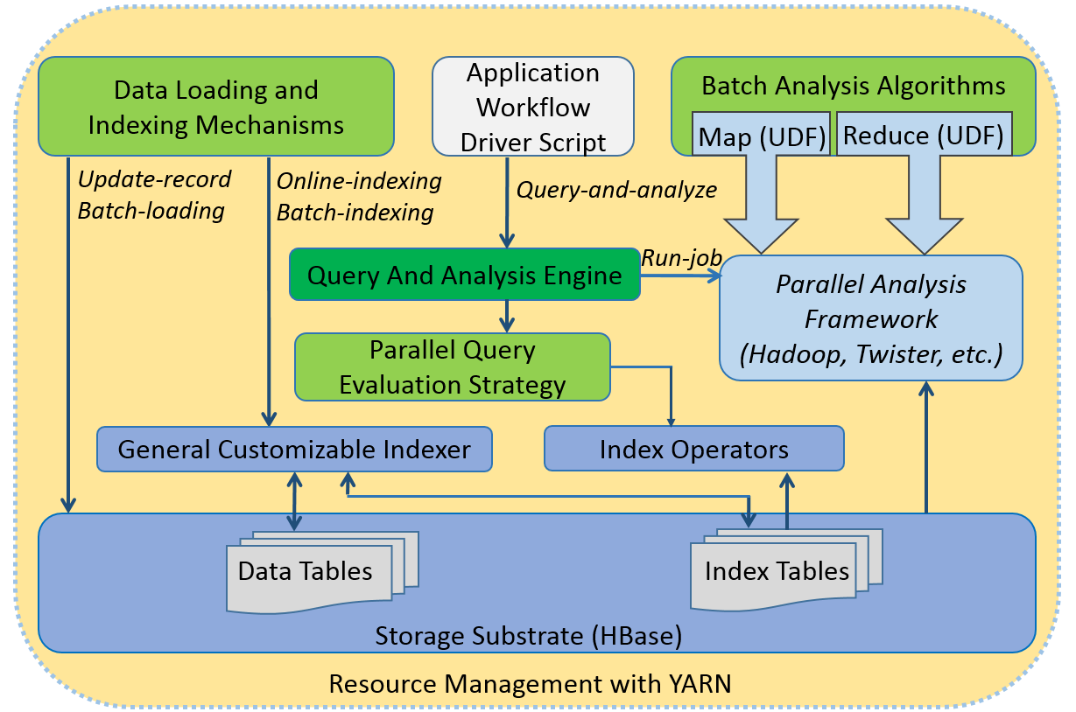
Integrated analysis stack based on YARN
- Dynamic adoption of different processing frameworks
- Integrates queries and analysis tasks

Slide 23
Analysis algorithms for composing workflows
Algorithm | Key feature | Time complexity
Related hashtag mining | Mostly relies on index; only accesses a small portion of original data. | O(H*M + N).
Meme daily frequency generation | Totally based on parallel scan of customized index. | O(N).
Domain name entropy computation | Totally based on parallel scan of customized index. | O(N).
Graph layout | First parallel implementation on iterative MapReduce; near-linear scalability. | O(I*N²).

Slide 24
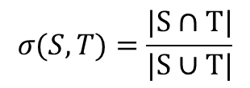
Related Hashtag mining
#mitt2012
$$σ(S,T)=\frac{|S∩T|}{|S∪T|}$$
Jaccard coefficient:
#p2
S: set of tweets containing seed hashtag s
T: set of tweets containing target hashtag t
σ > threshold means t is related to s
#vote
#obama
…
2012 presidential election
#p2
Meme index table
tweet id
tweet id
tweet id
tweet id
Mapper
…
Mapper
Mapper
…
Mapper
#vote, …
#obama
Reducer
Reducer
#vote: 0.54
…
#obama: 0.38
…

Slide 25
Domain name entropy computation
For each user, find the domain names posted during certain time
Compute entropy based on the domain name distribution
Meme Index Table (2012-06)
tweets
12393
13496
… (tweet ids)
“http://truthy.indiana.edu/”
2012-06-01: 3213409
2012-06-05: 6918355
… (time: user ID)
Map()
3213409, truthy.indiana.edu
…
Reduce()
3213409, 0.693147
user ID, entropy
…

Slide 26
Force-directed graph layout algorithm
Iterative MapReduce implementation of Fruchterman-Reingold
- force-directed graph layout algorithm, complexity O(I * N²)
- Twister-Ivy (now Harp)
- parallel force computation within iteration
- chain model broadcast across iteration

Slide 27
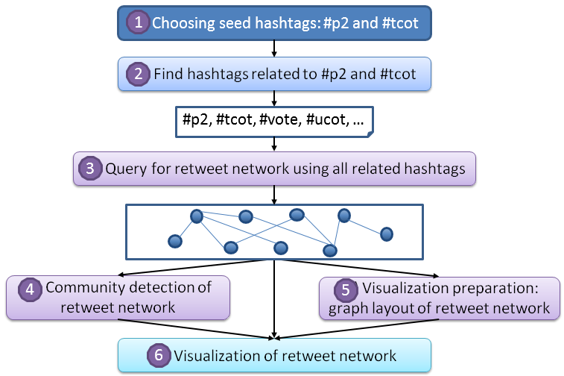
Composition of workflows
*
*
*
Reproduced results for 2010, extended to 2012 with a 20 times larger network

Slide 28
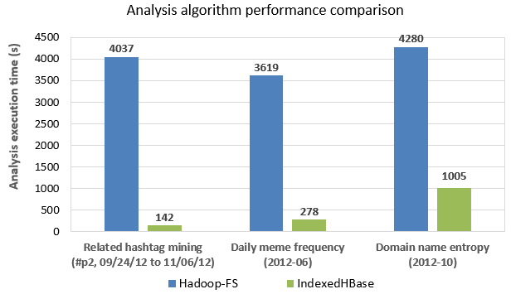
Performance analysis

Slide 29
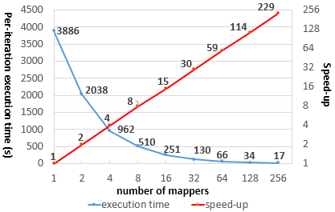
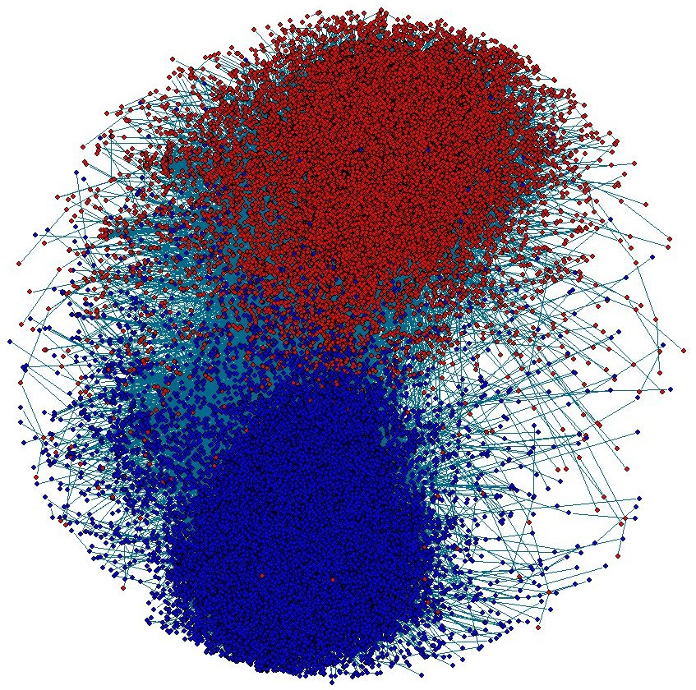
Performance analysis
Near linear scalability for Fruchterman-Reingold on Twister-Ivy
Per-iteration on sequential R for 2012 network: 6035 seconds
Xiaoming Gao, Judy Qiu. Social Media Data Analysis with IndexedHBase and Iterative MapReduce. MTAGS 2013
Xiaoming Gao, Judy Qiu. Supporting Queries and Analyses of Large-Scale Social Media Data with Customizable and Scalable Indexing Techniques over NoSQL Databases. CCGRID 2014.

Slide 30
Outline
Introduction - emerging Big Data characteristics and challenges
Storage substrate: challenge and contributions
Batch analysis module: challenge and contributions
Streaming analysis module: challenge and contributions
Summary

Slide 31
Streaming analysis module - introduction
Non-trivial parallel stream processing algorithms with global synchronization
Clustering of social media streams
Recent progress in learning data representations and similarity metrics
High-dimensional vectors: textual and network information
Expensive similarity computation: 43.4 hours to cluster 1 hour’s data with sequential algorithm
Goal: meet real-time constraint through parallelization

Slide 32
Sequential algorithm for clustering tweet stream
Online K-Means with sliding time window and outlier detection
Group tweets as protomemes: hashtags, mentions, URLs, and phrases.
Cluster protomemes using similarity measurement:
- Common user similarity:
- Common tweet ID similarity:
- Content similarity:
- Diffusion similarity:
- Combinations:
(Posting + mentioned + retweeting)

Slide 33
Online K-Means clustering
Slide time window by one time step
Delete old protomemes out of time window from their clusters
Generate protomemes for tweets in this step
For each new protomeme:
#p2
#p2

Slide 34
Sequential clustering algorithm
Final step statistics for a sequential run over 6 minutes data:
Time Step Length (s) | Total Length of Content Vector | Similarity Compute time (s) | Centroids Update Time (s)
10 | 47749 | 33.305 | 0.068
20 | 76146 | 78.778 | 0.113
30 | 128521 | 209.013 | 0.213
Notes:
120 clusters, time window length: 6 steps, outlier: 2 standard deviation

Slide 35
Parallelization with Storm - challenges
DAG organization of parallel workers: hard to synchronize cluster information
Worker Process
ActiveMQ
Broker
Clustering Bolt
…
Clustering Bolt
Synchronization Coordinator Bolt
Protomeme Generator Spout
…
tweet stream
Worker Process
Clustering Bolt
…
Clustering Bolt
Spout initiated synchronization
Clustering bolt initiated synchronization
Sync coordinator initiated synchronization

Slide 36
Parallelization with Storm - challenges
Sparsity of high-dimensional vectors make traditional synchronization expensive
Data point 1:
Data point 2:
Content_Vector: [“step”:1, “time”:1, “nation”: 1,
“ram”:1]
Diffusion_Vector: …
…
Content_Vector: [“lovin”:1, “support”:1, “vcu”:1,
“ram”:1]
Diffusion_Vector: …
…
Centroid:
Content_Vector: [“step”:0.5, “time”:0.5, “nation”: 0.5, “ram”:1.0, “lovin”:0.5,
“support”:0.5, “vcu”:0.5]
Diffusion_Vector: …
…
Cluster
Cluster-delta synchronization strategy

Slide 37
Solution – enhanced Storm topology
Worker Process
ActiveMQ
Broker
Clustering Bolt
…
SYNCINIT
CDELTAS
Clustering Bolt
PMADD
OUTLIER
SYNCREQ
Synchronization Coordinator Bolt
Protomeme Generator Spout
…
tweet stream
Worker Process
Clustering Bolt
…
Clustering Bolt
Bootstrap Information
Sequential or Parallel Batch Clustering Algorithm

Slide 38
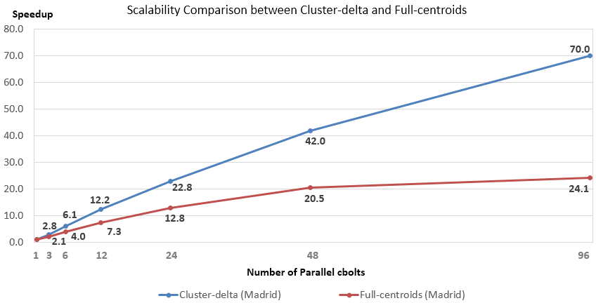
Scalability comparison
1 hour’s data for testing, first 10 mins for bootstrap
33 mins to process 50 mins’ data

Slide 39
Scalability comparison
Full-centroids synchronization
Number of clustering bolts | Total processing time (sec) | Compute time / sync time | Sync time per batch (sec) | Avg. length of sync message
3 | 67603 | 30.3 | 6.71 | 22,113,520
6 | 35207 | 15.1 | 6.71 | 21,595,499
12 | 19295 | 7.0 | 7.32 | 22,066,473
24 | 11341 | 3.2 | 8.24 | 22,319,413
48 | 7395 | 1.5 | 9.15 | 21,489,950
96 | 6965 | 0.7 | 12.93 | 21,536,799
Cluster-delta synchronization
Number of clustering bolts | Total processing time (sec) | Compute time / sync time | Sync time per batch (sec) | Avg. length of sync message
3 | 50381 | 252.6 | 0.62 | 2,525,896
6 | 22949 | 96.4 | 0.73 | 2,529,779
12 | 11560 | 42.2 | 0.81 | 2,532,349
24 | 6221 | 21.7 | 0.81 | 2,544,095
48 | 3490 | 8.4 | 1.08 | 2,559,221
96 | 2494 | 2.5 | 2.17 | 2,590,857

Slide 40
Comparison with related work
Projected/subspace clustering, density-based approaches
[Aggarwal 04], [Amini 12].
Parallel sequential leader clustering over tweet streams
[Wu 14]
Aurora, Borealis.
[Cherniack 03], [Abadi 05].
Xiaoming Gao, Emilio Ferrara, Judy Qiu. Parallel Clustering of High-Dimensional Social Media Data Streams. To appear at 15th IEEE/ACM International Symposium on Cluster, Cloud and Grid Computing (CCGRID 2015).

Slide 41
Summary of contributions
Storage substrate (2011-2012)
- customizable indexing framework over NoSQL databases
- data loading/indexing faster by multiple times
- queries faster by one to two orders of magnitude
Batch analysis module (2013-2014)
- integrated analysis stack based on YARN
- index-based analysis algorithms multiple to 10s of times faster than data scanning solutions
- first iterative MapReduce Fruchterman-Reingold, near-linear scalability
Streaming analysis module (2014-2015)
- novel cluster-delta synchronization to achieve scalability
- real-time processing of 10% Twitter stream

Slide 42
Publications
Thesis Related Publications:
[1] Xiaoming Gao, Emilio Ferrara, Judy Qiu. Parallel Clustering of High-Dimensional Social Media Data Streams. To appear at CCGRID 2015.
[2] Xiaoming Gao, Judy Qiu. Supporting Queries and Analyses of Large-Scale Social Media Data with Customizable and Scalable Indexing Techniques over NoSQL Databases. CCGRID 2014.
[3] Xiaoming Gao, Evan Roth, Karissa McKelvey, Clayton Davis, Andrew Younge, Emilio Ferrara, Filippo Menczer, and Judy Qiu. Supporting a Social Media Observatory with Customizable Index Structures - Architecture and Performance. Book chapter in Cloud Computing for Data Intensive Applications.
[4] Xiaoming Gao, Judy Qiu. Social Media Data Analysis with IndexedHBase and Iterative MapReduce. MTAGS ’13 at Super Computing 2013.
[5] Xiaoming Gao, Vaibhav Nachankar, Judy Qiu. Experimenting Lucene Index on HBase in an HPC Environment. HPCDB ’11 at Supercomputing 2011.
Other Publications:
[6] Xiaoming Gao, Yu Ma, Marlon Pierce, Mike Lowe, Geoffrey Fox. Building a Distributed Block Storage System for Cloud Infrastructure. CloudCom 2010.
[7] Xiaoming Gao, Mike Lowe, Yu Ma, Marlon Pierce. Supporting Cloud Computing with the Virtual Block Store System. eScience 2009.
[8] Robert Granat, Xiaoming Gao, Marlon Pierce. The QuakeSim Web Portal Environment for GPS Data Analysis. Proc. Workshop on Sensor Networks for Earth and Space Science Applications, 2009.
[9] Yehuda Bock, Brendan Crowell, Linette Prawirodirdjo, Paul Jamason, Ruey-Juin Chang, Peng Fang, Melinda Squibb, Marlon E. Pierce, Xiaoming Gao, Frank Webb, Sharon Kedar, Robert Granat, Jay Parker, Danan Dong. Modeling and On-the-Fly Solutions for Solid Earth Sciences: Web Services and Data Portal for Earthquake Early Warning System. Proc. IEEE International Geoscience & Remote Sensing Symposium, 2008.
[10] Marlon E. Pierce, Xiaoming Gao, Sangmi L. Pallickara, Zhenhua Guo, Geoffrey C. Fox. QuakeSim Portal and Services: New Approaches to Science Gateway Development Techniques. Concurrency & Computation: Practice & Experience, 2010.
[11] Marlon E. Pierce, Geoffrey C. Fox, Jong Y. Choi, Zhenhua Guo, Xiaoming Gao, and Yu Ma. Using Web 2.0 for Scientific Applications and Scientific Communities. Concurrency and Computation: Practice and Experience, 2009.
Awards and Honors:
Contributions to the grant proposal of NSF XPS: Rapid Prototyping HPC Environment for Deep Learning.
NSF Student Travel Grant for IEEE/ACM CCGrid 2014.
Best poster award for "A Survey of Cloud Storage Systems" at CloudCom 2010.
Best student poster award for "The Virtual Block Store System" at TeraGrid 2009

Slide 43
Acknowledgements
Committee members
Prof. Judy Qiu, Prof. Fil Menczer, Prof. Dirk Van Gucht, Prof. Geoffrey C. Fox.
Colleagues in SALSAHPC and PTI
Bingjing Zhang, Stephen Wu, Yang Ruan, Andrew Younge, Jerome Mitchell, Saliya Ekanayake,
Supun Kamburugamuve, Thomas Wiggins, Zhenghao Gu, Jaliya Ekanayake, Thilina Gunarathne,
Yuduo Zhou, Fei Teng, Zhenhua Guo, Tao Huang, Marlon Pierce, Yu Ma, Jun Wang, Robert Granat.
Collaborators from CNETS
Emilio Ferrara, Clayton Davis, Mohsen JafariAsbagh, Onur Varol, Karissa McKelvey,
Giovanni L. Ciampaglia, Alessandro Flammini.
Professors and staff of SOIC
Prof. Yuqing M. Wu, Koji Tanaka, Allan Streib, Rob Henderson, Gary Miksik, Lynne Mikolon,
Patty Reyes-Cooksey, Becky Curtis, and Christi Pike.
My family and dear friends!

Slide 44
Future work
Extend customizable indexing framework to other NoSQL databases
Integrate more processing frameworks such as Giraph and Harp
Integration with high-level languages such as Pig
Integrate Harp communication into parallel stream processing
Approach the speed of full Twitter stream

Slide 45
Implementation on HBase - IndexedHBase
Region split and dynamic load balancing for index table
Distributed indexers
…
Text Index Table
Text Index Table
Text Index Table
Text Index Table
a - f
g - k
l - r
s - z
a - k
g - k
Region server
Region server
Region server
Region server
HMaster

Slide 46
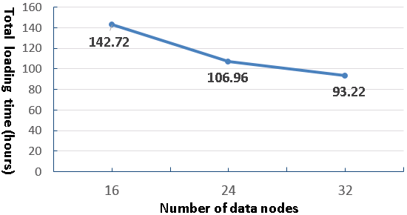
Scalable historical data loading
Measure total loading time for two month’s data with different cluster size on Alamo
- Total data size: 719 GB compressed, ~1.3 billion tweets
- Online indexing when loading each tweet

Slide 47
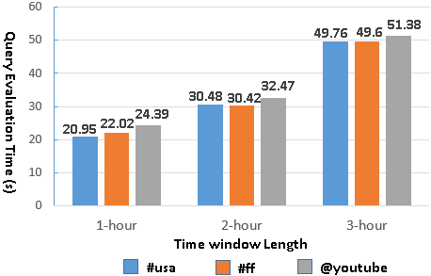
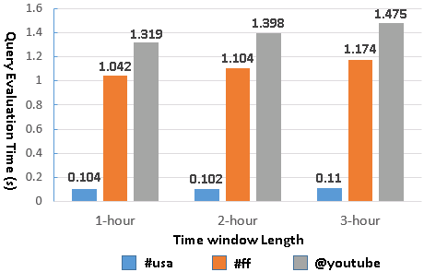
Query evaluation time with separate meme and time indices on Riak
Query evaluation time with customized meme index on IndexedHBase

Slide 48
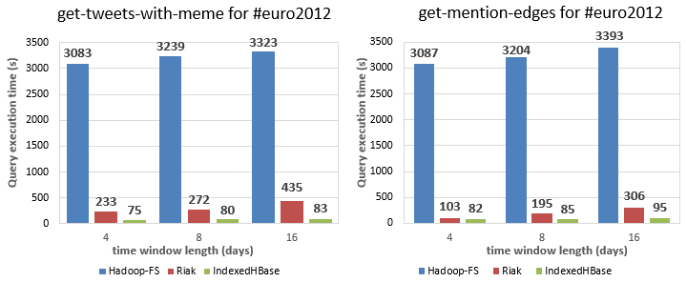

Slide 49
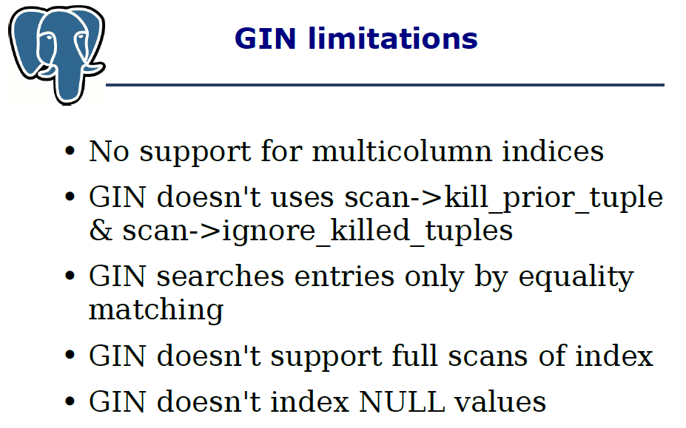

Slide 50
SQL query for user-post-count:
SELECT event_memes.meme_id AS meme,events.user_id AS user, COUNT(*) AS tweetCount
FROM (SELECT meme_id FROM event_memes
INNER JOIN events ON events.id=event_memes.event_id
WHERE DATE_FORMAT(events.time_stamp,'%Y-%m-%d') BETWEEN
__fromDay__ AND __toDay__
GROUP BY meme_id HAVING COUNT(*) BETWEEN __minMemeSize__ AND
__maxMemeSize__) MemeSize
INNER JOIN event_memes ON event_memes.meme_id=MemeSize.meme_id
INNER JOIN events ON events.id=event_memes.event_id
WHERE DATE_FORMAT(events.time_stamp,'%Y-%m-%d') BETWEEN __fromDay__
AND __toDay__
GROUP BY event_memes.meme_id,events.user_id

Slide 51
Client Application
insert(dataRecord)
index(dataRecord)
search(indexConstraints)
General Customizable Indexer
Basic Index Operator
User Defined Index Operator
Index Configuration File
User Defined Indexer
User Defined Indexer
…
HBase

Slide 52
Client application
Abstract data model and index structure
Mapping to table ops
Mapping to column family ops
Mapping to document ops
HBase
Cassandra
MongoDB
…

Slide 53
Suggested mappings for other NoSQL databases
Feature needed | Cassandra | Riak | MongoDB
Fast real time insertion and updates of index entries | Yes. Index key as row key and entry ID as column name, or index key + entry ID as row key. | Yes. Index key + entry ID as object key. | Yes. Index key + entry ID as “_id” of document.
Fast real time read of index entries | Yes. Index key as row key and entry ID as column name, or index key + entry ID as row key. | Yes. Index key + entry ID as object key. | Yes. Index key + entry ID as “_id” of document.
Scalable storage and access speed of index entries | Yes. | Yes. | Yes.
Efficient range scan on index keys | Yes with order preserving hash function, but “not recommended”. | Doable with a secondary index on an attribute whose value is object key, but performance unknown. | Doable with Index key + entry ID as “_id” of document, but performance unknown.
Efficient range scan on entry IDs | Yes with order preserving hash function and index entry ID as column name. | Doable with a secondary index on an attribute whose value is object key, but performance unknown. | Doable with Index key + entry ID as “_id” of document, but performance unknown.

Slide 54
Customizable indexing framework
Customizability through index configuration file
<index-config>
<source-recordset>tweets</source-recordset>
<index-name>textIndex</index-name>
<index-key sourcetype=“full-text”>{source-record}.text</index-key>
<index-entry-id>{source-record}.id</index-entry-id>
<index-entry-field>{source-record}.created_at</index-entry-field>
</index-config>
<index-config>
<source-recordset>users</source-recordset>
<index-name>snameIndex</index-name>
<indexer-class>iu.pti.hbaseapp.truthy.UserSnameIndexer</indexer-class>
</index-config>

Slide 55
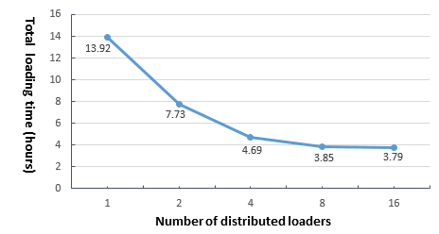
Scalable indexing of streaming data
Test potential data rate faster than current stream
Split 2013-07-03.json.gz into fragments distributed across all nodes
HBase cluster size: 8
Average loading and indexing speed observed on one loader: 2ms per tweet

Slide 56
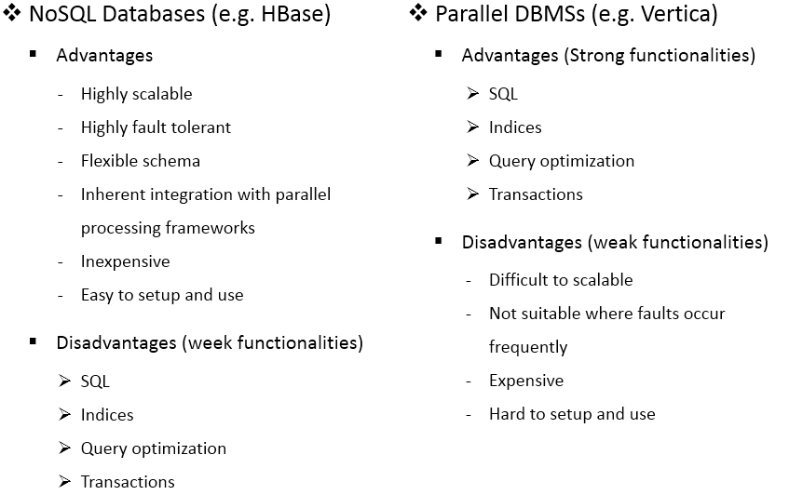
Storage substrate – parallel DBMS vs NoSQL
(Kyu-Young Whang in 2011 Internaltional Conference on Database Systems for Advanced Applications)

Slide 57
Parallel query evaluation strategy
get-retweet-edges(#p2, <2012-09-01, 2012-10-29>)
memeIndexTable-2012-09
memeIndexTable-2012-10
#p2
#p2
…
…
Tweet ID Search Phase
Parallel Evaluation Phase
Mapper
…
Mapper
Mapper
…
Mapper
Reducer
Reducer
1568 -> 2334 : 8
…
3677 -> 2099 : 5
…

Slide 58
Correctness verification
Ground truth dataset: 1 week of tweets containing trending hashtags
Run sequential and parallel algorithms with trending hashtags removed
Compute LFK-NMI: normalized mutual information [0, 1]
Parallel vs Sequential | Sequential vs ground truth | Parallel vs ground truth
0.728 | 0.169 | 0.185

Slide 59
Comparison with related work
Indices for queries in relational and NoSQL databases
HadoopDB
Shark and Spark
Xiaoming Gao, Judy Qiu. Social Media Data Analysis with IndexedHBase and Iterative MapReduce. Proc. Workshop on Many-Task Computing on Clouds, Grids, and Supercomputers (MTAGS 2013) at Super Computing 2013.
Xiaoming Gao, Judy Qiu. Supporting Queries and Analyses of Large-Scale Social Media Data with Customizable and Scalable Indexing Techniques over NoSQL Databases. Proc. 14th IEEE/ACM International Symposium on Cluster, Cloud and Grid Computing (CCGRID 2014).

Slide 60
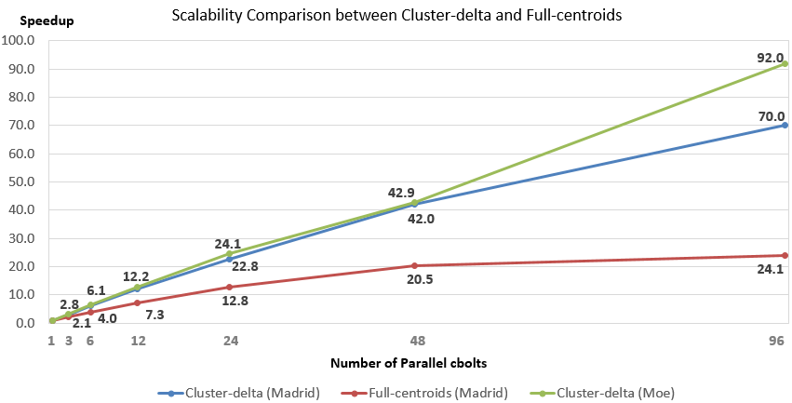
Scalability comparison
Madrid: non-peak time, 33 mins to process 50 mins’ data
Moe: peak-time, larger batch size, 39mins for 50 mins’ data

Slide 61
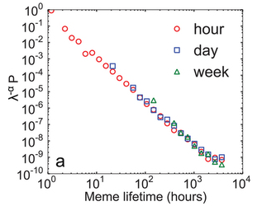
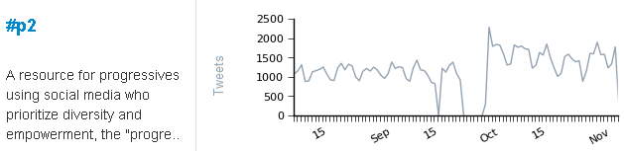
Apply customized indices in analysis algorithms
Hashtag daily frequency generation
#p2 : 2012-09-01|2344, 2012-09-02|32001, …
#tcot : 2012-09-01|5536, 2012-09-02|8849, …
…
Meme Index Table
tweets
259227
339330
… (tweet ids)
“#p2”
2012-09-23
2012-09-24
… (tweet creation time)
- Can be done by only scanning the index
- MapReduce over HBase index tables
Notes:
Include output visiualization

Slide 62
Online indexing and batch indexing mechanisms
Twitter streaming API
Data table region
Data table region
Stream input client
Stream distribution mechanism
mapper
mapper
Construct input data records
Construct input data records
Construct input data records
Construct input data records
…
…
General Customizable Indexer
General Customizable Indexer
General Customizable Indexer
General Customizable Indexer
Loader 1
Loader N
Node 1
Node N
HBase
HBase
…
Data tables
Index tables
Text Index table
Meme Index table
Online indexing for streaming data
Batch indexing for existing data tables

Slide 63
Streaming and historical data loading mechanisms
Twitter streaming API
.json.gz file
.json.gz file
Stream input client
Stream distribution mechanism
mapper
mapper
Construct input data records
Construct input data records
Construct input data records
Construct input data records
…
…
General Customizable Indexer
General Customizable Indexer
General Customizable Indexer
General Customizable Indexer
Loader 1
Loader N
Loader 1
Loader N
HBase
HBase
Data tables
Index tables
Data tables
Index tables

