Slide 1


High Performance, Federated,
Service-Oriented
Geographic Information Systems
Ahmet Sayar
(asayar@cs.indiana.edu)
Indiana University
Department of Computer Science
Advisor: Prof. Geoffrey C. Fox
Notes:
Today's presentation is on my research topic – High …….systems.
SRB
Slide 5 de FEDERATION u highlight et; motivation olarak neden federation yapma geregi duydun

Slide 2
Outline
Geographic Information Systems
Motivations and Research Issues
Federation framework
Federator oriented data access/query optimizations
Measurements and Analysis
Abstract framework for General Science Domains
Contributions and Future Work
Notes:
Correct the pronunciation of he word data!

Slide 3
Federated
Geographic Information Systems (GIS)
GIS is a system for creating, storing, sharing, analyzing and displaying geo-data and associated attributes.
From centralized systems to collaborative distributed systems
  Various client-server models, databases, HTTP, FTP
The primary function of federation is to display information as maps with potentially many different layers of information (Figure)
  Single point of access over integrated data views
Notes:
2. Over the past two decades, GIS has evolved from traditional centralized mainframe and desktop systems to collaborative distributed systems.
In the collaborative distributed systems, the resources span organizational disciplinary and technical boundaries and use different client-server models, data archiving systems and heterogeneous message transfer protocols.
3.The nature of the geographical applications requires seamless integration and sharing of spatial data from a variety of providers.
By the federated GIS we mean displaying information
Geographical applications are mostly DM applications and Decision making in Geographic Information Systems (GIS) increasingly…
Maps are complex structures composed of layers rendered from potentially separate data source
In order to support this we proposed a federation framework

Slide 4

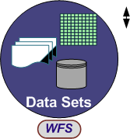
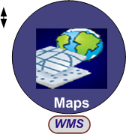



Interoperability Standards
Standards bodies: Open Geospatial Consortium (OGC) and ISO/TC211
Enable geographic information and services neutral and available across any network, application, or platform
Standards for services and data models
  Web Map Services (WMS) - rendering map images
  Web Feature Services (WFS) – serving data in common data model
  Geographic Markup Language (GML) : Content and presentation
Database
Adaptor/wrapper
Rendering Engine
Display Tools
Ex. Street Data
Ex. Street Layer
GML
Binary data
Notes:
0. In order to provide interoperable and extensible GIS framework, we adopted domain-specific standard specifications for data model and online-services from OGC.
3. WMS and WFS are two major services defined by OGC for creating a basic GIS framework enabling information rendering from heterogeneous data sources as map images.
-----
ISO/TC211 defines a high-level data model for public sectors, such as governments, federal agencies, and professional organization.
On the other hand, OGC is interested in developing both abstract definitions of Open GIS frameworks and technical implementations details of data models and to a lesser extend services.
WMS produces maps from the geographic data in GML provided by WFS. It also enables attribute/feature based data querying over data display by its standard service interfaces. OGC’s WFS implementation specification defines interfaces for data access and manipulation operations on geographic features. Via its standard service interfaces, a web user/client can combine, use and manage geo-data from different sources by invoking several standard operations

Slide 5
Motivations
Necessity for sharing and integrating heterogeneous data resources to produce knowledge
  Problems in data and storage heterogeneities
  Burden of individually accessing each data source
Data access/query do not scale with the data size increases
  Distributed nature of data and ownership
  Interoperability/compliance costs
Notes:
1. The internet and its associated web programming models have revolutionized accessibility to data/information sources.
To be able to produce knowledge from these data resources, they need to be shared, integrated and federated.
In order to be able to integrate the data/information, they need to be interoperable and provided with standard service interfaces.
However, in the real world, data is kept in different formats and stored in numerous incompatible storages and provided by heterogeneous systems and internet protocols.
2. Because of the interoperability-compliance costs and common problems with distributed nature of data and ownership issues, accessing/querying the data does not scale with data size.
On the other hand,
GIS require large data movement, processing and rendering in a responsive manner
Decision making for building early-warning systems
Crisis management for homeland security and natural disasters etc.
3. By using conventional communication networks, storage and computation resources, we obtained high degree of responsiveness.
Why is this problem you've worked on important

Slide 6
Research Issues
  Integrating GIS into Grid and e-Science
    Adopting Web Service principles into some features of GIS.
Federation
  Metadata aggregation of standard GIS Web Service components
  Unified data access/query/display from a single access point
Performance: Data access/query optimizations
  Adaptive optimized range queries
  Parallel data access/query via attribute-based query decomposition
Analyzing the applicability of such a framework to the other science domains
  Architectural principles and requirements
Notes:
Under the motivations we mentioned earlier, I will address these research issues throughout the presentation.
-Use the words “investigate”, research, explore
In terms of federation, we investigate how to aggregate standard web services capability meteadata and create an aggregated capability metadata enabling … over integrate data views from a single access point.
1. Capability metadata for each different group of components are defined by Standards
We define aggregated capability enabling hierarchical data definition in multi-layer format.
mapping of common data model to a display model enabling integration/overlaying with other data sets (integrated data-view)
2. Regarding the performance We will explore federator oriented data access/query optimization technique
Under this title …
2. Interoperability & Extensibility
Adoption of domain specific Open Standards -data model and services
Integrating Web Service principles into some features of GIS.
3. Generalizing the proposed federated GIS system to general domains in terms of architectural principles and requirements

Slide 7
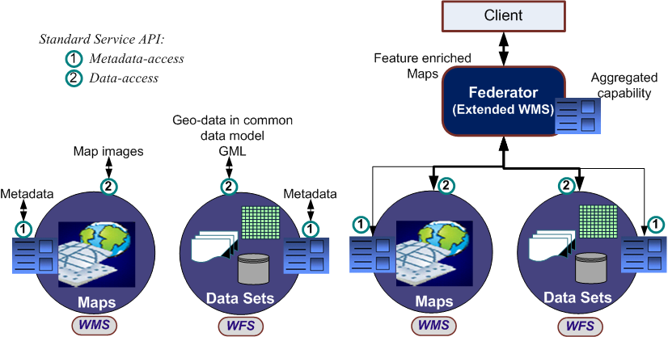
Federated Geographic Information System
Just-in-time or late-binding federation
Federation Framework
  Common data model (OGC defined)
  Standard Web Services (OGC defined – extended as Web Services)
  Federator (Introduced)
Federator :
  Collects/harvests domain specific standard capabilities
  Provides a global view of distributed data sources
Notes:
they can be composed by aggregating their capabilities.
developed in accordance with the Web Service interoperability Organization’s standards (WS-I).
Federator combines standard GIS data services through aggregating their standard capability metadata and enables unified data access/query.
Quality of services
Fine-grained dynamic information presentation
Enables more complex information creation by leveraging multiple data sources
Provides stateful access/query over stateless data services
Enables optimized parallel data access/query

Slide 8
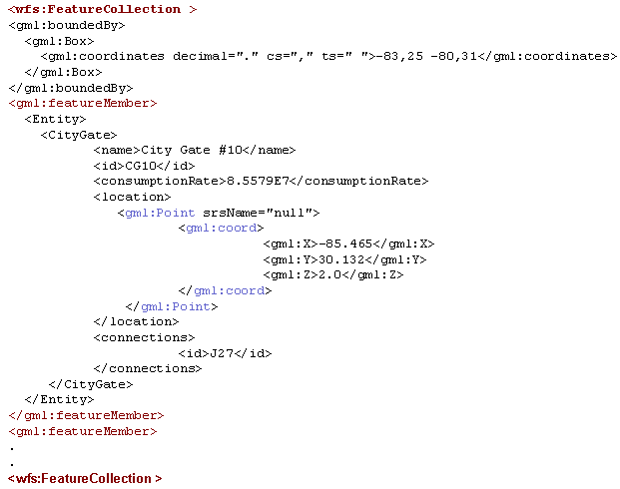
1. Common Data Model
Geographic Markup Language (GML)
  XML encoding for the transport and storage of geographic information
Separation of content and presentation
  Data is with the spatial (geometric) and non-spatial (attributive) features
  Enables display and query together
Allows geo-data and its attributes to be moved between disparate systems with ease
Can be processed by many XML tools in various environments
Each type of data sets has its own schema
  Composed of Geometry schema (geometry.xsd) and Feature Schema (feature.xsd)
Common data model examples from other domains
  Astronomy -> VOTable: Tabular data representation in XML
  Chemistry -> CML: Chemical data representation in XML
Geographic object described as feature member
Presentation
Content
Notes:
VOTable schema
http://www.ivoa.net/internal/IVOA/IvoaVOTable/VOTable-beta.xsd
CML Schema
http://cml.sourceforge.net/schema/cmlCore.xsd

Slide 9
2. Standard Data Components
Provide data sets in standard formats with standard service interfaces
Translate information into common data models with corresponding metadata
WFS: Provide data in common data model – GML type
  GetCapability, GetFeature, DescribeFeatureType
WMS: Geo-data rendering services – rendered GML as a layer – image type
  GetCapability, GetMap, GetFeatureInfo
Developed with OGC standards and extended with Web-Service Capabilities (WS-I standards)
SkyServers in Astronomy serve the same purpose as WFS in Geo-science
  Defined by IVOA Open standards
  Attribute-based access to distributed heterogeneous resources
  Standard data models (VOTable and FITS) - with standard service interfaces
Notes:
Relate these to SkyServers and scommands !!!
FITS: Flexible Image Transport System

Slide 10
3. Federator
Enables unified data access/query over standard data components
Aggregator of capability metadata of standard data components
  Aggregates, composes and orchestrates WMS and WFS services
  Expresses the compositions in its aggregated capability file
A Web Map Server but extended with federation and display services
Like a WMS to clients; and a client to the other WMS and WFS
Allows browsing of information from a single access point
Federator is like Storage Resource Broker (SRB) developed by SDSC
  Transparent access to multiple types of storage resources.
  Uses central metadata catalog (MCAT) for discovering data/services.
Notes:
Abstraction for transparent access to multiple types of storage resources.
Our federator uses aggregated capability metadata file kept in its local disk.

Slide 11
Capability Metadata
-OGC Defined-
<?xml version='1.0' encoding="UTF-8" standalone="no" ?>
<!DOCTYPE WMT_MS_Capabilities SYSTEM "http://toro.ucs.indiana.edu:8086/xml/capabilities.dtd">
<Capabilities version="1.1.1" updateSequence="0">
<Service>
<Name>CGL_Mapping</Name>
<Title>CGL_Mapping WMS</Title>
<OnlineResource xmlns:xlink="http://www.w3.org/1999/xlink" xlink:type="simple“
xlink:href="http://toro.ucs.indiana.edu:8086/WMSServices.wsdl" />
<ContactInformation>
…..
</ContactInformation>
</Service>
<Capability>
<Request>
<GetCapabilities>
<Format>WMS_XML</Format>
<DCPType><HTTP><Get>
<OnlineResource xmlns:xlink="http://w3.org/1999/xlink" xlink:type="simple“
xlink:href="http://toro.ucs.indiana.edu:8086/WMSServices.wsdl" />
</Get></HTTP></DCPType>
</GetCapabilities>
<GetMap>
<Format>image/GIF</Format>
<Format>image/PNG</Format>
<DCPType><HTTP><Get>
<OnlineResource xmlns:xlink="http://w3.org/1999/xlink" xlink:type="simple“
xlink:href="http://toro.ucs.indiana.edu:8086/WMSServices.wsdl" />
</Get></HTTP></DCPType>
</GetMap>
</Request>
<Layer>
<Name>California:Faults</Name>
<Title>California:Faults</Title>
<SRS>EPSG:4326</SRS>
<LatLonBoundingBox minx="-180" miny="-82" maxx="180" maxy="82" / >
</Layer>
</Capability>
</Capabilities>
OGC services are described with capability metadata
  XML-encoded
Capability metadata are accessed online through standard service interface “getCapability”
Information about the data sets and operations available on them with communication protocols, return types, attribute-based constraints.
Clients determine whether they can work with that server based on its capabilities.
Supported request types: getCapabilities, getMap
Supported return types
Service invocation point
Data-definition: Domain specific attribute-based constraints
Notes:
Service-level metadata describing the operations and content available at a service instance.
Every OGC Web Service must have the ability to describe its abilities by returning service metadata in response to a getCapabilities request.
Ex: Dublin Core and OAI-PMH (Open Archives Initiative Protocol for Metadata Harvesting) in digital libraries domain
(Dublin Core - RDF) - (Capability - GML) [relation mappings]
Dublin core: An attempt to improve resource discovery on the Web - now adopted more broadly
15 elements for descriptive metadata: Title, creator, subject, description, publisher, date, type, source, format etc. - looks like end node.
Dublin Core vs RDF (defined by W3C) - Capability vs GML
RDF and GML Imposes structural constraints on the expression of application data models for consistent encoding, exchange and processing of metadata
Usage is different: dc elements for resource description is embedded in rdf documents. In GML-capability case: capability utilizes the semantics of GML elements.
Dublin core is an application of RDF data model
Dc:date -> rdf:value

Slide 12
Illustration of Standard Services’ Capability Files
WMS
WFS
<Capabilities>
<Service>
<Name>
<OnlineResource>
<ContactInfo>
</Service>
<Capability>
<Request>
<GetCapability>
<GetMap>
<GetFeaturInfo>
</Request>
<LayerList>
<Data-1: Satellite img>
<Data-2: gas-pipeline>
<Data-3: Google-map>
</LayerList>
</Capability>
</Capabilities>
<Capabilities>
<Service>
<Name>
<OnlineResource>
<ContactInfo>
</Service>
<Capability>
<Request>
<GetCapability>
<GetFeature>
<DescribeFeaturType>
</Request>
<DataList>
<Data-1: gas-pipeline>
<Data-2: electric-power>
<Data-3: other-data>
</ DataList >
</Capability>
</Capabilities>
General Service Metadata
Operations -
Web Service Interfaces
Metadata about provided data/information
Notes:
Capability files schema are defined by OGC
<LayerList> and <DataList> tags have attribute based descriptions such as available bbox, spatial reference systems (SRS), output formats etc.
<service>:
General service metadata as a whole. And services’ invocation point.
Contact information such as names addresses etc.
<Request> names the actual operations that are supported. It also has some sub-tags about offered output formats and URL prefixes for each operations
<layerList>:The geographic information content offered for a portroyal by a WMS server is orgnized into “layers”
Moreover, each available map is advertised by a <layer> element.
WFS indicate which feature type they can serve and what operations are supported on each feature type.

Slide 13
Federator’s Template Capability Metadata
- Since Federator is an extended WMS, its capability is an extended WMS capability.
- Federated data sets are defined under the tag called “Layers” with the attribute “cascaded” set to 1.
- Federator publishes these data sets as if they are its own, and serves them indirectly
<Capabilities>
<Service>
<Name>
<OnlineResource>
<ContactInfo>
</Service>
<Capability>
<Request>
<GetCapability>
<GetMap>
<GetFeaturInfo>
</Request>
<Layers cascaded=‘1’>
<Layer-1: REFERENCE to remote WFS>
- Web Service invocation point
- Query schema
<Layer-2: REFERENCE to remote WMS>
- Web Service invocation point
</LayerList>
</Capability>
</Capabilities>
Ex. Federation for Pattern Informatics Geo-science Appl.
    [LayerData-1]
      Name: State-boundaries
      Type: WFS
      Invocation-point: http://organization/services/wfs/....
      Request-schema : “path to file.xml”
    [LayerData-2]
      Name: Satellite-map-images
      Type: WMS
      Invocation-point: http://organization/services/wms/....
    [LayerData-3]
      Name: Earthquake-seismic-records
      Type: WFS
      Invocation-point: http://organization/services/wfs/....
      Request-schema : “path to file.xml”
Extracted from federated
WFS and WMS capability metadata files
WMS Service Interface
Definitions of bindings to federated standard data services
See NEXT slide
Notes:
Federated data sets are defined under the tags called “layer” with attribute cascaded (i.e. federated) set to 1.
Since Federator is an extended WMS, aggregated capability is an extension to WMS’s standard capability.
Federator publishes these data sets as if it’s own, and serves them as second hand

Slide 14
Federator-oriented data access/query optimization for distributed map rendering
Notes:
.. for high-performance support in distributed map rendering.
Federated spatial database display
We propose federator-oriented data …optimization techniques for distributed map rendering

Slide 15
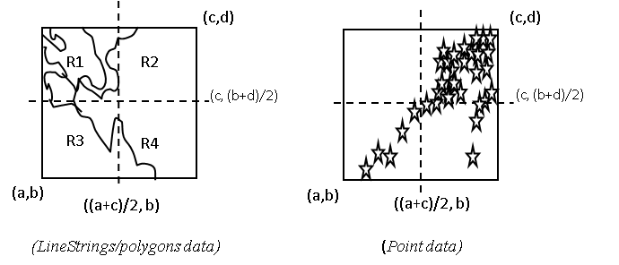
Performance Investigation
Interoperability requirements’ compliance costs
  Using XML-encoded common data model (GML)
  Costly query/response conversions at data resource (ex. WFS)
    XML-queries to SQL
    Relational objects to GML
  Variable-sized and unevenly-distributed nature of geo-data
  Range queries: Variable-sized and unevenly distributed
  Examples: County boundaries and Human population
>> Unexpected workload distribution: The work is decomposed into independent work pieces, and the work pieces are of highly variable sized
Notes:
In addition to distributed nature of the data and common problems with large data movement over the internet, interoperability requirements bring up some compliance costs in such a distributed federated information framework.
1-using semi-structured data model:
OGC recommends using GML data. GML carries content and the presentation tags together with the core data.
That enables the data sources to be queried and displayed together
Those resulting XML representations of data tend to be significantly larger than binary representations of the same data.
The larger document size means that the greater bandwidth is required to transfer of data, as compared to the equivalent binary representations.
2- There are also some characteristics of geo-data that make it difficult to design a distributed GIS with satisfactory performance.
Services provided by a GIS requires heavy CPU usage due to the complex computation involved in the underlying computational geometry.

Slide 16
Parallel Range Queries via Federator
Interactive
Client Tools
(x’,y’)
R1
R2
R2
Federator
(WMS)
Federator
(WMS)
(x’, (y+y’)/2)
[Range]
R3
R4
[Range]
(x,y)
1. Partitioning into 4
(R1), (R2), (R3), (R4)
((x+x’)/2, y)
3. Merging
Main query range:
[Range] = (R1)+(R2)+(R3)+(R4)
Single Query Range:[Range]
2. Query Creations
Q1, Q2, Q3, Q4
Q
WFS
Queries
WFS
WFS
WFS
Responses
DB
DB
Straight-forward
Parallel fetching
Notes:
In order to optimize range queries we applied query decomposition by partitioning their range attributes and making parallel queries instead of sending one large range.
Seems like a natural solution, but geo-data is variable sized and unevenly distributed.
It does not guarantee even-workload sharing.

Slide 17
Adaptive Range Query Optimization
Query approximation problem
Dynamic nature of data
Optimal partitioning of data is difficult
  polygons-points-linestrings are neither distributed uniformly nor of similar size
  The load they impose varies, depending on query range
  It is difficult to develop a fair partitioning strategy that is optimal for all range queries
Notes:
We address those issues by focusing on adaptive range query optimization …

Slide 18
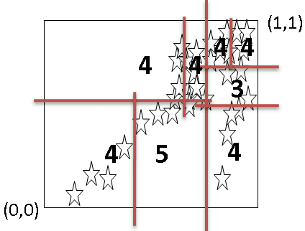
Workload Estimation Table (WT)
Aim: Cutting the 2-dimensional query ranges into smaller pieces with approximately equal query sizes.
Created once and synchronized/refined routinely with DB
Consideration of data dense/sparse regions
Each layer-data has its own distribution characteristics and WT
WT is consisted of <key, value> : <bbox, size> pairs.
  size ≤ pre-defined threshold query size
Lets illustrate this with a sample scenario
  Whole data range in database is (0,0,1,1) and 32MB of data size
  Each ‘ ’ corresponds to 1MB and
  Query size for each partition ≤ 5MB (max 5 ‘ ’ in each partition)
Database
(1,1)
(1,1)
4
8
WT consists of <key, value>
key: rectangle
value: query-size
4
Queries with different ranges
8
4
4
3
32
15
17
7
4
5
4
9
(0,0)
(0,0)
Federator
Notes:
Recursive bisection method
At each step find out the center of gravity on x and y coordinate alternatingly
We use apache ehcache for WT
Adjustment running at the batch
Not an actual query

Slide 19
WT Creation/refinement
- Two-level recursive bisection-
  PT(R, t, er) = PT(R₁, t, er) + PT(R₂, t, er)
    t: The max value of acceptable query size for a partition
    er (error rate) : The max acceptable degree of fluctuations in partitions’ query sizes
    er = [size(R1)-size(R2)] / size(R₂)
  PT(R, t, er) {
    [(R₁,size₁):(R₂,size₂)] = PTInBalance(R, er)
    If ((size₁ or size₂)≤ t) /*(sizes are almost the same)*/
      Put the partitions into WT as pairs
        <R₁, size₁>
        <R₂, size₂>
      And return;
    else
      PT(R₁,t,er); PT(R₂,t,er)
    }
(maxx,maxy)
R₁
R₂
(minx,miny)
mp = (minx+maxx)/2

Slide 20
WT Creation/refinement -Cont
(maxx,maxy)
PTInBalance(R, er){
  current_er = 1;
  l = minx
  r = maxx
  While(current_er > er){
    mp = (l+r)/2
    R₁ = minx, miny, mp, maxy /*R=R₁+R₂*/
    R₂ = mp, miny, maxx, maxy
    gml₁ = getData(R₁)
    gml₂ = getData(R₂)
    If(gml₁>gml₂); {r = mp}
    else {l = mp}
    current_er = (size(gml₁)-size(gml₂)) / max[size(gml₁), size(gml₂)]
    }
    return [(R₁,size(gml₁)):(R₂,size(gml₂))]
    }
/*Like finding out center of gravity*/
R₁
R₂
(minx,miny)
mp = (minx+maxx)/2
Remote data access to find out the data size for the corresponding range (R_{I})

Slide 21
WT Utilization in Parallel Queries
Lets say federator gets a query whose range is R
R is positioned in the WT to see the most efficient partitions for parallel queries
(1,1)
R overlaps with: p₅, p₆, p_{7,} p₈, p_{9,} and p₁₀
Instead of making one query in range R;
  Make 6 parallel queries:
    p₅, p₆, p_{7,} p₈, r₁ and r₂
    R = p₅+p₆+p₇+p₈+r₁+r₂
There are still minor fluctuations
  Inevitable partial overlapping (r₁ and r₂)
p₂
p₁
p₄
p₁₂
p₃
p₆
R
p₅
p₈
p₉
p₇
r₂
r₁
p₁₁
p₁₀
(0,0)
WT (Reflecting the distribution characteristics of data in DB)

Slide 22
Performance Evaluation over the Streaming GIS Web Services
How do the #of WFS and #of partitions together affect the performance?
When the WFS number is kept same, how does the partition-threshold size in WT affect the #of parallel queries and the performance?
Performance is evaluated with real data (earthquake seismic data) kept in relational tables in MySQL database
Replicated WFS and Databases
Servers/nodes are deployed on 2 (Quad-core) processors running at 2.33 GHz with 8 GB of RAM.
NB
Federator/WMS
NB
Earthquake seismic data (130MB in GML)
WFS
WFS
DB
S
P
DB
Partitioned main query
P
S: Subscriber
P: Publisher
NB: NaradaBroker (publish/subscribe-based data streaming over a topic)
Notes:
It is not like plain http connection
Single subscriber multiple NB for each WFS

Slide 23
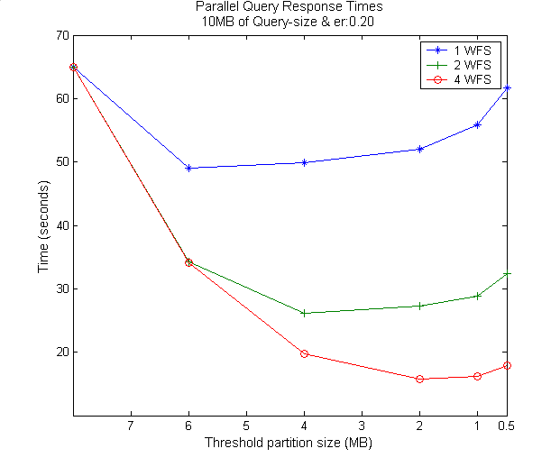
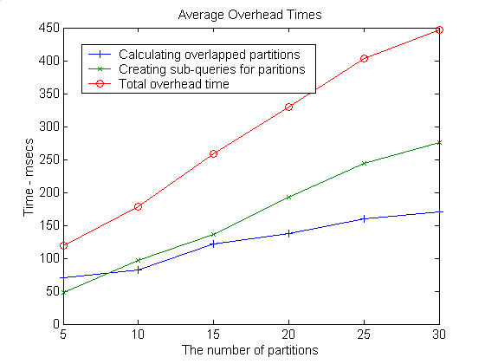
i
Avg. #of partitions
No prt
2.2
4.6
8.5
16.9
31.3
Figure shows how #of parallel queries affects the response times together with #of WFS
For the same query size (10MB) using different WT created with different “threshold partition size”
– The average values of 10 different query regions/ranges and each query is 10MB in size
- Without partitioning (single query); it takes average 64.51 seconds
- As the threshold partition size decreases, the number of partitions/parallel-queries increases (X-axis)
Notes:
The performance gain increases as the partition number increases and then increase rate decreases. The initial increase is due to improved load balance by reducing the effect of fluctuation in partitions’ loads, and the decrease is due to the non-parallelizable overheads and limited number of clusters.
1 2 4
6mb 49.0 34.2 34.1 avg:2prts
4mb 49.82 26.2 19.7 avg:4prts
2mb 52 27.3 15.8 avg:8pts
1mb 56.9 29.6 14.6 avg:16prts
.5mb 59.9+62.2+63.1 32.7+32+32.5 17.6+17.9 avg:31.2prts
Overhead times:
Avg. sub-query creation time for a particular partition: 10.89 msec
Merging the results: It is done in parallel and that does not effect performance – asynchronous run
I/O and cpu jobs run together.

Slide 24
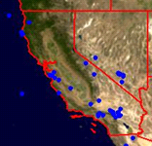
Test-Case Scenario: Multiple Distinct WFS and WMS
Real Geo-science application: Pattern Informatics
Federator federates
  WMS : Satellite map images (NASA JPL Labs)
  WFS :Earthquake seismic data (CGL) and State boundary lines (USGS)
Measurements:
  Baseline test: Sequential access to the sources
  Parallel access via federator
  Parallel access through WT in federator
Binary image
WMS
Satellite Maps
NASA-JPL California
Event-based dynamic map tools
GetMap
Federator
WFS-1
Binary image
GML
DB1
Earthquake Seismic data
CGL Indiana
2
1
1
Browser
toro.ucs.indiana.edu
gf12.ucs.indiana.edu
WFS-2
DB2
State boundary lines
USGS Colorado
Satellite Map
JPL
Earthquake data -CGL
2
State boundary lines -USGS
Notes:
We have used REAL DATA
USGS: United States Geological Survey
Earthquake forecasting code developed by Prof. John Rundle (UC Davis) and collaborators, uses seismic archives.

Slide 25
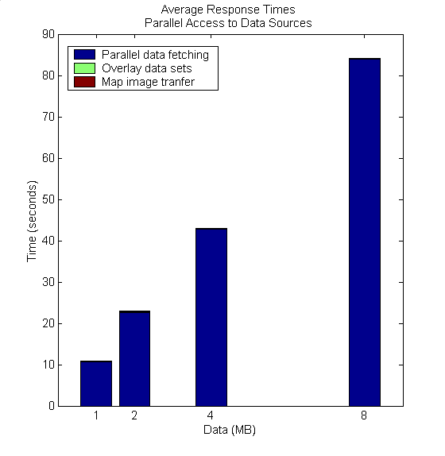
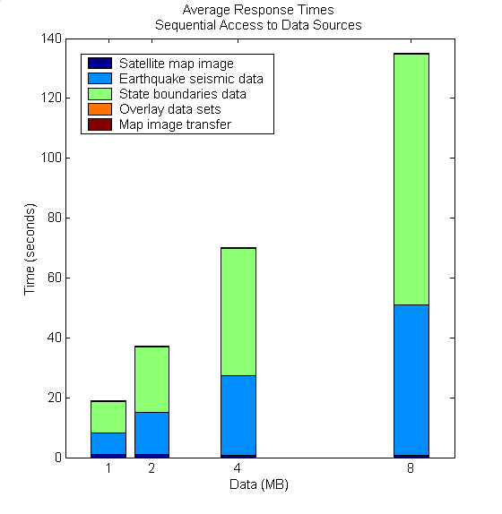
Query sizes for each data source
Query sizes for each data source
Improved performance results by accessing data sources parallel
The slowest data source’s response time defines the overall response time.
Performance gain from parallel access increases as the response time difference between data sets decreases.
Baseline test: Data sources are accessed one after another.
[Naturally] Unbalanced response times even for the same size of data
  Distinct data sources
Notes:
Time to fetch data sets in parallel = dk : k is the index of data from the slowest server
Synchronous access = ∑(d_{i}) i: from 1 to number of data to be fetched in parallel

Slide 26
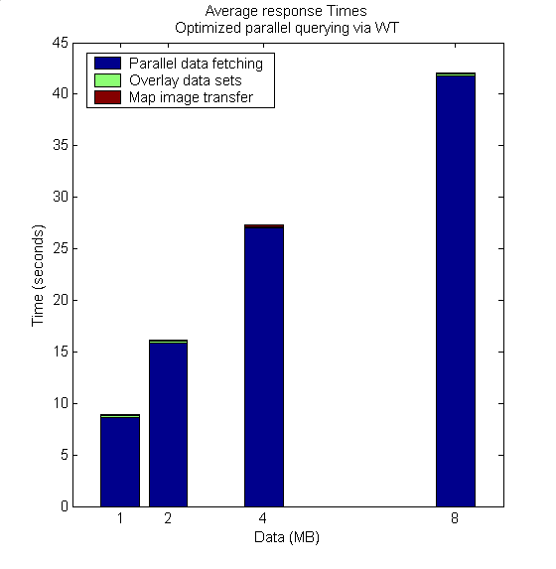
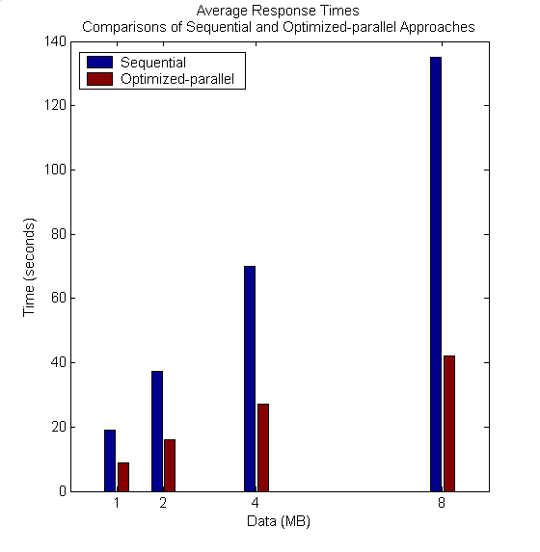
Further improvement: Applying adaptive parallel query optimization technique for individual data sets.
WT for state boundaries: [partition_size=2MB and error_rate=1.0]
  Data sources: frameworkwfs.usgs.gov and gridfarm18.ucs.indiana.edu
WT for earthquake seismic data: [partition_size=1MB and error_rate=0.2]
  Data sources: gridfarm12.ucs.indiana.edu and gf.17.ucs.indiana.edu
Notes:
Performance gain is not as much as expected from state boundaries.
It is linear ring and partitioning is not giving exact decomposition of the objects (feature elements)
There are minor repetitions of objects to be fetched.
For state boundaries 2 machines: gf12.ucs.indiana.edu, colorado.ccc
WT is created by thr:2mb, no er defined
For earthquake seismic data 2 machines: gf16.ucs.indiana.edu, gf2.ucs.indiana.edu
WT is created by thr:1mb, er=0.2

Slide 27
Summary of the Architecture
Federator’s natural characteristics allow optimized parallel processing
  Inherently datasets come from separate data sources
  Individual dataset decomposition and parallel processing
Parallelized the range queries by using data partitioning (to reduce synchronization) and dynamic load balancing (to improve speedup)
  Approximation of the workloads through WT
Success of the parallel access/query is based on how well we share the workload with worker nodes.
Modular: Extensible with any third-party OGC compliant data service
Enables the use of large data in Geo-science Grid applications in a responsive manner.

Slide 28
Generalizing the Problem Domain
GIS-style information model can be redefined in any application area such as Chemistry and Astronomy
  Application Specific Information Systems (ASIS).
Querying heterogeneous data sources as a single resource
  Heterogeneous: Local resource controls the definition of data
  Single resource: Removing the hassle of individually accessing each data source
Data is always at its originating source
Client/User-Query
Integrated View
federation
services
Standard service interfaces and
common data models
Mediator
Mediator
Mediator
DB
Files
WWW
Transparent/federated query and display of distributed heterogeneous data sources

Slide 29
Architectural Requirements
Constraints: Each domain has its own set of attributes to describe the data and services.
  Defining a core language (such as GML)
    Expressing the primitives of the domain
    Domain specific encoding of common data
  Key service components (such as WMS and WFS)
    Service type mediating heterogeneous data into the system as a common data model and std service interfaces
    Service type enabling rendering of common data model in a display format
  The capability file for each key service component
    Enabling inter-service communication to link services for the federation
Notes:
Developing a proposed GIS-like federated system requires
Data and service descriptions are :By Standard bodies of the related domain.
3. Defines service and data attributes, and their constraints and limitations to enable clients to make valid queries and get expected results.

Slide 30
Generalization of the Proposed Architecture - ASIS
Language (ASL) -> GML :Express domain specific features, semantics of data
Domain-specific equivalents of the WFS and WMS ➔ ASVS and ASVS
Federator aggregates metadata of distributed ASVS and ASFS to create application-based hierarchy of distributed data sources.
Mediators: Query and response conversions
  Data sources maintain their internal structure
Unified data query/access/display
Such as filtering, transformation, reasoning, data-mining, analysis
AS
Repository
Federator
ASVS
ASVS
ASFS
AS Tool
(ASVS)
AS Services
(user defined)
AS Tool
(ASFS)
4
3
2
1
Mediator
Mediator
Standard service API
Standard service API
AS
Sensor
AS
Sensor
Capability Federation
ASL-Rendering
Standard service API
Messages using ASL
Notes:
Abstract Components and data flow
We will need the domain-specific equivalents of the WMS and WFS
Feature Service (ASFS) -> WFS :Serving data in common language (ASL)
Rendering Services (ASVS) -> WMS : Visualizes information and provides a way of navigating ASFS compatible/mediated data resources
Federator
It is actually an ASVS but with an extended capabilities for capability federation and interacting and integrating multiple servers providing data in hierarchical/integrated data views defined in capabilities metadata.
ASL is domain specific XML-encoded common data model containing content and representation tags.
ASVS must visualize information and provide a way of navigating ASFS and their underlying database.
ASVS make successive queries to the related ASVSs to get the ASL data and render it to create final display for its clients. They provide comprehensible information in display formats.
ASFS are annotation services providing heterogeneous data in common data model (ASL) with an attribute-based query capability.
Capability helps clients to make valid requests for its successive queries.
Capability basically provides information about the data sets and operations available on them with communication protocols, return types, attribute-based constraints, etc.

Slide 31
Survey on Feasibility of Generalization
GIS is a mature domain in terms of information system studies and experiences and standard bodies, but many other fields do not have this.
Comparison/matching of ASIS’s elements with selected science domains
  Geo-science, Astronomy and Chemistry
  Comparison is based on data model, services and metadata counterparts
…ASIS Science Domains | Data Model ASL | Components ASFS ASVS |  | Metadata
GIS | GML | WFS | WMS | capability.xml schema
Astronomy | VOTable, FITS | SkyNode | VOPlot TopCat | VOResource
Chemistry | CML, PubChem | ---- | NO standard JChemPaint, JMOL | ----
Standard Bodies
OGC and ISO/TC211
IVOA
----
Notes:
In order to see the applicability of the GIS-style information model given, we have surveyed two science domains (Astronomy and Chemistry). Table 15 presents the results briefly in terms of service counterparts (ASIS vs. science domains)
IVOA: International Virtual Observatory Alliance
FITS: Flexible Image Transfer
SkyNodes are queried with ADQL Astronomy Distributed Query Language

Slide 32
Contributions
A SOA architecture to provide a common platform to integrate Geo-data sources into Geo-science Grid applications seamlessly and responsively.
Federated Service-oriented GIS framework
  Production of knowledge as integrated data-views in the form of multi-layer map images
  Hierarchical data definitions through metadata aggregation
  Unified interactive data access/query and display from a single access point.
Adaptive range-query optimization and applications to distributed map rendering
  Dynamic load balancing for sharing unpredictable workload
  Parallel optimized range queries through partitioning
Blueprint architecture for generalization of GIS-like federated information system enabling attribute-based transparent data access/query

Slide 33
Contributions (Systems Software)
Web Map Server (WMS) in Open Geographic Standards
  Extended with Web Service Standards, and
  Streaming map creation capabilities
GIS Federator
  Extended from WMS
  Provides application-specific and layer-structured hierarchical data as a composition of distributed GIS Web Service components
  Enables uniform data access and query from a single access point.
Interactive map tools for data display, query and analysis.
  Browser and event-based
  Extended with AJAX (Asynchronous Java and XML)

Slide 34
Acknowledgement
The work described in this presentation is part of the QuakeSim project which is supported by the Advanced Information Systems Technology Program of NASA's Earth-Sun System Technology Office.
Galip Aydin: Web Feature Server (WFS)

Slide 35
Thanks!....

Slide 36
BACK-UP SLIDES

Slide 37
Possible Future Research Directions
Integrating dynamic/adaptable resources discovery and capability aggregation service to federator.
Applying distributed hard-disk approach (ex. Hadoop) to handle large scale of workload estimation tables
Layered WT for different zoom levels
  Avoiding from unnecessary number of parallel queries
Extending the system with Web2.0 standards
Handling/optimizing multiple range-queries
  Currently we handle only bbox ranges

Slide 38
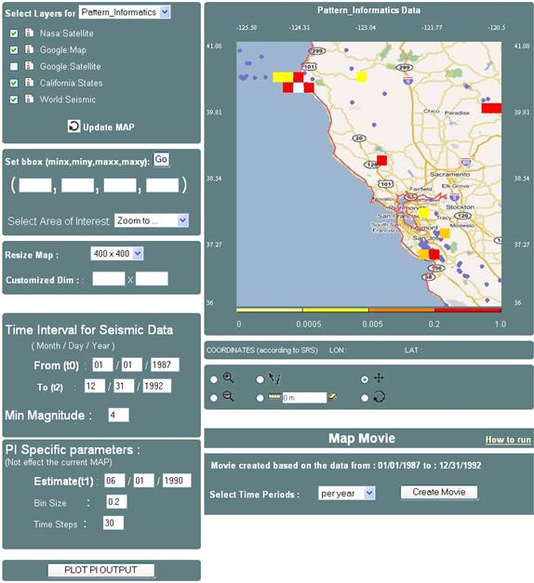
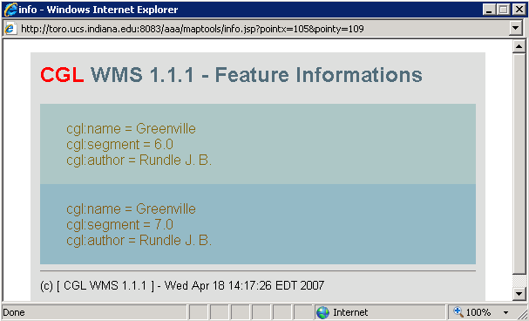
Hierarchical data
Integrated data-view
1
2
3
1: Google map layer
2: States boundary lines layer
3: seismic data layer
Event-based Interactive Tools :
Query and data analysis over integrated data views
Notes:
Since common data model based on content and presentation
We can also further query the data layers based on their attributes
Presentation tags are used for displaying.
Interactive Information Visualization tools provide researcher with remarkable capabilities to support discovery. By combining powerful data mining methods with user-controlled interfaces, users are able to benefit distributed heterogeneous data sources (access/attribute-based-query/display) from a single access point.
Users can begin with an overview, zoom-in on areas of interests, filter-out un-wanted items/layers, and click for details-on-demand.
With careful design and efficient algorithms, OGC provided data-layers can be enriched with some other data and/or processing resources.

Slide 39
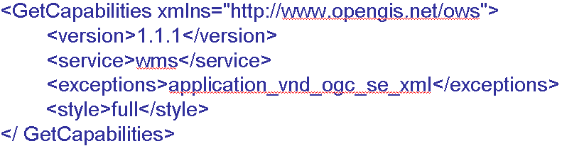
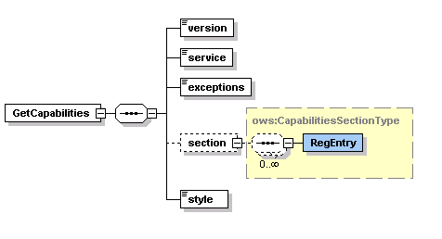
GetCapabilities Schema and Sample Request Instance

Slide 40
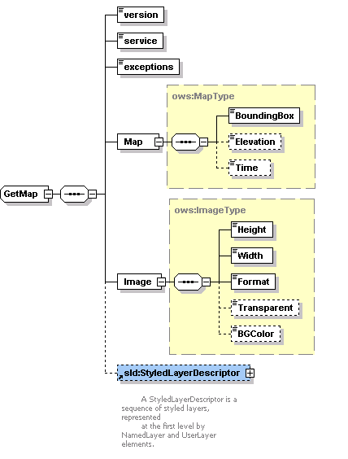
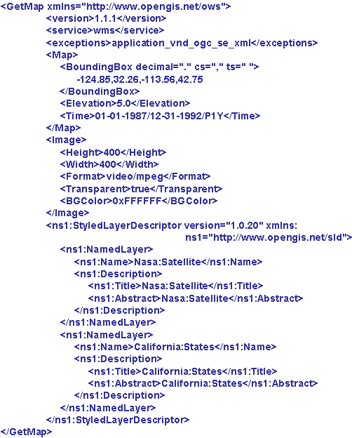
GetMap Schema and Sample Request Instance

Slide 41
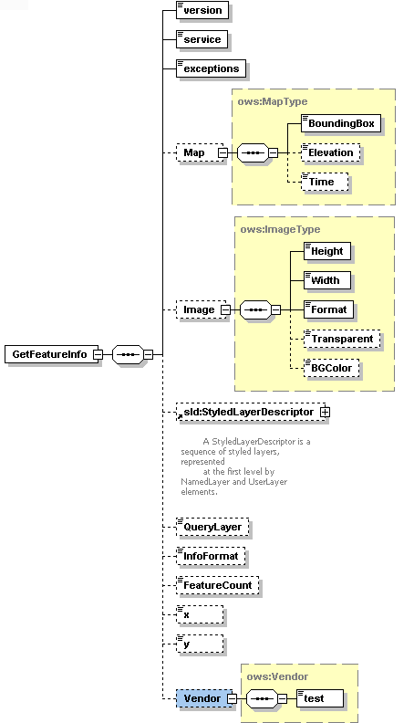
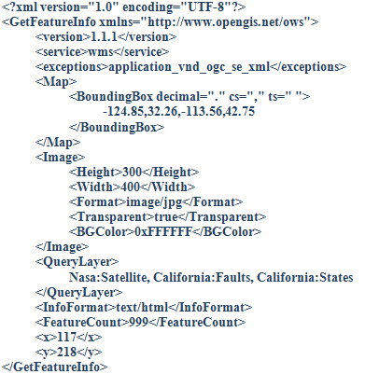

Slide 42
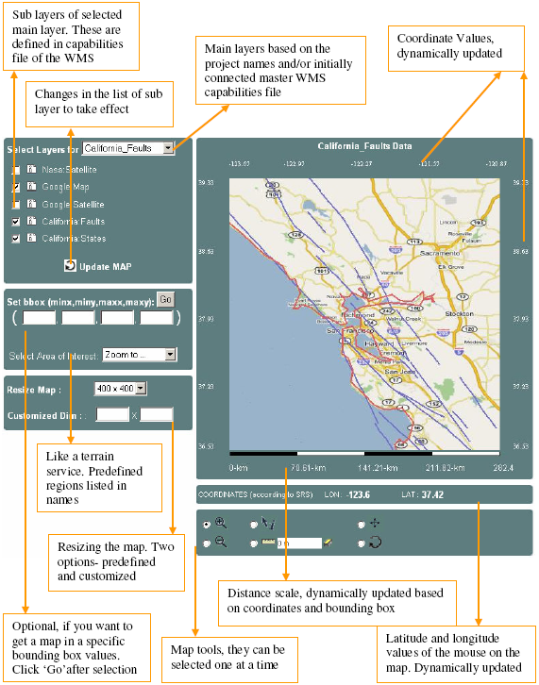
Event-based Interactive Map Tools
<event_controller>
  <event name="init" class="Path.InitListener" next="map.jsp"/>
  <event name="REFRESH" class=" Path.InitListener " next="map.jsp"/>
  <event name="ZOOMIN" class=" Path.InitListener " next="map.jsp"/>
  <event name="ZOOMOUT" class="Path.InitListener" next="map.jsp"/>
  <event name="RECENTER" class="Path.InitListener“next="map.jsp"/>
  <event name="RESET" class=" Path.InitListener " next="map.jsp"/>
  <event name="PAN" class=" Path.InitListener " next="map.jsp"/>
  <event name="INFO" class=" Path.InitListener " next="map.jsp"/>
</event_controller>

Slide 43
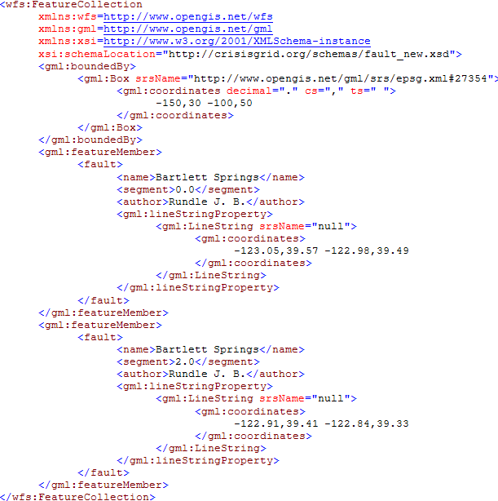
Sample GML document

Slide 44
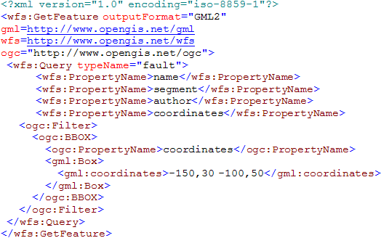
Sample GetFeature Request Instance

Slide 45
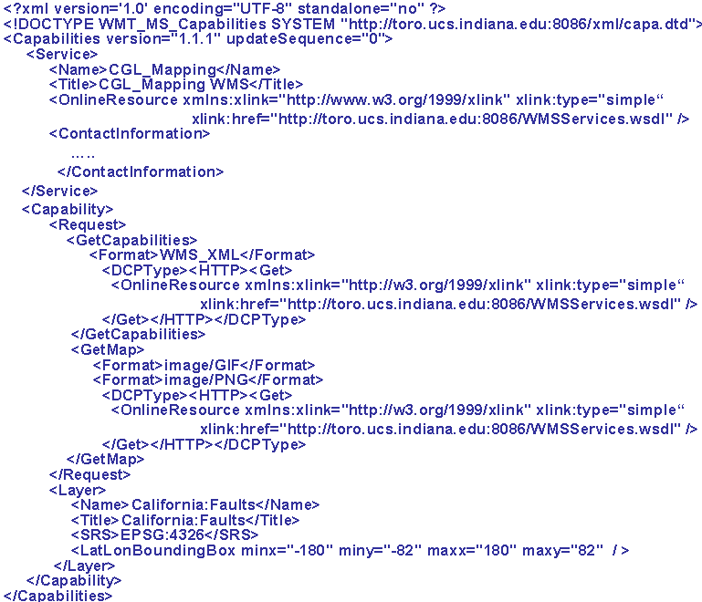
A Template simple capabilities file for a WMS

Slide 46
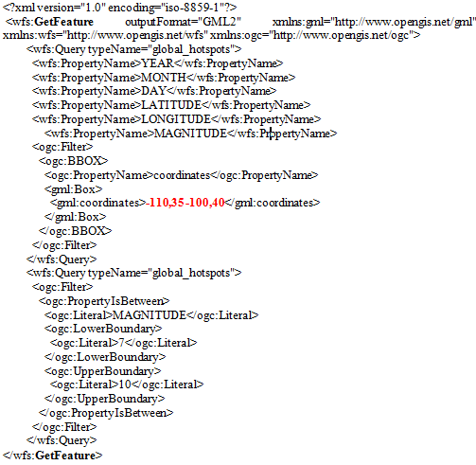
Sample GetFeature request to get feature data (GML) from WFS.
-110,35,-100,36
GFeature-1
-110,36,-100,37
GFeature-2
-110,37,-100,38
GFeature-3
-110,38,-100,39
GFeature-4
-110,39,-100,40
GFeature-5
Partition list as bbox values for sample case :
- Pn=5
- Main query getMap bbox 110,35 -100,40

Slide 47
Map rendering from GML
B
WMS
Converting objects into image
Plotting geometry
elements over the layer
Parsing and extracting geometry elements
Binary map image
GML
Notes:
Image conversion time in Figure is for resolution 400x400 in pixel.
Sample image conversion values are for JPEG creation
Average conversion time:25.43msec
Image conversion time changes based on
map images’ user-defined resolution values
Requested image format such as JPEG.

Slide 48
Standard Query (GetFeature)
<?xml version="1.0" encoding="iso-8859-1"?>
<wfs:GetFeature outputFormat="GML2" xmlns:gml="http://www.opengis.net/gml" >
<wfs:Query typeName="global_hotspots">
<wfs:PropertyName>LATITUDE</wfs:PropertyName>
<wfs:PropertyName>LONGITUDE</wfs:PropertyName>
<wfs:PropertyName>MAGNITUDE</wfs:PropertyName>
<ogc:Filter>
<ogc:BBOX>
<ogc:PropertyName>coordinates</ogc:PropertyName>
<gml:Box>
<gml:coordinates>-124.85,32.26 -113.36,42.75</gml:coordinates>
</gml:Box>
</ogc:BBOX>
</ogc:Filter>
</wfs:Query>
<wfs:Query typeName="global_hotspots">
<ogc:Filter>
<ogc:PropertyIsBetween>
<ogc:Literal>MAGNITUDE</ogc:Literal>
<ogc:LowerBoundary>
<ogc:Literal>7</ogc:Literal>
</ogc:LowerBoundary>
<ogc:UpperBoundary>
<ogc:Literal>10</ogc:Literal>
</ogc:UpperBoundary>
</ogc:PropertyIsBetween>
</ogc:Filter>
</wfs:Query>
</wfs:GetFeature>
Corresponding SQL query:
Select LATITUDE, LONGITUDE, MAGNITUDE from Earthquake-Seismic where
-124.85 < X < -113.36 & 32.26 < Y < 42.75
& 7 < MAGNITUDE < 10
Notes:
SQL queries are created from these attributes and their constraint range values

Slide 49
Streaming data transfer
XML Encoding: Size of the geospatial data increases with GML encoding which increases transfer times, or may cause exceptions
SOAP message creation overhead
Strategies: Streaming data flow extensions to GIS Web Services
  Web Service -as a handshake protocol.
  Data is transferred over publish-subscribe messaging systems.
  Enables client to render map images with partially returned data
Extension
client
WMS GML rendering
Subscriber
GML
(topic, IP, port)
Narada Brokering Server
GetFeature
Topic,IP,port
1
2
W S D L
WFS
Publisher
GML
server
DB
Notes:
1.2. stateless: needs to complete whole response to transfer transaction. But it might causes memory exception to create whole GML response.
Initial problems regarding data transfer and rendering in GIS developed in accordance with Open Standards
HTTP based query/response does not allow large scale data move
Rendering large scale XML data with common xml processors had some problems such as mem exception
The streaming technique is commonly used in transmitting multimedia contents. For web browsing images, streaming is not very crucial; the required number of pixels will be limited by the web browser’s screen size.

Slide 50
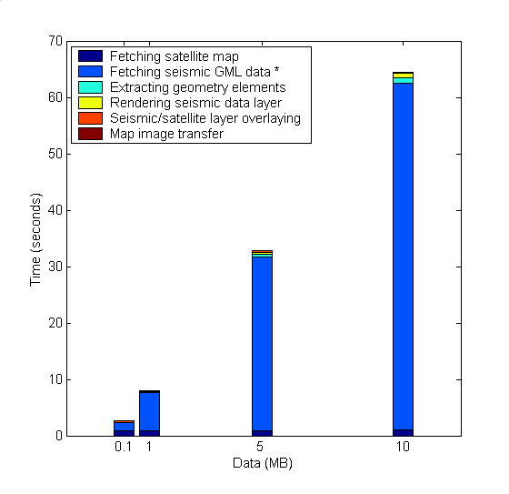
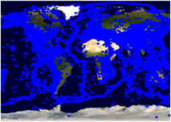
Overall performance evaluation (1)
Parallel query, rendering /display one dataset provided by 4 distinct WFS
Test Data
  NASA Satellite maps image from WMS (at California NASA JPL)
  Earthquake Seismic data from WFS (at Indiana Univ. CGL Labs)
Setup is in LAN
  gf12,17,18,19.ucs.indiana.edu.
  2 (Quad-core) processors running at 2.33 GHz with 8 GB of RAM.
Baseline System Test:
Using 1-WFS for querying earthquake seismic data
Detailed Average Response Times
Baseline-test:
WMS
NASA Satellite Map Images
JPL California
Binary map image
GetMap
1
Event-based dynamic map tools
Federator
Binary map image
GML
WFS-1
DB1
Replicated WFS and DBs
Browser
2
2
1
..
Earthquake Seismic records
1: NASA satellite
map images
2: Earthquake-
seismic records
CGL
Indiana
WFS-4
DB4
2
Notes:
Throughout the performance slides, we will be working on two-layers for simplicity.
These are the layers actually used in real geo-science applications Pattern Informatics and Virtual California
Performance enhancing design techniques are mostly focusing on XML-encoded common data model (GML) handling (transfer/rendering/display)
In this sense, GML data is fetched, rendered and overlaid on NASA satellite map images which is shown as layer 2 in the figure.
Binary map images are fast enough to access and display. Because there is no need burdening query and data conversion as it is done for GML.
We also have integrated and used Google Map as base map layer to overlay GML data. But not shown here.
Intel Xeon processors running at 2.33 GHz with 8 GB of memory and operating Red Hat Enterprise Linux ES release

Slide 51
Motivating Use Cases
Earthquake science applications
  Pattern Informatics (PI)
    Earthquake forecasting code developed by Prof. John Rundle (UC Davis) and collaborators, uses seismic archives.
  Virtual California (VC)
    Time series analysis code, can be applied to GPS and seismic archives. It can be applied to real-time and archival data.
Interdependent Energy Infrastructure Simulation System (IEISS) – Los Alamos National Laboratory (LANL)
  Models infrastructure networks (e.g. electric power systems and natural gas pipelines) and simulates their physical behavior, interdependencies between systems.
Notes:
In this slide I will discuss the motivating cases in which our proposed system can be applied.
For eg: in the earthquake…….there are 2 sample projects….
The next one is interdependent…………

