Slide 1
Towards HPC and Big Data Convergence in a Component Based Approach
Supun Kamburugamuve
May 14, 2018
Indiana University
Indiana University Bloomington
skamburu@indiana.edu
Advisor: Distinguished Professor. Geoffrey Fox
Committee: Professor. Judy Qiu, Professor. Martin Swany,
Professor. Minje Kim, Professor. Ryan Newton
`
Notes:
Our goal is to create an environment where machine learning, streaming and big data co-exist in a single framework. We are not about creating a machine learning framework. This presentation describes how we get here, the problems we encountered and the solutions we are providing.

Slide 2
Outline
Motivation
Performance of big data systems
Data driven applications
Limitations of streaming frameworks
HPC integration to big data
Requirements of next generation systems
Twister2
Twister:Net
Contributions

Slide 3
Performance of Big Data Systems
Comparing Spark, Flink and MPI
MDS, K-Means and Terasort

Slide 4
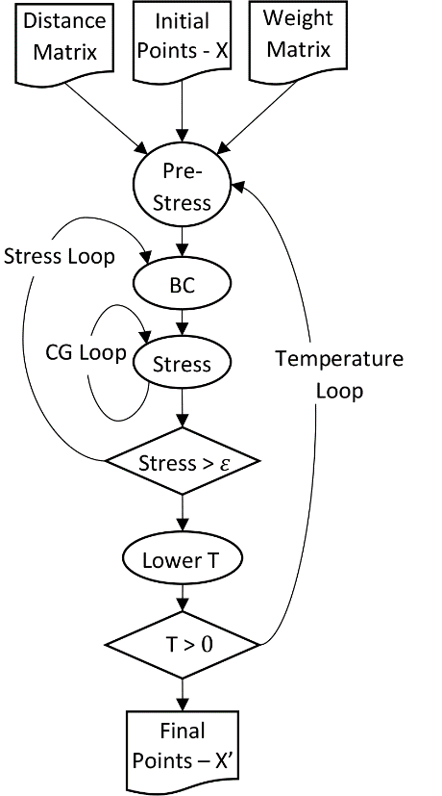
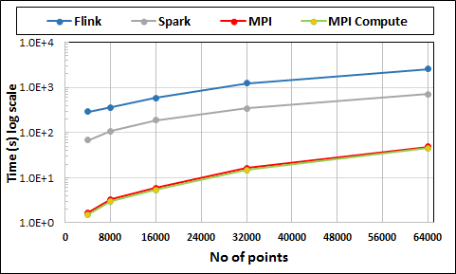
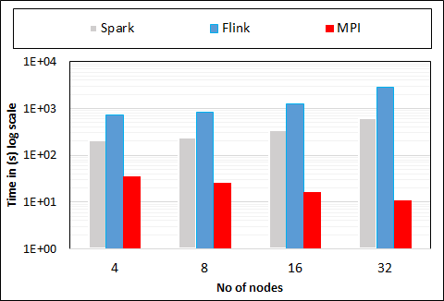
Multidimensional Scaling - 3 Nested Parallel Sections
Flink
Spark
MPI
MPI Factor of 20-200 Faster than Spark/Flink
MDS execution time on 16 nodes with 20 processes in each node with varying number of points
MDS execution time with 32000 points on varying number of nodes. Each node runs 20 parallel tasks

Slide 5
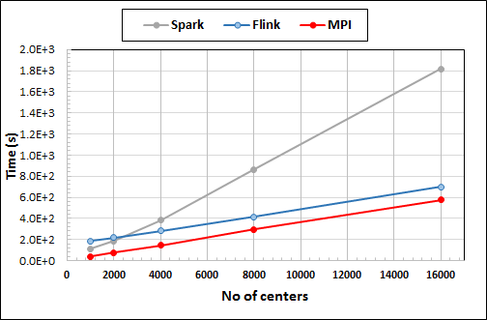
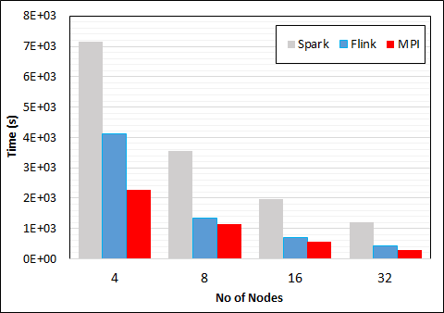
K-Means Clustering
Data Set <Points>
Dataflow for K-means
Data Set <Initial Centroids>
Map (nearest centroid calculation)
Reduce (update centroids)
Data Set <Updated Centroids>
Broadcast
K-Means execution time on 16 nodes with 20 parallel tasks in each node with 10 million points and varying number of centroids. Each point has 100 attributes.
K-Means execution time on varying number of nodes with 20 processes in each node with 10 million points and 16000 centroids. Each point has 100 attributes.
Notes:
Note the differences in communication architectures
Note times are in log scale
Bars indicate compute only times, which is similar across these frameworks
Overhead is dominated by communications in Flink and Spark

Slide 6
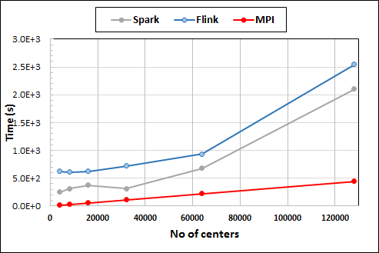
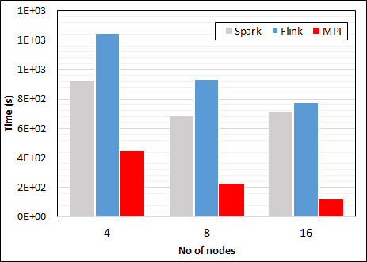
K-Means Clustering in Spark, Flink, MPI
K-Means execution time on 8 nodes with 20 processes in each node with 1 million points and varying number of centroids. Each point has 2 attributes.
K-Means execution time on varying number of nodes with 20 processes in each node with 1 million points and 64000 centroids. Each point has 2 attributes.
K-Means performed well on all three platforms when the computation time is high and communication time is low as illustrated in 10 million points and 10 iterations case. After lowering the computation and increasing the communication by setting the points to1 million and iterations to 100, the performance gap between MPI and the other two platforms increased.
Notes:
Note the differences in communication architectures
Note times are in log scale
Bars indicate compute only times, which is similar across these frameworks
Overhead is dominated by communications in Flink and Spark

Slide 7
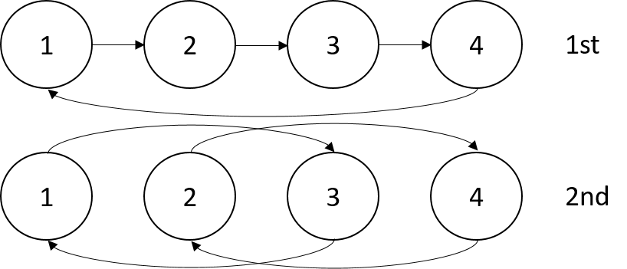
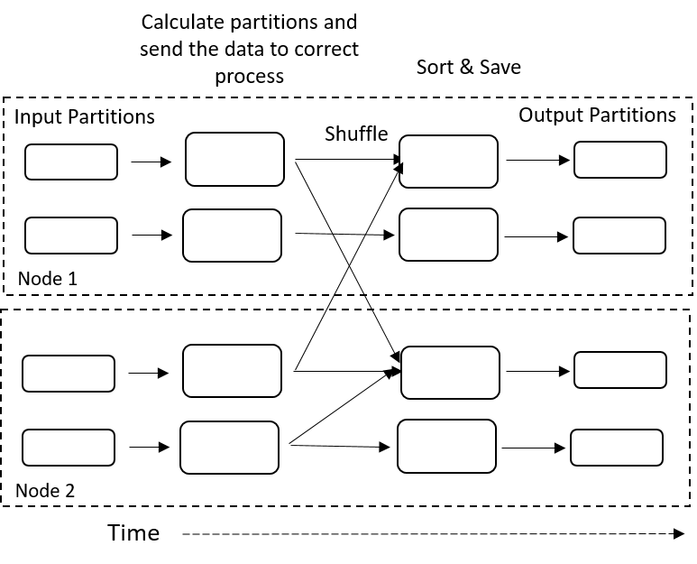
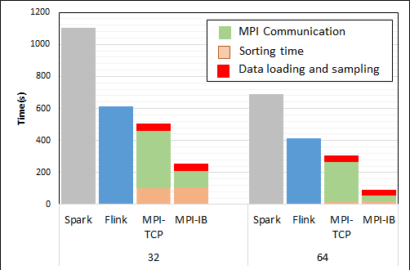
Terasort
Transfer data using MPI
Sorting 1TB of data records
Terasort execution time in 64 and 32 nodes. Only MPI shows the sorting time and communication time as other two frameworks doesn't provide a viable method to accurately measure them. Sorting time includes data save time. MPI-IB - MPI with Infiniband
Partition the data using a sample and regroup

Slide 8
Problem Statement
Big data systems are rich in usability but low in performance

Slide 9
Data analytics applications
Time Series Data Visualization

Slide 10
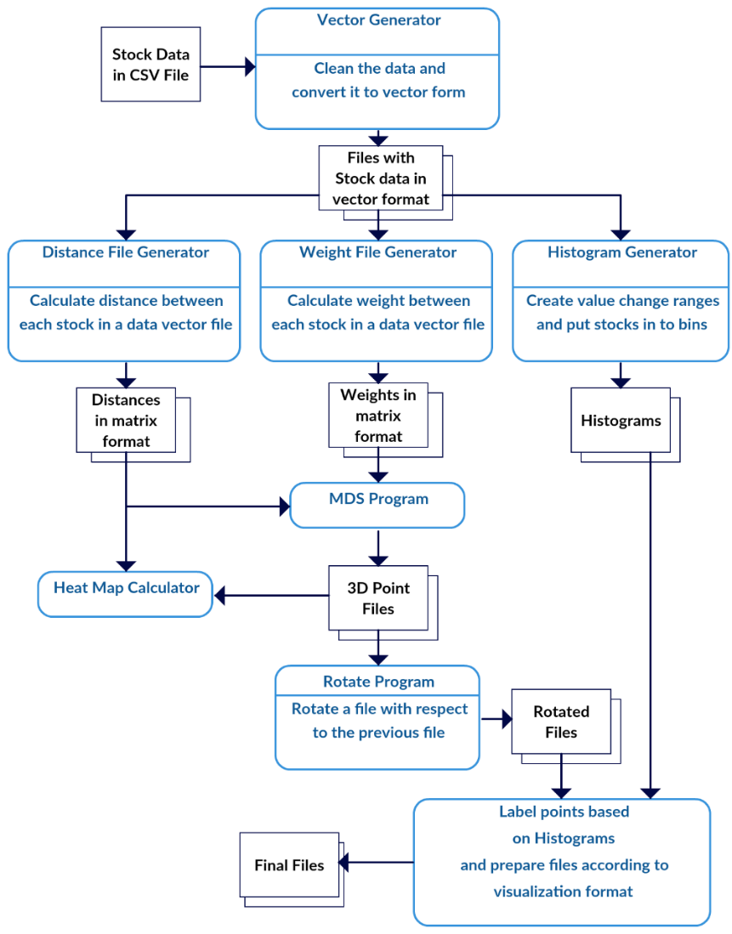
Time Series Data Visualization (US Stock data)
Input is a set of items with values at each time step
Segment the time series data into time windows
Define a distance metric between items in a given time window
Correlation
Apply dimension reduction to map these distances to 3D
Multidimensional Scaling
Align the 3D points of consecutive time windows so that they can be visualized
Visualize the data as a moving plot
WebPlotViz
Scripted Workflow
MPI Based parallel programs

Slide 11
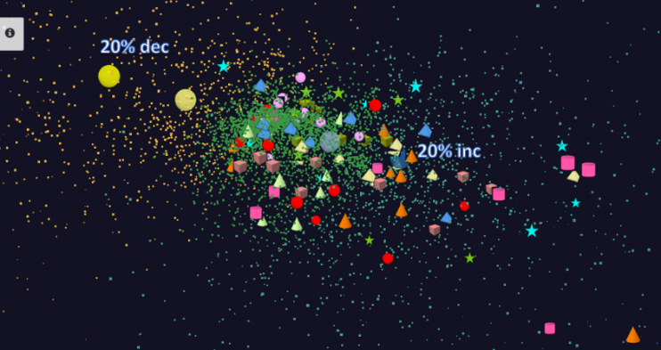
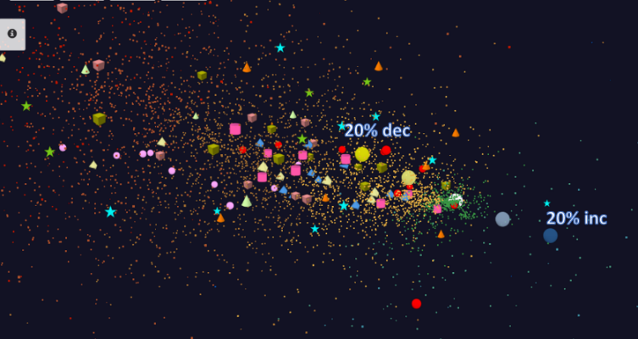
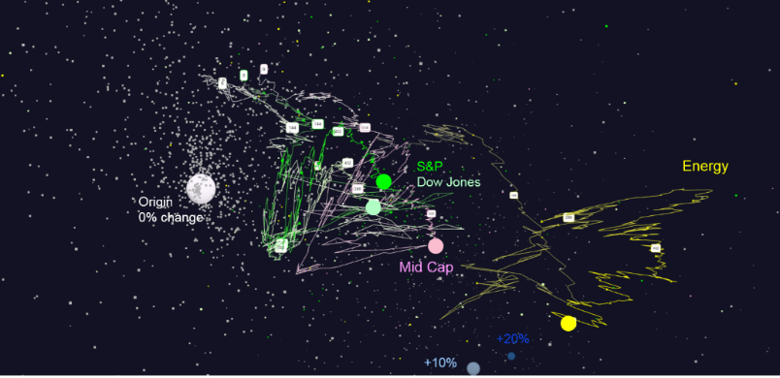
Stocks through time
1 Year time window with 7 day and 1 Day shifts
About 7000 stocks for each time window
Cluster based on ETFs, stock value changes
Trajectories to visualize the movement of stocks through time
For 7 days shifts, 570 data segments, for 1 day shifts 2500 data segments
Trajectories

Slide 12
Problem Statement
No existing framework is suitable for executing complete applications efficiently
MPI suitable for parallel applications
Big data tools are suitable for data processing
Seamless integration is difficult between MPI and big data tools
Cannot support Streaming, Data Processing and Machine Learning in a single environment

Slide 13
HPC Integration to Big Data
Apache Storm Communication Improvements
Integration of InfiniBand and Omni-Path to Apache Heron

Slide 14
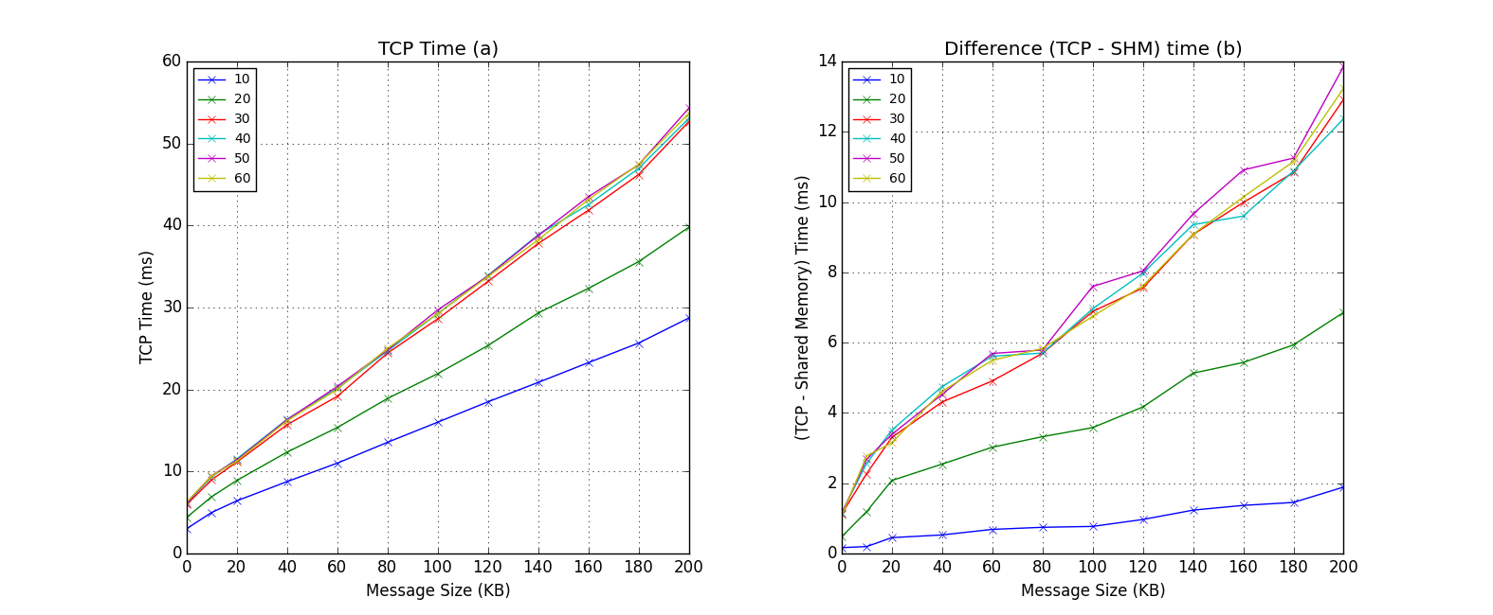
Apache Storm Memory Mapped Communications
Relative Importance of Shared Memory Communication to TCP
W
RabbitMQ
R
B
W
G
RabbitMQ
A topology with communications going through all the workers arranged in a line
W
Client
No significant difference
because we are using all
the workers in the cluster beyond 30 workers
11 Node cluster
1 Node – Nimbus & ZooKeeper
1 Node – RabbitMQ
1 Node – Client
8 Nodes – Supervisors with 4 workers each
Client sends messages with the current timestamp, the topology returns a response with the same time stamp. Latency = current time - timestamp
Default TCP implementation Latency
Y axis shows the difference in latency of default TCP implementation and shared memory based implementation (TCP - SHM)
About 25% reduction for 32 workers

Slide 15
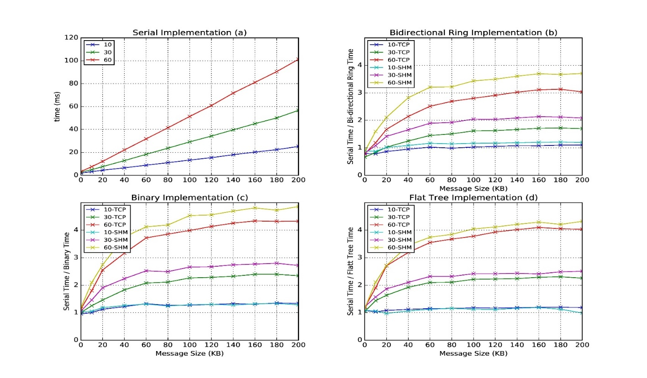
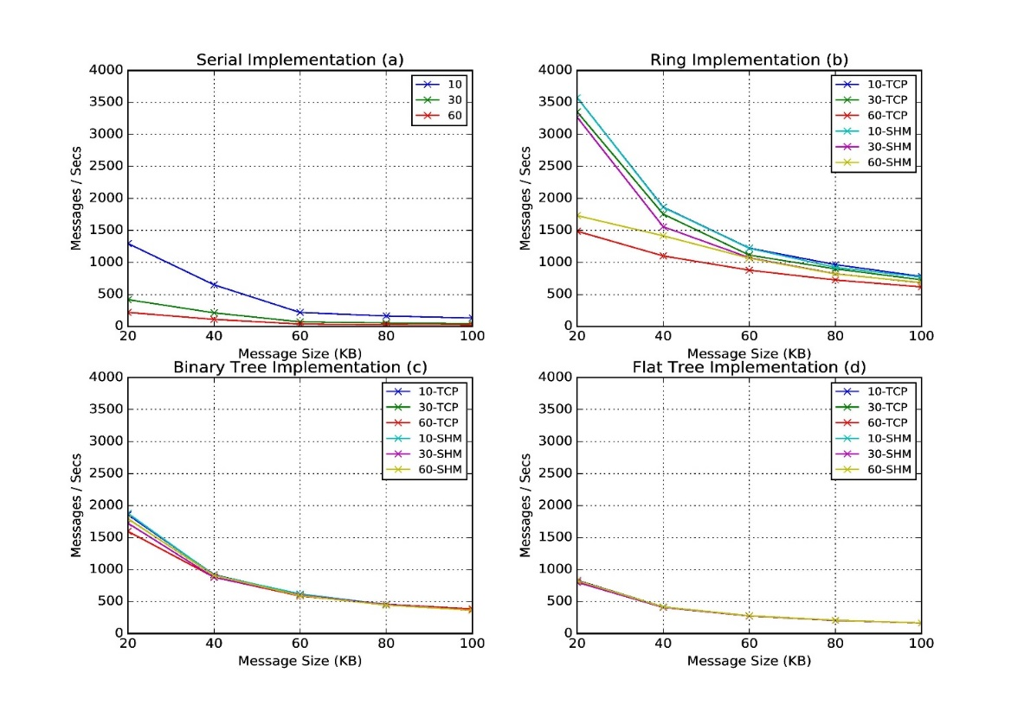
Apache Storm Broadcast
Speedup of latency with both TCP based and Shared Memory based communications for different algorithms
Throughput
Latency of binary tree, flat tree and bi-directional ring implementations compared to serial implementation. Different lines show varying parallel tasks with TCP communications and shared memory communications(SHM).
Throughput of serial, binary tree, flat tree and ring implementations. Different lines show varying parallel tasks with TCP communications and shared memory communications (SHM)

Slide 16
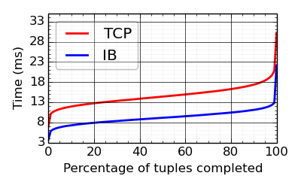
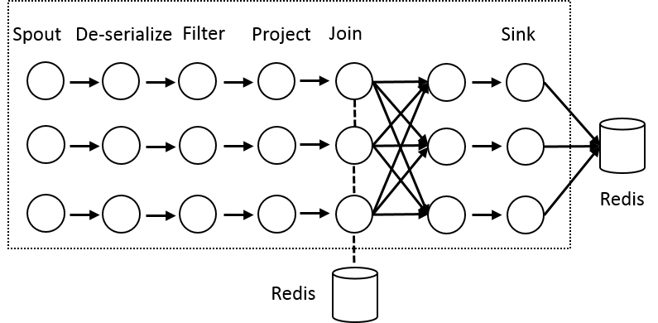
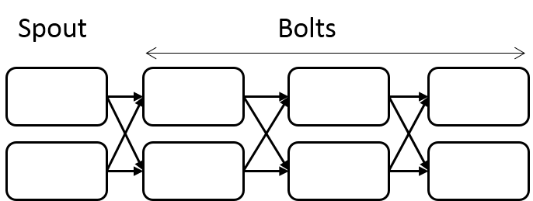
Apache Heron High Performance Interconnects
Infiniband & Intel Omni-Path integrations
Using Libfabric as a library
Natively integrated to Heron through Stream Manager without needing to go through JNI
Latency of the Topology A with 1 spout and 7 bolt instances arranged in a chain with varying parallelism and message sizes on InifniBand cluster.
Topology A. A long topology with 8 Stages
Yahoo Streaming Bench Topology on Haswell cluster

Slide 17
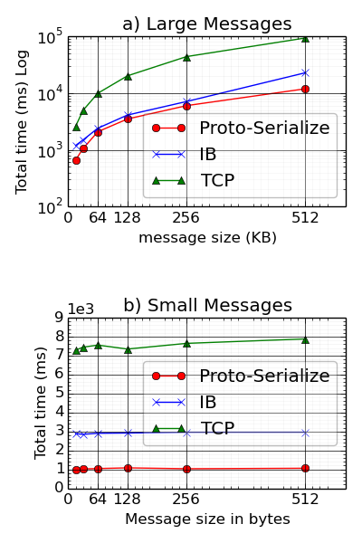
HPC-Heron Throughput & Serialization Overhead
Topology B, Total time to serialize messages and Total time of a message
Throughput of the Topology B with 32 bolt instances and varying message sizes and spout instances. The message size varies from 16K to 512K bytes. The spouts are changed from 8 to 32. The experiments are conducted on Haswell cluster.

Slide 18
HPC with Big data frameworks - Conclusions
Can achieve good performance with HPC features
Case by case basis
Different frameworks are designed to support different use cases
Limited performance improvement due to architectural limitations

Slide 19
Next Generation Parallel & Distributed Systems

Slide 20
Status of Parallel & Distributed Computing
HPC is best for parallel computing
Big data systems are designed for distributed computing
One can use different methods to gain performance on a sub-optimal system
Change / Improve algorithm
Overlap IO with computation
Big data systems are driven by rich set of applications
Even with a sub-optimal system there will always be applications that runs well
Usability is key
Fault tolerance is important
Fault tolerance doesn’t necessarily mean the system works without data loss

Slide 21
Apache Big data Systems
Top down designs targeting one type of applications
Users want to use them for every type of application
Monolithic designs with fixed choices
Harder to change
Low performance
Software engineering
Not targeting advanced hardware
Only high level APIs/abstractions available
Harder for an advanced user to optimize an application

Slide 22
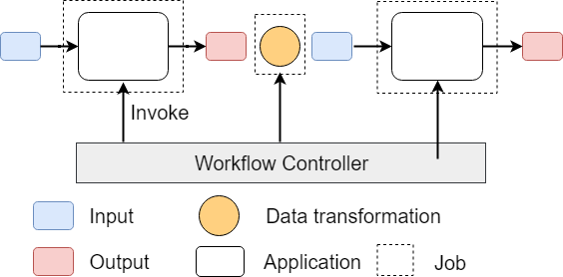
Workflow vs Dataflow
The dataflow can expand from Edge to Cloud
Workflow Controlled by Workflow Engine or a Script
Dataflow application running as a single job

Slide 23
Layers of Parallel Applications
Data partitioning and placement
Manage distributed data
Data Management
Computation Graph
Execution (Threads/Processes), Scheduling of Executions
Task System
Internode and Intracore Communication
Network layer
Communication
What we need to write a parallel application
Three main abstractions

Slide 24
Twister2
Big data toolkit
Source code: https://github.com/DSC-SPIDAL/twister2
Apache License
30,000 Lines of code
6 Developers and 4 Volunteers

Slide 25
Overview
A computing environment (toolkit) that allows three types of applications to co-exist
Streaming
Machine Learning
Data Processing
We believe MPI / Harp is best for ML
Twister2 provides the distributed environment to create data driven applications

Slide 26
Approach
Clearly define and develop functional layers (using existing technology when possible)
Develop layers as independent components
Use interoperable common abstractions but multiple polymorphic implementations.
Allow users to pick and choose according to requirements
Communication + Data Management
Communication + Static graph
Use HPC features when possible

Slide 27
Twister2 Components

Slide 28
Twister2 Components

Slide 29
Different applications at different layers
Spark, Flink
Hadoop, Heron, Storm
None

Slide 30
Resource Allocation
Job Submission & Management
twister2 submit
Resource Managers
Slurm
Nomad
Kubernetes
Mesos

Slide 31
Twister:Net
Dataflow Communication Library

Slide 32
Overview
No library implements optimized dataflow communication operations
Need both BSP and Dataflow Style communications
MPI / RDMA / TCP
Every major big data project implements communications on their own
Different semantics for same operation
Communication is implemented at a higher level – Only point to point operations are considered at the communication level
Data driven higher level abstractions
Handling both streaming and batch

Slide 33
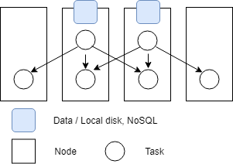
Requirements
Modeling dataflow graph
Preserving data locality
Streaming computation requirements
Complete graph is executing at any given time
Data locality
Tasks running in different nodes
Two tasks reads data and distributed them for processing
Communication Operations
Streaming - All the tasks of execution graph running

Slide 34
Dataflow Communications
Non-blocking
Dynamic data sizes
Streaming model
Batch case is modeled as a finite stream
The communications are between a set of tasks in an arbitrary task graph
Key based communications
Communications spilling to disks

Slide 35
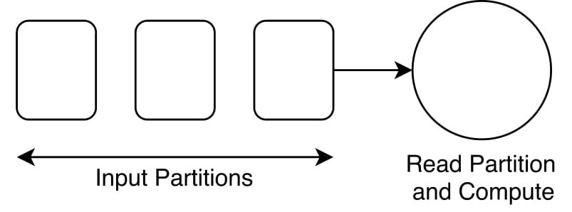
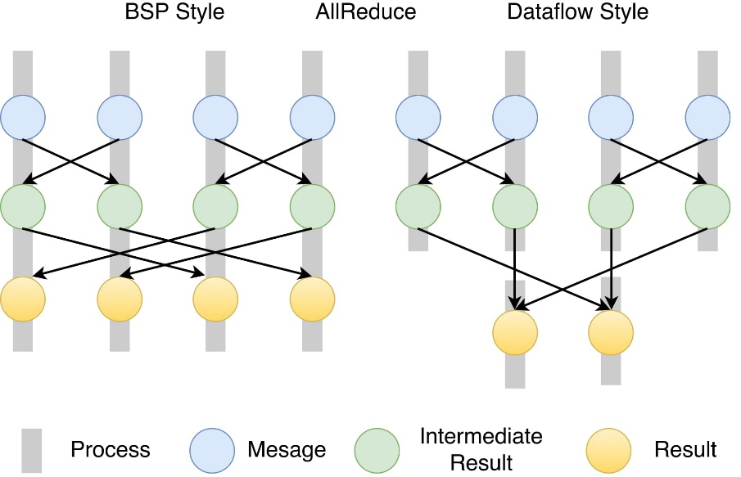
Twister:Net
Standalone Communication library capturing dataflow communications
Big data computation model
Communication can be invoked by multiple tasks in a process
AllReduce in an arbitrary task graph (right) compared to MPI (left)

Slide 36
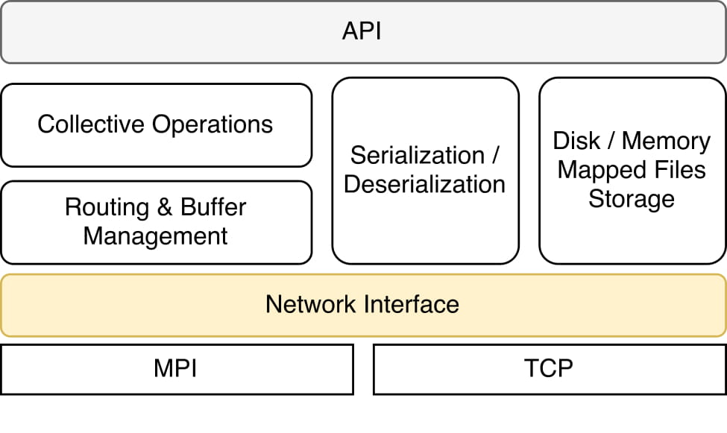
Twister:Net
Communication operators are state full
Buffer data, handle imbalanced communications, act as a combiner
Thread safe
Initialization
MPI
TCP / ZooKeeper
Buffer management
The messages are serialized by the library
Back-pressure
Uses flow control by the underlying channel
Architecture
Reduce | Gather | Partition | Broadcast
AllReduce | AllGather | Keyed-Partition
Keyed-Reduce | KeyedGather
Batch and Streaming versions
Optimized operation vs Serial

Slide 37
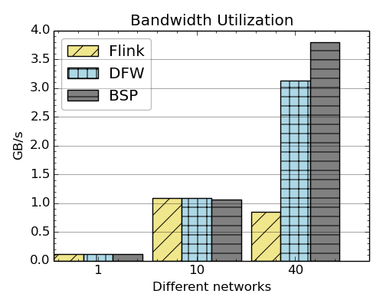
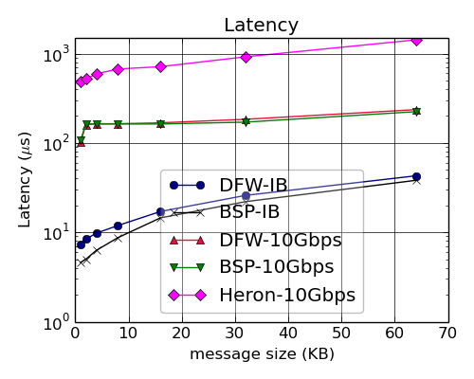
Bandwidth & Latency
Latency and bandwidth between two tasks running in two nodes
Bandwidth utilization of Flink, Twister2 and OpenMPI over 1Gbps, 10Gbps and IB with Flink on IPoIB
Latency of MPI and Twister:Net with different message sizes on a two-node setup

Slide 38
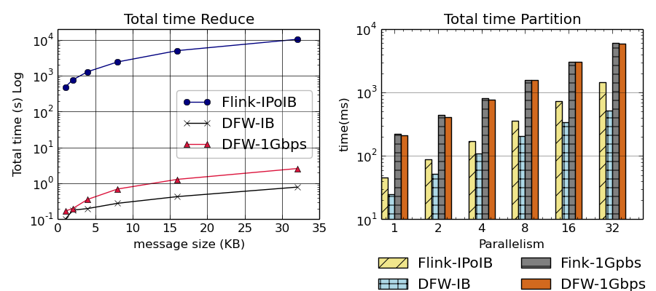
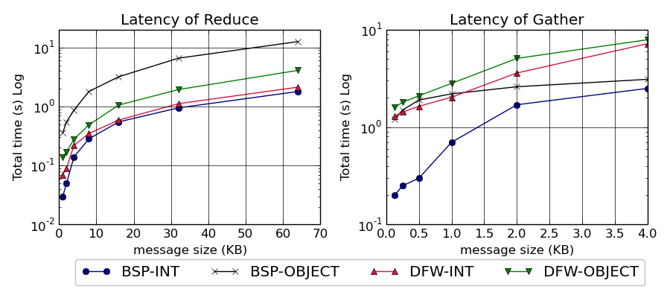
Flink, BSP and DFW Performance
Total time for Flink and Twister:Net for Reduce and Partition operations in 32 nodes with 640-way parallelism. The time is for 1 million messages in each parallel unit, with the given message size
Latency for Reduce and Gather operations in 32 nodes with 256-way parallelism. The time is for 1 million messages in each parallel unit, with the given message size. For BSP-Object case we do two MPI calls with MPIAllReduce / MPIAllGather first to get the lengths of the messages and the actual call. InfiniBand network is used.

Slide 39
Latency vs Heron
Speedup of about 100
Latency of Heron and Twister:Net DFW for Reduce, Broadcast and Partition operations in 16 nodes with 256-way parallelism

Slide 40
Direct Heron Communication Improvements
Stream Manager
Stream Manager
Sub Task
Sub Task
Sub Task
Sub Task
Sub Task
Sub Task
Sub Task
Sub Task
Sub Task
Sub Task
Sub Task
Sub Task
Sub Task
Sub Task
Sub Task
Sub Task
Container
Container
Container
Container
This architecture doesn’t work for parallel communications, Stream Manger is a bottleneck
Removed Stream Managers and allowed tasks to communicate

Slide 41
Heron direct implementation
Broadcast
Latency of broadcast with 16 nodes and 64, 128 and 256 parallel tasks. Message size varying from 1K to 32K
Reduce
Latency of reduce with 16 nodes and 64, 128 and 256 parallel tasks. Message size varying from 1K to 32K

Slide 42
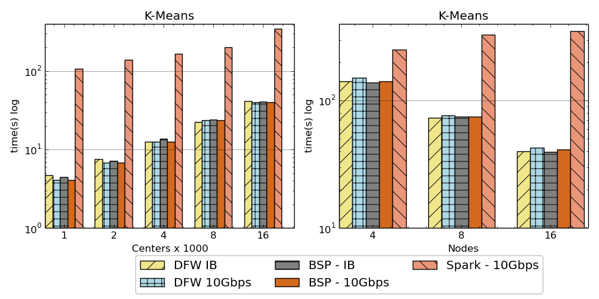
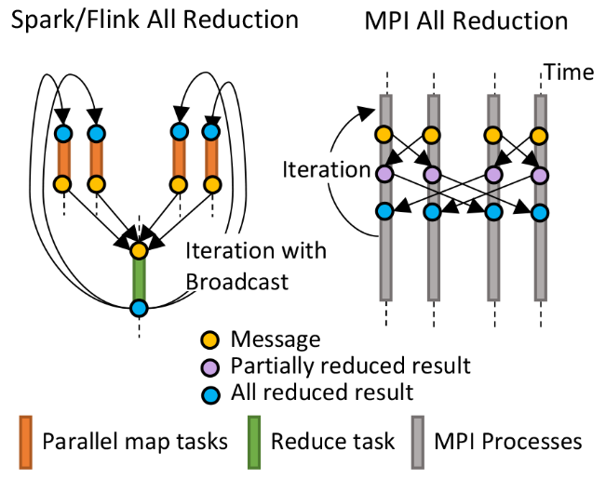
K-Means algorithm performance
AllReduce Communication
Left: K-means job execution time on 16 nodes with varying centers, 2 million points with 320-way parallelism. Right: K-Means wth 4,8 and 16 nodes where each node having 20 tasks. 2 million points with 16000 centers used.

Slide 43
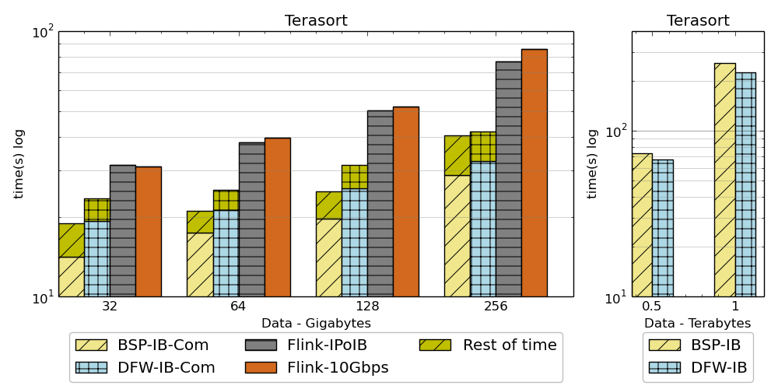
Sorting Records
For DFW case, a single node can get congested if many processes send message simultaneously.
Left: Terasort time on a 16 node cluster with 384 parallelism. BSP and DFW shows the communication time. Right: Terasort on 32 nodes with .5 TB and 1TB datasets. Parallelism of 320. Right 16 node cluster (Victor), Left 32 node cluster (Juliet) with InfiniBand.
Partition the data using a sample and regroup
BSP algorithm waits for others to send messages in a ring topology and can be in-efficient compared to DFW case where processes do not wait.

Slide 44
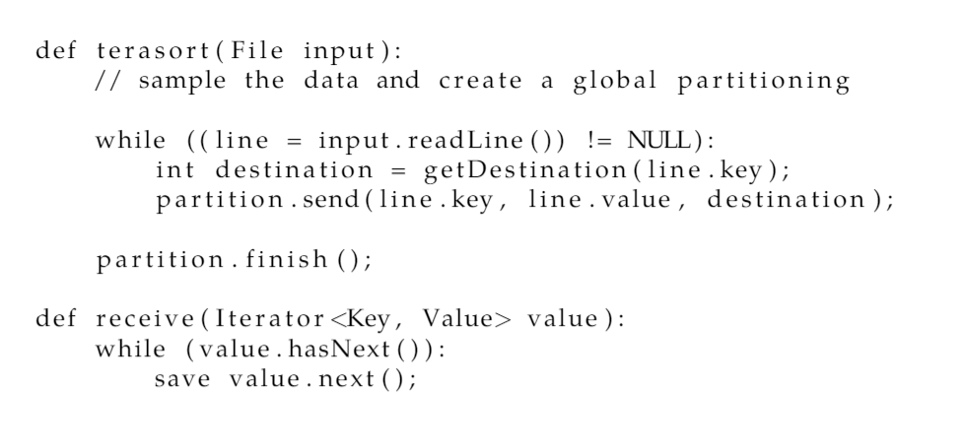
Sorting Records
Dataflow Partition operation

Slide 45
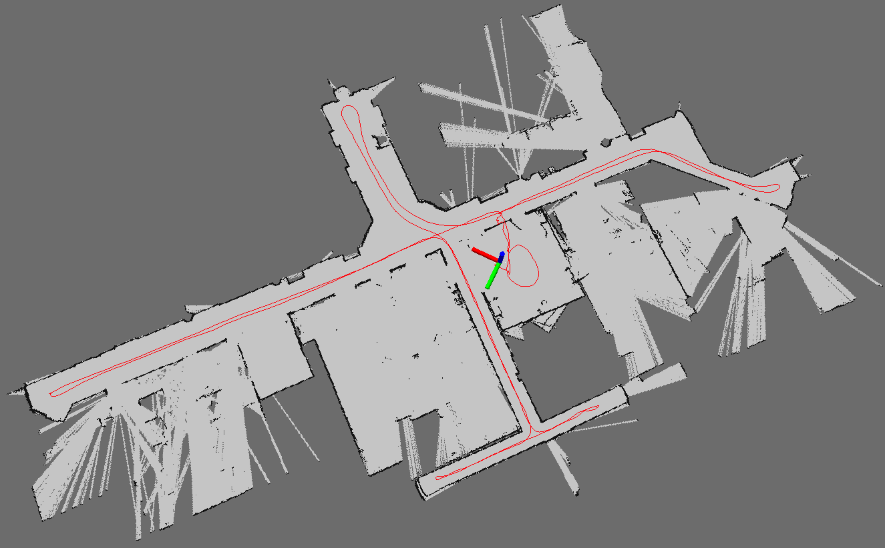
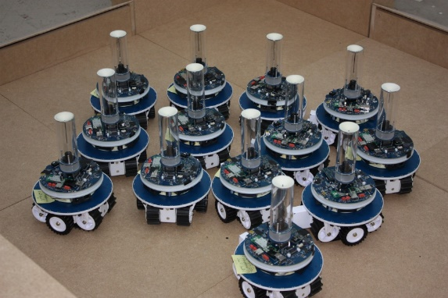
Robotic Algorithms
Simultaneous Localization and Mapping
N-Body Collision Avoidance
Robot with a Laser Range Finder
Robots need to avoid collisions when they move
Map Built from Robot data

Slide 46
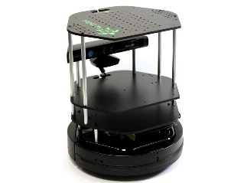
Simultaneous Localization and Mapping
Rao blackwellized particle filter based SLAM
Sending to
pub-sub
Sending to
Persisting
to storage
Multiple
streaming
workflows
Streaming
workflow
A stream application with some tasks running in parallel
Gateway
Message Brokers
RabbitMQ, Kafka
Streaming SLAM Algorithm
Apache Storm
End to end delays without any processing is less than 10ms
Hosted in FutureSystems OpenStack cloud which is accessible through IU network

Slide 47
Storm Streaming Application
Distribute the particles among parallel worker (ScanMatcher Instances)
LaserScan spout receives laser and odometer readings via the message broker.
Dispatcher broadcasts it to the parallel tasks.
Each ScanMatcher task receives the laser reading, updates its assigned particles
Resampling bolt receives particle values and resamples them. Calculates new particle assignments using the Hungarian algorithm with relocation costs.
Resampling bolt broadcasts particle assignments
Scatter particle values
Distribute maps according to assignments
Output best particle map
ScanMatcher bolt send acknowledgment to the dispatcher, indicating their willingness to accept the next reading.
Distributed Streaming Computation

Slide 48
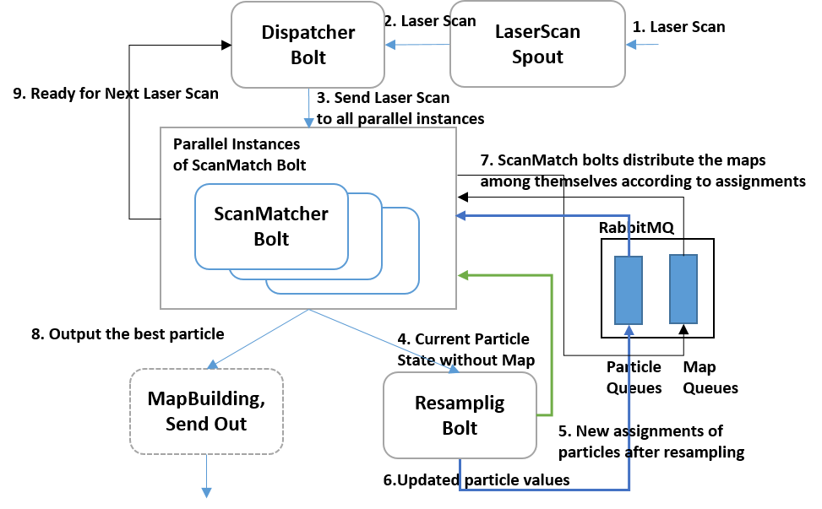
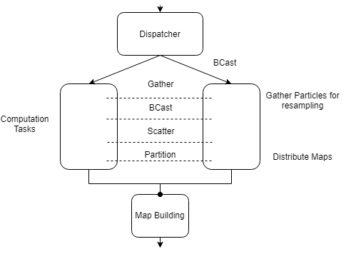
SLAM Streaming Algorithm
The SLAM Computation is viewed as a black box running a parallel computation
Storm Topology
Twister2 Application

Slide 49
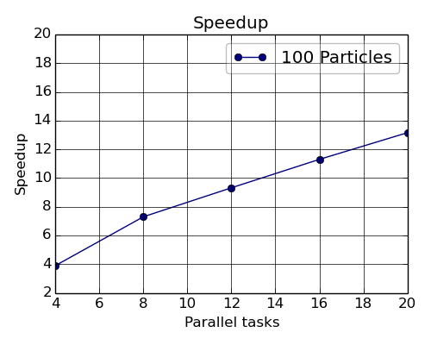
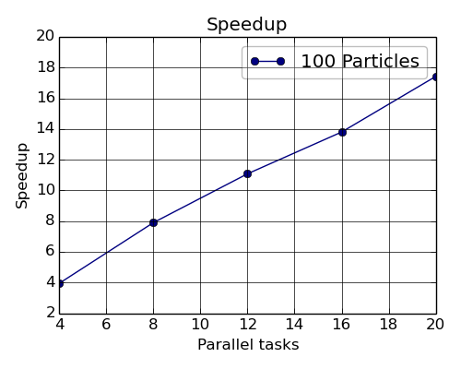
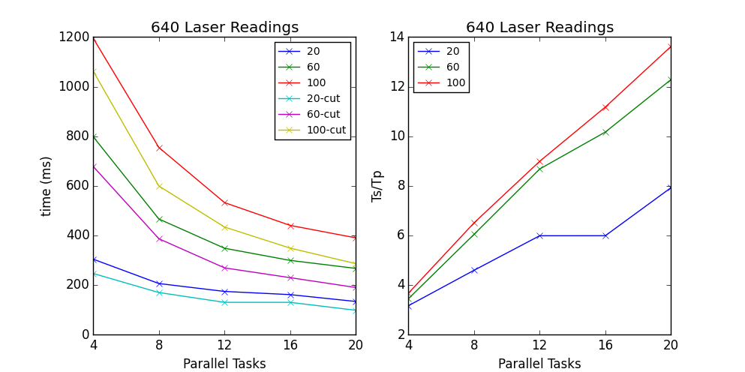
Performance of SLAM
180 Laser readings
Twister2 Implementation speedup.
640 Laser readings
180 Laser readings
640 Laser readings
Storm Implementation Speedup

Slide 50
Task System
Streaming
Complete task graph executing all the time
Batch
Graph executing in stages
Iterative
Graph executing in stages

Slide 51
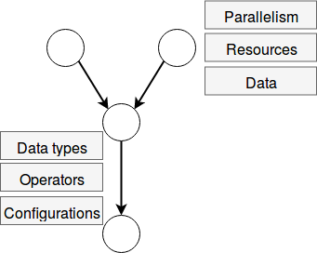
Task System
User defined operator
Generate computation graph dynamically
Dynamic scheduling of tasks
Allow fine grained control of the graph
Generate computation graph statically
Dynamic or static scheduling
Suitable for streaming and data query applications
Hard to express complex computations, especially with loops
Hybrid approach
Combine both static and dynamic graphs
Communication

Slide 52
Task Graph Execution
User Graph
Scheduler
Scheduler Plan
Execution Planner
Execution Plan
Executor
Worker Plan
Network
Scheduling Algorithms
Task Scheduler is pluggable
Executor is pluggable
Scheduler running on all the workers
Streaming
Round robin
First fit
Batch
Data locality aware

Slide 53
Contributions
Performance analysis of Big Data Tools
Time series data visualization
Parallel streaming algorithms
HPC integration to big data
Twister2 Big data toolkit
Unified framework for batch and streaming processing
Twister:Net provides a convergence path for big data and HPC by identifying the key differences between them

Slide 54
Future Work
Twister:Net
Implement additional communication patterns along with different algorithms
Support higher level message based reductions efficiently i.e. Protobuf, Thrift
Integrate Harp
Integrate with RDMA
Decouple MPI from its execution giving Twister2 native BSP library
Twister:Net to big data systems (Heron, Spark)
Task System
Different scheduling algorithms
Execution strategies for different application types
Support central scheduling
Naiad model
Hierarchical task graphs – Dataflow nodes encapsulate task graphs

Slide 55
Future Work
Fault tolerance
Streaming fault tolerance using lightweight barrier injection
Batch fault tolerance - check pointing
API
Streamline the APIs
Provide established APIs such as Storm, Flink or Spark
Distributed data management
RDD, Streamlet, DataSet
Edge Computing
Dataflow graphs expanding from edge to cloud

Slide 56
Papers
Supun Kamburugamuve, Pulasthi Wickramasinghe, Kannan Govindarajan, Ahmet Uyar, Gurhan Gunduz, Vibhatha Abeykoon, Geoffrey Fox. "Twister:Net - Communication Library for Big Data Processing in HPC and Cloud Environments" In Review, IEEE Cloud 2018, San Francisco, USA
Supun Kamburugamuve, Karthik Ramasamy, Martin Swany, and Geoffrey Fox. 2017. Low Latency Stream Processing: Apache Heron with Infiniband & Intel Omni-Path. In Proceedings of the10th International Conference on Utility and Cloud Computing (UCC '17). ACM, New York, NY, USA, 101-110. DOI: https://doi.org/10.1145/3147213.3147232
Supun Kamburugamuve, Kannan Govindarajan, Pulasthi Wickramasinghe, Vibhatha Abeykoon, and Geoffrey Fox. "Twister2: Design of a big data toolkit." In EXAMPI 2017 workshop SC17 Conference, Denver CO. 2017.
Supun Kamburugamuve, Wickramasinghe Pulasthi, Ekanayake Saliya, Fox Geoffrey C. "Anatomy of machine learning algorithm implementations in MPI, Spark, and Flink." The International Journal of High Performance Computing Applications. 2017:1094342017712976,http://dx.doi.org/10.1177/1094342017712976
Supun Kamburugamuve, Saliya Ekanayake, Milinda Pathirage, and Geoffrey Fox. "Towards high performance processing of streaming data in large data centers." In Parallel and Distributed Processing Symposium Workshops, 2016 IEEE International, pp. 1637-1644. IEEE, 2016.
Supun Kamburugamuve, Leif Christiansen, and Geoffrey Fox. "A framework for real time processing of sensor data in the cloud." Journal of Sensors 2015.
Supun Kamburugamuve, Hengjing He, Geoffrey Fox, and David Crandall. "Cloud-based parallel implementation of slam for mobile robots." In Proceedings of the International Conference on Internet of things and Cloud Computing, p. 48. ACM, 2016.
Supun Kamburugamuve, Pulasthi Wickramasinghe, Saliya Ekanayake, Chathuri Wimalasena, Milinda Pathirage, and Geoffrey Fox. "TSmap3D: Browser visualization of high dimensional time series data." In Big Data (Big Data), 2016 IEEE International Conference on, pp. 3583-3592. IEEE, 2016.

Slide 57
Papers
Geoffrey C. Fox, Supun Kamburugamuve, and Ryan D. Hartman. "Architecture and measured characteristics of a cloud based internet of things." In Collaboration Technologies and Systems (CTS), 2012 International Conference on, pp. 6-12. IEEE, 2012.
Saliya Ekanayake, Supun Kamburugamuve, and Geoffrey C. Fox. "SPIDAL Java: high performance data analytics with Java and MPI on large multicore HPC clusters." In Proceedings of the 24th High Performance Computing Symposium, p. 3. Society for Computer Simulation International, 2016.
Saliya Ekanayake, Supun Kamburugamuve, Pulasthi Wickramasinghe, and Geoffrey C. Fox. "Java thread and process performance for parallel machine learning on multicore hpc clusters." In 2016 IEEE International Conference on Big Data, pp. 347-354. IEEE, 2016.
Hengjing he, Supun Kamburugamuve, Geoffrey C. Fox, and Wei Zhao. "Cloud based real-time multi-robot collision avoidance for swarm robotics." International Journal of Grid and Distributed Computing, May 7 (2015).
Geoffrey Fox, Judy Qiu, Shantenu Jha, Saliya Ekanayake, and Supun Kamburugamuve. "Big data, simulations and hpc convergence." In Workshop on Big Data Benchmarks, pp. 3-17. Springer International Publishing, 2015.
Geoffrey C. Fox, Judy Qiu, Supun Kamburugamuve, Shantenu Jha, and Andre Luckow. "Hpc-abds high performance computing enhanced apache big data stack." In Cluster, Cloud and Grid Computing (CCGrid), 2015 15th IEEE/ACM International Symposium on, pp. 1057-1066. IEEE, 2015.
Qiu J, Kamburugamuve S, Lee H, Mitchell J, Caldwell R, Bullock G, Hayden L. Teaching, Learning and Collaborating through Cloud Computing Online Classes, EduHPC, SC17 Workshops

Slide 58
Acknowledgements
My Advisors
Prof. Geoffrey Fox
Prof. Judy Qiu
Prof. Martin Swany
Prof. Minje Kim
Prof. Ryan Newton
Twister2 Team
Pulasthi Wickramasinghe, Kannan Govindarajan, Ahmet Uyar, Gurhan Gunduz, Vibhatha Abeykoon and UOM Final Year Project Group
Dr. Saliya Ekanayake
Digital Science Center Staff

Slide 59
Backup Slides

Slide 60
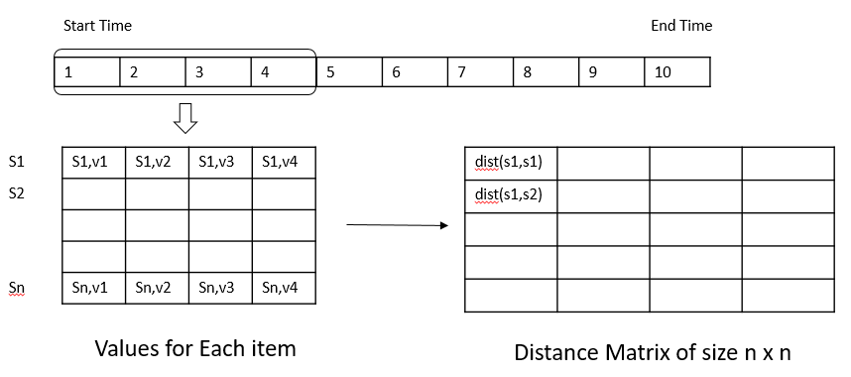
Data segmentation and calculations
Sliding Window
Distance matrix calculation
Accumulating Window

Slide 61
Calculate Relationships between items
Start Time
End Time
1 | 2 | 3 | 4 | 5 | 6 | 7 | 8 | 9 | 10
S1 | S1,v1 | S1,v2 | S1,v3 | S1,v4
S2
Sn | Sn,v1 | Sn,v2 | Sn,v3 | Sn,v4
 | dist(s1,s1)
 | dist(s1,s2)
Values for Each item
Distance Matrix of size n x n

Slide 62
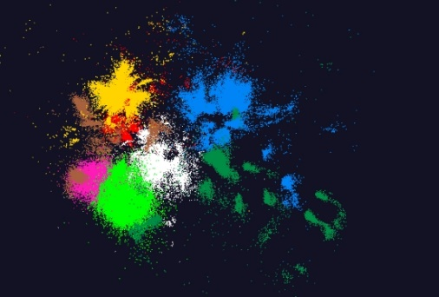
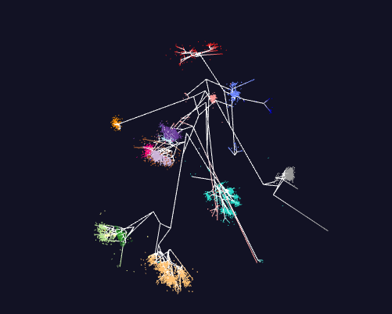
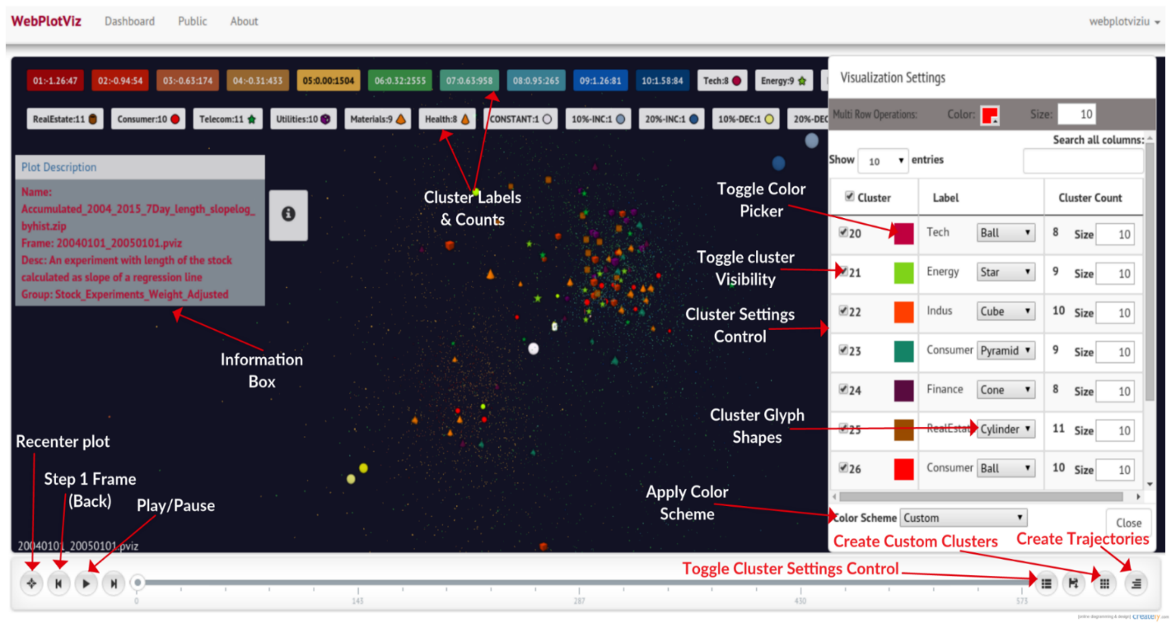
WebPlotViz
100k points
Trees
Front end view (Browser)
Plot visualization & time series animation (Three.js)
Upload
Request Plots
JSON Format Plots
Web Request Controllers (Play Framework)
Server
Upload format to JSON Converter
Data Layer (MongoDB)
http://spidal-gw.dsc.soic.indiana.edu/
MongoDB

Slide 63
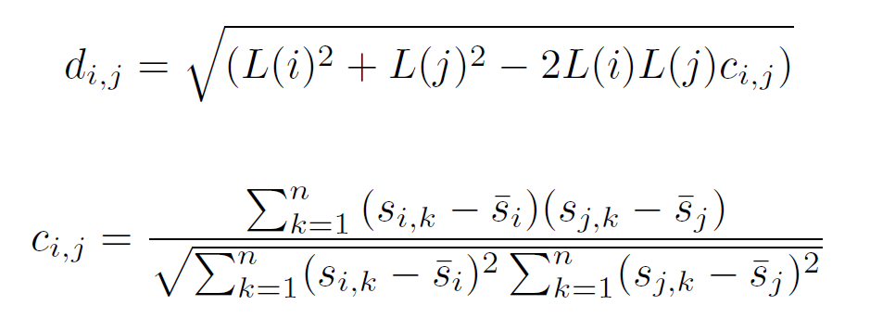
Stock Data
Data obtained from the Center for Research in Security Prices (CRSP) database through the Wharton Research Data Services (WRDS)
Daily stock prices from 2004 to 2015
Each segment have multiple stocks with values for each day in that segment
$$d_{i,j} Distance betwe two stocks i and j$$
$$c_{i,j} Correlation betwe two stocks i and j$$
$s_{i,k} k^{th} value of stock i$
$$L\left(i\right)=1$$
or

Slide 64
HPC Runtime versus ABDS distributed Computing Model on Data Analytics
Hadoop writes to disk and is slowest; Spark and Flink spawn many processes and do not support AllReduce directly; MPI does in-place combined reduce/broadcast and is fastest
Need Polymorphic Reduction capability choosing best implementation
Use HPC architecture with
Mutable model
Immutable data

Slide 65
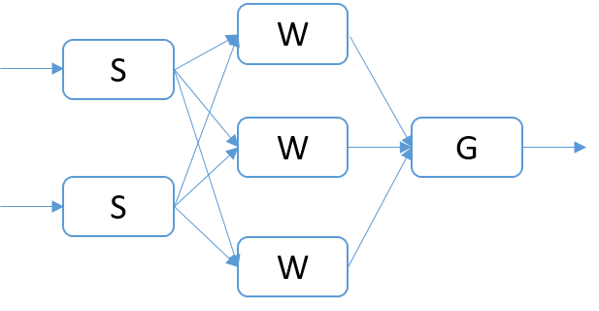
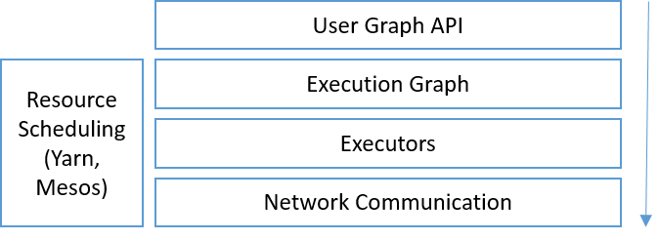
Streaming Application
Stream of events
Event processing logic
User Graph
Execution Graph
User graph is converted to an execution graph
Communication methods
Broadcast, Round Robin, Direct, Stream Partitioning

Slide 66
Three Algorithms for broadcast
Serial Broadcast
Flat tree
Binary tree
Ring
Example broadcasting communications for each algorithm in a 4 node cluster with each machine having 4 workers. The outer green boxes show cluster machines and inner small boxes show workers. The top box displays the broadcasting worker and arrows illustrate the communication among the workers

Slide 67
Execution Graph Distribution in the Storm Cluster
Node-1
Node-2
S
W
S
G
W
W
Worker
Worker
Worker
Worker
Two node cluster each running two workers. The tasks of the Topology is assigned to the workers

Slide 68
Communications in Storm
B
W
Node-1
Node-2
Node-1
Node-2
B-1
W-2
W-4
W-6
B-1
W-2
W-4
W-6
W-1
W-3
W-5
W-7
W-1
W-3
W-5
W-7
Worker
Worker
Worker
Worker
Worker
Worker
Worker
Worker
Worker and Task distribution of Storm
A worker hosts multiple tasks. B-1 is a task of component B and W-1 is a task of W
Communication links are between workers
These are multiplexed among the tasks

Slide 69
Default Broadcast
Node-1
Node-2
B-1
W-2
W-4
W-6
W-1
W-3
W-5
W-7
Worker
Worker
Worker
Worker
B-1 wants to broadcast a message to W, it sends 6 messages through 3 TCP communication channels and send 1 message to W-1 via memory

Slide 70
Shared Memory Communications
Read packet by packet sequentially
Write
Reader
Writer 01
Obtain the write location atomically and increment
write | Packet 1 | Packet 2 | Packet 3
Writer 02
Write
Shared File
Use a new file when the file size is reached
Reader deletes the files after it reads them fully
Fields
ID | No of Packets | Packet No | Dest Task | Content Length | Source Task | Stream Length | Stream | Content
16 | 4 | 4 | 4 | 4 | 4 | 4 | Variable | Variable
Bytes
Packet Structure

Slide 71
Apache Heron High Performance Interconnects
Topology A. A long topology with 8 Stages
Topology B. A shallow topology with 2 Stages
Heron Architecture
Haswell Cluster:
Intel Xeon E5-2670 running at 2.30GHz.
24 cores (2 sockets x 12 cores each)
128GB of main memory
56Gbps Infiniband and 1Gbps dedicated Ethernet connection
Heron Interconnect Integration

Slide 72
Apache Heron Omni-Path Latency
Latency of the Topology A with 1 spout and 7 bolt instances arranged in a chain with varying parallelism and message sizes. a) and b) are with 2 parallelism and c) and d) are with 128k and 128bytes messages. The results are on KNL cluster.

Slide 73
Infiniband Latency
Latency of the Topology A with 1 spout and 7 bolt instances arranged in a chain with varying parallelism and message sizes. a) and b) are with 2 parallelism and c) and d) are with 128k and 128bytes messages. The results are on Haswell cluster with IB.

Slide 74
Communication Models
MPI Characteristics: Tightly synchronized applications
Efficient communications (ns latency) with use of advanced hardware
In place communications and computations (Process scope for state)
Dataflow: Model a communication as part of a graph
Nodes - computation Tasks, Edges - asynchronous communications
A computation is activated when its input data dependencies are satisfied
Streaming dataflow: Pub-Sub with data partitioned into streams
Streams are unbounded, ordered data tuples
Order of events important and group data into time windows
Machine Learning dataflow: Iterative computations and keep track of state
There is both Model and Data, but only communicate the model
Collective communication operations such as AllReduce, AllGather
Can use in-place MPI style communication

Slide 75
K-means Computation Graph
All Reduce
Internal
Execution Nodes
Data Set <Points>
Workflow Nodes
Graph for K-means
Data Set <Initial Centroids>
Map (nearest centroid calculation)
Reduce (update centroids)
Data Set <Updated Centroids>
Dataflow Communication
Broadcast
K-Means compute
K-Means dataflow graph in Spark, MPI
Iterate
K-Means in MPI

Slide 76
Runtime Architectures
Spark
Flink
Heron

Slide 77
SLAM Performance of Parallel vs Serial
Parallel behavior of the algorithm with 640 laser readings (left) and 180 readings (right). For each dataset, the top graph shows mean times and the bottom graph shows the speedup

Slide 78
Analysis of Performance
Reduced Overheads
I/O, garbage collection, and Compute time
Overhead of imbalanced parallel computation
Overheads
Improved performance

